Slide 1
Elevator Industry Safety Partners
1910 General Industry
Permit Required Confined Space
OSHA 1910.146

Slide 2
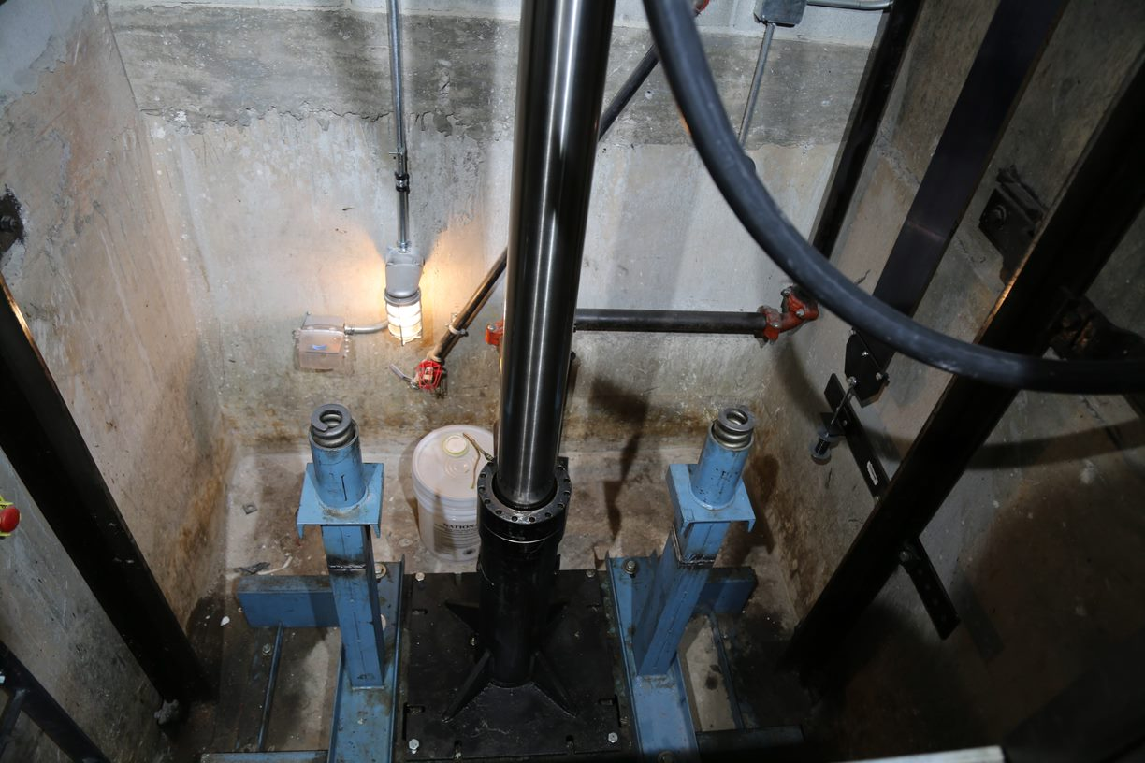
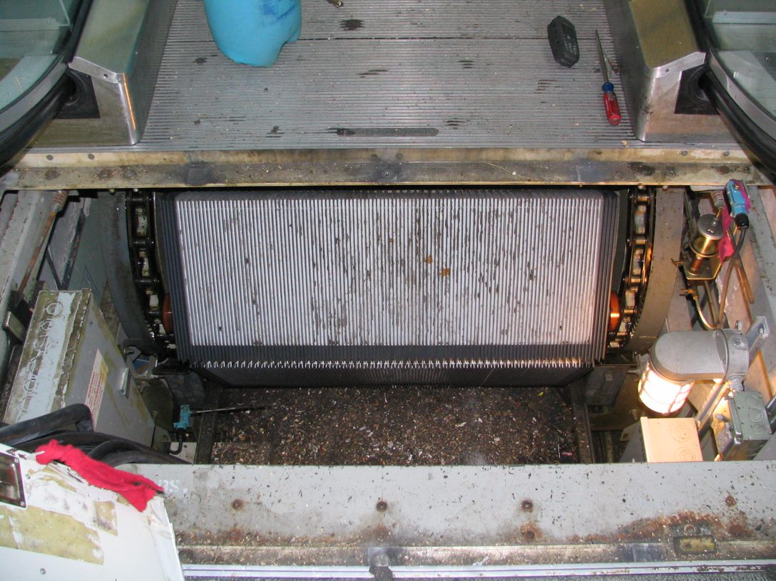
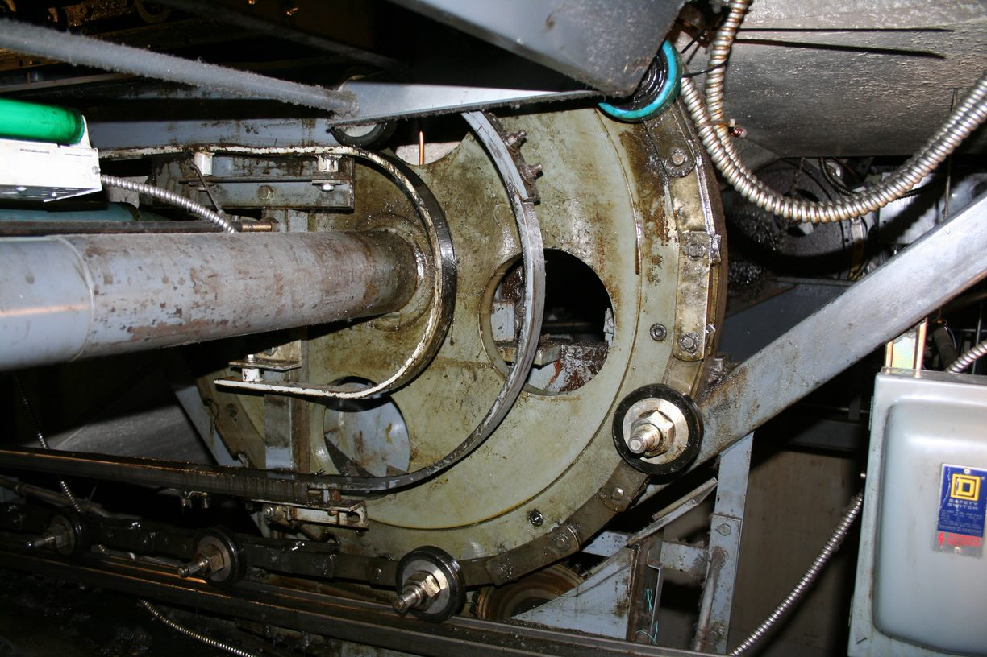
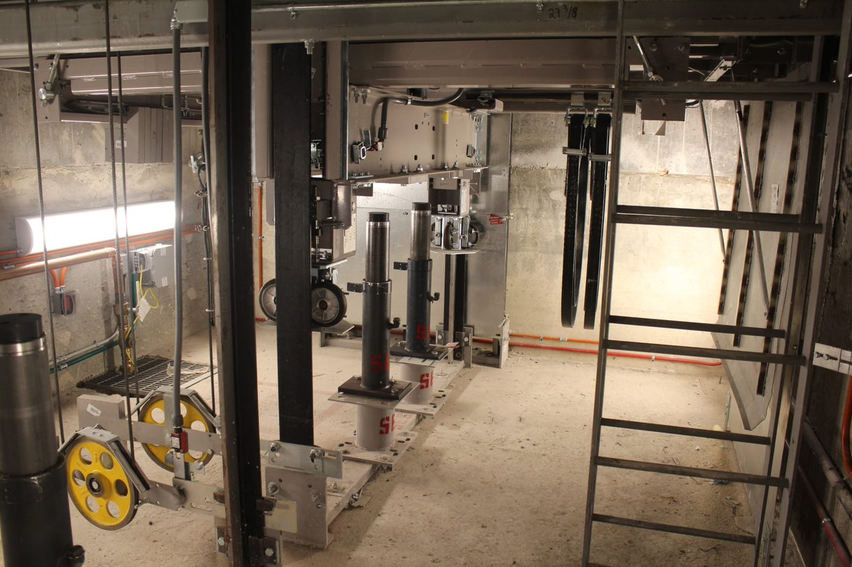
What is a Permit Required Confined Space?
This space?
This?
How about here?
Here?

Slide 3
Conveyance pits, hoistways, cartops, and machinery spaces
are potentially a permit required confined space.
Knowing what to look for is the key to saving your life.
If the area you need to access meets the criteria to be
designated as a permit space, your employer must develop
practices and procedures to protect employees from the
hazards of entry into that space.

Slide 4
Incident - Fatal:
An employee was working alone to repair the elevator. The elevator carriage crushed the employee.
The employer was cited for the following violations of the OSHA 1910 General Industry Permit Required Confined Space Program Standards:
1910.146(d)(3): Develop and implement the means, procedures, and practices necessary for safe permit space entry operations.
1910.146(g)(1): The employer shall provide training so that all employees whose work is regulated by this section acquire the understanding, knowledge, and skills necessary for the safe performance of the duties assigned under this section.
1910.147(c)(4)(i): Procedures shall be developed, documented and utilized for the control of potentially hazardous energy when employees are engaged in the activities covered by this section.
1910.147(d)(3): Machine or equipment isolation. All energy isolating devices that are needed to control the energy to the machine or equipment shall be physically located and operated in such a manner as to isolate the machine or equipment from the energy source(s).

Slide 5
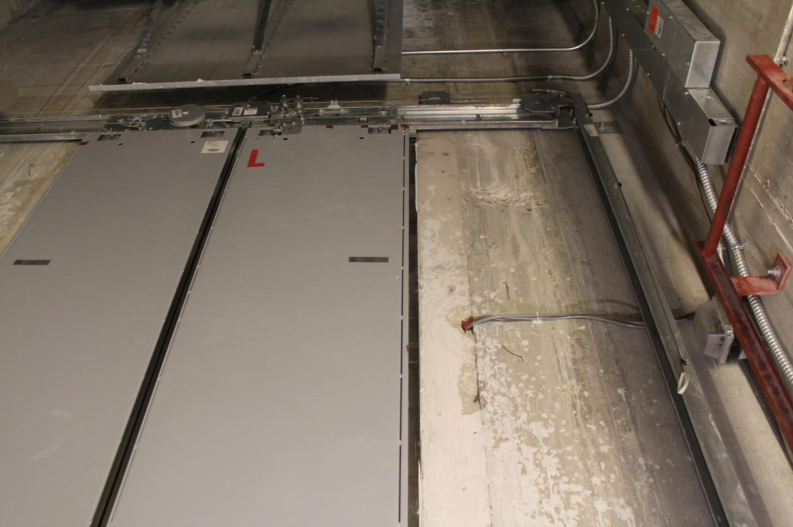
OSHA defines Confined Space as a space that:
(1) Is large enough and so configured that an employee can bodily enter and perform assigned work; and
(2) Has limited or restricted means for entry or exit, and
(3) Is not designed for continuous employee occupancy.
Examples:
Boilers
Sewers
Tunnels
Manholes
Tank cars
Diked areas
Storage bins
Vaults
Wells
Pumping stations
Water meter chambers
Pits
Let’s take a deeper look at 1, 2, and 3.

Slide 6
1. Large enough for bodily entry:
A person can fit inside the space.
2. Limited entrance and exit:
The need to use a ladder to exit.
A door that is difficult to open or a doorway that is too small to
exit walking upright.
Obstructions such as pipes, conduit, or materials that a worker
would need to crawl over or squeeze around.

Slide 7
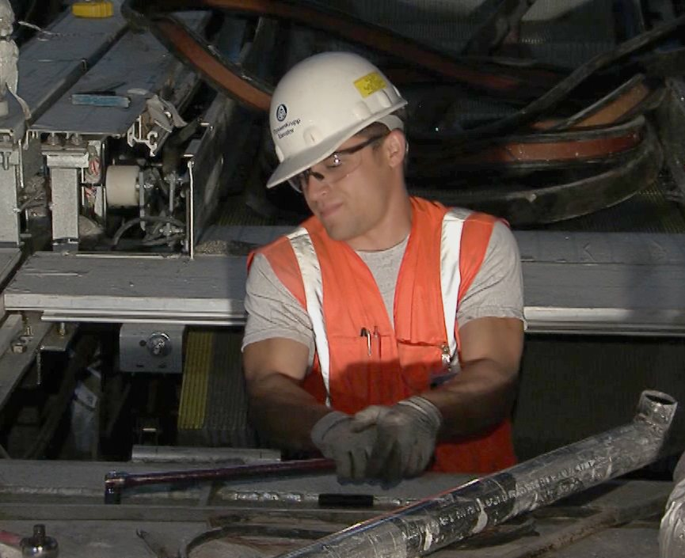
3. Not intended for continuous occupancy:
Space is not designed with features such as ventilation, lighting, and sufficient
room to work and move around.

Slide 8
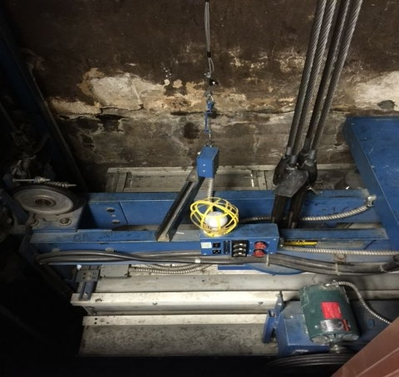
OSHA defines a Permit-required confined space (permit space) as a confined space that has one or more of the following characteristics:
Hazardous atmosphere
Material that could engulf a person
A shape that could trap or asphyxiate someone
Any other recognized safety hazard
Other hazards which may exist in confined spaces include falling objects, slips, trip and fall hazards, sloping floors or converging walls, poor lighting, extreme heat or cold, electrical hazards, mechanical hazards, biological hazards, and any other hazard that will prevent a worker from self-rescue.

Slide 9
Atmospheric Hazards
Atmospheric hazards in permit required confined space are very serious.
- Lack of oxygen
- Oxygen enrichment
- Gases
- Vapors
- Dusts in the air

Slide 10
Atmospheric Hazards (con’t.)
They can suffocate you, poison you, or cause an explosion.
Permit Required Confined spaces may have:
- No air movement
- Harmful build-ups of gases, vapors, or dusts
- Ordinary products which can become deadly
Normal oxygen in air is 20.9%
Oxygen enrichment happens when oxygen is added to a space causing oxygen above 23.5% Oxygen deficiency happens when oxygen is consumed or displaced. It’s life threatening below 19.5%
An oxygen level between 19.5% and 23.5% is considered safe, but trained workers will find out if toxic vapors are displacing oxygen.

Slide 11
Engulfment
A liquid like water or a flowable solid like grain can engulf you. You may drown or be suffocated.
A pocket of air can form below a hardened upper layer of grain. The layer can give way causing a worker to be buried / engulfed.

Slide 12
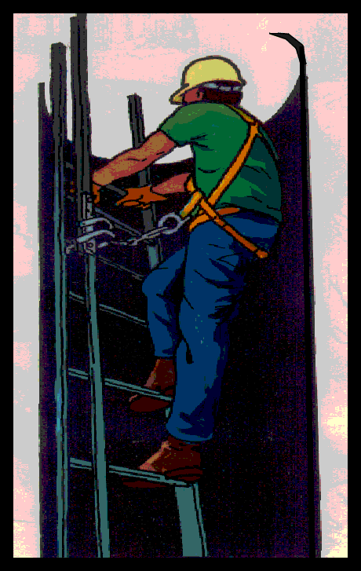
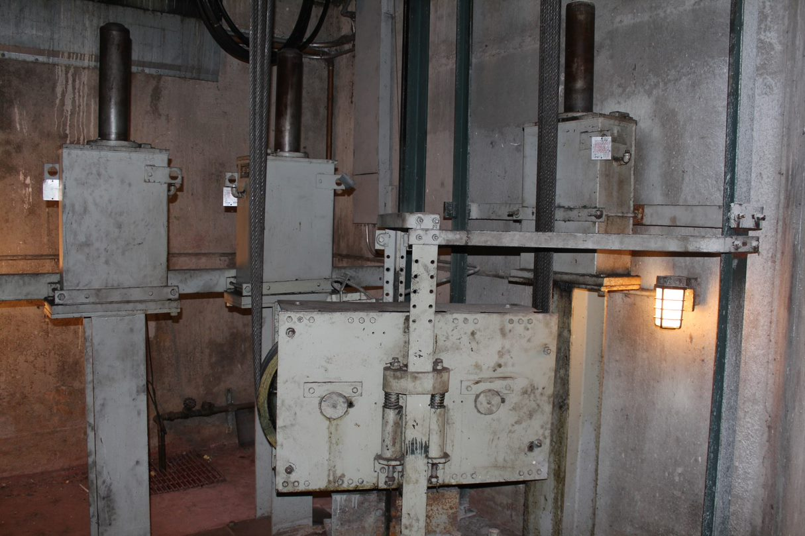
Other Permit Required Confined Space Hazards
These hazards can injure you or keep you from escaping.
- Space narrows
- Corrosive chemicals
- Noise
- Electricity
- Poor lighting
- Extreme heat or cold
- Falling objects
- Falls
- Mechanical hazards

Slide 13
Who Is Responsible for Permit Required Confined Space Work?
Controlling contractor is primary point of contact.
It’s all about communication
Host employer must provide info about spaces pre entry
Controlling contractor must pass on info to entry employers pre-entry
Entry employers must tell each other about hazards and inform the controlling contractor as well
Everyone must communicate before and after entry
Host Employer
Pre entry
Post entry
Controlling Contractor
Pre entry
Post entry
Pre entry
Entry Emp
Entry Emp
Must coordinate during entry

Slide 14
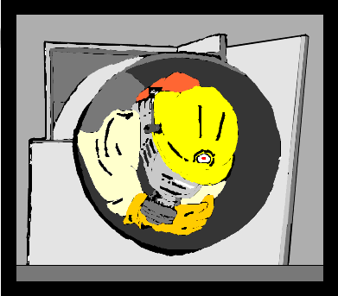
Three Types of Workers
Authorized entrant, attendant, and supervisor.
Authorized entrant must...
Know the hazards you may face during entry, including symptoms, signs, and consequences of exposure.
Properly use all required personal protective equipment.
Communicate with the attendant as necessary to enable the attendant to monitor your status and alert entrants of any need to evacuate.
Alert the attendant whenever you detect any warning sign or symptom of exposure to a dangerous situation or a prohibited condition.
Exit from the space as quickly as possible when the attendant tells you to do so, when you recognize any warning sign, when you detect a prohibited condition, or when you hear the evacuation alarm.

Slide 15
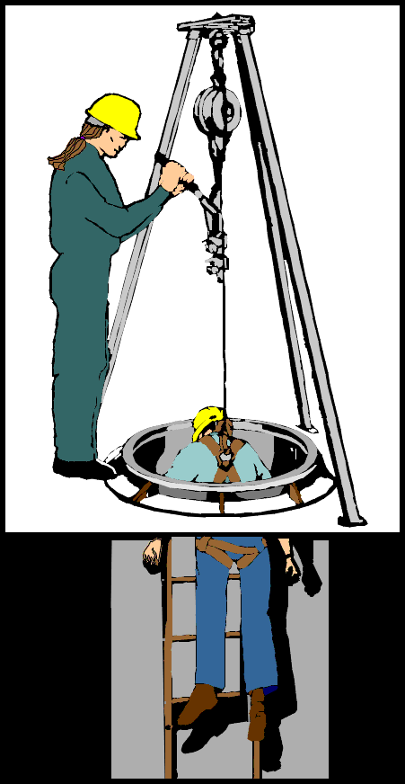
The Attendant
The attendant must:
Know hazards that may be faced during entry.
Know possible behavioral effects of the hazards.
Continuously maintain accurate count of entrants.
Remain outside space during entry operations until relieved.
Communicate with entrants to monitor their status and alert them of need to evacuate.
Monitor activities inside and outside of space.
Summon rescue and emergency services when necessary.
Warn unauthorized persons to stay away.
Perform non-entry rescues per employer’s procedure.
Perform no duties that interfere with your primary duty to monitor entrants.

Slide 16
The Entry Supervisor
The entry supervisor has overall responsibility for the entry.
Entry supervisor must…
Know hazards that may be faced during entry.
Verify that acceptable conditions for entry exist.
Terminate entry when prohibited condition arises.
Verify that rescue services are available.
Remove unauthorized persons who enter or attempt to enter during the entry operations.
Determine that acceptable entry conditions are maintained.

Slide 17
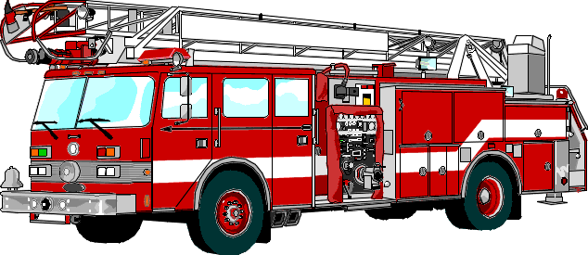
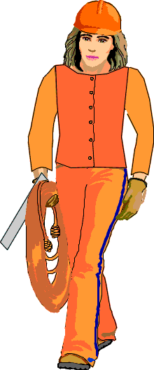
The Rescue Team
May be onsite (coworkers)
Or offsite (fire dept.)
Rescue team must…
Be properly trained in procedures and PPE use.
Practice rescues at least annually from similar space.
Be trained in basic first aid and CPR, one currently certified.
Use retrieval equipment, if it does not increase hazard.
Your contractor may choose to use offsite rescue team. For example, the local fire department but they must be properly trained and equipped.
Your contractor must also arrange to be notified if offsite responders will be unable to respond for a period of time because of another emergency or training.

Slide 18
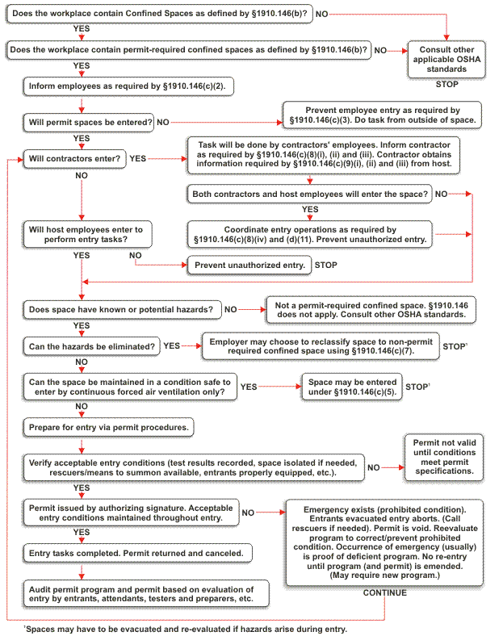
Confined space flow chart

Slide 19
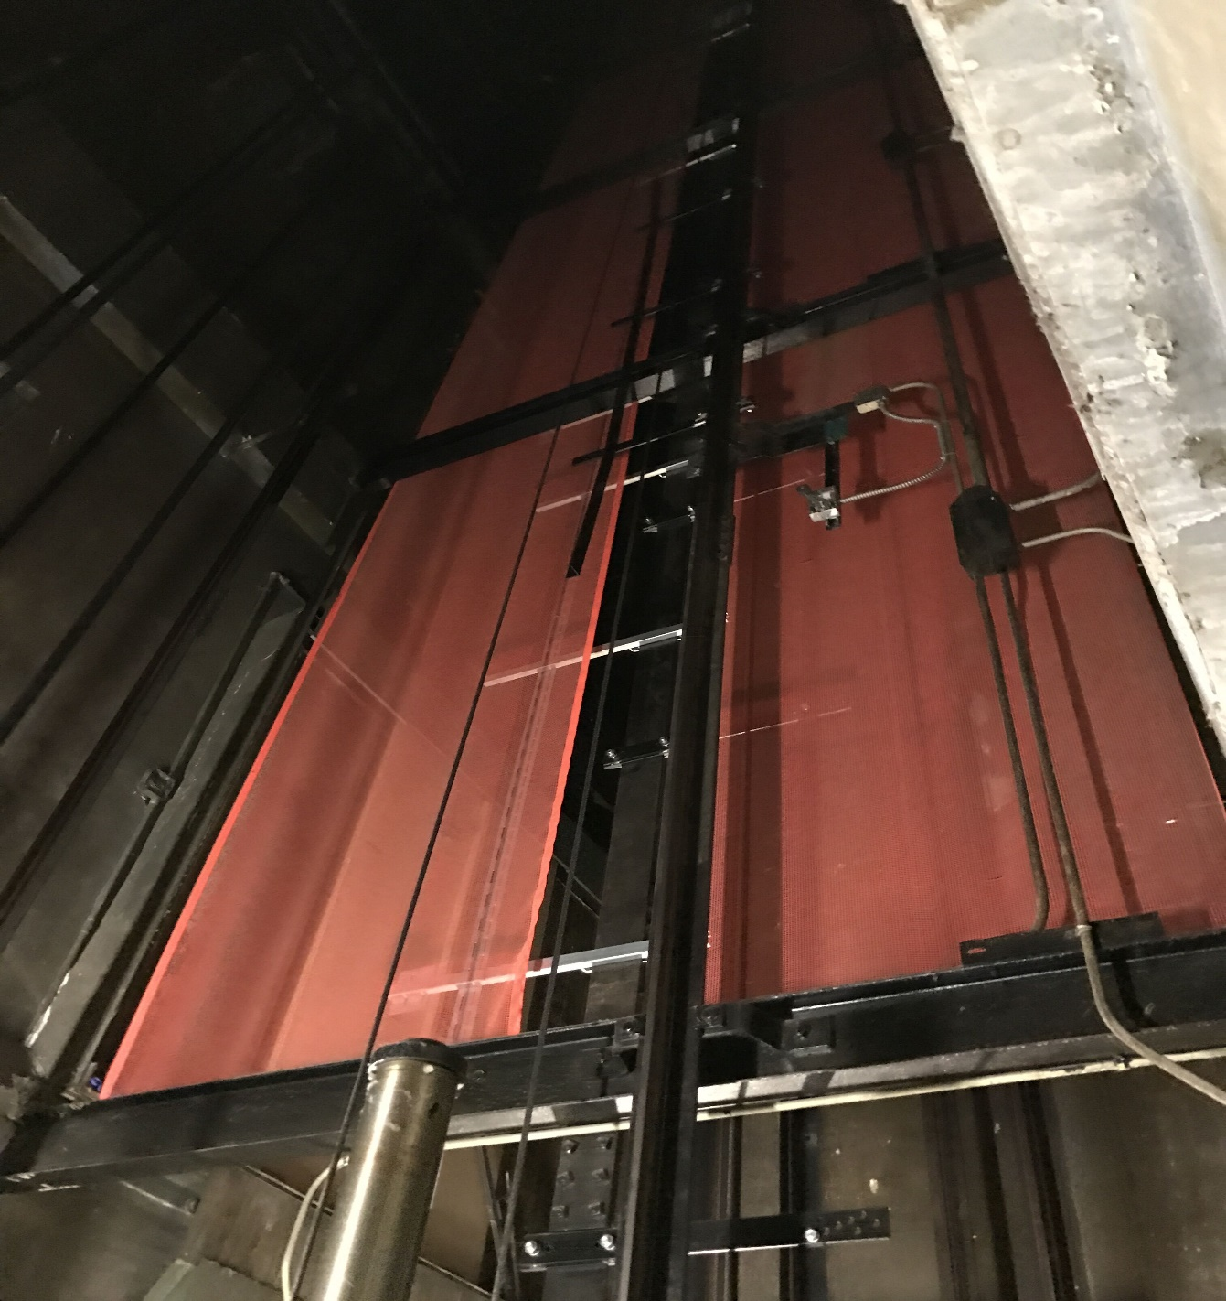
A space classified by the employer as a permit-required confined space may be reclassified as a non-permit confined space under the following procedures:
If the permit space poses no actual or potential atmospheric hazards and if all hazards within the space are eliminated without entry into the space (If it is necessary to enter the permit space to eliminate hazards, such entry shall be performed under the permit system)
If testing and inspection during that entry demonstrate that the hazards within the permit space have been eliminated, the permit space may be reclassified as a non-permit confined space for as long as the hazards remain eliminated.

Slide 20
Incident - Fatal:
An employee was troubleshooting elevator equipment. The elevator car unexpectedly traveled downward, crushing the employee between the elevator car and the steel structure. The employee sustained a crushed chest and head.
The employer was cited for the following violations of the OSHA 1910 General Industry Permit Required Confined Space Program Standards:
1910.146(d)(3): Develop and implement the means, procedures, and practices necessary for safe permit space entry operations.
1910.146(g)(1): The employer shall provide training so that all employees whose work is regulated by this section acquire the understanding, knowledge, and skills necessary for the safe performance of the duties assigned under this section.
1910.147(c)(4)(i): Procedures shall be developed, documented and utilized for the control of potentially hazardous energy when employees are engaged in the activities covered by this section.
1910.147(d)(3): Machine or equipment isolation. All energy isolating devices that are needed to control the energy to the machine or equipment shall be physically located and operated in such a manner as to isolate the machine or equipment from the energy source(s).

Slide 21
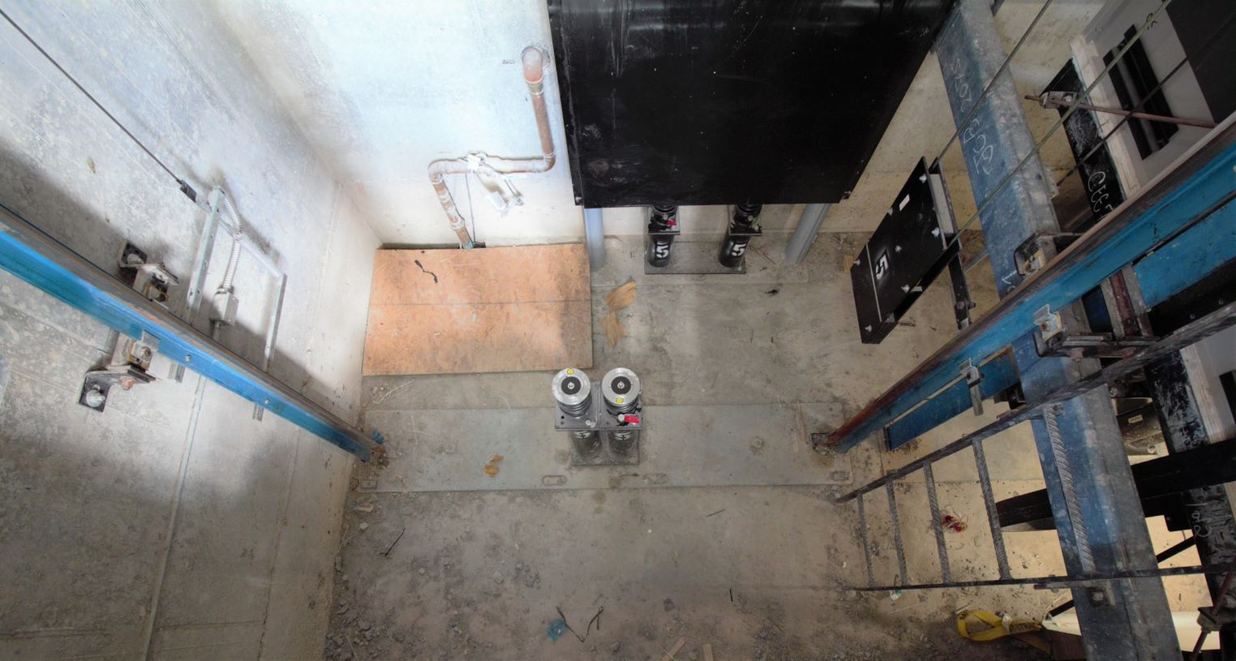
Summary:
Some things to consider the next time you go to a jobsite…
Does that escalator truss or elevator pit meet the conditions of a permit required confined space? What about the hoistway?
A dumbwaiter pit or shaft? LULA? Rack and pinion hoist?

Slide 22
Through the Alliance between OSHA’s 10 Regional Offices and the Elevator Contractors of America (ECA), Elevator Industry Work Preservation Fund (EIWPF), International Union of Elevator Constructors (IUEC), National Association of Elevator Contractors (NAEC), National Elevator Industry Educational Program (NEIEP), and National Elevator Industry Inc. (NEII), collectively known as The Elevator Industry Safety Partners, developed this Industry Specific Training for informational purposes only. It does not necessarily reflect the official views of OSHA or the U.S. Department of Labor. May 2021
Under the Occupational Safety and Health Act, employers are responsible (http://www.osha.gov/as/opa/worker/employer-responsibility.html) for providing a safe and healthy workplace and workers have rights (https://www.osha.gov/workers). OSHA can help answer questions or concerns from employers and workers. OSHA's On-Site Consultation Program (https://www.osha.gov/consultation) offers free and confidential advice to small and medium-sized businesses, with priority given to high-hazard worksites. For more information, contact your regional or area OSHA office (https://www.osha.gov/contactus/bystate), call 1-800-321-OSHA (6742), or visit https://www.osha.gov/.

