Slide 1

Hazardous Materials
General Industry
Notes:
Terminal Objective:
Given current OSHA and industry information regarding general industry worksite illnesses, injuries, and/or fatalities, the student will be able to describe preventative/protective measures for hazardous materials found in the workplace.

Slide 2
Introduction
Lesson objectives:
Describe employer requirements for chemical safety at the workplace.
Describe how to recognize chemical hazards associated with the workplace.
Describe how chemical hazards affect the body.
Describe how to safely handle chemicals in the workplace.
Notes:
Terminal Objective:
Given current OSHA and industry information regarding construction worksite illnesses, injuries, and/or fatalities, the student will be able to describe preventative/protective measures for hazardous materials found in the workplace.
Enabling Objectives:
Identify ways that hazardous materials are introduced into the body (inhalation, absorption, ingestion, injection)
Identify hazards (e.g. physical, health, environmental) associated with hazardous materials, including injuries that may occur.
Describe methods for eliminating physical hazards of hazardous materials.
Describe methods for eliminating health hazards of hazardous materials.

Slide 3

What’s in it for you?
Source: Construction Safety Council, used with permission.
Notes:
Hazardous materials in the workplace can cause severe health problems and/or physical injury to the worker.
Employers have the responsibility to anticipate, recognize, evaluation and control hazards associated with hazardous materials in the workplace.
Hazard abatement must be accomplished through a hierarchy of controls.
Hazardous materials can unexpectedly be brought home to a workers’ family causing illness!
Photo source: Construction Safety Council, used with permission.

Slide 4
Exposure to Hazardous Materials
What are hazardous materials?
Group of products for which the storage, handling, and use are regulated under the Hazardous Materials standard
Primarily associated with physical hazard
May also pose health hazard
Notes:
Multiple and varying definitions for the term “hazardous materials” can be found in different federal and state regulations. OSHA does not define the term, “hazardous materials,” in its Hazardous Materials standard, 29 CFR 1910 Subpart H, but rather refers to the following products for which the storage, handling, and use are regulated under the standard:
Compressed gases
Acetylene
Hydrogen
Oxygen
Nitrous oxide
Flammable liquids
Flammable materials used in spray finishing operations
Explosive and blasting agents
Liquefied petroleum gases
Anhydrous ammonia
Highly hazardous chemicals
Hazardous waste and exposure to substances during hazardous waste operations and emergency response
Liquids used in dipping and coating operations

Slide 5
Exposure to Hazardous Materials
Examples of worksite exposure:
Operations involving the storage, handling, and/or use of:
  Compressed gases
    Liquefied gases – anhydrous ammonia, chlorine, propane, nitrous oxide, and carbon dioxide
    Non-liquefied gases – oxygen, nitrogen, helium, and argon
    Dissolved gases - acetylene
Notes:
Exposure to Hazardous Materials in the Workplace
In the workplace, exposure to hazardous materials may come from the manufacturing, storage and/or process that uses or creates a situation as defined by the NFPA as being a hazardous (classified) location.
OSHA standards 29 CFR 1910, Subpart H lists requirements for the following situations, all of which have the potential to expose employees to hazardous materials:
The proper use/storage of compressed gases
The proper use/storage of flammable liquids
Spray finishing operations using flammable and combustible materials
Storage and handling of liquefied petroleum gases
The process safety management requirements of highly hazardous chemicals (PSM)
The work associated with hazardous waste operations and emergency response (HAZWOPER)
Dipping and coating operations

Slide 6
Exposure to Hazardous Materials
  Flammable liquids
    Category 1 – ethyl ether, isopentane, propylene oxide
    Category 2 – acetone, benzene, ethyl alcohol, gasoline isopropyl alcohol, toluene
    Category 3 – naphtha, turpentine, xylene
    Category 4 – ethylene glycol, glycerine
  Cryogenics and refrigerated liquids – oxygen, nitrogen, argon, hydrogen, helium LNG, Liquid methane, carbon monoxide
  Liquefied petroleum gases (LPGs) – propane, propylene, butane, and butylene
  Explosives and blasting agents
Notes:
Exposure to Hazardous Materials in the Workplace
In the workplace, exposure to hazardous materials may come from the manufacturing, storage and/or process that uses or creates a situation as defined by the NFPA as being a hazardous (classified) location.
OSHA standards 29 CFR 1910, Subpart H lists requirements for the following situations, all of which have the potential to expose employees to hazardous materials:
The proper use/storage of compressed gases
The proper use/storage of flammable liquids
Spray finishing operations using flammable and combustible materials
Storage and handling of liquefied petroleum gases
The process safety management requirements of highly hazardous chemicals (PSM)
The work associated with hazardous waste operations and emergency response (HAZWOPER)
Dipping and coating operations

Slide 7
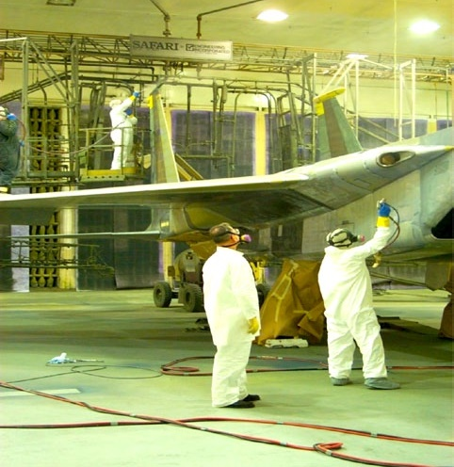
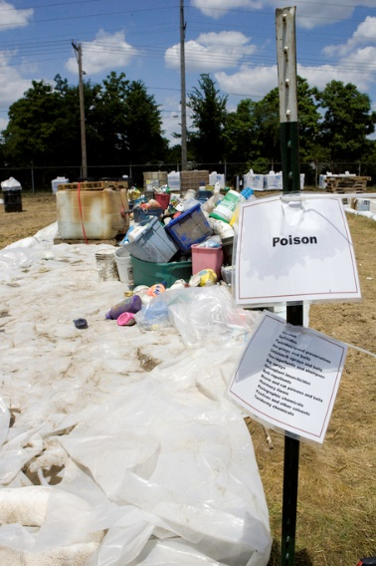
Exposure to Hazardous Materials
Spray finishing operations
Dipping and coating operations
Processing of highly hazardous chemicals
Clean-up and management of hazardous waste operations and emergency response
Source: OSHA; courtesy of U.S. Air Force
Source: FEMA; S. Shapira
Notes:
Exposure to Hazardous Materials in the Workplace
In the workplace, exposure to hazardous materials may come from the manufacturing, storage and/or process that uses or creates a situation as defined by the NFPA as being a hazardous (classified) location.
OSHA standards 29 CFR 1910, Subpart H lists requirements for the following situations, all of which have the potential to expose employees to hazardous materials:
The proper use/storage of compressed gases
The proper use/storage of flammable liquids
Spray finishing operations using flammable and combustible materials
Storage and handling of liquefied petroleum gases
The process safety management requirements of highly hazardous chemicals (PSM)
The work associated with hazardous waste operations and emergency response (HAZWOPER)
Dipping and coating operations

Slide 8
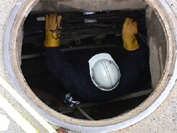
Exposure to Hazardous Materials
Additional precautions for hazard exposures:
Hazardous (classified) locations
Confined spaces
Source: OSHA

Slide 9
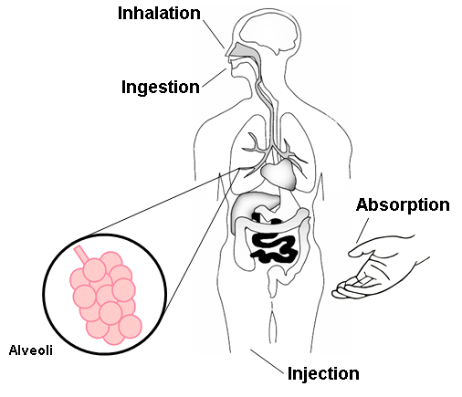
Exposure to Hazardous Materials
Routes of entry:
Inhalation*
Ingestion
Absorption
Injection
* Most Common
Source: Construction Safety Council, used with permission.
Notes:
Inhalation is the primary route of entry for hazardous chemicals in the work environment. Nearly all materials that are airborne can be inhaled. Remember, if you can smell it, you’re inhaling it!
Ingestion - toxic materials can be swallowed and enter the body through the gastrointestinal tract. In the workplace, people can unknowingly ingest harmful chemicals when you eat, drink, or smoke in a contaminated work areas.
Absorption through the skin is another route of entry. The skin is the largest organ of your body and a common exposure site for liquid and airborne chemicals. Absorption through the skin can occur quite rapidly if the skin is cut or abraded. Intact skin is an effective barrier to many hazardous materials.
Injection occurs when a sharp object punctures the skin, allowing a chemical or infectious agent to enter your body. For example, injection can occur when a contaminated object such as a rusty nail punctures the skin.

Slide 10




Hazards of Hazardous Materials
Types of health hazards associated with hazardous materials:
Acute/chronic toxicity
Skin corrosion or irritation
Aspiration hazard
Serious eye damage
or eye irritation
Respiratory or
skin sensitization
Germ cell mutagenicity
Carcinogenicity
Reproductive toxicity
Specific target organ toxicity
Source of pictograms: OSHA
Notes:
Health hazard means a chemical which is classified as posing one of the following hazardous effects: acute toxicity (any route of exposure); skin corrosion or irritation; serious eye damage or eye irritation; respiratory or skin sensitization; germ cell mutagenicity; carcinogenicity; reproductive toxicity; specific target organ toxicity (single or repeated exposure); or aspiration hazard.
For the purpose of this lesson, the following health hazards will be discussed: acute toxicity, skin corrosion or irritation, and aspiration hazard
https://www.osha.gov/Publications/OSHA3636.pdf
Pictograms:
Skull and Crossbones – acute toxicity (fatal or toxic)
Exclamation Mark – irritant (skin and eye), skin sensitizer, acute toxicity (harmful), narcotic effects, respiratory tract irritant
Health Hazard – carcinogen, mutagenicity, reproductive toxicity, respiratory sensitizer, target organ toxicity, aspiration toxicity
Corrosion – skin corrosives, burns, eye damage

Slide 11





Hazards of Hazardous Materials
Types of physical hazards associated with hazardous materials:
Oxidizer
Flammable
Explosion
Corrosive to metal
High-pressure systems
Source of pictograms: OSHA
Notes:
Physical hazard means a chemical that is classified as posing one of the following hazardous effects: explosive; flammable (gases, aerosols, liquids, or solids); oxidizer (liquid, solid or gas); self-reactive; pyrophoric (liquid or solid); self-heating; organic peroxide; corrosive to metal; gas under pressure; or in contact with water emits flammable gas.
For the purpose of this lesson, the following physical hazards will be discussed: explosive/flammable and gas under pressure
https://www.osha.gov/Publications/OSHA3636.pdf
Pictograms:
Flame Over Circle – oxidizers
Flame – flammables, pyrophorics, self-heating, emits flammable gas, self-reactives, organic peroxides
Exploding bomb – explosives, self-reactives, organic peroxides
Corrosion – corrosive to metals
Gas cylinder – gases under pressure

Slide 12
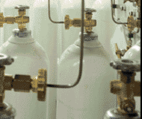
Hazards of Hazardous Materials
Compressed gases:
Oxygen displacement
Fires
Explosion
Toxic gas exposures
Physical hazards associated with high pressure systems
Source: OSHA
Notes:
“Hazards associated with compressed gases include oxygen displacement, fires, explosions, and toxic gas exposures, as well as the physical hazards associated with high pressure systems. Special storage, use, and handling precautions are necessary in order to control these hazards.” https://www.osha.gov/SLTC/compressedgasequipment/index.html
Gases under pressure are gases which are contained in a receptacle at a pressure of 200 kPa (29 psi) (gauge) or more, or which are liquefied or liquefied and refrigerated.
Cylinders of compressed gases and cryogenic liquids can be extremely hazardous if misused. Besides the hazard associated with high pressure, the chemical hazard of the cylinder contents must be considered. In addition, some of these materials, especially the cryogenic fluids, are extremely cold when released. Certain precautions must be observed in storage, handling, and use of these materials in order that minimize these hazards
Asphyxiant, there are two types of asphyxiants, simple asphyxiants and chemical asphyxiants. The examples given above represent simple asphyxiants, meaning that the presence of the listed gas will displace oxygen causing an oxygen deficiency environment resulting in a hazardous atmosphere. An example of a chemical is carbon monoxide, where the lack of oxygen is not the determining factor of a hazardous atmosphere, but rather the presence of a dangerous substance, i.e., carbon monoxide. Carbon monoxide molecules attach themselves to red blood cells and are then deposited into the organs and tissue of the body, causing a chemical reaction in the body and ultimately death.
Oxidizing agent,

Slide 13
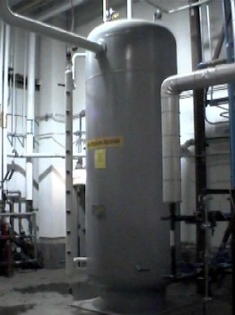
Hazards of Hazardous Materials
Cryogenic and refrigerated liquids:
Extreme cold
Extreme pressure
Asphyxiation
Fire or explosion
Source: OSHA

Slide 14
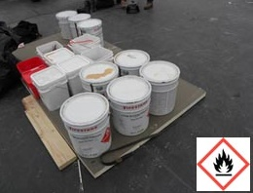
Hazards of Hazardous Materials
Flammable liquids:
Fire
Explosion
Source: OSHA
Criteria for Flammable Liquids
Category | Criteria
1 | Flashpoint < 73.4°F and initial boiling point ≤ 95°F
2 | Flashpoint < 73.4°F and initial boiling point > 95°F
3 | Flashpoint ≥ 73.4°F and ≤ 140°F
4 | Flashpoint > 140°F and ≤ 199.4°F
29 CFR 1910.1200 Appendix B, B.6.2
Notes:
Flammable liquid means a liquid having a flash point of not more than 93°C (199.4°F).
Flash point means the minimum temperature at which a liquid gives off vapor in sufficient concentration to form an ignitable mixture with air near the surface of the liquid.
A flammable liquid shall be classified in one of four categories:
Flash point < 23°C (73.4°F) and initial boiling point ≤ 35°C (95°F)
Flash point < 23°C (73.4°F) and initial boiling point > 35°C (95°F)
Flash point ≥ 23°C (73.4°F) and ≤ 60°C (140°F)
Flash point > 60°C (140°F) and ≤ 93°C (199.4°F)

Slide 15

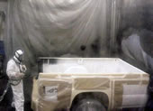
Hazards of Hazardous Materials
Spray finishing:
Flammable/combustible materials
Health hazards
Example: Isocyanates
  Powerful irritant to eyes and gastrointestinal and
  respiratory tracts
  Inflammation to skin
Source of photos: NIOSH
Notes:
Definitions applicable to Subpart H – Hazardous Materials
Source: Spray Operations, OSHA Safety and Health Topic, https://www.osha.gov/SLTC/sprayoperations/controls.html
“Spray operations can present both physical and health hazards to those involved. The OSHA ventilation standard for general industry (29 CFR 1910.94) defines a "spray-finishing operation" as the "employment of methods wherein organic or inorganic materials are utilized in dispersed form for deposit on surfaces to be coated, treated, or cleaned." This may include such diverse activities as the application of flammable and combustible liquids, such as paint, in a spray booth or spray area, electrostatic coating operations, and automobile body lining operations.”
Source: Isocynates, NIOSHhttp://www.cdc.gov/niosh/topics/isocyanates/
“Isocyanates are a family of highly reactive, low molecular weight chemicals. They are widely used in the manufacture of flexible and rigid foams, fibers, coatings such as paints and varnishes, and elastomers, and are increasingly used in the automobile industry, autobody repair, and building insulation materials. Spray-on polyurethane products containing isocyanates have been developed for a wide range of retail, commercial, and industrial uses to protect cement, wood, fiberglass, steel and aluminum, including protective coatings for truck beds, trailers, boats, foundations, and decks.
Isocyanates are powerful irritants to the mucous membranes of the eyes and gastrointestinal and respiratory tracts. Direct skin contact can also cause marked inflammation. Isocyanates can also sensitize workers, making them subject to severe asthma attacks if they are exposed again. There is evidence that both respiratory and dermal exposures can lead to sensitization. Death from severe asthma in some sensitized subjects has been reported. Workers potentially exposed to isocyanates who experience persistent or recurring eye irritation, nasal congestion, dry or sore throat, cold-like symptoms, cough, shortness of breath, wheezing, or chest tightness should see a physician knowledgeable in work-related health problems.” (NIOSH)

Slide 16



Hazards of Hazardous Materials
Liquefied petroleum gases (LPG):
Pictograms:
Signal word: Danger
Hazard statements:
  Extremely flammable gas.
  Contains gas under pressure;
  may explode if heated.
  May cause frostbite.
  May form explosive mixtures in air.
  May displace oxygen and cause rapid suffocation.
Source: OSHA
Notes:
Commonly referred to as propane or butane and used as a fuel. People can be exposed to LPG in the workplace by breathing it in, skin contact, and eye contact. OSHA has set the legal limit (Permissible Exposure Limit) for LPG exposure in the workplace as 1000 ppm (1800 mg/m³) over an 8-hour workday.

Slide 17
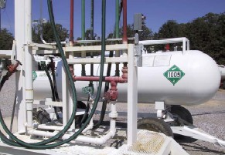




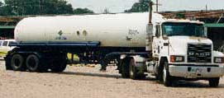
Hazards of Hazardous Materials
Anhydrous ammonia:
Pictograms:
Signal word: Danger
Hazard statements
  Flammable Gas
  Contains gas under pressure
  May explode if heated
  Toxic if inhaled
  Causes severe skin burns and eye damage
  Corrosive to respiratory tract
Source of photos: OSHA
Notes:
Ammonia is not, strictly speaking, a poison and repeated exposure to it produces no additive (chronic) effects on the human body. However, even in small concentrations in the air it can be extremely irritating to the eyes, throat, and breathing passages.
Anhydrous ammonia primarily affects three areas of the body:
Eyes
Lungs
Skin
Exposure to ammonia vapor may cause:
Convulsive coughing
Difficult or painful breathing
Pulmonary congestion
Death
The odor threshold for ammonia is between 5 - 50 parts per million (ppm) of air. The permissible exposure limit (PEL) is 50 ppm averaged over an 8 hour shift. It is recommended that if an employee can smell it they ought to back off and determine if they need to be using respiratory protection.
Ammonia is NH₃ chemical structure made out of Nitrogen and three Hydrogen atoms. The main cause of its acidic odor is Nitrogen. It can be found also in some cleaning products, cat urine, and sometimes in human sweat.

Slide 18
Hazards of Hazardous Materials
  Hazardous (classified) locations:
    Class I – flammable gases or vapors
      Division 1
      Division 2
    Class II – combustible dust
      Division 1
      Division 2
    Class III – ignitable fibers or flyings
Notes:
A hazardous (classified) location exists when a manufacturing, storage or handling process provides a fuel, consisting of a flammable gas, flammable liquid-produced vapors, combustible liquid-produced vapors, combustible dust, combustible flying or fiber, or some combination of these three elements; and these flammable components can be mixed with enough oxygen from the ambient air to form an explosive atmosphere between the LFL and UFL.
The NFPA Publication 70, NEC (National Electric Code) per the NEC, hazardous locations are defined in terms of Class, Division and Group.
Note: The following descriptions of hazardous locations as defined by the NFPA has been simplified to accommodate for time and to stay focused on hazard recognition and avoidance goals of the OSHA Outreach Program.
Class I Locations
Class I locations are those in which flammable gases or vapors are or may be present in the air in quantities sufficient to produce explosive or ignitable mixtures
Class I, Division 1 locations:
Ignitable concentrations of flammable gases or vapors may exist under normal operating conditions.
Ignitable concentrations of such gases or vapors may exist frequently because of repair or maintenance operations or because of leakage.
Breakdown or faulty operation of equipment or processes might release ignitable concentrations of flammable gases or vapors, and might also cause simultaneous failure of electric equipment.
Class I, Division 2 locations:
Volatile flammable liquids or flammable gases are handled, processed or used, but the hazardous liquids, vapors or gases will normally be confined within closed containers or closed systems from which they can escape only in the event of accidental rupture or breakdown of such containers or systems, or as a result of abnormal operation of equipment.
Ignitable concentrations of gases or vapors are normally prevented by positive mechanical ventilation, and which might become hazardous through failure or abnormal operations of the ventilating equipment.
Adjacent to a Class I, Division 1 location, and to which ignitable concentrations of gases or vapors might occasionally be communicated unless such communication is prevented by adequate positive-pressure ventilation from a source of clean air, and effective safeguards against ventilation failure are provided.
Class II Locations
Class II hazardous locations are areas where combustible dust, rather than gases or liquids, may be present in varying hazardous concentrations. Class II locations are further subdivided into two divisions.
Class II, Division 1 location. One of the following three situations must exist in order for an area to be considered a Class II, Division 1 location:
Where combustible dust is present in the air under normal operating conditions in such a quantity as to produce explosive or ignitable mixtures. This could be on a continuous, intermittent or periodic basis.
Where an ignitable and/or explosive mixture could be produced if a mechanical failure or abnormal machinery operation occurs.
Where electrically conductive dusts in hazardous concentrations are present.
Class II, Division 2 location. One of following two situations must exist in order for an area to be considered a Class II, Division 2 location:
Combustible dust will not normally be in suspension in the air in quantities sufficient to produce explosive or ignitable mixtures, and dust accumulations will normally be insufficient to interfere with the normal operation of electric equipment or other apparatus, but combustible dust may be in suspension in the air as a result of infrequent malfunctioning of handling or processing equipment.
Resulting combustible dust accumulations on, in or in the vicinity of the electric equipment may be sufficient to interfere with the safe dissipation of heat from electric equipment or may be ignitable by abnormal operation or failure of electric equipment.
Class III Locations
Class III hazardous locations contain easily ignitable fibers or flyings, but the concentration of these fibers or flyings are not suspended in the air in such quantities that would produce ignitable mixtures. Class III locations are further subdivided into two divisions.
Class III, Division 1: Easily ignitable fibers or materials producing combustible flyings are handled, manufactured or used.
Class III, Division 2: Easily ignitable fibers are stored or handled, other than in the process of manufacture.

Slide 19
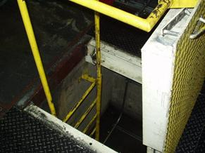
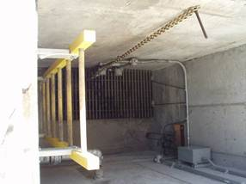
Hazards of Hazardous Materials
  Confined spaces:
Limited or restricted means for entry/exit; not designed for continuous occupancy
PRCS contains or has potential to contain hazardous atmospheres
Source of photos: OSHA
Notes:
Source: Confined Spaces, OSHA Safety and Health Topics, https://www.osha.gov/SLTC/confinedspaces/hazards_solutions.html
“Confined spaces may be encountered in virtually any occupation; therefore, their recognition is the first step in preventing fatalities. …deaths in confined spaces often occur because the atmosphere is oxygen-deficient, toxic or combustible…”
“What are confined spaces?
Many workplaces contain areas that are considered "confined spaces" because while they are not necessarily designed for people, they are large enough for workers to enter and perform certain jobs. A confined space also has limited or restricted means for entry or exit and is not designed for continuous occupancy. Confined spaces include, but are not limited to, tanks, vessels, silos, storage bins, hoppers, vaults, pits, manholes, tunnels, equipment housings, ductwork, pipelines, etc.
OSHA uses the term "permit-required confined space" (permit space) to describe a confined space that has one or more of the following characteristics: contains or has the potential to contain a hazardous atmosphere; contains material that has the potential to engulf an entrant; has walls that converge inward or floors that slope downward and taper into a smaller area which could trap or asphyxiate an entrant; or contains any other recognized safety or health hazard, such as unguarded machinery, exposed live wires, or heat stress.”

Slide 20

Health, Physical, Environmental
Health, Physical, Environmental
GHS – Hazard Classification

Slide 21

GHS: Environmental Hazards
GHS: Environmental Hazards
Hazardous to the Aquatic Environment
✓Acute – injury after short term exposure
✓Chronic – injury during the organism life cycle
- Includes fish, crustaceans, and algae or other aquatic plants
The environmental hazards are not covered by OSHA . The competent authority for those would be EPA

Slide 22
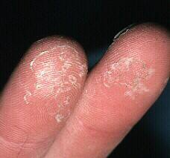
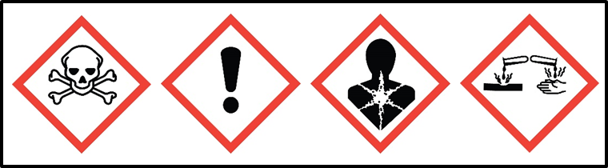
GHS Health Hazards (10)
GHS Health Hazards (10)
Acute Toxicity
Skin corrosion/Irritation
Serious eye damage/eye irritation
Respiratory or skin sensitization
Germ cell mutagenicity
Carcinogenicity
Reproductive toxicity
Specific Target organ toxicity – Single exposure
Specific Target organ toxicity – repeated exposure
Aspiration hazard
Notes:
Generally there are 10 Health Hazards associated with hazardous materials

Slide 23

Definitions: Health Hazards
Definitions: Health Hazards
Acute toxicity “refers to those adverse effects occurring following oral or dermal administration of a single dose of a substance, or multiple doses given within 24 hours, or an inhalation exposure of 4
hours”.
– Substances are assigned to one of five included categories based on oral, dermal, and inhalation toxicity.
OSHA did not adopt category 5

Slide 24
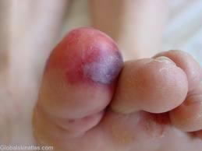
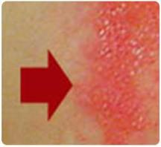
Definitions:Health Hazards
Skin corrosion is defined as “the production of irreversible damage to the skin; namely, visible necrosis through the epidermis and into the dermis, which was followed by the
application of a test substance for up
to 4 hours”.
– GHS does not require additional testing.
Based on available data for that chemical
Corrosive reactions are typified by ulcers, bleeding, bloody scabs.
Visible damage to skin after contact with substance

Slide 25

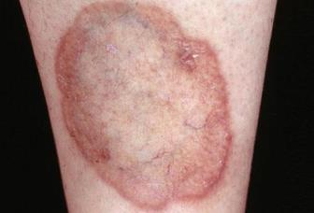
Definitions: Health Hazards
Skin irritation is defined as “the production of reversible damage to the skin following the application of a test substance for up to 4 hours”.
Before contact
OSHA adopted two categories for the Skin Corrosion/irritation hazard class
After contact

Slide 26
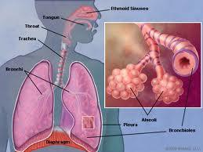
Definitions: Health Hazards
Skin sensitizer “means a chemical that induces an allergic response following skin contact”.
Respiratory sensitizer “means a chemical that will lead to hypersensitivity of the airways following inhalation of the chemical”.
– There are two categories for the Respiratory or Skin
Sensitization hazard class

Slide 27
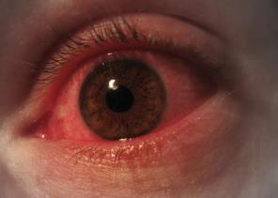
Definitions: Health Hazards
Definitions: Health Hazards
Two categories for eye hazards
Eye irritation is defined as “the production of changes in the eye following the application of test substance to the anterior surface of the eye, which are full reversible within 21 days of application”.

Slide 28

Definitions: Health Hazards
Definitions: Health Hazards
Serious eye damage is defined as the production of tissue damage in the eye, or serious physical decay of vision, following application of a test substance to the anterior surface of the eye, which is not fully reversible within 21 days of application”.

Slide 29


Definitions: Health Hazards
Definitions: Health Hazards
Germ Cell Mutagenicity
A mutation “is defined as a permanent change in the amount or structure of the genetic material in a cell”.
The term mutagenic and mutagen “will be used for agents giving rise to an increased occurrence of mutations in populations of cells and/or organisms”.
Two categories in this hazard class

Slide 30
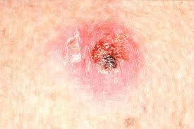
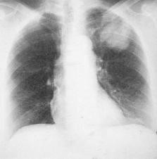
Definitions: Health Hazards
Definitions: Health Hazards
Carcinogen “means a substance or a mixture of substances which induce cancer or increase its incidence.”
Skin cancer
– Substances and mixtures which have induced benign and malignant tumors in well-performed experimental studies on animals are considered also to be presumed or suspected human carcinogens.
Two categories in this hazard
Lung cancer

Slide 31


Definitions: Health Hazards
Reproductive toxicity “includes adverse effects on sexual function and fertility in adult males and females, as well as adverse effects on development of the offspring”.
– Adverse effects on development of the offspring means “any effect of chemicals which interferes with normal development of the conceptus either before or after birth”.
Two categories in this hazard

Slide 32

Definitions: Health Hazards
Definitions: Health Hazards
Specific Target Organ Toxicity (STOT)
  Single exposure means “specific, non-lethal target organ toxicity arising from a single exposure to a chemical”.
  Repeated exposure requires more than one instance of exposure.

Slide 33

Definitions: Health Hazards
STOT is caused by chemicals that are specific target organ toxicants and, as such, present a potential for adverse health effects in people who are exposed to it.
  STOT – single exposure has three hazard categories
  STOT – repeated exposure has two hazard categories.

Slide 34

Definitions:Health Hazards
Definitions: Health Hazards
Aspiration means “the entry of a liquid or solid chemical directly through the oral or nasal cavity, or indirectly from vomiting, into the trachea and lower respiratory system”.
  Includes severe acute effects such as chemical pneumonia, varying degrees of pulmonary injury or death following aspiration.
  Two categories but Only one category adopted by OSHA

Slide 35





New Definitions
New Definitions…
GHS – Physical Hazards
Notes:
Generally speaking there are 16 physical hazards associated with hazardous materials

Slide 36
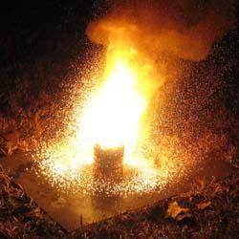
GHS Physical Hazards (16)
GHS Physical Hazards (16)
Explosives
Flammable gases
Flammable aerosols
Oxidizing gases
Gases under pressure
Flammable liquids
Flammable solids
Self-reactive substances and mixtures
Pyrophoric liquids
Pyrophoric solids
Self-heating substances and mixtures
Substances and mixtures which, in contact with water, emit flammable gases
Oxidizing liquids
Oxidizing solids
Organic peroxides
Corrosive to metals

Slide 37
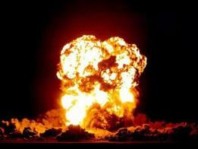
Physical Hazards
Physical Hazards…
Explosive Substances and Mixtures
  Solid or liquid substances capable of producing gas at such a high temperature and pressure that it can cause damage to surroundings.
  Divided into 7 categories based on type of damage produced

Slide 38

Physical Hazards
Physical Hazards...
Flammables, include
  Flammable Gases
  Flammable Aerosols
  Flammable Liquids
  Flammable Solids

Slide 39
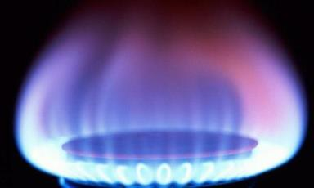
Physical Hazards
Physical Hazards...
Flammable gas means a gas having a flammable range with air at 20°C (68°F) and a standard pressure of 101.3 kPa (14.7 psi).
– Two categories

Slide 40

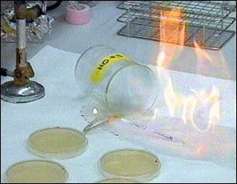
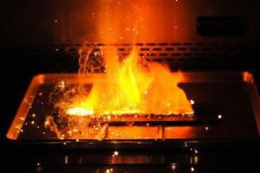
Physical Hazards
Physical Hazards...
Flammable Liquids
  Any liquid with a flash point of
93°C (199.4°F) or less.
  Four categories
Flammable Solids means a solid, usually in a powder or granular form, that is easily combustible through friction
  Two categories

Slide 41
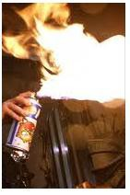
Physical Hazards
Physical Hazards...
Aerosol means “any non-refillable receptacle containing a gas compressed, liquefied or dissolved under pressure, and fitted with a release device allowing the contents to be ejected as particles in suspension in a gas, or as a foam, paste, powder, liquid or gas.”
Flammable Aerosols
  Contain Flammable components
  Two categories

Slide 42
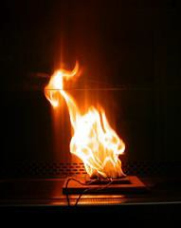
Physical Hazards
Physical Hazards …
Oxidizing gas “means any gas which may, generally by providing oxygen, cause or contribute to the combustion of other material more than air does”. One category.
Oxidizing Liquids and Solids
  Though not necessarily combustible on their own, generally by yielding oxygen cause or contribute combustion of other material.
  Three categories

Slide 43
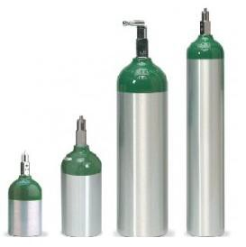
Physical Hazards
Physical Hazards ...
Gases Under Pressure
  Gases contained in a receptacle at a pressure of 200 kPa (29 psi) or more, which are liquefied or liquefied and refrigerated
  Includes 4 groups: compressed gases, liquefied gases, dissolved gases and refrigerated liquefied gases

Slide 44
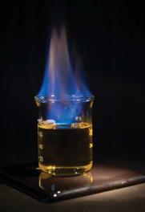
Physical Hazards …
Self-reactive substances & mixtures are thermally unstable liquid or solid chemicals liable to undergo a strongly exothermic decomposition even without participation of oxygen (air).
Divided in 6 categories similar to those in
the transport sector
Excludes oxidizers, organic peroxides and
explosives.

Slide 45
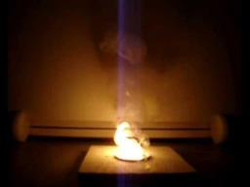
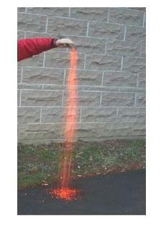
Physical Hazards
Physical Hazards …
Pyrophoric Solids / Liquids means a solid or liquid “which, even in small quantities, is liable to ignite within five minutes after coming into contact with air”.
  Mildly pyrophoric solids can be handled in the air for brief periods of time.
  One category for each

Slide 46
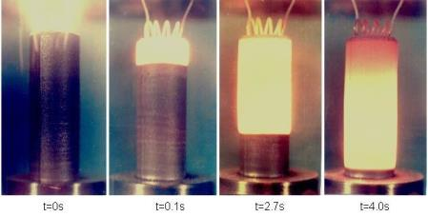
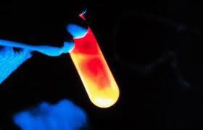
Physical Hazards …
Self-Heating Substances & Mixtures
Solids or liquids, other than pyrophoric, which by reaction with air and without energy supply is liable to self heat. (Two categories)
They require large amounts of material and long periods of time to ignite.

Slide 47
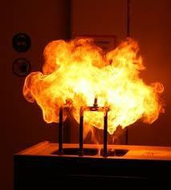
Physical Hazards …
Substances & Mixtures which in contact with water, Emit Flammable Gas are solid or liquid chemicals which, by interaction with water, are liable to become spontaneously flammable or to give off flammable gases in dangerous quantities
– Divided into 3 categories

Slide 48
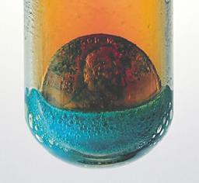

Physical Hazards …
Corrosive to Metals “means a chemical which by chemical action will materially damage, or even destroy, metals”
  One category.
Organic Peroxides
  Organic liquids or solids that can decompose explosively, burn rapidly, be sensitive to friction and react dangerously with other chemicals.
  7 categories adopted similar to those in
transport sector

Slide 49
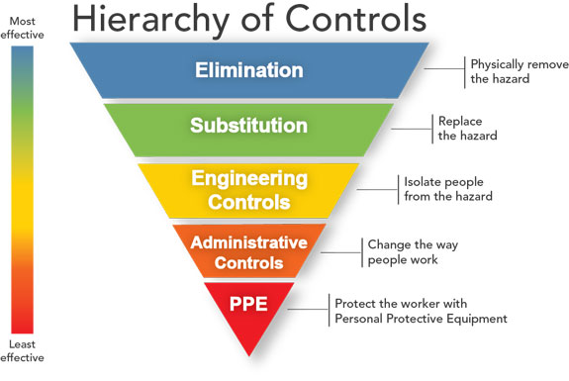
Controlling Physical Hazards
Source: NIOSH
Notes:
Source: Hierarchy of Controls (n.d.), NIOSH Workplace Safety and Health Topics, http://www.cdc.gov/niosh/topics/hierarchy
“Controlling exposures to occupational hazards is the fundamental method of protecting workers. Traditionally, a hierarchy of controls has been used as a means of determining how to implement feasible and effective control solutions….
Elimination and Substitution
Elimination and substitution, while most effective at reducing hazards, also tend to be the most difficult to implement in an existing process. If the process is still at the design or development stage, elimination and substitution of hazards may be inexpensive and simple to implement. For an existing process, major changes in equipment and procedures may be required to eliminate or substitute for a hazard.
Engineering Controls
Engineering controls are favored over administrative and personal protective equipment (PPE) for controlling existing worker exposures in the workplace because they are designed to remove the hazard at the source, before it comes in contact with the worker. Well-designed engineering controls can be highly effective in protecting workers and will typically be independent of worker interactions to provide this high level of protection. The initial cost of engineering controls can be higher than the cost of administrative controls or PPE, but over the longer term, operating costs are frequently lower, and in some instances, can provide a cost savings in other areas of the process….
Administrative Controls and PPE
Administrative controls and PPE are frequently used with existing processes where hazards are not particularly well controlled. Administrative controls and PPE programs may be relatively inexpensive to establish but, over the long term, can be very costly to sustain. These methods for protecting workers have also proven to be less effective than other measures, requiring significant effort by the affected workers.”

Slide 50

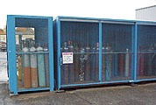
Controlling Physical Hazards
Compressed gases:
Compressed gas cylinders shall be in a safe condition to the extent that this can be determined by visual inspection.
Source of graphics: OSHA
Notes:
Compressed gas cylinders shall be in a safe condition to the extent that this can be determined by visual inspection.
Visual and other inspections of compressed gas cylinders shall be conducted in accordance with:
Hazardous Materials Regulations of the Department of Transportation (49 CFR parts 171-179 and 14 CFR part 103)
Compressed Gas Association Pamphlets C-6-1968 and C-8-1962, which is incorporated by reference as specified in Sec. 1910.6.
Compressed Gas Association Pamphlet P-1-1965, which is incorporated by reference as specified in Sec. 1910.6.
Compressed Gas Association Pamphlets S-1.1-1963 and 1965 addenda and S-1.2-1963, which is incorporated by reference as specified in Sec. 1910.6.
General Guidelines for Compressed Gas Cylinders:
A cylinder should always carry a legible label or stencil identifying the contents.
Do not deface or remove any markings, labels, decals, tags or stencil marks used for identification of cylinder contents.
Empty cylinders and cylinder storage areas should be clearly marked with appropriate labels and signs. Assigned storage spaces shall be located where cylinders will not be damaged by passing or falling objects, or subject to tampering by unauthorized persons.
Cylinders should not be kept in unventilated enclosures, such as lockers or cupboards. Ensure cylinders are stored and used in a dry, well ventilated area.
Cylinders should be stored out of direct sunlight and away from other sources of heat.
Do not tamper with the safety relief device in valve or cylinder or attempt to repair or alter a cylinder, valve, or safety relief device.
Cylinder valves should be closed at all times except when cylinder is in active use.
Cylinders of oxidizing gases, including oxygen (except those on a welding cart that is in use on a regular basis) must be stored at least 20 feet (6.1 m) away from any flammable gas or separated by a 5 foot (1.5m) high 30 minute (minimum) fire resistant wall. Oxidizing gases must also be stored away from combustible materials.

Slide 51
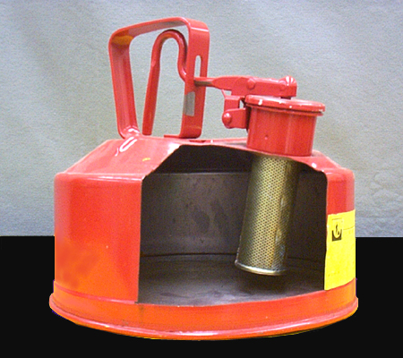
Controlling Physical Hazards
Safety can:
Not more than
5 gallons capacity
Spring-closing lid
Designed to relieve internal pressure when subjected to fire.
Source of photos: OSHA
Notes:
“Safety Can”
Safety cans shall mean an approved container, of not more than 5 gallons capacity, having a spring-closing lid and spout cover and so designed that it will safely relieve internal pressure when subjected to fire exposure.
Safety cans must have a Nationally Recognized Testing Laboratory (NRTL) approval.

Slide 52
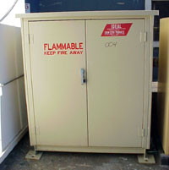
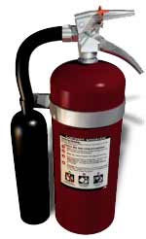
Controlling Physical Hazards
Cabinets:
Not more than 60 gallons
of Category 1, 2, or 3
flammable liquids, nor
more than 120 gallons of Category 4 flammable liquids.
Suitable fire control devices shall be available at locations where flammable liquids are stored.
Source of photos: OSHA
Notes:
“Cabinets”
Maximum capacity. Not more than 60 gallons of Category 1, 2, or 3 flammable liquids, nor more than 120 gallons of Category 4 flammable liquids may be stored in a storage cabinet.
"Extinguishers." Suitable fire control devices, such as small hose or portable fire extinguishers, shall be available at locations where flammable liquids are stored.

Slide 53
Controlling Physical Hazards
Ventilation:
Category 1 or 2 flammable liquids, or Category 3 flammable liquids with a flashpoint below 100 °F (37.8 °C), shall be ventilated at a rate of not less than 1 cubic foot per minute per square foot of solid floor area.
Notes:
“Ventilation”
Category 1 or 2 flammable liquids, or Category 3 flammable liquids with a flashpoint below 100 °F (37.8 °C), shall be ventilated at a rate of not less than 1 cubic foot per minute per square foot of solid floor area. This shall be accomplished by natural or mechanical ventilation with discharge or exhaust to a safe location outside of the building. Provision shall be made for introduction of makeup air in such a manner as not to short circuit the ventilation. Ventilation shall be arranged to include all floor areas or pits where flammable vapors may collect.

Slide 54
Controlling Physical Hazards
Explosion-proof apparatus:
Apparatus enclosed in a case that is capable of withstanding an explosion of a specified gas or vapor that may occur within it and of preventing the ignition of a specified gas or vapor surrounding the enclosure by sparks, flashes or explosion of the gas or vapor within, and that operates at such an external temperature that it will not ignite a surrounding flammable atmosphere.
Notes:
“Explosion-proof apparatus”
Apparatus enclosed in a case that is capable of withstanding an explosion of a specified gas or vapor that may occur within it and of preventing the ignition of a specified gas or vapor surrounding the enclosure by sparks, flashes or explosion of the gas or vapor within, and that operates at such an external temperature that it will not ignite a surrounding flammable atmosphere.

Slide 55
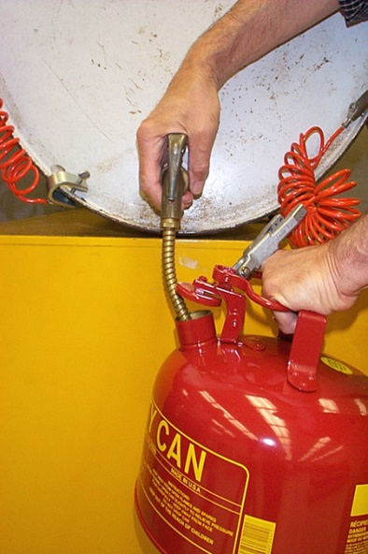
Controlling Physical Hazards
Grounding:
Category 1 or 2 flammable liquids, or Category 3 flammable liquids with a flashpoint below 100 °F (37.8 °C), shall not be dispensed into containers unless the nozzle and container are electrically interconnected.
Source of graphics: OSHA
Notes:
“Grounding”
Category 1 or 2 flammable liquids, or Category 3 flammable liquids with a flashpoint below 100 °F (37.8 °C), shall not be dispensed into containers unless the nozzle and container are electrically interconnected. Where the metallic floorplate on which the container stands while filling is electrically connected to the fill stem or where the fill stem is bonded to the container during filling operations by means of a bond wire, the provisions of this section shall be deemed to have been complied with.
“Grounding - eliminates a difference in static charge potential between conductive objects and ground.
Although bonding will eliminate a difference in potential between objects, it will not eliminate a difference in potential between these objects and earth unless one of the objects is connected to earth with a ground wire.” (OSHA DTE Outreach topic materials)

Slide 56
Controlling Physical Hazards
Intrinsically safe:
An apparatus/equipment in which all the circuits in which any spark or thermal effect is incapable of causing ignition of a mixture of flammable or combustible material in air.
Notes:
“Intrinsically safe”
An apparatus/equipment in which all the circuits in which any spark or thermal effect is incapable of causing ignition of a mixture of flammable or combustible material in air under prescribed test conditions as described in ANSI/UL 913 Edition 8.

Slide 57

Controlling Health Hazards
Source: OSHA
Notes:
Elimination and/or substitution controls can be accomplished by transitioning to safer chemicals.

Slide 58
Controlling Health Hazards
Source: NIOSH
Notes:
Engineering controls
Change process to minimize contact with hazardous chemicals.
Isolate or enclose the process.
Use of wet methods to reduce generation of dusts or other particulates.
General dilution ventilation.
Use fume hoods
Administrative controls
Rotate job assignments.
Adjust work schedules so that workers are not overexposed to a hazardous chemical.
Personal protective equipment
Use chemical protective clothing.
Wear respiratory protection. [See the Respiratory Protection Safety and Health Topics page]
Use gloves.
Wear eye protection.
Note: To achieve compliance with OSHA standards related to the exposure of hazardous materials, engineering and/or administrative controls must first be implemented before allowing the use of personal protective equipment (PPE). PPE (respirators) may only be used when engineering controls are not feasible or used in conjunction with other engineering/administrative controls.

Slide 59
Controlling Health Hazards
Source: NIOSH
Notes:
Engineering controls
Change process to minimize contact with hazardous chemicals.
Isolate or enclose the process.
Use of wet methods to reduce generation of dusts or other particulates.
General dilution ventilation.
Use fume hoods
Note: To achieve compliance with OSHA standards related to the exposure of hazardous materials, engineering and/or administrative controls must first be implemented before allowing the use of personal protective equipment (PPE). PPE (respirators) may only be used when engineering controls are not feasible or used in conjunction with other engineering/administrative controls.

Slide 60
Controlling Health Hazards
Source: NIOSH
Notes:
Administrative controls
Rotate job assignments.
Adjust work schedules so that workers are not overexposed to a hazardous chemical.
Establish and enforce safe work practices
Train employees
.

Slide 61
Controlling Health Hazards
Source: NIOSH
Notes:
Personal protective equipment
Use chemical protective clothing.
Wear respiratory protection. [See the Respiratory Protection Safety and Health Topics page]
Use gloves.
Wear eye protection.
Remember: To achieve compliance with OSHA standards related to the exposure of hazardous materials, engineering and/or administrative controls must first be implemented before allowing the use of personal protective equipment (PPE). PPE (respirators) may only be used when engineering controls are not feasible or used in conjunction with other engineering/administrative controls.

Slide 62
Controlling Health Hazards
Process Safety Management (PSM) of highly hazardous chemicals:
Regulations designed to prevent the release of toxic, reactive, flammable and/or explosive chemicals.
Contains a list and threshold limits for when employers must comply.
  Anhydrous Ammonia - 10,000 lbs
  Chlorine - 1,500 lbs
Notes:
Process Safety Management of Highly Hazardous Chemicals (PSM)
Hazardous chemical releases pose a significant threat to workers. The key provision of process safety management (PSM) is process hazard analysis (PHA), a careful review of what could go wrong and what safeguards must be implemented to prevent releases of hazardous chemicals.

Slide 63
Controlling Health Hazards
Hazardous Waste Operations and Emergency Response (HAZWOPER):
Applies to employers and their employees who are exposed to hazardous substances and who are engaged in several operations including clean-up, treatment, storage and disposal of hazardous waste.
Notes:
Hazardous Waste Operations and Emergency Response (HAZWOPER)
The Hazardous Waste Operations and Emergency Response Standard (HAZWOPER) applies to five distinct groups of employers and their employees. This includes any employees who are exposed or potentially exposed to hazardous substances -- including hazardous waste -- and who are engaged in one of the following operations as specified by 1910.120(a)(1)(i-v) and 1926.65(a)(1)(i-v):
Clean-up operations -- required by a governmental body, whether federal, state, local, or other involving hazardous substances -- that are conducted at uncontrolled hazardous waste sites;
Corrective actions involving clean-up operations at sites covered by the Resource Conservation and Recovery Act of 1976 (RCRA) as amended (42 U.S.C. 6901 et seq.);
Voluntary clean-up operations at sites recognized by federal, state, local, or other governmental body as uncontrolled hazardous waste sites;
Operations involving hazardous wastes that are conducted at treatment, storage, and disposal facilities regulated by Title 40 Code of Federal Regulations Parts 264 and 265 pursuant to RCRA, or by agencies under agreement with U.S. Environmental Protection Agency to implement RCRA regulations; and
Emergency response operations for releases of, or substantial threats of releases of, hazardous substances regardless of the location of the hazard.

Slide 64
Hazardous Materials Worksheet
Complete the Worksheet
Notes:
Using a known hazardous material and its safety data sheet (SDS), complete the following worksheet details.
Checklist created by Construction Safety Council, used with permission.

Slide 65
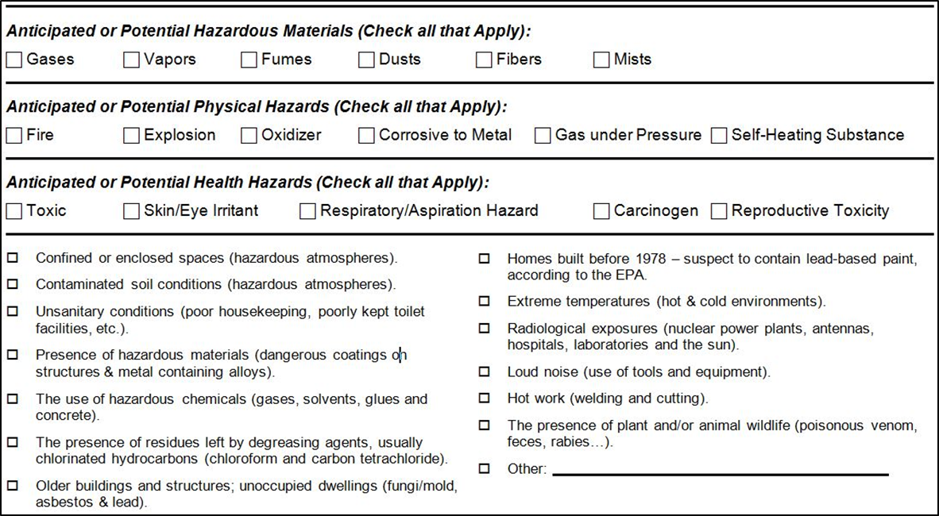
Hazardous Materials Worksheet
Hazard Anticipation
Source: Construction Safety Council, used with permission.
Notes:
Use as discussion and/or complete using a known hazardous material.
Checklist created by Construction Safety Council, used with permission.

Slide 66
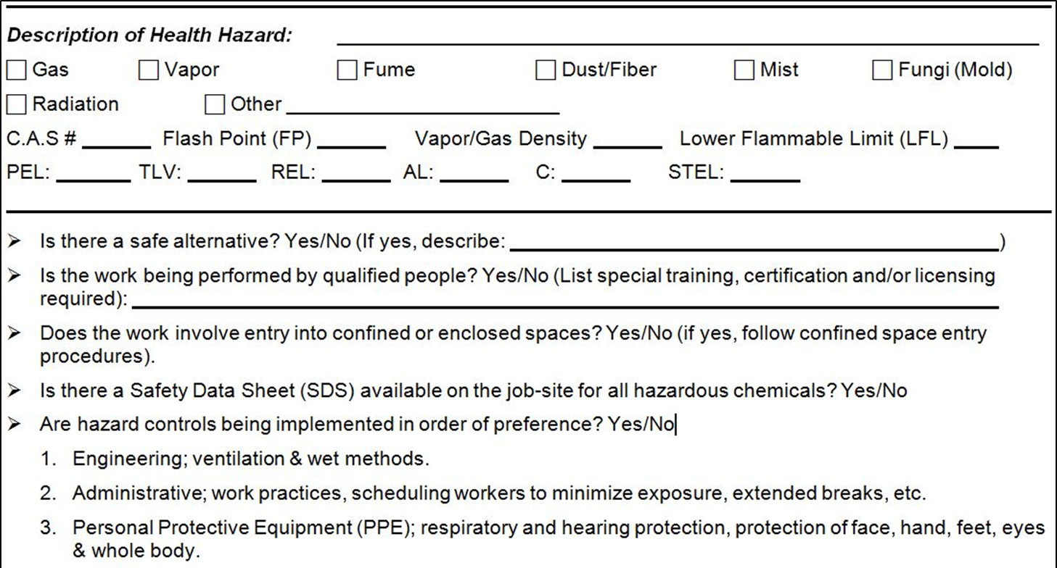
Hazardous Materials Worksheet
Hazards Identification
Source: Construction Safety Council, used with permission.
Notes:
Use as discussion and/or complete using a known hazardous material.
Checklist created by Construction Safety Council, used with permission.

Slide 67
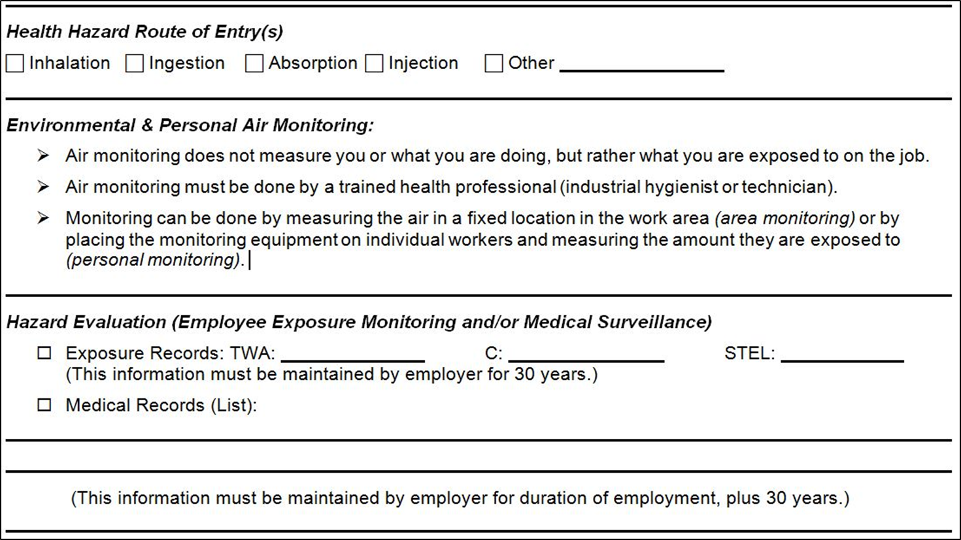
Hazardous Materials Worksheet
Hazards Evaluation
Source: Construction Safety Council, used with permission.
Notes:
Use as discussion and/or complete using a known hazardous material.
Checklist created by Construction Safety Council, used with permission.

Slide 68
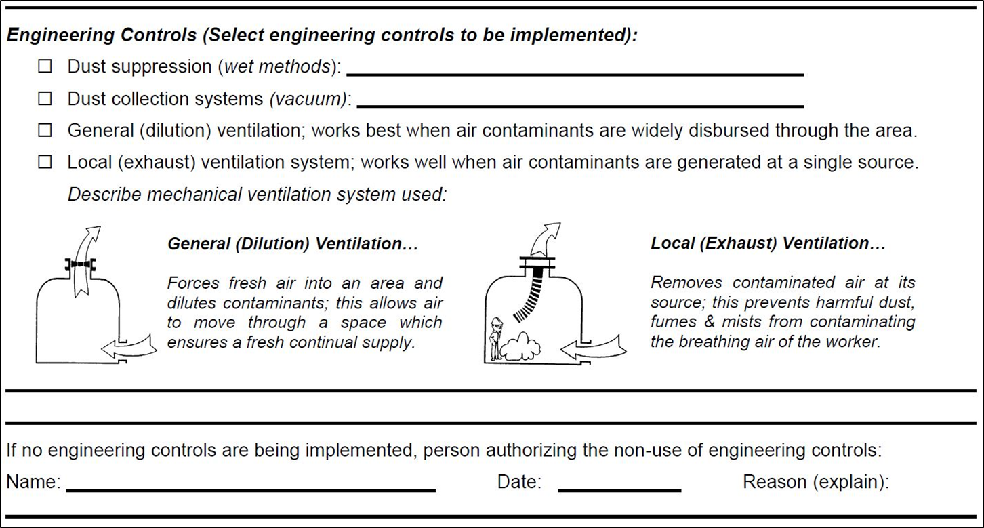
Hazardous Materials Worksheet
Hazards Controls - Engineering
Source: Construction Safety Council, used with permission.
Notes:
Use as discussion and/or complete using a known hazardous material.
Checklist created by Construction Safety Council, used with permission.

Slide 69
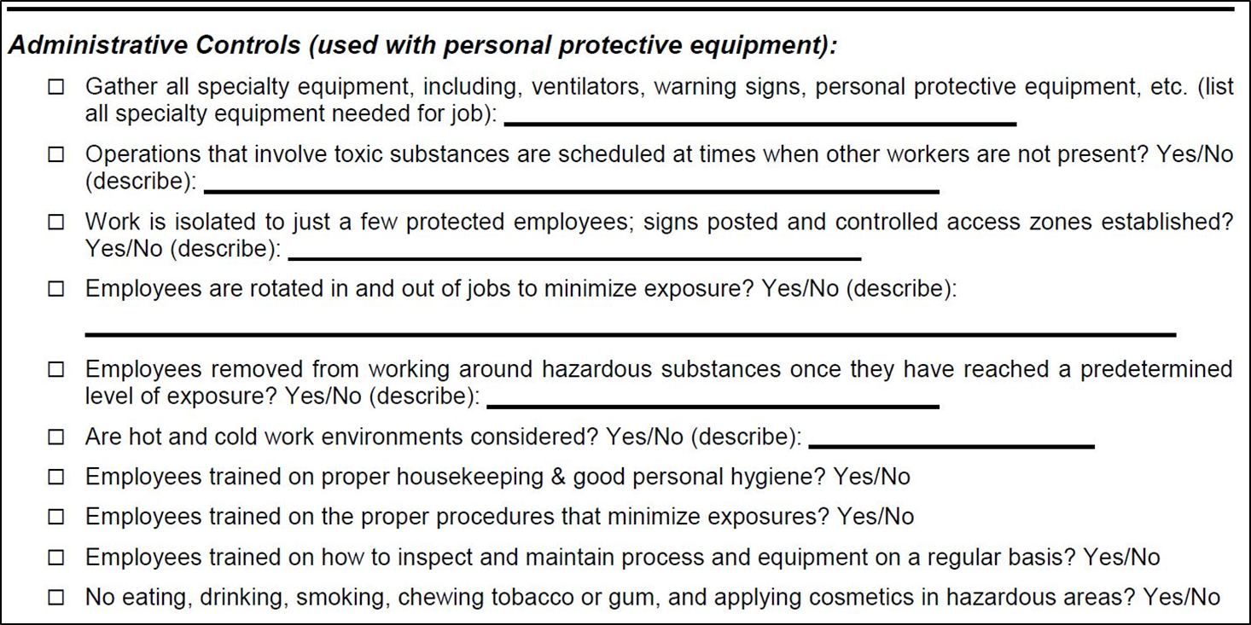
Hazardous Materials Worksheet
Hazards Controls - Administrative
Source: Construction Safety Council, used with permission.
Notes:
Use as discussion and/or complete using a known hazardous material.
Checklist created by Construction Safety Council, used with permission.

Slide 70
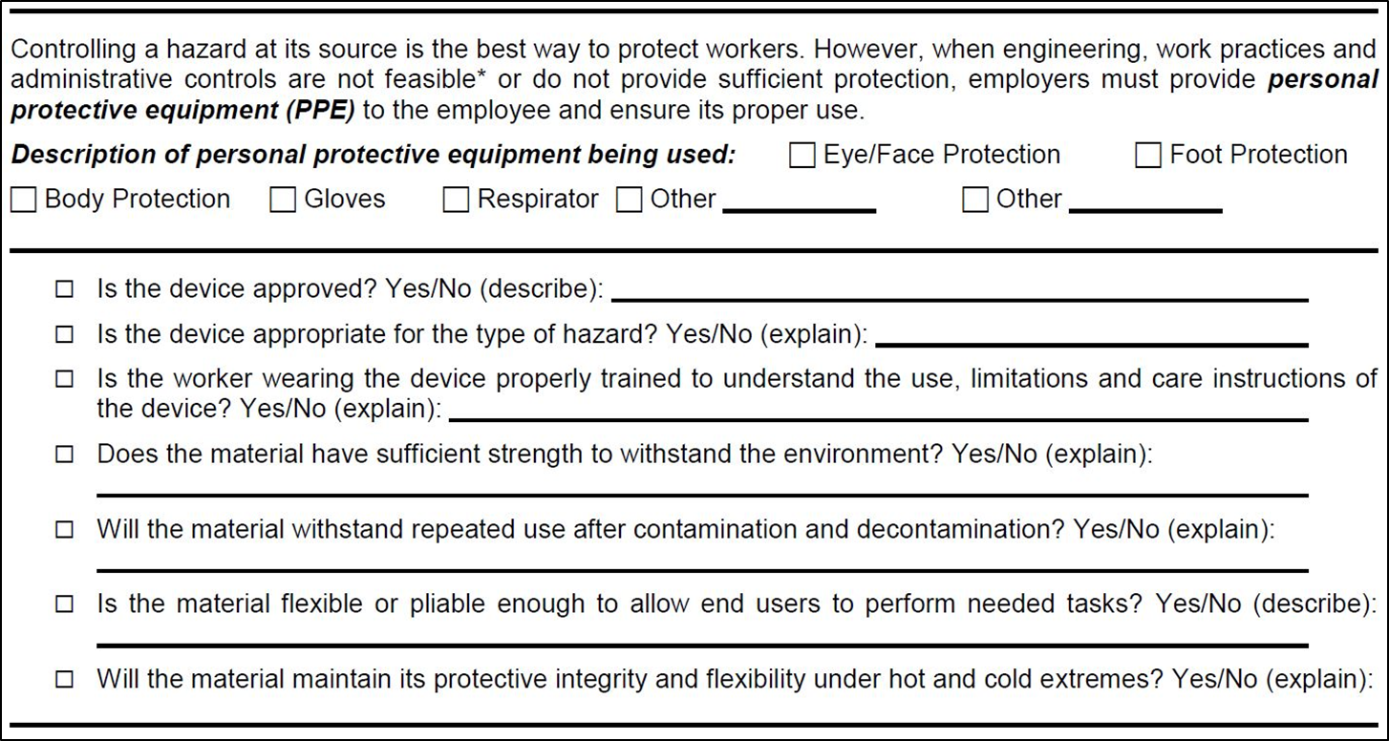
Hazardous Materials Worksheet
Hazards Controls - PPE
Source: Construction Safety Council, used with permission.
Notes:
Use as discussion and/or complete using a known hazardous material.
Checklist created by Construction Safety Council, used with permission.

Slide 71

Summary
Stop health hazards before they stop you!
Source: Construction Safety Council, used with permission.
Notes:
If the work involves many different or complex processes, a professional may be needed to help conduct job-site evaluation and personal exposure monitoring. Sources of help include insurance companies, contractor associations, trade unions, and private consultants with safety and health expertise.
OSHA offers assistance through its regional and area offices and consultation services. Contact your local OSHA office for more information.
Even when outside help is received, it is important that all employees remain involved in the process of identifying and correcting hazards because job-site conditions change every day. New circumstances and a recombination of existing circumstances may cause old hazards to reappear and new hazards to appear. In addition, employees must be ready and able to implement whatever hazard elimination or control measures a professional consultant recommends.
Image Source: Construction Safety Council, used with permission.

Slide 72
Knowledge Check
The most common route of entry by which hazardous materials are introduced into the body is ___.
  inhalation
  absorption
  ingestion
  injection
Answer: a. inhalation

Slide 73
Knowledge Check
Flammability is which type of hazard?
  Carcinogenic
  Health
  Physical
  Mutagenic
Answer: c. Physical

Slide 74
Knowledge Check
Which of the following hazards is an example of a physical hazard?
  Oxidizer
  Exposure to carcinogen
  Chronic toxicity
  Acute toxicity
Answer: a. Oxidizer

Slide 75
Knowledge Check
Which of the following hazards is an example of a health hazard?
  Fire hazard
  Acute toxicity
  Explosive
  High pressure
Answer: b. Acute toxicity

Slide 76
Knowledge Check
Which of the following is the preferred order of controlling hazards, or “hierarchy of controls,” for hazardous materials?
  PPE, Administrative Controls, Engineering Controls, Elimination
  Administrative Controls, Engineering Controls, Elimination, PPE
  Engineering Controls, Elimination, PPE, Administrative Controls
  Elimination, Engineering Controls, Administrative Controls, PPE
Answer: d. Elimination, Engineering Controls, Administrative Controls, PPE

Slide 77
Knowledge Check
When transferring a flammable liquid from one container to another, the containers should be ___ to prevent static electricity from creating a fire hazard.
  ventilated or pressurized
  ventilated and pressurized
  bonded or grounded
  bonded and grounded
Answer: d. bonded and grounded

Slide 78
Knowledge Check
Which of the following hazard controls is an example of an engineering control?
  Enclosing an operation to prevent contact with the hazardous material
  Training employees on the proper handling and storage of a hazardous material
  Implementing a procedure for the proper use of a hazardous material
  Requiring personal protective equipment to be worn when working with a hazardous material
Answer: a. Enclosing an operation to prevent contact with the hazardous material

Slide 79
Through the Alliance between OSHA’s 10 Regional Offices and the Elevator Contractors of America (ECA), Elevator Industry Work Preservation Fund (EIWPF), International Union of Elevator Constructors (IUEC), National Association of Elevator Contractors (NAEC), National Elevator Industry Educational Program (NEIEP), and National Elevator Industry Inc. (NEII), collectively known as The Elevator Industry Safety Partners, developed this Industry Specific Training for informational purposes only. It does not necessarily reflect the official views of OSHA or the U.S. Department of Labor. May 2021
Under the Occupational Safety and Health Act, employers are responsible (http://www.osha.gov/as/opa/worker/employer-responsibility.html) for providing a safe and healthy workplace and workers have rights (https://www.osha.gov/workers). OSHA can help answer questions or concerns from employers and workers. OSHA's On-Site Consultation Program (https://www.osha.gov/consultation) offers free and confidential advice to small and medium-sized businesses, with priority given to high-hazard worksites. For more information, contact your regional or area OSHA office (https://www.osha.gov/contactus/bystate), call 1-800-321-OSHA (6742), or visit https://www.osha.gov/.

Slide 80
Questions?

