Slide 1
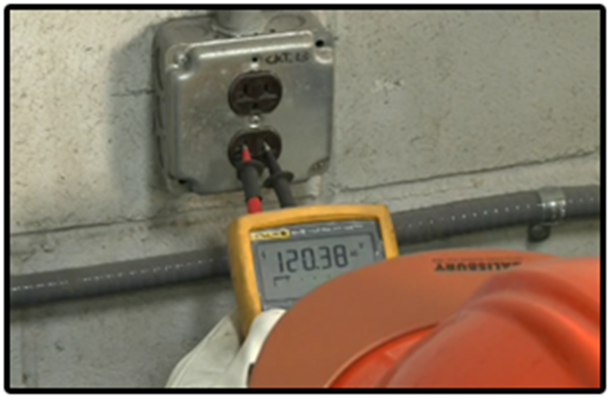
1910 General Industry
Electrical

Slide 2
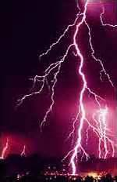
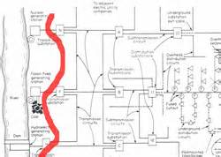
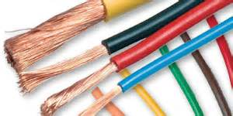
Electrical
Source of photos: OSHA

Slide 3
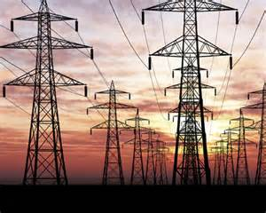
Introduction
Lesson objectives:
  Identify major electrical hazards
  Describe types of electrical hazards
  Describe electrical protection methods
  Recognize employer requirements to protect workers from electrical hazards
Source: OSHA
Notes:
Enabling Objectives:
Identify major electrical hazards.
Describe types of electrical hazards.
Describe electrical protection methods.
Recognize employer requirements to protect workers from electrical hazards.

Slide 4
Introduction
Definitions:
Electricity – movement
of the free electrons between
atoms
  Related terms:
    Current – the movement of
    electrical charge
    Resistance – opposition to current flow
    Voltage – a measurement of electrical force
Source: NIOSH

Slide 5
Introduction
Conductors – substances such as metals that have little resistance to electricity
Insulators – substances such as dry wood, rubber, glass, and Bakelite that have high resistance to electricity
Grounding – a conductive connection to the earth which acts as a protective measure

Slide 6
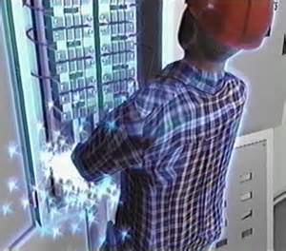
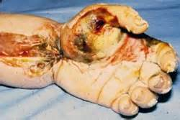
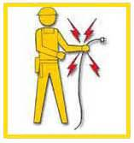
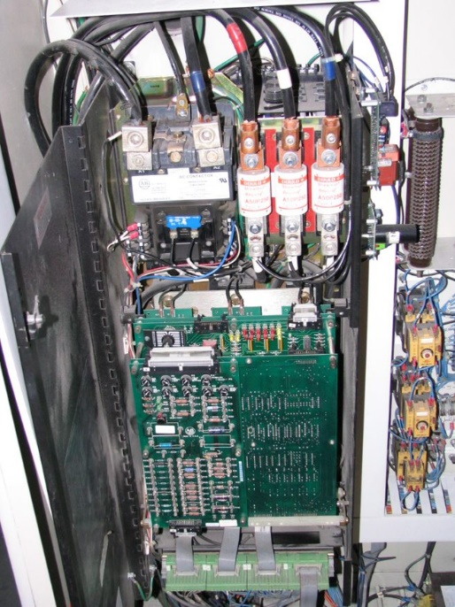
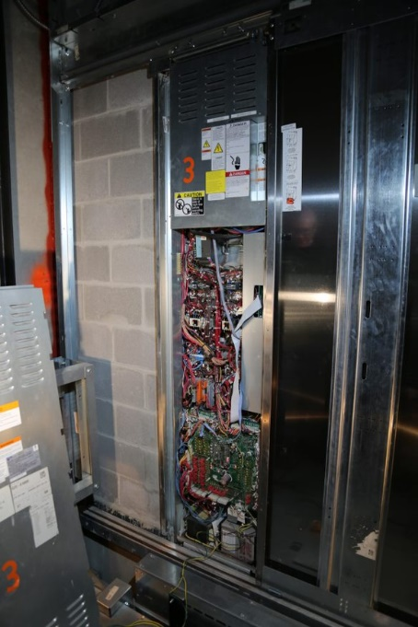

Electrical Hazards
Serious injuries and death can be caused by electrical hazards such as arc flash, shocks, burns, falls, and fires. Source of graphics: OSHA
Notes:
Source: https://www.osha.gov/Publications/osha3075.pdf
“Most electrical accidents result from one of the following three factors:
• unsafe equipment or installation,
• unsafe environment, or
• unsafe work practices.”

Slide 7
Electrical Hazards
Examples of electrical hazards that could cause workers to be electrocuted:
https://www.osha.gov/video/shipyard_accidents/08_welder_electrocuted.html
https://www.osha.gov/video/shipyard_accidents/15_lockout_tagout_failure.html
Notes:
Discuss examples given in class.
Watch OSHA videos and discuss videos.
Video #1: Repair Welder Electrocuted – 1 fatality (runtime: 00:02:23)
Video #2: Electrical Panel Repair Results in Electrocution – 1 fatality (runtime: 00:01:56)

Slide 8
Electrical Hazards
BE SAFE:
Burns
Electrocution
Shock
Arc flash/arc blast
Fire
Explosions
Notes:
BE SAFE by recognizing, avoiding and protecting against all of these electrical hazards.

Slide 9
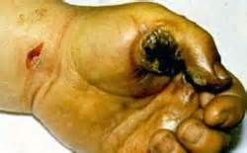
Electrical Hazards
Burns:
Most common shock-related injury
Three types of electrical burns:
Electrical
Arc flash
Thermal contact
Source: OSHA
Notes:
Electrical burns are the most common shock-related injury.
The three types of burns from electricity are:
- Electrical burns result from heat generated by the flow of electric current through the body.
- Arc/Flash burns are high temperature burns caused by an electric arc or explosion.
-Thermal contact burns occur when skin comes in contact with overheated electric equipment.

Slide 10
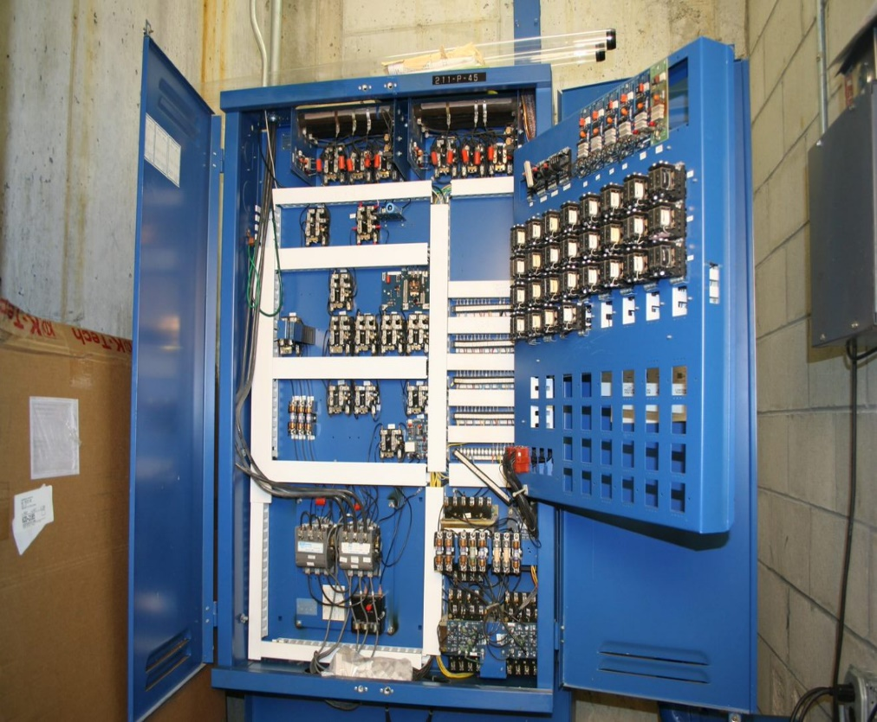
Electrical Hazards
Electrocution:
Is fatal
Meaning: to kill with electrical shock
Results when a human is exposed to a lethal amount of electrical energy
Notes:
Electrocution is fatal; it means to kill with electrical shock.
Electrocution results when a human is exposed to a lethal amount of electrical energy.

Slide 11

Electrical Hazards
Shock:
Body becomes part
of electrical circuit
Reflex response to
passage of electric
current through the body
Source: OSHA
Notes:
Shock results when the body becomes part of the electrical circuit; current enters the body at one point and leaves at another.
Electrical shock is defined as a reflex response to the passage of electric current through the body.

Slide 12
Electrical Hazards
Arc flash/Arc blast
Arc flash
  Sudden release of electrical energy through air when a high-voltage gap exists and there is a breakdown between conductors
  Gives off thermal radiation (heat) and bright, intense light that can cause burns
  Temperatures as high as 35,000°F
Notes:
An arc flash is the sudden release of electrical energy through the air when a high-voltage gap exists and there is a breakdown between conductors.
An arc flash gives off thermal radiation (heat) and bright, intense light that can cause burns.
Temperatures have been recorded as high as 35,000°F.

Slide 13
Electrical Hazards
Arc blast – high-voltage arcs can also produce considerable pressure waves by rapidly heating the air and creating a blast
Notes:
High-voltage arcs can also produce considerable pressure waves by rapidly heating the air and creating a blast
An arc flash can be spontaneous or result from inadvertently bridging electrical contacts with a conducting object. Other causes may include dropped tools or the buildup of conductive dust or
corrosion.
For more information on arc flash/blast, including best practices in electrical safety, refer to NFPA
70E: Standard for Electrical Safety in the Workplace available online at: http://www.nfpa.org/codes-and-standards/all-codes-and-standards/list-of-codes-and-standards?mode=code&code=70E

Slide 14
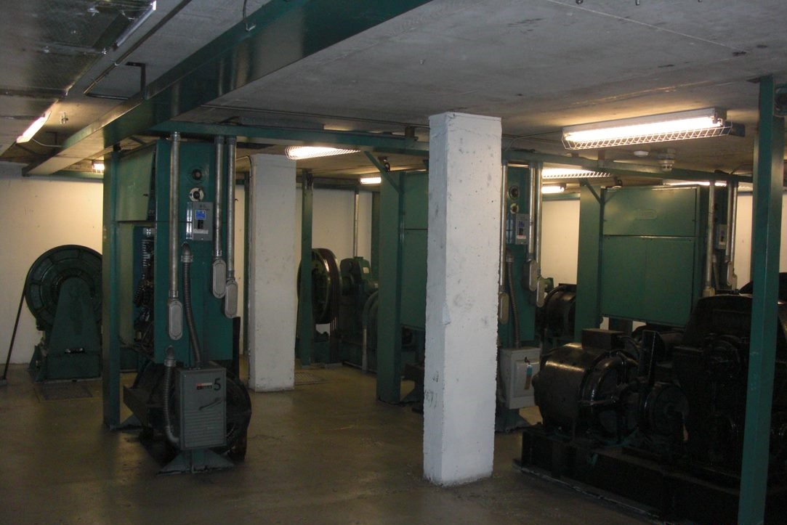
Common Causes of Arc Flash
Common causes include:
Dust
Dropping tools
Accidental touching
Condensation
Material failure
Corrosion
Faulty installation
Wiring errors

Slide 15
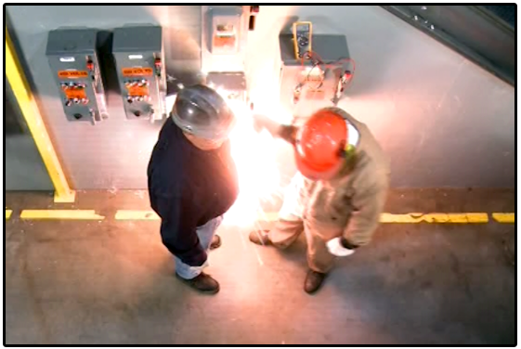
Arc Flash Prevention
Preventing an arc flash incident starts by following up-to-date safe work practices and procedures. The National Fire Protection Association, or NFPA, publishes current safe work practices that will enable you to recognize and avoid arc flash hazards.
Almost all arc flash accidents happen when workers are untrained or ignore safe work practices.
Never work on an electrical task without being properly
qualified for the work being performed.

Slide 16
Electrical Hazards
Fire:
Most result from problems with "fixed wiring”
Problems with cords, plugs, receptacles, and switches also cause electrical fires
Notes:
Fire
Most electrical distribution fires result from problems with "fixed wiring" such as faulty electrical outlets and old wiring.
Problems with cords (such as extension and appliance cords), plugs, receptacles, and switches also cause electrical fires.

Slide 17
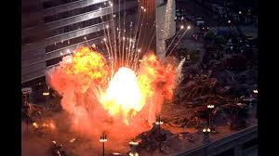
Electrical Hazards
Explosions:
Occur when electricity ignites explosive mixture of material in the air
Note:
Electricity is source of these hazards
All hazards are of equal importance
Lesson focuses on eliminating electrical hazards
Notes:
Explosions
An explosion can occur when electricity ignites an explosive mixture of material in the air.
Note that although electricity is the source of these hazards, and all of these hazards are of equal importance, this lesson focuses on eliminating electrical hazards.

Slide 18
Electrical Hazards
Examples of fatal accidents:
Case #1: Worker electrocuted when the ladder came in contact with overhead power lines
Case #2: Worker electrocuted when mast came in contact with high voltage overhead lines
Notes:
Case #1: Two workers were moving an aluminum ladder. One of them was electrocuted when the ladder came in contact with overhead power lines.
Case #2: Worker was raising a mast on a water well drilling truck when the mast came in contact with high voltage overhead lines, electrocuting the worker.
Provide examples of accidents related to the type of work your audience does. Locate accident summaries on OSHA’s website. Go to: http://www.osha.gov/pls/imis/accidentsearch.html. Within the keyword field, enter a keyword to be searched against. For example, to obtain accident investigations involving electrocutions, enter the key word electrocuted. To view a list of key words, use the keyword list at the bottom of the Accident Investigation Search page.

Slide 19
Electrical Hazards
Case #3: Worker changing energized ballast on light fixture was electrocuted and fell to the concrete floor while working from an 8' fiberglass stepladder.
Notes:
Case #3: Worker was fatally injured when he was electrocuted and fell to the concrete floor while working from an 8' fiberglass stepladder. Worker was changing an energized ballast on a two-bulb florescent light fixture, located approximately 11.5 ft. off the ground.

Slide 20
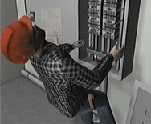
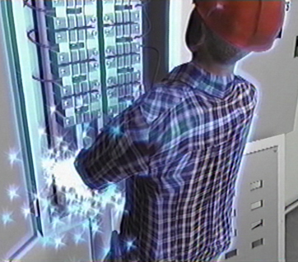
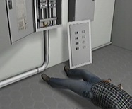
Electrical Hazards
U.S. Bureau of Labor Statistics:
156 electrocutions for 2014
Up from 141 in 2013
Source of graphics: OSHA
Notes:
NOTES:
For the most current statistical data, or for more detail, see: http://www.bls.gov/iif/

Slide 21
Types of Electrical Hazards
Contact with overhead power lines:
Overhead and buried
power lines carry
extremely high voltage
Risks
Electrocution (main risk)
Burns and falls
Source: NIOSH
Notes:
Contact with overhead power lines
Overhead and buried power lines are especially hazardous because they carry extremely high voltage.
Fatalities are possible as electrocution is the main risk; however, burns and falls from elevations are also hazards that workers are exposed to while working in the vicinity of high voltage power lines.

Slide 22
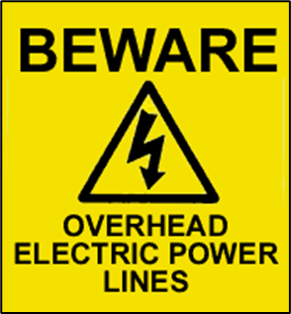
Types of Electrical Hazards
Cranes are not the only equipment that can reach overhead power lines.
Use of ladders or suspension in a man-basket under or near power lines are risks.
Source: OSHA
Notes:
Workers may not realize that cranes are not the only equipment that reaches overhead power lines.
Working on a ladder or in a man-basket suspended under or near power lines also poses a risk of electrocution.

Slide 23
Types of Electrical Hazards
Important: the covering on an overhead power line is primarily for weather protection; therefore, workers need to know that if they touch a power line, covered or bare, death is probable.
https://www.osha.gov/dts/vtools/construction/ladder_powerline_fnl_eng_web.html
Notes:
Important to note: The covering on an overhead power line is primarily for weather protection; therefore, workers need to know that if they touch a power line, covered or bare, death is probable.
Voltages of overhead lines range from 120 to 750,000 volts. The most reliable way to know the voltage is to ask the utility company that owns the line.
Video: Electrocution: Work Safely with Ladders Near Power Lines (Runtime: 00:05:39)

Slide 24
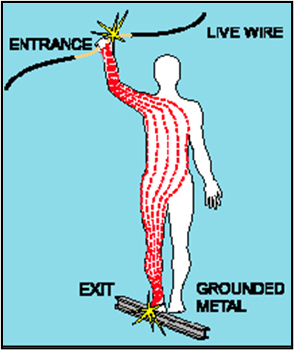
Types of Electrical Hazards
Contact with energized sources:
Live parts:
The major hazards
Electrical shock and burns
Electrical shock occurs
when the body becomes
part of the electric circuit
Source: OSHA
Notes:
The major hazards regarding contact with energized sources are electrical shock and burns. Electrical shock occurs when the body becomes part of the electric circuit, either when an individual comes in contact with both wires of an electrical circuit, one wire of an energized circuit and the ground, or a metallic part that has become energized by contact with an electrical conductor.

Slide 25
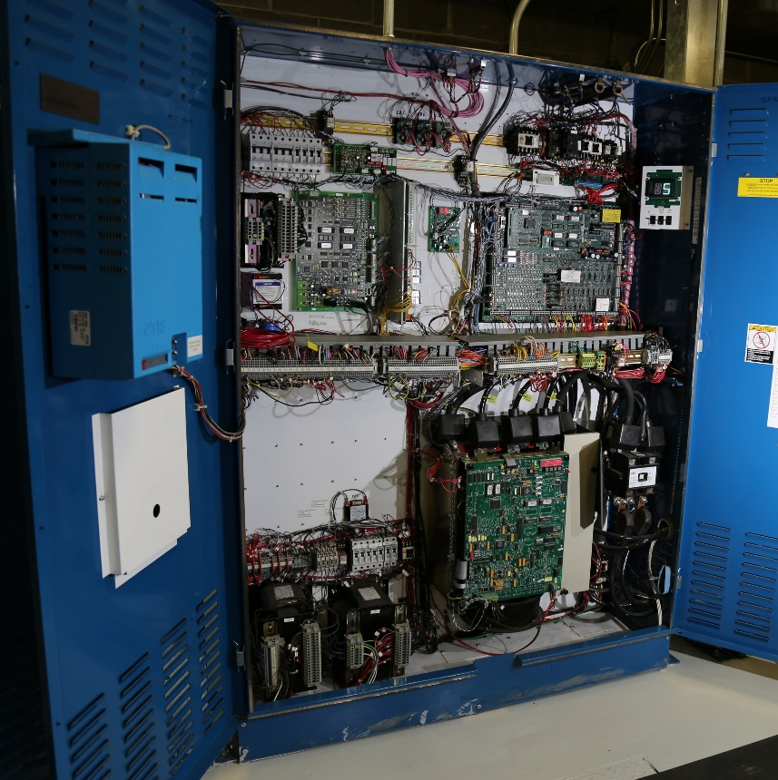
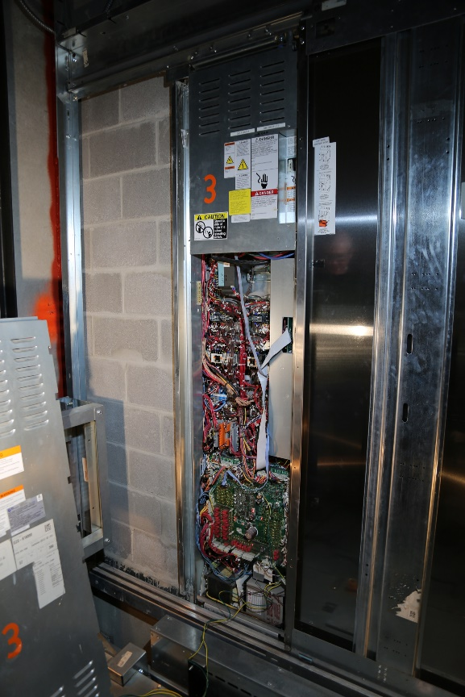
Elevator Industry-Related Electrical Hazards
Control cabinet doors should be closed any time work is not being done. This will eliminate accidental contact with any live components. The controller may be located inside the hoistway, and only accessible from the car top. Whenever possible, perform LOTO procedures before doing any work inside the control panel. Always follow your company’s LOTO and live work processes.

Slide 26
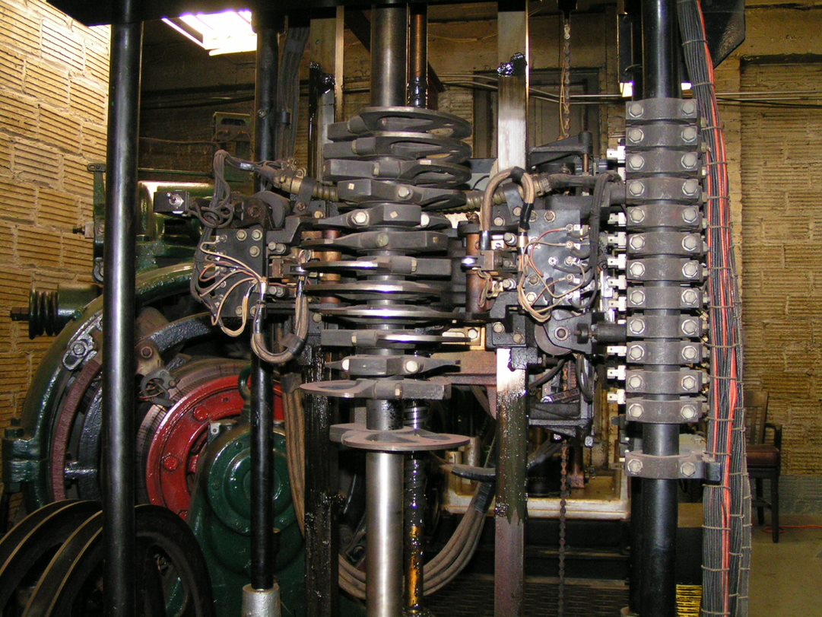
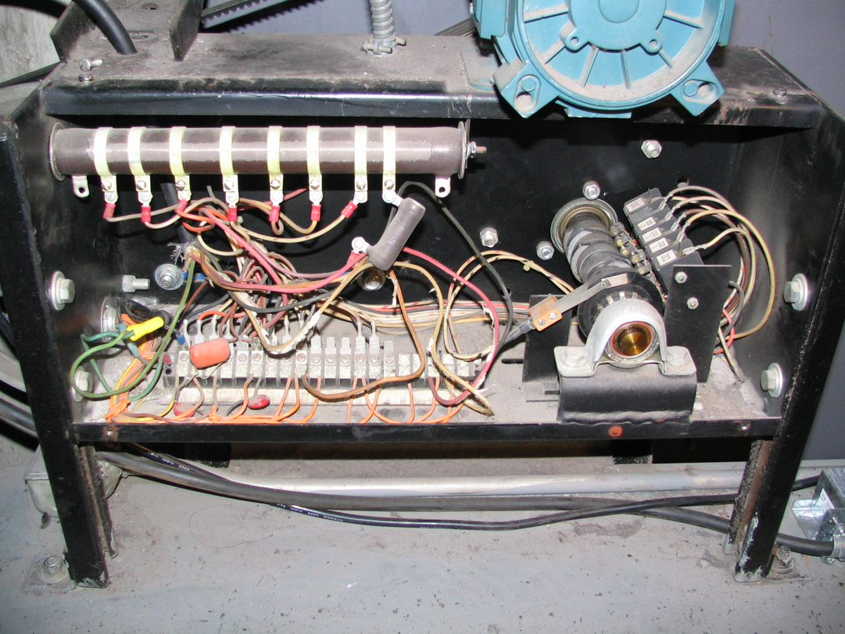
Elevator Industry-Related Electrical Hazards
Unguarded electrical equipment in the machine room can be dangerous. This selector has exposed electrical connections.
When you remove the cover on any equipment, such as this door operator, you expose yourself to the risk of shock.
Always perform LOTO whenever possible and follow your companies electrical safe work practices.

Slide 27
Types of Electrical Hazards
Severity and effects of an electrical shock depend on a number of factors:
Pathway through the body
Amount of current
Length of time of the exposure
Whether skin is wet or dry
Water
Great conductor
Allows current to flow more easily in wet conditions and through wet skin
Notes:
The severity and effects of an electrical shock depend on a number of factors, such as the pathway through the body, the amount of current, the length of time of the exposure, and whether the skin is wet or dry.
Water is a great conductor of electricity, allowing current to flow more easily in wet conditions and through wet skin.

Slide 28
(1,000 milliamperes = 1 amp; therefore, 15,000 milliamperes = 15 amp circuit)
Current | Reaction
Below 1 milliampere | Generally not perceptible
1 milliampere | Faint tingle
5 milliampere | Slight shock felt; not painful but disturbing. Average individual can let go. Strong involuntary reactions can lead to other injuries
6-25 milliamperes (women) | Painful shock, loss of muscular control
9-30 milliamperes (men) | The freezing current or “let-go” range. Individual cannot let go, but can be thrown away from the circuit if extensor muscles are stimulated.
50-150 milliampres | Extreme pain, respiratory arrest, severe muscular contractions. Death is possible.
1,000-4,300 milliamperes | Rhythmic pumping action of the heart ceases. Muscular contraction and nerve damage occur; death likely
10,000 milliamperes | Cardiac arrest, severe burns; death probable
This table shows the body’s reaction when exposed to various levels of current. Source: OSHA

Slide 29
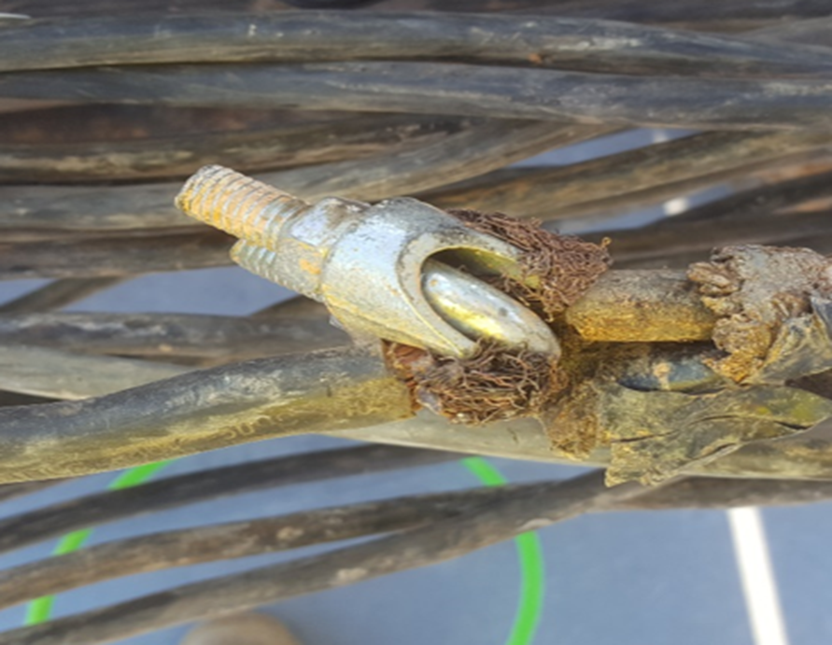
Types of Electrical Hazards
Damaged or bare wires
  Fault current may travel through a body, causing electrical burns or death, if:
    Power supply is not grounded
    Path has been broken
    There are live parts or bare wires
  Extreme conditions and rough treatment can change electrical equipment from safe to hazardous
Notes:
If power supply to electrical equipment is not grounded or the path has been broken, or if there are live parts or bare wires, a fault current may travel through a worker's body, causing electrical burns or death.
Even when the power system is properly grounded, electrical equipment can instantly change from safe to hazardous because of extreme conditions and rough treatment.

Slide 30
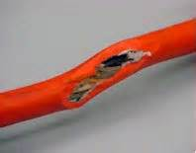
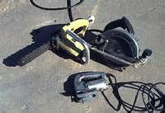
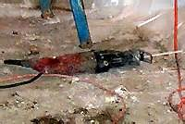
Types of Electrical Hazards
Defective equipment or tools
These photos show examples of defective equipment/tools. Source of photos: OSHA

Slide 31
Types of Electrical Hazards
Improper repairs
  Examples of incidents:
    Ballast strap not replaced after repair = Electrocution of 11-year-old boy
    Cutting off bleed resistor on capacitor= causes 370-volt shock
    Removing and leaving off terminal insulator on capacitor = causes 440-volt shock
Notes:
Mercury vapor light fixture on the wood pole was repaired and the ballast strap was not replaced causing the ballast to short from movement the secondary wiring energizing the connecting electrical conduit.
Bleed resistors are used to bleed off potential electrical stored energy from capacitors.
Rubber insulators are required over capacitor terminals in locations of contact.

Slide 32
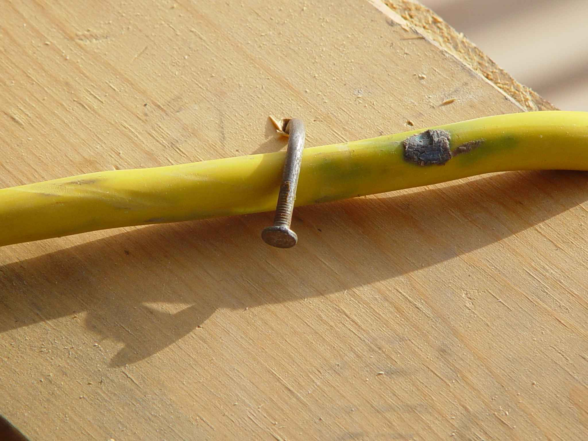
Types of Electrical Hazards
Improper use:
Extension and flexible cords
  Care
  Connection
  Capacity
Source: TEEX SH 46F1-HT06
Notes:
Because they are exposed, flexible, and unsecured, extension and flexible cords are more susceptible to damage than fixed wiring. Hazards are created when cords, cord connectors, receptacles, and cord- and plug connected equipment are improperly used and maintained.
To reduce hazards, flexible cords must connect to devices and to fittings in ways that prevent tension at joints and terminal screws. A flexible cord may be damaged by door or window edges, staples and fastenings, abrasion from adjacent materials, or simply by aging. If the electrical conductors become exposed, there is a danger of shocks, burns, or fire.
Overloading extension cords can cause them to overheat. Capacity of the extension cord should be labeled on the UL tag.

Slide 33
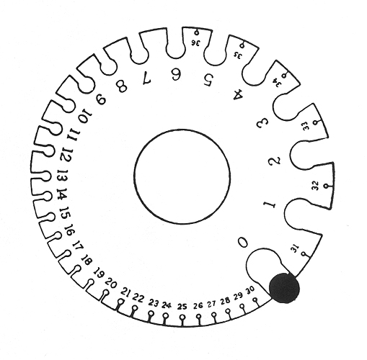
Types of Electrical Hazards
  Capacity affected by
    Size of wire
      14 gauge = 15 amps
      12 gauge = 20 amps
    Length of the cord
      UL tag capacity
      In general any cord over 100 ft. requires one size larger cord
      (14 gauge to 12 gauge)
Source: OSHA
Notes:
The higher the wire gauge number of the wire in the cord the less current it can carry.
Length of the cord also effects its capacity. The UL tag capacity is related to it length. In general any cord over 100 ft. requires one size larger cord. (14 gauge to 12 gauge)

Slide 34
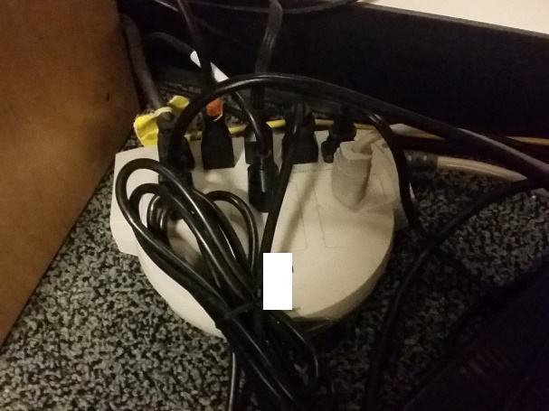
Types of Electrical Hazards
Power strips:
  Can be overloaded
  because of multiple
  plug arrangement
  Most have overload protection
  but often malfunction causing fire
  Use fixed wiring when possible
Source: UBATC
Notes:
Power strips capability to be overloaded because of the multiple plug arrangement. Most have overload protection but often malfunction causing fire. Use fixed wiring when possible.

Slide 35
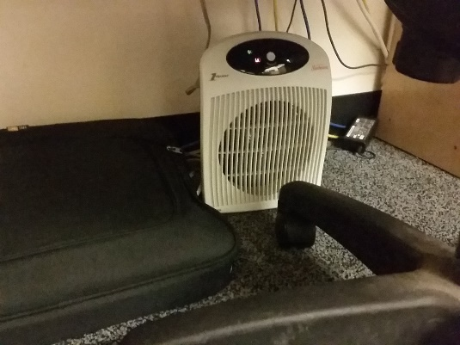
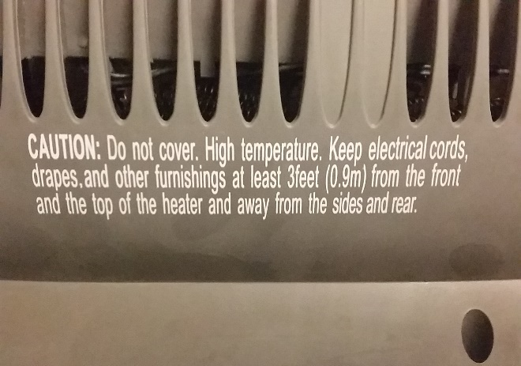
Types of Electrical Hazards
Portable heaters and appliances:
  Dangerous if manufacturer recommendations
  not followed
  Do not plug into a power strip!
  This causes overloads and fires.
Source of photos: UBATC
Notes:
Portable heaters and appliances are often not used as the manufacturer recommends. Do not plug into a power strip! This causes overloads and fires.

Slide 36
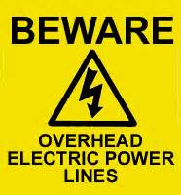
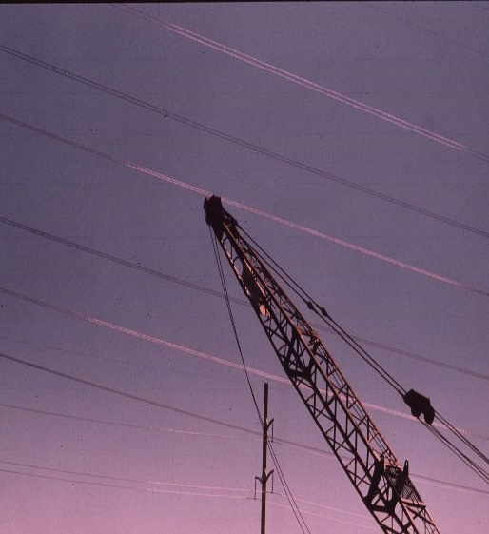
Electrical Protection Methods
Maintain safe distance from
overhead power lines:
Staying away
Following table shows the safe power line clearance distance for various line voltages.
https://youtu.be/Y2MwX738e1Y
Source of graphics: OSHA
Notes:
Maintain safe distance from overhead power lines
Staying away from power lines is the best option.
The following table shows the safe power line clearance distance for various line voltages.

Slide 37
Electrical Protection Methods
Voltage (nominal, kV, alternating current) | Minimum Clearance Distance (feet)
Up to 50 | 10
Over 50 to 200 | 15
Over 200 to 350 | 20
Over 350 to 500 | 25
Over 500 to 750 | 35
Over 750 to 1000 | 45
Over 1000 | (As established by the power line owner/operator or registered professional engineer who is a qualified person with respect to electrical transmission and distribution)
This table shows the minimum clearance distances, in feet, for different power line voltages. Source: OSHA
Notes:
29 CFR 1926.1408 provides requirements for safe distances.
“Note: The value that follows "to" is up to and includes that value. For example, over 50 to 200 means up to and including 200kV.”

Slide 38
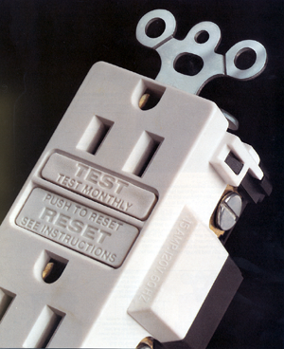
Electrical Protection Methods
Use ground fault circuit interrupters (GFCIs):
Designed to protect people from electrical shock
Detects ground faults and interrupts electric current
Limits duration of electrical shock
Source: OSHA
Notes:
A "GFCI" is a ground fault circuit interrupter that is designed to protect people from severe and sometimes fatal electrical shock. A GFCI detects ground faults and interrupts the flow of electric current, and is designed to protect the worker by limiting the duration of an electrical shock.
NOTE:
If the light or tool [other product] remains “ON” when the “Test” button is pushed, the GFCI is not working properly or has been incorrectly installed (miswired). If this is the case, a qualified electrician (equivalent to qualified electrician is a ‘licensed’, ‘certified’, and/or ‘registered’ electrician) needs to be contacted to properly wire or replace the GFCI device.

Slide 39

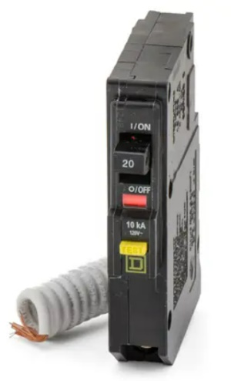

Electrical Protection Methods
Three types of GFCIs:
Receptacle GFCIs
Circuit Breaker GFCIs
Temporary/portable GFCIs
These photos show examples of the three types of GFCI. Source of photos: OSHA
Notes:
1. Receptacle GFCI: Often found on construction work sites, outdoor areas and other locations where damp conditions do or could exist.
2. Temporary/portable GFCI: AP portable GFCI is an extension cord combined with a GFCI. It adds flexibility in using receptacles that are not protected by GFCls. Extension cords with GFCI protection incorporated should be used when
permanent protection is unavailable.
3. Circuit Breaker GFCI: The GFCI circuit breaker controls an entire circuit, and is installed as a replacement for a circuit breaker on the main circuit board. Rather than install multiple GFCI outlets, one GFCI circuit breaker can protect the
entire circuit. At sites equipped with circuit breakers, this type of GFCI might be installed in a panel box to give protection to selected circuits. Circuit breaker GFCIs should be tested monthly. Keep in mind that the test will disconnect power to
everything on the circuit.

Slide 40
Electrical Protection Methods
Inspect portable tools and extension cords:
Workers need to inspect extension cords and power cords prior to their use for any cuts, abrasions, or any other damage
Electric hand tools that are old, damaged, or misused may have damaged insulation inside
Notes:
Extension cords may have damaged insulation. Sometimes the insulation inside an electrical tool or appliance is damaged. When the insulation is damaged, exposed metal parts may become energized if a live wire inside touches the metal parts

Slide 41
Electrical Protection Methods
Use power tools and equipment as designed:
Follow tool safety tips to avoid misusing equipment
Follow manufacturer’s instructions
Notes:
OSHA standards:
- Use only equipment that is approved [29 CFR 1926.403(a)]
- Use all equipment according to the manufacturer's instructions [29 CFR 1926.403(b)(2)]

Slide 42
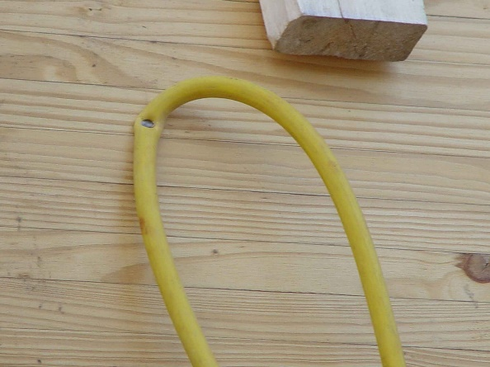
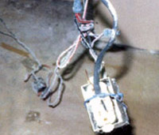
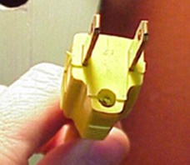
Electrical Protection Methods
Common examples of misused equipment
Source: TEEX SH 46F1-HT06
Source of photos: OSHA
Source of photos: OSHA
These photos show examples of equipment misuse.
Notes:
Common examples of misused equipment
• Using multi-receptacle boxes designed to be mounted by fitting them with a power cord and placing them on the floor.
• Fabricating extension cords with ROMEX wire.
• Using equipment outdoors that is labeled for use only in dry, indoor locations.
• Attaching ungrounded, two-prong adapter plugs to three-prong cords and tools.
• Using circuit breakers or fuses with the wrong rating for over-current protection, e.g., using a 30-amp breaker in a system with 15- or 20-amp receptacles. Protection is lost because it will not trip when the system’s load has been exceeded.
• Using modified cords or tools, i.e., ground prongs removed, face plates, insulation, etc.
• Using cords or tools with worn insulation or exposed wires.

Slide 43
Electrical Protection Methods
Tool safety tips
Never carry a tool by the cord
Never yank the cord to disconnect it
Keep cords away from heat, oil, and sharp edges
Disconnect when not in use and when changing accessories such as blades and bits

Slide 44
Electrical Protection Methods
Avoid
Avoid accidental starting - do not hold fingers on the switch button while carrying a plugged-in tool
Use
Use gloves and appropriate footwear
Store
Store in dry a place when not using

Slide 45
Electrical Protection Methods
Don’t use
Don’t use in wet/damp environments
Keep
Keep working areas well lit
Ensure
Ensure that cords do not cause a tripping hazard
Remove
Remove damaged tools from use
Use
Use double-insulated tools

Slide 46
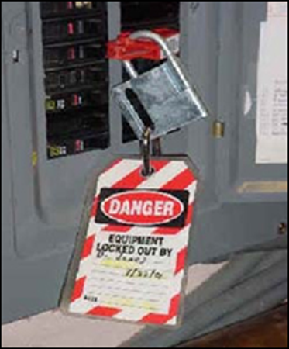
Electrical Protection Methods
Follow lockout/tagout (LOTO) procedures:
Lockout/tagout
Essential safety procedure
Protects workers from injury while working on or near electrical circuits and equipment
Prevents contact with operating equipment parts such as, blades, gears, shafts, etc.
Source: OSHA
Notes:
Source: NIOSH Electrical Safety Manual [2009-113]: http://www.cdc.gov/niosh/docs/2009-113
Lockout/tagout is an essential safety procedure that protects workers from injury while working on or near electrical circuits and equipment. In addition, lockout/tagout prevents contact with operating equipment parts such as, blades, gears, shafts, etc.

Slide 47
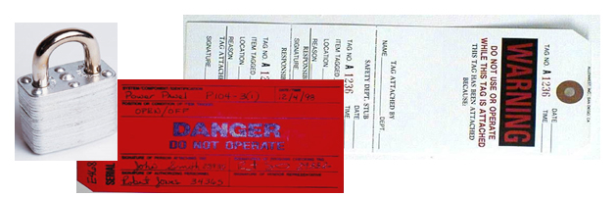
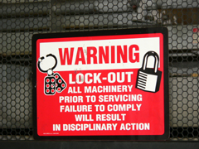
Electrical Protection Methods
  LOTO prevents the unexpected release of hazardous gases, fluids, or solid matter in areas where workers are present
Source of photos: OSHA
Notes:
To protect against being electrocuted, workers need to follow lockout/tagout procedures. When performing lockout/tagout on circuits and equipment, the following checklist can be used:
• Identify all sources of electrical energy for the equipment or circuits in question
• Disable backup energy sources such as generators and batteries
• Identify all shut-offs for each energy source
• Notify all personnel that equipment and circuitry must be shut off, locked out, and tagged out (Simply turning a switch off is not enough)
• Shut off energy sources and lock switch gear in the OFF position. Each worker should apply his/her individual lock and keys kept with the worker
• Test equipment and circuitry to ensure they are de-energized. This must be done by a qualified person
• Deplete stored energy (for example, in capacitors) by bleeding, blocking, grounding, etc.
• Apply a lock or tag to alert other workers that an energy source or piece of equipment has been locked or tagged out
• Make sure all workers are safe and accounted for before equipment and circuits are unlocked and turned back on. Only a qualified person may determine when it is safe to re-energize circuits.

Slide 48
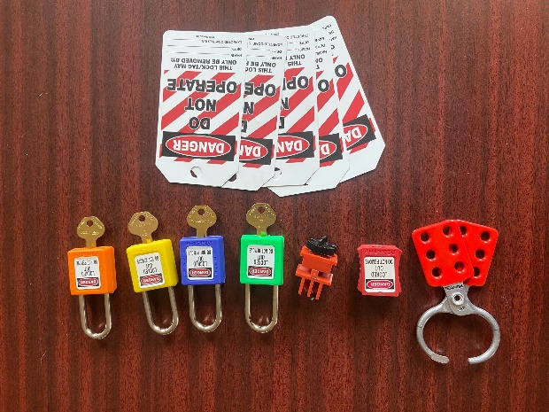
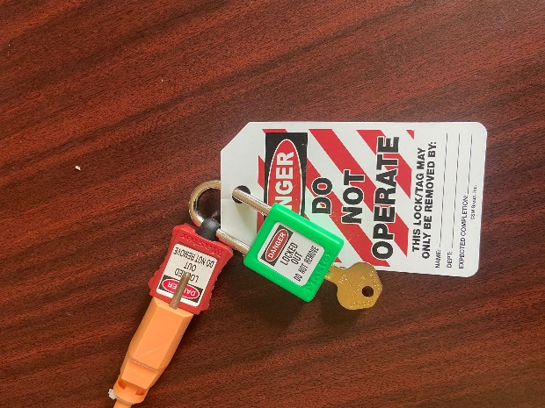
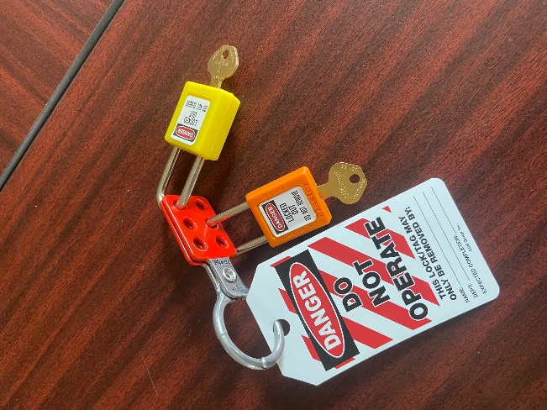
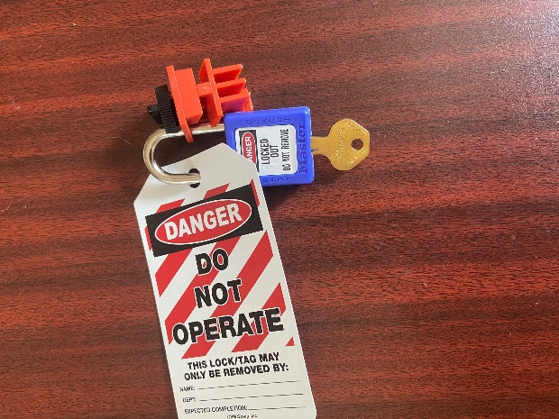
Lockout/Tagout
LOTO equipment must be identifiable as LOTO specific.
LOTO for power tools or equipment with a plug
LOTO for circuit breakers
LOTO for multiple locks

Slide 49
Lockout/Tagout
Following is a general step by step process for performing LOTO. Always follow your company's policies & procedures.
Lockout/Tagout (LOTO) –Sequence of Steps
1. Gain control of the conveyance and ensure that it is secured from public access. Make sure all necessary PPE and diagnostic hardware is readily available prior to commencing energy shut down.
2. Identify and locate the specific circuit or conveyance and corresponding disconnect you intend to de-energize. Stand to the side and face away while switching off the disconnect.

Slide 50
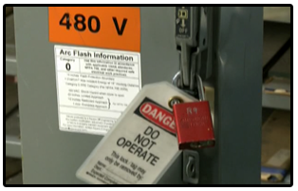
Lockout/Tagout
Lockout and Tagout (LOTO) –Sequence of Steps cont.
3. Place the appropriate lock to isolate the equipment. NOTE: If more than one employee is working on the equipment that is locked out, each employee shall place his/her personal lock on the disconnect.
4. Place a “Danger: Do Not Operate” tag with the following four items: company name, employee name, date and a contact number.

Slide 51

Lockout/Tagout
Lockout and Tagout (LOTO) –Sequence of Steps cont.
5. Identify a known, (LIVE), voltage source and test the functionality of the multimeter or non-contact voltage detector against this source.

Slide 52
Lockout/Tagout
Lockout and Tagout (LOTO) –Sequence of Steps cont.
6. Test and verify that the voltage has been disconnected (DEAD) with a non-contact voltage detector or a multimeter. Check each leg to ground, and on ungrounded or above ground system check leg to leg to complete verification of absence of energy.
NOTE: If only de-energizing the mainline, be aware that the controller may still have live 110/120-volt circuit for cab lighting and fan. Also, verify that voltage has been dissipated from capacitors and AC drive units.

Slide 53
Lockout/Tagout
Lockout and Tagout (LOTO) –Sequence of Steps cont.
7. Re-verify that the functionality of the multimeter or non-contact voltage detector worked properly before and after the measurement. Check against a known (LIVE) voltage source.
8. Ensure that all potentially hazardous stored energy is relieved, disconnected, restrained, and otherwise rendered safe. Hydraulic elevator units must be landed on buffers, pipe stands, or have rail blocks installed when working on the pressurized system. Mechanical safeguarding of escalators and moving walks shall be put in place to protect from stored energy.

Slide 54
Lockout/Tagout
Lockout and Tagout (LOTO) –Sequence of Steps cont.
9. Perform work.
10. Re-energize the conveyance following these steps:
  Replace all guards and remove all tools
  Recheck to ensure control of the conveyance and that is secure from public access
  The employee(s) who applied personal locks shall remove their own lock and tag
Make sure all workers are safe and accounted for before equipment and circuits are unlocked and turned back on.
  Stand to the side and face away, announce “power going on” when powering the disconnect on
  Check that the conveyance has been properly returned to service

Slide 55
Electrical Protection Methods
Power source identification:
Mark
Mark all breakers accordingly for the circuits they protect
Mark
Mark all disconnect means accordingly for the equipment they service
Identify
Identify all voltages with proper labeling
Notes:
Power source identification
Make sure that all breakers are marked accordingly for the circuits they protect.
Make sure that all disconnect means are marked accordingly for the equipment they service.
Make sure that all voltages are identified with proper labeling.

Slide 56
Employer Requirements
Employer requirements to protect workers:
Ensure
Ensure overhead power line safety
Isolate
Isolate electrical parts
Supply
Supply ground-fault circuit interrupters (GFCI) protection
Establish and implement
Establish and implement an AEGCP
Ensure
Ensure power tools are maintained in a safe condition
Ensure
Ensure proper guarding
Provide
Provide training
Enforce
Enforce LOTO safety related work practices
Ensure
Ensure proper use of flexible cords and power strips
Ensure
Ensure proper identification of power sources
Notes:
(AEGCP) assured equipment grounding control program.

Slide 57
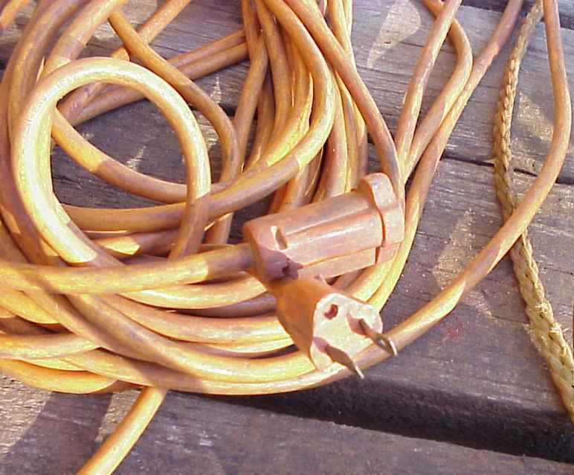
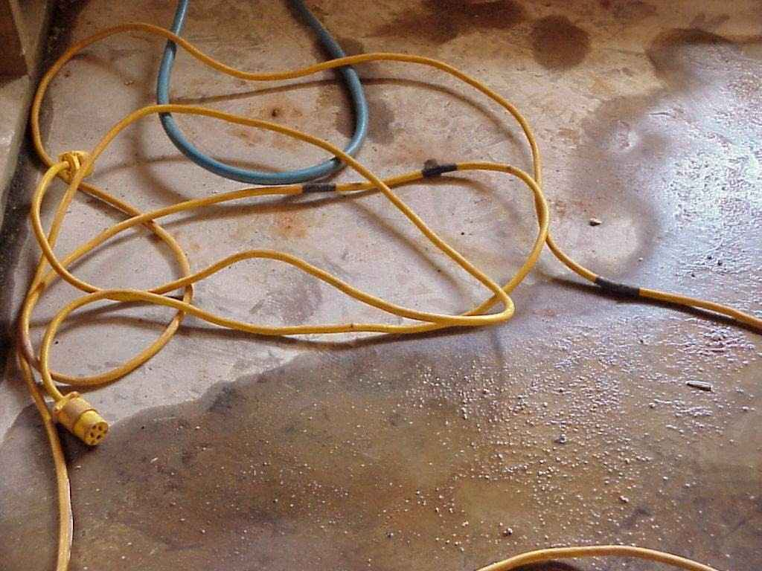
What’s Wrong?
Identify the hazards in these photos. Source of photos: TEEX SH 46F1-HT06
Notes:
Photo on left: ground missing
Photo on right: cord in water; cord taped to repair
Source: TEEX Susan Harwood Grant # 46F1-HT06

Slide 58


What’s Wrong?
Identify the hazards in these photos. Source of photos: OSHA
Notes:
Photo on left: open electrical panel in motor control room; wet mop stored at electrical disconnect.
Photo on right: breakers in panel not identified
Source: https://www.osha.gov/SLTC/etools/poultry/general_hazards/elec_hazards.html

Slide 59
Knowledge Check
What is electricity?
  The movement of atoms within an object
  The movement of free electrons between atoms
  Solid mass
  Movement within the nucleus of an atom
Answer: b. The movement of free
electrons between atoms

Slide 60
Knowledge Check
“Electrocution” means ___.
  received a mild electrical shock
  killed by electrical shock
  exposed to electrical current
  any accident involving electricity
Answer: b. killed by electrical shock

Slide 61
Knowledge Check
True or false: Arc flash/arc blast can reach maximum temperatures up to 350˚F.
  True
  False
Answer: b. False - temperatures
can reach up to 35,000˚F

Slide 62
Knowledge Check
Which gauge of wire will carry the most current?
  14 gauge
  12 gauge
  10 gauge
  00 gauge
Answer: d. 00 gauge – the lower the
wire gauge number, the
more current it can carry

Slide 63
Knowledge Check
What does GFCI stand for?
  Ground Flexible Conduit Insulator
  Ground Flow Current Interceptor
  Ground Fault Circuit Interrupter
  Ground Floor Connection Intersector
Answer: c. Ground Fault Circuit
Interrupter

Slide 64
Knowledge Check
Which of the following is a safe practice?
  Carrying a power tool by the cord
  Holding fingers on switch button while carrying a plugged-in tool
  Keeping cords away from heat, oil, and sharp edges
  Yanking cord to disconnect plug from outlet
Answer: c. Keeping cords away from
heat, oil, and sharp edges

Slide 65
Knowledge Check
Who is responsible for ensuring that overhead power lines are de-energized?
  Power company
  Employer
  Employee
  Municipality
Answer: b. Employer

Slide 66
Through the Alliance between OSHA’s 10 Regional Offices and the Elevator Contractors of America (ECA), Elevator Industry Work Preservation Fund (EIWPF), International Union of Elevator Constructors (IUEC), National Association of Elevator Contractors (NAEC), National Elevator Industry Educational Program (NEIEP), and National Elevator Industry Inc. (NEII), collectively known as The Elevator Industry Safety Partners, developed this Industry Specific Training for informational purposes only. It does not necessarily reflect the official views of OSHA or the U.S. Department of Labor. May 2021
Under the Occupational Safety and Health Act, employers are responsible (http://www.osha.gov/as/opa/worker/employer-responsibility.html) for providing a safe and healthy workplace and workers have rights (https://www.osha.gov/workers). OSHA can help answer questions or concerns from employers and workers. OSHA's On-Site Consultation Program (https://www.osha.gov/consultation) offers free and confidential advice to small and medium-sized businesses, with priority given to high-hazard worksites. For more information, contact your regional or area OSHA office (https://www.osha.gov/contactus/bystate), call 1-800-321-OSHA (6742), or visit https://www.osha.gov/.

Slide 67


