Slide 1


Vehicle Safety
Elevator Industry Safety Partners
Elevator Industry
Safety Partners

Slide 2

Describe the effects of distracted driving
Tips for defensive driving
Describe the effects of aggressive driving
Describe the importance of driver passenger restraints
Recognize hazards while refueling
Identify road and traffic hazards

Slide 3
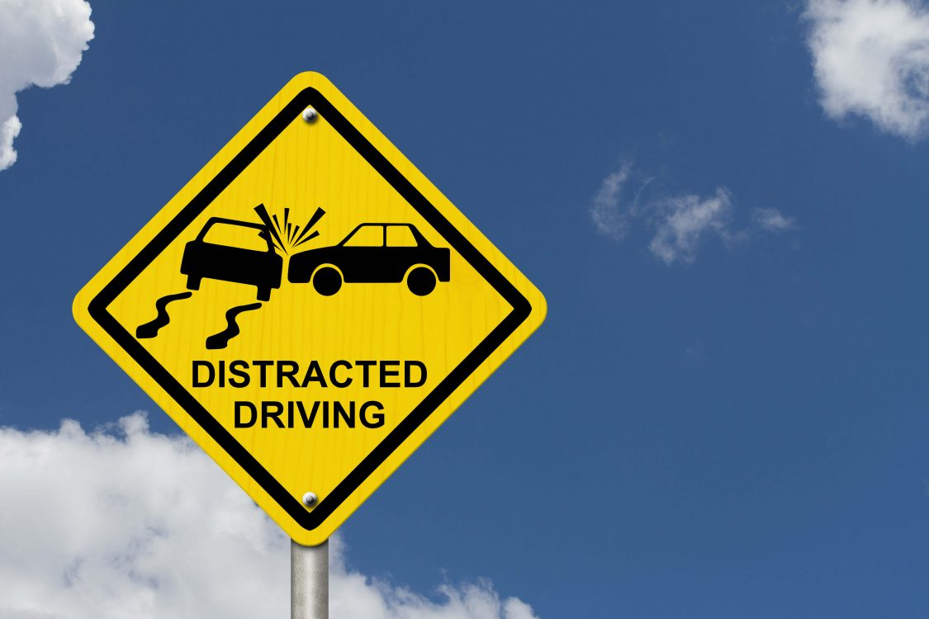
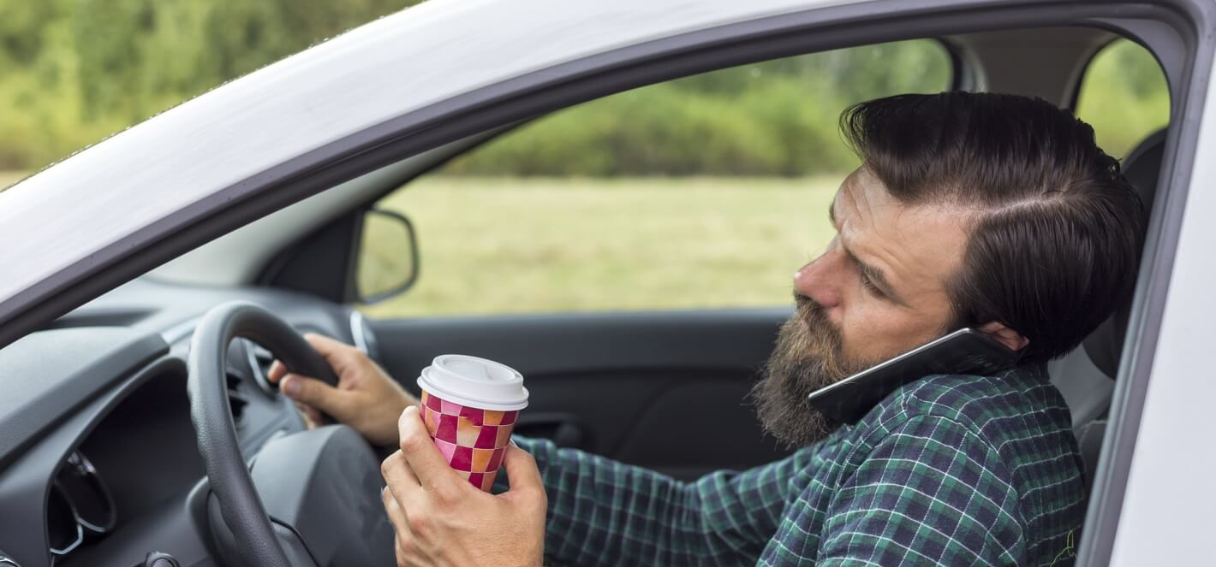
WHAT IS DISTRACTED DRIVING?
Distracted Driving is ANY activity that diverts attention away from the primary task of driving.

Slide 4
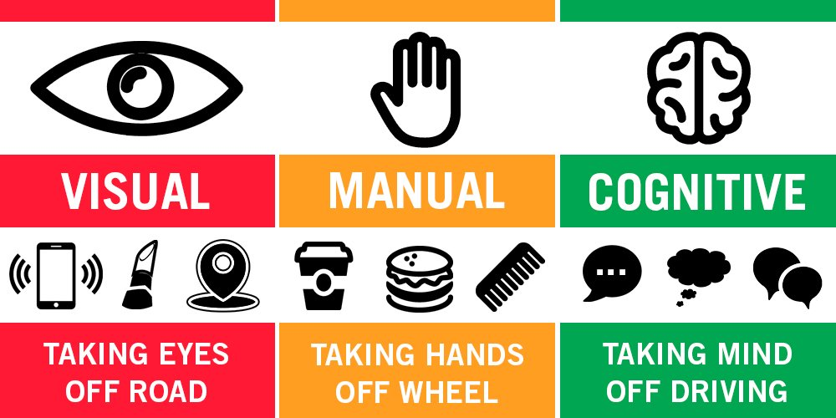
3-TYPES OF DISTRACTED DRIVING

Slide 5
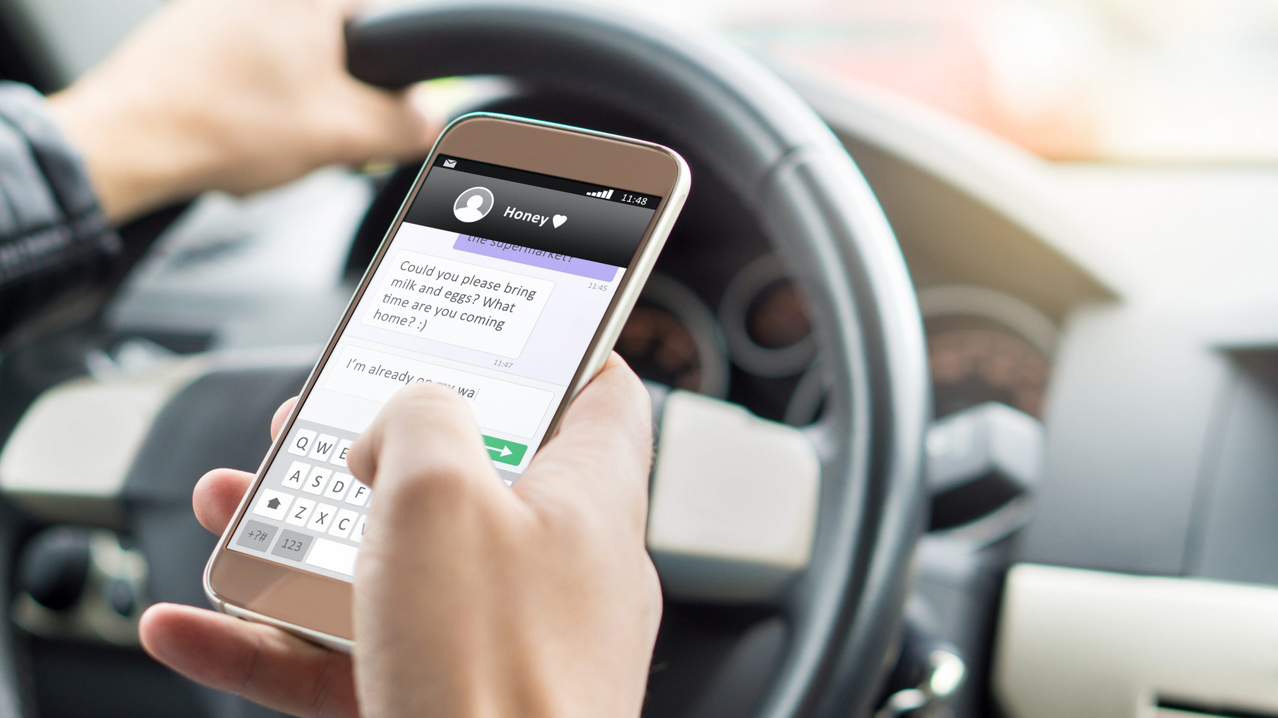
How Many of You Have Done This? Visual, Manual, & Cognitive - Distracted Driving

Slide 6
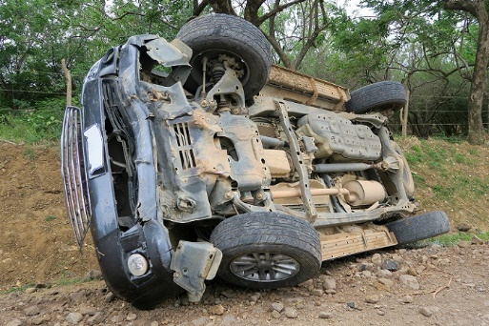
Distracted Driving is Dangerous
Reading a text causes drivers , on average, to take their eyes of the road for 5 Seconds. If you are driving 55 miles per hour, that means that drivers move around the length of a Football Field with their eyes closed in five seconds.
Texting while driving is 6 Times more deadly than driving while drunk.
25% of car accidents are a direct result of cell phone usage while driving.

Slide 7
Distracted Driving in the Elevator Industry
Driver Fatigue – Late Night Trouble Callback after Working All Day
Talking on the Phone While Driving. (Even Work-Related Phone Calls)
Eating your lunch while driving.
Hungover from the night before.
Thinking about family or work stresses
CAN YOU THINK OF ANY?

Slide 8
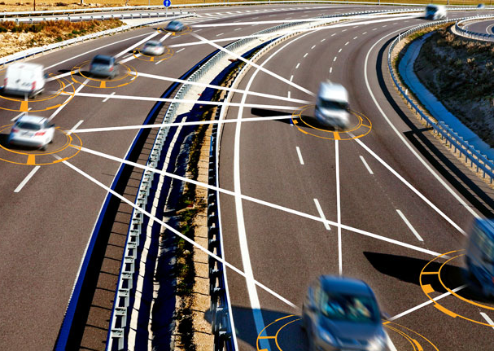
Defensive Driving
Do you remember the last accident or near accident you experienced while driving? If you avoided the accident, do you remember how you avoided it?
Defensive driving is more than just avoiding accidents and hoping everything will turn out fine. This practice is a skillset that allows you to identify potential hazards and adapting your driving to prevent an accident. By anticipating situations, you’ll be able to act immediately to avoid a potentially hazardous accident.

Slide 9
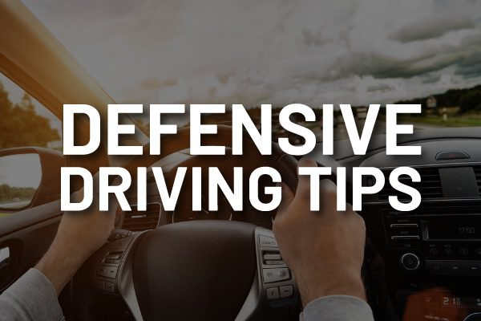
Search ahead on the road.
Keep your eyes moving.
Avoid distractions.
Be fit to drive.
Expect the unexpected
Control your speed.
Manage your space.
Maintain your vehicle.
Always choose the safest action.
Use the space management system.

Slide 10

Aggressive Driving!
The National Highway Traffic Safety Administration (NHTSA) defines aggressive driving as occurring when “an individual commits a combination of moving traffic offenses so as to endanger other persons or property.”

Slide 11

Behaviors of Aggressive Driving
Following improperly
Improper or erratic lane changing
Illegal driving on road shoulder, in ditch, or on sidewalk or median
Passing where prohibited
Operating the vehicle in an erratic, reckless, careless, or negligent manner or suddenly changing speeds
Failure to yield right of way
Failure to obey traffic signs, traffic control devices, or traffic officers, failure to observe safety zone traffic laws
Failure to observe warnings or instructions on vehicle displaying them
Failure to signal
Driving too fast for conditions or in excess of posted speed limit
Racing
Making an improper turn

Slide 12
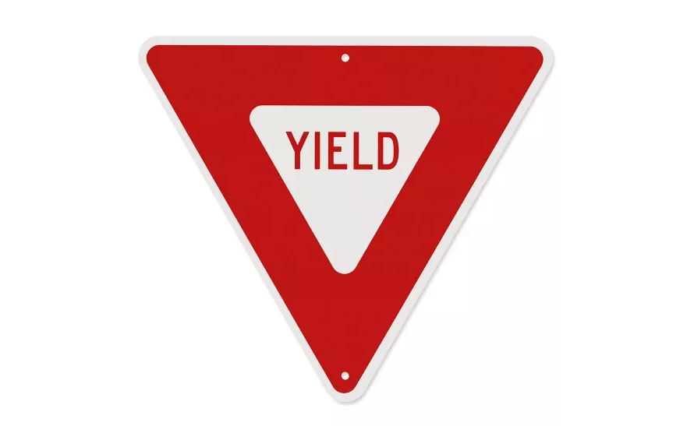




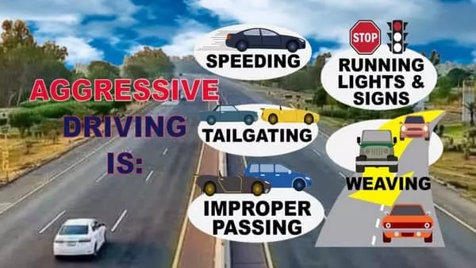




Have you EXPERIENCED an aggressive driving situation?
Have you been an aggressive driver?

Slide 13
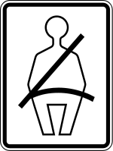
Driver
& Passenger
Restraint
OSHA Standard:
1926.601(b)(9)Seat belts and anchorages meeting the requirements of 49 CFR Part 571 (Department of Transportation, Federal Motor Vehicle Safety Standards) shall be installed in all motor vehicles.

Slide 14
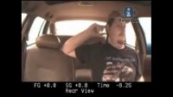
Six
Reasons To Wear A Seatbelt
Saves Lives
Prevents Injuries
Keeps Passengers from Projection
Airbags Can’t Work Alone
You’ll Avoid a Traffic Ticket
Following Company Safety Policy
Do You Know of an instance where a seatbelt has saved a life?

Slide 15
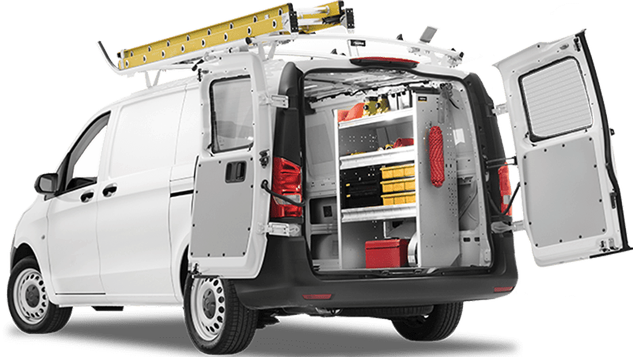
OSHA Standard
1926.601 (b) (7)
Tools and material shall be secured to prevent movement when transported in the same compartment with employees.

Slide 16
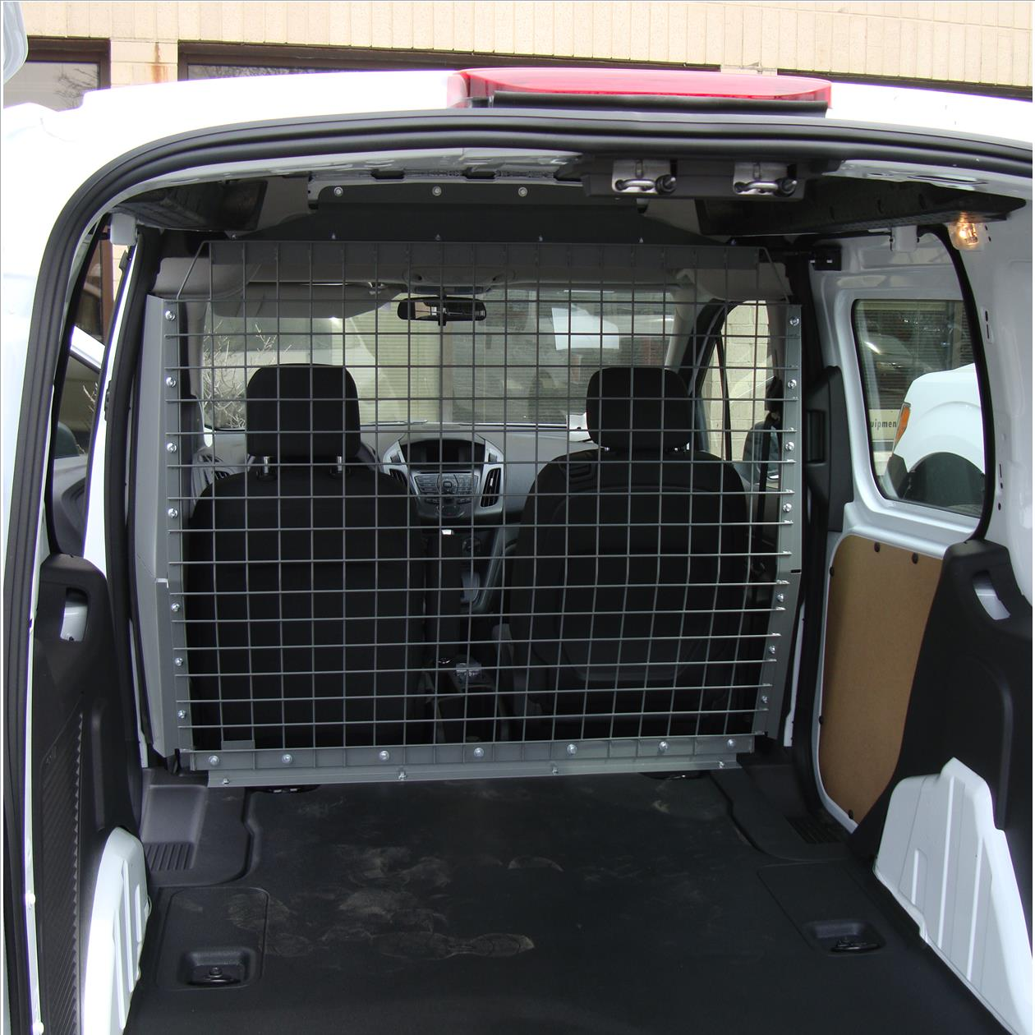
Work Van/Vehicle
Safety Cages, Bulkheads, or Partitions
Safety partitions help prevent driver and passenger injury caused by shifting cargo loads during a crash or sudden stop.

Slide 17
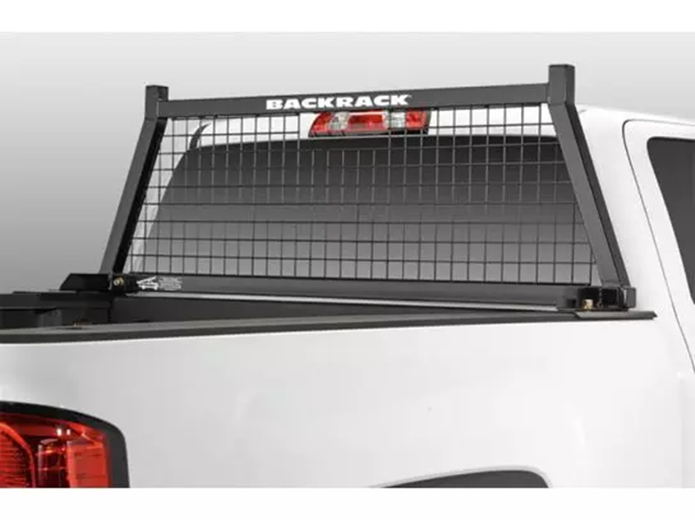
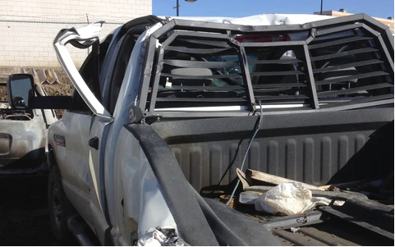
Rear Window Guard / Headache Rack
NEW
USED
IT CAN SAVE YOUR LIVE! IT CAN SAVE YOUR LIVE! IT CAN SAVE YOU LIVE!
IT CAN SAVE YOUR LIVE! IT CAN SAVE YOUR LIVE! IT CAN SAVE YOU LIVE!

Slide 18

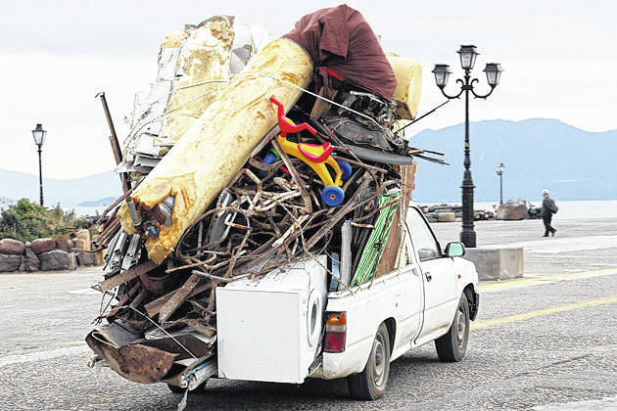

Always Safely Secure Your Loads!

Slide 19
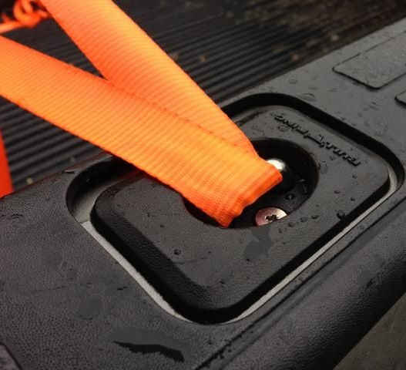
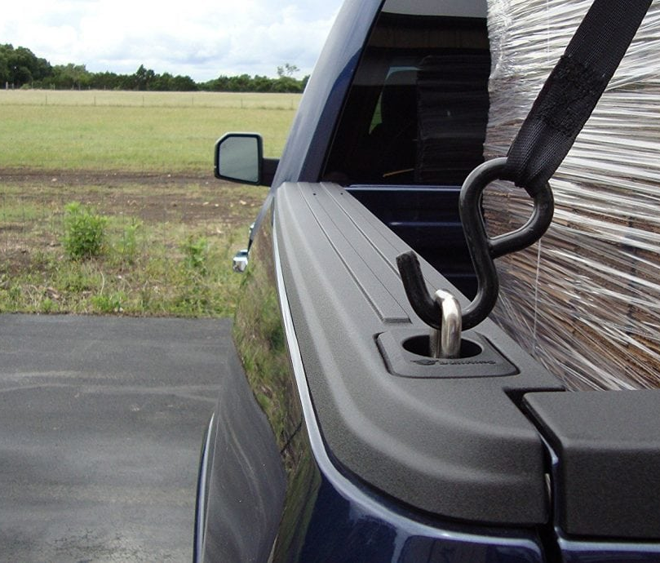
Steps to Safely Secure Your Load When Driving
1. Use tie down points to secure your loads

Slide 20
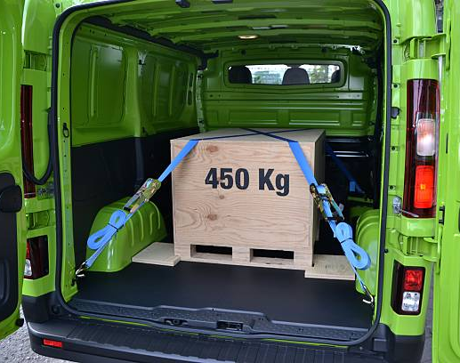
Steps to Safely Secure Your Load When Driving
2. Use Ratchet Straps When Securing Loads in Vehicle

Slide 21
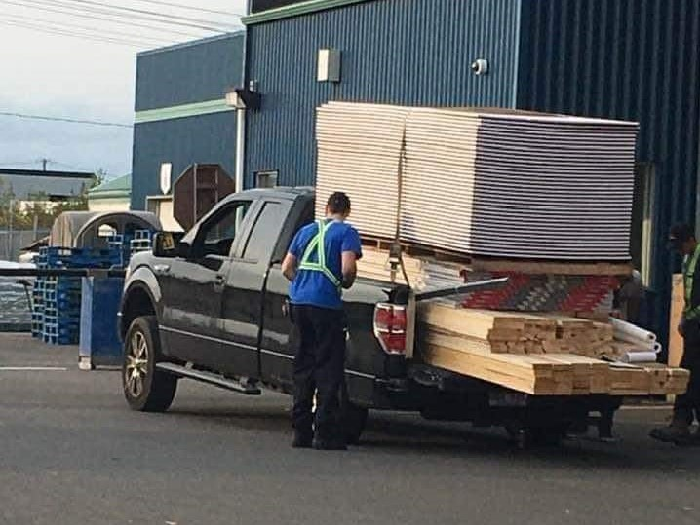
Steps to Safely Secure Your Load When Driving
3. Know How Much Your Load Weighs & Never! Overload the Capacity of Your Vehicle.

Slide 22

Refueling Safety
Turn off the engine.
Avoid anything that involves lighting a fire – no smoking!
Don’t use a cell phone – it can cause a sudden spark.
Be mindful of static electricity – it can ignite fuel vapor.
Be aware of theft – wallet, keys, tools, computer.

Slide 23

Physical and Roadway Hazards
Intersections, crosswalks & driveways where other drivers seek to join the road
Objects – People, tires, garbage, branches or debris in the road
Road surface changes - like potholes, loose gravel, mud, ice may demand a shift in lane position and require a reduction in speed
Weather changes- could reduce traction or limit visibility.
Hills and curves in the road- may require reduced speed, shifting gears, or alter lane position.

Slide 24

SUMMARY
“Safety isn’t expensive, it’s priceless.” – Author unknown
“No Safety, Know Pain. Know Safety, No Pain.” – Author unknown
“Working safely may get old, but so do those who practice it.” – Author unknown

Slide 25


