Slide 1
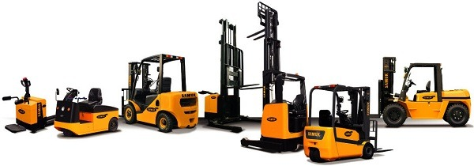

POWERED INDUSTRIAL TRUCKS
OSHA 29 CFR 1910.178

Slide 2
BLS Statistic’s
Training Requirements
Safe Operation
Daily inspection
Electric motor hand trucks
Electric motor rider trucks
Rough terrain forklift trucks
Internal combustion forklifts
Objectives

Slide 3
A mobile, power-propelled truck used to carry, push, pull, lift, stack or tier materials (American Society of Mechanical Engineers definition)
Vehicles that are used for earth moving and over-the-road hauling are excluded
PIT’s are commonly known as forklifts, pallet trucks, rider trucks, forktrucks or lift trucks
Can be powered through electric or combustion engines
Definition of Powered Industrial Trucks

Slide 4
According to the U.S. Bureau of Labor
Statistic’s
From 2011 to 2017, 614 workers lost their lives in forklift related incidents and more than 7,000 nonfatal injuries with days away from work occurred every year.
An estimated 20 - 25% of accidents are caused by,
a lack of training or inadequate training.

Slide 5
Fatalities by Age Group
27% 35 - 44
22% 25 - 34
21% 45 - 54
12% 56 - 64
10% 20 - 24
5% 65 & Over
3% Under 20

Slide 6
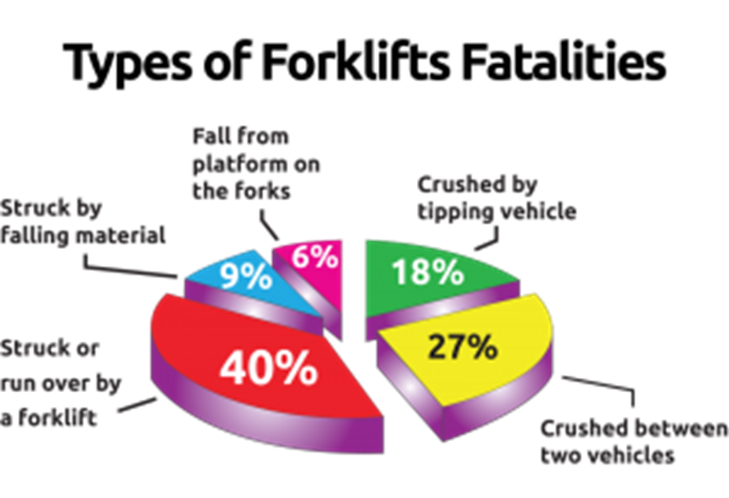
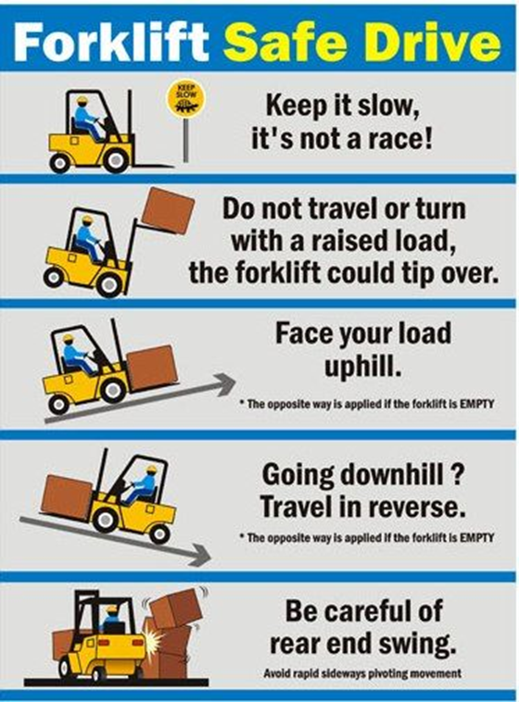
Types of Forklifts Fatalities
Powered industrial truck accidents cause approximately
100 fatalities, 36,340 serious injuries and non-serious injuries
reach approximately 61,800 each year in general industry
and construction annually.
If companies implemented more stringent training policies, ‘
OSHA estimates that about 70% of forklift accidents in the US
could be prevented.

Slide 7
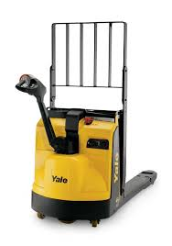
The scope provisions of 1910.178(a), which are based on ANSI B56.1-1969, cover:
Fork trucks, tractors, platform lift trucks, motorized hand trucks and other specialized industrial trucks powered by electric motors or internal combustion engines
The standard does not apply to compressed air or non-flammable compressed gas-operated industrial trucks, farm vehicles or vehicles intended primarily for earth moving or over the road hauling

Slide 8
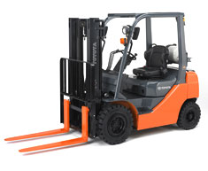
Powered industrial truck operator training requirements are performance oriented
Allows employers to tailor a training program to characteristics of their workplaces and the particular types of powered industrial trucks used

Slide 9
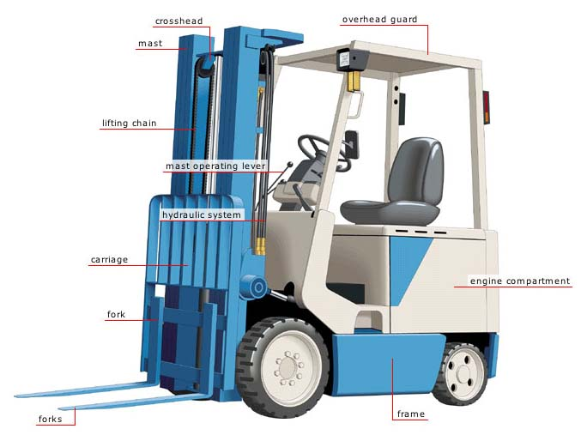
Only trained and authorized operators shall be permitted to operate fork trucks
Employer must ensure training has been provided to include formal instruction (classroom), practical training (hands on) and evaluation

Slide 10
Operator Training
SAFE OPERATION:
The employer shall ensure that each powered industrial truck operator is competent to operate a powered industrial truck safely, as demonstrated by successful completion of the training and evaluation specified in the OSHA standard
Prior to permitting an employee to operate a powered industrial truck (except for training purposes), the employer shall ensure that each operator has successfully completed the required training (or previously received appropriate training)

Slide 11
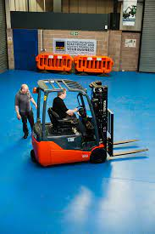
Trainees may only operate a powered industrial truck:
Under direct supervision of a person who has the knowledge, training and experience to train operators and evaluate their competence; and
Where such operation does not endanger the trainee or other employees

Slide 12

Training Program
Training shall consist of a combination of:
Formal instruction (e.g., lecture, discussion, interaction, computer learning, written material)
Practical training (demonstrations and exercises performed by the trainee)
Evaluation of the operator’s performance in the workplace

Slide 13
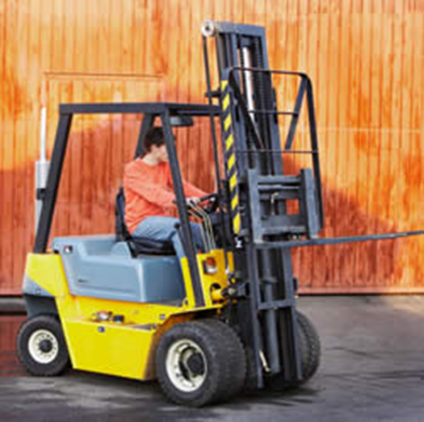
Training Program
Training and evaluation shall be conducted by a person with the knowledge, training and experience to instruct powered industrial truck operators and evaluate their competence.

Slide 14
Training Program Content
PIT Operators shall receive initial training in the following topics (excepting topics that the employer can demonstrate are not applicable to safe operation in the employer’s workplace):
→ TRUCK-RELATED TOPICS
→ WORKPLACE-RELATED TOPICS
→ REQUIREMENTS OF THE STANDARD

Slide 15
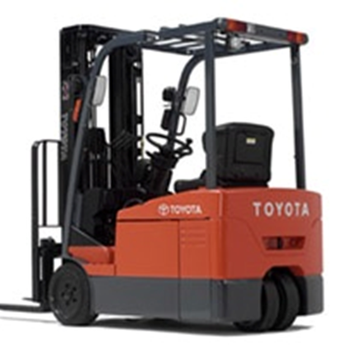
Training Program Content
TRUCK-RELATED TOPICS:
Fork and attachment adaptation, operation, and use
Vehicle capacity and stability
Vehicle inspection/maintenance operator will perform
Operating limitations
Other instructions, etc.

Slide 16
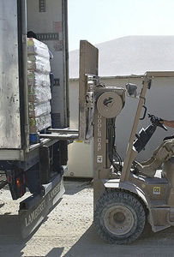
Training Program Content
WORKPLACE-RELATED TOPICS:
Operating in hazardous locations
Operating on ramps and sloped surfaces
Potentially hazardous environmental conditions
Operating in closed environments or other areas where poor ventilation or maintenance could cause carbon monoxide or diesel exhaust buildup

Slide 17
Refresher Training and Evaluation
Refresher training, including evaluation of effectiveness of that training, shall be conducted to ensure the operator has the knowledge and skills needed to operate the powered industrial truck safely.
Refresher training is required when:
Unsafe operation
Accident or near-miss
Evaluation indicates a need
Different type of equipment is introduced
Workplace conditions change

Slide 18
Refresher Training and Evaluation
An evaluation of each powered industrial truck operator’s performance must be conducted:
After initial training
After refresher training
At least once every three (3) years

Slide 19
Avoidance of
Duplicative Training
If operator has previously received training in a topic specified in this section, and training is appropriate to the truck and working conditions encountered, additional training in that topic is not required if operator has been evaluated and found competent to operate the truck safely.

Slide 20

Safely operating a forklift requires preparation, anticipation and careful attention in order to maintain control of the vehicle at all times. This section will identify recommended practices associated with each of the following operations:
Pre-Operation
A vehicle that needs repair, defective or in any way unsafe should be removed from service. The problem should be recorded on a log and reported to a supervisor immediately. This section discusses pre-operation and operational inspections that operators should perform to ensure that forklifts will operate safely. Only operators who have been trained and evaluated in accordance with 29 CFR 1910.178 can operate forklifts.
Operating the Forklift
Pre-Operation Inspection

Slide 21
Requirements and Recommended Practices
OSHA requires that all forklifts be examined at least daily before being placed in service. The operator should conduct a pre-start visual check with the key off and then perform an operational check with the engine running. The forklift should not be placed in service if the examinations show that the vehicle may not be safe to operate.
A vehicle in need of repair, defective or in any way unsafe, should not be driven and should be taken out of service immediately. Any problems should be recorded on the appropriate documents and reported to a supervisor.
Before starting your vehicle conduct a pre-operation (or pre-start) inspection that checks a variety of items, including but not limited to:
Fluid levels – oil, water, and hydraulic fluid.
Leaks, cracks or any other visible defect including hydraulic hoses and mast chains. NOTE: Operators should not place their hands inside the mast. Use a stick or other device to check chain tension.
Tire condition and pressure including cuts and gouges.
Condition of the forks, including the top clip retaining pin and heel.
Load backrest extension.
Finger guards.
Safety decals and nameplates. Ensure all waring decals and plates are in place and legible.
Operator manual on truck and legible.
Operator compartment. Check for grease and debris.
All safety devices are working properly including the seat belt.
Operating the Forklift
Pre-Operation Inspection (Continue)

Slide 22
Operating the Forklift
(Cont.)
After completing the pre-operation inspection, operators should conduct an operational inspection with the engine running. The inspection includes:
Accelerator linkage.
Inch control (if equipped).
Brakes and Steering.
Drive control: forward and reverse.
Hoist and lowering control.
Attachment control.
Horn and Lights.
Back-up alarm
Unusual noises or vibrations should be reported immediately.
Removal from Service
While driving, be aware of these potential hazards:
Mechanical breakdown.
Overheating and Fire.
Leakage.

Slide 23
Operator Responsibility & General Safe Operation
Operator Responsibility
Safe operation is the responsibility of the operator.
The operator shall develop safe work habits and also be aware of hazardous conditions in order to protect themselves, other personnel, the truck and other materials.
The operator shall be familiar with the operation and function of all controls and instruments before undertaking to operate the truck.
Before operating any truck, operators shall have read and be familiar with the operator's and owner's manual for the particular truck being operated and they shall also abide by all safety rules and practices.

Slide 24
Operator Responsibility & General Safe Operation
(Cont.)
General Safe Operation
Unauthorized personnel shall not be permitted to operate material handling equipment.
Never ride on a pallet truck that was not designed for a rider.
If you are on a rider truck, never dismount until it has come to a complete stop.

Slide 25
Stability Triangle

Slide 26
Vertical Stability

Slide 27

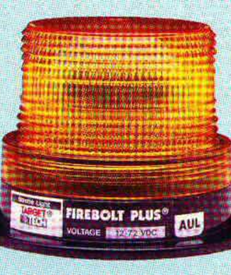
Lighting
Fork trucks must have lights on both ends where general lighting is less than two lumens per square foot.

Slide 28
Truck Operations
Trucks shall not be driven up to anyone standing in front of a bench/other fixed object.
No person shall be allowed to stand or pass under the elevated portion of any truck.
Only the operator shall be permitted to ride unless additional seats/seatbelts are provided.
If a truck is parked on an incline, the wheels shall be chocked/blocked.

Slide 29
Additional Requirements
When grades are more than 10 percent, loaded trucks shall be driven with the load upgrade.
Only safely-arranged loads should be handled.
Do not operate trucks with leaks in their fuel systems.

Slide 30
Traveling
All traffic regulations must be observed.
Three truck lengths away from truck ahead.
Stunt driving, racing, horseplay never permitted.
Must drive slowly when floor is wet.
Never run over loose objects on the roadway.

Slide 31
Traveling
Only loads within rated capacity should be moved.
Fork trucks with defective parts must be removed from service until repaired.
Fork trucks must be thoroughly inspected before each work shift.
Speed shall be reduced to a safe level while negotiating turns.

Slide 32
Traveling
Only stable or safely-arranged loads shall be handled.
Defects shall be immediately reported and corrected.
Cross railroad tracks diagonally

Slide 33
Safe loading and unloading
Safe loading/unloading
Approach the load squarely with forks level. While not part of the pallet truck: attention should be given to the condition of pallets.
Loads should not be shifted by butting with the truck.
Ensure the forks are under the pallet all the way and the load wheels are not contacting the pallet frame.
Raise the load for traveling.
It is the responsibility of the operator to ensure that a load is properly and neatly stacked, and where applicable, secured.

Slide 34
Safe loading and unloading
(Cont.)
Safe loading/unloading
Place the heaviest objects nearest the bottom of the load.
Round objects should be blocked.
It is the responsibility of the operator to know the capacity and gross weight of their loaded truck. Operate and travel only in areas approved for your load.
The operator will always carry loads in the lowered position.
If the stack area is not level, the approach must be from the uphill side and the truck must be LEVEL laterally before the load is raised.

Slide 35
OPERATING A LIFT TRUCK SAFELY
OPERATING A LIFT TRUCK SAFELY
Traveling
Pallet trucks shall not be driven up to anyone standing in front of a bench or other fixed object.
Operators shall ensure that no passengers ride on the pallet truck.
Keep legs and feet inside the confines or guards of the lift truck.
Operators must look around before starting to move. A safe distance will be maintained from the edge of ramps or platforms while on any elevated dock.
Always travel with the pallet truck forks as low as possible.

Slide 36
OPERATING A LIFT TRUCK SAFELY
(Cont.)
OPERATING A LIFT TRUCK SAFELY
Traveling
Avoid driving over loose objects or holes in the floor.
Always look in the direction of travel before moving, particularly when traveling in reverse. This includes the short reverse movement which is required when turning the truck around in confined spaces.
Watch the swing of the pallet truck when turning corners. While negotiating turns, reduce speed to a safe level. Turn a smooth motion. Except when maneuvering at a very low speed, the steering shall be completed at a moderate even rate.
It is the responsibility of the operator to maintain a safe speed at ALL times. It is the responsibility of the operator to reduce vehicle speed when traveling on uneven road surfaces.
The operator will reduce speed when: on wet and slippery floors, in congested areas, descending ramps or inclines, crossing bridge plates, vision is restricted, carrying a load or traveling over uneven surfaces.

Slide 37
OPERATOR CHECKLIST FOR SAFE OPERATING CONDITION
1. OPERATING CONDITION
Any powered hand pallet truck not in safe operating condition shall be removed from service. All repairs shall be made by authorized personnel.
2. LOCATION
No repairs shall be made in Class I, II, or III Locations (hazardous materials areas).
3. FIRE HAZARDS
Repairs to the electrical systems of pallet trucks which involve fire hazards shall be conducted only in locations designated for such repairs.
4. ELECTRICAL
Trucks in need of repairs to the electrical system shall have the battery disconnected prior to such repairs.
5. PARTS
All parts of any such pallet truck requiring replacement shall be replaced only by parts equivalent to those used in the original design.

Slide 38
OPERATOR CHECKLIST FOR SAFE OPERATING CONDITION
6. ALTERATIONS
Pallet trucks shall not be altered so that the relative positions of the various parts are different from what they were when originally received from the manufacturer, nor shall they be altered either by the addition of extra parts not provided by the manufacturer or by the elimination of any parts.
7. DAILY INSPECTION
Pallet trucks shall be examined before being placed in service and shall not be placed in service if the examination shows condition adversely affecting the safety of the vehicle. Such examination shall be made at least daily. Where pallet trucks are used on a round-the-clock basis, they shall be examined before each shift. Defects when found shall be immediately reported and corrected. Check all fluid levels (Engine, transmission, hydraulic)
8. TEMPERATURE
When the temperature of any part of any truck is found to be in excess of its normal operating temperature, thus creating a hazardous condition, the vehicle shall be removed from service and not returned to service until cause for such overheating has been eliminated.
9. CLEANING
Pallet trucks shall be kept in a clean condition, free from lint, excess oil, and grease. Non-combustible agents should be used for cleaning trucks. Low flash point (below 100°F solvents shall not be used, High flash point (at or above 100°F solvents may be used. Precautions regarding toxicity, ventilation, and fire hazards shall be consistent with the agent or solvent used.

Slide 39
Electric Motor Hand Trucks or Hand/Rider Trucks
All starts, stops and turns should be easy and gradual, particularly when the truck is loaded.
Keep to the right when passing. Operators must be sure the operator of another vehicle is aware of his presence and intended action.
Maintain a distance of 3 truck lengths behind another truck going in the same direction.
Slow down and sound horn (short blasts) at cross aisles, doorways, or when approaching other trucks.
Always be aware of Pedestrians.
The operator will stop and sound the horn at blind corners, railway crossings, elevators or whenever vision is obscured. Operators must always be alert and look for pedestrians.
The operator will travel in reverse if the load being carried obstructs forward view.
Other trucks traveling in the same direction at intersections, blind spots, or other dangerous locations, shall not be passed
All traffic regulations shall be observed.

Slide 40
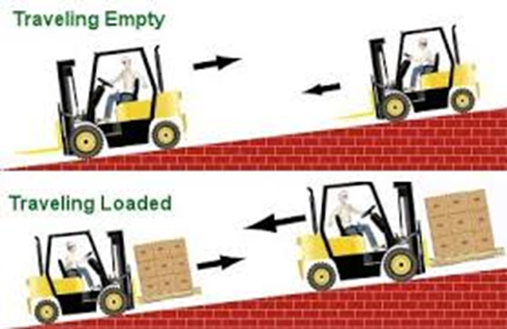
Electric Motor Hand Trucks or Hand/Rider Trucks (Cont.)
Under all travel conditions, the truck will be operated with complete control at all times, inside or outside.
Stunt driving and horse play will not be permitted.
Operation on ramps or inclines requires special attention. Brakes should be tested, and speed reduced before descending. No person shall be permitted to walk down ramps ahead of the truck. Extreme caution is required when operating near the edge of ramps & docks.
The operator will always travel straight up and straight down ramps. Never attempt to turn the vehicle while on a ramp.

Slide 41
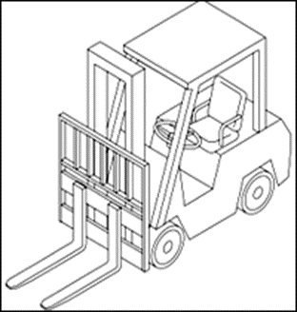

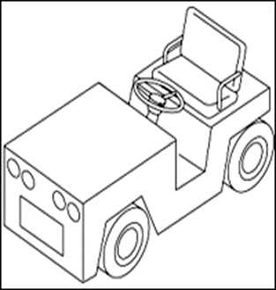
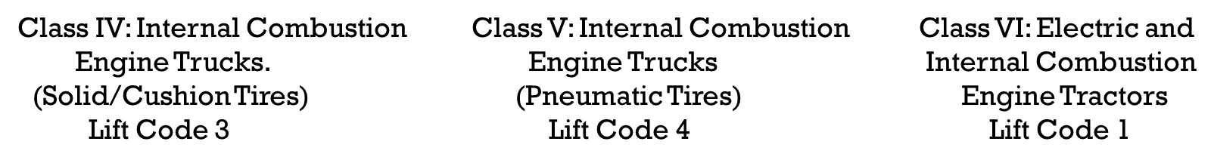
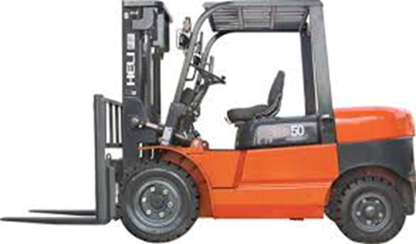
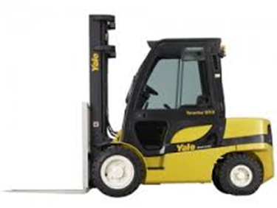
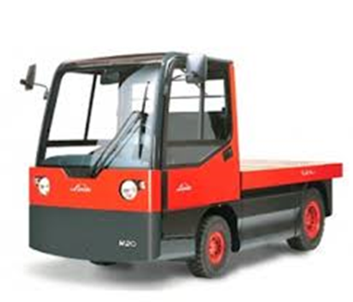
Class IV Class V Class Vi

Slide 42
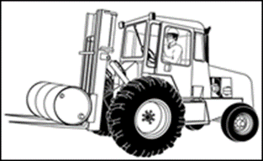
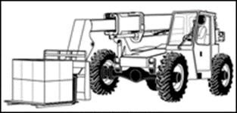
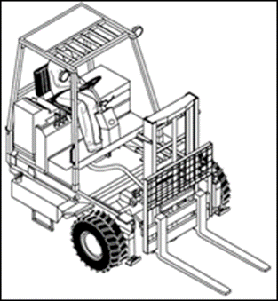
Rough Terrain Forklift Trucks
Rough terrain forklift is a generic term used to describe forklifts typically intended for use on unimproved natural terrain and disturbed terrain construction sites. However, the term “rough terrain” does not imply that the forklift can be safely operated on every conceivable type of terrain.
There are three basic types of rough terrain forklift:
This is an example of a ruggedly constructed forklift and is designed to be used primarily outdoors.
Vertical Mast Type
This is an example of a vehicle equipped with a telescoping boom, which enables it to pick and place loads at various distances and lift heights in front of the machine. The ability to reach out in front of the forklift allows the operator flexibility in the placement of a load.
Variable Reach Type
This is an example of a portable self-propelled rough terrain forklift that is typically transported to the job site. It is mounted on a carrier to the back of a truck/trailer and is used to unload heavy items from the truck/trailer at the job site. Note that not all truck/trailer mounted forklifts are rough terrain forklifts.
Truck/Trailer Mounted Type

Slide 43
Power sources
The two main power sources for powered industrial trucks are internal combustion, which uses a traditional engine that runs on liquid petroleum gas (LPG), compressed natural gas (CNG), gasoline, diesel, or other fuel, and electric, which uses an on-board battery. This section provides information on these power sources, including some of the potential hazards and possible solutions associated with their use and with refueling and battery charging/changing operations.
Other power sources that may become more widespread in the future include fuel cells and hybrid systems. Hydrogen fuel cells will have zero emissions and quiet operation plus the ability to be refueled as quickly as gasoline engines. Hybrid systems will use a combination of fuel cells and batteries.

Slide 44
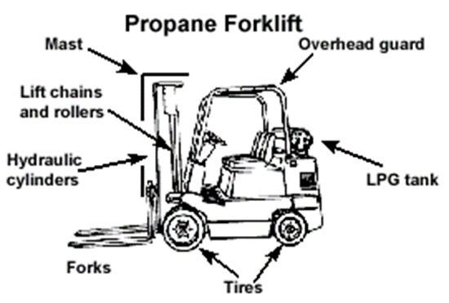
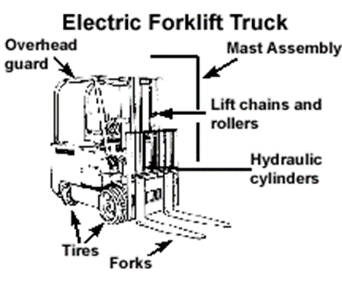
Operating the Forklift
Electric Forklifts
Cables and connectors for frayed or exposed wires.
Battery restraints.
Electrolyte levels.
Hood latch.
Always use personal protective equipment such as a face shield, rubber apron and rubber gloves when checking electrolyte.
Internal Combustion Forklifts
Engine oil and coolant.
Brake reservoir.
Air filter, belts, hoses, and hood latch.
Radiator.
Liquid Propane Forklifts
Properly mounted tank.
Pressure relief valve pointing up.
Hose connectors.
Tank restraint brackets.
Tank for dents and cracks.
Tank fits within profile of truck.
Leaks.
Always use personal protective equipment such as a face shield, long sleeves, and gauntlet gloves when checking liquid propane tanks and fittings.

Slide 45
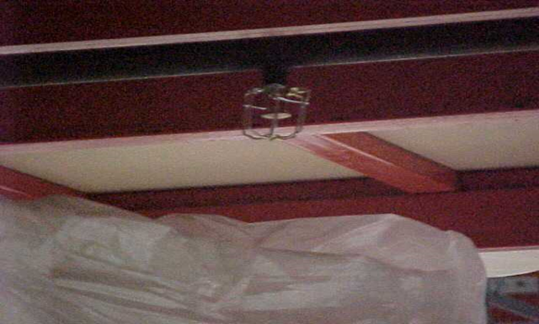
Employees are required to keep arms and legs from being placed between the uprights of the mast or outside the running lines of the truck and must also wear seatbelts (as applies).
Keep stored materials at least 18 inches below sprinklers and away from lights and pipes.
Truck Operations

Slide 46
Forklifts powered by internal combustion engines run on a variety of fuels, including gasoline, diesel fuel, liquid petroleum gas (LPG), and compressed natural gas. Forklifts with internal combustion engines can be quickly refueled but require regular maintenance checks for leaks of fuel or oil and worn parts to keep systems working properly. Forklifts powered by internal combustion engines are also used indoors, although this may increase exposure to exhaust and noise.
The most widely used forklifts have an internal combustion engine powered by fuels that include gas, liquid petroleum, diesel fuel, and compressed natural gas. Forklifts with internal combustion engines can be quickly refueled but require regular maintenance checks for leaks of fuel or oil, worn parts requiring replacement, and to keep systems working properly. Newer forklifts with internal combustion engines have on-board sensors that monitor and adjust emissions and have catalytic converters that help reduce emissions.
Potential Hazards
Exposure to engine exhaust containing carbon monoxide. If the engine is not properly combusting fuel,
the exhaust may contain high levels of carbon monoxide.
Exposure to spills and leaks of fuel and oil.
Internal Combustion

Slide 47
Requirements and Recommended Practices: Do not operate in a poorly ventilated area where vapors can concentrate.
Carefully wash away or completely evaporate spillage of oil or fuel.
As part of the pre-operation inspection, check all fluid levels, including oil, water, and hydraulic.
Check for leaks from the hydraulic cylinder, the battery, and the fuel system.
Check the exhaust color for incomplete combustion. For example, black smoke may be an indication of incomplete combustion.
Check and report unusual noises or excessive vibration.
Internal Combustion (Cont.)

Slide 48
Internal Combustion
Refueling: Gasoline and Diesel
Forklifts that use gasoline are easy to refuel. However, gasoline is very flammable.
Potential Hazards
Exposure to explosive vapors.
Requirements and Recommended Practices
Refuel only at designated safe locations.
A designated safe location outdoors is preferable to a refueling area indoors. Do not refuel trucks in hazardous areas or around heat sources.
Stop the engine during refueling.
Do not smoke while refueling.
Do not allow the forklift to become low on fuel or run out of fuel. Sediment or other impurities in the tank could be drawn into the fuel system causing difficulties in starting and actual damage to the internal components.

Slide 49
Internal Combustion
Refueling: Gasoline and Diesel (Cont.)
Fill the fuel tank at the end of each day.
Do not fill the tank to the top: it may overflow because fuel expands as it is heated.
Follow correct refueling procedures:
  Park the forklift in a designated refueling area.
  Place the transmission in Neutral.
  Lower the forks to the ground.
  Engage the parking brake.
  Shut off the engine.
  Open the filler cap.
  Fill the tank slowly (if spillage occurs, wipe off fuel and wash down the area with water).
  Close the filler cap.

Slide 50
Internal Combustion
Refueling: Liquid Petroleum Gas
Liquid petroleum gas (LPG) is a commonly used fuel for forklifts. It is a safe fuel when handled properly. When handled improperly, it can cause serious injury or death.
Potential Hazards
LPG vapor is heavier than air and will seek the lowest lying area. If not adequately dissipated, it will collect in pockets and possibly ignite when exposed to a heat source.
LPG is extremely flammable.
LPG is extremely cold when exposed to the atmosphere. If your skin is exposed to LPG, you can get frostbite.
Requirements and Recommended Practices
Do not refuel LPG-powered trucks in confined areas where LPG vapors could collect if a leak occurs.
Do not leave LPG-powered trucks near heat sources, stairways, exits, or other egress areas.
When parking LPG-powered trucks for a long period of time, turn the service valve off.
Only trained and authorized personnel should replace LPG containers.
Follow proper procedures for storing and handling liquid petroleum gas. 29 CFR 1910.110

Slide 51
Electric Powered Industrial Trucks
Electric-powered forklifts are most commonly used indoors in warehouses. Unlike internal combustion forklifts, electric forklifts are quiet and generally nonpolluting but present other serious hazards that must be addressed.
Electric forklifts produce zero emissions, virtually eliminate the hazard of carbon monoxide poisoning, and run more quietly than internal combustion forklifts. However, electric forklifts present other serious hazards that must be addressed.
Potential Hazards
Electric forklifts are powered by large lead-acid batteries, which must be routinely charged. The hazards and recommended practices for charging and changing batteries are reviewed below.
Requirements and Recommended Practices
Designate an area for the purpose of battery charging.
Make sure that the forklift is charged before using.
Recognize that heavy loads drain the battery more quickly.

Slide 52
Electric Powered Industrial Trucks
(Cont.)
Battery Charging Area
A properly equipped battery charging area will have:
No smoking.
Warning signs posted.
Adequate fire protection. Ample and readily available water supply for flushing and neutralizing spilled electrolyte.
An eyewash able to provide a 15-minute flow. For large installations, there should be a plumbed drench shower and an eyewash.
A phone or other means of communication in the event of an emergency.
Adequate ventilation to avoid the build up of hydrogen gas during battery charging.
Soda ash or other neutralization materials in the immediate area.
A dry chemical, CO2 or foam fire extinguisher.
Means to protect charging apparatus from damage from trucks.

Slide 53
Batteries
Must protect chargers from vehicle damage.
Must adequately ventilate for vapors from gassing batteries:
Hydrogen gas emitted
Very flammable
Overhead hoist or equivalent must be used to handle batteries.
Wear appropriate PPE.

Slide 54
Batteries
A carboy tilter or siphon must be provided for handling electrolyte.
Pour acid into water, not vice versa.
Open battery cover or compartment to dissipate heat.
Prevent any open flames, sparks or electric arcs in battery charging areas.

Slide 55
Operating
the
Forklift
Traveling
&
Maneuvering
Mounting and Dismounting
Potential Hazards:
Hitting head on overhead cage.
Slips, trips, and falls.
Requirements and Recommended Practices:
Be sure that your hands are clean and dry to prevent slipping when grabbing handhold.
Check your shoes for grease before entering the vehicle.
Grasp handhold and get a good grip. Never grab the steering wheel because it could cause you to lose balance if it moves.
Always be careful with your footing when mounting and dismounting vehicle.
Pull or lower your body carefully into or out of cab. Dismounting is the opposite of mounting – do not jump.
Wear appropriate footwear to prevent skids.

Slide 56
Other Hazards While Operating the Forklift
Falling Loads
Falling from Platforms, Curbs, Trailers, etc..
Obstructed Views
Inattention
Riders
Vehicle Not Maintained
Carbon Monoxide
Rough - Uneven - Unleveled floors
Unusual Loads
Classified Areas
Narrow Aisles
Pedestrians

Slide 57
Summary
It’s the responsibility of the employer to follow all the training requirements.
Always follow the employer's safe operation policy.
Make sure you do daily inspection before operating the equipment.
Always follow the requirements and recommended practices while operating the forklift.
Always be alare of your surroundings

Slide 58


