Slide 1
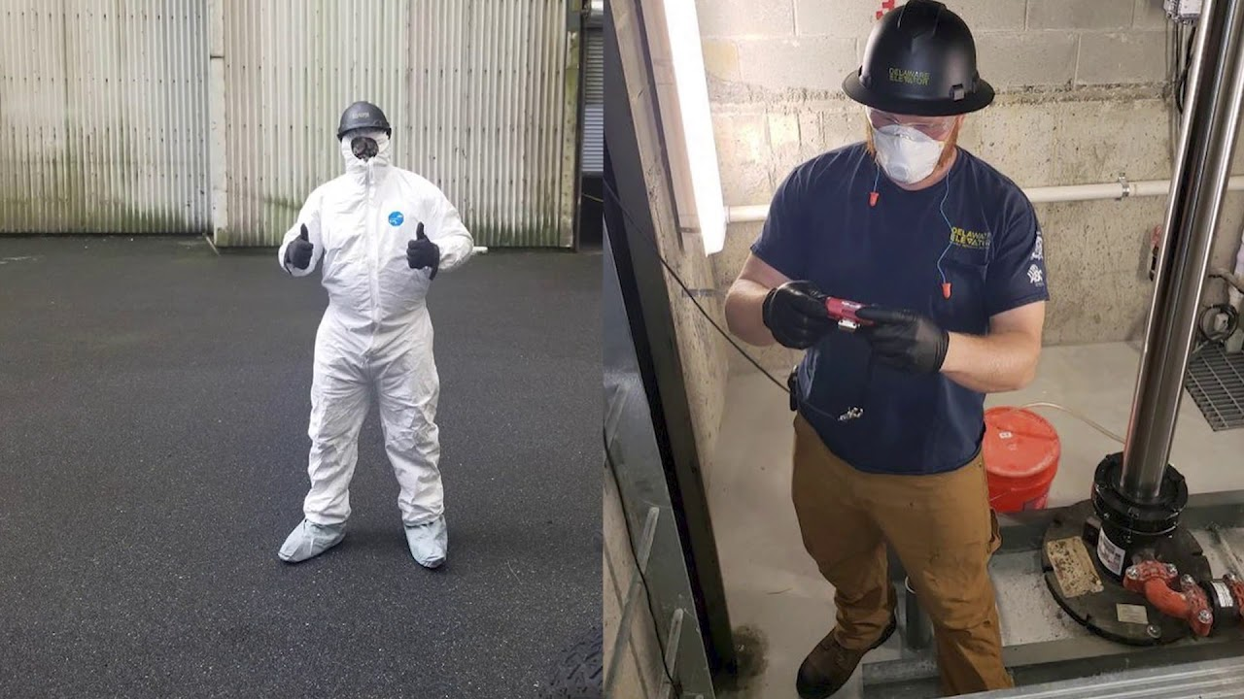
Think Safety !
Three States of Mind That Lead to Critical Errors
Elevator Industry Safety Partners

Slide 2
Three States of Mind that Lead to Critical Errors
By the end of this presentation, you will be able to recognize:
Frustration
Fatigue
Complacency
Describe ways to cope with frustration, fatigue, and complacency.

Slide 3
Distractions
One of the biggest driving forces of critical errors is distractions. There’s various forms of distractions that can lead to unsafe work practices. These include but are not limited to:
Cell phone usage
Problems in home life
Working in public
Personal Issues
Everyone has some degree of distraction throughout the day. Managing how much these distractions affect your work and state of mind is key.
No phone call is more important than your life or the life of those around you.
This Photo by Unknown Author is licensed under CC BY-NC-ND

Slide 4
Job site safety is an ever-present issue that is a constant threat in any environment with trades working around and above us. The greatest way to prevent accidents is to train people how to reduce the risk to zero or how to put controls in place that will limit the possibility of an accident. Workplace mishaps can be dramatically reduced with the correct mindset and attitude by recognizing three common errors that open the door to injury.

Slide 5
Frustration
Frustration is a mindset that almost everybody experiences at some point in life. Having the right tools to manage frustration and turn negatives into positives is key to being able to avoid accidents and injuries. Creating a workplace that prevents frustration from developing is key. Employees can get frustrated at poor procedures, bad communication, wrong or insufficient materials and problems at home.

Slide 6
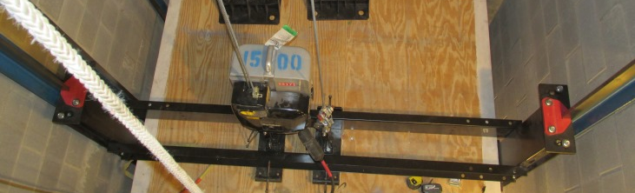
Frustration - being Rushed
Employees often feel constant pressure to complete tasks as quickly as possible so that they can move onto the next task or finish the day early. Rushing reduces the quality of workmanship and increases the chances of not following the correct safely steps to complete tasks. Accidents increase on Fridays, holiday weekends or when jobs are behind schedule, driving and using cell phones.
It’s important to remind employees that working safety is the priority, even if it means finishing the job later.

Slide 7
Fatigue
Fatigue greatly reduces production and performance. A tired driver is said to be as dangerous on the road as a drunk driver, which illustrates the dangers of fatigue. It is very important to identify when a worker is fatigued to take the correct course of action. A great danger in hotter climates is heat stress, which causes fatigue and can result in death. Having heat stress safety plans are an essential training topic for all work forces.
To avoid fatigue, employees should not overwork or work overly long hours. Companies must set realistic deadlines and attainable goals for employees.

Slide 8
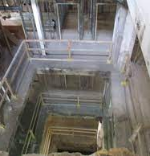
Complacency
Complacency can be the most dangerous mindset that results in an injury or accident, the constructor thinking it will never happen to me, or the mentality that it will just take a minute when jumping into a pit. The first step to an accident involves the false belief that experience makes you invulnerable. Accidents can happen to anybody at any time and one’s sense should always be finely tuned to each situation’s risks.

Slide 9
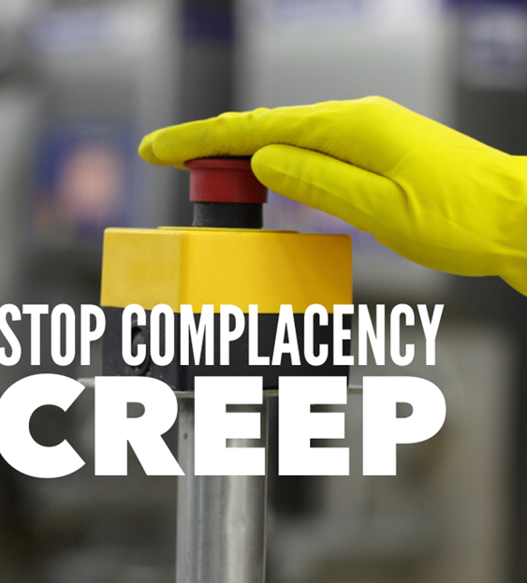
Complacency
A false sense of security is the result of poor training and following bad practices, which leads to accidents. These mindsets can cause or contribute to critical errors which increase the probability of injury:

Slide 10
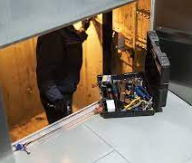
Complacency
Eyes not on task
Working with general public present
Hazards with the equipment
Jumping on the cartop without following procedures
Mind not on task
Working with other trades in uncontrolled areas
Walking into the line of fire
Losing balance, traction or grip
Complacency

Slide 11
Are you Safe or Lucky….Who Are you?
Complacency Vs. Commitment
LUCK
SAFE PRACTICES
Always be on the move
SAFE PRACTICES
I’M
LUCKY
Complacency
Commitment
I trust the building won't turn on power
I hope that the car top safety switches work
I am careful around fall hazards
I trust that the rigging equipment is ok
I Lock Out and Verify Power is off
I test Inspection and Stop Switches
I wear Fall Protection
I inspect and check my rigging equipment

Slide 12
Causes of Complacency:
Systematic Desensitization: When we hear a message repeatedly or have gradual exposure to a dangerous activity, over time we become immune to the message or danger.

Slide 13
Causes of Complacency:
Normalization of Deviance: A long-term phenomenon in which individuals or teams repeatedly “get away” with a deviation from established standards until it is no longer seen as a deviation; it becomes the implied standard. We do something without getting hurt, so we keep doing it. And the more we don’t get hurt…the more we believe we can’t.

Slide 14
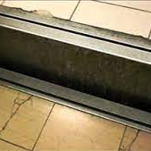
Inattentional Blindness : “We see what we look for”. When we are focused on one thing—like getting a job done quickly—we pay little attention to hazards that may be around us. Expecting what is “supposed” to happen can result in missing the unexpected or out-of-the-ordinary.

Slide 15
Optimism Bias: Scientists call this a “Mild Positive Illusion”. The rest of us call it “Rose-Colored Glasses”. We overestimate the likelihood of positive events and underestimate the likelihood of negative events. We don’t think an accident can happen to us, but we’re sure going to win the lottery one day.

Slide 16
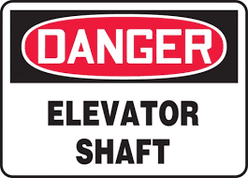
Warning Signs
Accepting Lower Standards of Performance: For example, not completing or following an inspection sheet or checklist.
Erosion of Desire to Remain Proficient: Not making the effort to keep learning leads to falling behind.

Slide 17
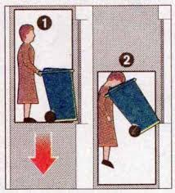
Warning Signs
Boredom and Inattention: It’s a chore to come to work, day after day, people don’t feel challenged…or valued.
Satisfaction with the Status Quo: People resist change, no continuous improvement
Neglecting Personal Safety Items: At first, this may seem trivial, but ignoring even the smallest item of personal safety may be a strong symptom of complacency.

Slide 18
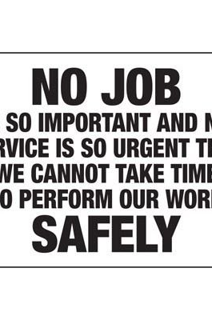
Requires two kinds of Awareness:
Situational Awareness
See the big picture, not just the details. Be aware of everything around you and how they might interact to create a dangerous situation.
Assess the entire area before exiting your vehicle, leaving a building, etc.
Watch for parked, occupied vehicles
Notice body language – keep distance between you and strangers (two arms’ length minimum)
If conversation gets confrontational – leave the area immediately
Keep one hand free when walking – dominant hand if possible

Slide 19
Requires two kinds of Awareness:
Situational Awareness
Assess the entire situation before you start the job assessment
What or who could enter my work zone and create a hazard?
Plan for the unexpected – what to do if…
Plan escape route – know what you will do in an emergency

Slide 20
Requires two kinds of Awareness:
Self-Awareness
Think about what you’re thinking about. Pay attention to your mindset and where your focus is.
State of mind
Frustration
Rushing
Fatigue
Mind on task
Avoid distractions – cell phones
Work/move with intention

Slide 21
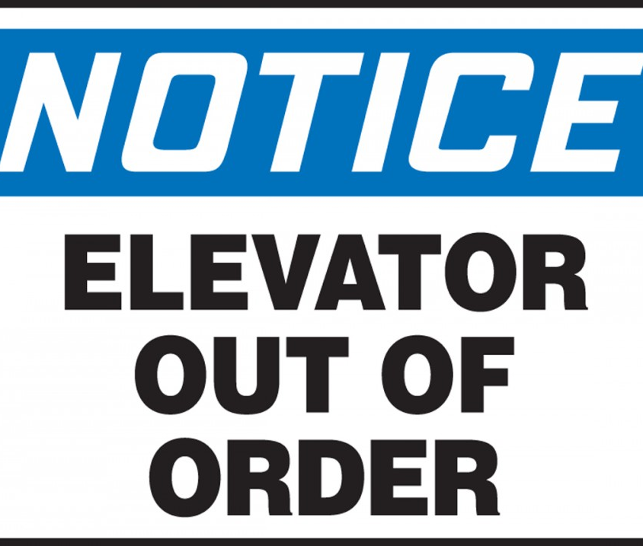
Leader Responsibility
Keep Safety Fresh:
Stay current on the latest safety information, and practice and follow safety policies and procedures.
Demand Safety:
Don’t tolerate any deviation from safe practices. Hold yourself accountable and always be a role model for safety. If you see a co-worker doing something unsafe, speak up. You just might save their life!

Slide 22
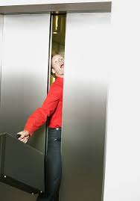
Frustration, fatigue, and complacency can have devastating effects on the job. Frustration can come from many places:
Home
Work
Co-workers
Learn to manage your frustrations. Don’t allow yourself or others to become complacent with safety. Keep it fresh and always first.
In the conveyance industry, a one second distraction could cost you dearly. Take the steps necessary to eliminate distractions.

Slide 23
Through the Alliance between OSHA’s 10 Regional Offices and the Elevator Contractors of America (ECA), Elevator Industry Work Preservation Fund (EIWPF), International Union of Elevator Constructors (IUEC), National Association of Elevator Contractors (NAEC), National Elevator Industry Educational Program (NEIEP), and National Elevator Industry Inc. (NEII), collectively known as The Elevator Industry Safety Partners, developed this Industry Specific Training for informational purposes only. It does not necessarily reflect the official views of OSHA or the U.S. Department of Labor. May 2021
Under the Occupational Safety and Health Act, employers are responsible (http://www.osha.gov/as/opa/worker/employer-responsibility.html) for providing a safe and healthy workplace and workers have rights (https://www.osha.gov/workers). OSHA can help answer questions or concerns from employers and workers. OSHA's On-Site Consultation Program (https://www.osha.gov/consultation) offers free and confidential advice to small and medium-sized businesses, with priority given to high-hazard worksites. For more information, contact your regional or area OSHA office (https://www.osha.gov/contactus/bystate), call 1-800-321-OSHA (6742), or visit https://www.osha.gov/.

