Slide 1

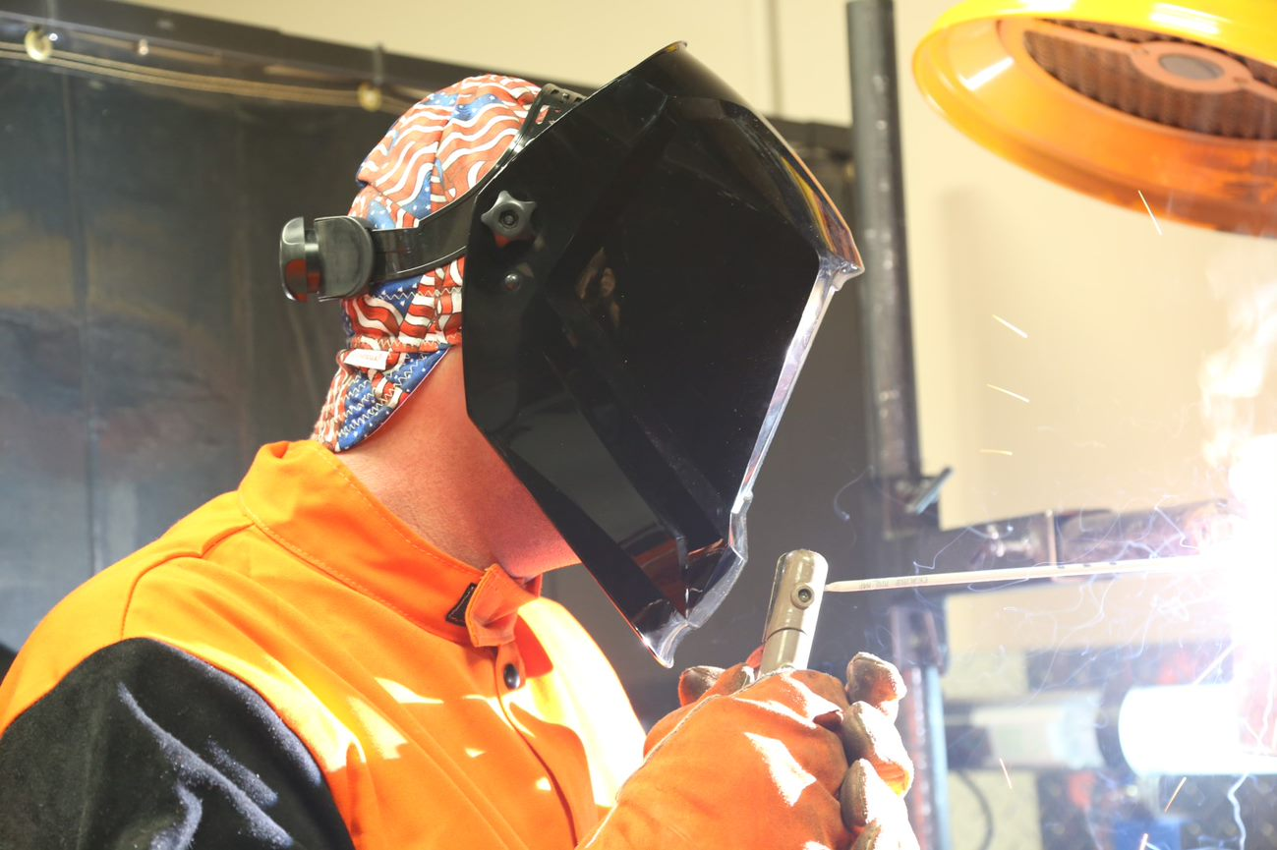
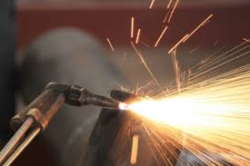
29 CFR 1926 - Subpart J
Welding and Cutting

Slide 2
Welding and Cutting
Overview:
1926 Subpart J provides the requirements for welding and cutting including fire prevention and protection, confined spaces, personal protective equipment , ventilation, and securing cylinders.

Slide 3
Welding and Cutting
Subpart J
1926.350 - Gas Welding and Cutting
1926.351 - Arc Welding and Cutting
1926.352 - Fire Prevention
1926.353 - Ventilation and Protection in Welding, Cutting, and Heating
1926.354 – Welding, Cutting, and heating in way of preservative coatings

Slide 4
Welding and Cutting
Objectives:
By the end of this session, students will be able to:
Describe employer responsibilities for protection when welding and oxy-acetylene cutting
Describe employee responsibilities when welding and oxy-acetylene cutting
Identify equipment commonly used in welding and oxy-acetylene cutting
Identify hazards and implement proper safety procedures for use and storage of welding and oxy-acetylene cutting equipment

Slide 5
Welding and Cutting
Vertical and Horizontal OSHA Standards
29 CFR 1926 Subpart J covers requirements for welding and cutting in the construction environment. There are some additional requirements that are covered in other Standards. These are referred to as horizontal standards.
Horizontal Standards
Horizontal standards are the OSHA standards that apply to most workplaces.
Examples of horizontal standards include:
PPE (1910 Subpart I)
Fire Protection (1910 Subpart L)
Hazard Communication (1910.1200)
Vertical Standards
Vertical standards apply to specific industries or operations, practices, conditions, processes, means, methods, equipment, or installations.
Examples of OSHA vertical standards include:
OSHA's 1926 Construction Standards
OSHA's 1915 Shipyard Standards

Slide 6
Welding and Cutting
Vertical and Horizontal OSHA Standards
Integrating Vertical and Horizontal Standards
Almost all workplaces have vertical standards to implement along with the horizontal standards.
For example, restaurants follow the horizontal standards of fire safety, but they also follow specific vertical standards regarding open flames, food safety and public health.
The same applies to construction. The construction industry follows the common horizontal regulations, but it also has specific vertical standards to follow on machinery, tools, ventilation and safety equipment.
This presentation will reference the 1926 vertical standard for construction but will also reference any applicable horizontal standard.
Knowing both types of standards is critical for the conveyance industry to keep its workers safe.

Slide 7
Welding and Cutting
§1910.253 — Gas Welding and Cutting
General requirements:
Flammable mixture.
Mixtures of fuel gases and air or oxygen may be explosive and shall be guarded against
Maximum pressure.
Under no condition shall acetylene be generated, piped (except in approved cylinder manifolds) or utilized at a pressure in excess of 15 psig (103 kPa gauge pressure) or 30 psia (206 kPa absolute).
Apparatus.
Only approved apparatus such as torches, regulators or pressure-reducing valves, acetylene generators, and manifolds shall be used
Notes:
PSIG, pounds per square inch gauge is the term for pressure specified by a gauge or other pressure measurement device. It gives the difference between the pressure in a pipe or tank and the pressure of the atmosphere (atm)
PSIA, pounds per square inch absolute is a term that describes the absolute pressure in PSI, including the pressure of the atmosphere. Absolute pressure is also sometimes referred to as “total pressure.”
Kilopascal (kPa), one thousand times the unit of pressure and stress in the metre-kilogram-second system

Slide 8
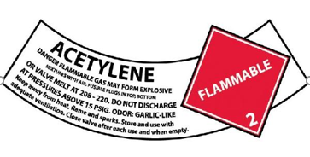

Welding and Cutting
§1910.253 — Oxygen-fuel gas welding and cutting
Cylinders and containers:
Compressed gas cylinders shall be legibly marked, for the purpose of identifying the gas content, with either the chemical or the trade name of the gas.
Such marking shall be by means of stenciling, stamping, or labeling, and shall not be readily removable. Whenever practical, the marking shall be located on the shoulder of the cylinder.
Notes:
The gas cylinders you are using must be marked to identify what is inside them. It can be painted on, stamped on, or with a label.

Slide 9
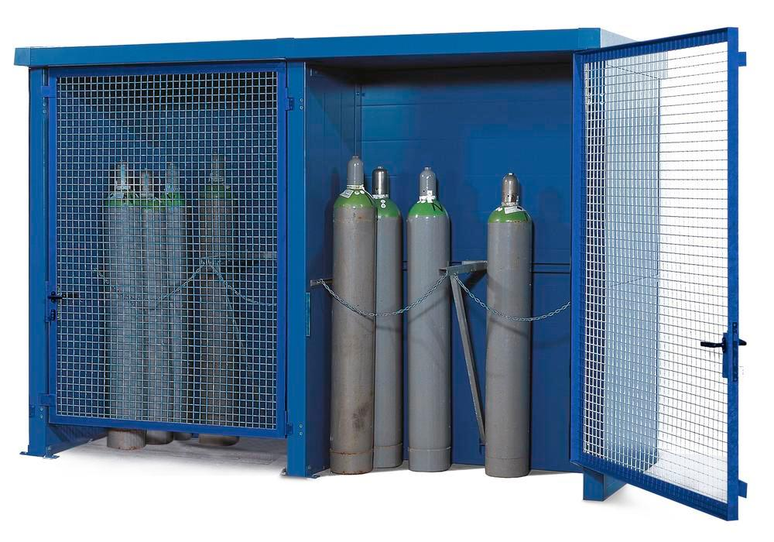
Welding and Cutting
§1926.350 and 1910.253 — Oxygen-fuel gas welding and cutting
Storage of Cylinders:
Cylinders shall be kept away from radiators and other sources of heat
Inside of buildings, cylinders shall be stored in a well-protected, well-ventilated, dry location, at least 20 (6.1 m) feet from highly combustible
materials in an assigned location
Assigned storage spaces shall be located where cylinders will not be knocked over or damaged by passing or falling objects, or subject to tampering by unauthorized persons
Cylinders shall not be kept in unventilated enclosures such as lockers and cupboards
Empty cylinders shall have their valves closed

Slide 10
Welding and Cutting
§1926.350 — Oxygen-fuel gas welding and cutting
Storage of Cylinders cont:
Oxygen cylinders in storage shall be separated from fuel-gas cylinders or combustible materials (especially oil or grease), a minimum distance of 20 feet (6.1 m) or by a noncombustible barrier at least 5 feet (1.5 m) high having a fire-resistance rating of at least one-half hour
Valve protection caps, where cylinder is designed to accept a cap, shall always be in place except when cylinders are in use or connected for use

Slide 11
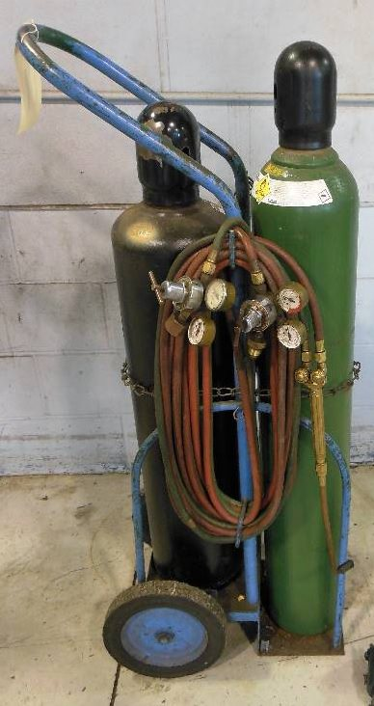
Welding and Cutting
§1926.350 — Oxygen-fuel gas welding and cutting
Operating procedures:
Cylinders, cylinder valves, couplings, regulators, hose, and apparatus shall be kept free from oily or greasy substances
When transporting cylinders by a crane or derrick, a cradle, boat, or suitable platform shall be used. Slings or electric magnets shall not be used for this purpose
Valve-protection caps shall not be used for lifting cylinders from one vertical position to another
Unless cylinders are secured on a special truck, regulators shall be removed and valve-protection caps, when provided for, shall be put in place before cylinders are moved. Cylinder valves shall be closed before moving cylinders

Slide 12
Welding and Cutting
§1926.350 — Oxygen-fuel gas welding and cutting
Operating procedures cont.:
Cylinders shall be kept far enough away from the actual welding or cutting operation so that sparks, hot slag, or flame will not reach them, or fire-resistant shields shall be provided
Cylinders shall not be placed where they might become part of an electric circuit
Cylinders shall be kept away from radiators, piping systems, layout tables, etc., that may be used for grounding electric circuits such as for arc welding machines
Any practice such as the tapping of an electrode against a cylinder to strike an arc shall be prohibited
Cylinders shall never be used as rollers or supports, whether full or empty.

Slide 13
Welding and Cutting
§1926.350 — Oxygen-fuel gas welding and cutting
Operating procedures cont.:
Before connecting the regulator to the cylinder valve, the valve shall be opened slightly for an instant and then closed. Always stand to one side of the outlet when opening the cylinder valve
Never crack a fuel-gas cylinder valve near other welding work or near sparks, flame, or other possible sources of ignition
Before a regulator is removed from a cylinder valve, the cylinder valve shall be closed, and the gas released from the regulator
An acetylene cylinder valve shall not be opened more than one and one-half turns of the spindle, and preferably no more than three-fourths of a turn
Where a special wrench is required, it shall be left in position on the stem of the valve while the cylinder is in use so that the fuel-gas flow can be quickly turned off in case of emergency

Slide 14
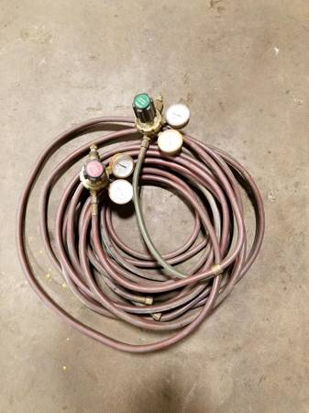
Welding and Cutting
§1910.253 — Oxygen-fuel gas welding and cutting
Protective equipment, hose, and regulators:
Equipment shall be installed and used only in the service for which it is approved and as
recommended by the manufacturer
Hose for oxy-fuel gas service shall comply with the Specification for Rubber Welding Hose, 1958, Compressed Gas Association and Rubber
Manufacturers Association
When parallel lengths of oxygen and acetylene
hose are taped together for convenience and to
prevent tangling, not more than 4 inches (10.2
cm) out of 12 inches (30.5 cm) shall be covered
by tape.

Slide 15
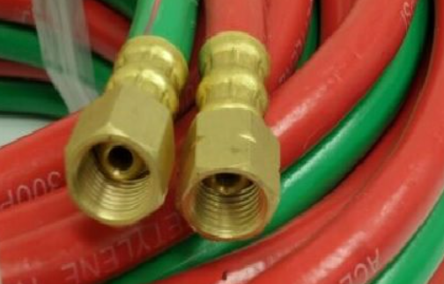
Welding and Cutting
§1910.253 — Oxygen-fuel gas welding and cutting
Protective equipment, hose, and regulators cont.:
Hose connections shall be clamped or otherwise securely fastened in a manner that will withstand, without leakage, twice the pressure to which they are normally subjected in service
Hose showing leaks, burns, worn places, or other defects rendering it unfit for service shall be repaired or replaced

Slide 16
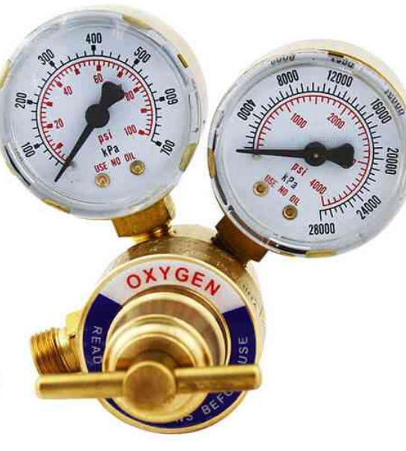
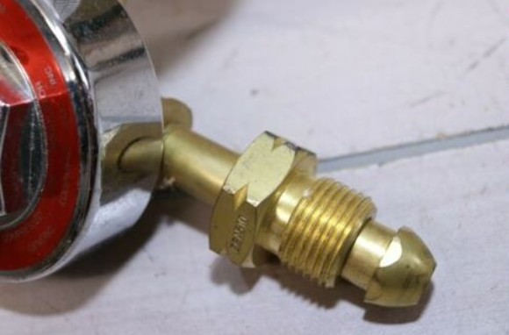
Welding and Cutting
§1910.253 — Oxygen-fuel gas welding and cutting
Pressure-Reducing regulators:
Pressure-reducing regulators shall be used only for the gas and pressures for which they are intended
Gages on oxygen regulators shall be marked "USE NO OIL."
When regulators or parts of regulators, including gages, need repair, the work shall be performed by skilled mechanics who have been properly instructed
Union nuts and connections on regulators shall be inspected before use to detect faulty seats which may cause leakage of gas when the regulators are attached to the cylinder valves

Slide 17

Welding and Cutting
Which type of welding uses a fuel gas mixed with oxygen?
Oxy-Acetylene welding
What is the maximum working pressure of acetylene in cutting operations?
15 psig
If lifting the welding cart by a crane, do the regulators have to be removed?
Yes

Slide 18
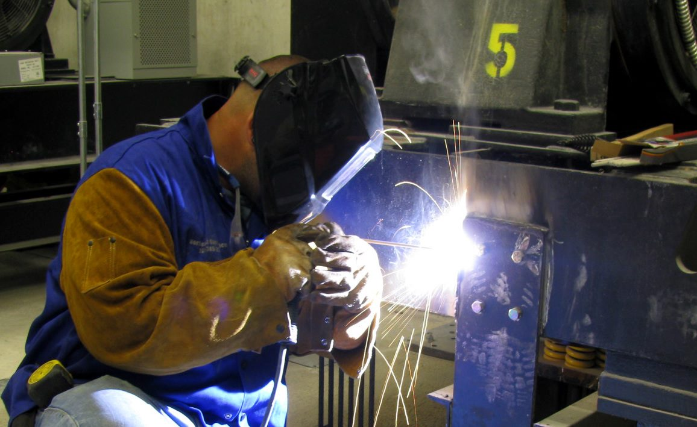
Welding and Cutting
§1926.351 — Arc welding and cutting
In the arc welding process, an electric current passing through the welding rod or electrode is forced to jump or arc across a gap. The resulting arc produces the intense heat necessary for the arc welding and cutting operation.
Arc welding is used to fabricate nearly all types of carbon and alloy steels, the common nonferrous metals, and is indispensable in the repair and reclamation of metallic machine parts

Slide 19
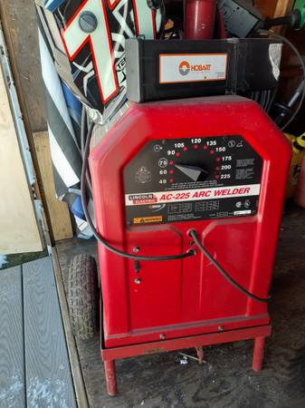
Welding and Cutting
§1910.254 — Arc welding and cutting
General:
Welding equipment shall be chosen for safe application to the work to be done
Welding equipment shall be installed safely
Workmen designated to operate arc welding equipment shall have been properly instructed and qualified to operate such equipment

Slide 20
Welding and Cutting
§1910.254 — Arc welding and cutting
Environmental Conditions:
Standard machines for arc welding service shall be designed and constructed to carry their rated load with rated temperature rises
Unusual service conditions may exist, and in such circumstances, machines shall be especially designed to safely meet the requirements of the service:
Exposure to steam or excessive humidity
Exposure to abnormal vibration or shock
Exposure to excessive dust
Exposure to weather
Exposure to unusual seacoast or shipboard conditions

Slide 21
Welding and Cutting
§1910.254 — Arc welding and cutting
Voltage - The following limits shall not be exceeded:
Alternating-current machines
Manual arc welding and cutting — 80 volts
Automatic (machine or mechanized) arc welding and cutting — 100 volts
Direct-current machines
Manual arc welding and cutting — 100 volts
Automatic (machine or mechanized) arc welding and cutting-100 volts
When special welding and cutting processes require values of open circuit voltages higher than the above, means shall be provided to prevent the operator from making accidental contact with the high voltage by adequate insulation or other means.
Notes:
Does anyone know the difference between manual and automatic?
Manual Welding: Manual welding is welding in which entire welding operations are controlled by hand i.e. the electrode holder, welding hand torch, controlled by hands only
Semiautomatic Welding: Semi-automatic welding is one in which equipment used controls the filler metal feed but the advance of the welding is manually controlled i.e a wire feeder is attached to the welding equipment which advances the filler metal continuously through welding torch and the torch is controlled manually for the welding
Machine Welding: Machine welding is defined as the welding done with the equipment that has controls that can be adjusted by the welding operator , or adjusted under the welding operator’s direction, in response to changes in the welding conditions. The torch, gun or electrode holder id held by a mechanical device i.e. in this technique all of the welding operations is controlled by either of mechanical or electronic devices and welding operators may manually vary during welding as per the configuration of the welding joint to create sound weld
Automatic Welding: Automatic welding is defined as the welding done with the equipment which perform the welding operations without adjustment of the controls by a welding operator.

Slide 22
Welding and Cutting
§1910.254 — Arc welding and cutting
Design
On all types of arc welding machines, control apparatus shall be enclosed except for the operating wheels, levers, or handles.
Terminals for welding leads should be protected from accidental electrical contact by personnel or by metal objects i.e., vehicles, crane hooks, etc.
Installation
The frame or case of the welding machine (except engine-driven machines) shall be grounded
Chains, wire ropes, cranes, hoists, and elevators shall not be used to carry welding current
All ground connections shall be checked to determine that they are mechanically strong and electrically adequate for the required current

Slide 23
Welding and Cutting
§1910.254 — Arc welding and cutting
Supply connections and conductors
A disconnecting switch or controller shall be provided at or near each welding machine which is not equipped with such a switch or controller mounted as an integral part of the machine.
The rated current-carrying capacity of the supply conductors shall be not less than the rated primary current of the welding machines
Operation and maintenance
Workers assigned to operate or maintain arc welding equipment shall be acquainted with the requirements of this section and with 1910.252*
Before starting operations all connections to the machine shall be checked to make certain they are properly made, and coiled welding cable shall be spread out before use to avoid serious overheating and damage to insulation.
Notes:
1910.252 is the general requirements for welding we reviewed earlier

Slide 24
Welding and Cutting
§1910.254 — Arc welding and cutting
Operation and maintenance cont.
Grounding of the welding machine frame shall be checked. Special attention shall be given to safety ground connections of portable machines
Electrode holders when not in use shall be so placed that they cannot make electrical contact with persons, conducting objects, fuel or compressed gas tanks
Electric Shock Hazard: Cables with splices within 10 feet (3 m) of the holder shall not be used. The welder should not coil or loop welding electrode cable around parts of his body
Maintenance
The operator should report any equipment defect or safety hazard to his supervisor and the use of the equipment shall be discontinued until its safety has been assured. Repairs shall be made only by qualified personnel
Cables with damaged insulation or exposed bare conductors shall be replaced. Joining lengths of work and electrode cables shall be done by the use of connecting means specifically intended for the purpose. The connecting means shall have insulation adequate for the service conditions

Slide 25
Welding and Cutting
29-Year-Old Welder Electrocuted
At approximately 3:45 a.m. a 29-year-old maintenance worker was electrocuted as he attempted to turn off a welder.
A maintenance man at a steel treatment plant was walking along a metal walkway in the plant, when he discovered the victim lying on his back in a convulsive state. Electrical arcs were visible from the handle of the welding cart to the floor. As other employees arrived at the scene, one pulled the plug on the welder. The police and the fire department rescue squad were called. The rescue squad transported the victim to a local hospital, where he was pronounced dead at 5:08 a.m.
The examination of the welder at the local police station revealed that the cables on the welder (particularly the positive or electrode cable) had exposed conductors. Numerous cuts and abrasions exposed large areas of the conductor cables. Continuity checks on the four terminals of the welder plug indicated that the wiring of the plug cable provided an adequate ground path. The insulation on the welder’s electrode holder was broken with large pieces of insulation completely missing.
Inspection of the receptacle box revealed that the cover plate was designed for a different style receptacle. Additionally, the receptacle box did not have a conductor (wire) attached to the ground terminal. A continuity check on the receptacle indicated an open circuit (no ground connection). Without a complete ground connection, the victim most likely completed an electrical conducting path from the frame of the welding machine or any one of the uninsulated areas on the cables. Water on the floor increased the area that could result in a ground fault and reduced the resistance of the path to ground.
Notes:
Management shall recognize its responsibility for the safe usage of cutting and welding equipment on its property
Installation: All ground connections shall be checked to determine that they are mechanically strong and electrically adequate for the required current
Cables with damaged insulation or exposed bare conductors shall be replaced.

Slide 26
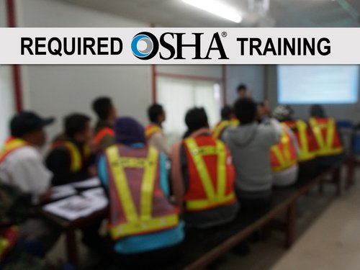
Welding and Cutting
1926.352 and 1910.252 Fire Prevention
Employer Responsibilities:
Management shall recognize its responsibility for the safe usage of cutting and welding equipment on its property and provide employees proper PPE for the work they perform
Based on fire potentials of the facility, establish areas for cutting and welding, and establish procedures for cutting and welding, in other areas
Designate an individual responsible for authorizing cutting and welding operations in areas not specifically designed for such processes
Ensure that cutters or welders and their supervisors are suitably trained in the safe operation of their equipment and the safe use of the process
Advise all contractors about flammable materials or hazardous conditions they may not be aware.

Slide 27
Welding and Cutting
1910.252 - General Requirements - Fire Prevention and Protection
Supervisor Responsibilities:
Is responsible for the safe handling of the cutting or welding equipment and the safe use of the cutting or welding process
Shall determine the combustible materials and hazardous areas present or likely to be present in the work location
Shall determine that fire protection and extinguishing equipment are properly located at the site and if fire watchers are required, see that they are available at the site
OHSA defines a supervisor as a person who has charge of a workplace or authority over a worker.
If you were the person doing the cutting or welding, would you be considered the supervisor?
Notes:
Supervisor: This is a broad definition that can apply to many different people in a workplace, including people in management, on the shop floor, in a bargaining unit, and individuals whose job title does not include the word "supervisor".
Entry supervisor means the person (such as the employer, foreman, or crew chief) responsible for determining if acceptable entry conditions are present at a permit space where entry is planned, for authorizing entry and overseeing entry operations, and for terminating entry as required by this section

Slide 28
Welding and Cutting
1910.252 - General Requirements - Fire Prevention and Protection
Employee Responsibilities:
Read and follow all health and safety postings
Follow safe work practices
Help reduce work hazards
Report all occupational injuries, illnesses and hazardous conditions
Cooperate during an OSHA inspection
Exercise rights under the OSH Act in a responsible manner
Employees must follow all OSHA safety and health standards AND all rules issued by their employers that are intended to comply with OSHA’s health and safety standards and the OSH Act.
Workplace injuries and accidents have a cost. Fines and penalties, lost productivity, lost time and wages, lower morale. Everyone must do their part to keep the workers and workplace safe.

Slide 29

Welding and Cutting
Who is responsible for supplying your welding and cutting PPE?
The employer
Who determines that fire protection and extinguishing equipment are properly located at the site?
The supervisor

Slide 30
Welding and Cutting
1926.352 - Fire Prevention and Protection
Basic Precautions
Fire hazards
If the object to be welded or cut cannot readily be moved, all movable fire hazards in the vicinity shall be taken to a safe place.
Guards
If the object to be welded or cut cannot be moved and if all the fire hazards cannot be removed, then guards shall be used to confine the heat, sparks, and slag, and to protect the immovable fire hazards. Guards could be welding pads, blankets, or curtains.
Notes:
Fire hazards: If the object that will be welded or cut can’t be moved to a safe location, then you have to remove any fire hazards in the area.
Guards: If you can’t move the object and can’t remove the fire hazards, guards will have to be used to confine any heat, sparks, and slag to protect the immovable fire hazard.

Slide 31
Welding and Cutting
1910.252 - General Requirements - Fire Prevention and Protection
Special Precautions
Wherever there are floor openings or cracks in the flooring that cannot be closed, precautions shall be taken so that no readily combustible materials on the floor below will be exposed to sparks which might drop through the floor. The same precautions shall be observed regarding cracks or holes in walls, open doorways and open or broken windows.
Fire extinguishers. Suitable fire extinguishing equipment shall be maintained in a state of readiness for instant use. Such equipment may consist of pails of water, buckets of sand, hose or portable extinguishers depending upon the nature and quantity of the combustible material exposed.
Note: Not all fires are the same. You must have the right fire extinguisher size and agent for the hazard.
Notes:
Floor openings: If there are openings in the floor or walls that could allow sparks or slag to fall to fall to the floor below, precautions must be taken to protect combustible material on the lower floor.
What are some precautions you can take? Fire extinguisher. Also buckets of water or sand, a hose, depending on the type of combustible material.
Note: The fire extinguisher must be the proper type and size for the situation.

Slide 32



Welding and Cutting
Types of Fires and Fire Extinguishers
Class A Fires
Fires in ordinary combustibles, such as wood, paper, cloth, rubber and many plastics.
Class A extinguisher : Water and foam fire extinguishers. Water extinguishers are for Class A fires only
Class B Fires
Fires in flammable liquids or flammable gases. DOES NOT include fires involving cooking oils and grease.
Class B extinguisher: Cartridge operated dry chemical fire extinguisher. Ordinary dry chemical is for Class B and C fires only.
Class C Fires
Fires involving energized electrical equipment. Remove the power and a Class C fire becomes one of the other classes of fire.
Class C extinguishers: Clean Agent Fire Extinguishers. Clean agent extinguishers are effective on Class A, B and C fires.
Notes:
Class B: Carbon dioxide. A carbon dioxide fire extinguisher works on a Class B fire by expelling CO2 to suffocate the fire, removing the oxygen necessary to keep it burning. It also helps with removing the heat, as the discharge is very cold.
Class C: Halogenated or clean agent extinguishers include the halon agents as well as the newer and less ozone depleting halocarbon agents. They extinguish the fire by interrupting the chemical reaction and/or removing heat from the fire triangle.

Slide 33

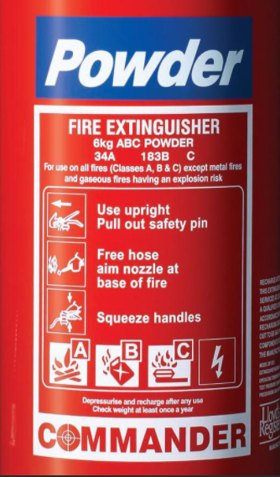
Welding and Cutting
Types of Fires and Fire Extinguishers
Class D Fires
Fires in combustible metals, such as magnesium, titanium, zirconium, sodium, lithium and potassium.
Class D extinguishers: Dry Powder Fire Extinguishers. Dry powder extinguishers are for Class D or combustible metal fires ONLY. They are ineffective on all other classes of fires.
Class K Fires
Fires involving vegetable oils, animal oils, or fats in cooking appliances. They use a process called saponification (turn fat or oil into soap by reaction with an alkali) by releasing an alkaline agent to create a foam that traps vapors and puts the fire out.
Most portable extinguishers are rated for use with more than one classification of fire. For example, an extinguisher with a BC rating is suitable for use with fires involving flammable liquids and energized electrical equipment. An extinguisher with an ABC rating is suitable for use with fires involving ordinary combustibles, flammable liquids and energized electrical equipment. An extinguisher that is rated for use with multiple hazards should include a symbol for each hazard type.
Notes:
Class D: Dry powder extinguishers are similar to dry chemical extinguishers except that they extinguish the fire by separating the fuel from the oxygen element or by removing the heat element of the fire triangle.
Class K: Commonly used in restaurant kitchens, class K fire extinguishers can effectively put out fires caused by cooking fats, greases, and oils.
The moral of the story:
When welding or cutting, make sure you have the proper type of extinguisher for the combustible material you are protecting.

Slide 34
Welding and Cutting
1910.252 - General Requirements - Fire Prevention and Protection
Other Special Precautions
Fire Watch:
Fire Watchers are required when:
welding and cutting is performed in locations where other than a minor fire might develop.
Appreciable combustible materials are closer than 35 feet to the point of operation
Appreciable combustible materials are more than 35 feet away but are easily ignited by sparks
Wall or floor openings within a 35-foot radius expose combustible material in adjacent areas including concealed spaces in walls or floors
Combustible materials are adjacent to the opposite side of metal partitions, walls, ceilings, or roofs and are likely to be ignited by conduction or radiation
A fire watch shall be maintained for at least one half hour** after the completion of welding or cutting operations and fire watchers must have fire extinguishing equipment available and be trained in it’s use
Notes:
**NFPA 51B:
Fires can start after the hot work is complete. The fire watch must remain on site for a minimum of 60 minutes to monitor for smoldering fires, per NFPA 51B. The permit authorizing individual could require the fire watch to remain on site longer depending on the conditions of the work site.
HotWorkFactSheet.pdf (nfpa.org)

Slide 35
Welding and Cutting
1910.252 - General Requirements - Fire Prevention and Protection
Prohibited Areas
Cutting or welding shall not be permitted in the following situations:
In areas not authorized by management
In sprinkled buildings when protection is impaired
In the presence of explosive atmospheres
In areas near the storage of large quantities of exposed, readily ignitable materials
Welding or cutting containers
Used containers.
No welding, cutting, or other hot work shall be performed on used drums, barrels, tanks or other containers until they have been cleaned so thoroughly as to make certain that there are no flammable materials present or any substances such as greases, tars, acids, or other materials which when subjected to heat, might produce flammable or toxic vapors. Any pipelines or connections to the drum or vessel shall be disconnected or blanked.
Notes:
Containers:
Welding or cutting of used containers can only be done if the container has been properly cleaned to ensure there aren’t any flammable materials present or any substances that could produce flammable or toxic vapors.
Any connection to the drum or tank must be disconnected or blanked.

Slide 36
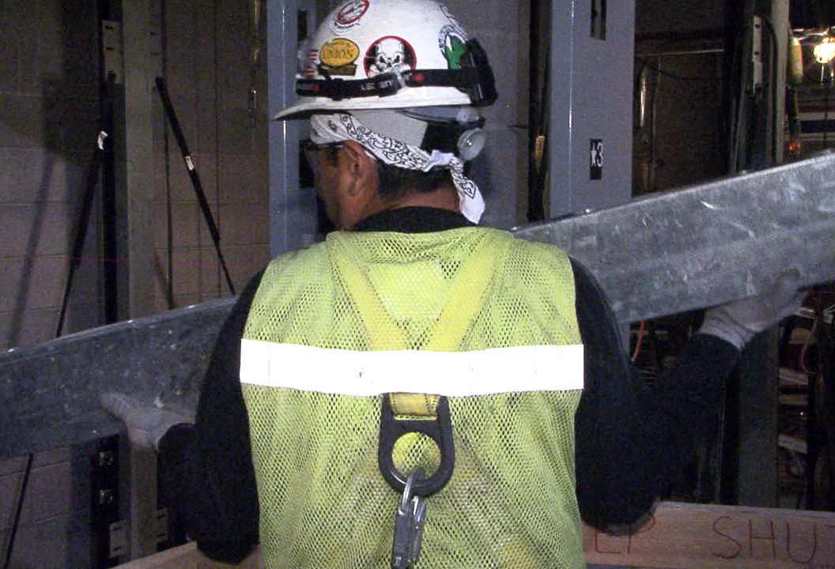
Welding and Cutting
1910.252 - General Requirements – Welding and Cutting
Protection of Personnel
General:
Fall Protection:
A welder or helper working on platforms, scaffolds, or runways shall be protected against falling. This may be accomplished using railings, approved personal fall arrest or restraint systems, or some other equally effective safeguards
Welding cable:
Welders shall place welding cable and other equipment so that it is clear of passageways, ladders, and stairways.
Shielding. Whenever practicable, all arc welding and cutting operations shall be shielded by noncombustible or flameproof screens which will protect employees and other persons working in the vicinity from the direct rays of the arc.

Slide 37
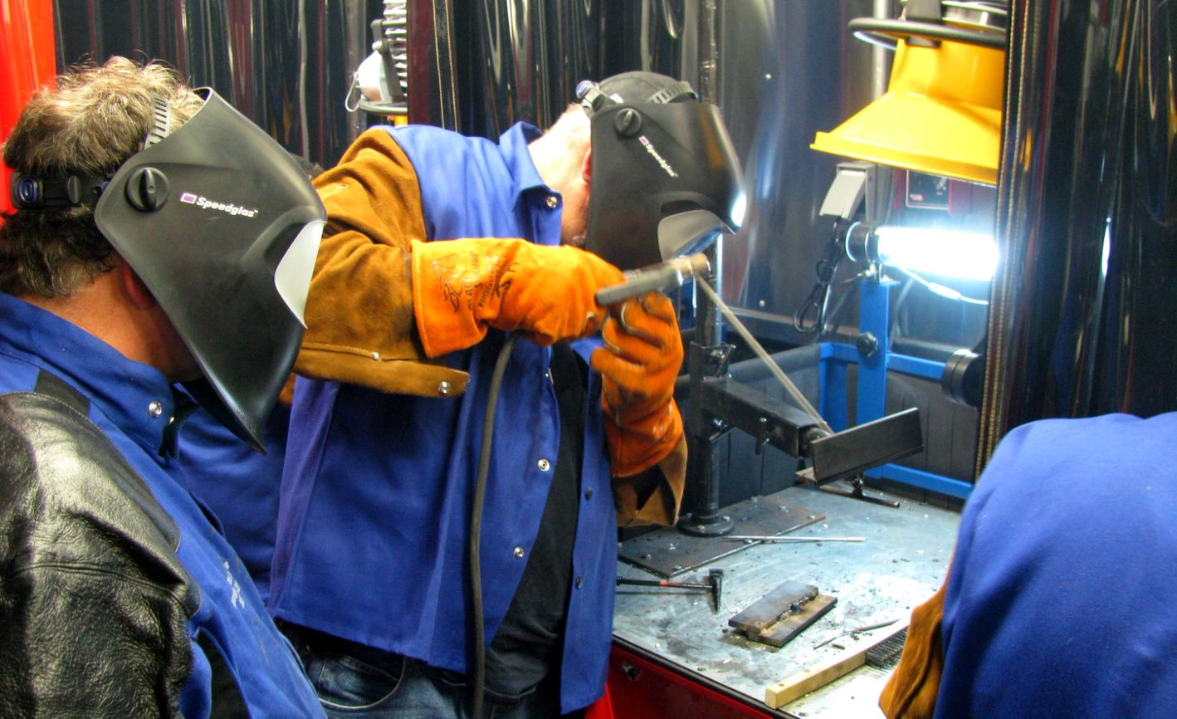
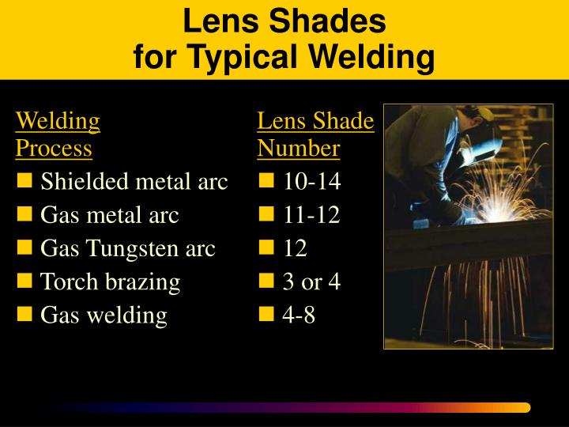
Welding and Cutting
1910.252 - General Requirements – Protection of Personnel
Eye Protection:
Helmets or hand shields shall be used during all arc welding or arc cutting operations, excluding submerged arc welding. Helpers or attendants shall be provided with proper eye protection
Goggles or other suitable eye protection shall be used during all gas welding or oxygen cutting operations. Spectacles without side shields, with suitable filter lenses are permitted for use
during gas welding operations on light work, for torch brazing or for inspection.
Notes:
Helmets or hand shields must be used during arc welding or arc cutting, including helpers or attendants (except for submerged arc welding). Anyone know what submerged welding is?
Submerged-arc welding (SAW) is a common arc welding process that involves the formation of an arc between a continuously fed electrode and the workpiece. A blanket of powdered flux generates a protective gas shield and a slag which protects the weld zone. The arc is submerged beneath the flux blanket and is not normally visible during welding.
Goggles or suitable specs must be used for gas welding or oxygen cutting with suitable filter lenses.
Glasses without side shields, with the proper filter lenses are allowed during light gas welding, brazing, or inspecting.

Slide 38
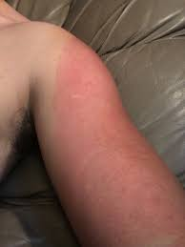
Welding and Cutting
1910.252 - General Requirements – Protection of Personnel
Protective clothing:
Employees exposed to the hazards created by welding, cutting, or brazing operations shall be protected by personal protective equipment. Appropriate protective clothing required for any welding operation will vary with the size, nature and location of the work to be performed.
At a minimum, wear a long sleeve shirt and leather gloves when welding or cutting
It may be necessary to wear a leather welders
jacket
Or…….. you could get the sunburn…..
Arc welding gives off very strong UV rays. It doesn’t take long for exposed skin to be burned.

Slide 39
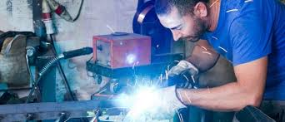
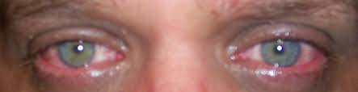
Welding and Cutting
What’s wrong with this picture?
And here is our friend 30 minutes later…
Not wearing a helmet
Not wearing a long sleeve shirt
Click this link
Premium Welding | Funny welder welding work - YouTube
Notes:
Your eyes can be permanently damaged if you don’t protect them during welding operations. Even if just tac welding, wear a helmet.

Slide 40
Welding and Cutting
1926.353 and 1910.252 - Work in Confined Space
Confined spaces:
Confined space is intended to mean a relatively small or restricted space such as a tank, boiler, pressure vessel, or small compartment of a ship
Ventilation is a prerequisite to work in confined spaces. Confined spaces must be adequately ventilated to prevent the accumulation of toxic materials or oxygen deficiency.
When welding or cutting is being performed in any confined spaces the gas cylinders and welding machines shall be left on the outside
Where a welder must enter a confined space through a manhole or other small opening, means shall be provided for quickly removing him in case of emergency, such as a body harness and lifelines. An attendant with a preplanned rescue procedure shall be stationed outside to observe the welder at all times and be capable of putting rescue operations into effect
When arc welding is to be suspended for any substantial period of time, such as during lunch or overnight, all electrodes shall be removed from the holders and the holders carefully located so that accidental contact cannot occur and the machine be disconnected from the power source
In order to eliminate the possibility of gas escaping through leaks or improperly closed valves, when gas welding or cutting, the torch valves shall be closed and the gas supply to the torch positively shut off at some point outside the confined area whenever the torch is not to be used for a substantial period of time, such as during lunch hour or overnight
Notes:
Confined space:
The space is big enough for you to bodily enter and perform your work
Not designed for continuous occupancy
Has limited means for entering and exiting
PRCS: contains one of these:
Has or has the potential to contain a hazardous atmosphere
Contains material that has the potential to engulf you (water, oil, grain…)
Has walls that converge inward or floors that slope downward and taper into an area that could trap or asphyxiate you
OR, contains ANY OTHER recognized safety hazard
Be aware, that a confined space where welding or cutting is taking place may be reclassified as a permit required confined space if the atmosphere changes.
Airline respirators. In circumstances for which it is impossible to provide such ventilation, airline respirators or hose masks approved for this purpose by the National Institute for Occupational Safety and Health (NIOSH) under 42 CFR part 84 must be used.

Slide 41
Tractor-Trailer Repairman Dies while Welding Interior Wall of a Tanker
Welding and Cutting
A 34 year-old welder (the victim) and an assistant began preparing a tanker-trailer for repairs. The victim was the shop foreman and had been performing tanker repairs for approximately 15 years.
The tanker was a multi-compartment type with four compartments of different sizes with a leak in an interior wall that required welding. The tanker compartments were steam cleaned for 1 to 1-1/2 hours to remove trapped chemicals and vapors from the tanker. The chemical in this instance was lacquer-thinner.
The victim and assistant entered the tanker compartment to do pre-treatment work to the leak before welding. The assistant remarked about the “strong fumes” in the compartment; however, the victim decided to continue the repair operations. When the pre-treatment was completed, the victim instructed the assistant to leave the compartment, pass in the welding equipment and to stay on top of the tanker to attach the lids to the other compartments. Upon leaving the compartment, the assistant again mentioned the “strong fumes.”
The written company safety policy required that an explosion meter was to be used at this point. The explosion meter was available and was in working condition. However, the victim did not follow the safety policy and requested the assistant to pass in the welding equipment. After passing in the equipment, the assistant began replacing the compartment lids as instructed. An explosion occurred as the victim began welding the leak.
The autopsy report lists the cause of death as “multiple blunt force injuries”.
Notes:
An explosimeter is a gas detector which is used to measure the amount of combustible gases present in a sample. When a percentage of the lower explosive limit (LEL) of an atmosphere is exceeded, an alarm signal on the instrument is activated.
Used containers.
No welding, cutting, or other hot work shall be performed on used drums, barrels, tanks or other containers until they have been cleaned so thoroughly as to make absolutely certain that there are no flammable materials present or any substances such as greases, tars, acids, or other materials which when subjected to heat, might produce flammable or toxic vapors
PRCS?

Slide 42
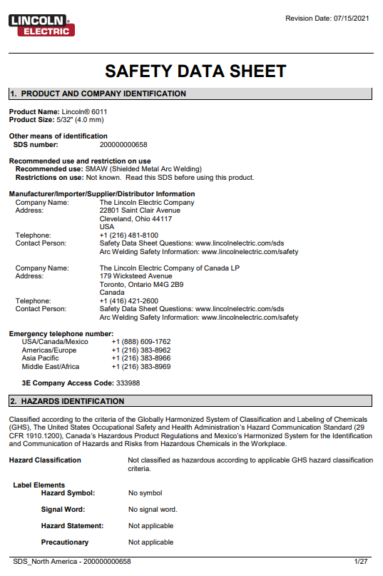
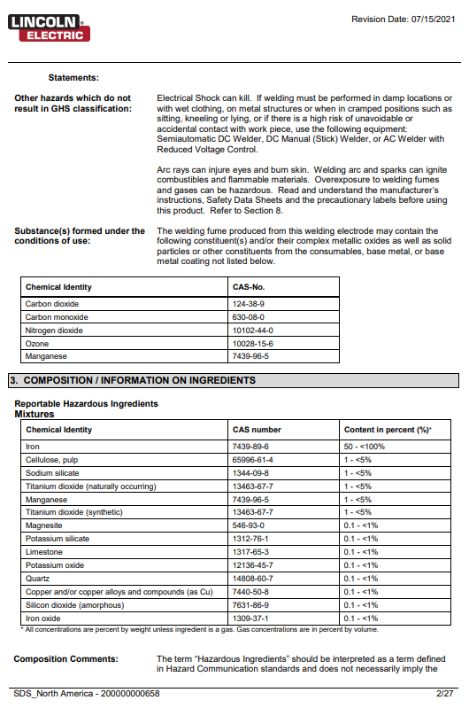
Welding and Cutting
1910.252 - General Requirements – Hazard Communication
Hazard communication:
The employer shall include the potentially hazardous materials employed in fluxes, coatings, coverings, and filler metals, all of which are potentially used in welding and cutting, or are released to the atmosphere during welding and cutting, in the program established to comply with the Hazard Communication Standard (HCS) (§1910.1200). The employer shall ensure that each employee has access to labels on containers of such materials and safety data sheets, and is trained in accordance with the provisions of §1910.1200.
SDS outlines a product’s…
Identity and composition
Potential hazards
Safe use
Handling information
Manufacturer contact information
Notes:
The company must have a Haz Com program and must include any potentially hazardous materials used in fluxes, coatings, coverings, and filler metals used in welding and cutting, or hazardous materials released into the air during those operations. Employees must have access to labels on containers and SDS, and must be trained how to read those labels and SDS.
ZLE_SDS_NA-EN-200000000658.pdf (lincolnelectric.com)

Slide 43
Welding and Cutting
§1926.354 — Welding, cutting, and heating in way of preservative coatings
Protective coatings are used on metals to keep them from rusting or corroding. Before welding, cutting, or heating on any surface covered by a preservative coating whose flammability is not known, a test shall be made by a competent person to determine its flammability.
When coatings are determined to be highly flammable, they shall be stripped from the area to be heated to prevent ignition.
The preservative coatings shall be removed a sufficient distance from the area to be heated to ensure that the temperature of the unstripped metal will not be appreciably raised. Artificial cooling of the metal surrounding the heating area may be used to limit the size of the area required to be cleaned.
Elevator personnel may encounter protective coatings on rails, machine beams, hydraulic jacks, and galvanized metal.
When welding galvanized steel, the zinc coating vaporizes and mixes with the air to form zinc oxide fumes. The galvanized coating also has a small lead content. When welding galvanized steel this lead vaporizes and when mixed with air, forms lead oxide fumes. These fumes are dangerous and can lead to long-term health problems and should at all costs be avoided.

Slide 44
Welding and Cutting
There is a splice in your welding lead 6’ from the holder. Is it safe to use?
No (10’ or more)
Who can repair a welding machine?
Only a qualified person can repair a welding machine
Notes:
Pass out second knowledge check sheet

Slide 45
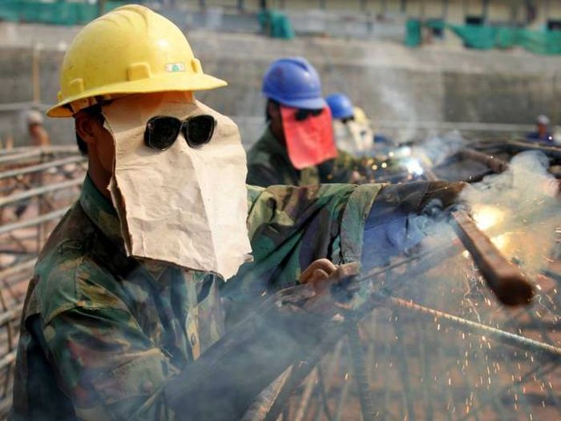
Welding and Cutting
Anything wrong here?
But I got on a long sleeve shirt
Improper helmets/shields for electric arc welding

Slide 46
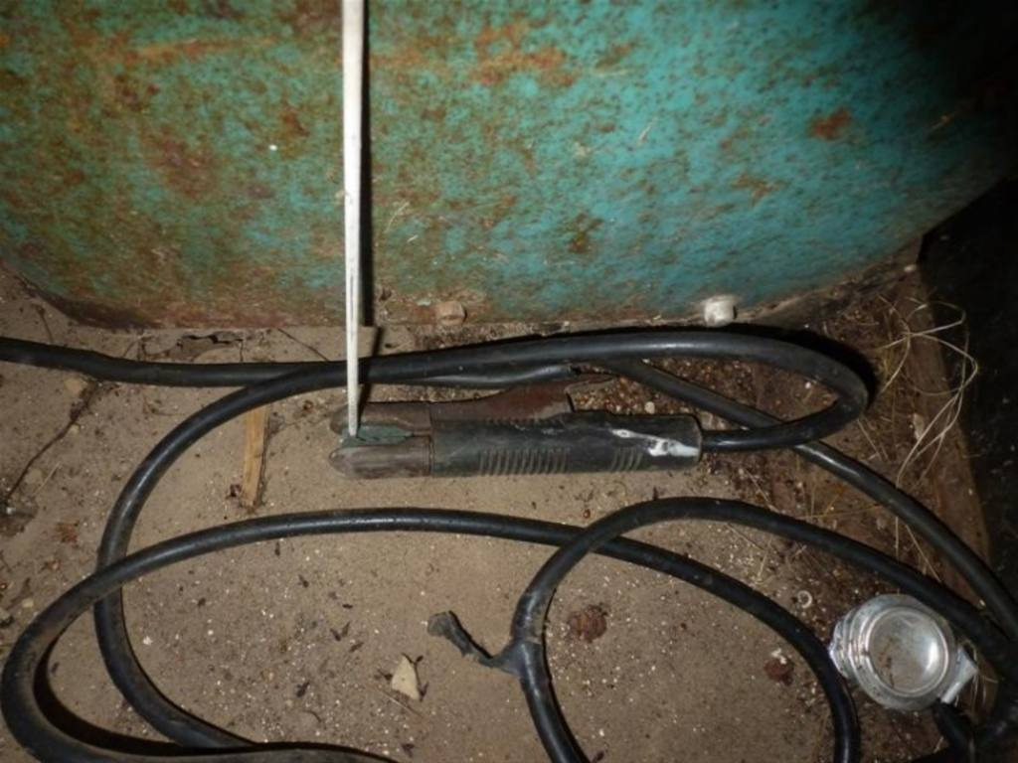
Welding and Cutting
Anything wrong here?
Electrode left in the holder
This repair looks a little sketchy

Slide 47

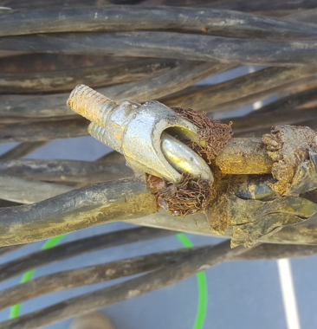
Welding and Cutting
Definitely not a splice made by an elevator constructor……

Slide 48
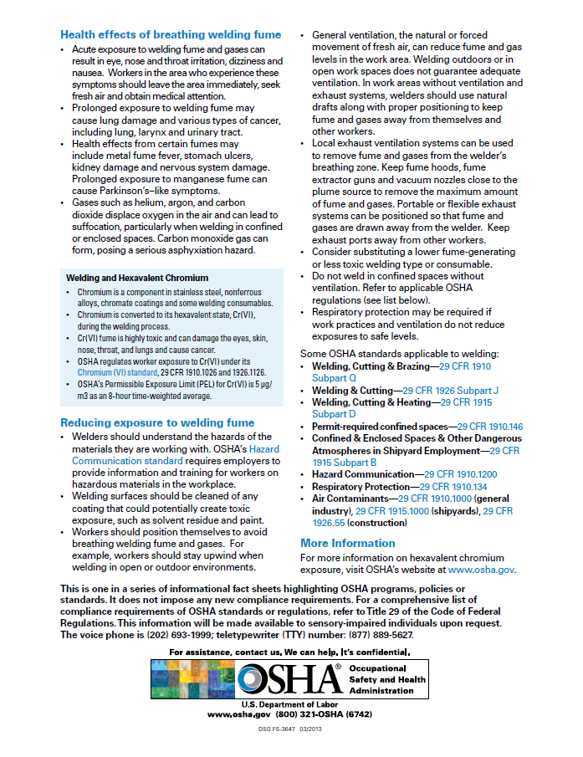
Welding and Cutting
Notes:
OSHA_FS-3647_Welding.pdf

Slide 49
Welding and Cutting
Summary…
We reviewed the OSHA Standards and discussed the different types of welding and cutting equipment covered by 1926 Subpart J and 1910 Subpart Q. Your employer must provide you training on the equipment you will be using, and you, the employee must always follow the proper safety procedures and use the proper PPE.
Workplace accidents are costly:
Personal hardship (pain and suffering)
Loss of work and wages
Poor employee morale
Reduced productivity
Your family needs you and they are counting on you. Don't let them down. Work safe!

Slide 50
A little humor with some wisdom
10 BIGGEST WELDING FAILS - YouTube

Slide 51
Through the Alliance between OSHA’s 10 Regional Offices and the Elevator Contractors of America (ECA), Elevator Industry Work Preservation Fund (EIWPF), International Union of Elevator Constructors (IUEC), National Association of Elevator Contractors (NAEC), National Elevator Industry Educational Program (NEIEP), and National Elevator Industry Inc. (NEII), collectively known as The Elevator Industry Safety Partners, developed this Industry Specific Training for informational purposes only. It does not necessarily reflect the official views of OSHA or the U.S. Department of Labor. May 2021
Under the Occupational Safety and Health Act, employers are responsible (http://www.osha.gov/as/opa/worker/employer-responsibility.html) for providing a safe and healthy workplace and workers have rights (https://www.osha.gov/workers). OSHA can help answer questions or concerns from employers and workers. OSHA's On-Site Consultation Program (https://www.osha.gov/consultation) offers free and confidential advice to small and medium-sized businesses, with priority given to high-hazard worksites. For more information, contact your regional or area OSHA office (https://www.osha.gov/contactus/bystate), call 1-800-321-OSHA (6742), or visit https://www.osha.gov/.

Slide 52

Welding and Cutting

