Slide 1

1926 Construction
Focus Four
Struck-By Hazards

Slide 2
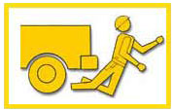
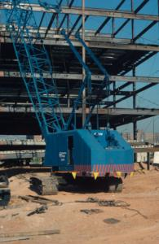
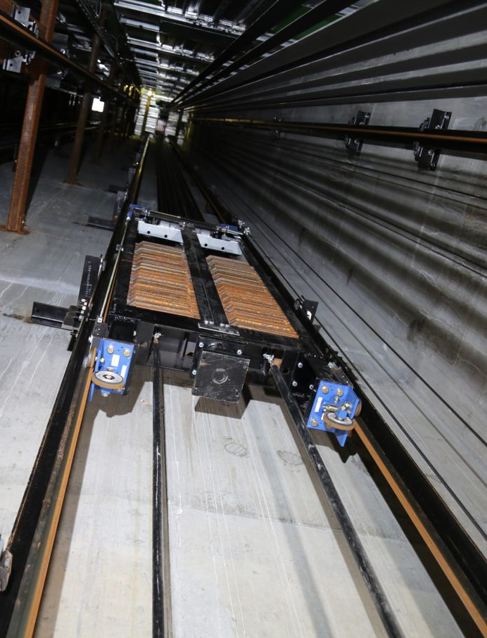
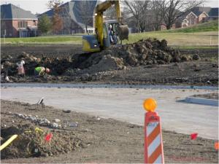
Struck-By Hazards
Focus Four
Struck-By Hazards

Slide 3

Struck-By Hazards
Focus Four
Objectives
By the end of the session, students will be able to:
List the three main causes of struck-by fatalities.
Describe how to prevent struck-by fatalities.
Describe safe equipment operation to avoid struck-by accidents.

Slide 4
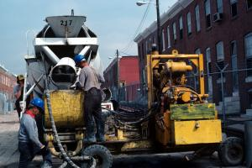
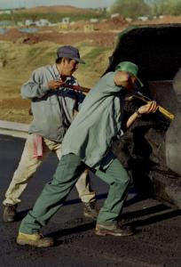
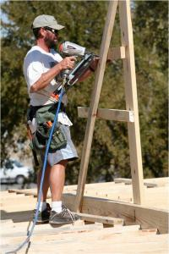
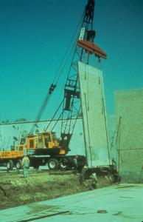
Struck-By Hazards
Focus Four
The Second Leading Cause of Construction Fatalities Is Being Struck by an Object or a Piece of Equipment
Vehicles
Heavy Equipment
Falling Objects
Flying Objects
Notes:
Struck-by accidents primarily involve workers struck by equipment or vehicles. 25% of all “struck-by-vehicle” workplace fatalities are construction workers, more than any other occupation.
Struck by also includes: falling materials hitting workers below scaffold, below floor openings, or on lower levels below vertically hoisted materials; also, horizontally transported materials that slide off decks, flat beds etc.
Flying objects like particles from power tools, nail guns, or powder actuated tools are the third most common cause of struck-by fatalities.

Slide 5
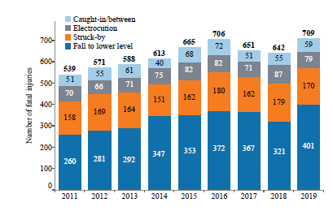
Struck-By Hazards
Focus Four
The Second Leading Cause of Construction Fatalities Is Being Struck by an Object or a Piece of Equipment
Notes:
Source: CPWR Data Bulletin – Fatal Injury Trends in Construction

Slide 6
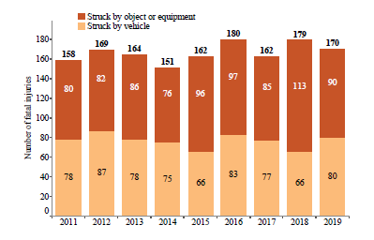
Struck-By Hazards
Focus Four
The Second Leading Cause of Construction Fatalities Is Being Struck by an Object or a Piece of Equipment
From 2011 to 2019, more workers were fatally injured from being struck by an object or piece of equipment than struck by a vehicle.
Notes:
Source: CPWR Data Bulletin – Fatal Injury Trends in Construction

Slide 7
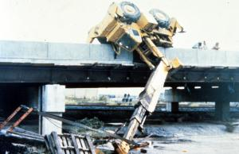
Struck-By Hazards
Focus Four
Vehicle and Roadway Hazards
What Are the Leading Causes of Highway Worker Fatalities?
For highway workers on foot…
being struck by construction equipment.
For highway equipment operators…
equipment rollover.
Notes:
Main causes of mobile heavy equipment deaths:
• Workers on foot are struck by construction equipment, usually when it’s backing up or changing direction.
• The operators are most often killed when the equipment rolls over while on a slope, or when material is loaded or unloaded.
• Operators or mechanics are run over or caught in equipment when the brakes aren’t set, equipment is left in gear, wheel chocks are not used, or the equipment and controls aren’t locked out.
• Workers on foot or in a trench are crushed by falling equipment loads, backhoe buckets, or other moving parts.

Slide 8
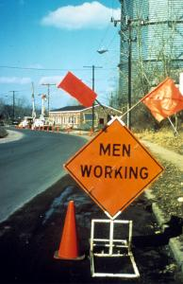
Struck-By Hazards
Focus Four
Vehicle and Roadway Hazards
If vehicle safety practices are not observed at your site, you risk being pinned between construction vehicles and walls, struck by swinging backhoes, crushed beneath overturned vehicles, you risk being struck by trucks or cars.
How Do I Avoid Hazards?
Use traffic signs, barricades or flaggers when construction takes place near public roadways
Workers must be highly visible in all levels of light. Warning clothing, such as red or orange vests, are required; and if worn for night work, must be of reflective material.
Communicate with operators by radio and/or eye contact
Notes:
All workers near active traffic, rights-of-way, working around moving construction equipment or in areas where visibility is limited should wear high visibility clothing.
Elevator constructors unload equipment from roadways and occasionally at night. Follow all of these precautions.

Slide 9
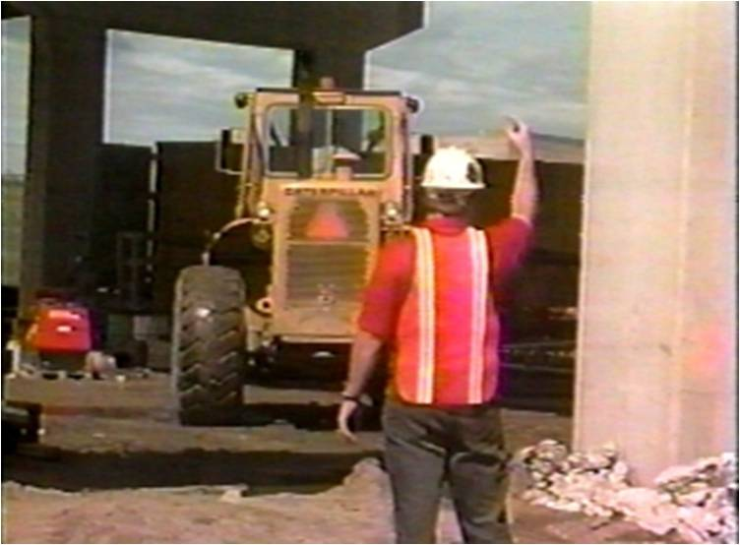
Struck-By Hazards
Focus Four
Vehicle and Roadway Hazards
How Do I Avoid Hazards?
Do not drive a vehicle in reverse gear with an obstructed rear view, unless it has an audible reverse alarm, or another worker signals that it is safe.
Drive vehicles or equipment only on roadways or grades that are safely constructed and maintained.
Do not exceed a vehicle's rated load or lift capacity.
Set parking brakes when vehicles and equipment are parked, and chock the wheels if they are on an incline.
Notes:
All of these precautions apply to equipment that may be operated by elevator constructors.
1926.601(b)(4) No employer shall use any motor vehicle equipment having an obstructed view to the rear unless:
(i) The vehicle has a reverse signal alarm audible above the surrounding noise level or:
(ii) The vehicle is backed up only when an observer signals that it is safe to do so.

Slide 10
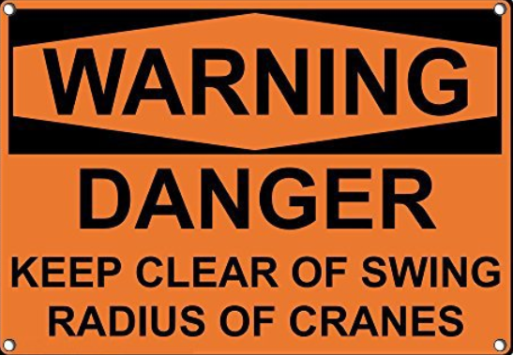
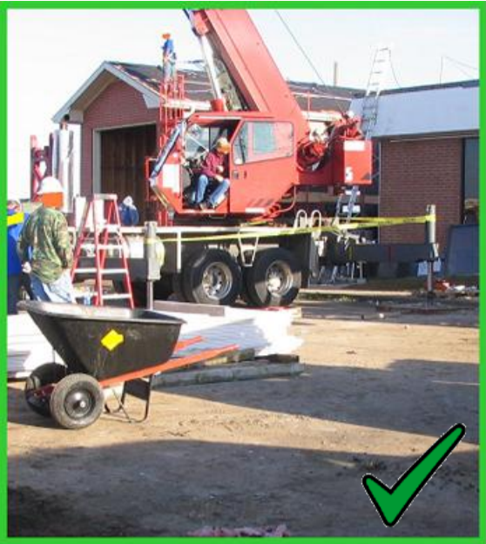
Struck-By Hazards
Focus Four
Crane Hazards
When working near equipment that swings, use a barricade to identify the unsafe area.
Notes:
the purpose of §1926.550(a)(9) is to mark the boundaries of the danger area caused by the crane's swing radius and warn employees to stay out.

Slide 11
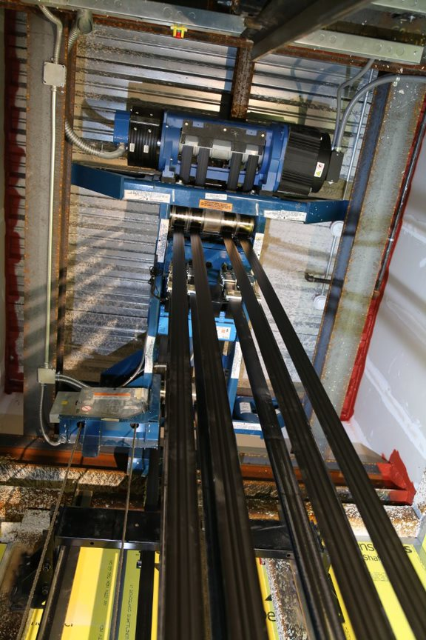
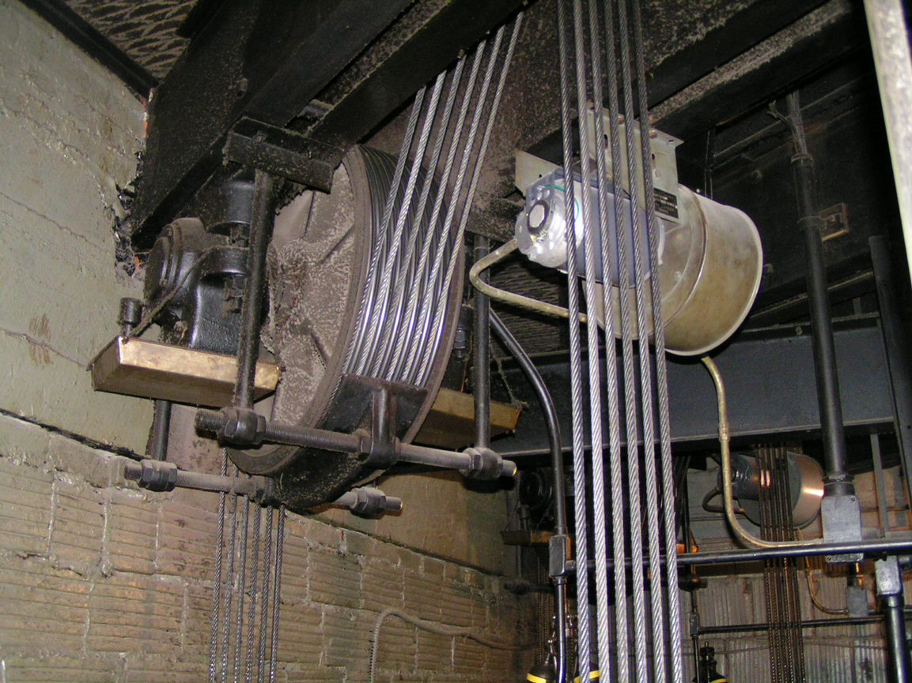
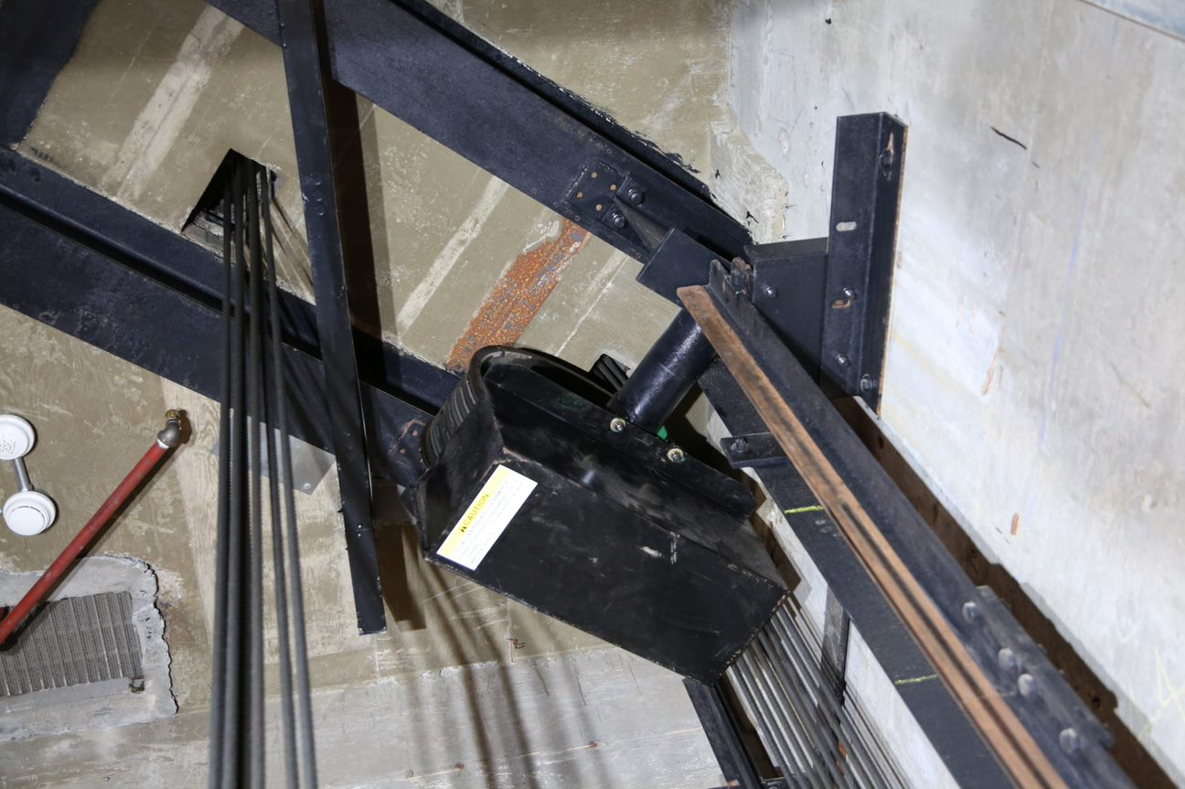
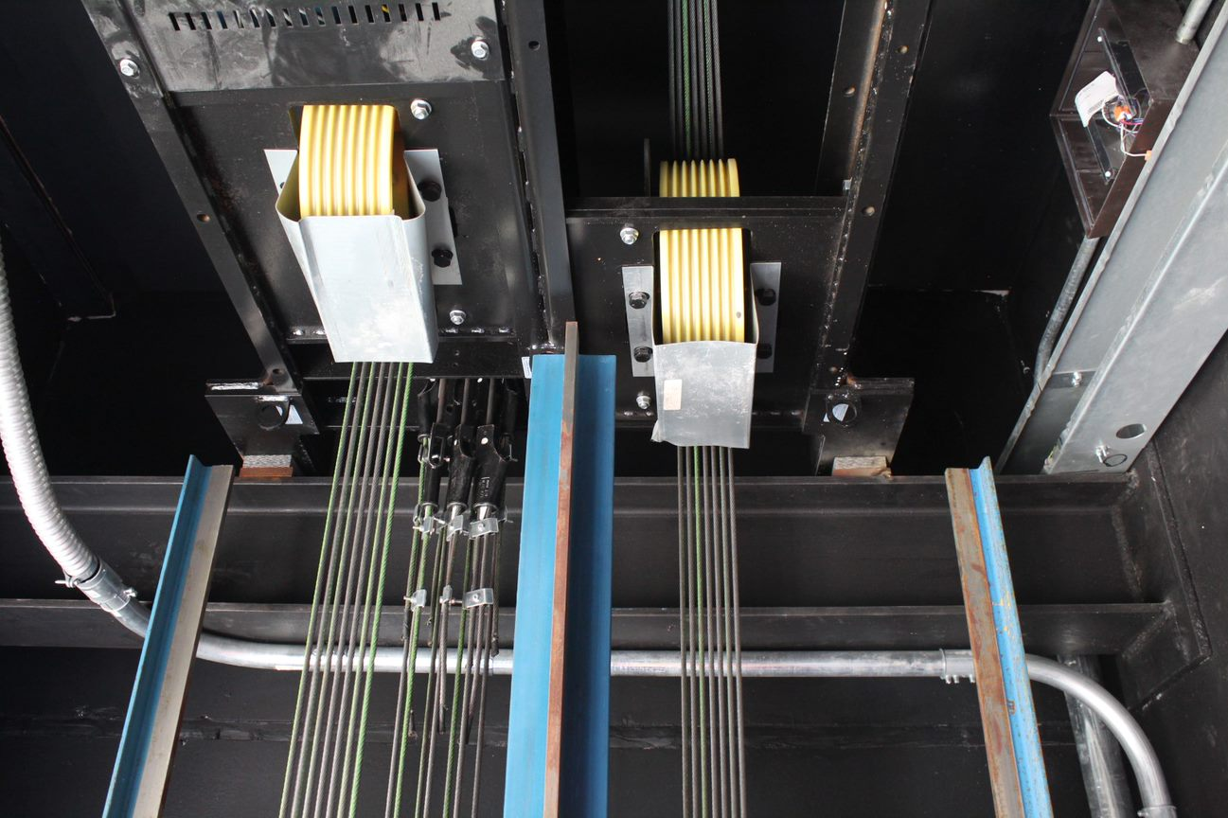
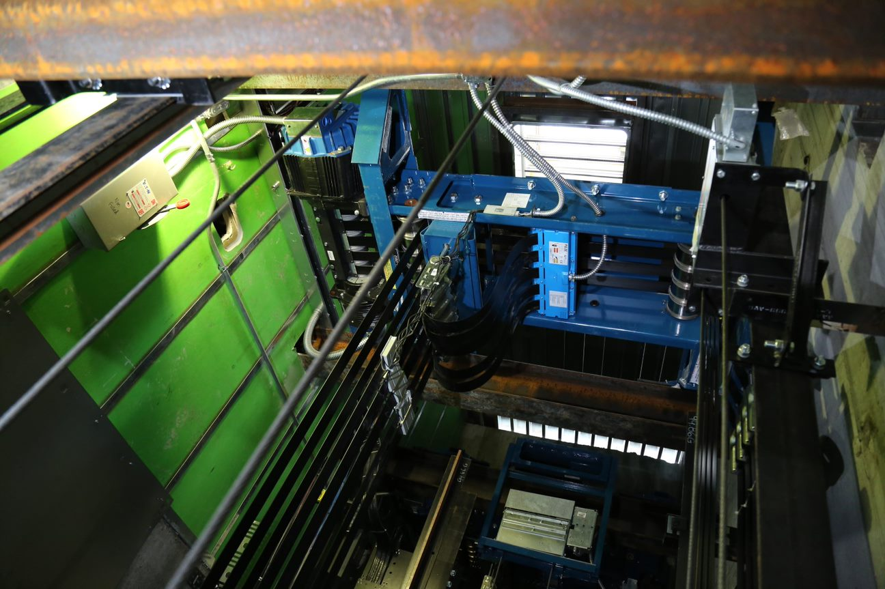
Struck-By Hazards
Focus Four
Overhead Obstructions
When working from any cartop, be aware of low overhead clearances and low hanging equipment.

Slide 12
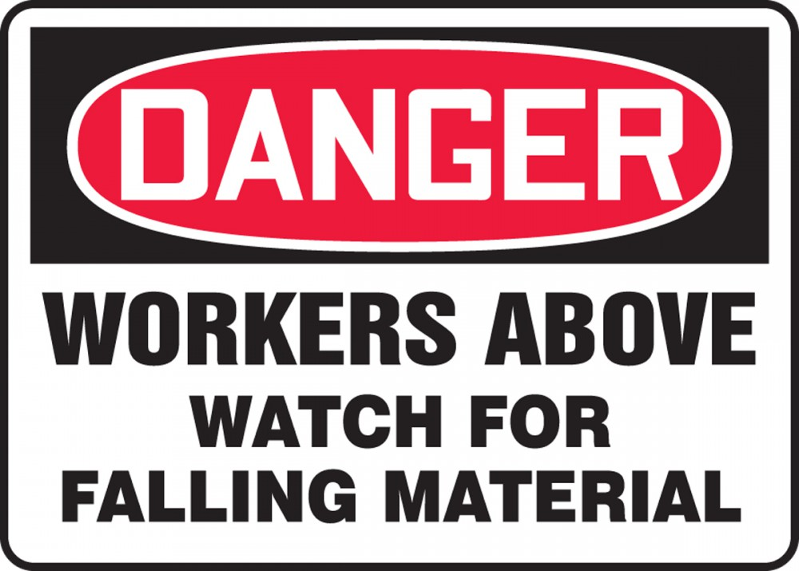
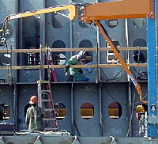
Struck-By Hazards
Focus Four
Falling Objects

Slide 13
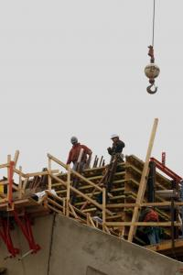

Struck-By Hazards
Focus Four
Falling Objects
You are at risk from falling objects when you are beneath cranes, scaffolds, etc., or where overhead work is being performed.
Rigging failure
Loose or shifting materials
Lack of overhead protection

Slide 14
Struck-By Hazards
Focus Four
Falling Objects
How Do I Avoid Hazards?
Wear hardhats
Stack materials to prevent sliding, falling, or collapse
Use debris nets, catch platforms, or canopies to catch or deflect falling objects
Avoid working underneath loads being moved
Barricade hazard areas and post warning signs
Secure tools and materials to prevent them from falling on people below
Notes:
Can anyone think of any others?

Slide 15
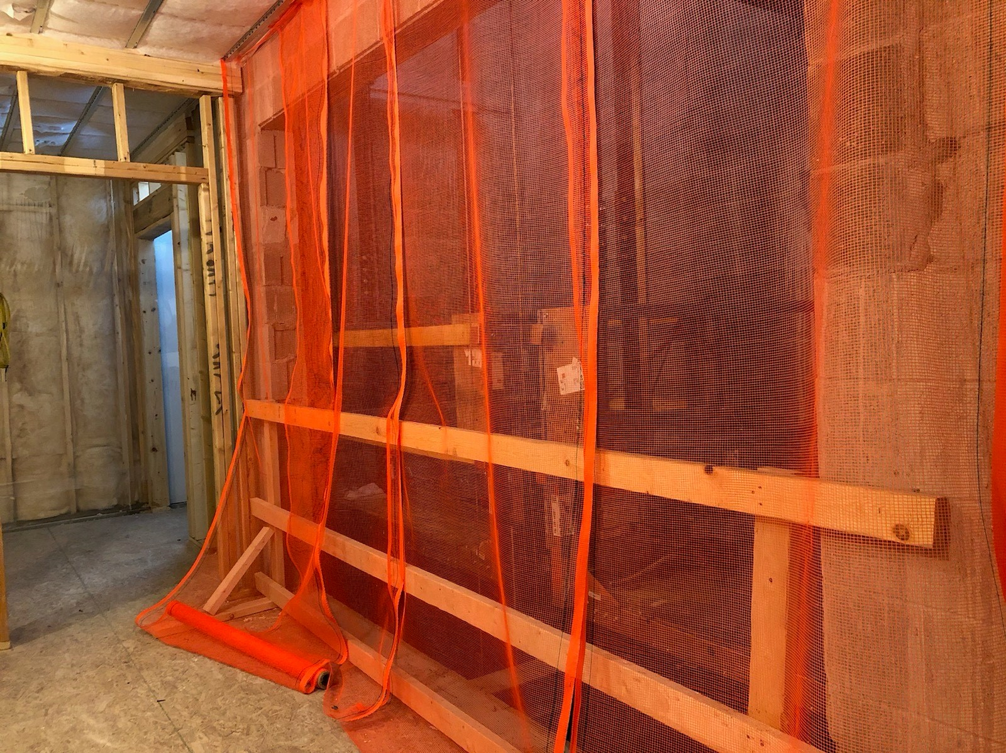
Struck-By Hazards
Focus Four
Falling Objects
Objects coming down the elevator hoistway
Overhead protection is required on false cars and temporary platforms. This can be accomplished by screening at the hoistway entrances, or as a solid roof.

Slide 16
Struck-By Hazards
Focus Four
ACCIDENT
A mechanic and 2 apprentices were on the job site and the 2 apprentices were hooking up the governor rope on a new construction job.
One apprentice was in the pit on the side of the car platform that had the releasing carrier for the car safeties. The governor rope was taped (spliced) and hanging in the hoistway approximately 2 floors above the pit. The tape needed to be removed to attach the governor rope.
One of the apprentices went up to the ground floor (2 floors above the pit). He could not reach the taped splice, so he decided to tape a knife to a stick to cut the tape splicing the governor ropes together.

Slide 17
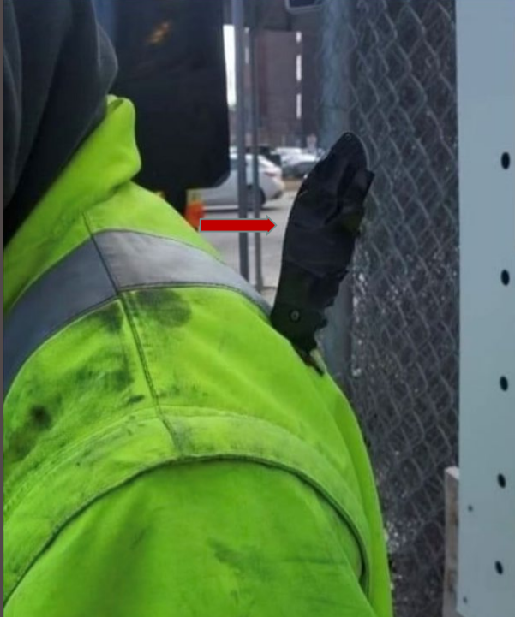
Struck-By Hazards
Focus Four
The apprentice who was trying to cut the tape thought the other apprentice had exited the pit.
While trying to cut the tape he slipped which caused him to move forward against the barricade and unfortunately drop the stick with the knife attached.
The apprentice in the pit was not protected and the knife with a 3” blade entered his upper left back. The mechanic heard the commotion and then came over and cut the stick from the knife. The injured apprentice was able to exit the pit and the building on his own and EMS was notified.
The apprentice received 12 staples and several stitches to his shoulder.
Notes:
Recommendations & Lessons Learned:
◦ Always follow the company Safety Policy
◦ Always perform a JHA/JSA per company policy
◦ Never perform stacked work
◦ Never use any makeshift tools

Slide 18
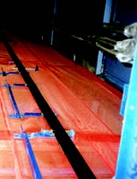
Struck-By Hazards
Focus Four
Falling Objects
When working in a multi-car hoistway, screening should be installed between adjacent cars. This will help with falling objects, and provide a separation between running cars.

Slide 19
Struck-By Hazards
Focus Four
Elevator Counterweight
The counterweight runs in the opposite direction of the car and passes within a few inches. Always be aware of the position of the counterweight.

Slide 20
Struck-By Hazards
Focus Four
ACCIDENT
A construction crew was adjusting counterweight guard brackets in the pit from an elevated working platform.
A 1st year Apprentice was on the working platform with a 4th year Apprentice. The Adjuster and Mechanic were on the car top, 58 floors above.
The 1st year Apprentice crouched partly under the counterweight with his left foot on a spreader beam and right foot on the platform. The 4th year Apprentice had just stepped away to grab a tool.
The Adjuster and Mechanic heard the command “car up” over the radio. As they ran the car up, the counterweight came down and struck the Apprentice.
Accident re-enactment photo

Slide 21
Struck-By Hazards
Focus Four
ACCIDENT cont.
The 4th Year Apprentice heard the 1st year calling out his name. He looked down into the pit to see the Apprentice lying on the grating. He called out over the radio “Stop, stop! Run the car down!”
The 4th year entered the pit and assessed the 1st year lying on the grating. The 1st year was able to climb out of the pit from the pit ladder.
The employer’s on-site safety and GC safety teams were notified immediately and attended to the Apprentice. He was transported to the hospital and determined to have suffered 3 fractured vertebrae and placed in a back brace.

Slide 22
Struck-By Hazards
Focus Four
ACCIDENT cont.
Recommendations and lessons learned:
Always perform a detailed JHA
Never place your body or limbs in the path of travel
Install standard railing on working platforms as required
Test and verify two-way communication
All personnel must exit the pit prior to moving the conveyance
Verbally repeat commands for direction of movement and all personnel are clear prior to initiating movement
Use separate, dedicated radio channels and repeaters

Slide 23
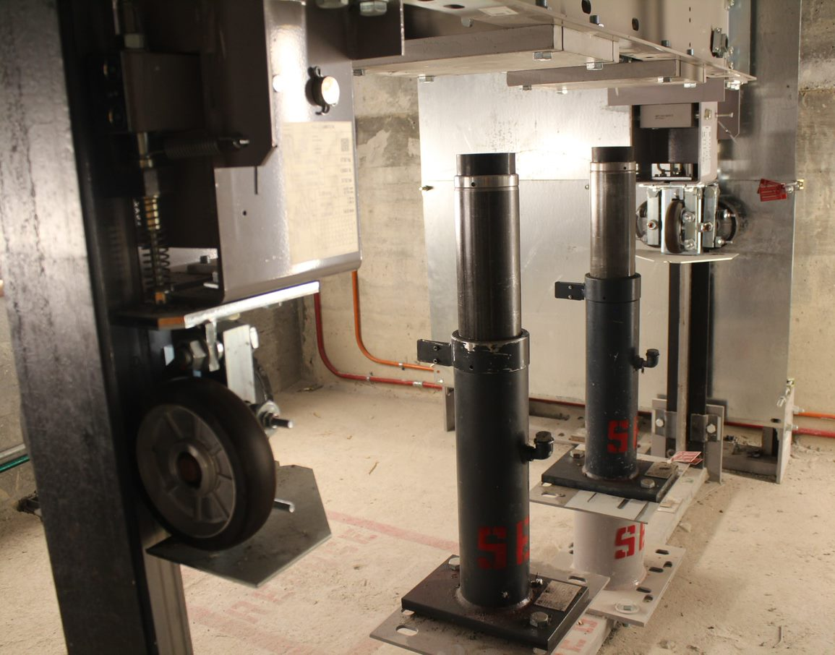
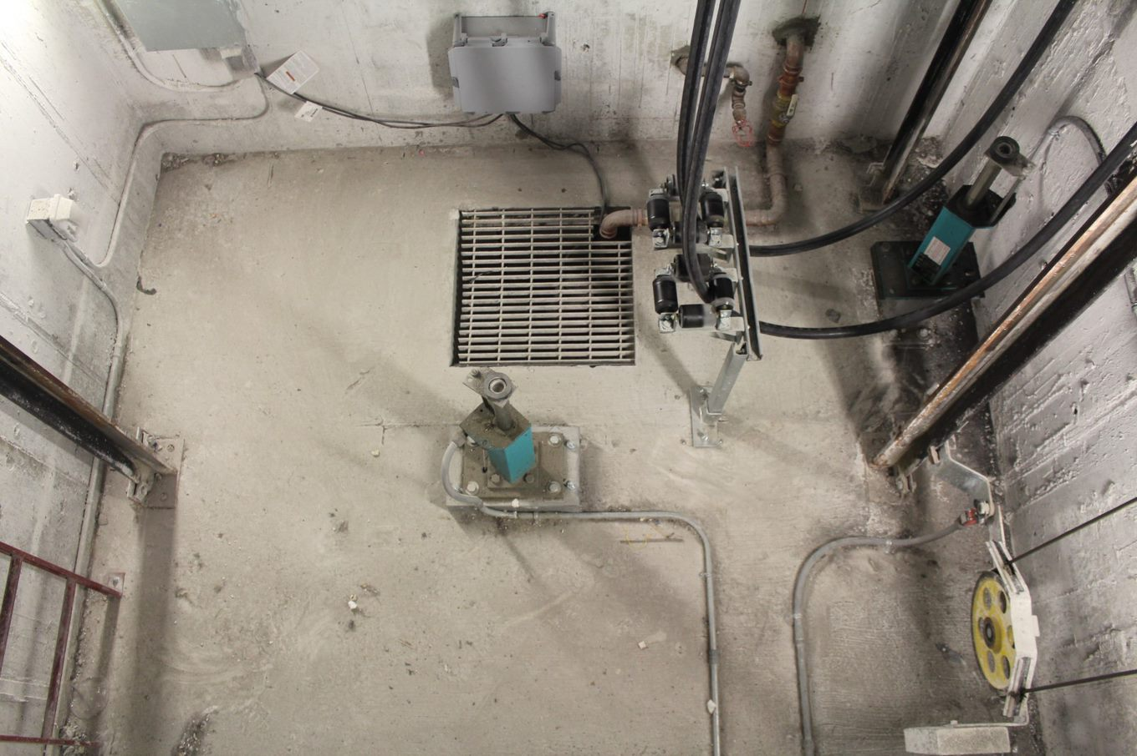
Struck-By Hazards
Focus Four
Pit Access: Struck-by car or counterweight
Be aware of car position when accessing the pit. Always perform LOTO and secure the car from unintended movement according to your company safety procedures before entering the pit. Identify refuge space in the pit before entering.
Notes:
Pit access procedures will vary depending on the type of equipment and the purpose for entering the pit.

Slide 24
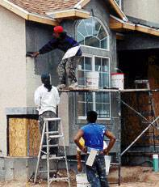
Struck-By Hazards
Focus Four
What’s Wrong With This Picture?
Workers could be struck by falling objects from scaffold
Workers not wearing hard hats

Slide 25
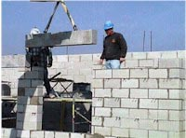
Struck-By Hazards
Focus Four
Struck-By Hazards When Handling Material
Many workers are hurt or killed from handling loads including: loads falling out of rigging, being struck by swinging or descending loads and being pulled off upper elevations from swinging loads.
Rigging equipment can fail, loads can shift or roll.

Slide 26
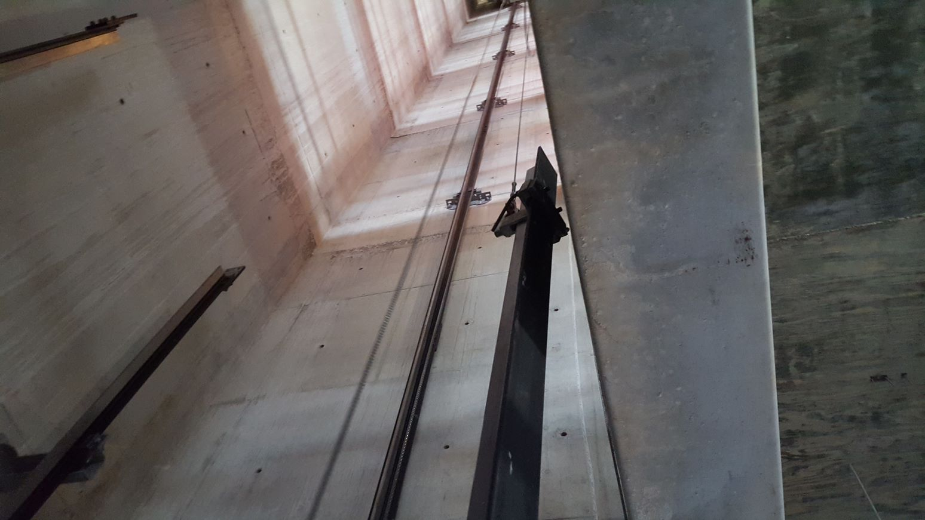
Struck-By Hazards
Focus Four
Working Under a Suspended Load
Elevator Constructors should never work under a suspended load.
During hoisting operations within the hoistway, workers should be positioned outside the hoistway and should control the load by using taglines from the open entrances.
If you are installing rails and brackets from a false car or running platform, never allow the load to be hoisted above you.

Slide 27
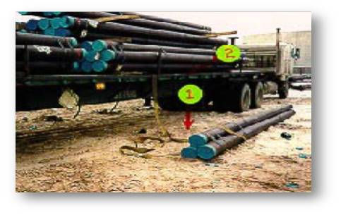
Struck-By Hazards
Focus Four
Struck-By Hazards When Handling Material
Pipes, stacks of material, etc., can roll off a truck when bindings are removed.
Unsecured material can fall from forklifts and other equipment.
A worker was killed when these pipes rolled off the truck and crushed him.

Slide 28
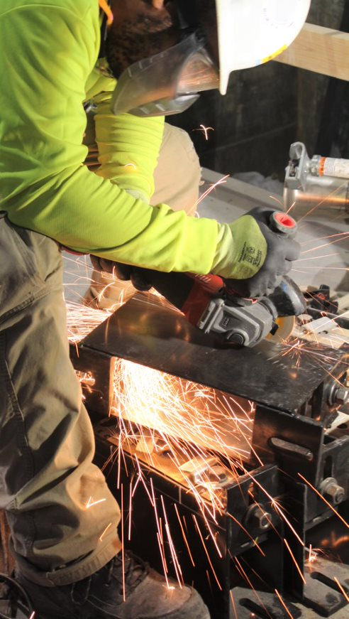
Struck-By Hazards
Focus Four
Struck-By Flying Objects
Tools can create particles when chipping, grinding, sawing, brushing, or hammering.
Particles from some tools move at high speed and can hit with the force of a bullet, like those from pneumatic and powder-actuated tools.
How can you be protected from flying objects?
Be sure you are properly trained before using any power tool and always wear the proper PPE.
Notes:
Wearing the proper PPE protects the user of the tool from injury.
This elevator constructor is cutting a rail bracket with a portable grinder. Notice the proper PPE: Gloves, full face shield, long sleeve shirt. Also notice the guard on the grinder is adjusted correctly.
There is a danger from flying objects when power tools like saws, grinders, hammer drills or wire wheels cause metal or wood particles to become airborne. Injuries can range from minor abrasions to concussions, blindness, or death.
Pneumatic tools are dangerous because they are operated by compressed air.
Powder-actuated tools are even more dangerous because they use gunpowder and shoot “pins” that can injure or kill a worker like a bullet from a gun.

Slide 29
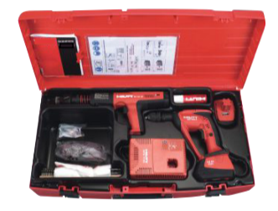
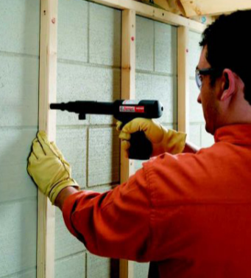
Struck-By Hazards
Focus Four
Struck-By Flying Objects
While it is not common to use powder actuated tools and nail guns in the elevator industry, other trades will be using them around you. The following slides will give you the basic knowledge of how these tools work and some safety requirements for when they are being used.

Slide 30
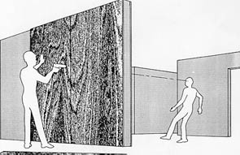
Struck-By Hazards
Focus Four
Struck-By Flying Objects
A 22-year-old Carpenter Apprentice was killed when he was struck in the head by a nail that was fired from a powder-actuated tool.
OSHA Fatal Facts
Notes:
A 22-year-old carpenter apprentice was killed when he was struck in the head by a nail that was fired from a powder-actuated tool. A nearby tool operator, trying to anchor a plywood form he would use to pour a concrete wall, fired the gun causing the nail to pass through the hollow wall. The nail traveled 27 feet before striking the victim. The tool operator had never received training in the proper use of the tool, and none of the employees in the area were wearing personal protective equipment.
Federal OSHA investigated this accident and recommended:
Institute a program for frequent and regular inspections of the job site, materials, and equipment by a competent person(s).
Require employees exposed to the potential hazards associated with flying nails to use appropriate personal protective equipment.
Train employees using powder-actuated tools in the safe operation of the particular tool.
Train employees operating powder-actuated tools to avoid firing into easily penetrated materials.

Slide 31
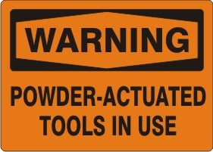
Struck-By Hazards
Focus Four
Struck-By Flying Objects
Using powder actuated tools correctly and safely – 1926.302(e):
Only employees who have been trained in the operation of the particular tool in use shall be allowed to operate a powder-actuated tool
Personal protective equipment is required – eye/face, hands, hearing protection
Notes:
Powder actuated tools are commonly called Hilti guns (Hilti, however, is only one of many manufacturers of powder actuated tools).
Powder-actuated tools act like loaded guns. They use explosive powder to fasten fixtures like steel track for walls to concrete or steel beams. The explosive force of the shot has enough force to penetrate concrete, steel, and masonry substrates.
Handle powder-actuated tools with the same safety precautions as you would a firearm.
Tips to remember:
Always keep hands clear of the open muzzle end of the tool.
Always test powder-actuated tools before each use to assure that the tools and their safety devices are all working properly. Remove tools with any defects.
Never back-nail materials with the tip of the gun pointing toward your body.
Never shoot a surface unless you are certain the fastener will not pass completely through the surface, or unless the surface is "backed."
Wear proper PPE such as eye, face, and hearing protection and hardhats when using powder-actuated tools.
Do not use or store powder-actuated tools near flammable, explosive, or combustible materials.

Slide 32
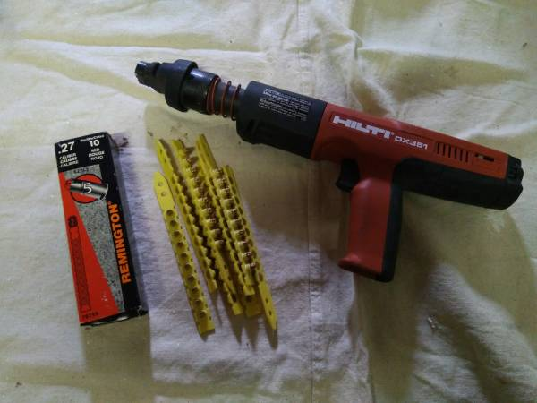
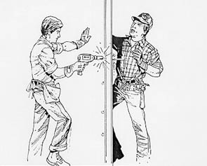
Struck-By Hazards
Focus Four
Struck-By Flying Objects
Using powder actuated tools correctly and safely cont.:
Never load the tool until you are ready to use it
Always insert the fastener
before cocking the tool
Never cock the tool against the hand or point the tool at anyone
Always check penetrations
and use proper loads
Notes:
Second image is from OSHA Fatal Facts:
Two employees were doing remodeling construction and were building a wall. One of the workers was killed when he was struck by a nail fired from a powder-actuated tool. The tool operator, while attempting to anchor plywood to a 2" × 4" stud, fired the tool. The nail penetrated the stud and the plywood partition prior to striking the victim.

Slide 33
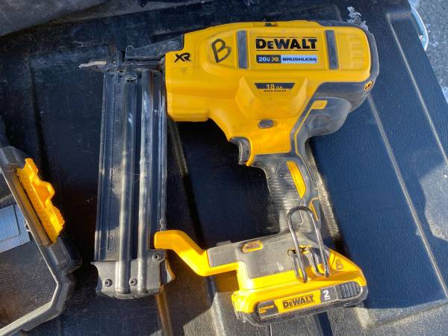
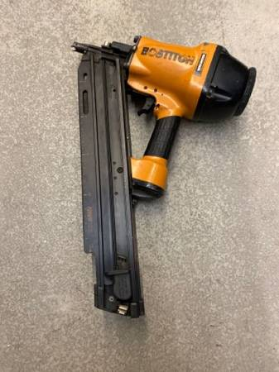
Struck-By Hazards
Focus Four
Struck-By Flying Objects
Nail Guns
May be air or battery operated
Proper training is required prior to use
Equipment must be inspected prior to use
All safety switches must be installed and operating properly
As with powder tools, proper PPE must be worn

Slide 34
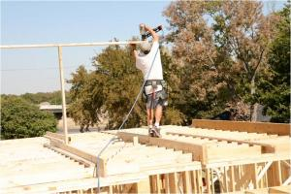
Struck-By Hazards
Focus Four
Struck-By Flying Objects
What’s wrong here?
Nail Guns cont.
NEVER point a nail gun toward you or co-workers
ALWAYS wear proper PPE when using any power tool. In this picture: the user should be using hard hat, hearing and eye protection, fall protection
PPE and training are useless if you don’t use it. Who is counting on you to work safe and come home at the end of the day? Don’t let your family down….
Safety first, safety always!

Slide 35
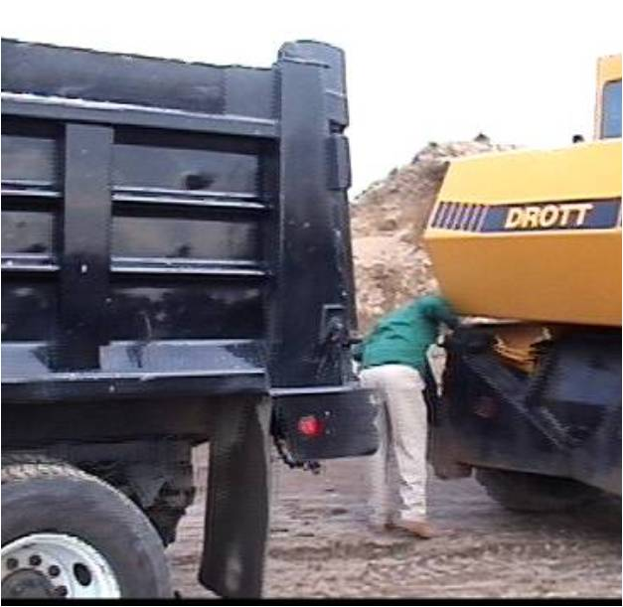
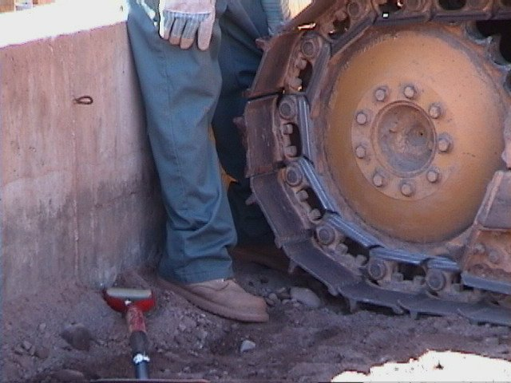
Struck-By Hazards
Focus Four
What’s the hazard here?
Both workers could be crushed by moving equipment

Slide 36
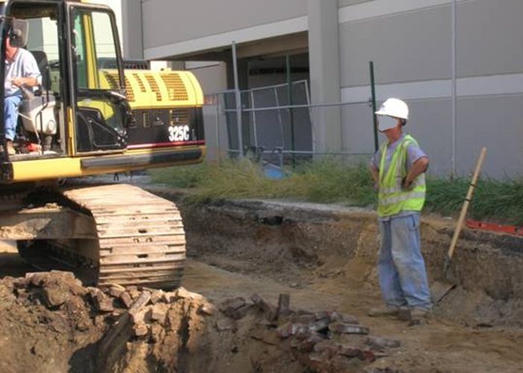
Struck-By Hazards
Focus Four
What’s the hazard here?
Avoid struck-by hazards by not working within the swing radius of heavy equipment

Slide 37
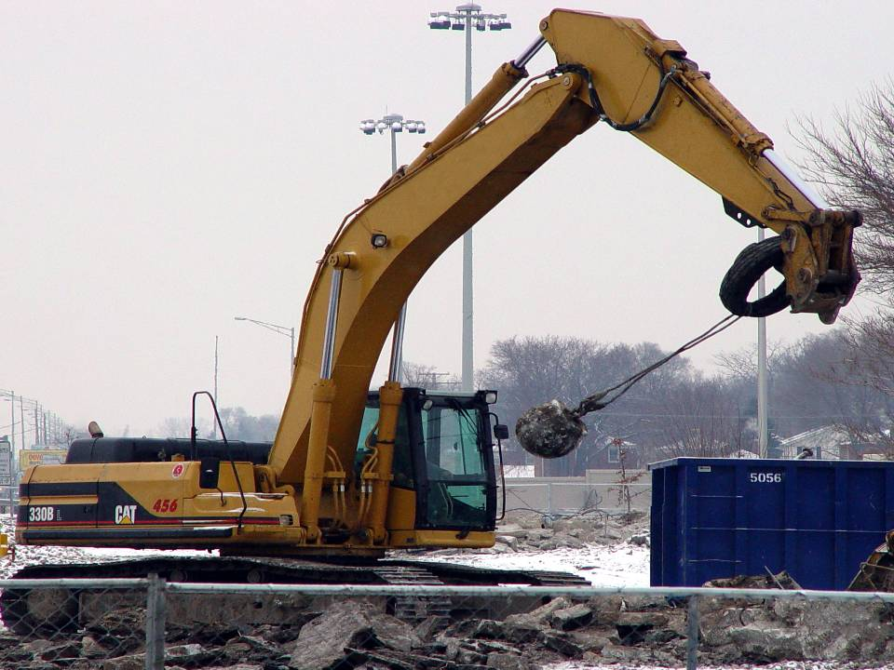
Struck-By Hazards
Focus Four
What’s the hazard here?
The wrecking ball is loosely attached to arm; could come loose and strike operator’s cab
A worker could be struck by the wrecking ball, hit, or run over by the excavator
Source: Construction Safety Council

Slide 38
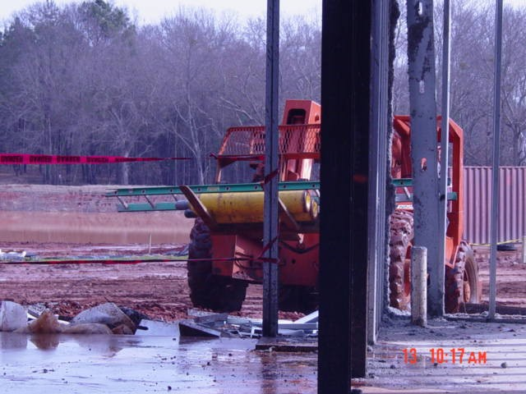
Struck-By Hazards
Focus Four
What’s the hazard here?
Unsecured gas cylinders are being transported, exposing workers to struck-by hazard from flying projectiles
Source: National Photo Archive ID #1470

Slide 39
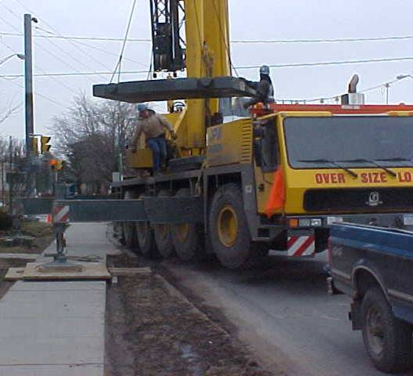
Struck-By Hazards
Focus Four
What’s the hazard here?
Stay clear of loads that are suspended or about to be suspended which create struck-by hazards from falling or swinging objects. If control of the load by a worker is necessary then a tag line should be used
Source: OTI Course #2080

Slide 40
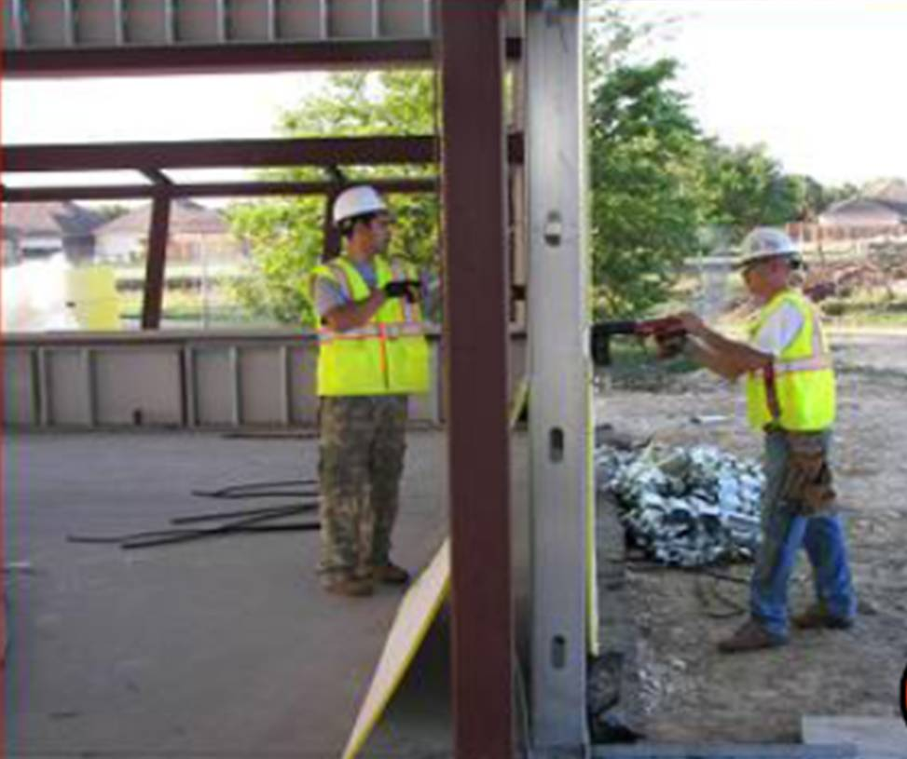
Struck-By Hazards
Focus Four
What’s the hazard here?
Powder-actuated tools can create flying object struck-by hazards. Never drive into easily penetrated materials when workers are on the other side
Source: Susan Harwood Grant Number SH-17792-08-60-F-48 by Compacion Foundation

Slide 41
Struck-By Hazards
Focus Four
Summary:
As you can see, struck-by hazards are everywhere. They fall into one of three categories:
Vehicle and roadway hazards
Falling objects
Flying objects
Struck-by hazards are preventable. Stay clear of operating vehicles and equipment, communicate with operators and maintain eye contact, avoid blind spots, wear high visibility clothing, and never stand under a load.
Power and powder actuated tools are dangerous and should only be used after proper training and only as directed. PPE must always be used and you must perform penetration checks when setting up the tool.
Remember who is counting on you to come home safe each day.

Slide 42
Struck-By Hazards
Focus Four
Through the Alliance between OSHA’s 10 Regional Offices and the Elevator Contractors of America (ECA), Elevator Industry Work Preservation Fund (EIWPF), International Union of Elevator Constructors (IUEC), National Association of Elevator Contractors (NAEC), National Elevator Industry Educational Program (NEIEP), and National Elevator Industry Inc. (NEII), collectively known as The Elevator Industry Safety Partners, developed this Industry Specific Content for informational purposes only. It does not necessarily reflect the official views of OSHA or the U.S. Department of Labor. May 2021
Under the Occupational Safety and Health Act, employers are responsible (http://www.osha.gov/as/opa/worker/employer-responsibility.html) for providing a safe and healthy workplace and workers have rights (https://www.osha.gov/workers). OSHA can help answer questions or concerns from employers and workers. OSHA's On-Site Consultation Program (https://www.osha.gov/consultation) offers free and confidential advice to small and medium-sized businesses, with priority given to high-hazard worksites. For more information, contact your regional or area OSHA office (https://www.osha.gov/contactus/bystate), call 1-800-321-OSHA (6742), or visit https://www.osha.gov/.

Slide 43

Struck-By Hazards
Focus Four

