Slide 1

1926 Construction
Stairways and Ladders

Slide 2
Stairways and Ladders
Objectives
By the end of this session, participants will be able to:
Identify types of stairways and ladders used at a construction site.
Describe types of hazards (i.e., slips, trips, and falls) associated with the use of stairs and ladders.
Describe protective methods used to prevent stairway and ladder hazards.
Recognize employer requirements to protect workers from stairway and ladder hazards.
Notes:
1926 Subpart X - Stairways and Ladders
Enabling Objectives:
Identify types of stairways and ladders used at a construction site.
Describe types of hazards (i.e., slips, trips, and falls) associated with the use of stairs and ladders.
Describe protective methods used to prevent stairway and ladder hazards.
Recognize employer requirements to protect workers from stairway and ladder hazards.

Slide 3
Stairways and Ladders
Introduction
Falls are the leading cause of fatalities in constructions
Falls from ladders make up about one-third of these fatalities
Approximately 25,000 injuries per year due to falls from stairways and ladders
Falls are preventable

Slide 4
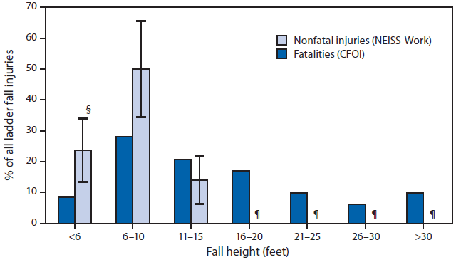
Stairways and Ladders
Introduction
Percentage of ladder fall fatalities* and nonfatal ladder fall injuries treated in emergency departments,† by fall height (when documented) — United States, 2011
Source: CDC
Notes:
Reference: Centers for Disease Control and Prevention. 2014. “Occupational Ladder Fall Injuries – United States, 2011.” Morbidity and Mortality Weekly Report (MMWR). Access at http://www.cdc.gov/mmwr/preview/mmwrtml/mm6316a2.htm?s_cid=mm6316a2_w.
Abbreviations:
CFOI = Census of Fatal Occupational Injuries;
NEISS-Work = National Electronic Injury Surveillance System–occupational supplement;
BLS = Bureau of Labor Statistics.
* Percentage of ladder fall fatalities were generated with restricted access to BLS CFOI microdata and might differ from results released by BLS. Fatality counts on which the percentages are calculated are based are 82 cases where ladder height was indicated and include deaths to workers of all ages, volunteer workers, and resident military personnel.
† Excludes 31 fatalities and 22,600 nonfatal injuries with unknown fall height.
§ 95% confidence interval.
¶ Nonfatal emergency department–treated injuries in this height category did not meet criteria for publication without compromise of confidentiality.

Slide 5
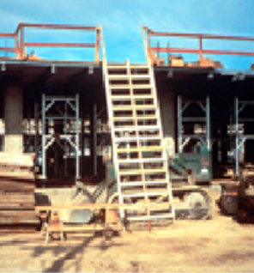
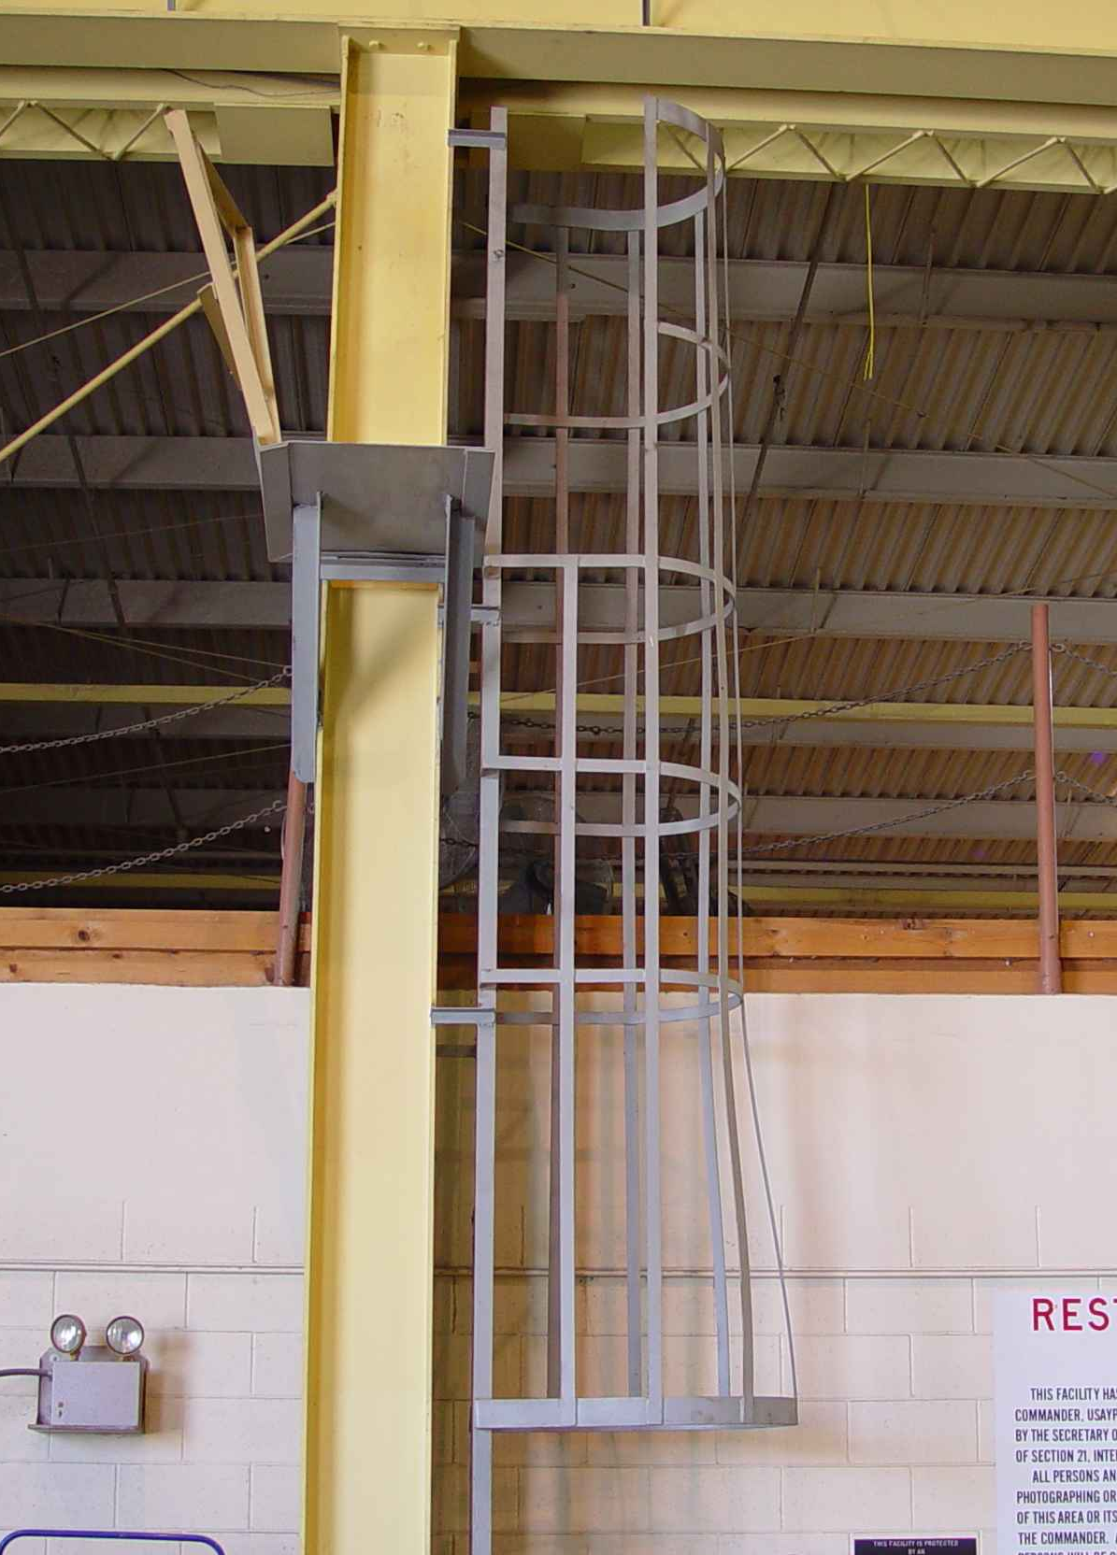
Stairways and Ladders
Types of Ladders & Stairways
Fixed ladders
Source: OSHA
Source: TEEX Harwood
Notes:
https://www.osha.gov/Publications/ladders/osha3124.html
Fixed ladder – a ladder that cannot be readily moved or carried because it is an integral part of a building or structure.
Job-made wooden ladder – “…a ladder constructed at the construction site. It is not commercially-manufactured. A job-made wooden ladder provides access to and from a work area. It is not intended to serve as a work platform. These ladders are temporary, and are used only until a particular phase of work is completed or until permanent stairways or fixed ladders are installed.” (OSHA DOC FS-3661 05/2013)
https://www.osha.gov/Publications/OSHA3661.html

Slide 6
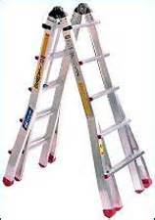
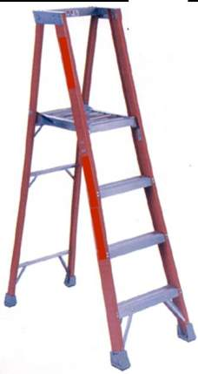
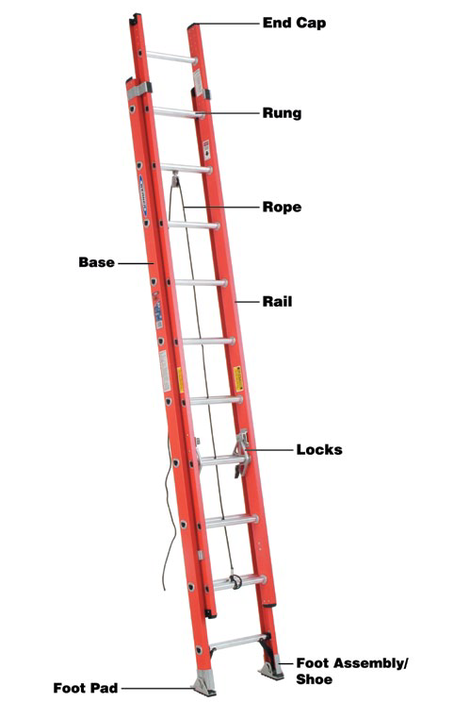

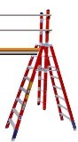
Stairways and Ladders
Types of Ladders & Stairways
Portable ladders
Source of photos: OSHA
Notes:
Portable ladder – a ladder that can be readily moved or carried
Self-supporting – stepladder, platform ladder, tressel ladder, or other foldout types
Non-self-supporting – extension ladder or other leaning types

Slide 7
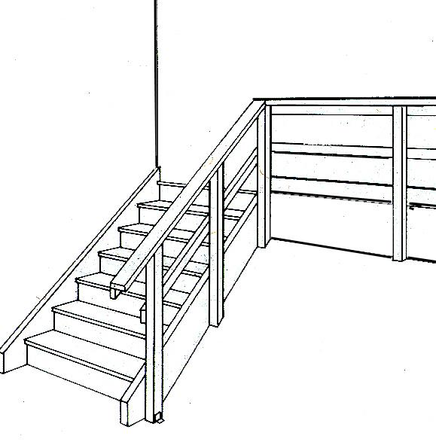
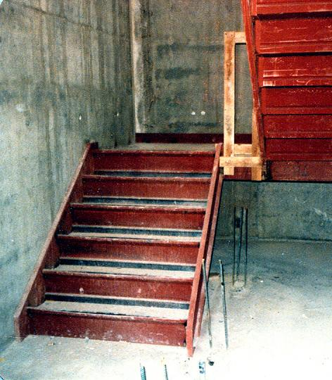
Stairways and Ladders
Types of Ladders & Stairways
Stairways
Source of graphics: OSHA
Notes:
Stairways
Temporary stairways - stairways that will not be a permanent part of the structure on which construction work is being performed.
Permanent stairways
Metal pan stairs – metal pan landings and treads filled with concrete or other material for permanent use. During construction, “foot traffic is prohibited on stairways with pan stairs where the treads and/or landings are to be filled in with concrete or other material at a later date, unless the stairs are temporarily fitted with wood or other solid material at least to the top edge of each pan” [1926.1052(b)(1)]

Slide 8
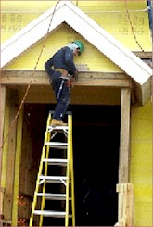
Hazards Associated with
Stairs and Ladders
Stairways and Ladders
Slips
Trips
Falls
Improper use of the top rung of a step ladder
Source of photos: OSHA
Notes:
Reference – OSHA Publication 3124, Stairways and Ladders
Slips
Grease, oil, wet paint, or other slippery spills/debris
Slippery coatings on ladder
Trips
Poor housekeeping/clutter
Power cords, construction materials, or other items in work area that create tripping hazard
Falls – conditions leading to injury-causing incidents involving falls from ladders or stairways
Improper set-up
Using ladders with structural defects
Portable ladders not extending 3 feet above landing surface
Not securing ladder correctly
Standing on top two steps of a stepladder
Overreaching when working from a ladder
Inadequate or missing guardrails or handrails on stairways

Slide 9
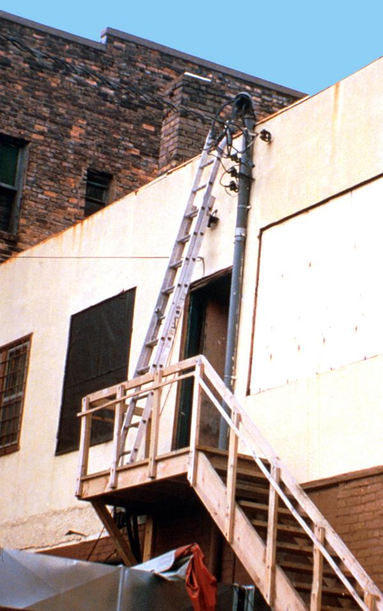
Hazards Associated with
Stairs and Ladders
Stairways and Ladders
Electrical Hazards
Falling Objects
Protruding objects, sharp edges, or rough spots
This is an unsafe condition.
Source: OSHA
Notes:
Reference – OSHA Publication 3124, Stairways and Ladders
Other potential hazards
Ladder contact with power lines
Falling objects from elevated level when objects are placed on ladders or stairways or are being carried up/down the ladder or stairway
Protruding objects, sharp edges, or rough spots on stairways that could cause injuries

Slide 10
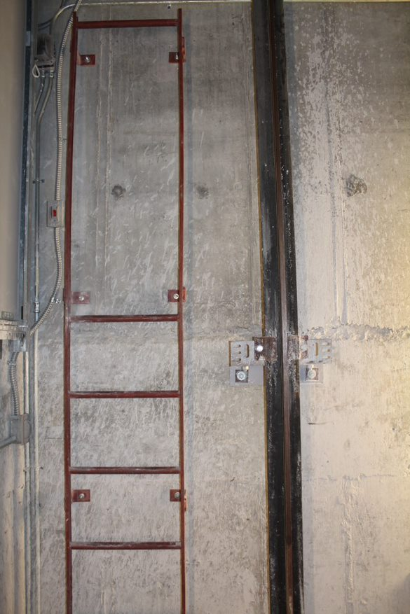
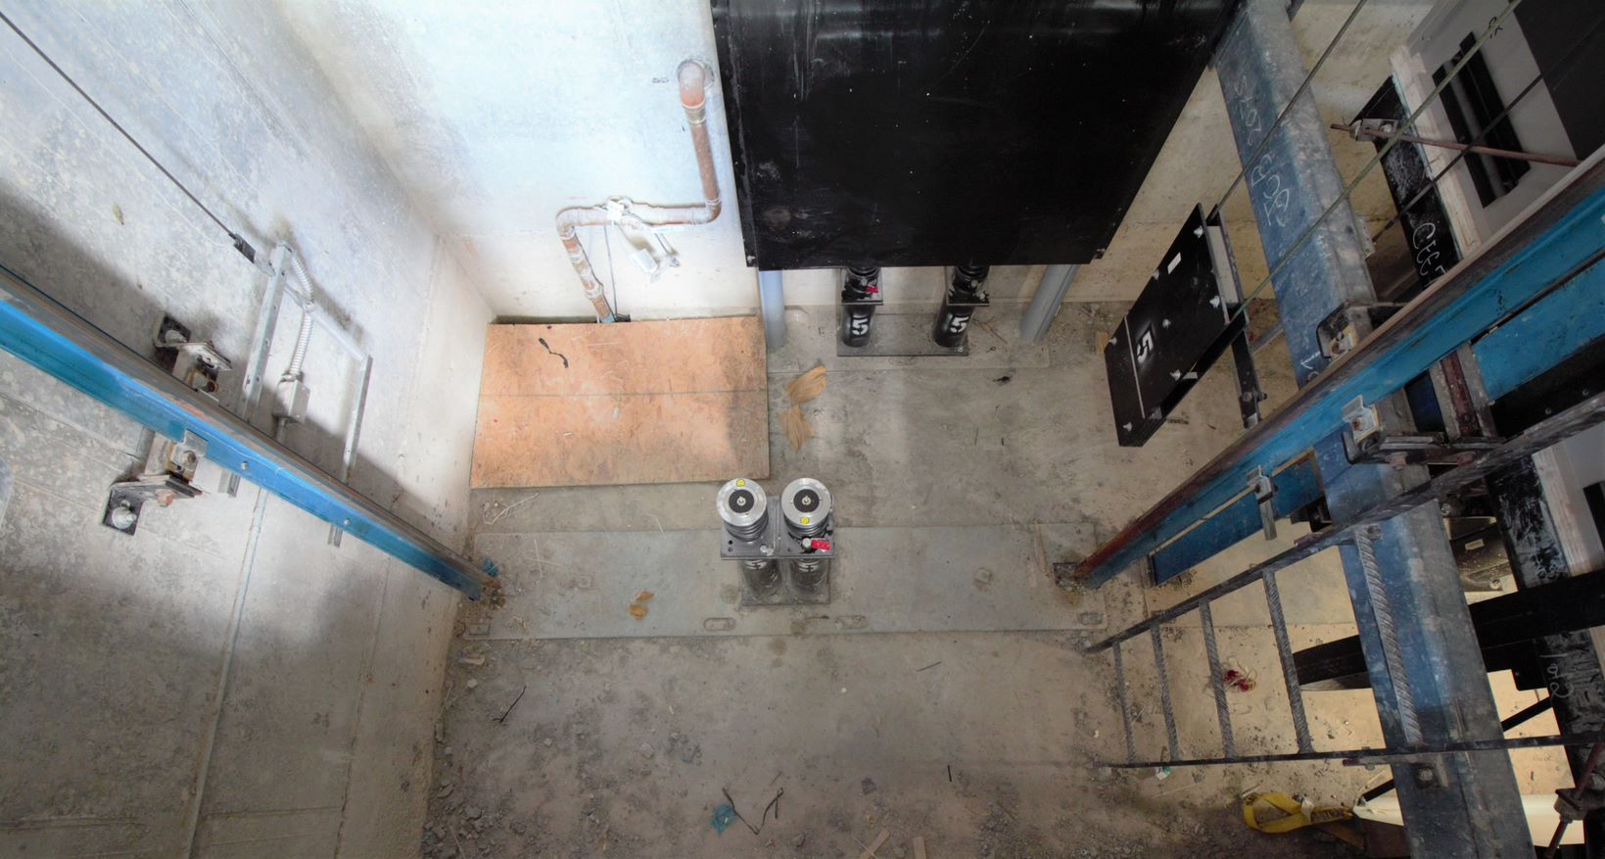
Stairways and Ladders
Hazards Associated with Stairs and Ladders
Use caution when accessing a pit ladder, and make sure you have control
of the conveyance before entering the pit.
Pit ladders are often installed with their rungs close to
the pit wall. Be aware of your footing and always
maintain 3 points of contact. ASME A17.1 section 2.2.4
lists the requirements for pit ladders.
Notes:
The ladder must extend at least 48 in. above the sill of the access door or handgrips shall be provided to the same height.
The ladder rungs, cleats, or steps must be at least 16 in. wide. When there are obstructions, the width can be decreased to less than 16 in., but not less than 9 in.
The ladder rungs, cleats, or steps must be spaced 12 in. ± 0.5 in. on center, at least to the height of access door sill, and must minimize slipping (e.g., knurling, dimpling, coating with skid-resistant material, etc.).
Must have a clear distance of at least 4.5 in. from the centerline of the rungs, cleats, or steps to the nearest permanent object in back of the ladder.
Side rails, if provided, must have a clear distance of not less than 4.5 in. from their centerline to the nearest permanent object.
The ladder must be capable of sustaining a load of 300 lb.

Slide 11
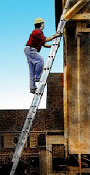
Reducing or Eliminating Hazards
Stairways and Ladders
Ladders
  Safe practices
  Ladder requirements
  Structural defects
Source: OSHA
Notes:
Reference – OSHA Publication 3124, Stairways and Ladders

Slide 12
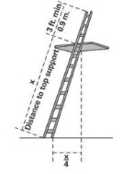
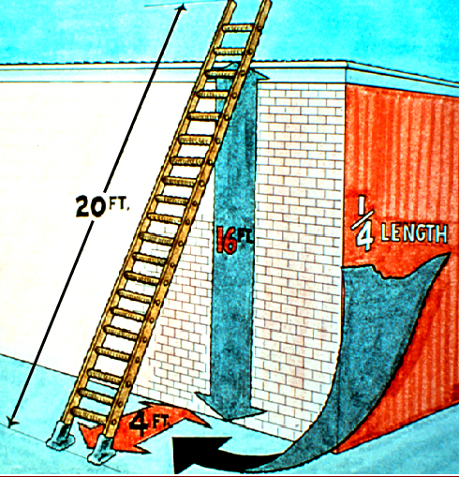
Reducing or Eliminating Hazards
Stairways and Ladders
Ladder-use practices
  Extend side rails 3 feet above the upper landing surface
  Don’t exceed load/capacity
  Use only as designed
  Angle ladder so the horizontal distance of bottom is ¼ the working length of the ladder
Source of graphics: OSHA
Notes:
Extend side rails of portable ladders 3 feet above the upper landing surface
When extension is not possible, secure ladder and provide a grasping device to assist workers in mounting/dismounting ladder
A ladder extension must not deflect under a load that would cause the ladder to slip off its support
Keep ladders free of oil, grease, and other slippery substances
Do not exceed maximum intended load of a ladder or the manufacturer’s rated capacity
Use ladders only for the purpose for which they were designed
Angle non-self-supporting ladders so the horizontal distance from the top support to the foot of the ladder is ¼ the working length of the ladder. Job-made wooden ladders should have an angle that equals about 1/8 the working length.

Slide 13
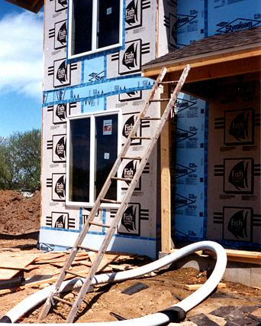
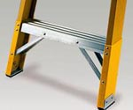
Reducing or Eliminating Hazards
Stairways and Ladders
  Pitch fixed ladders no more than 90 degrees from the horizontal
  Avoid use of ladder on surfaces that are:
    Unstable
    Not level
    Slippery
  Secure ladders to
  prevent movement
This ladder is not on a stable surface and is not properly positioned.
Source of photos: OSHA
Notes:
Reference – OSHA Publication 3124, Stairways and Ladders
Pitch fixed ladders no more than 90 degrees from the horizontal, measured from the back side of the ladder, when used.
Use ladders only on stable and level surfaces or secure ladders to prevent movement.
Do not use ladders on slippery surfaces, unless they are secured or have slip-resistant feet to prevent movement. Slip-resistant feet must not be used as a substitute for the care in placing, lashing, or holding a ladder upon a slippery surface.

Slide 14
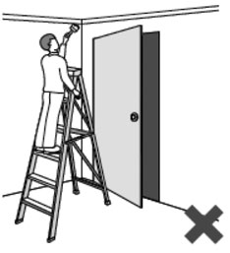
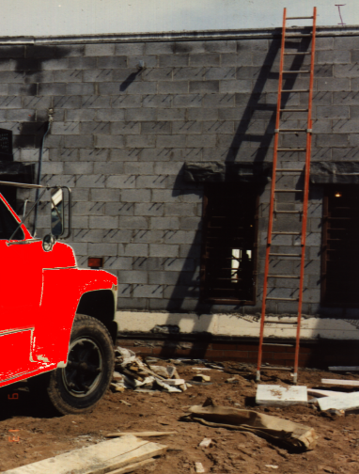
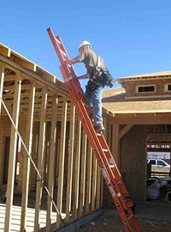
Reducing or Eliminating Hazards
Stairways and Ladders
  Prevent movement/displacement
    Secure
    Barricade
  Keep clear areas around
  top and bottom
  Equally support rails of
  non-self-supporting ladder
  at the top
Source of photos: OSHA
Notes:
Reference – OSHA Publication 3124, Stairways and Ladders
When using a ladder in a doorway, passageway, driveway, or other area where it can be displaced by workplace activities or traffic, secure the ladder to prevent movement or a barricade to keep traffic/activities away from the ladder.
Keep clear areas around top and bottom of ladders.
Equally support the two rails of a non-self-supporting ladder at the top, unless it is equipped with a single support attachment.

Slide 15

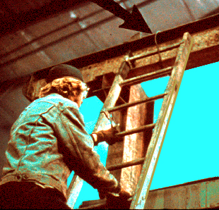
Reducing or Eliminating Hazards
Stairways and Ladders
  Ascending or descending ladder
    Maintain 3-point contact
    Face ladder
    Stay inside side rails
    Never carry tools/objects in hands
    Be extra careful getting on or off
Source: OSHA
Source: OSHA
Notes:
Reference – OSHA Quick Card, Portable Ladder Safety, OSH3246-09N-05
Always maintain a 3-point (two hands and a foot, or two feet and a hand) contact on the ladder when climbing.
Keep your body near the middle of the step and always face the ladder while climbing.
Additional reference – OSHA Fact Sheet, Reducing Falls in Construction: Safe Use of Extension Ladders, DOC FS-3660 (06/2013)
Maintain a 3-point contact (two hands and a foot, or two feet and a hand) when climbing/descending a ladder.
• Face the ladder when climbing up or descending.
• Keep the body inside the side rails.
• Use extra care when getting on or off the ladder at the top or bottom. Avoid tipping the ladder over sideways or causing the
ladder base to slide out.
• Carry tools in a tool belt or raise tools up using a hand line. Never carry tools in your hands while climbing up/down a ladder.

Slide 16
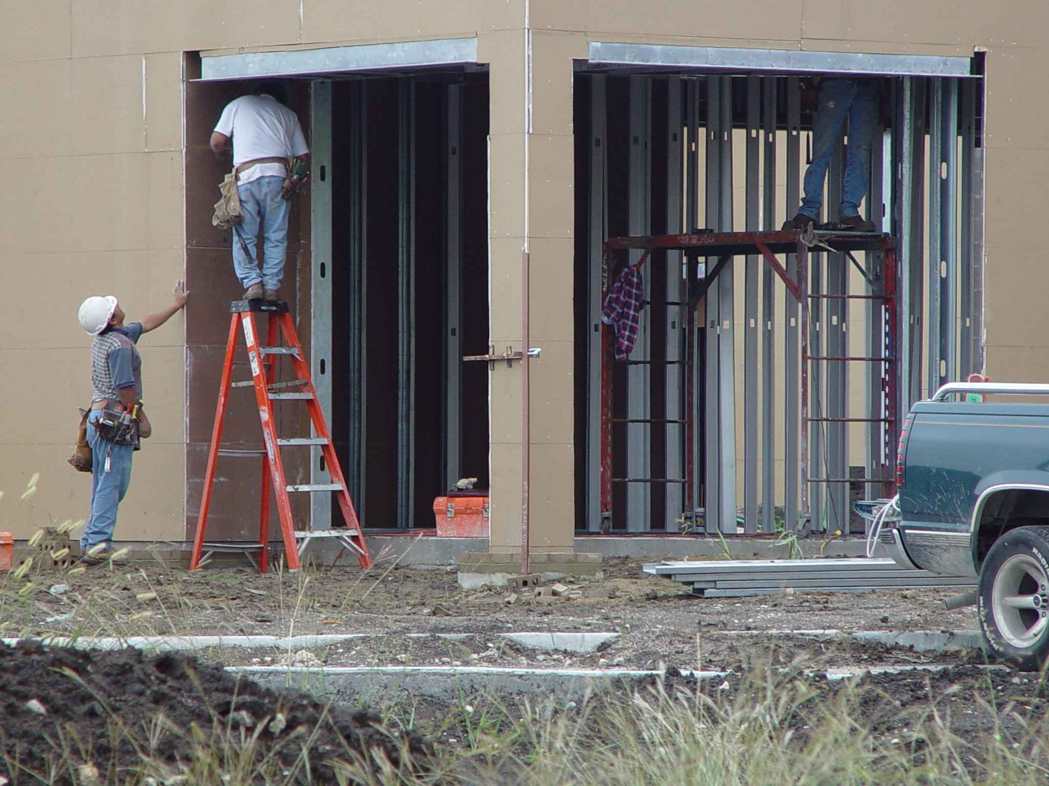
Reducing or Eliminating Hazards
Stairways and Ladders
  Don’t move, shift, or extend while in use
  When exposed to energized electrical equipment, use nonconductive side rails
  Don’t use the top two steps of a stepladder
  Don’t climb the cross-bracing on the rear section of a stepladder
Source: TEEX – Harwood
Notes:
Reference – OSHA Publication 3124, Stairways and Ladders

Slide 17
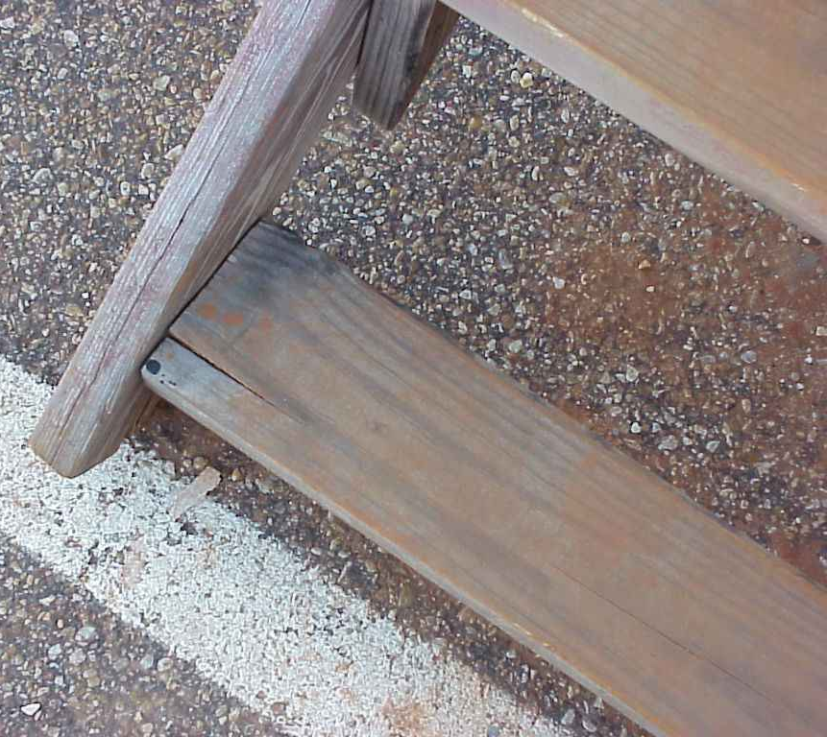
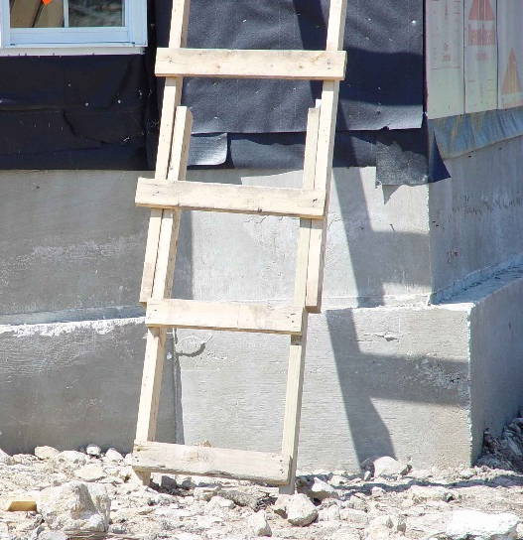
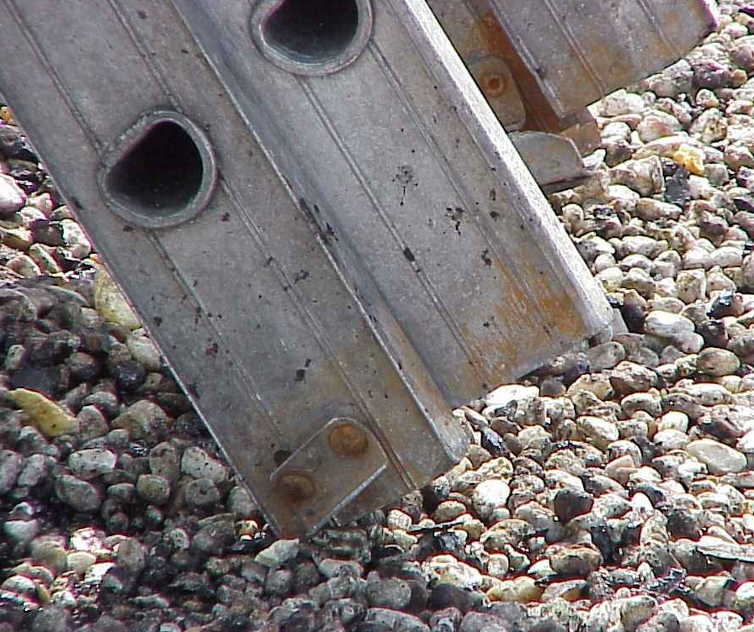
Reducing or Eliminating Hazards
Stairways and Ladders
  Don’t use single-rail ladders
  Inspect (competent person)
    Visible defects periodically, and after any incident that could affect their safe use
Source of photos: TEEX - Harwood
Notes:
Reference – OSHA Publication 3124, Stairways and Ladders

Slide 18
Reducing or Eliminating Hazards
Stairways and Ladders
Ladder requirements:
  Provide double-cleated ladder or two or more ladders:
    When having 25 or more employees using as only means of access to work area;
    When serving two-way traffic.
Source: OSHA
Notes:
Reference – OSHA Publication 3124, Stairways and Ladders

Slide 19
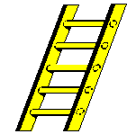
Reducing or Eliminating Hazards
Stairways and Ladders
  Rungs, cleats, and steps:
    Parallel, level, and uniformly spaced
    Spacing
      Along portable or fixed ladder side rails –
      10 to 14 inches apart
      Between center lines on step stools –
      8 to 12 inches apart
      Between center lines on extension trestle ladders – 8 to 18 inches apart; extension section 6 to 12 inches
Source: OSHA
Notes:
Reference – OSHA Publication 3124, Stairways and Ladders

Slide 20
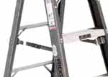
Reducing or Eliminating Hazards
Stairways and Ladders
  Don’t tie or fasten together to create longer sections, unless design allows
  Side rail of spliced side rails must have strength equal to one-piece side rail
  Stepladder must have a metal spreader or locking device
  to hold in open position.
Source: OSHA
Source: OSHA
Notes:
Reference – OSHA Publication 3124, Stairways and Ladders
Do not tie or fasten together ladders to create longer sections, unless design is specific for that use.
The resulting side rail of spliced side rails must have strength equal to a one-piece side rail of same material.

Slide 21
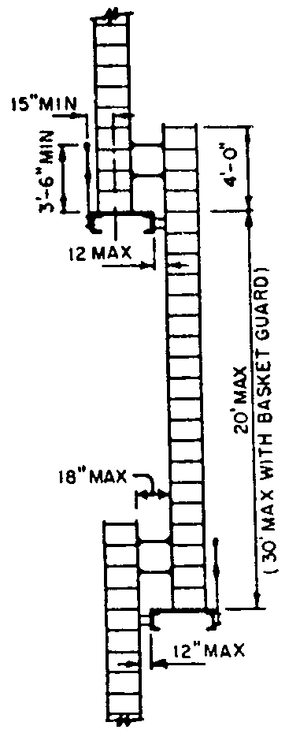
Reducing or Eliminating Hazards
Stairways and Ladders
  Platforms or landings - offset two or
  more separate ladders used to reach
  an elevated work area
  Ladder surface - free of projections, sharp edges, or abrasive materials that could puncture or cut user, or snag clothing
  Wood ladders - not coated with any opaque covering, except for identification or warning labels only on one face of a side rail
Source: OSHA
Notes:
Reference – OSHA Publication 3124, Stairways and Ladders

Slide 22
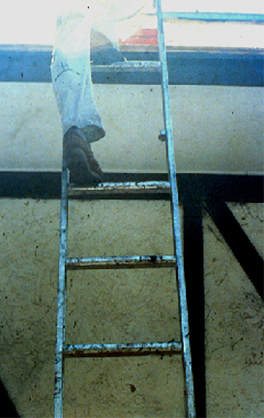
Reducing or Eliminating Hazards
Stairways and Ladders
  Remove defective ladders from service
    Broken or missing parts
    Corrosion
    Other faulty or defective components
  Mark defective or tag “Do Not Use”
  Repair to original design criteria
Source: OSHA
Notes:
Reference – OSHA Publication 3124, Stairways and Ladders
Remove from service any ladder with structural defect
Broken or missing rungs, cleats, or steps
Broken or split rails
Corroded parts
Other faulty or defective components
Mark as defective or tag “Do Not Use”
Repair ladder to condition meeting its original design criteria before being returned to use

Slide 23
Reducing or Eliminating Hazards
Stairways and Ladders
Stairs
  Handrails
  Stair rail systems
  Stair requirements
  Temporary pan stairs
Source: OSHA
Notes:
Reference – OSHA Publication 3124, Stairways and Ladders

Slide 24
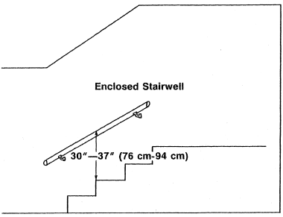
Reducing or Eliminating Hazards
Stairways and Ladders
Install handrail on stairways
  4 or more risers
  30 inches of rise
Source: OSHA
Notes:
Reference – OSHA Publication 3124, Stairways and Ladders
Install at least one handrail on stairways with four or more risers or more than 30 inches of rise

Slide 25
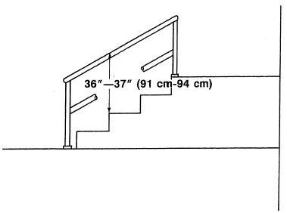
Reducing or Eliminating Hazards
Stairways and Ladders
Install stair rail system
  Toprail, mid-rail, and sometimes a toeboard
  Unprotected sides and edges of stairs with rise
  of 6 or more feet
Source: OSHA
Notes:
Reference – OSHA Publication 3124, Stairways and Ladders
Install a stair-rail system, including a top rail, mid-rail, and sometimes a toeboard, along the unprotected sides and edges of stairways that rise six feet or more
Must be between 30-36 inches from the upper surface of the stair rail system to the surface of the tread
Must be able to withstand a force of at least 200 pounds

Slide 26
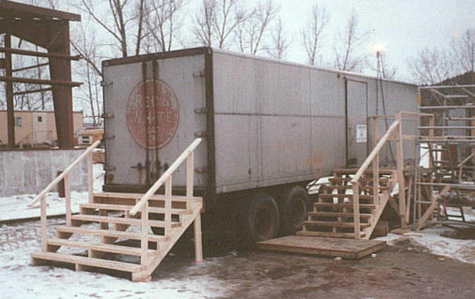
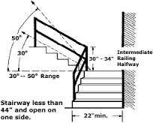
Reducing or Eliminating Hazards
Stairways and Ladders
Build/maintain stairs that meet OSHA requirements
  Uniform riser height and tread depth
  30 to 50 degrees angle
  Landings every 12 feet
  Remove projections
  Correct slippery conditions
Source: OSHA
Uniform - 30 & 50 deg. angle
No more than 1/4 inch
variation in any stairway system
Source: OSHA
Notes:
Reference – OSHA Publication 3124, Stairways and Ladders
Build/maintain stairs that meet OSHA requirements:
Uniform riser height and uniform tread depth with less than ¼ inch variation
Built and installed at an angle between 30 – 50 degrees on the diagonal
Install landings (minimum 30 inches deep and 20 inches wide) at least every 12 feet of vertical rise; protect sides with standard 42” guardrail system
Remove dangerous projections, such as protruding nails, from all stairway/rail parts
Correct slippery conditions on stairways with slip-resistant material

Slide 27
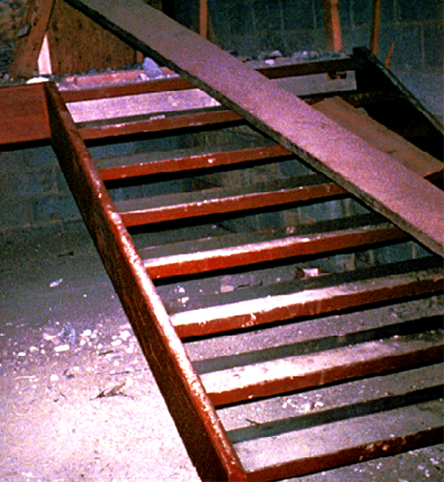
Reducing or Eliminating Hazards
Stairways and Ladders
Temporary pan stairs
  Secure in place before filling
  Fill to top edge
  Replace worn treads and landings
Source: OSHA
Notes:
Reference – OSHA Publication 3124, Stairways and Ladders
Fill temporary pan stairs to the top edge of each pan, and replace treads and landings when worn below the top edge.
Metal pan landings and metal pan treads must be secured in place before filling.

Slide 28
Employer requirements
Stairways and Ladders
Comply with OSHA standards related to stairs and ladders
  Training
  Inspection
Comply with manufacturers’ requirements and recommendations for all ladders.
Notes:
Reference – OSHA Publication 3124, Stairways and Ladders

Slide 29
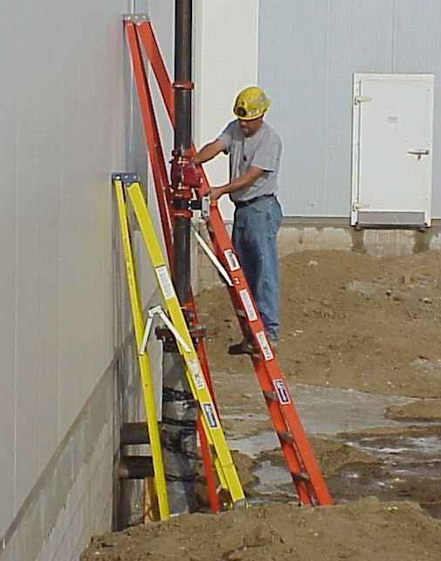
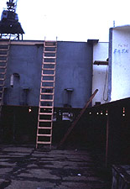
Hazard Recognition - Ladders
Stairways and Ladders
Identify ladders hazards and solutions
Step ladder set up wrong. Not self supporting
Ladder rails don’t extend 3’ above the landing
Source: TEEX – Harwood
Source: OSHA
Notes:
Reference – OSHA Publication 3124, Stairways and Ladders
Photo on left: stepladder is not set up properly to be self-supporting.
1926.1053(b)(4)
Ladders shall be used only for the purpose for which they were designed.
Photo on right: Ladder side rails do not extend at least 3 feet above upper landing surface. 1926.1053(b)(1) When portable ladders are used for access to an upper landing surface, the ladder side rails shall extend at least 3 feet (.9 m) above the upper landing surface to which the ladder is used to gain access; or, when such an extension is not possible because of the ladder's length, then the ladder shall be secured at its top to a rigid support that will not deflect, and a grasping device, such as a grabrail, shall be provided to assist employees in mounting and dismounting the ladder

Slide 30
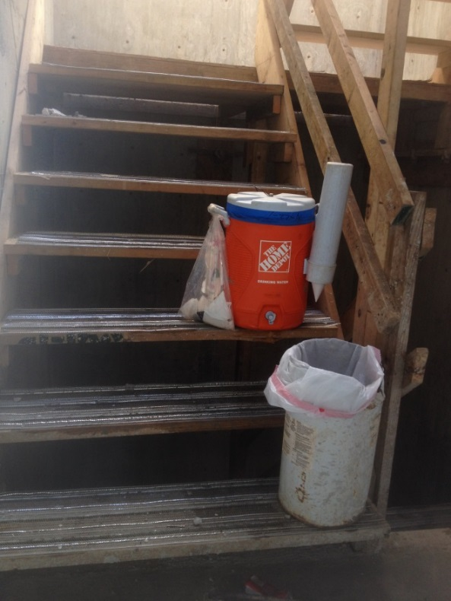
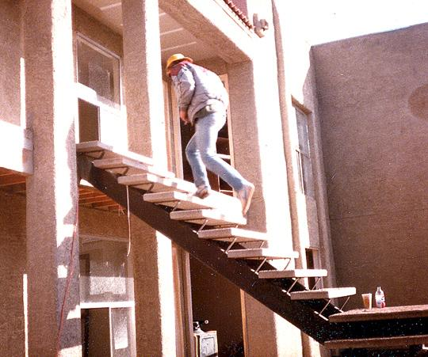
Hazard Recognition - Stairs
Stairways and Ladders
Identify stair hazards and solutions
Stairs require handrails
Cooler and bucket inhibit access
Source: Luis Diaz
Source: OSHA
Notes:
Reference – OSHA Publication 3124, Stairways and Ladders
Photo on left: Cooler and bucket limiting access.
1926.1051(a)(3)
When a building or structure has only one point of access between levels, that point of access shall be kept clear to permit free passage of employees. When work must be performed or equipment must be used such that free passage at that point of access is restricted, a second point of access shall be provided and used.
Photo on right: no handrails,
1926.1052(c)(1)
Stairways having four or more risers or rising more than 30 inches (76 cm), whichever is less, shall be equipped with:
1926.1052(c)(1)(i)
At least one handrail; and
1926.1052(c)(1)(ii)
One stairrail system along each unprotected side or edge.

Slide 31
Stairways and Ladders
Summary
Key components for ladder safety:
  A competent person must inspect
  Use the correct ladder for the job
  Use the correct angle, supports,
  treads, cross braces, and rails
  Don’t overload
  Your employer must train you in
  proper use of a ladder

Slide 32
Stairways and Ladders
Summary
Key components for stairway safety
  Treads
  Rails
    Handrails
    Stair rails
    Guardrails
  Landings and Platforms

Slide 33
Knowledge Check
Stairways and Ladders
When portable ladders are used for access to an upper landing surface, how many feet above the upper landing must the side rails extend?
  2 feet
  3 feet
  4 feet
  5 feet
b. 3 feet

Slide 34
Knowledge Check
Stairways and Ladders
You can use metal ladder around power lines or exposed energized electrical equipment.
  True – but only if there isn’t any other option to get the work done.
  False – you should never use a metal ladder in this circumstance.
b. False – never use a metal
ladder in this circumstance

Slide 35
Knowledge Check
Stairways and Ladders
Handrails must be able to withstand, without failure, how many pounds of weight applied within 2 inches of the top edge in any downward or outward direction?
  300 pounds
  250 pounds
  200 pounds
  175 pounds
c. 200 pounds

Slide 36
Knowledge Check
Stairways and Ladders
Stairways that have four or more risers MUST have a stair rail.
  True
  False
a. True

Slide 37
Knowledge Check
Stairways and Ladders
A non-self-supporting ladder should be set up at ___ (horizontal distance/working length of ladder).
  90-degree angle
  30-degree angle
  1:2 angle
  1:4 angle
d. 1:4 angle

Slide 38
Stairways and Ladders
Through the Alliance between OSHA’s 10 Regional Offices and the Elevator Contractors of America (ECA), Elevator Industry Work Preservation Fund (EIWPF), International Union of Elevator Constructors (IUEC), National Association of Elevator Contractors (NAEC), National Elevator Industry Educational Program (NEIEP), and National Elevator Industry Inc. (NEII), collectively known as The Elevator Industry Safety Partners, developed this Industry Specific Training for informational purposes only. It does not necessarily reflect the official views of OSHA or the U.S. Department of Labor. May 2021
Under the Occupational Safety and Health Act, employers are responsible (http://www.osha.gov/as/opa/worker/employer-responsibility.html) for providing a safe and healthy workplace and workers have rights (https://www.osha.gov/workers). OSHA can help answer questions or concerns from employers and workers. OSHA's On-Site Consultation Program (https://www.osha.gov/consultation) offers free and confidential advice to small and medium-sized businesses, with priority given to high-hazard worksites. For more information, contact your regional or area OSHA office (https://www.osha.gov/contactus/bystate), call 1-800-321-OSHA (6742), or visit https://www.osha.gov/.

Slide 39

Stairways and Ladders

