Slide 1

1926 Construction
Materials Handling, Storage, Use, and Disposal

Slide 2
Materials Handling, Storage, Use, and Disposal
Materials Handling
Lesson Overview
  Types of material handling equipment.
  Hazards associated with material handling activities
  Prevention of hazards associated with material handling equipment
  Employer requirements to protect workers from material handling hazards
Notes:
Enabling Objectives:
Identify types of material handling equipment.
Describe hazards associated with material handling activities (e.g., storage, use, and disposal).
Identify methods to prevent hazards associated with material handling equipment.
Recognize employer requirements to protect workers from material handling hazards.

Slide 3

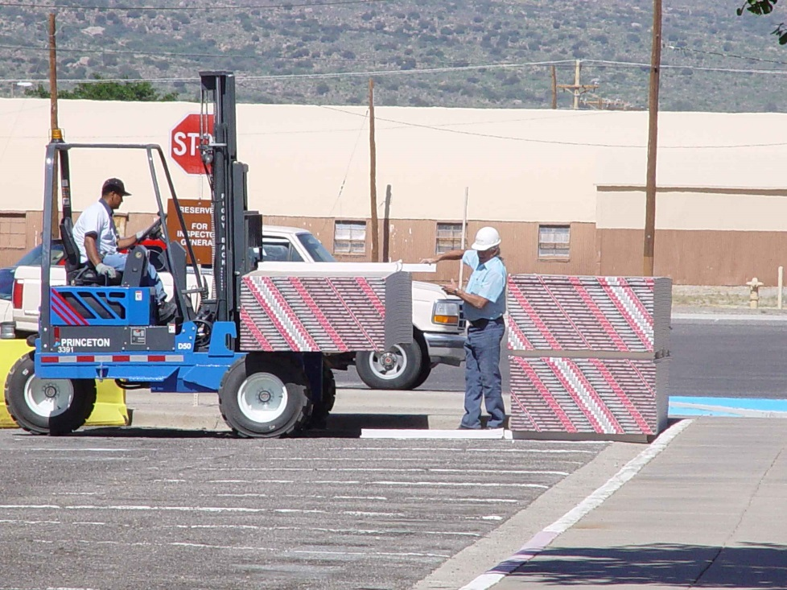
Types of Equipment
Materials Handling
Powered
Industrial Trucks
Conveyors
Source: OSHA
Source: TEEX-Harwood
Notes:
OSHA 1996, https://www.osha.gov/doc/outreachtraininghtmlfiles/mathan.html
Many industries rely on efficient handling and storage of materials through diverse operations to function properly. A variety of tools/equipment is used to move, store, use, and dispose of materials. For example, in construction, the following operations may exist: “hoisting tons of steel with a crane, driving a truck loaded with concrete blocks, manually carrying bags and material, and stacking drums, barrels, kegs, lumber, or loose bricks.”

Slide 4
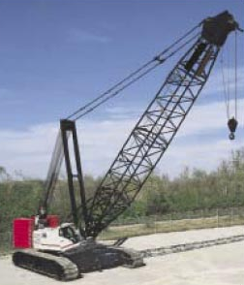
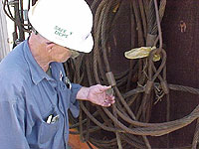
Types of Equipment
Materials Handling
Cranes
Slings
Source: OSHA
Source: OSHA
Notes:
OSHA 1996, https://www.osha.gov/doc/outreachtraininghtmlfiles/mathan.html
“To help reduce potential accidents associated with workplace equipment, employees need to be trained in the proper use and limitations of the equipment they operate. This includes knowing how to effectively use equipment such as conveyors, [powered industrial trucks or forklifts], cranes, and slings.”

Slide 5
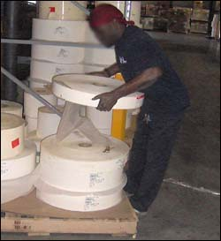
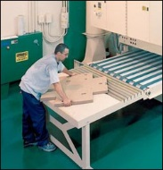
Factors Contributing to Injuries
Materials Handling
Weight and bulkiness of objects
Bending, twisting, turning movements
Source: OSHA
Source: OSHA
Notes:
OSHA 2002, https://www.osha.gov/Publications/osha2236/pdf
“Workers frequently cite the weight and bulkiness of objects that they lift as major contributing factors to their injuries.” A study from 1999 found that 420,000 back injuries occurred from workplace accidents. Causes of the injuries included lifting heavy or bulky items and bending, twisting, or turning movements.

Slide 6
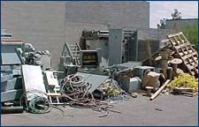
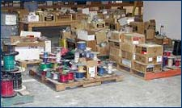
Hazards
Materials Handling
Improper operation of equipment
Accumulated materials or clutter
  Source of photos: OSHA
Notes:
Examples of improper operation of equipment – overloads, unsafe speeds,
Poor housekeeping presents tripping hazards, fire/explosion hazards, or hazards associated with harboring pests (rats, mice, etc.)

Slide 7
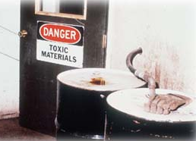
Hazards
Materials Handling
Unsafe conditions of materials or containers
Flammability or toxicity of some materials
  Source: OSHA
Notes:
Examples of unsafe conditions – protruding nails, dry rot, deteriorated containers
Primary hazards associated with flammable materials are explosion and fire.

Slide 8
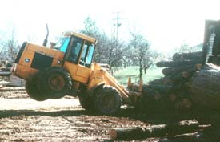
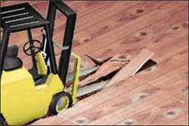
Hazards
Materials Handling
Weight of materials
Binding ties or other devices that secure bundles or
bound materials
Source: OSHA
Source: OSHA
Notes:
Exceeding load capabilities of equipment, floors, or storage shelves can cause:
Equipment to fail or turn-over/tip-over
Falling/dropped loads
Floors to collapse
Storage shelves to collapse or fall over
Binding ties or other securing devices are likely under tension, which can cause them to snap or “fly-off” when cut improperly.

Slide 9
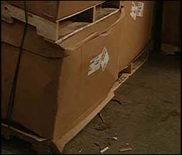
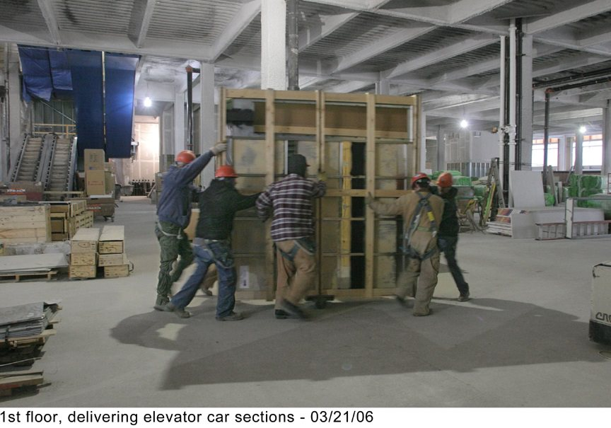
Hazards
Materials Handling
Falling objects
Lifting, pushing, pulling, or otherwise manually moving large, heavy items
Source: OSHA
Notes:
Falling objects – due to improper handling or storage, overloading capacity, etc.
Manually moving large, heavy, and/or irregularly-shaped objects can cause injuries; back injuries are a common injury associated with manual moving of heavy, bulky items

Slide 10
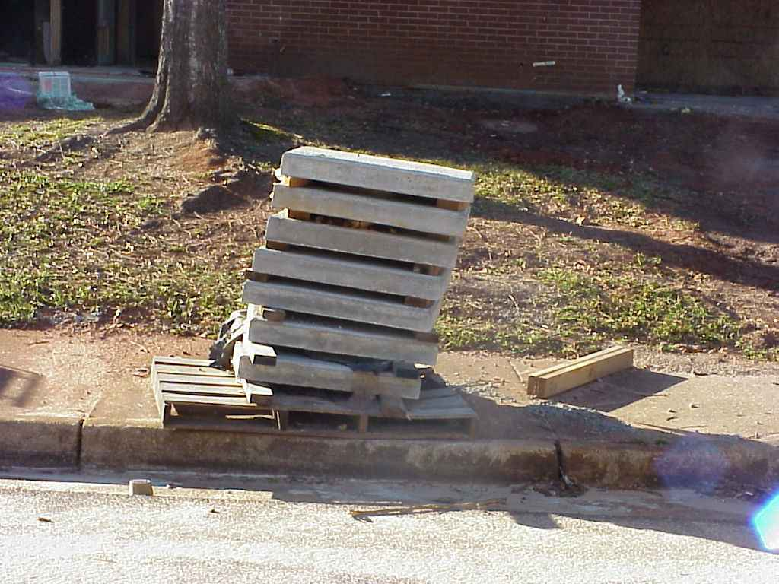
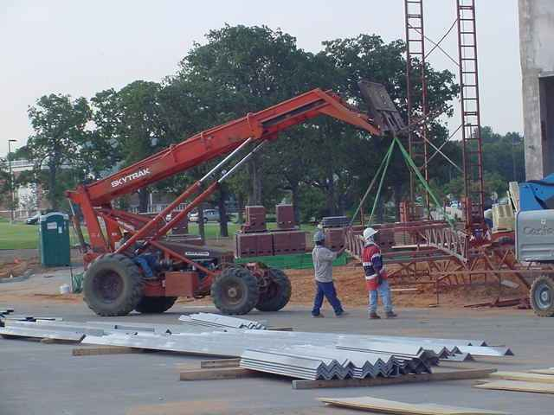
Hazards
Materials Handling
Improperly stacked materials
Struck-by or caught in/between hazards
Source of photos: TEEX - Harwood
Notes:
Improperly stacked materials have potential for sliding, falling, or collapsing, which can lead to struck-by or crushed-by incidents.
Equipment, machinery or falling loads lead to struck-by or caught-in/-between incidents

Slide 11
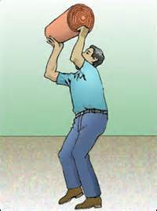
Injuries
Materials Handling
Types of injuries commonly reported
  Sprains, strains, tears
  Soreness and pain
  Bruises and contusions
  Cuts, lacerations, and
  punctures
Source: OSHA
Notes:
OSHA 2002, https://www.osha.gov/Publications/OSHA2236/osha2236.html:
Back injuries − lifting or bending and then twisting and turning
Strains and sprains − improper lifting or carrying loads too large or heavy
Fractures and bruises from − struck by materials or caught in pinch points
Cuts and bruises – falling materials that have been improperly stacked or had ties/securing devices incorrectly cut/removed

Slide 12
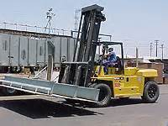
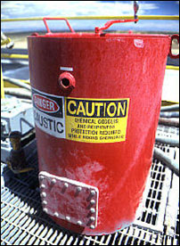
Injuries
Materials Handling
Examples of events or exposures leading to
injuries
  Contact with objects
  and equipment
  Transportation incidents
  Exposure to harmful substances or environments
Source: OSHA
Source: OSHA

Slide 13
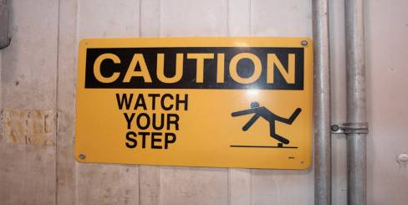
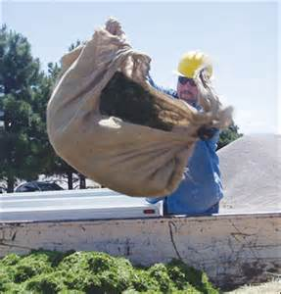
Injuries
Materials Handling
  Falls, slips, trips, or loss of balance
  Repetitive motion
  Overexertion
Source: OSHA
Source: OSHA
Notes:
Analyze job tasks and identify potential hazards associated with a task; determine/use ways to control conditions/actions of the workplace to minimize dangers.

Slide 14
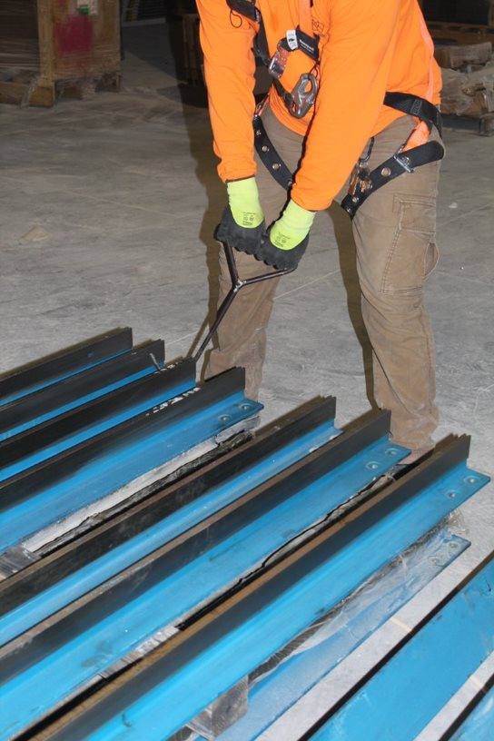
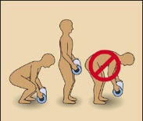
Preventing Hazards
Materials Handling
Moving materials manually
  Use devices to assist with holding loads
  Wear PPE
  Use proper lifting technique
  Seek help for oversized loads
  Use blocking materials
Source of photos: OSHA
Notes:
OSHA 2002, https://www.osha.gov/Publications/OSHA2236/osha2236.html:
Attach handles or holders to loads.
Always wear appropriate personal protective equipment. “Using the following personal protective equipment prevents needless injuries when manually moving materials:
Hand and forearm protection, such as gloves, for loads with sharp or rough edges.
Eye protection.
Steel-toed safety shoes or boots.
Metal, fiber, or plastic metatarsal guards to protect the instep area from impact or compression.
See OSHA's booklet, Personal Protective Equipment (OSHA 3077), for additional information.”
Use proper lifting techniques.
Break load into parts; get help with heavy or bulky items.
Lift with legs, keep back straight, do not twist.
Use handling aids – such as steps, trestles, shoulder pads, handles, and wheels.
Avoid lifting above shoulder level.
“To prevent injury from oversize loads, workers should seek help in the following:
When a load is so bulky that employees cannot properly grasp or lift it,
When employees cannot see around or over a load, or
When employees cannot safely handle a load. “
“Employees should use blocking materials to manage loads safely. Workers should also be cautious when placing blocks under a raised load to ensure that the load is not released before removing their hands from under the load. Blocking materials and timbers should be large and strong enough to support the load safely. In addition to materials with cracks, workers should not use materials with rounded corners, splintered pieces, or dry rot for blocking.”

Slide 15
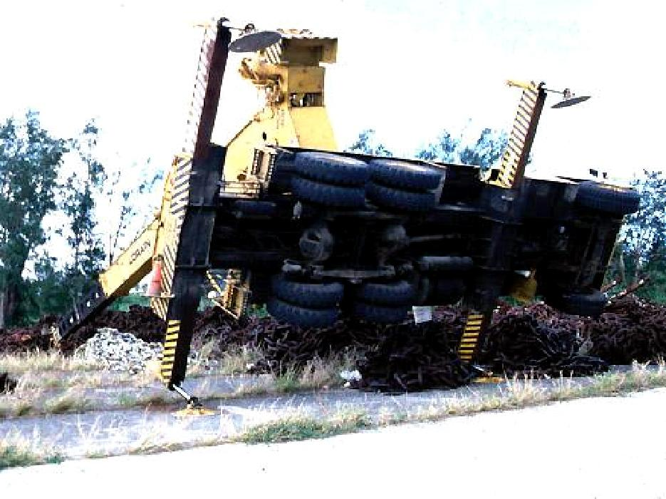
Preventing Hazards
Materials Handling
Cranes
  Major types of crane accidents
    Contact with power lines
    Overturns
    Falls
    Mechanical failure
Source: OSHA
Notes:
OSHA 2002, https://www.osha.gov/Publications/OSHA2236/osha2236.html:

Slide 16
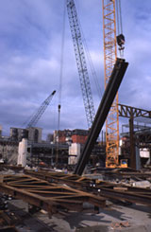

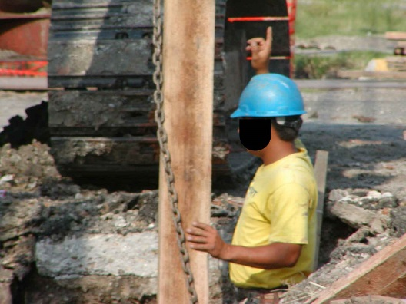
Preventing Hazards
Materials Handling
  Hoisting tons of material, steel, and concrete with cranes
  Operated only by
  thoroughly trained
  and competent workers
Source: OSHA
Source: TEEX - Harwood
Notes:
OSHA 2002, https://www.osha.gov/Publications/OSHA2236/osha2236.html:
Crane operators:
Must be qualified
Should know what they are lifting and what it weighs
“For example, the rated capacity of mobile cranes varies with the length of the boom and the boom radius. When a crane has a telescoping boom, a load may be safe to lift at a short boom length or a short boom radius, but may overload the crane when the boom is extended and the radius increases.”

Slide 17
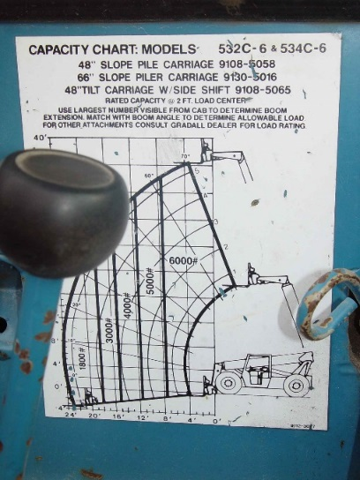
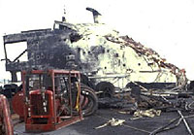
Preventing Hazards
Materials Handling
  Eliminate/reduce crane
  hazards by:
    Knowing
      Load
      Capacity of the crane
      When the load is safe to lift
    Always checking crane
    load chart and never exceed load limits
Source: TEEX - Harwood
Notes:
OSHA 2002, https://www.osha.gov/Publications/OSHA2236/osha2236.html
“To reduce the severity of an injury, employers must take the following precautions:
Equip all cranes that have adjustable booms with boom angle indicators.
Provide cranes with telescoping booms with some means to determine boom lengths unless the load rating is independent of the boom length.
Post load rating charts in the cab of cab-operated cranes. (All cranes do not have uniform capacities for the same boom length and radius in all directions around the chassis of the vehicle.)
Require workers to always check the crane's load chart to ensure that the crane will not be overloaded by operating conditions.
Instruct workers to plan lifts before starting them to ensure that they are safe.
Tell workers to take additional precautions and exercise extra care when operating around power lines.
Teach workers that outriggers on mobile cranes must rest on firm ground, on timbers, or be sufficiently cribbed to spread the weight of the crane and the load over a large enough area. (Some mobile cranes cannot operate with outriggers in the traveling position.)
Direct workers to always keep hoisting chains and ropes free of kinks or twists and never wrapped around a load.
Train workers to attach loads to the load hook by slings, fixtures, and other devices that have the capacity to support the load on the hook.
Instruct workers to pad sharp edges of loads to prevent cutting slings.
Teach workers to maintain proper sling angles so that slings are not loaded in excess of their capacity.“

Slide 18
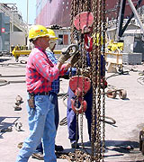
Preventing Hazards
Materials Handling
    Inspection of crane by a qualified person
      Modified, repaired, or adjusted
      Post-assembly
      At least every 12 months
      Equipment not in regular use
    Visual inspection by a
    competent person
      Prior to each shift
      Monthly
Source: OSHA
Notes:
OSHA 2002, https://www.osha.gov/Publications/OSHA2236/osha2236.html
“Ensure that all cranes are inspected frequently by persons thoroughly familiar with the crane, the methods of inspecting the crane, and what can make the crane unserviceable. Crane activity, the severity of use, and environmental conditions should determine inspection schedules.
Ensure that the critical parts of a crane—such as crane operating mechanisms, hooks, air, or hydraulic system components and other load-carrying components—are inspected daily for any maladjustment, deterioration, leakage, deformation, or other damage.“

Slide 19
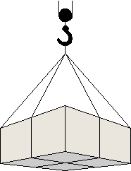
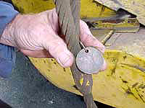
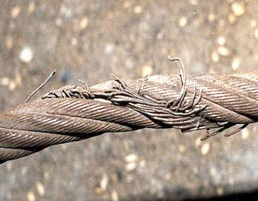
Preventing Hazards
Materials Handling
Slings
  Connect a crane hook to a load
  Proper selection
  Inspection
Source of photos: OSHA
Notes:
https://www.osha.gov/doc/outreachtraining/htmlfiles/slings.html
Selection of slings
“Slings are generally one of six types: chain, wire rope, metal mesh, natural fiber rope, synthetic fiber rope, or synthetic web. In general, use and inspection procedures tend to place these slings into three groups: chain, wire rope and mesh, and fiber rope web. Each type has its own particular advantages and disadvantages. Factors that should be taken into consideration when choosing the best sling for the job include the size, weight, shape, temperature, and sensitivity of the material to be moved, as well as the environmental conditions under which the sling will be used.”
Inspection
“Designate a competent person to conduct inspections of slings before and during use, especially when service conditions warrant.”
Damaged or defective slings must be removed from service.

Slide 20
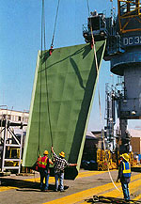
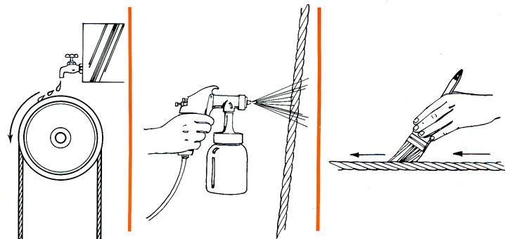
Preventing Hazards
Materials Handling
  Reduce sling hazards by:
    Lubrication
    Do not shorten with knots,
    bolts, or other devices,
    or kink legs
    Keep clear of loads
    Avoid sudden movement
Source: OSHA
Source: OSHA
Notes:
OSHA 2002, https://www.osha.gov/Publications/OSHA2236/osha2236.html
“Ensure that workers observe the following precautions when working with slings:
Remove immediately damaged or defective slings from service.
Do not shorten slings with knots or bolts or other makeshift devices.
Do not kink sling legs.
Do not load slings beyond their rated capacity.
Keep suspended loads clear of all obstructions.
Remain clear of loads about to be lifted and suspended.
Do not engage in shock loading.
Avoid sudden crane acceleration and deceleration when moving suspended loads.”

Slide 21
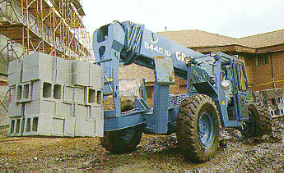
Preventing Hazards
Materials Handling
Forklifts
  Main causes of injuries
    Forklift overturns
    Forklift striking workers on foot
    Persons crushed by forklifts
    Persons falling from forklifts
Source: OSHA

Slide 22

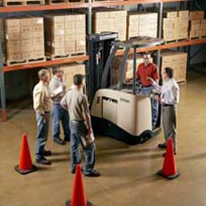
Preventing Hazards
Materials Handling
  Illegal forklift operators
    Anyone under 18
    Anyone not properly trained and certified
Source of photos: OSHA
Notes:
https://www.osha.gov/SLTC/etools/pit/assistance/index.html
The training provided must be applicable to the work site and working conditions. Trainees must be supervised by a competent persons and may not operate trucks where they would endanger anyone.
The requirements of the standards must be taught, as well as truck-related and workplace-related topics.
Three separate aspects of powered industrial truck training must be completed:
1. Formal training – lecture, discussion, interactive computer learning, written materials
2. Practical training – demonstrations and exercises performed by the trainee
3. Evaluation – practical observance and determination of the trainees’ competence and capability

Slide 23
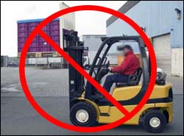
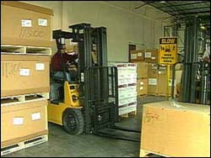
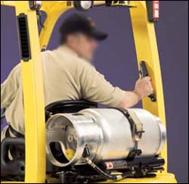
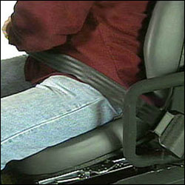
Preventing Hazards
Materials Handling
  Driving the forklift
    Obstructed vision
    Travel path
    Approaching people
    Elevated platform
    Seat belts and ROPS
    Raising/lowering forks
    Safe distance
Source of photos: OSHA
Notes:
OSHA n.d., https://www.osha.gov/SLTC/etools/pit/operations/index.html
Slow down and sound the horn at locations where vision is obstructed.
Look toward the travel path and keep a clear view of it.
Don’t drive up to anyone standing in front of a bench or other fixed object.
Don’t drive with the work platform elevated.
Use seatbelts with ROPS.
Don’t raise or lower the forks while the forklift is moving.
Maintain safe distance approximately three truck lengths from the truck ahead.

Slide 24
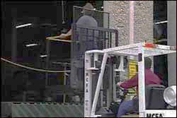
Preventing Hazards
Materials Handling
  Elevating workers with forklift
    Standing on forks
    Lifting personnel
    Approved lift platform
    Restraining means
Source: OSHA
Notes:
OSHA n.d., https://www.osha.gov/SLTC/etools/pit/operations/index.html
Don’t use a forklift to elevate workers who are standing on the forks.
Only lift personnel with approved lift platform; elevate a worker on an approved lift platform only when the vehicle is directly below the work area.
Whenever a truck is used to elevate personnel, secure the elevating platform to the lifting carriage or forks of the forklift.
Use a restraining means, such as rails, chains, or a body belt with a lanyard for the worker(s) on the platform.

Slide 25
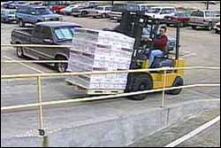
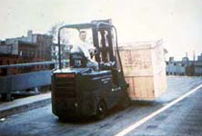
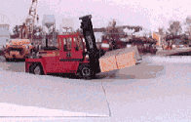
Preventing Hazards
Materials Handling
  Driving forklift on grades/ramps
    Use extreme caution
    No turns
    Tilting and raising load
    Point load up the incline
Source of photos: OSHA
Notes:
Use extreme caution when driving on grades or ramps.
Do not turn on grades or ramps.
On grades, tilt the load back and raise it only as far as needed to clear the road surface.
When ascending or descending grades are greater than 10%, drive loaded trucks with the load upgrade
OSHA n.d., https://www.osha.gov/SLTC/etools/pit/workplacehazards/ramps.html
“When traveling with a load, the load should point up the incline, regardless of direction of travel.
Going up the incline:
Drive forward.
Forks pointed upgrade.
Use a spotter if load blocks the driver's view.
Going down the incline:
Drive in reverse.
Turn head and face downgrade.
Forks pointed up the grade.
NOTE: When walking with a pallet truck with or without a load, the forks should be pointed downgrade, regardless of direction of travel.”

Slide 26
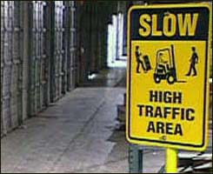
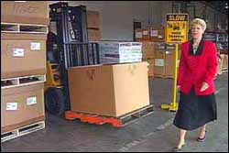
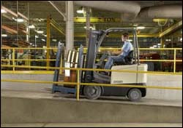
Preventing Hazards
Materials Handling
  Forklift operating speed
    Tip-overs
    Turning
    Avoiding collisions
    Wet and slippery floors
    Ascending/descending
    Obstructed vision
Source of photos: OSHA
Notes:
OSHA n.d., https://www.osha.gov/SLTC/etools/operations/manueuvering.html#operating
Driving too fast can cause tip-overs. Slow down when turning.
Forklifts cannot stop quickly; avoid collisions with pedestrians and obstacles by controlling speed so that forklift can be stopped in time.
Slow down on wet and slippery floors, and when ascending or descending grades.
Where vision is obstructed, such as cross aisles or around corners, slow down and sound horn.

Slide 27
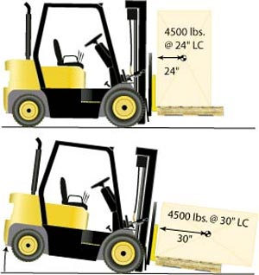
Preventing Hazards
Materials Handling
  Avoiding Excess Weight
    Do not exceed weight capacity of forklift
    Center loads and secure to keep from shifting to maintain balance of weight
Source: OSHA
Notes:
Do not exceed weight capacity of forklift.
Center loads and secure to keep from shifting to maintain balance of weight
OSHA n.d., https://www.osha.gov/SLTC/etools/pit/operations/loadhandling.html
Center load and secure.
Heaviest part of load should be placed nearest the front wheels.
“Do not overload. Know the stated capacity of your forklift and do not exceed it. Only by keeping within the weight limit can you operate the forklift safely.”
“A forklift’s capacity is rated for a specified load center. If the load is off-center, improperly distributed, or oversized, it may exceed capacity and unbalance the forklift.”

Slide 28
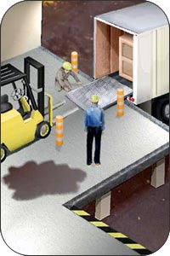
Preventing Hazards
Materials Handling
  Use of dock boards for loading/uploading
    Bridging space
    Securing portable dock boards
    Handholds for dock boards
Source: OSHA
Notes:
Use appropriate weight-rated platform to bridge space.
Secure portable dock boards so that they will not move.
Ensure that dock boards have handholds or some other effective way to lift, manage, or move them safely.

Slide 29
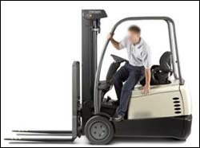
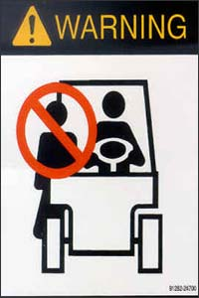
Preventing Hazards
Materials Handling
  Exiting the forklift
    Set brake, lower forks/lifting carriage, neutralize controls
    Stand-up type forklift
  Riding the forklift
    No passengers allowed
    Exception – seat is provided
Source of photos: OSHA
Notes:
OSHA n.d., https://www.osha.gov/SLTC/etools/pit/operations/maneuvering.html#mounting
Exiting the forklift:
Hands need to be clean and dry to prevent slipping when grabbing handhold.
Get a good grip on handhold; do not grab steering wheel.
Be careful with footing when mounting or dismounting forklift to avoid slipping; wear appropriate footwear and keep shoes clean and free from grease.
When getting into or out of cab, pull/lower your body; do not jump out of forklift.
OSHA n.d., https://www.osha.gov/SLTC/etools/pit/workplacehazards/pedestriantraffic.html
Riding the forklift:
“The OSHA standard [29 CFR 1910.178(m)(3)] states that unauthorized personnel are prohibited from riding on a forklift. If riders are authorized, a safe place must be provided.
Unless authorized, never carry passengers -- NO RIDERS.
Use only specialized equipment designed to raise personnel.
Never transport employees on a platform. Employees can only be hoisted up and down.
Never transport employees on the forks.”

Slide 30
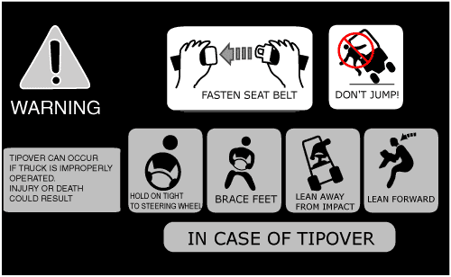
Preventing Hazards
Materials Handling
  Avoiding struck-by/crushed-by
    Don’t jump from an overturning, sit-down type forklift
    Stay with the truck, hold on firmly, and
    lean in the opposite direction of the overturn
Source: OSHA
Notes:
OSHA n.d., https://www.osha.gov/SLTC/etools/pit/operations/maneuvering.html.
“For tip-overs on sit-down counterbalanced trucks:
Don't jump. Stay in the forklift.
Hold tight to the steering wheel.
Brace feet.
Lean AWAY from the impact.
Lean forward.
Note: Tip-over procedures for other types of forklifts may vary. For example operators of stand-up forklifts with rear-entry access should step backwards off the forklift if a tip-over occurs.”

Slide 31
Preventing Hazards
Materials Handling
  Forklift training – do not operate a forklift without proper training and licensing.
  Reporting damage – any damage or problems that occur to a forklift during a shift should be reported to the supervisor.
Source: OSHA

Slide 32



Preventing Hazards
Materials Handling
Earth-moving equipment
  Scrapers
  Loaders
  Crawlers
  Bulldozers
  Off-highway trucks
  Graders
  Tractors
Source of photos: TEEX - Harwood

Slide 33

Preventing Hazards
Materials Handling
Earth-moving equipment
  Seatbelts
  Reverse gear not used unless that piece of equipment has:
    Back-up signal alarm or
    Signaler
  Operator properly trained
Source: OSHA
Notes:
Provide seatbelts; exceptions: equipment is designed for standup operation or equipment does not have ROPS or adequate canopy protection
If equipment has an obstructed rear view, it cannot be used in reverse unless it has a signal alarm.

Slide 34


Employer Requirements
Materials Handling
Comply with OSHA standards related to materials handling, including:
  Training requirements, including requirements for forklift training.
  Inspection requirements
Source of photos: OSHA
Notes:
29 CFR 1926.602
Training requirements for operators of powered industrial trucks are located in 1910.178(l).
Per 1910.178(l)(2)(ii), “training shall consist of a combination of formal instruction…, practical training…, and evaluation of the operator’s performance in the workplace.”

Slide 35

Employer Requirements
Materials Handling
Comply with manufacturers’ requirements and recommendations for materials handling equipment.
Source : OSHA

Slide 36


Recognizing Hazards
Materials Handling
Identify potential hazards and possible solutions:
Protruding screws
Lumber pile is too high. It could fall on the worker
Source of photos : OSHA
Notes:
Left photo: Hazard – protruding wood screws; Solution – remove any protruding objects from wood
Right photo: Hazard – height of lumber pile; Solution – if being manually handled, should not exceed 16 feet high, and lumber piles shall not exceed 20 feet in height.

Slide 37


Recognizing Hazards
Materials Handling
Identify potential hazards and possible solutions:
Poor housekeeping
Unstable brick stack
Source: OSHA
Source: TEEX - Harwood
Notes:
Left photo: Hazard - Unstable stacked materials; Solution – stack bricks in a manner that will keep them from falling, do not stack them more than 7 feet high, and taper back a loose brick stack after it is 4 feet high.
Right photo: Hazard – poor housekeeping, using work area for storage of materials; Solution – keep work areas free from accumulated materials that cause tripping, fires, or explosion hazards, or may contribute to harboring of pests.

Slide 38


Recognizing Hazards
Materials Handling
Identify potential hazards and possible solutions:
Damaged strap
Blocks improperly stacked
Source of photos : TEEX Harwood
Notes:
Left photo: Hazard – lifting strap is damaged; Solution – replace lifting strap
Right photo: Hazard – concrete blocks placed vertically on scaffolds can fall and strike someone below; Solution – stack blocks horizontally; prevent materials from falling.
1926.451(h)(1) In addition to wearing hardhats each employee on a scaffold shall be provided with additional protection from falling hand tools, debris, and other small objects through the installation of toeboards, screens, or guardrail systems, or through the erection of debris nets, catch platforms, or canopy structures that contain or deflect the falling objects. When the falling objects are too large, heavy or massive to be contained or deflected by any of the above-listed measures, the employer shall place such potential falling objects away from the edge of the surface from which they could fall and shall secure those materials as necessary to prevent their falling.

Slide 39
Knowledge Check
Materials Handling
How old do you have to be to operate a forklift, regardless of training?
  16
  18
  21
  25
b. You must be at least 18 years
old to operate a forklift.

Slide 40
Knowledge Check
Materials Handling
One good way to prevent materials handling hazards is to ___.
  Refuse to allow personnel to ride equipment without a seat and seatbelt
  Report all damaged equipment immediately
  Operate within manufacturer’s specifications
  All of these.
d. All of these are good ways to
prevent materials handling hazards.

Slide 41
Knowledge Check
Materials Handling
Which of the following is a method for eliminating or reducing crane operation hazards?
  Operators should know how much they are lifting as well as the rated capacity of the crane.
  A competent person should visually inspect the crane once a year.
  Never exceed the load limit by more than 10%.
  All of these.
a. Crane operators should know how
much they are lifting and the rated
capacity of the crane.

Slide 42
Knowledge Check
Materials Handling
Employers must comply with OSHA standards related to materials handling, including training and _____.
  Equipment
  Operations
  Inspection
  All of these.
c. Employers must comply with OSHA
standards for training and inspection.

Slide 43
Materials Handling
Through the Alliance between OSHA’s 10 Regional Offices and the Elevator Contractors of America (ECA), Elevator Industry Work Preservation Fund (EIWPF), International Union of Elevator Constructors (IUEC), National Association of Elevator Contractors (NAEC), National Elevator Industry Educational Program (NEIEP), and National Elevator Industry Inc. (NEII), collectively known as The Elevator Industry Safety Partners, developed this Industry Specific Training for informational purposes only. It does not necessarily reflect the official views of OSHA or the U.S. Department of Labor. May 2021
Under the Occupational Safety and Health Act, employers are responsible (http://www.osha.gov/as/opa/worker/employer-responsibility.html) for providing a safe and healthy workplace and workers have rights (https://www.osha.gov/workers). OSHA can help answer questions or concerns from employers and workers. OSHA's On-Site Consultation Program (https://www.osha.gov/consultation) offers free and confidential advice to small and medium-sized businesses, with priority given to high-hazard worksites. For more information, contact your regional or area OSHA office (https://www.osha.gov/contactus/bystate), call 1-800-321-OSHA (6742), or visit https://www.osha.gov/.

Slide 44

Materials Handling

