Slide 1

Intro
1
BCTD – AFL Smart Mark Module
Health and Safety Program Management

Slide 2
Intro
2
BCTD – AFL Smart Mark Module
Objectives: At the end of this training, you will be able to:
Explain the key elements of an injury and illness prevention program
Describe roles and responsibilities in establishing an injury and illness prevention program
Conduct a Job Hazard Analysis
List 3 potential problems with incentive programs
Identify 3 contributing factors to actual construction workplace fatalities using root cause analysis

Slide 3



Elements
3
Intro
BCTD – AFL Smart Mark Module
Explain the key elements in an injury and illness prevention program
Objective 1

Slide 4
Key Principles of Health and Safety
Employer is responsible for maintaining a safe and healthy workplace
Employees should be involved in developing policies and programs
There should be no sanctions for H&S related activities
Employer should implement best and most effective practices/policies to protect workers from hazards

Slide 5









Elements
4
Intro
BCTD – AFL Smart Mark Module
OSHA, NIOSH, ANSI, and DOE agree on the six elements of a successful safety program.
What do you think they are?
Management commitment
Employee involvement
Hazard identification and assessment
Hazard prevention and control
Education and training
Program evaluation and improvement
DOE

Slide 6

Elements
5
Intro
BCTD – AFL Smart Mark Module
Does OSHA require employers to have a comprehensive written
health and safety program?
NO… Some individual standards, like lead, respiratory protection, and others require written programs, but there is no requirement for a comprehensive written program.
OSHA has been working on the Injury and Illness Prevention Program (I2P2) standard.
Some of the State plan States have written H & S program requirements.

Slide 7

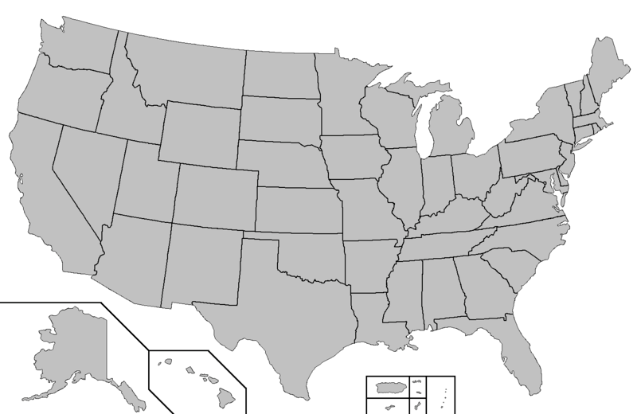

















Elements
6
Intro
BCTD – AFL Smart Mark Module
OSHA found the 34 states that require H&S programs had a 9% - 60%
drop in incidents

Slide 8

Elements
7
Intro
BCTD – AFL Smart Mark Module
Describe management roles and responsibilities in establishing an injury and illness
prevention program
Objective 2

Slide 9


Elements
8
Intro
BCTD – AFL Smart Mark Module
What specific H&S duties are management’s responsibility?
What do you think?
Notes:
Implementing a program
Hazard identification and assessment: Daily Inspection, JSA, accident investigation
Hazard prevention and control: PPE, fall protection, LOTO, machine guarding,
Education and training
Program evaluation and improvement: review 300 logs, employee suggestions, annual review of LOTO

Slide 10

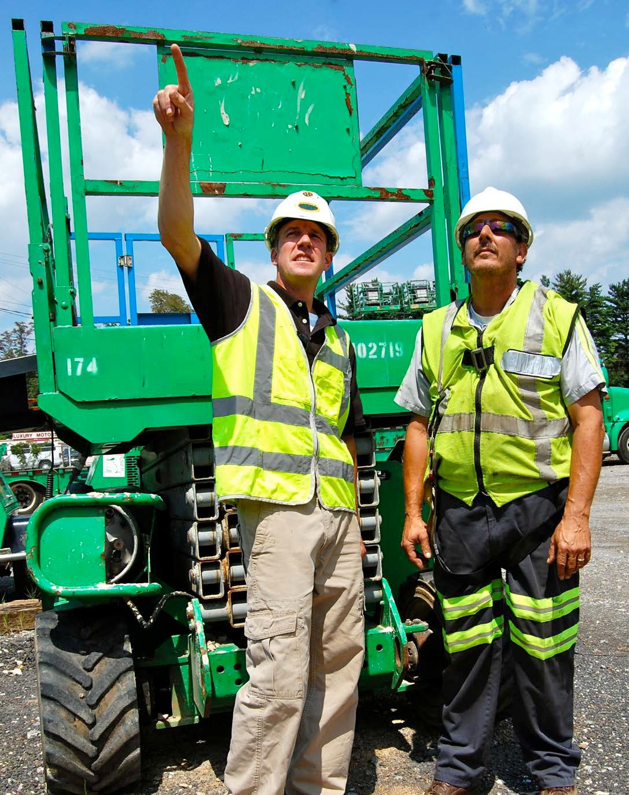
Elements
9
Intro
BCTD – AFL Smart Mark Module
In what parts of the safety program should employees be involved?
Photo courtesy Sunbelt Rental
Notes:
Informing management of hazards
Asking questions if they don’t know what to do
Assist with program review, conducting low level training, assisting with any investigations, identify improvements to controls in the their workplaces

Slide 11

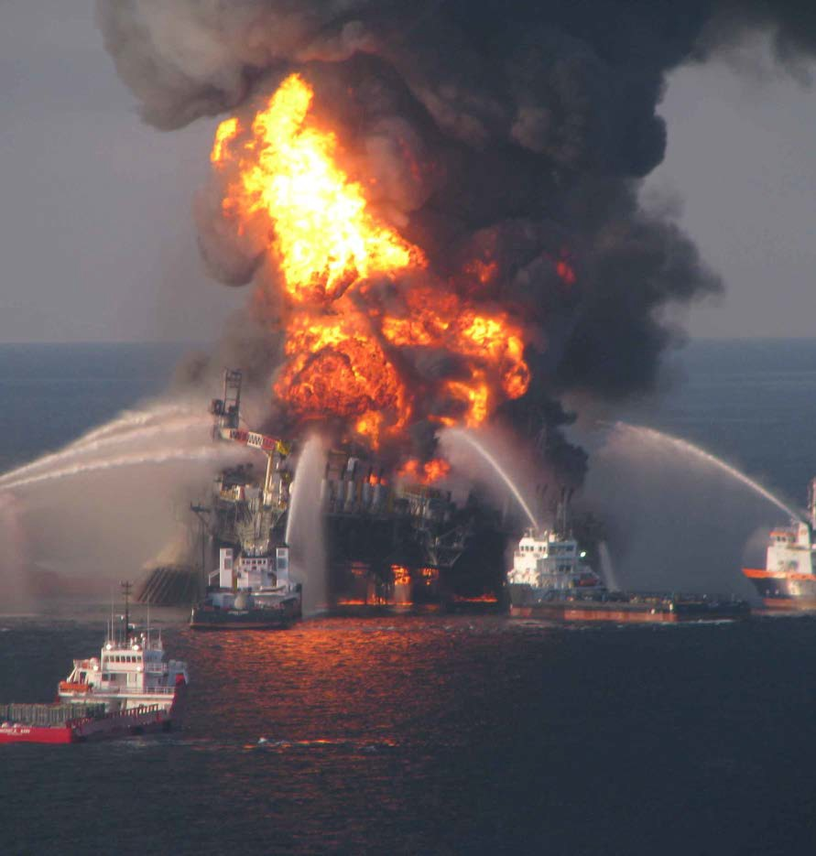
Elements
10
Intro
BCTD – AFL Smart Mark Module
An example of a standard where OSHA requires employee involvement
In the Process Safety Mgt standard, OSHA requires employee participation in hazard analyses

Slide 12

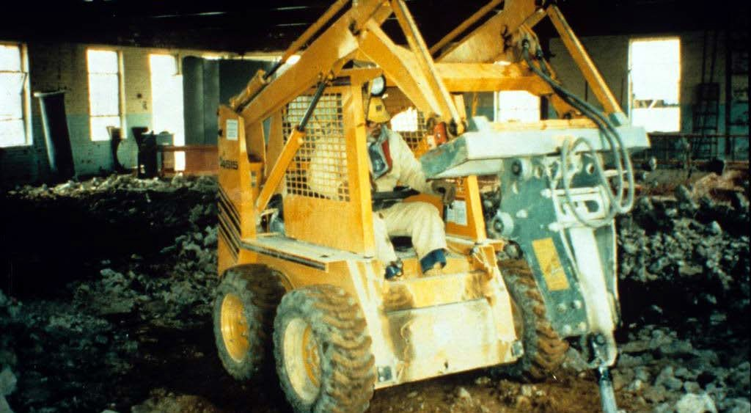
Elements
11
Intro
BCTD – AFL Smart Mark Module
What are some different ways foremen and workers can identify hazards?
Photo courtesy eLCOSH
Notes:
Pre job analysis
Daily inspections by foreman and workers
Inspections for a 3rd party

Slide 13

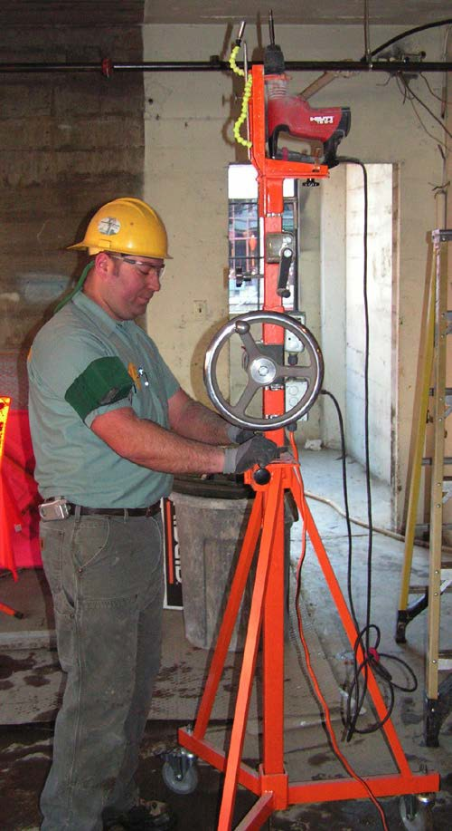


Elements
12
Intro
BCTD – AFL Smart Mark Module
Before putting a worker in PPE what other controls should be considered?
Inverted drill press What type of control?
Notes:
Training on use, limitations and daily inspections
Requiring daily inspections
Replacing faulty equipment

Slide 14








Elements
13
Intro
BCTD – AFL Smart Mark Module
We should always try to apply the hierarchy of controls
Most Effective Elimination
Substitution
Engineering Controls
Administrative Controls
Least Effective
Personal Protective Equip.

Slide 15
Elements
BCTD – AFL Smart Mark Module
13
Intro
PPE is last because it puts the burden on the worker and is least effective
Most Effective Elimination
Substitution
Engineering Controls
Administrative Controls
Personal Protective Equip.
Least Effective

Slide 16









Elements
14
Intro
BCTD – AFL Smart Mark Module
Match controls to Hazards
 | Hazards | Control
1 | Working at heights wearing a full body harness
2 | Using water-based hand cleaner rather than cleaning up with turpentine
3 | Working from a mast climber rather than normal scaffolding
4 | Training workers how to safely remove lead paint
5 | Switching workers after 4 hours on a noisy piece of equipment to reduce the personal exposure
6 | Halting all asbestos use in products
7 | Marking which outlets aren’t GFCI protected
Elimination
Substitution Engineering Controls
Administrative Controls Personal Protection

Slide 17








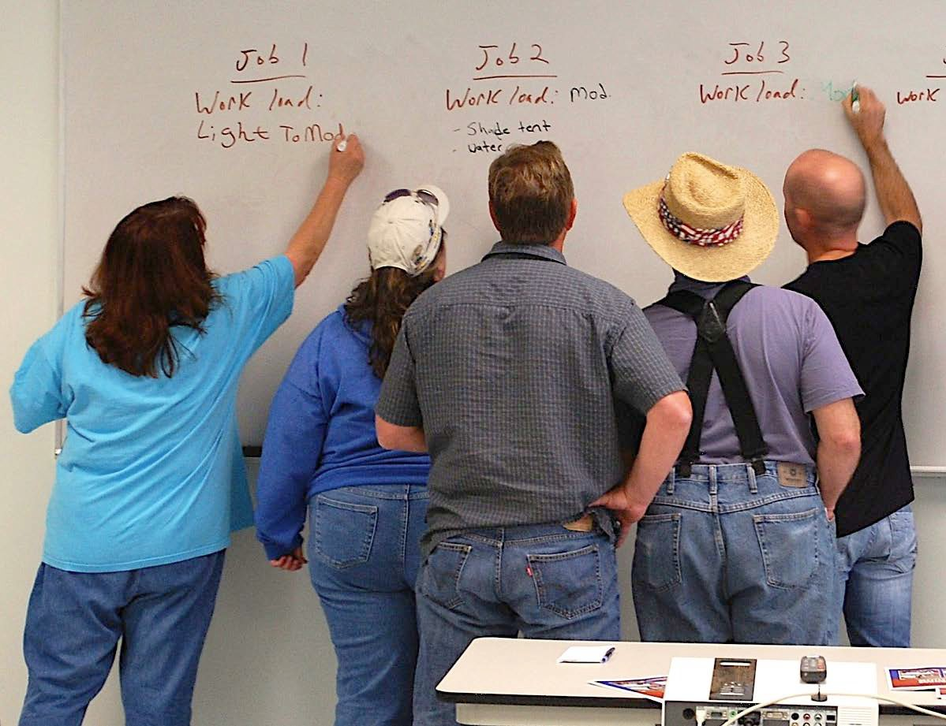








Elements
15
Intro
BCTD – AFL Smart Mark Module
Education and training are important, where are they in the hierarchy of controls?
Safety Program Element 5
Elimination
Substitution Engineering Controls Administrative Controls Personal Protection
Notes:
The superintendent needs training
The foreman needs training
The workers need training
Reinforce the training by checking for compliance
Tool box meetings as refresher
Retrain those who don’t follow the rules

Slide 18
Subpart C
16
Intro
BCTD – AFL Smart Mark Module
Regulatory framework 1926 Subpart C
General Safety and Health Provisions

Slide 19

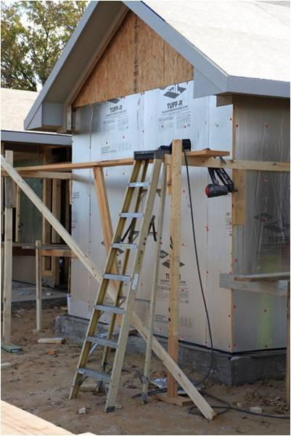
Subpart C
18
Intro
BCTD – AFL Smart Mark Module
1926.20(a)(1)
no contractor or subcontractor for any part of the contract work shall require any laborer
or mechanic employed in the
Employers can’t require us to
work in unsafe conditions
performance of the contract
to work in surroundings or under working conditions which are unsanitary,
hazardous, or dangerous
to his health or safety
Notes:
The employer should inspect the area before allowing workers to work for the day
The employer should remove or eliminate any hazards before allowing work to take place
The employer must provide the necessary safety controls, PPE, and Training before allowing work to take place

Slide 20

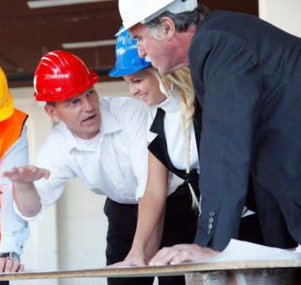
Subpart C
20
Intro
BCTD – AFL Smart Mark Module
1926.20(b)(1)
It shall be the
responsibility of the
employer to initiate and
maintain such programs
as may be necessary to
comply with this part.
Employers must start
safety programs and keep them current.

Slide 21

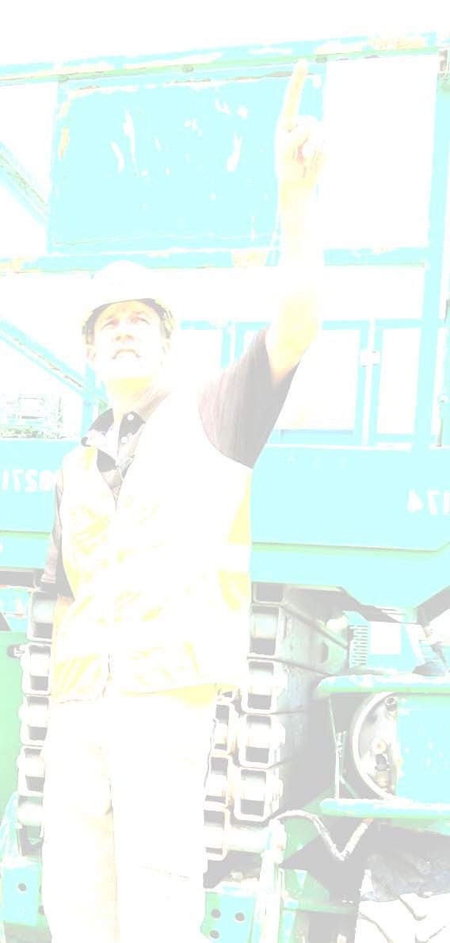
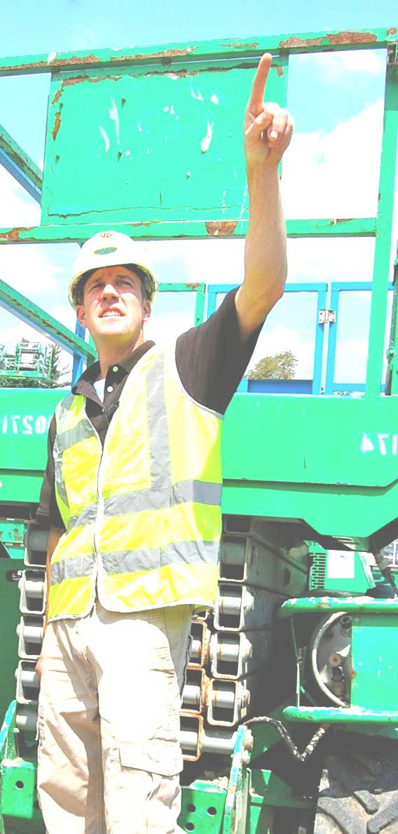

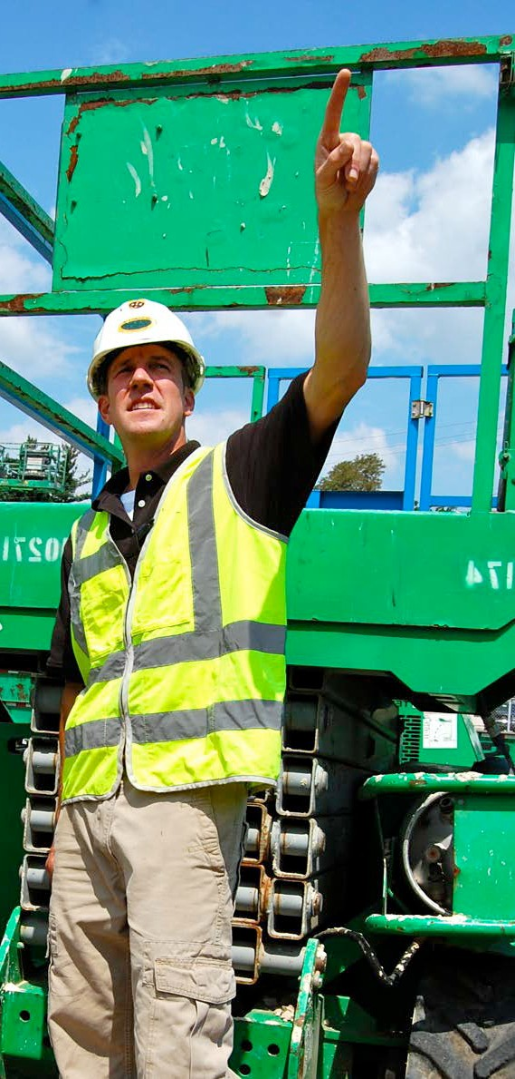
Subpart C
21
Intro
BCTD – AFL Smart Mark Module
1926.20(b)(2)
(2) Such programs shall
provide for frequent and
regular inspections of the
The Safety program must
have competent persons making frequent and regular inspections
job sites, materials, and
equipment to be made
by competent persons
designated by the
employers.
Photo courtesy Sunbelt Rentals
Notes:
Daily inspections are not adequate as the work environment changes
Coming back from lunch is usually a good time for a re inspection

Slide 22

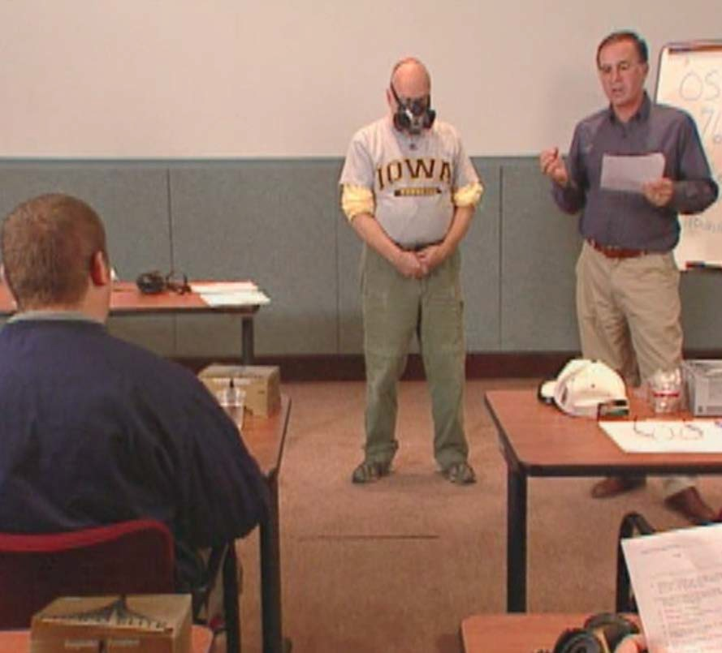
Subpart C
23
Intro
BCTD – AFL Smart Mark Module
1926.20(f)(2)
The employer must train
each affected employee
in the manner required
Employers must train us
by the standard, and
each failure to train
an employee may be
considered a
separate violation.
Notes:
Training is not just telling. If there is a skill the worker must practice tasks like wearing PPE, performing LOTO, operating any equipment whether small or large.

Slide 23

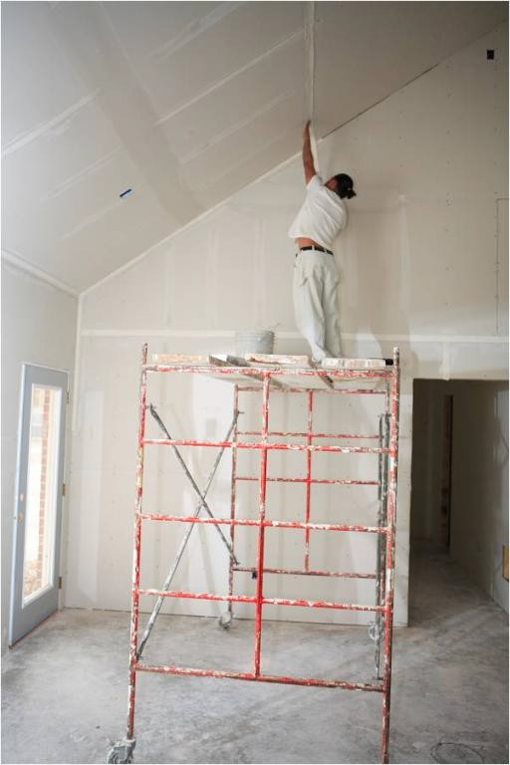
Subpart C
25
Intro
BCTD – AFL Smart Mark Module
1926.21(b)(2)
The employer shall instruct
each employee in the
Our employer must train us
to recognize hazards and how to avoid, control, or eliminate unsafe conditions
recognition and avoidance of unsafe conditions and
the regulations applicable
to his work environment to
control or eliminate any
hazards or other exposure
to illness or injury.

Slide 24

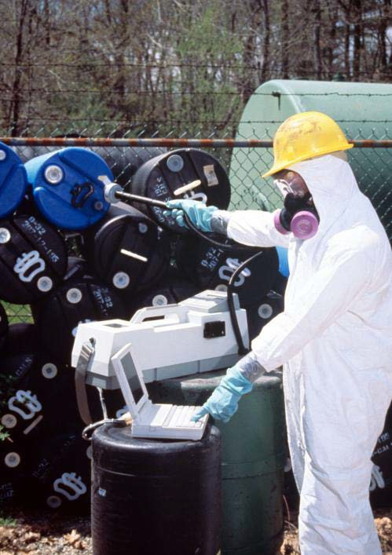
Subpart C
26
Intro
BCTD – AFL Smart Mark Module
1926.21(b)(3)
Employees required to
handle or use poisons,
caustics, and other harmful
substances shall be
instructed regarding the
safe handling and use, and
Employers must
show us how to handle dangerous chemicals safely.
be made aware of the potential hazards, personal
hygiene, and personal
protective measures
required.
Notes:
All elevator constructors need hazard communication training. Because they work with chemicals
All elevator constructors need training on PPE; welding goggles, gloves when working with hazardous chemicals, use of face shield and safety glasses when working with caustic chemicals

Slide 25

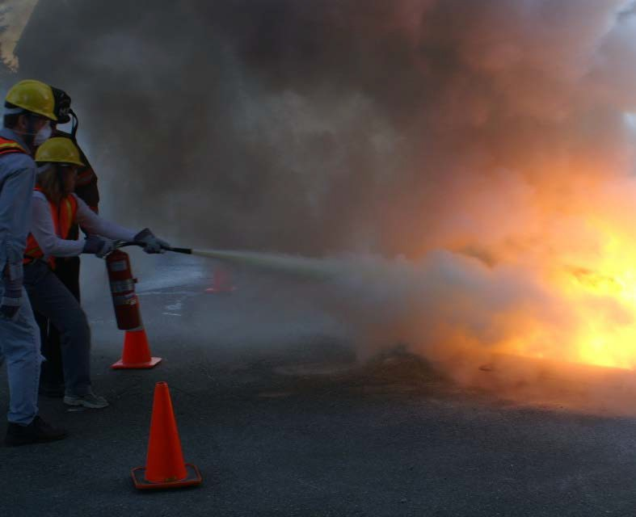

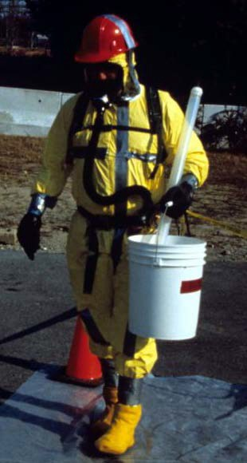
Subpart C
28
Intro
BCTD – AFL Smart Mark Module
1926.21(b)(5)
Employees required
to handle or use
flammable liquids,
gases, or toxic
materials shall be
instructed in the
safe handling and
use of these materials and made aware
Employers must teach us specific OSHA
rules for safe handling of flammable and toxic materials
of the specific requirements contained
in Subparts D, F, and other applicable
subparts of this part.

Slide 26
Subpart C
29
Intro
BCTD – AFL Smart Mark Module
1926 Subpart C
Questions to think about
Of all the highlighted paragraphs, which ONE do you think is the MOST important? Why?
What does it have to do with Health and Safety Programs in Construction?
Do employers comply with this Subpart now?

Slide 27

JHA
30
Intro
BCTD – AFL Smart Mark Module
Conduct a Job Hazard Analysis
Objective 3

Slide 28


JHA
31
Intro
BCTD – AFL Smart Mark Module
How to perform a Job Hazard Analysis?
OSHA’s guide for employers says:
Involve your employees
Review your accident history
Conduct a preliminary job review
List, rank, and set priorities for hazardous jobs
Outline the steps or tasks

Slide 29


JHA
32
Intro
BCTD – AFL Smart Mark Module
Job Hazard Analysis is the most used tool because of its applicability
Can JHAs be performed for all jobs, whether special or routine?
How should we establish priorities for analyzing your jobs?
How do we break the job down?
Is this a job best left to Safety Professionals?

Slide 30
JHA
33
Intro
BCTD – AFL Smart Mark Module
Breaking every job or activity down to each step is critical
Step | Potential Hazard | Control
1.
2.
3.
4.
Here’s an example of a form that could be used to do a JHA

Slide 31

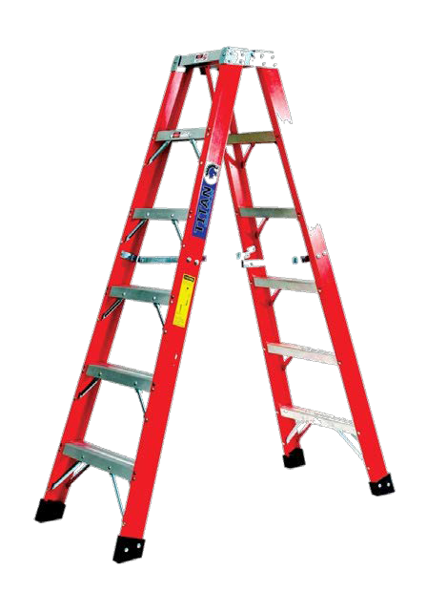
JHA
34
Intro
BCTD – AFL Smart Mark Module
Joint Exercise: let’s do a JHA for unloading a truck at the job site
Step | Potential Hazard | Control
Notes:
Fall hazards – might not be a large fall height, but still a concern.
Is the rigging under pressure
Ergonomic hazards
Potential need to use material handling equipment
Do we need gloves

Slide 32
JHA
35
Intro
BCTD – AFL Smart Mark Module
Let’s do a group exercise
In your group, identify a major job activity that someone has coming up that would lend itself to a JHA
Work through each step of that activity using the JHA form in your manual
Each group will need:
  A person to write down the JHA on a flip chart
  A reporter to present your findings to the larger group
Let’s take 15 minutes

Slide 33


JHA
36
Intro
BCTD – AFL Smart Mark Module
What is a “What-if Analysis?”

Slide 34
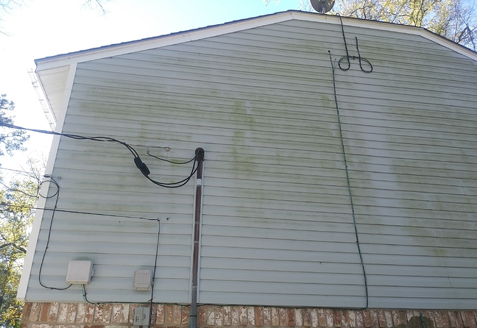
JHA
37
Intro
BCTD – AFL Smart Mark Module
Let’s apply a What-if Analysis to a real situation

Slide 35
JHA
37
Intro
BCTD – AFL Smart Mark Module
You need to clean this siding. The roof peak is 20’. There is a satellite feed, a 220 V power drop and an alarm box. You are using a chemical that is slightly corrosive.
Notes:
Fall hazards
Electrocution hazards
Chemical hazards
Are there people working below
Is the ground flat and stable

Slide 36
JHA
39
Intro
BCTD – AFL Smart Mark Module
Let’s apply a What-if Analysis to this project
What-If? | Result | Controls in place or needed
Start each question with “What if…?”
Notes:
Fall hazards
Electrocution hazards
Chemical hazards
Are there people working below
Is the ground flat and stable

Slide 37

Incentive Programs
41
Intro
BCTD – AFL Smart Mark Module
List 3 potential problems with incentive programs
Objective 4

Slide 38

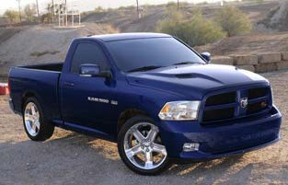



Incentive Programs
42
Intro
BCTD – AFL Smart Mark Module
Safety Incentive Programs
Do They Work?

Slide 39



Incentive Programs
43
Intro
BCTD – AFL Smart Mark Module
“People focus on getting the reward rather than the benefit of going home every day without being injured.”
Andrew R. McIlvaine 2009
SAFETY
ALL STAR

Slide 40


Incentive Programs
44
Intro
BCTD – AFL Smart Mark Module
Safety incentives
How do they work?
Do they really prevent accidents?
How are they viewed by OSHA?
Is there a better way?

Slide 41

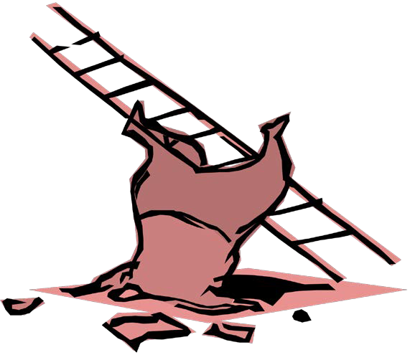

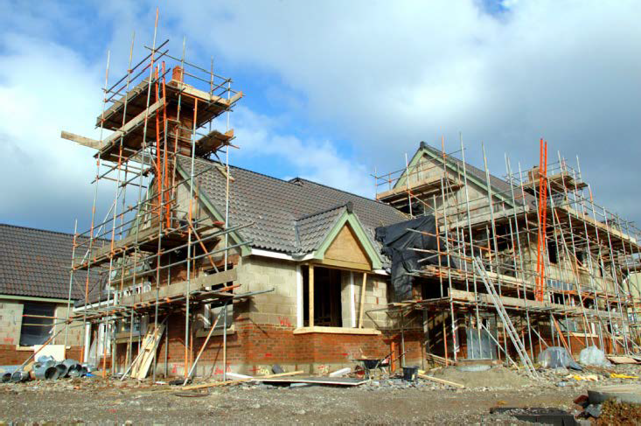








Incentive Programs
45
Intro
BCTD – AFL Smart Mark Module
Incentive program goals
Lower accident rates
Improve productivity
Improve employee morale
Lower insurance rates

Slide 42

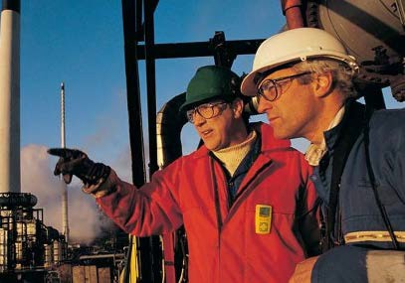




Incentive Programs
46
Intro
BCTD – AFL Smart Mark Module
What is supposed to happen?
Hazards reported and corrected in a timely manner
Positive reinforcement for acceptable behavior
Rewards for safe work practices

Slide 43


Incentive Programs
47
Intro
BCTD – AFL Smart Mark Module
“Good incentive programs feature positive reinforcement for:
demonstrating safe work practices
taking active measures in
  hazard recognition,
  analysis,
  and prevention.”
    R. Davis Layne, Exec. Dir. VPPPA

Slide 44
Incentive Programs
48
Intro
BCTD – AFL Smart Mark Module
Unfortunately, incentive programs often have some negative effects.
Can you think of any?
Hiding injuries
Employer – to - worker intimidation
Worker – to - worker intimidation
Others?

Slide 45

Incentive Programs
50
Intro
BCTD – AFL Smart Mark Module
Workers hide their injuries
The winner chuckled as he gave a brief acceptance speech:
“I can’t believe I won this.
I broke my foot four months ago and hid it so I would still have a chance to win this…
Good thing I did.”
Bruce Buckley, ENR – Engineering News Record

Slide 46
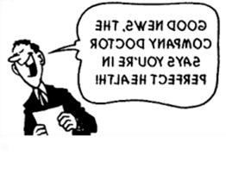

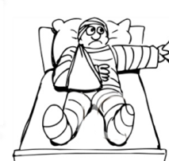
Incentive Programs
52
Intro
BCTD – AFL Smart Mark Module
Even health care providers feel pressure
More than half the occupational health practitioners surveyed said they felt pressure from employers to play down injuries or illnesses
Nearly half—47 percent— felt similar pressure from employees

Slide 47
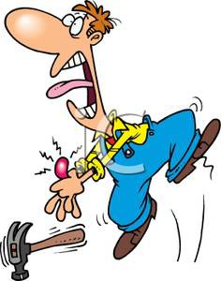


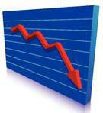

Incentive Programs
53
Intro
BCTD – AFL Smart Mark Module
Why employers don’t report all injuries
Can’t
Bid
Fewer projects
Injured worker
Insurance rates go up
Profits go down
Injury reported

Slide 48

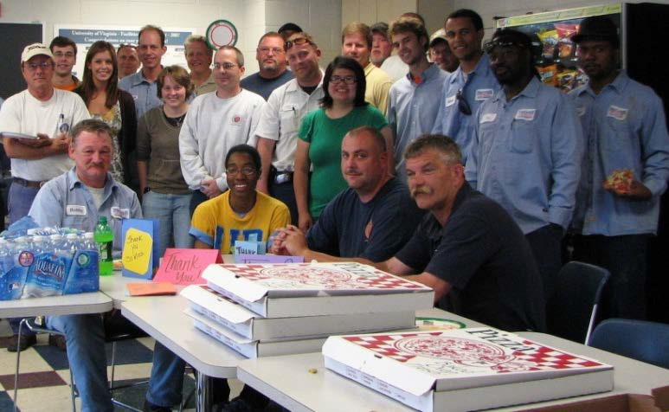
Incentive Programs
54
Intro
BCTD – AFL Smart Mark Module
Workers feel peer pressure
“When all workers on a team get a reward only if no one on the team has an injury,
there may be pressure on all team members to not report injuries.”
GAO 2009

Slide 49

Incentive Programs
55
Intro
BCTD – AFL Smart Mark Module
OSHA’s position on incentive programs
Incentive programs that discourage employees from reporting their injuries are problematic because, under section 11(c), an employer may not "in any manner discriminate" against an employee because the employee exercises a protected right, such as the right to report an injury.
3/12/2012 Memo from: Richard E. Fairfax, CIH Deputy Assistant Secretary of Labor for OSHA

Slide 50
Incentive Programs
56
Intro
BCTD – AFL Smart Mark Module
What is wrong with the following statements from actual
Safety Incentive Programs?

Slide 51

Incentive Programs
58
Intro
BCTD – AFL Smart Mark Module
$$ Company Cash $$
If the company operates three months without a lost-time accident or doctor case,
each employee will get $50 in “Company Cash”, redeemable for company merchandise or time off.
Each accident requiring medical care causes the value of everyone’s “company cash” to drop $10, and each lost-time case causes the value to drop $25.
The injured employee himself loses $25 of his “Cash” for a minor accident and the entire amount for a lost-time case.

Slide 52





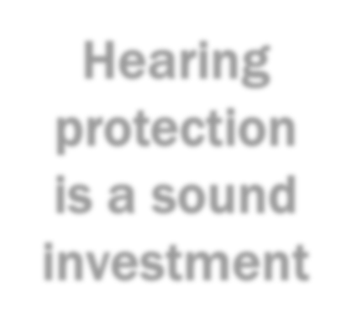

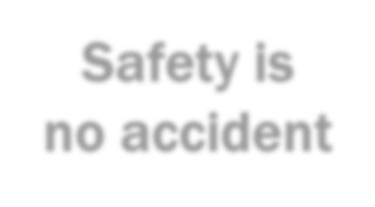

Incentive Programs
59
Intro
BCTD – AFL Smart Mark Module
** Your Company Info Board **
Safety Slogan
A different safety slogan is posted on the site each month.
At the end of the month, a management member draws a employee’s name from a hat.
A call is made to the employee's
Slogan of the Month
Hearing protection is a sound investment
Safety is no accident
residence. If the person answering
the phone is able to quote the safety slogan, he/she is wins a prize.

Slide 53

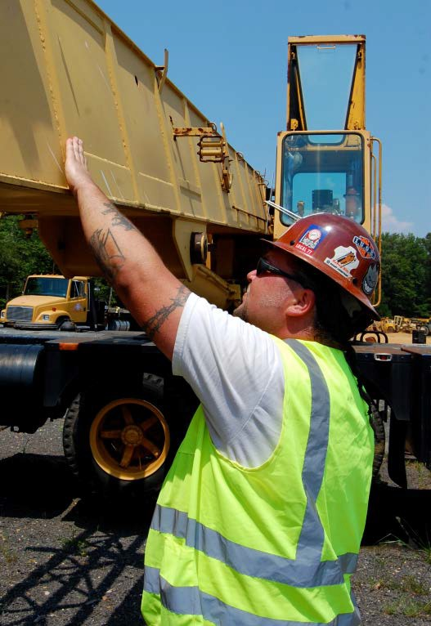
Incentive Programs
60
Intro
BCTD – AFL Smart Mark Module
If a company is:
Using safe work practices Analyzing hazards (JHAs)
Proactively preventing potential hazards Recognizing, reporting, and abating hazards
What incentives could they offer workers that would promote these policies, without encouraging
non-reporting of injuries and accidents?

Slide 54

Root Cause
62
Intro
BCTD – AFL Smart Mark Module
Identify 3 contributing factors to actual construction workplace accident
through root cause analysis
Objective 5

Slide 55

Root Cause
63
Intro
BCTD – AFL Smart Mark Module
We Can Identify Contributing Factors
The process of evaluating an accident to find the contributing factors is called a:
“Root Cause Analysis”
There are several methods of Root Cause Analysis
We will look at one of the methods called the “5 Why’s”
5 Why’s

Slide 56
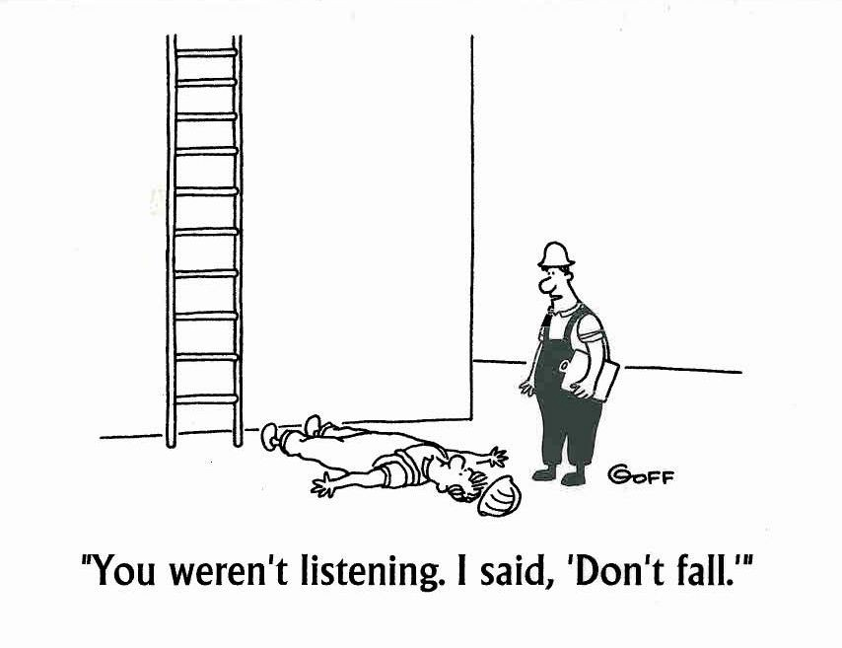
Root Cause
64
Intro
BCTD – AFL Smart Mark Module
Workers Get Blamed for Accidents

Slide 57
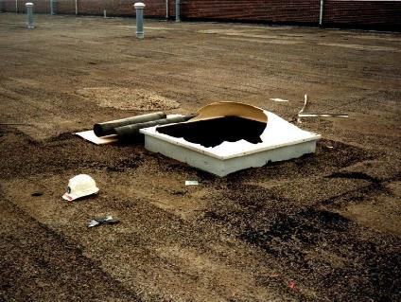
Let’s Get to the Facts
An Elevator Constructor was taking a lunch on a rooftop. He/She decided to sit on the skylight trying to have a more comfortable sitting position. When he/she leaned back they fell through the skylight sustaining severe injuries.
A roofing company was also repairing the roof at the time of the accident
The roofing company foreman was on the roof at the time of the accident
The site was managed by a general contractor who’s superintendent was on the site daily
Notes:
Walk the students through this scenario

Slide 58
Root Cause
67
Intro
BCTD – AFL Smart Mark Module
5 Why’s
Why was he/she up on the roof?
Why was there no protections around the skylight?
Why didn’t the superintendent identify this hazard?
Why didn’t the foreman identify this hazard?
Why did he/she choose that location for his/her lunch?.

Slide 59
Root Cause
69
Intro
BCTD – AFL Smart Mark Module
Any other Whys?
Why did he fall and get injured?

Slide 60
Root Cause
71
Intro
BCTD – AFL Smart Mark Module
Our root cause analysis found four contributing factors to this accident:
The general contractor didn’t require JHA’s before each work shift
The superintendent and foreman were not performing daily inspections
The elevator company did not inspect the workplace prior to assigning the work
The roofing contractor did not guard the skylight

Slide 61
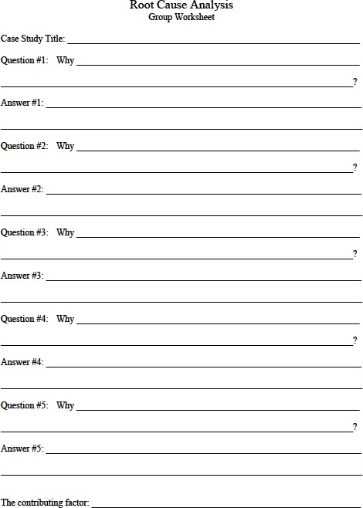
Root Cause
72
Intro
BCTD – AFL Smart Mark Module
Group exercise
Use the information on the next slide to conduct your Root Cause Analysis
Select a record keeper
Conduct a root cause analysis using the “5-why’s” method
Record the questions you ask and the answers you discover
Be prepared to report results
This worksheet is in your manual

Slide 62
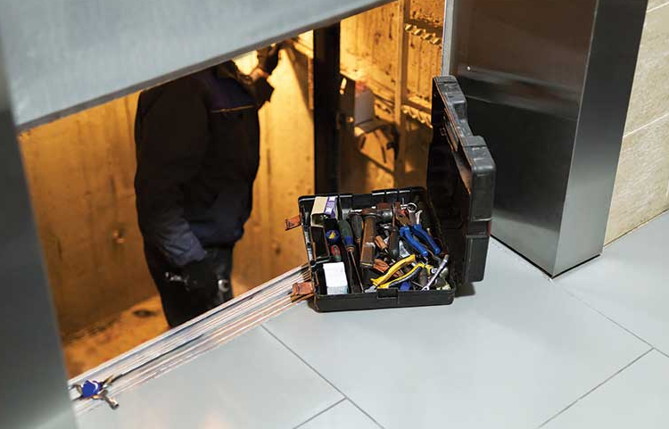
An elevator worker is trapped and later rescued by the fire department. The worker was entering the pit to retrieve someone's car keys. A power outage occurred right as the worker entered the pit. The elevator car dropped a couple feet trapping the worker.
Notes:
Add more information if the students ask more question. Facilitate the report out from each group.

Slide 63
Reporting Time

Slide 64
Intro
81
Summary
BCTD – AFL Smart Mark Module
Let’s summarize what we’ve learned by answering the following questions
What are management’s responsibilities related to managing safety and health
What is the hierarchy of controls and why have we emphasized them?
Why is worker involvement critical in conducting JHAs and incident investigations?
What are the potential pitfalls of injury reporting incentive programs?

Slide 65
Health and Safety Program Management
Through the Alliance between OSHA’s 10 Regional Offices and the Elevator Contractors of America (ECA), Elevator Industry Work Preservation Fund (EIWPF), International Union of Elevator Constructors (IUEC), National Association of Elevator Contractors (NAEC), National Elevator Industry Educational Program (NEIEP), and National Elevator Industry Inc. (NEII), collectively known as The Elevator Industry Safety Partners, developed this Industry Specific Training for informational purposes only. It does not necessarily reflect the official views of OSHA or the U.S. Department of Labor. May 2021​
​
Under the Occupational Safety and Health Act, employers are responsible (http://www.osha.gov/as/opa/worker/employer-responsibility.html) for providing a safe and healthy workplace and workers have rights (https://www.osha.gov/workers). OSHA can help answer questions or concerns from employers and workers. OSHA's On-Site Consultation Program (https://www.osha.gov/consultation) offers free and confidential advice to small and medium-sized businesses, with priority given to high-hazard worksites. For more information, contact your regional or area OSHA office (https://www.osha.gov/contactus/bystate), call 1-800-321-OSHA (6742), or visit https://www.osha.gov/.​

Slide 66

^{R}Intr^{oot}o Cause
82
Summary
BCTD – AFL Smart Mark Module
Questions or comments?

