Slide 1

1926 Construction
Introduction to OSHA

Slide 2

Introduction to
OSHA
Directorate of Training and Education
OSHA Training Institute

Slide 3
Lesson Overview
Purpose:
To provide workers with introductory information about OSHA
Topics:
  Why is OSHA important to you?
  What rights do you have under OSHA?
  What responsibilities does your employer have under OSHA?
  What are OSHA standards?
  How are OSHA inspections conducted?
  Where can you go for help?

Slide 4
Topic 1:
Why is OSHA Important to You?
5,333 workers were killed on the job in 2019 (3.5 per 100,000 full-time equivalent workers)
An average of nearly 15 workers die every day
1,088 Hispanic or Latino workers were killed from work-related injuries in 2019
2.8 million serious workplace injuries and illnesses were reported by private industry employers in 2019
The of results work injuries and illnesses may include lower morale and increased cost to train replacement workers.
OSHA Makes a Difference
Worker deaths in America are down–on average, from about 38 worker deaths a day in 1970 to 15 a day in 2019.
Worker injuries and illnesses are down–from 10.9 incidents per 100,000 workers in 1972 to 3.5 per 100,000 in 2019.
Notes:
Bureau of Labor Statistics (bls.gov/iif/ )The of results work injuries and illnesses may include lower morale and increased cost to train replacement workers.
(Notable 510) Q #1. When I researched the data on this slide, the numbers have gone up from 2013. 4,405 fatalities in 2013. 85 per week, 12 per day.
1061 fatalities were in private sector construction, 1 in 5. 5% increase from 2018, most since 2007. 307 were suicides.

Slide 5

History of OSHA
OSHA stands for the Occupational Safety and Health Administration, an agency of the U.S. Department of Labor
OSHA’s responsibility is to improve worker safety and health protection
On December 29, 1970, President Nixon signed the OSH Act
This Act created OSHA, the agency, which formally came into being on April 28, 1971

Slide 6
OSHA’s Mission
The mission of OSHA is to ensure safe and healthful working conditions for working men and women by setting and enforcing standards and by providing training, outreach, education and assistance.
Some of the things OSHA does to carry out its mission are:
  Developing job safety and health standards and enforcing them through worksite inspections
  Providing training programs to increase knowledge about occupational safety and health

Slide 7
Topic 2:
What Rights Do You Have Under OSHA?
You have the right to:
  A safe and healthful workplace
  Know about hazardous chemicals
  Report injury to employer
  Complain or request hazard correction from employer
  Training
  Hazard exposure and medical records
  File a complaint with OSHA
  Participate in an OSHA inspection
  Be free from retaliation for exercising safety and health rights

Slide 8


Worker Rights
Handout #1:
OSHA Poster
Have you seen this poster at your place of work?
Why was OSHA created?

Slide 9


Your Right to…
Worker Protection is Law: The Occupational Safety and Health Act of 1970 (OSH Act)
OSHA was created to provide workers the right to a safe and healthful workplace
It is the duty of the employers to provide workplaces that are free of known dangers that could harm their employees
This law also gives workers important rights to participate in activities to ensure their protection from job hazards

Slide 10

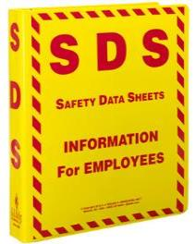
Your Right to…
Employers must have a written, complete hazard communication program that includes information on:
  Container labeling,
  Safety Data Sheets (SDSs), and
  Worker training.
    The training must include the physical and health hazards of the chemicals and how workers can protect themselves
The Hazard Communication Standard (HCS) requires chemical manufacturers, distributors, or importers to provide Safety Data Sheets (SDSs) (formerly known as Material Safety Data Sheets or MSDSs) to communicate the hazards of hazardous chemical products. As of June 1, 2015, the HCS required new SDSs to be in a uniform format.

Slide 11

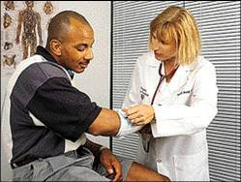
Your Right to…
OSHA’s Recordkeeping rule requires most employers with more than 10 workers to keep a log of injuries and illnesses
Workers have the right to report an injury* and review the current log
Workers also have the right to view the annually posted summary of injuries and illnesses (OSHA 300A)
*It is against the OSHA law to retaliate or discriminate against a worker for reporting an injury or illness

Slide 12

Your Right to…
Workers may bring up safety and health concerns in the workplace to their employers without fear of discharge or discrimination
OSHA rules protect workers who raise concerns to their employer or OSHA about unsafe or unhealthful conditions in the workplace

Slide 13


Your Right to…
Workers have a right to get training from employers on a variety of health and safety hazards and standards that employers must follow
Some required training covers topics such as chemical hazards, equipment hazards, noise, confined spaces, fall hazards in construction, and personal protective equipment, along with a variety of other subjects
Training must be in a language and vocabulary workers can understand

Slide 14

Your Right to…
1910.1020: right to examine & copy records
Examples of toxic substances and harmful physical agents are:
  Metals and dusts, such as lead, cadmium, and silica
  Biological agents, such as bacteria, viruses, and fungi
  Physical stress, such as noise, heat, cold, vibration, repetitive motion, and ionizing and non-ionizing radiation

Slide 15

Your Right to…
Workers may file a confidential complaint with OSHA if they believe a violation of a safety or health standard or an imminent danger situation exists in the workplace
Workers may request that their name not be revealed to the employer
If a worker files a complaint, they have the right to find out OSHA’s action on the complaint and request a review if an inspection is not made
Note:
Often the best and fastest way to get a hazard corrected is to notify your supervisor or employer.

Slide 16

Your Right to…
Employee representative can accompany OSHA inspector
Workers can talk to the inspector privately
Workers may point out hazards, describe injuries, illnesses, or near misses that resulted from those hazards and describe any concern about a safety or health issue
Workers can find out about inspection results and abatement measures and, may object to dates set for a violation to be corrected

Slide 17

Your Right to…
Workers have the right to be free from retaliation for exercising safety and health rights
Workers have a right to seek safety and health on the job without fear of punishment
This right is spelled out in Section 11(c) of the OSH Act
Workers have 30 days to contact OSHA if they feel they have been punished for exercising their safety and health rights

Slide 18

Provide a workplace free from recognized hazards and comply with OSHA standards
Provide training required by OSHA standards
Keep records of injuries and illnesses
Provide medical exams when required by OSHA standards and provide workers access to their exposure and medical records
Not discriminate against workers who exercise their rights under the Act (Section 11(c))
Post OSHA citations and hazard correction notices
Provide and pay for most PPE

Slide 19
Employer Responsibilities (cont.)
REPORTING AND RECORDING CHECKLIST
Employers must: Report each worker death to OSHA Report each work-related hospitalization, amputation, or loss of an eye Maintain injury & illness records Inform workers how to report an injury or illness to the employer Make records available to workers Allow OSHA access to records Post annual summary of injuries & illnesses

Slide 20
Topic 4:
What are OSHA Standards?
OSHA standards are:
Rules that describe the methods employers must use to protect employees from hazards
Designed to protect workers from a wide range of hazards
Four Groups of OSHA Standards
General Industry*
Construction
Maritime
Agriculture
*General Industry is the set that applies to the largest number of workers and worksites
Where there are no specific standards, employers must comply with the General Duty Clause of the OSH Act.

Slide 21
OSHA Standards (cont.)
These standards also:
Limit the amount of hazardous chemicals, substances, or noise that workers can be exposed to
Require the use of certain safe work practices and equipment
Require employers to monitor certain hazards and keep records of workplace injuries and illnesses

Slide 22
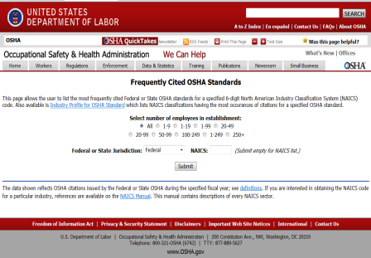
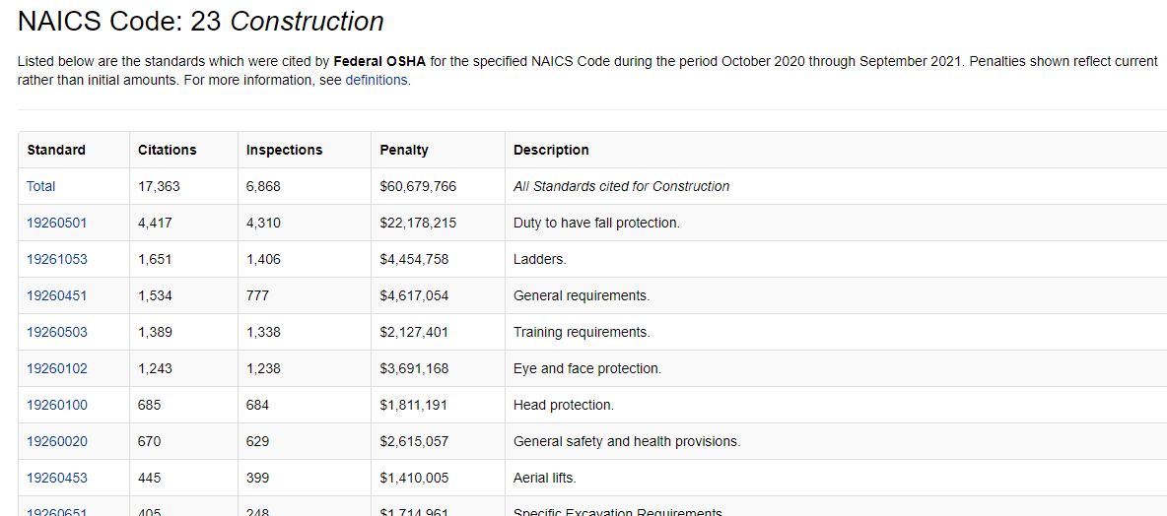
Most Frequently Cited OSHA Standards
OSHA’s website provides information regarding the most frequently cited standards
Click: Frequently Cited OSHA Standards to view current data
“Select number of employees in establishment,” select ALL or one of the options listed
“Federal or State Jurisdiction,” select Federal - or from the dropdown menu, select a specific state
“NAICS,” enter ALL for all Industry groups, or enter a valid 2 to 6-digit code for a specific Industry from the NAICS Manual
Shown are search results for: All sizes of establishments, in Federal jurisdiction, with a Construction NAICS code of “23”
Common Most Frequently Cited Standards:
Fall Protection; Hazard Communication; Scaffolding; Respiratory Protection; Electrical; Powered Industrial Trucks; Ladders

Slide 23

The OSH Act authorizes OSHA compliance safety and health officers (CSHOs) to conduct workplace inspections at reasonable times
OSHA conducts inspections without advance notice, except in rare circumstances (e.g., Imminent Danger)
In fact, anyone who tells an employer about an OSHA inspection in advance can receive fines and a jail term

Slide 24


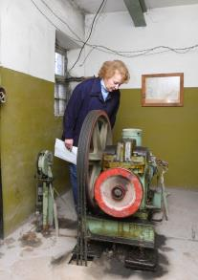
Different Types of OSHA Inspections
Imminent danger
Fatality or hospitalizations
Worker complaints/ referrals
Targeted inspections—Local Emphasis Program (LEP), National Emphasis Program (NEP), and particular hazards or industries
Follow-up Inspections
24

Slide 25

VIOLATION TYPE | PENALTY
WILLFUL A violation that the employer intentionally and knowingly commits or a violation that the employer commits with plain indifference to the law. | OSHA may propose penalties of up to $70,000 for each willful violation, with a minimum penalty of $5,000 for each willful violation.
SERIOUS A violation where there is substantial probability that death or serious physical harm could result and that the employer knew, or should have known, of the hazard. | There is a mandatory penalty for serious violations which may be up to $7,000.
OTHER-THAN-SERIOUS A violation that has a direct relationship to safety and health, but probably would not cause death or serious physical harm. | OSHA may propose a penalty of up to $7,000 for each other-than-serious violation.
REPEATED A violation that is the same or similar to a previous violation. | OSHA may propose penalties of up to $70,000 for each repeated violation.

Slide 26

Questions for Review
Give an example of a reason why OSHA would conduct an inspection at your workplace.
What are the types of OSHA violations?

Slide 27

Sources within the workplace/worksite
Sources outside the workplace/worksite
How to file an OSHA complaint

Slide 28

Employer or supervisor, co-workers, and union representatives
Safety Data Sheet (SDS) for information on chemicals
Labels and warning signs
Employee orientation manuals or other training materials
Work tasks and procedures instruction

Slide 29

OSHA website: http://www.osha.gov and OSHA offices (you can call or write)
Compliance Assistance Specialists in the area offices
National Institute for Occupational Safety and Health (NIOSH) – OSHA’s sister agency
OSHA Training Institute Education Centers
Doctors, nurses, other health care providers
Public libraries
Other local, community-based resources

Slide 30
How to Raise a Concern
Handout #7: Identifying
Safety and Health Problems
in the Workplace
Review handout to become more aware of workplace hazards
Discuss if anyone has discovered safety and/or health problems in the workplace/site

Slide 31

Download the OSHA complaint form from OSHA’s website
File the complaint online
  Workers can file a complaint
  A worker representative can file a complaint
Telephone or visit local regional or area offices to discuss your concerns
Complete the form – be specific and include appropriate details
OSHA determines if an inspection is necessary
Workers do not have to reveal their name

Slide 32
Group Activity: Filing a Complaint
Handout #8a:
General Industry
Each group reviews the handout and discusses the industry-specific scenario
Groups need to determine what information would be important to include in their complaint
Have the class discuss the groups’ results:
  What was included in the complaint?
  What was added to the complaint?

Slide 33
Group Activity: Filing a Complaint
Handout #8b:
Construction
Each group reviews the handout and discusses the industry-specific scenario
Groups need to determine what information would be important to include in their complaint
Have the class discuss the groups’ results:
  What was included in the complaint?
  What was added to the complaint?

Slide 34
Group Activity: Filing a Complaint
Handout #8c:
Maritime Industry
Each group reviews the handout and discusses the industry-specific scenario
Groups need to determine what information would be important to include in their complaint
Have the class discuss the groups’ results:
  What was included in the complaint?
  What was added to the complaint?

Slide 35
Questions for Review
What are some resources inside the workplace that will help you find information on safety and health issues?
What are some resources outside the workplace that will help you find information on safety and health issues?

Slide 36

This lesson covered:
The importance of OSHA, including the history of safety and health regulation leading to the creation of OSHA and OSHA’s mission;
Worker rights under OSHA;
Employer responsibilities;
OSHA standards;
OSHA inspections; and
Safety and health resources, including how to file a complaint.

Slide 37
Thank You!

