Slide 1

Heat Stress Awareness and Prevention

Slide 2
Objectives
By the end of this presentation, you will be able to:
Define heat stress
Describe common heat-related disorders
Discuss heat stress risk factors and statistics
Identify heat stress evaluation criterion
Detail heat stress controls
Provide heat stress resources

Slide 3
Heat initiative elements
Heat-related fatality cases show that workplaces with temperatures above 70 degrees Fahrenheit may have a heat hazard present when work activities are at or above a moderate workload.
Assessing worker exposure in conditions that may present a heat hazard is critical for knowing when to implement a heat-related illness prevention program.

Slide 4
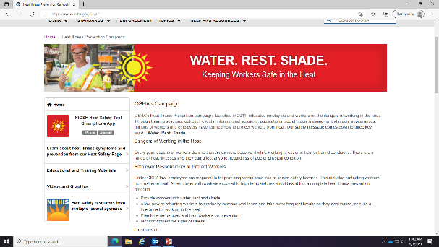
Heat Initiative Element: the Memo
New Heat Initiative Memo- Signed September 1, 2021
Expands on Heat Campaign launched in 2011
https://www.osha.gov/heat
Notes:
You can see the full body of this memo at https://www.osha.gov/heat

Slide 5
Heat Initiative Elements: Scope
Establishes a trigger “heat priority days” when heat index exceeds 80 degrees F
Proactive vs. Reactive approach
Applies to indoor and outdoor worksites

Slide 6
Heat Initiative Elements: BLS Data

Slide 7
Heat Initiative Elements: OIS Data
2015-2020 Federal only

Slide 8
Check Your Learning (1)
The Heat Initiative Memo establishes a trigger “heat priority days” – this is when the __________ exceeds 80ºF
Temperature
Heat Index
Heat Index
Notes:
Correct answer: b) Heat Index

Slide 9
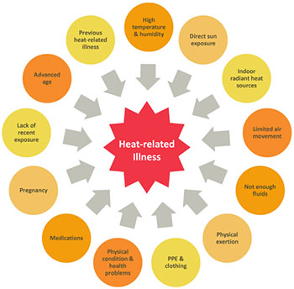
Heat-related Illness
Although heat hazards are common in indoor and outdoor work environments, heat-related illness and fatalities are preventable. Many risk factors contribute to the risk for heat-related illness (see Figure 1.). A heat-related illness occurs when there is an increase in the worker's core body temperature above healthy levels. As core temperature rises, the body is less able to perform normal functions.

Slide 10
The terms heat stress and heat strain represent the relationship and difference between external factors and the body's core temperature control mechanisms.

Slide 11
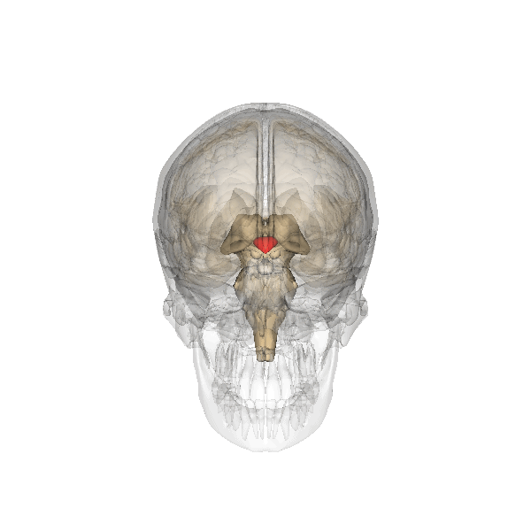
What Is Heat Stress?
Heat Stress – The net heat load to which a worker is exposed. Physical exertion, environmental factors, and clothing worn all contribute to heat stress.
Hypothalamus (a small but crucial part of the brain).
  Controls Thermoregulation
Homeostasis
  Your body heat content is steady, not changing
Hyperthermia
  Your body heat content is rising
Hypothermia
  Your body heat content is falling
Notes:
hypothalamus, a small but crucial part of the brain. It controls several important functions including thermoregulation. If the hypothalamus senses internal temperatures growing too hot or too cold, it will automatically send signals to the skin, glands, muscles, and organs.

Slide 12
Types of Heat-Related Disorders
Heat Stroke
Heat Exhaustion
Heat Syncope
Heat Cramps
Heat Rash

Slide 13
Heat Stroke
Most serious
Thermoregulation failure
  Stop sweating
  Unable to cool down
  Body temperature rises rapidly to > 104 ˚F
Death or permanent disability if not treated
Notes:
Heat Stroke is the most serious heat-related illness and should be treated as a medical emergency. Heat stroke occurs when the body becomes unable to adequately dissipate heat, losing the ability to regulate core body temperature. The core body temperature rises rapidly, the sweating mechanism may fail, and the body is unable to cool down. When heat stroke occurs, the body temperature can rise to 41oC (106°F) or higher within 10 to 15 minutes. Thinking clearly, perception, planning, and other mental processes become impaired, and the worker may be unable to recognize dangerous situations. Heat stroke can cause death or permanent disability if emergency medical treatment is not given.

Slide 14
Heat Stoke Symptoms
High body temperature
Confusion
Loss of coordination
Hot, dry skin or profuse sweating
Throbbing headache
Seizures/coma

Slide 15
Heat Stroke First Aid
Request immediate medical assistance
Move the worker to a cool, shaded area
Remove excess clothing
Apply cool water to their body
  Areas of high blood circulation
Fan their body

Slide 16
Heat Exhaustion
Body’s response to an excessive loss of water and salt
Symptoms
  Rapid heart beat
  Heavy sweating
  Extreme weakness or fatigue
  Dizziness
  Nausea/vomiting
  Irritability
  Fast, shallow breathing
  Slightly elevated body temperature
Notes:
Heat Exhaustion is often a precursor to heat stroke. It is often accompanied by elevated core body temperatures around 38°C–39°C (100.4°F–102.2°F). Symptoms may include headache, nausea, dizziness, fatigue, weakness, thirst, heavy sweating, irritability, and a decreased urine output.

Slide 17
Heat Exhaustion First Aid
Rest in a cool area
Drink plenty of water or other cool beverages
  Non-alcoholic beverages
  Sports drink
Take a cool shower, bath, or sponge bath
Take to a medical clinic or emergency room

Slide 18
Heat Cramps
Affect workers who sweat a lot during strenuous activity
Sweating depletes the body's salt and moisture levels
Low salt levels in muscles causes painful cramps
Symptoms
  Muscle pain or spasms
    Abdomen
    Arms
    Legs
Notes:
Heat Cramps are caused by the body's depleted salt and water levels from excessive sweating resulting in muscle cramps or spasms. They usually occur in the muscles used during work. The symptoms include spastic contractions and pain in voluntary muscles mainly in the arms, legs, or torso.

Slide 19
Heat Cramp First Aid
Stop all activity, and sit in a cool place
Drink clear juice or a sports beverage
Stretch effected muscles
Seek medical attention if any of the following apply:
  The worker has heart problems
  The worker is on a low-sodium diet
  The cramps do not subside within one hour

Slide 20
Heat Syncope
Blood vessels dilate
  Reduced blood flow to the brain
Fainting or dizziness
  Prolonged standing
  Sudden rising from a sitting or lying position
Dehydration
Lack of acclimatization
Notes:
Heat Syncope usually occurs after prolonged standing or sudden rising from a sitting or supine position. Heat syncope symptoms include light-headedness, dizziness, and fainting. Dehydration and inadequate acclimatization often contribute to heat syncope.

Slide 21
Heat Syncope First Aid
Sit or lie down in a cool place
  At the onset of symptoms
Slowly drink water, clear juice, or a sports beverage
Elevate the feet
Refrain from vigorous activity

Slide 22
Heat Rash
Skin irritation caused by excessive sweating during hot, humid weather
Symptoms
  Looks like a red cluster of pimples or small blisters
  Neck and upper chest, in the groin, under the breasts, and in elbow creases
Notes:
Heat Rash is skin irritation caused by excessive sweating. Excessive moisture and sweat obstructs sweat ducts and forms itchy and painful red pimple/blister clusters and skin lesions. It is exacerbated in hot and humid weather and common on the neck, chest, groin, armpits, elbow creases, and behind the knees.

Slide 23
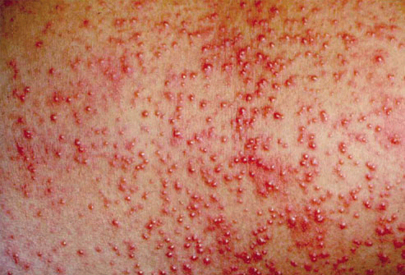

Slide 24
Heat Rash First Aid
Try to work in a cooler, less humid environment
Keep the affected area dry
Use powder to increase comfort
Don’t use ointments or creams
  Making the skin warm or moist may make the rash worse

Slide 25
Heat-related Illness Prevention Program
An effective heat-related illness prevention program is incorporated in a broader safety and health program and aligns with OSHA's Recommended Practices for Safety and Health Programs core elements. Specifically, heat-related illness prevention is most effective when management commits to identifying and reducing exposure to heat stress hazards.
The heat-related illness prevention program should establish how the employer will determine if workers are exposed to a heat hazard based on environmental conditions (e.g., weather or indoor temperature and humidity), clothing, and workload. The heat-related illness prevention program should also include policies/procedures for controlling heat hazards.

Slide 26
Heat-related Illness Prevention Program cont.
The American Conference of Governmental Industrial Hygienists (ACGIH®) has established an Action Limit (AL) for un-acclimatized workers and a Threshold Limit Value (TLV®) for acclimatized workers, see Heat Stress and Strain: TLV® Physical Agents 7th Edition Documentation (2017).
These limits, which vary by WBGT (Wet-bulb Globe Temperature) and metabolic rate, are intended to maintain the core body temperature to within one degree Celsius of normal (37 degrees Celsius or 98.6 Fahrenheit for most people).
ACGIH provides guidance for maintaining awareness about when workers may be exposed to heat stress above the AL or TLV so that preventive actions are taken to reduce the exposure. Heat-related illness prevention programs may include policies for using these guidelines to implement environmental controls, plan work schedules, and use personal protective equipment (PPE).

Slide 27
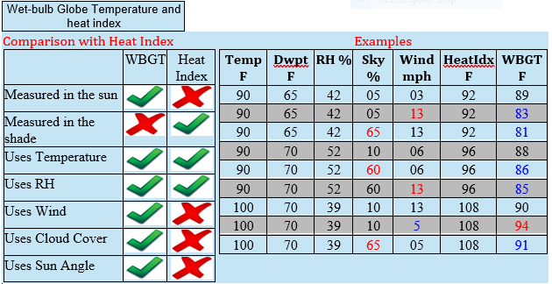
Heat-related Illness Prevention Program cont.
The Wet-bulb Globe Temperature (WBGT) is a measure of the heat stress in direct sunlight, which considers temperature, humidity, wind speed, sun angle and cloud cover (solar radiation). This differs from the heat index, which takes into consideration temperature and humidity and is calculated for shady areas. If you work or exercise in direct sunlight, this is a good element to monitor. Military agencies, OSHA and many nations use the WBGT as a guide to managing workload in direct sunlight.

Slide 28
Heat-related Illness Prevention Program cont.
The most effective way to prevent heat-related illness and fatality is to reduce heat stress in the workplace (e.g., increase air movement, reduce temperature, reduce humidity, and protect workers from solar radiation or other radiant heat sources). The following are some engineering controls that may reduce heat stress:
Use air conditioning
Increase general ventilation
Provide cooling fans
Run local exhaust ventilation where heat is produced (e.g., laundry vents)
Use reflective shields to block radiant heat
Insulate hot surfaces (e.g., furnace walls)
Stop leaking steam
Provide shade for outdoor work sites

Slide 29
Heat-related Illness Prevention Program cont.
When engineering controls are not enough to keep worker exposure below the AL or TLV, administrative controls are another way to prevent a worker's core body temperature from rising. Some administrative controls that may reduce heat stress include:
Acclimatize workers starting the first day working in the heat
Re-acclimatize workers after extended absences
Schedule work earlier or later in the day
Use work/rest schedules
Limit strenuous work (e.g., carrying heavy loads)
Use relief workers when needed

Slide 30
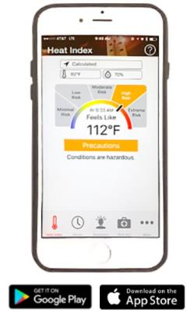
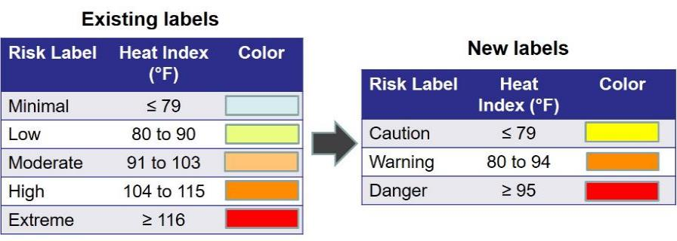
Improvements to OSHA-NIOSH Heat App
NIOSH and OSHA are changing the App’s risk levels

Slide 31
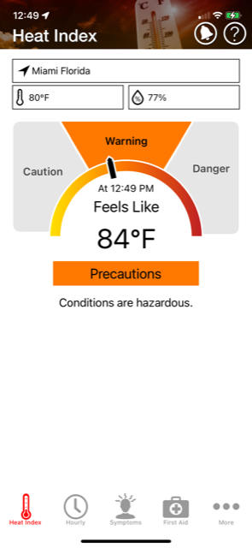
OSHA-NIOSH Heat App
The first page of the app shows the current heat index for your location, or any location that you enter.

Slide 32
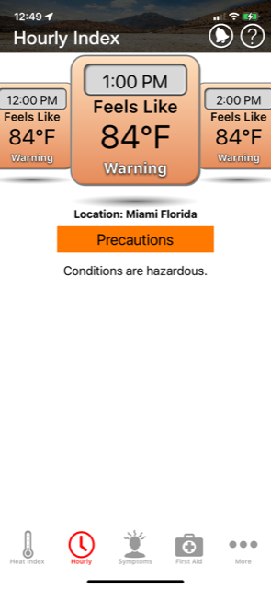
OSHA-NIOSH Heat App
The second page of the app shows the hourly heat index for your location, or any location that you enter.

Slide 33
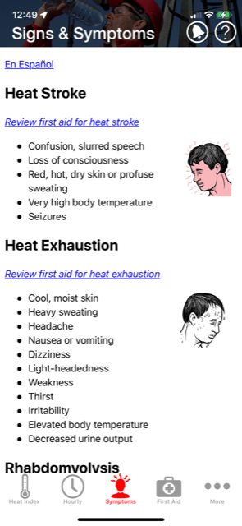
OSHA-NIOSH Heat App
The third page of the app shows the symptoms associated with the related heat illness.

Slide 34
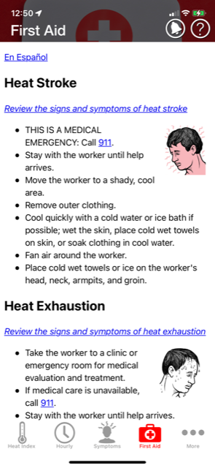
OSHA-NIOSH Heat App
The fourth page of the app shows the first aid associated with the related heat illness.

Slide 35
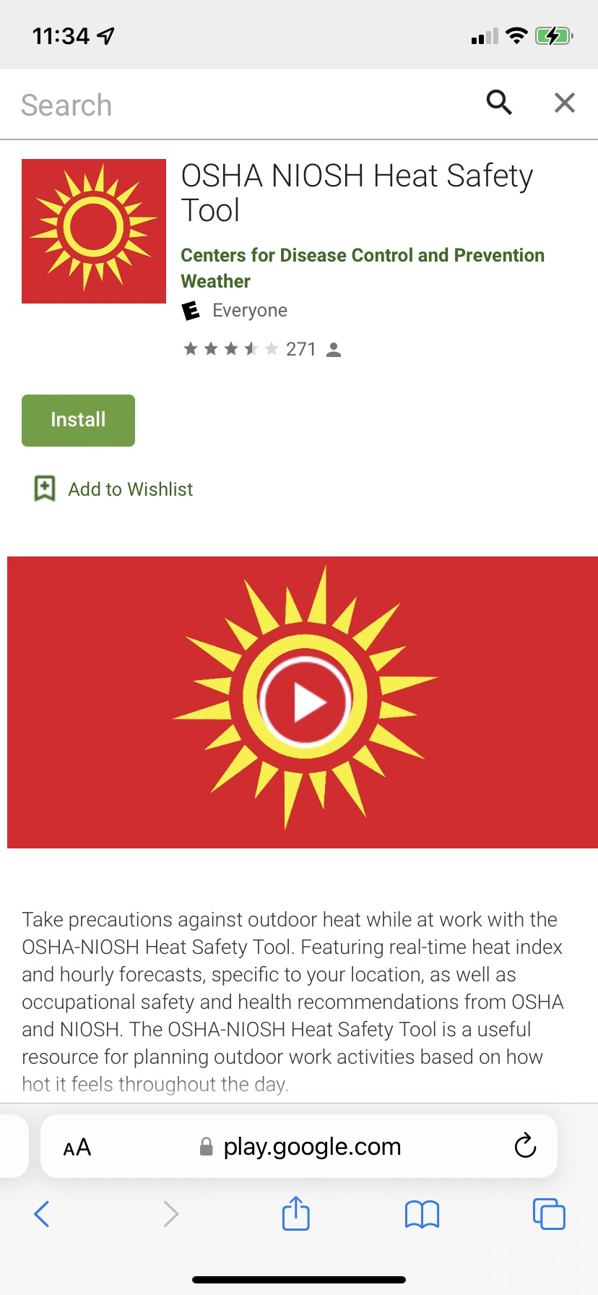
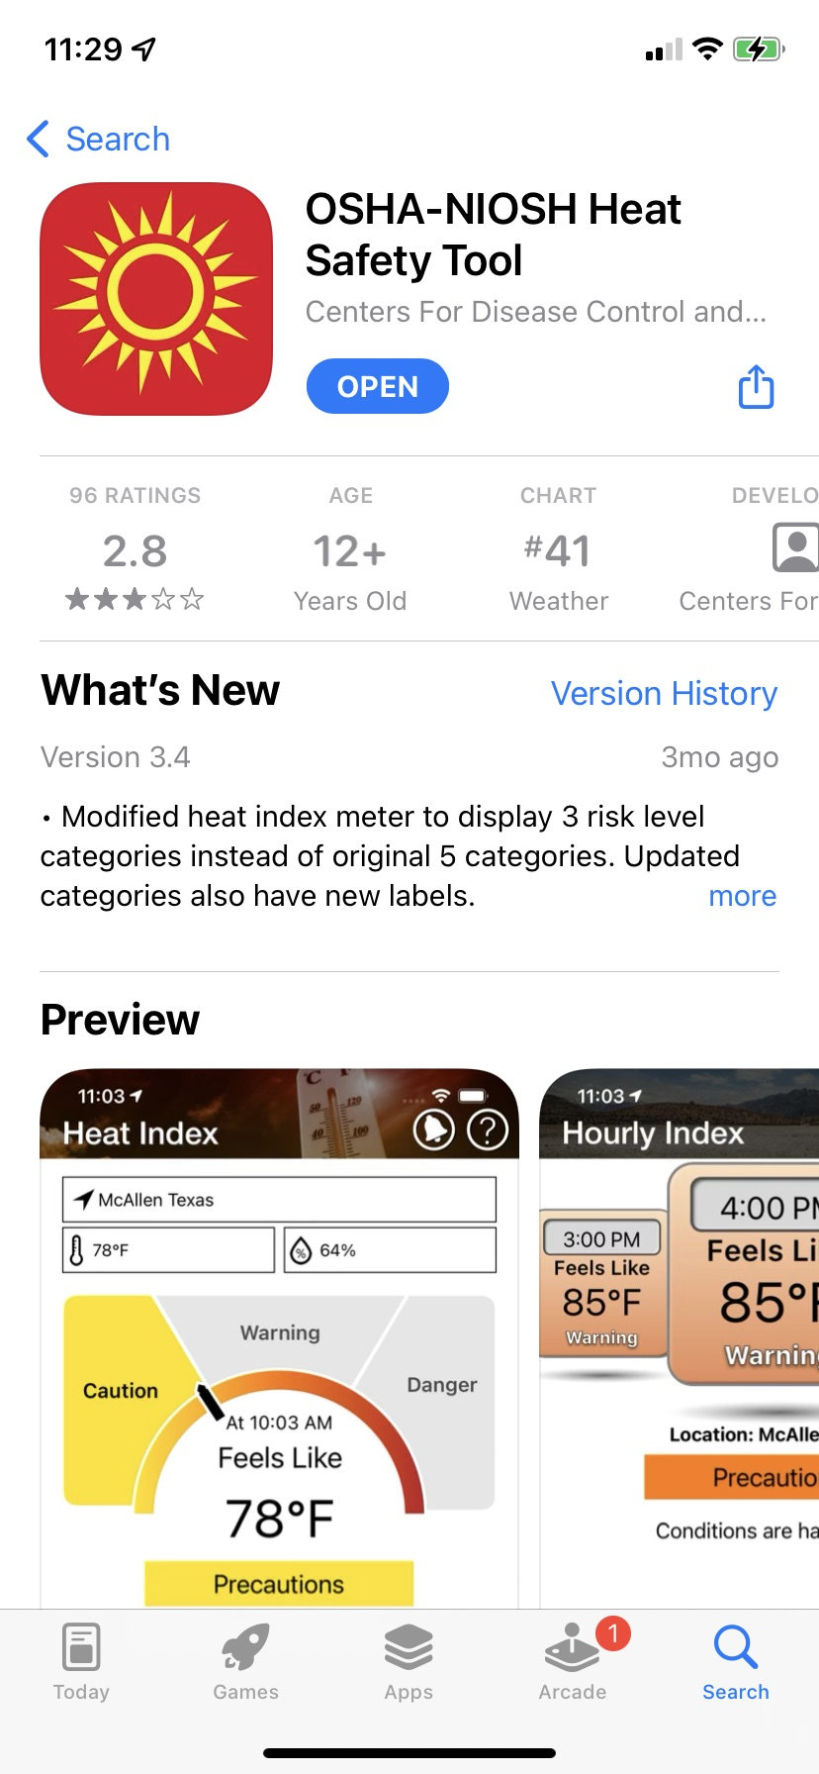
Available in the app store or on Google Play

Slide 36
Heat Hazard Assessment
Environmental factors (e.g., humidity, wind, temperature, and radiant heat), clothing, and workload (i.e., metabolic rate) are considered when determining if there is a heat hazard present in an indoor or outdoor workplace.
Step 1: Determine WBGT
Step 2: Add Clothing Adjustment Factor (CAF) to Determine WBGT Effective
Step 3: Determine the Metabolic Work Rate
Step 4: Determine the Threshold Limit Value or Action Limit

Slide 37
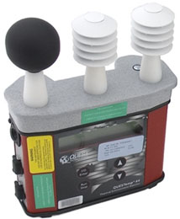
Step 1: Determine WBGT
A WBGT meter is the most accurate tool for adjusting the temperature for heat stress factors including humidity, air movement (i.e., wind), radiant heat, and temperature.
WBGT meters have three sensors that input data into a calculation that adjusts the temperature to represent the impact humidity, wind, and radiant heat have on heat strain cooling effectiveness.
If a WBGT meter is not available or if the assessment is for hazards that may have been present in the past (e.g., heat hazard determination after a heat incident), the Argonne National Laboratory calculator uses an algorithm to adjust the temperature for heat stress factors using weather data available online.
Quest Waterless wet-bulb meter
Notes:
Wet Bulb Globe Temperature (WBGT)

Slide 38
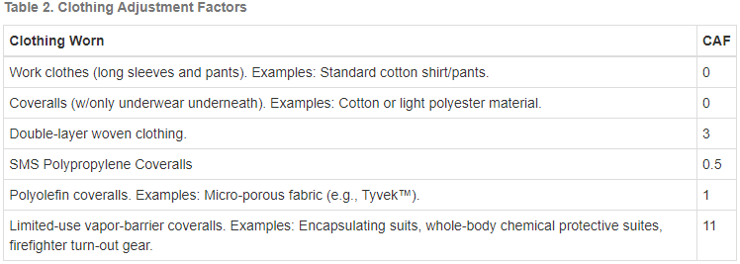
Step 2: Add Clothing Adjustment Factor (CAF) to Determine WBGT Effective
Identify the CAF based on the clothing workers are wearing from Table 2.
Add the CAF to the WBGT to determine WBGT_{eff}.

Slide 39
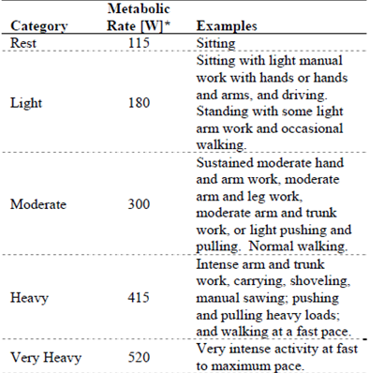
Step 3: Determine the Metabolic Work Rate
The metabolic work rates represent impacts to the body core temperature from the heat produced internally as exertion increases. Select a work category in Table 3 that best represents the workload using the examples as a guide. If different work activities are planned for the day, using the heaviest workload activity to determine the estimated metabolic rate (MR_{est}) will indicate if it is possible the workers exposure will exceed the TLV or AL without controls. Using the lowest expected work load will indicate if other controls are necessary to reduce exposure for any work activity (i.e., scheduling work at a different time).
Table 3

Slide 40
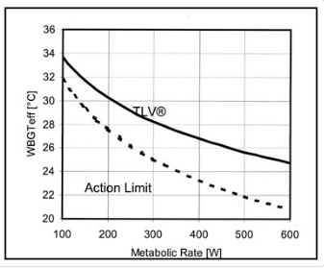
Step 4: Determine the Threshold Limit Value or Action Limit
The TLV is the temperature at which there is a heat hazard present for an acclimatized worker and the AL is the temperature at which there is a heat hazard present for a non-acclimatized worker. Once these limits are reached, either through environmental factors or workload, controls are necessary to prevent heat-related illness. Controls include work/rest regimens, shade, and hydration.
Determine the TLV or AL by using Figure 4, ACGIH TLV & Action Limit.
The TLV is where the WBGTeff and the metabolic rate intersect with the solid line and AL is where they intersect with the dotted line.
Figure 4
Notes:
For example, an acclimatized worker with job activities that require normal walking (300 W) is below the TLV in a 28 degrees Celsius WBGTeff environment.
However, if the same worker in the same environment increases activity to fast-pace walking (415 W) the exposure will be above the TLV.

Slide 41
Example Problem
As thoroughly as possible, determine if there were heat hazards present in the following example.
Example: In Toledo, Ohio, on June 8, 2002, at 4 pm, a 30-year-old male landscaper mowing-assistant collapsed and died of heat stroke after a day of caring for residential lawns [NIOSH 2002].
Post-incident interviews indicate the worker complained of feeling light-headed and short of breath two hours before his death, but he refused assistance offered to him by his partner. Others said that the worker was on medication that had a warning about exposure to extreme heat, and this might have interfered with body temperature regulation.
The landscape worker was wearing two pairs of work pants on the day he died, but his partner did not notice any profuse sweating or flushed or extremely dry skin. Interviews with the emergency responders indicate that when the worker collapsed, emergency medical services (EMS) treated the victim at the site, and then transported him to the hospital. At the hospital he was pronounced dead with an internal temperature of 42°C (107.6°F).

Slide 42
Answer:
Since wind, humidity, and barometric pressure site measurements are not given in this example problem, the historical data was found online at Weather Underground by entering the location and date.
Given and Assumptions
Date of Incident: June 8, 2002
Air Temperature: 77°F (25°C) – From Weather Underground
Cloud Cover: Clear – From Weather Underground
Wind Speed: 4.6 mph – From Weather Underground
Relative Humidity: 56% - From Weather Underground
Time: 2 pm The worker's symptoms began two hours before his death at 4:00 pm
Barometric Pressure: 30.13 in Hg - From Weather Underground
Clothing Adjustment Factor (CAF): 3 – From Table 3

Slide 43
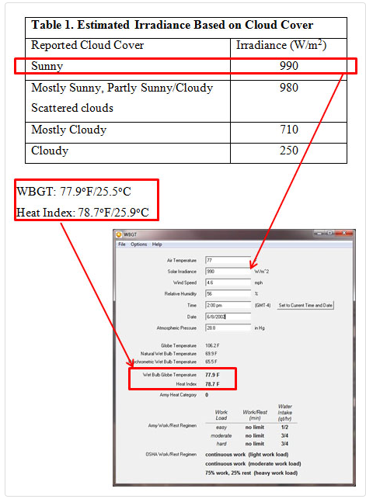
Step 1: Determine WBGT
Use historic weather data and enter it into a WBGT estimation calculator.
Using Table 1, solar irradiance for clear/sunny may be estimated as 990 W/m²
WBGT calculates to 77.9°F/25.5°C
The Heat index calculates to 78.7°F/25.9°C
Notes:
An example of a WBGT calculator can be found at https://www.omnicalculator.com/physics/wet-bulb

Slide 44
Step 2: Determine WBGT_{eff}
WBGT_{eff} = WBGT_{out} + Clothing Adjustment Factor (CAF) (Use Celsius)
The worker's two pairs of work pants fall under the double layer woven clothing in Table 2; therefore, the Clothing Adjustment Factor (CAF) is 3.
WBGT_{eff} = 25.5°C (WBGT_{out} ) + 3 (CAF)
WBGT_{eff} = 28.5°C
Notes:
Wet Bulb Global Temperature Outside = WBGT_{out}

Slide 45
Step 3: Determine the metabolic work rate
Lawn care falls under "Heavy work" on Table 3, as it requires intensive, repetitive work and heavy material/equipment handling.
Using Table 3, Metabolic Rate = 415 Watts
Table 3

Slide 46
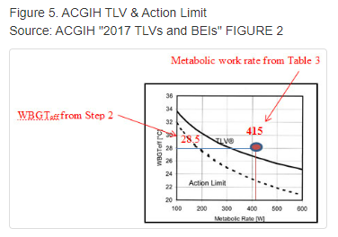
Step 4: Determine if exposure was above the Threshold Limit Values
Using Table 3, metabolic rate at 415 and 28.5°C WBGT_{eff} in Figure 4, the TLV (27°C) was exceeded indicating that the worker was exposed to excessive heat stress at the time of death.
Other factors in this example indicate the victim was exposed to excessive heat stress at the time of his death. The worker’s core temperature at death was 42°C. Additionally, the victim experienced heat stress symptoms; he was light-headed and short of breath.

Slide 47
Key Information
New workers are at high risk of heat stroke
70% of fatalities happen during the first week
Examples:
  18yo in Ohio, died on first day as landscaper
  23yo in Texas, died on third day as construction worker
  45yo in Missouri, died on third day as roofer
Have an acclimatization program so that new workers can gain heat tolerance gradually!

Slide 48
Key Information cont.
Workers suffer exertional heat-related illnesses
Strenuous physical activity can be hazardous even if temperatures are not extreme
Moderate or heavy intensity workload generates metabolic heat
Take precautions when Heat Index ≥ 80ºF
Normal summer temperatures can kill.
Allow workers to take plenty of breaks.

Slide 49
Check Your Learning (2)
____ of heat-related fatalities happen during the first week.
70%
30%
70%
Notes:
Correct answer: a) 70%

Slide 50
Heat Stress Risk Factors
Environmental
  Air movement, humidity, and radiant heat sources
Worker
  Surface area/weight ratio
  Age
  Physical fitness
  Alcohol consumption
  Prior heat injury
  Acclimatization
  Drug use
  PPE

Slide 51
Heat Stress Risk Factors cont.
Unloading equipment at a jobsite can expose you to the risk for heat related illness.
The best tool you can use is the OSHA/NIOSH Heat Index App. It is user friendly and takes all the guesswork out of determining if you are at risk.
Indoors, machine rooms and hoistways can be dangerously hot if not climate controlled.
Your company’s heat-related illness prevention program will include policies/procedures for working in or controlling heat hazards.

Slide 52
Notable Heat Illness Statistics
NOAA
  115 heat related deaths per year
  1980 heat wave killed > 1,250
  1995 Chicago heat wave killed > 700
  August 2003 Europe heat wave killed ~ 50,000

Slide 53
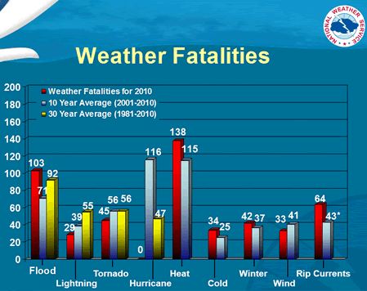

Slide 54
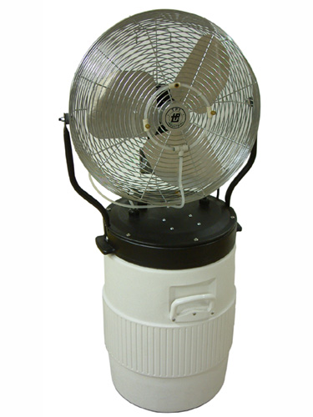

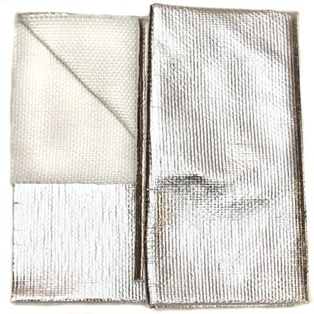
Available Heat Stress Controls
Engineering controls
  General ventilation
  Fans
  Air conditioning
  Local air cooling
  Insulation
  Barriers and shields

Slide 55

Available Heat Stress Controls
Administrative and work practice
  Training
  Procedures/policies
  Work scheduling
    Cooler seasons – maintenance
    Cooler part of the day
  Acclimatization
  Frequent breaks/rehydrate
  Medical screening
  Relief workers

Slide 56
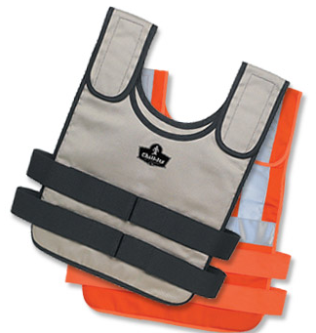
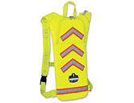
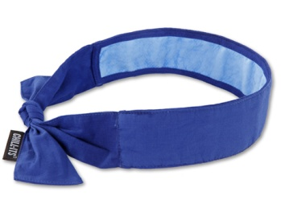
Available Heat Stress Controls
Personal protective equipment
  Breathable clothing
  Reflective clothing
  Vests/suits
  Bandanas/towels
  Hydration packs

Slide 57
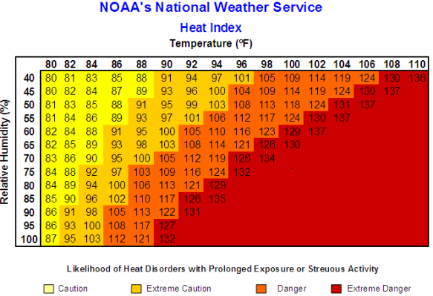
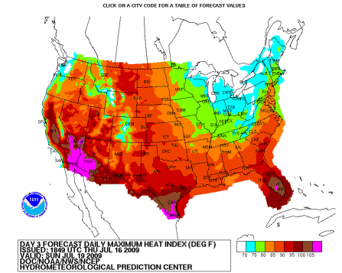
How Do I Prevent Heat Stress?
Acceptable OSHA methods (OSHA interpretation):
  Permit workers to drink water at liberty
  Establish provisions for a work/rest regimen
  Develop a heat stress program

Slide 58
How Do I Prevent Heat Stress?
Developing a heat stress program (OSHA interpretation)
  Training
    Effects of heat stress;
    Recognition of heat-related illness symptoms; and
    Prevention of heat-induced illnesses
  Medical screening program;

Slide 59
How Do I Prevent Heat Stress?
Developing a heat stress program (OSHA interpretation)
  Acclimation program for new employees or employees returning to work from absences of three or more days;
  Heat-related emergency procedures; and
  Provisions that first aid be administered immediately to employees displaying symptoms of heat-related illness.

Slide 60


What Resources Are Available to Me?
OSHA
  Heat Illness Campaign
  Heat Stress Safety & Health Topics Page
  Feasible and acceptable methods interpretation
  Protecting Workers from the Effects of Heat Fact Sheet
  Protecting Workers from Heat Stress Quick Card
  Working Outdoors in Warm Climates Fact Sheet
ACGIH
  ACGIH Heat Stress and Strain TLV

Slide 61
What Resources Are Available to Me?
NIOSH
  Heat Stress Workplace Safety and Health Topics Page
  Protecting Yourself from Heat Stress Fast Facts
  Occupational Exposure to Hot Environments Criteria Document
NOAA’s Heat Hazard Page
CCOHS
  Hot Environments – Health Hazard Page

Slide 62
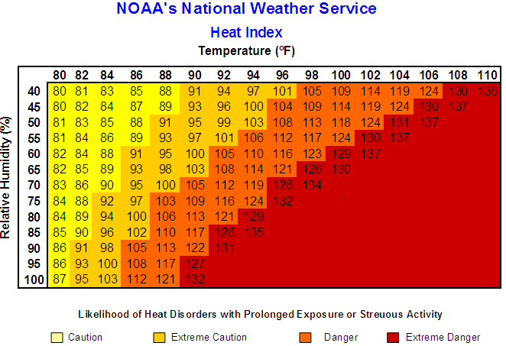

Slide 64
Through the Alliance between OSHA’s 10 Regional Offices and the Elevator Contractors of America (ECA), Elevator Industry Work Preservation Fund (EIWPF), International Union of Elevator Constructors (IUEC), National Association of Elevator Contractors (NAEC), National Elevator Industry Educational Program (NEIEP), and National Elevator Industry Inc. (NEII), collectively known as The Elevator Industry Safety Partners, developed this Industry Specific Training for informational purposes only. It does not necessarily reflect the official views of OSHA or the U.S. Department of Labor. May 2021​
Under the Occupational Safety and Health Act, employers are responsible (http://www.osha.gov/as/opa/worker/employer-responsibility.html) for providing a safe and healthy workplace and workers have rights (https://www.osha.gov/workers). OSHA can help answer questions or concerns from employers and workers. OSHA's On-Site Consultation Program (https://www.osha.gov/consultation) offers free and confidential advice to small and medium-sized businesses, with priority given to high-hazard worksites. For more information, contact your regional or area OSHA office (https://www.osha.gov/contactus/bystate), call 1-800-321-OSHA (6742), or visit https://www.osha.gov/.​

Slide 65

BCTD – AFL Smart Mark Module
Questions?

