Slide 1

Tools - Hand and Power
29 CFR 1926 Subpart I

Slide 2
Objectives
1926 Subpart I
At the end of this course, students will be able to:
  Familiarize themselves with OSHA’s minimum requirements for hand and power tools
  Identify safe design, installation, and use of tools
  Identify various tool hazards and abatement methods

Slide 3
Amputations Special Emphasis Program
Goal to reduce occupational exposures to amputations
Struck by and caught between injuries
  Lockout/tagout
  Machine guarding
Increase outreach to employers and employees
  Training events (Internal and external)
  Compliance inspections
  Consultation visits
  Publications
Amputations must be reported within 24 hours

Slide 4
Subpart I: Tools – Hand and Power
1926.300 – General requirements
1926.301 – Hand tools
1926.302 – Power-operated hand tools
1926.303 – Abrasive wheels and tools

Slide 5
Subpart I: Tools – Hand and Power
1926.304 – Woodworking tools
1926.305 – Jacks: lever and ratchet, screw, and hydraulic
1926.306 – Air receivers
1926.307 – Mechanical power-transmission apparatus

Slide 6
Common Hand and Power Tools
Hand Tools | Power Tools
Hammers Saws Chisels Shovels Pry bars Pliers Screwdrivers Wrenches Measuring tools | Electric/air/powder Drill motors Nailers/staplers Impact wrenches Impact/roto hammers Jackhammers Soil tampers/compactors Grinders Bandsaws/block saws/table saws Powder actuated tools Concrete mix/vibrators

Slide 7
Basic Tool Safety Rules
Maintain regularly
Inspect before use
Operate according to manufacturer’s recommendations
Use appropriate PPE
Use guards

Slide 8
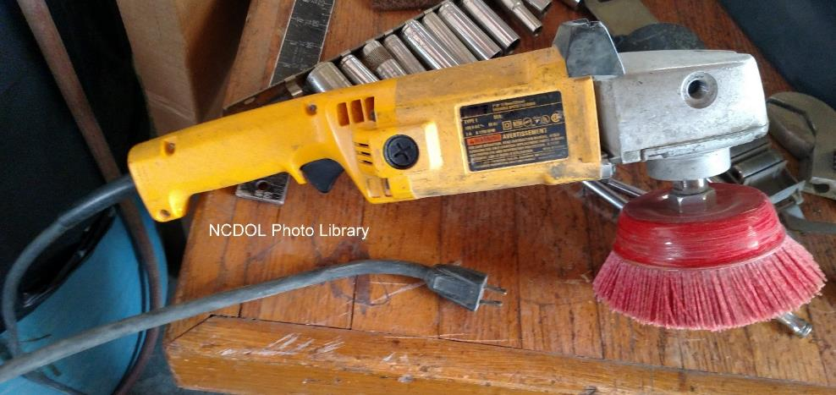
General Requirements
1926.300(a)
All hand and power tools furnished by the employer, or the employee must be maintained in a safe condition.

Slide 9
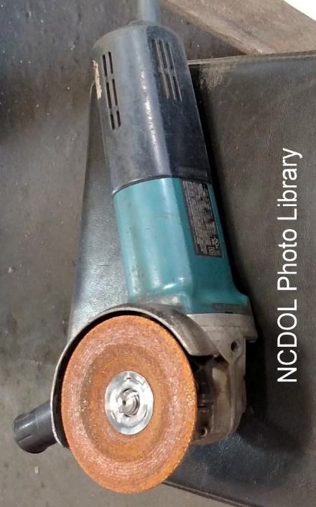
Guarding
1926.300(b)(2)
Belts, gears, shafts, pulleys, sprockets, spindles, drums, fly wheels, chains, or other reciprocating, rotating or moving parts of equipment shall be guarded if such parts are exposed to contact by employees or otherwise create a hazard.

Slide 10
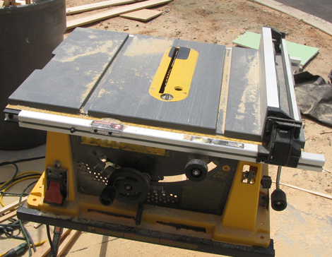
Guarding
1926.300(b)(3)
Guarding provided to protect employees from hazards created by:
  Point of operation
  Ingoing nip points
  Rotating parts
  Flying chips and sparks
NCDOL Photo Library
Non-compliant table saw with guard removed

Slide 11
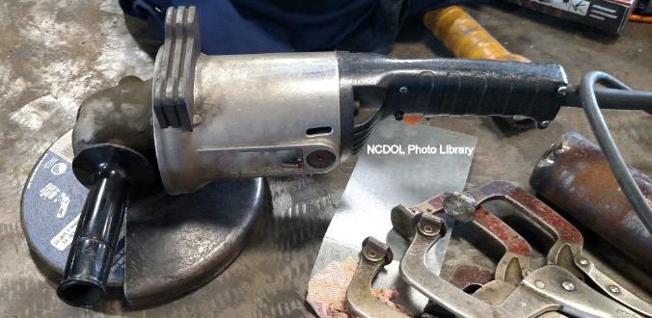
Types of Guarding
1926.300(b)
Fixed guards
Interlocked guards
Adjustable guards
Self-adjusting guards
Fixed Guard

Slide 12
Point of Operation Guarding
1926.300(b)(4)
Point of operation
  Area on a machine where work is actually performed upon the material being processed.
  Shall be guarded.
Special hand tools for placing and removing material shall be such as to permit easy handling of material without the operator placing a hand in the danger zone.

Slide 13
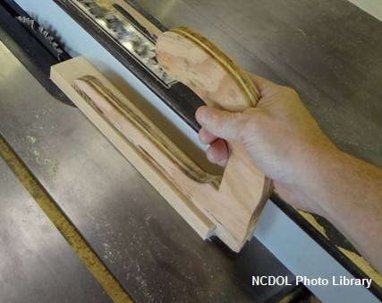
Miscellaneous Aids
Holding tools
Push stick or block
Awareness barriers
Shields
Push stick does not eliminate blade guard requirement.

Slide 14
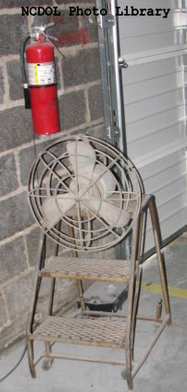
Exposure of Blades
1926.300(b)(5)
Blades of fans less than 7 feet above floor must be guarded.
Guard openings no larger than ½ inch.
Note hazards in this photo: There are several issues (including guard opening).

Slide 15
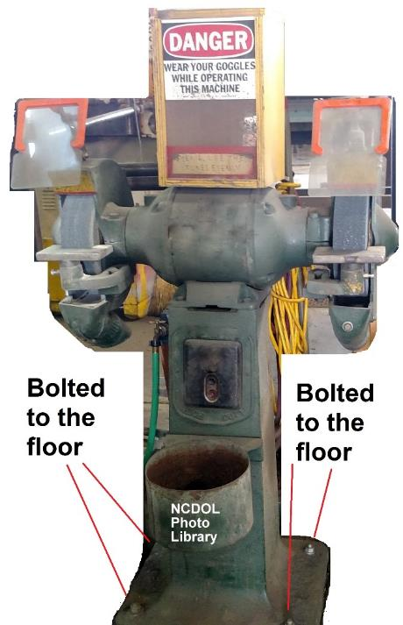
Anchoring Fixed Machinery
1926.300(b)(6)
Machines designed for fixed location must be anchored to prevent walking or moving.

Slide 16
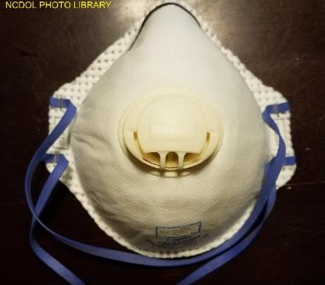
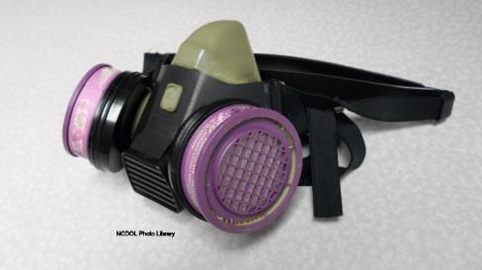
Personal Protective Equipment
1926.300(c)
Employees exposed to the hazard of falling, flying, abrasive, and splashing objects, or exposed to harmful dusts, fumes, mists, vapors, or gases, shall be provided with the personal protective equipment necessary to protect them from the hazard.

Slide 17
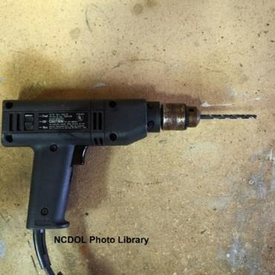
Switches
1926.300(d)
Positive “on-off” control
  Routers, planers, shears, scroll saws, laminate trimmers, jig saws, nibblers
Momentary contact “on-off”
control
  Power drills, grinders, tappers, disc
  and belt sanders, reciprocating saws
Constant pressure switch
  Circular saw, chain saw, and
  percussion tools

Slide 18
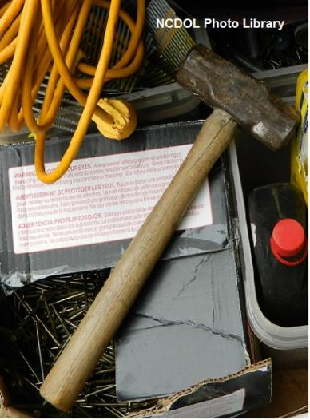
Hand Tool Hazards
1926.301(a) - (d)
Employers shall not issue or permit the use of unsafe hand tools.
Wrenches shall not be used when jaws are sprung to the point that slippage occurs.
Impact tools shall be kept free of mushroomed heads.
Wooden handles shall be kept free of splinters or cracks and shall be kept tight in the tool.
Cracked handle

Slide 19
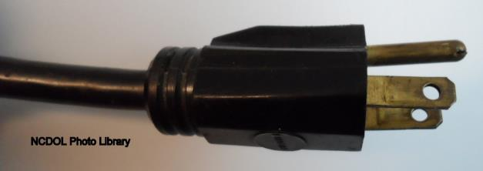
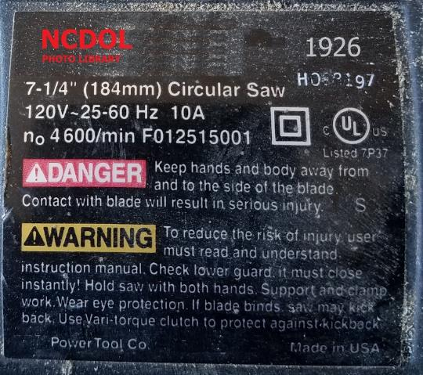

Power-Operated Hand Tools
1926.302(a)(1)
Electric power operated tools shall either be of the approved double-insulated type or grounded in accordance with Subpart K of this part.
Plug with a grounding pin
Double - insulated markings

Slide 20
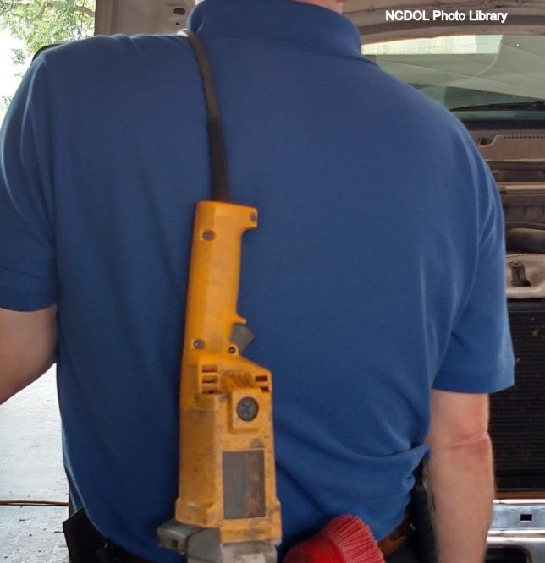
Power-Operated Hand Tools
1926.302(a)(2)
Use of electric cords for hoisting or lowering tools shall not be permitted.

Slide 21

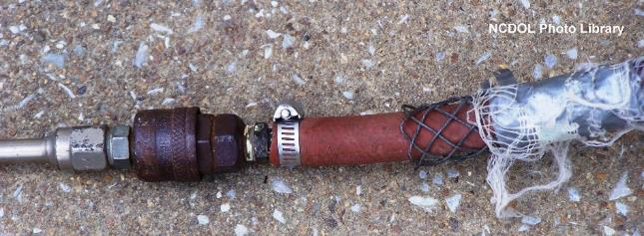
Power-Operated Hand Tools
1926.302(b)(1)
Pneumatic power tools
  Shall be secured to the hose or whip by some positive means to prevent the tool from becoming accidentally disconnected.
Positive locking device
Improper and unsecure

Slide 22
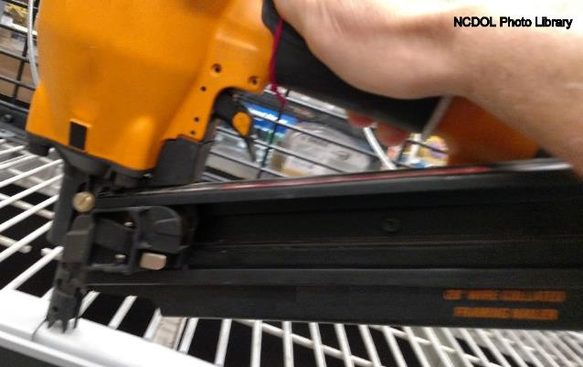
Power-Operated Hand Tools
1926.302(b)(3)
Pneumatic power tools
  Must have a safety device on the muzzle to prevent the tool from ejecting fasteners unless the muzzle is in contact with work surface.
    Covers tools operating at more than 100 p.s.i.
Framing nailer

Slide 23
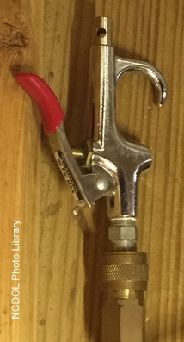
Power-Operated Hand Tools
1926.302(b)(4)
Compressed air must not be used for cleaning.
  Exception
    Where reduced to less than 30 p.s.i. with effective chip guarding and PPE

Slide 24
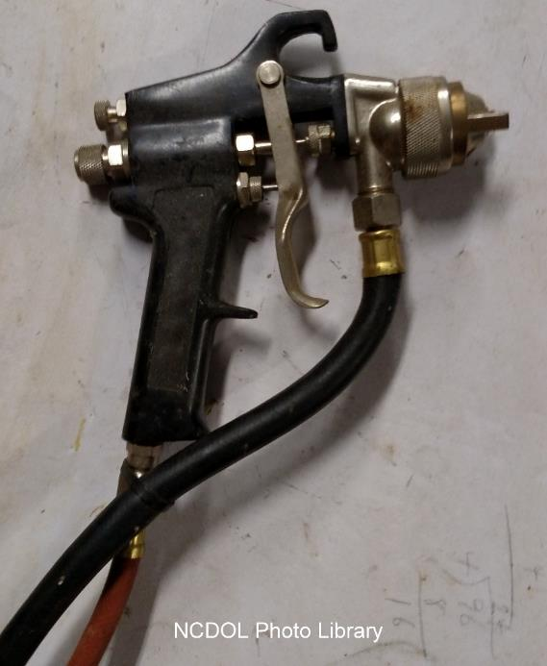
Power-Operated Hand Tools
1926.302(b)(8)
Airless spray guns
  Operating at 1,000 p.s.i. or more must be equipped with an automatic or visible manual safety device.
  Safety device prevents pulling trigger until manually released.

Slide 25
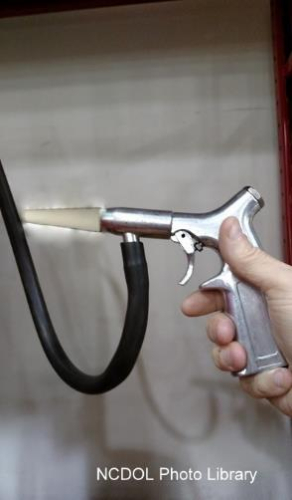
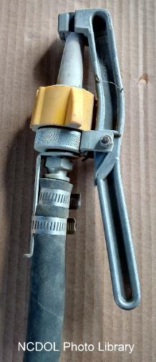
Power-Operated Hand Tools
1926.302(b)(10)
Abrasive blast cleaning nozzles
  Must be equipped with operating valve which must be held open manually.
Correct
Incorrect – Valve is held in open position by a hose clamp.

Slide 26
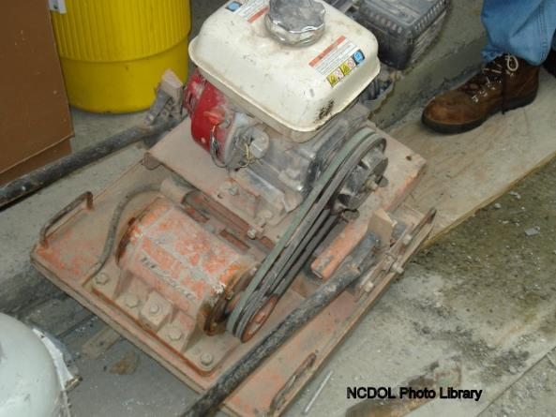
Power-Operated Hand Tools
1926.302(c)(1)
Fuel powered tools must be stopped while being refueled, serviced, or maintained.
Fuel must be transported, handled, and stored in accordance with Subpart F- Fire Protection and Prevention.
Non-compliant soil tamper
due to missing belt guard.

Slide 27
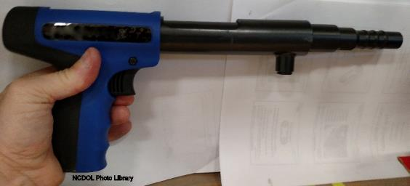
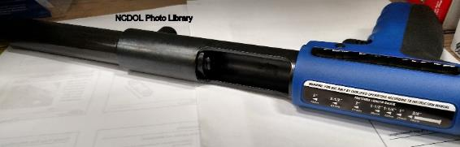
Powder-Actuated Tools
1926.302(e)
User must be trained.
Test tool each day before loading to ensure the safety devices are working properly.
Any tool found not in proper working order, or that develops a defect during use, shall be immediately removed from service.
Wear suitable ear, eye, and face protection.

Slide 28
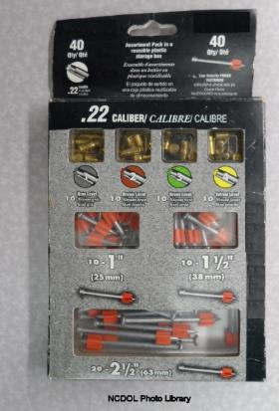
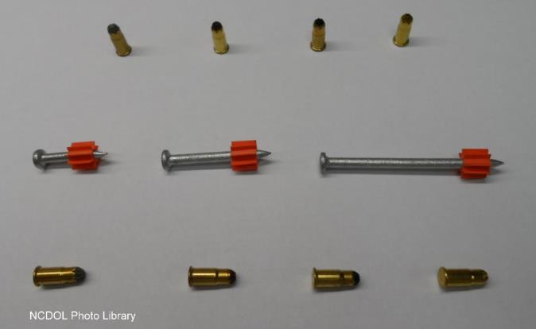
Powder-Actuated Tools
1926.302(e)
Don’t use in explosive or flammable atmosphere.
Tools shall not be loaded until just prior to intended firing time.

Slide 29
Powder-Actuated Tools
1926.302(e)
Keep hands clear of the barrel end.
Never point the tool at anyone.
Use with the correct shield, guard, or attachment recommended by the manufacturer.
Loaded tools shall not be left unattended.

Slide 30
A Fatal Fact
A 22-year-old carpenter’s apprentice was killed when struck in head by a nail fired from a powder actuated tool.
Tool operator was attempting to anchor a plywood form in preparation for pouring a concrete wall.
Tool operator had never received training on how to properly use the tool.
All area employees were not wearing PPE.

Slide 31
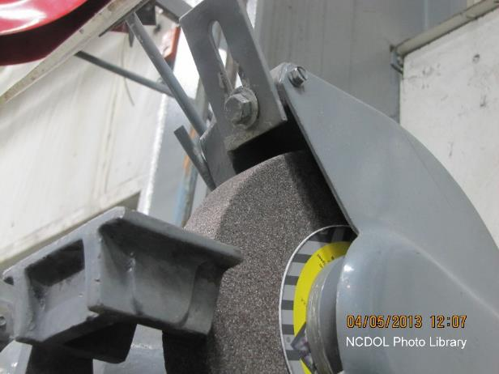
Abrasive Wheel Machinery
1926.300(b)(7)
Distance between the wheel periphery and the adjustable tongue shall not exceed ¼ inch.
Tongue guard out of adjustment

Slide 32
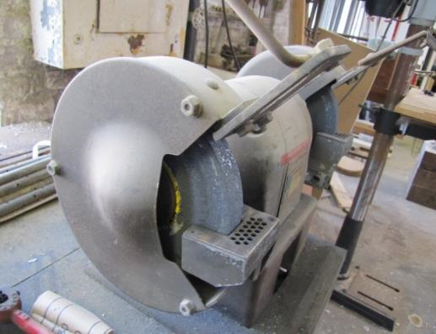
Abrasive Wheels and Tools
1926.303(b)(1)-(2)
Abrasive wheels shall be used only on machines provided with safety guards.
Wheel safety guards cover the spindle end, nut, and flange projections.
NCDOL Photo Library

Slide 33

Use of Abrasive Wheels
1926.303(c)(1)
Floor and bench-mounted grinders
  Angular exposure of the grinding wheel periphery and sides for safety guards used on machines should not exceed 90 degrees or
  ¼ of the periphery.
NCDOL Photo Library
270-degree guard

Slide 34
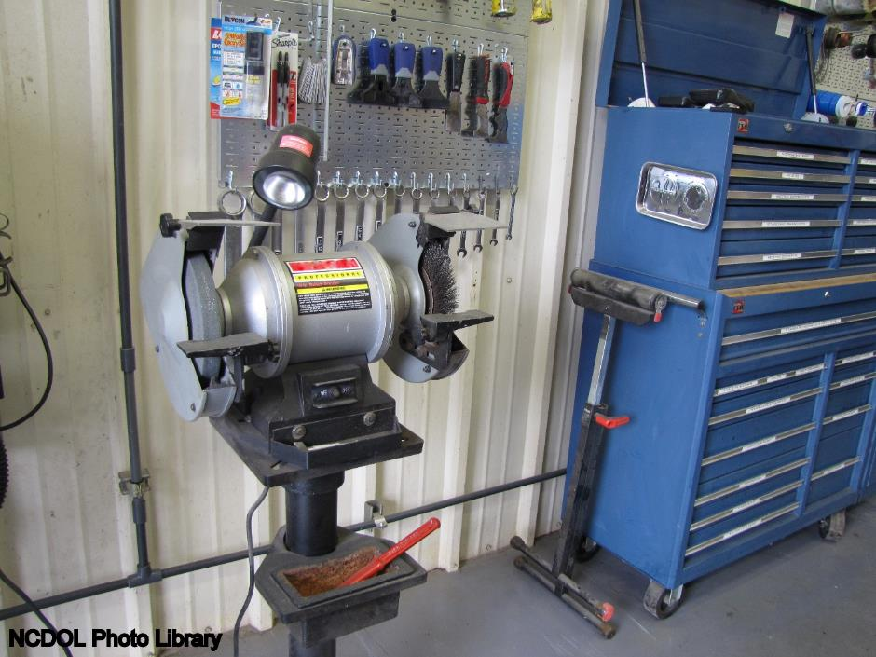
Use of Abrasive Wheels
1926.303(c)(2)
Work rests must be adjusted closely to the wheel with a maximum opening of ⅛ inch.

Slide 35
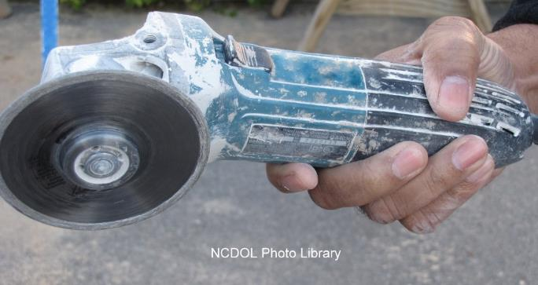
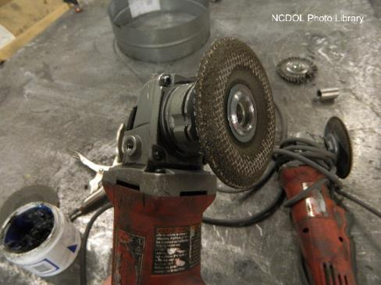
Use of Abrasive Wheels
1926.303(c)(5)
Vertical portable grinders must have safety guard on tool with a maximum exposure angle of 180 degrees.
Non-compliant portable grinders without guards.

Slide 36

Use of Abrasive Wheels
1926.303(c)(5)
Install the proper type guard located so as to be between the operator and the wheel during use.
Guard adjusted to deflect broken pieces of wheel away from operator.

Slide 37
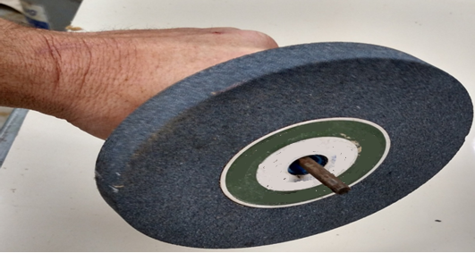
Use of Abrasive Wheels
1926.303(c)(7)
All abrasive wheels must be closely inspected and ring-tested before mounting to ensure that they are free from cracks and defects.
NCDOL Photo Library

Slide 38
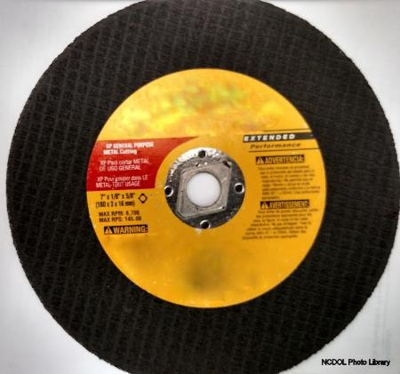
Use of Abrasive Wheels
1926.303(c)(8)
Ensure the spindle speed does not exceed the maximum speed marked on the wheel.
Grinding wheels must fit freely on the spindle.
Tighten the spindle nut only enough to hold the wheel in place.
Maximum RPM 8,700

Slide 39
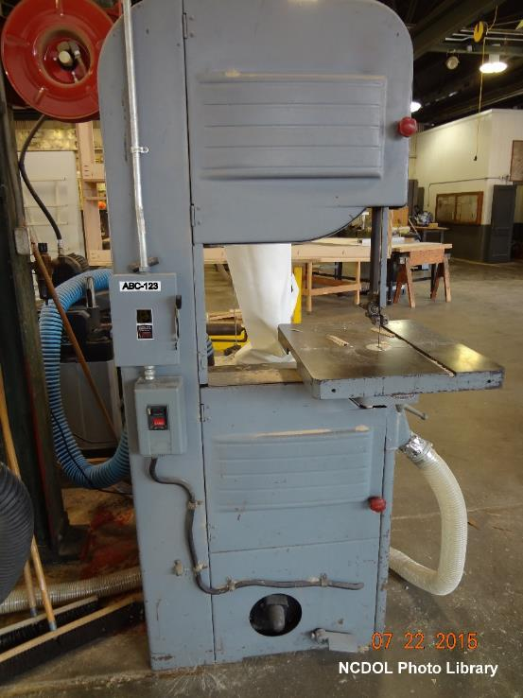
Woodworking Tools
1926.304(a)
Fixed power-driven woodworking tools must be provided with a disconnect switch.
Switch can either be locked or tagged in
the off position.

Slide 40
Woodworking Tools
1926.304(d), (f)
Portable circular saws
  Must be equipped with guards above and below the base plate or shoe.
  Upper and lower guard must cover the saw to the depth of the teeth.
  Lower guard must automatically return to the covering position over the blade teeth when tool is withdrawn from the work.
  Mechanical or electrical power control provided for operator to cut off power.
    Control is located on machine where operator does not have to leave his position at the point of operation.

Slide 41
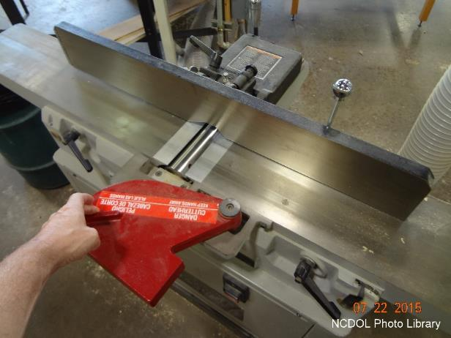
Woodworking Tools
1926.304(f)
Jointers
  Hand-fed jointer with horizontal cutting head must have an automatic guard.
    Must cover the working side of the fence or gage
    Automatically adjust and cover the unused portion of the head

Slide 42
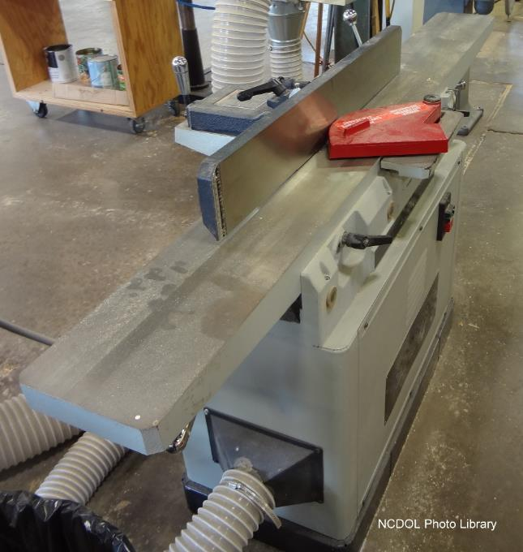
Woodworking Tools
1926.304(f)
Hand-fed jointers
  With horizontal cutting head must have a guard.
  Must cover the section of head back of the gage or fence.

Slide 43
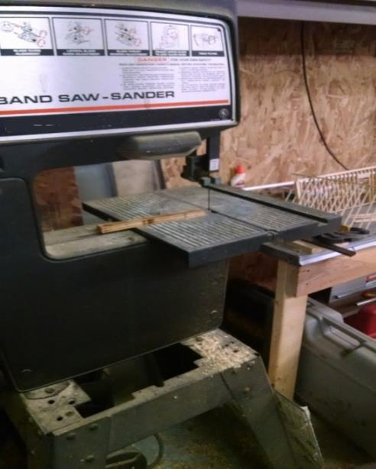
Woodworking Tools
1926.304(f)
Bandsaws and band re-saws
  All portions of saw blade must be enclosed or guarded except working portion between guide rollers and the table.
  Bandsaw wheels must be fully encased.
NCDOL Photo Library

Slide 44
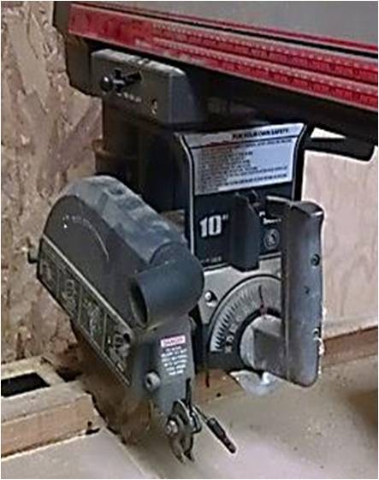
Woodworking Tools
1926.304(g)(1)
Radial saws
  Guard to prevent the operator from coming in contact with the rotating blade.
NCDOL Photo Library

Slide 45
Woodworking Tools
1926.304(g)(1)
Radial saws
  Lower portion of blade must be guarded on both sides.
    Guarded to the full diameter of the blade
    Will adjust itself to
    the thickness of the
    stock
This saw does not comply
with the requirement.
NCDOL Photo Library

Slide 46
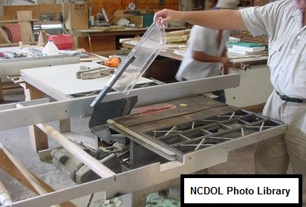
Woodworking Tools
1926.304(i)(1)
Hand-fed ripsaws
  Provided with a hood guard.
  Hood must completely enclose portion of saw blade above the table.
  Mounting must be strong enough to resist any reasonable side thrust.
Spreader

Slide 47
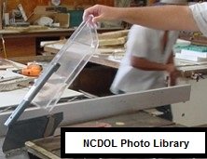
Woodworking Tools
1926.304(i)(1)
Hand-fed ripsaws
  Hood guard must automatically adjust itself to thickness of material being cut.
  Remain in contact with material.

Slide 48
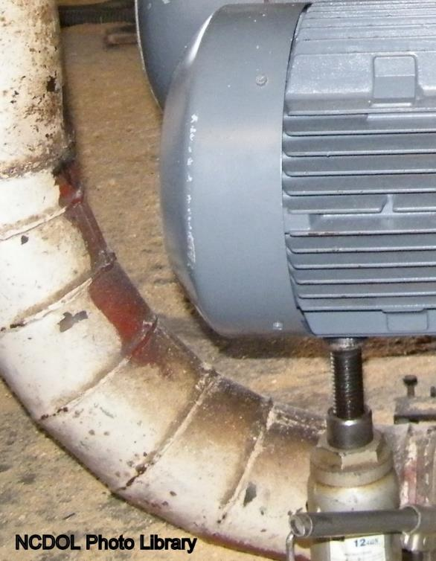
Jacks
1926.305(a)(1)
Manufacturer’s rated capacity must be marked on all jacks and must not be exceeded.
All jacks must have a positive stop to prevent over travel.

Slide 49
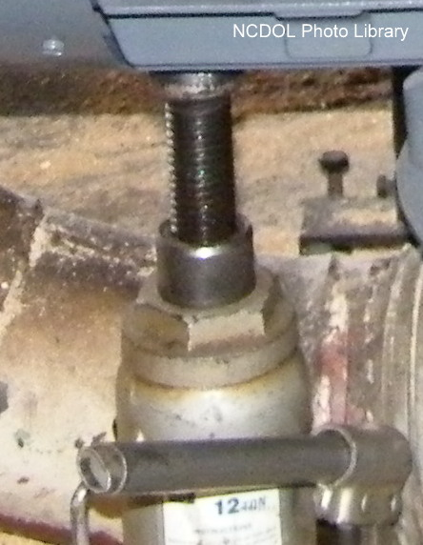
Jacks
1926.305(c), (d)(1)(i)
Operation
  Base seated on a firm, level surface
  Where there is a possibility of slippage
    Use wood block between cap and load
    Crib, block, or secure
    load after it is raised
Notes:
NCDOL Photo Library Closed Case file # 314877093
Proper maintenance of jacks is essential for safety. All jacks must be inspected before each use and lubricated regularly. If a jack is subjected to an abnormal load or shock, it should be thoroughly examined to make sure it has not been damaged.
1926.305(c) Blocking. When it is necessary to provide a firm foundation, the base of the jack shall be blocked or cribbed. Where there is a possibility of slippage of the metal cap of the jack, a wood block shall be placed between the cap and the load.
1926.305(d)(1) “Operation and maintenance.” (i) After the load has been raised, it shall be cribbed, blocked, or otherwise secured at once.

Slide 50
Jacks
1926.305(d)(1)(iii)-(vi)
Maintenance
  Properly lubricate and inspect at regular intervals.
  Repair or replacement parts shall be examined for possible defects.
  Defective jacks removed from service until repaired.

Slide 51
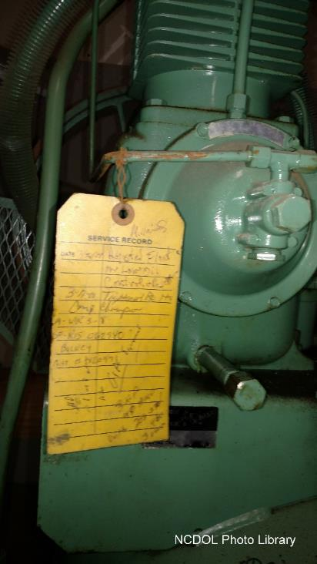
Air Receivers
1926.306(a)(2)
Air receiver must be constructed in accordance with American Society of Mechanical Engineers (ASME) Boiler and Pressure Code Section VIII – 1968.
Notes:
.

Slide 52
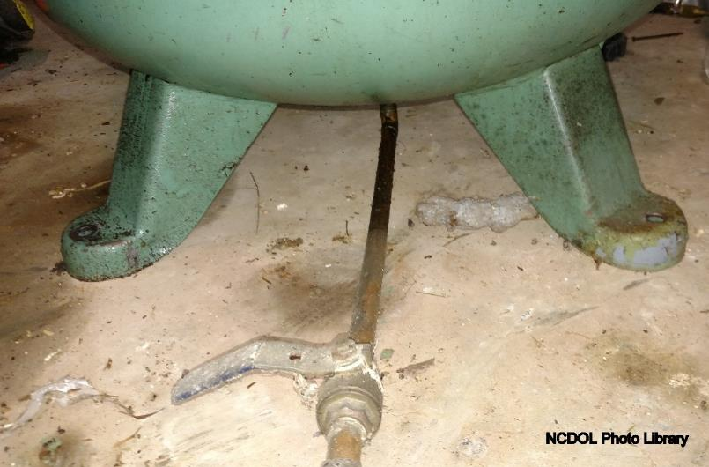
Air Receivers
1926.306(b)(1)
Installed so that all drains, handholds, and manholes are easily accessible.

Slide 53
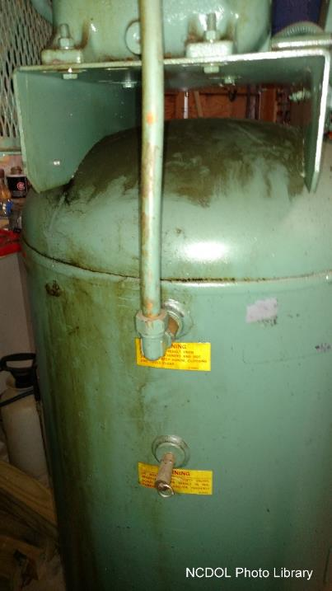
Air Receivers
1926.306(b)(3)(i)-(iv)
Must be equipped with an indicating pressure gage and at least one spring-loaded safety valve.
Safety valves must be tested frequently and at regular intervals to determine operating condition.

Slide 54
Practice 1
The manufacturer is responsible for the safe condition of tools and equipment used by employees.
a. True
b. False
Notes:
False. Employer is responsible per 1926.300

Slide 55
Practice 2
Compressed air shall not be used for cleaning purposes except where reduced to less than _____ psi at the tip.
  30
  35
  40
  50
Notes:
a. Where reduced to less than 30 p.s.i. with effective chip guarding and PPE. 1926.304(b)(2)

Slide 56
Practice 3
Work rests must be adjusted closely to the wheel with a maximum opening of ___ inch.
a. 1/2
b. 1
c. 1/8
d. .75
Notes:
c. 1/8

Slide 57
Practice 4
If an employee uses their own tools, the employer has no responsibility to ensure the tools are in good working order.
True or False
Notes:
False

Slide 58
Summary
In this course, we discussed:
  OSHA’s minimum requirements for hand and power tools
  Safe design, installation, and use of tools
  Hazard identification
  Abatement methods

Slide 59
Through the Alliance between OSHA’s 10 Regional Offices and the Elevator Contractors of America (ECA), Elevator Industry Work Preservation Fund (EIWPF), International Union of Elevator Constructors (IUEC), National Association of Elevator Contractors (NAEC), National Elevator Industry Educational Program (NEIEP), and National Elevator Industry Inc. (NEII), collectively known as The Elevator Industry Safety Partners, developed this Industry Specific Training for informational purposes only. It does not necessarily reflect the official views of OSHA or the U.S. Department of Labor. May 2021
Under the Occupational Safety and Health Act, employers are responsible (http://www.osha.gov/as/opa/worker/employer-responsibility.html) for providing a safe and healthy workplace and workers have rights (https://www.osha.gov/workers). OSHA can help answer questions or concerns from employers and workers. OSHA's On-Site Consultation Program (https://www.osha.gov/consultation) offers free and confidential advice to small and medium-sized businesses, with priority given to high-hazard worksites. For more information, contact your regional or area OSHA office (https://www.osha.gov/contactus/bystate), call 1-800-321-OSHA (6742), or visit https://www.osha.gov/.

Slide 60


