Slide 1
1926 Subpart CC
Cranes

Slide 2
Cranes and Hoists
By the end of this presentation, students will be able to:
1. Describe precautions for crane use near power lines.
2. Recognize employer requirements to protect workers from crane
hazards.
3. Identify common hand signals for cranes.
4. Describe communication requirements for cranes.
5. Identify common causes of crane accidents.

Slide 3
Cranes and Hoists
Types of Crane Accidents
Contact with power lines
Overturns
Mechanical Failures

Slide 4
Cranes and Hoists
Types of Crane Accidents
Contact with power lines
Contact with power lines is a leading cause of crane accidents.
You must be aware of placement of power lines surrounding worksite
You must maintain clearance of at least 20 feet from energized electrical lines unless other precautions have been implemented
Notes:
Source: OSHA.gov

Slide 5
Cranes and Hoists
Types of Crane Accidents
2. Overturns
Causes:
Overloads
Outrigger failure
High winds
Side pull
Improper maintenance
Notes:
Source: OSHA.gov

Slide 6
Cranes and Hoists
Types of Crane Accidents
3. Mechanical Failures
Routine maintenance should be followed to prevent accidents due to mechanical failure. Components with excessive wear should be repaired and replaced as soon as possible.
Notes:
Source: OSHA.gov

Slide 7
Cranes and Hoists
Other causes of crane accidents include:
Under the hook lifting device,
Dropped loads,
Boom collapse,
Crushing by the counterweight,
Outrigger use
Rigging failures
Notes:
Source: OSHA.gov

Slide 8
Cranes and Hoists
Common Causes of Crane Accidents
Reasons accidents occur:
Poor Load Planning/Instability
Not knowing the weight of the load or the characteristics of the crane. Instability of crane, instability of load, or poor ground conditions (not level or too soft) can contribute to crane accidents.
2. Lack of communication
Lack of communication between the crane operator and ground personnel.
Lack of training
Operators who do not have proper training in crane operation and safety procedures may lead to crane accidents. Everyone involved in maintaining, repairing, and assembling the crane should have training.
Inadequate maintenance or inspection of equipment
Timely, consistent inspections by experienced and well-trained inspectors can prevent accidents. As mentioned previous, routine maintenance should be followed and components with excessive wear should be repaired and replaced as soon as possible.

Slide 9
Cranes and Hoists
Conditions and actions that create hazardous environments for crane operations.
Improper loading rating.
Solution: Check to ensure the load does not exceed the crane’s rated capacity.
Excessive speeds.
Solution: Maintain safe speed of operation in accordance with manufacturer’s recommendations.
No hand signals.
Solution: Ensure the signal person meets OSHA’s qualifications.
Inadequate inspections and maintenance.
Solution: Check all crane equipment and controls to ensure proper operation is possible before use. Plan and preform routine inspections and maintenance.
Unguarded parts.
Solution: Ensure that all required guards are securely in place.
Unguarded swinging radius.
Solution: Barricade accessible areas within the crane’s swing radius.

Slide 10
Cranes and Hoists
Conditions and actions that create hazardous environments for crane operations cont.
7. Working too close to power lines.
Solution: Watch for overhead power lines and maintain safe working clearance of at least 20 feet from energized electrical lines.
8. Improper exhaust systems.
Solution: Ensure equipment exhaust is properly maintained and is in proper working condition.
9. Shattered windows.
Solution: Replace damaged windows to ensure proper visibility.
10. No steps or guardrails on walkways.
Solution: Ensure that all walkways are equipped with standard railings.
11. No boom angle indicator.
Solution: Ensure all operational aids including boom angle indicators are working properly.
12. Not using outriggers.
Solution: Fully extend outriggers in accordance with the lifting conditions and the load chart.

Slide 11
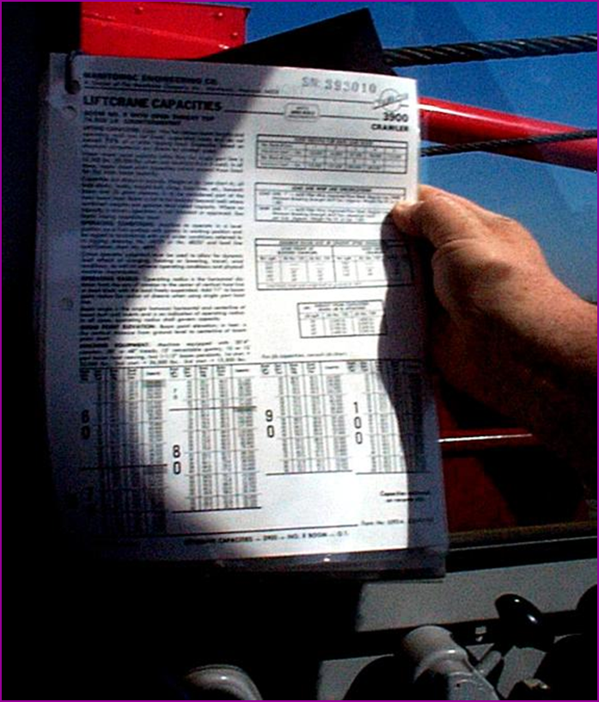
Cranes and Hoists
Load Capacity – Speed - Warnings
1926.1417(c)(1)The procedures applicable to the operation of the equipment, including rated capacities (load charts), recommended operating speeds, special hazard warnings, instructions, and operator's manual, must be readily available in the cab at all times for use by the operator.
Make sure the crane operator can see the:
Rated Load Capacities
Operating Speeds
Special Hazard Warning
Instructions
Operator’s manual
Source: OSHA

Slide 12
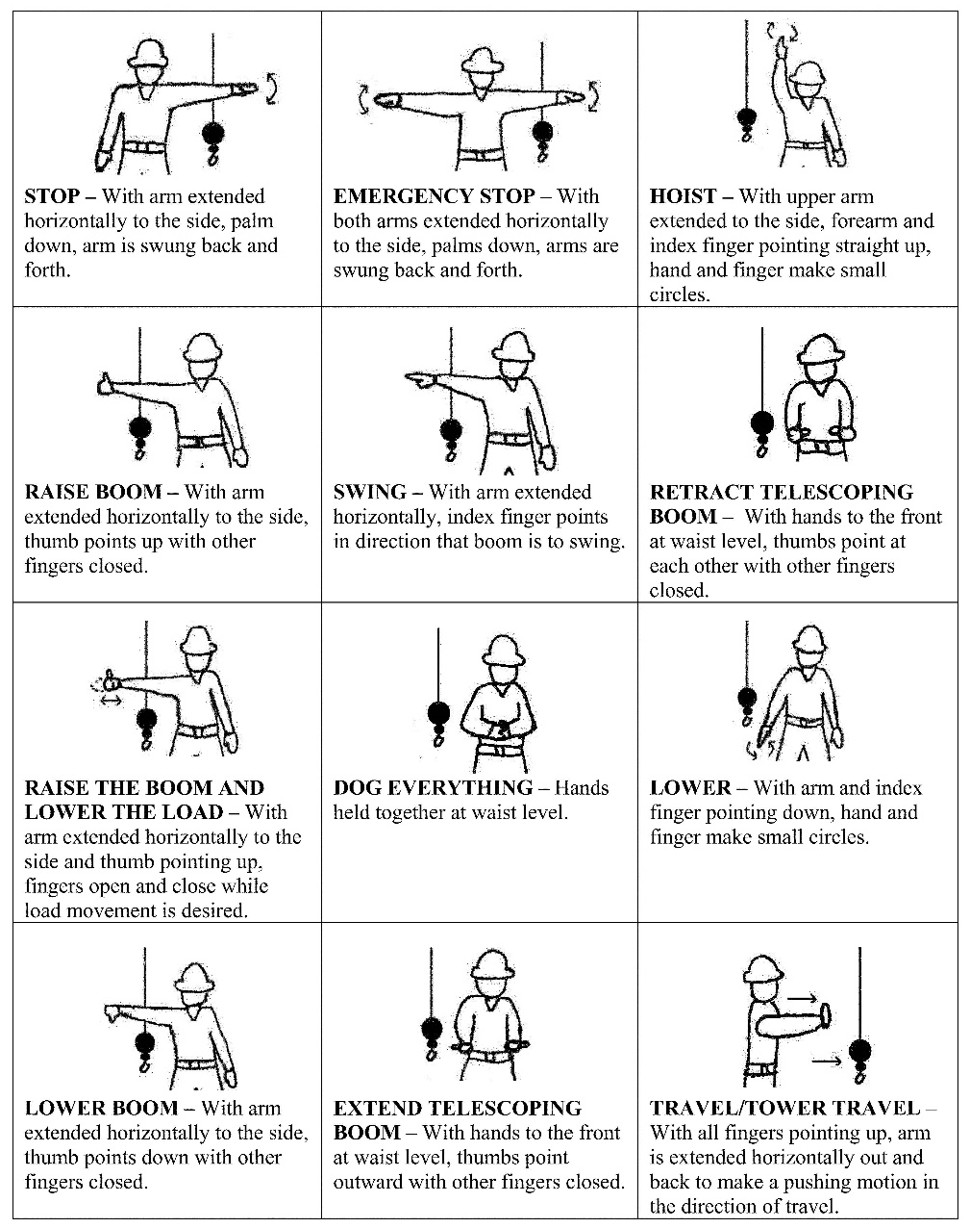
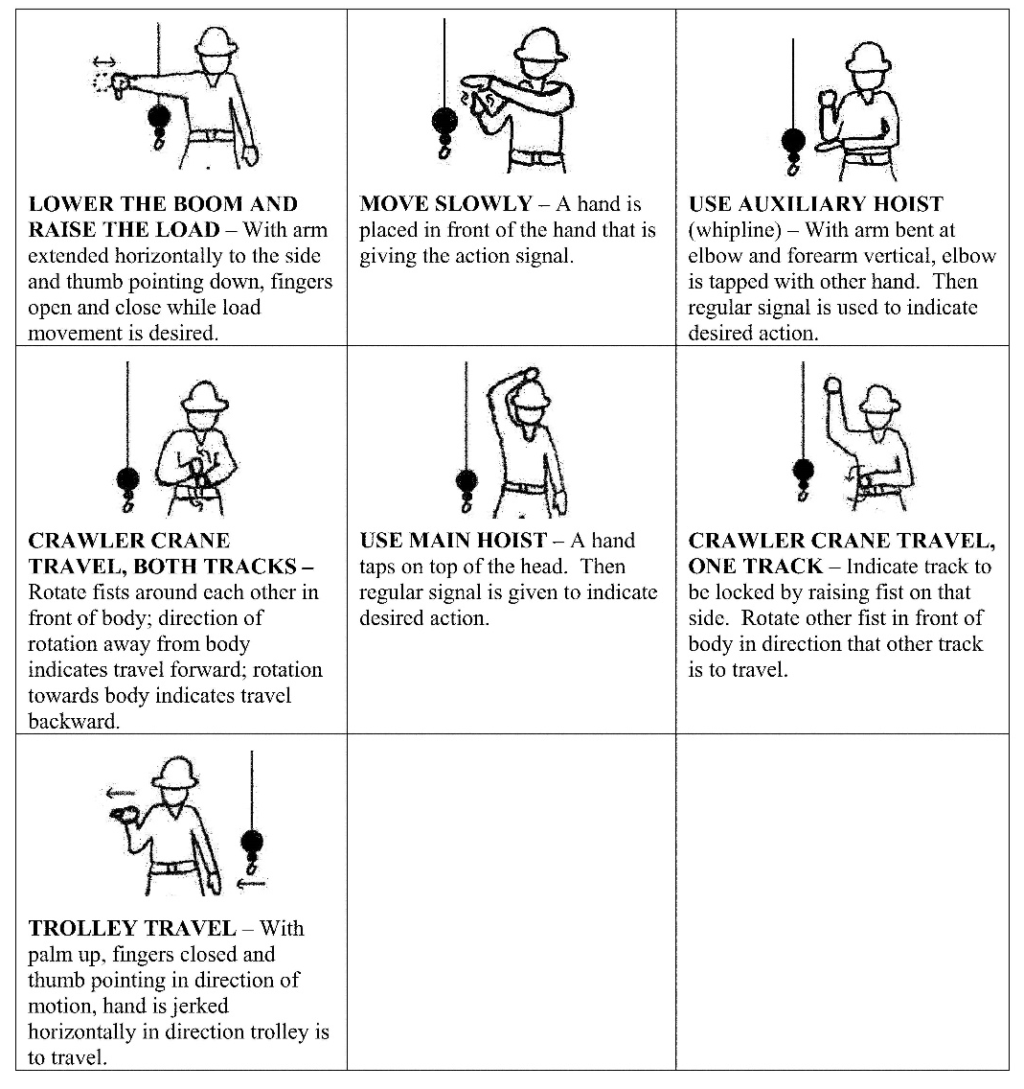
Cranes and Hoists
1926.1422 Hand signal charts must be either posted on the equipment or conspicuously posted in the vicinity of the hoisting operations.
Source: Federal Register - OSHA
Notes:
An illustration of the signals must be posted on the equipment or in the vicinity of the operations.

Slide 13
Cranes and Hoists
§1926.1421 — Voice signals
Voice signals can be used in place of hand signals with the following requirements:
(a) Prior to beginning operations, the operator, signal person and lift director (if there is one), must contact each other and agree on the voice signals that will be used. Once the voice signals are agreed upon, these workers need not meet again to discuss voice signals unless another worker is added or substituted, there is confusion about the voice signals, or a voice signal is to be changed.
Each voice signal must contain the following three elements, given in the following order: function (such as hoist, boom, etc.), direction; distance and/or speed; function, stop command.
For example:
Hoist, Hoist Up, 10 Feet, Hoist Stop
Swing, Swing Right, 5 Feet, Swing Stop
Travel, Travel Forward, 3 Feet, Travel Stop
(c) The operator, signal person and lift director (if there is one), must be able to effectively communicate in the language used.

Slide 14
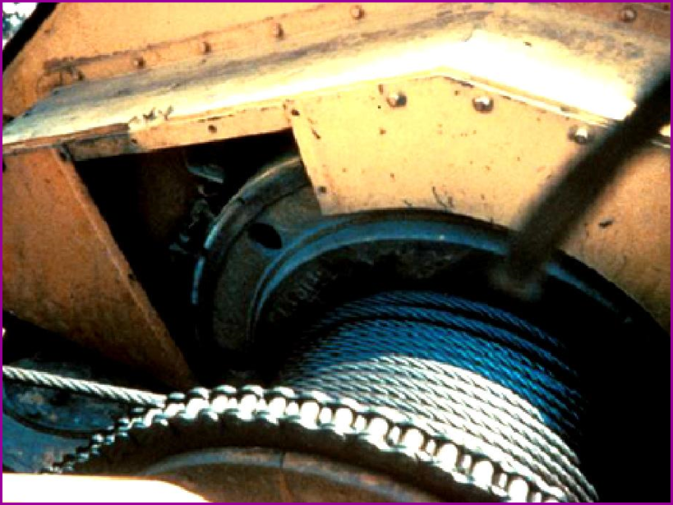
Cranes and Hoists
Guard moving parts such as gears or belts.
1926.1433(d)(8) Belts, gears, shafts, pulleys, sprockets, spindles, drums, fly wheels, chains, and other parts or components that reciprocate, rotate or otherwise move must be guarded where contact by employees (except for maintenance and repair employees) is possible in the performance of normal duties.
Source: OSHA

Slide 15
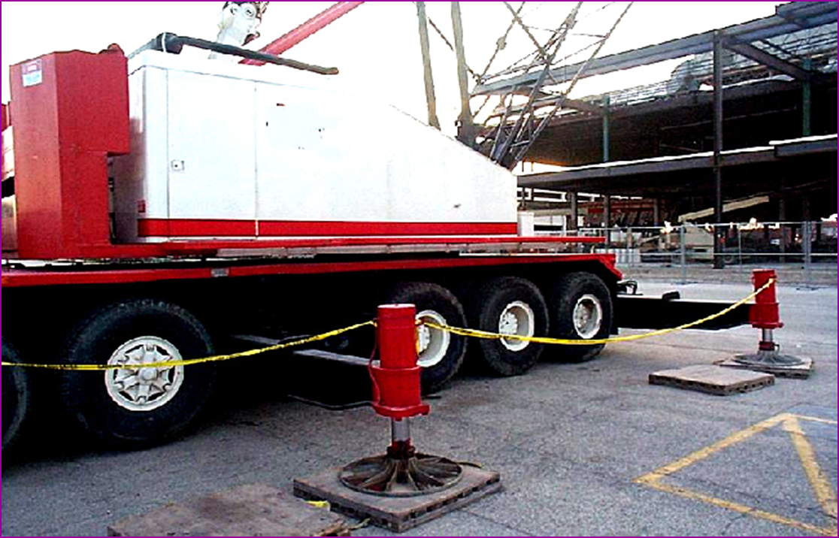
Cranes and Hoists
Swing Radius
Stay out of the swing radius of the crane.
Make sure there are barrier guards showing the swing radius.
The preferred way to protect employees in these situations is to completely barricade the entire swing radius of the equipment and prevent employee access to the area.
Source: OSHA
Notes:
1926.1424(a)(2)To prevent employees from entering these hazard areas, the employer must:
1926.1424(a)(2)(i)Train each employee assigned to work on or near the equipment ("authorized personnel") in how to recognize struck-by and pinch/crush hazard areas posed by the rotating superstructure.
1926.1424(a)(2)(ii)Erect and maintain control lines, warning lines, railings or similar barriers to mark the boundaries of the hazard areas. Exception: When the employer can demonstrate that it is neither feasible to erect such barriers on the ground nor on the equipment, the hazard areas must be clearly marked by a combination of warning signs (such as "Danger--Swing/Crush Zone") and high visibility markings on the equipment that identify the hazard areas. In addition, the employer must train each employee to understand what these markings signify.

Slide 16
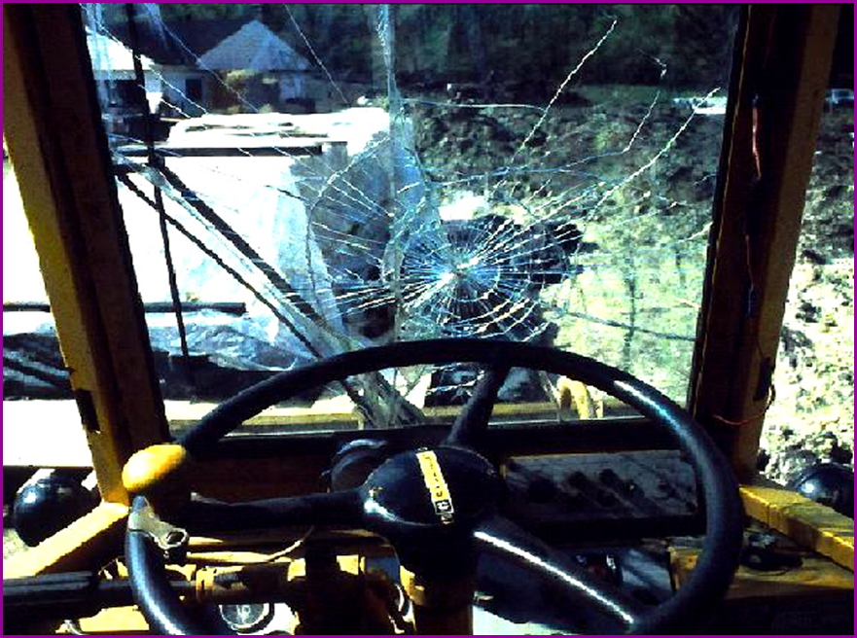
Cranes and Hoists
Operator Visibility
Make sure broken windows or other obstructions do not prevent the operator from seeing.
Source: OSHA
Notes:
1926.1433(d)(7)(iii)(C) Windows must be of safety glass or material with similar optical and safety properties, that introduce no visible distortion or otherwise obscure visibility that interferes with the safe operation of the equipment.

Slide 17
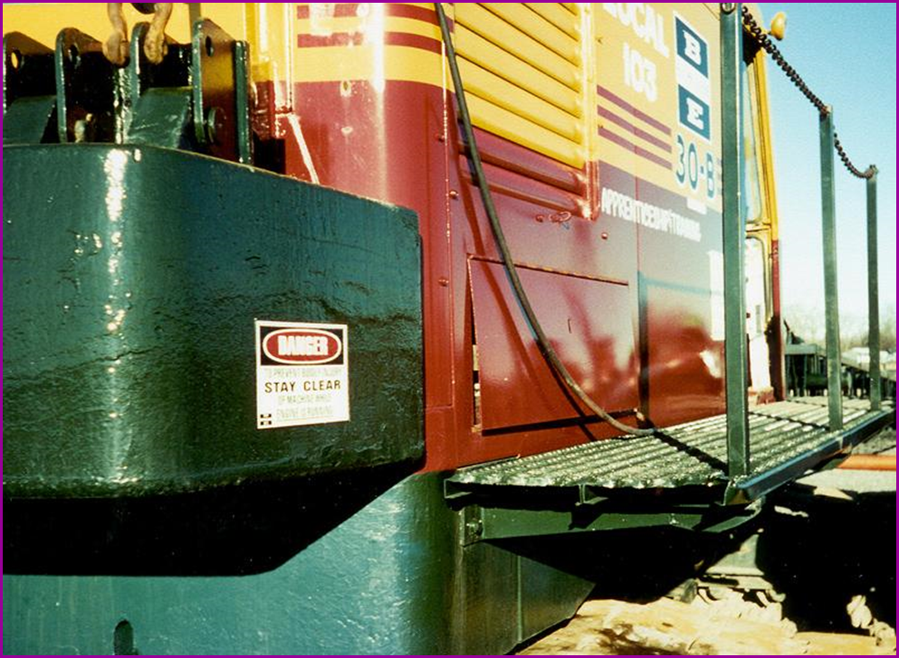
Cranes and Hoists
Guardrails
Runways and steps need to have guardrails, handholds and slip resistant surfaces.
Source: OSHA

Slide 18
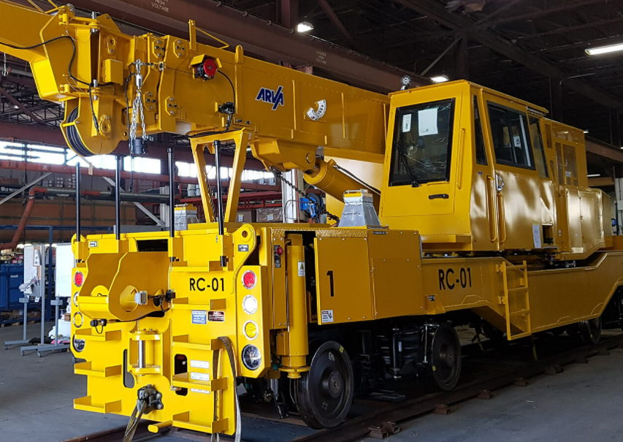
Cranes and Hoists
Use ladders/steps to get to the upper portion of the cab.
Notes:
APPLICABLE OSHA STANDARD
1926.1423(c)(3)Equipment manufactured after November 8, 2011 must be equipped so as to provide safe access and egress between the ground and the operator work station(s), including the forward and rear positions, by the provision of devices such as steps, handholds, ladders, and guardrails/railings/grabrails. These devices must meet the following criteria:
1926.1423(c)(3)(i)Steps, handholds, ladders and guardrails/railings/grabrails must meet the criteria of SAE J185 (May 2003) (incorporated by reference, see § 1926.6) or ISO 11660-2:1994(E) (incorporated by reference, see § 1926.6) except where infeasible.
1926.1423(c)(3)(ii)Walking/stepping surfaces, except for crawler treads, must have slip-resistant features/properties (such as diamond plate metal, strategically placed grip tape, expanded metal, or slip-resistant paint).

Slide 19
Cranes and Hoists
Crane Operations
Load capacity/speed of operation – make sure that the crane operator can see the rated load capacity and the proper operating speeds and is aware of any hazard warnings or instructions. Operators are not allowed to use cell phones while working on a crane, except when communicating with the signal person.
Weight of load – determine the weight of the load and use this information to calculate the proper way to lift and move the load. The maximum load that can be lifted can be limited by these factors:
Unlevel ground or crane
High winds
Not using outriggers
Use of extensions, jibs
Limits of the wire rope, slings, or lifting devices being used.

Slide 20
Cranes and Hoists
Crane Operations Cont.
3. Basic lifting principles – use these to govern a crane’s mobility and safety during lifting
operations. These principles are:
Center of gravity
Leverage
Stability
Structural integrity
4. Hand signals – an illustration of signals must be posted in the vicinity of the hoisting
operation. The signal person must meet OSHA’s qualification requirements. A signal
person is required when any of the following conditions apply:
Point of operation is not in full view of operator.
Operator’s view is obstructed in the direction of equipment is traveling
Either the operator or the person handling the load determines a signal person is needed for safety concerns
5. Power lines – stay clear of power lines.
6. Swing radius – stay out of the swing radius of the crane and make sure that there are
barricades restricting access within the swing radius area.
7. Suspended loads – keep the load as close as possible to the ground when picking up
and carrying a load.

Slide 21
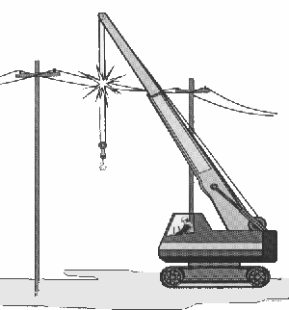
Cranes and Hoists
Crane Use Near Power Lines
Boom or crane contact with energized power lines accounts for nearly 45% of crane accidents.
Source: NIOSH

Slide 22
Cranes and Hoists
Crane Use Near Power Lines
Pre-operational requirements:
Identify work zone
Determine proximity to power lines, if closer than 20 feet, if so, must do one of the following three:
De-energize and ground
Ensure no part of equipment, load line, or load gets closer than 20 feet to power line
Determine line’s voltage and minimum approach
distance permitted under Table A.

Slide 23
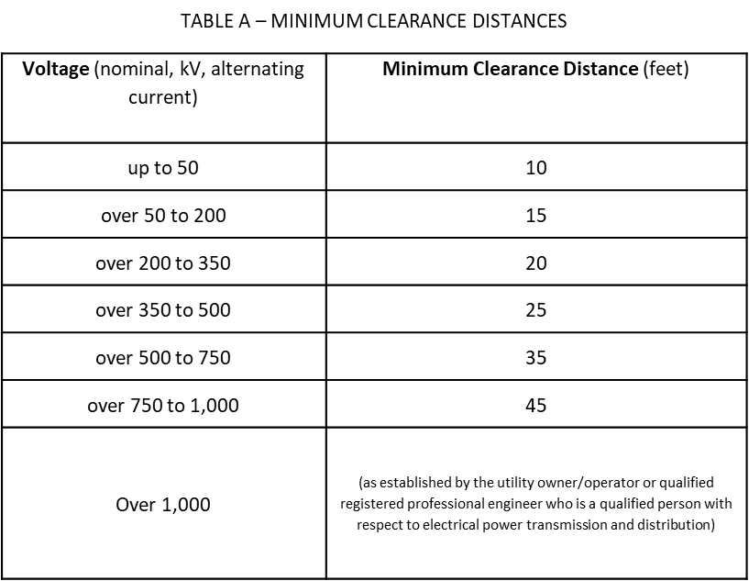
Cranes and Hoists
Crane Use Near Power Lines
Identify work zone
Determine if any part of crane, load line, or load could get closer than 20 feet to a power line if operated at maximum working radius in the work zone. If so, must meet requirements in one of three options:
De-energize and ground
Ensure no part of equipment, load line, or load gets closer than 20 feet to power line
Determine line’s voltage and minimum approach distance permitted under Table A.

Slide 24
Cranes and Hoists
Employer Requirements
Employers are required to:
A. Comply with all applicable employer requirements related to:
Assembly/Disassembly of crane
Power line safety
Procedures applicable to the operational functions of equipment, including attachments
Qualifications/certifications of:
Crane operator
Signal person
Rigger
Other applicable OSHA requirements, including
Training requirements
Inspections requirements
B. Designate a competent person to inspect all machinery and equipment prior to
each use and during use, to make sure it is in safe operating condition.
C. Comply with manufacturers’ requirements and recommendations for cranes
and related equipment.

Slide 25
Cranes and Hoists
Training Requirements
Employers must provide training:
Overhead power lines
Signal persons
Operators
Competent persons and qualified persons
Crush/pinch points
Tag-out
Training Administration
Evaluate employees’ understanding of information provided in training
Provide refresher training
Provide training at no cost to employee

Slide 26
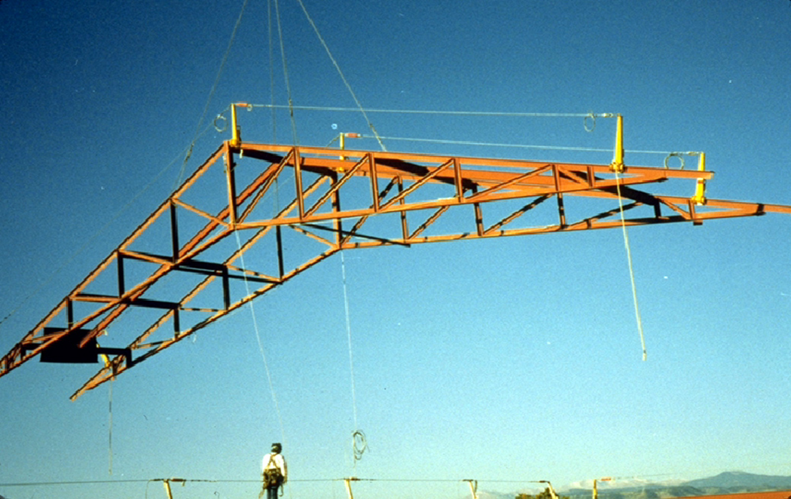
Cranes and Hoists
Hazard Recognition
Don’t stand under suspended loads. Keep the load as close as possible to the ground when picking and carrying a load.
Photo source: OSHA
Notes:
1926.1425(b) While the operator is not moving a suspended load, no employee must be within the fall zone, except for employees:
1926.1425(b)(1)
Engaged in hooking, unhooking or guiding a load;
1926.1425(b)(2)
Engaged in the initial attachment of the load to a component or structure; or
1926.1425(b)(3)
Operating a concrete hopper or concrete bucket.

Slide 27
Cranes and Hoists
Knowledge Check
Nearly 45% of crane accidents are the result of the boom or crane making contact with __.
other cranes
work zone barricades
energized power lines
workers on the ground
c. energized power lines

Slide 28
Cranes and Hoists
Knowledge Check
Before beginning equipment operations with power lines present, the employer must ___.
identify the work zone and determine proximity to power lines
notify utility company of lift and estimate voltage of power lines
locate the fall zone and test load by lifting it at least 20 feet off the ground
remove hazard area barriers and observe weather conditions
a. identify the work zone and determine proximity to power lines

Slide 29
Cranes and Hoists
Knowledge Check
A broken window that distorts the operator’s visibility of the task is acceptable for operation.
True
False
b. False

Slide 30
Cranes and Hoists
Knowledge Check
Which of the following must be readily available to the crane operator for use at all times?
Load charts and recommended operating speeds
Special hazard warnings
Instructions and operator’s manual
All of the above
d. All of the above

Slide 31
Cranes and Hoists
Through the Alliance between OSHA’s 10 Regional Offices and the Elevator Contractors of America (ECA), Elevator Industry Work Preservation Fund (EIWPF), International Union of Elevator Constructors (IUEC), National Association of Elevator Contractors (NAEC), National Elevator Industry Educational Program (NEIEP), and National Elevator Industry Inc. (NEII), collectively known as The Elevator Industry Safety Partners, developed this Industry Specific Training for informational purposes only. It does not necessarily reflect the official views of OSHA or the U.S. Department of Labor. May 2021​
​
Under the Occupational Safety and Health Act, employers are responsible (http://www.osha.gov/as/opa/worker/employer-responsibility.html) for providing a safe and healthy workplace and workers have rights (https://www.osha.gov/workers). OSHA can help answer questions or concerns from employers and workers. OSHA's On-Site Consultation Program (https://www.osha.gov/consultation) offers free and confidential advice to small and medium-sized businesses, with priority given to high-hazard worksites. For more information, contact your regional or area OSHA office (https://www.osha.gov/contactus/bystate), call 1-800-321-OSHA (6742), or visit https://www.osha.gov/.​

Slide 32
Cranes and Hoists

