Slide 1
Confined Spaces
In Construction
1926 Subpart AA

Slide 2
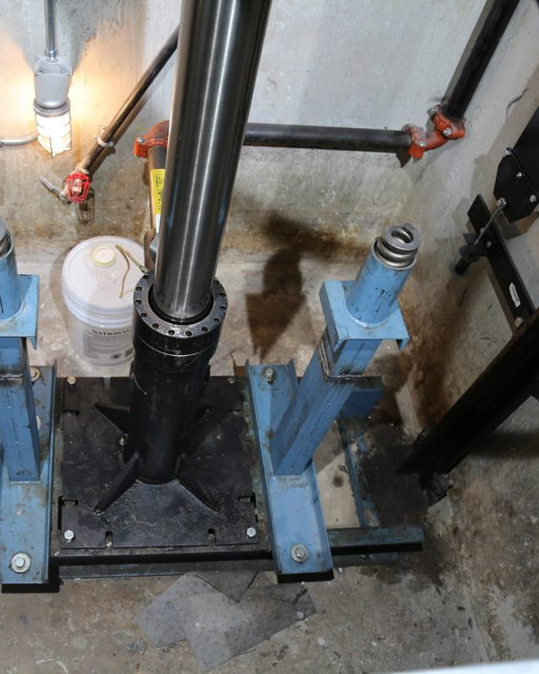
Confined Spaces
Many buildings and construction sites contain areas that are considered confined spaces. If your co-worker became unconscious in an elevator pit, would you jump in to rescue them? How do you know the air in that space is safe to breath?
This training will help you understand the risks associated with confined spaces and the procedures your employer has in place to protect you and those around you.

Slide 3
Confined Spaces
Objectives:
By the end of this session, students will be able to:
Identify Confined Spaces and determine if they are Permit Required Spaces
Identify the most common Confined Space hazards
Know responsibilities of entrants, attendants, entry supervisors, contractors
Understand the requirements for Rescue & Emergency Services

Slide 4
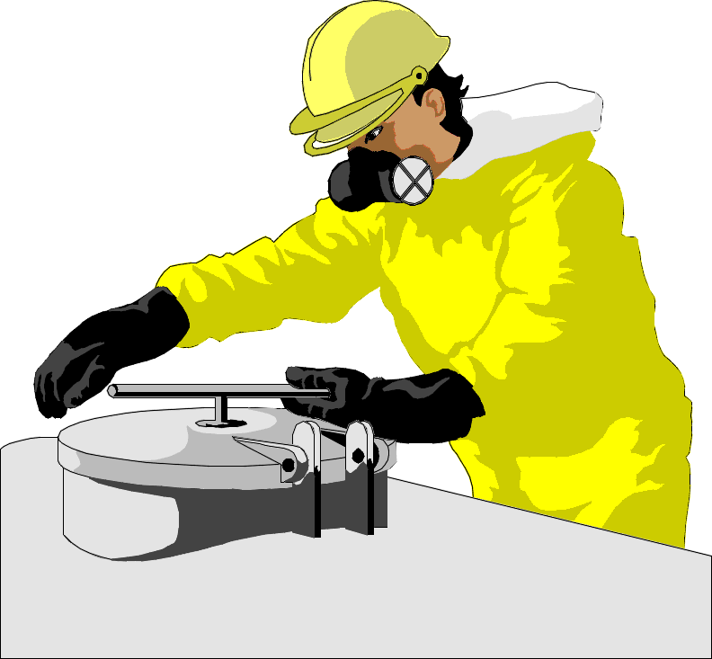
Confined Spaces
OSHA defines confined spaces as a space that:
Is large enough and so configured that
an employee can bodily enter it;
(2) Has limited or restricted means for entry and exit; and
(3) Is not designed for continuous employee occupancy.
Examples:
Boilers
Sewers
Tunnels
Manholes
Tank cars
Diked areas
Storage bins
Vaults
Wells
Pumping stations
Water meter chambers
Open top spaces more than 4 ft. deep
pits (such as elevator, escalator, pump,
valve or other equipment)
Transformer vaults
Storm drains
Turbines
Notes:
1926.1202
Confined space means a space that:
(1) Is large enough and so configured that an employee can bodily enter it;
(2) Has limited or restricted means for entry and exit; and
(3) Is not designed for continuous employee occupancy.

Slide 5
Confined Spaces
CFR 1926 Subpart AA―Confined Spaces in Construction
§1926.1203 General requirements.
Elevator shafts and pits, escalator and moving walk wellways and pits, dumbwaiters, and many other conveyances meet the requirements of confined space if they have the following 3 things:
Limited entrance and exit:
The need to use a ladder to exit
A door that is difficult to open or a doorway that is too small to exit walking upright
Obstructions such as pipes, conduit, or materials that a worker would need to crawl over or squeeze around

Slide 6
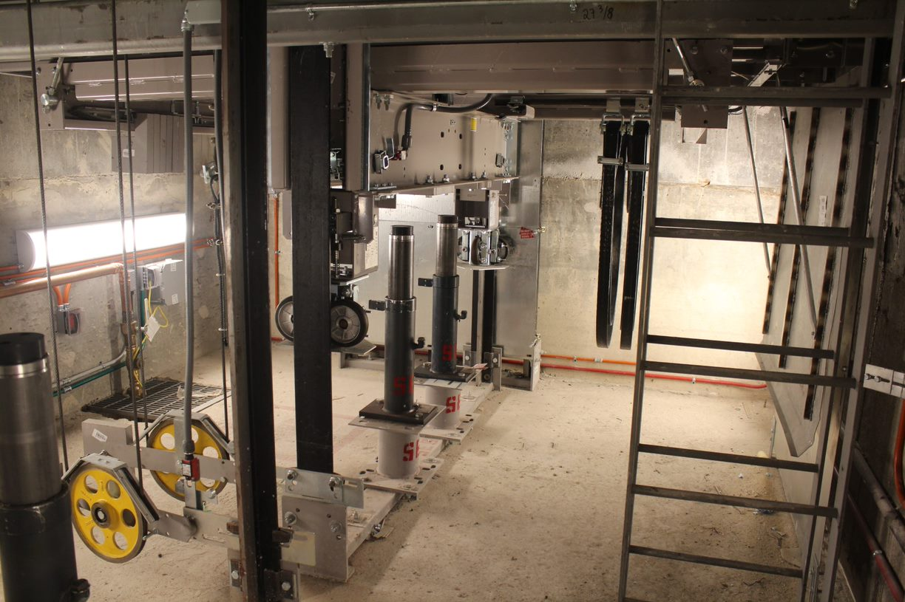
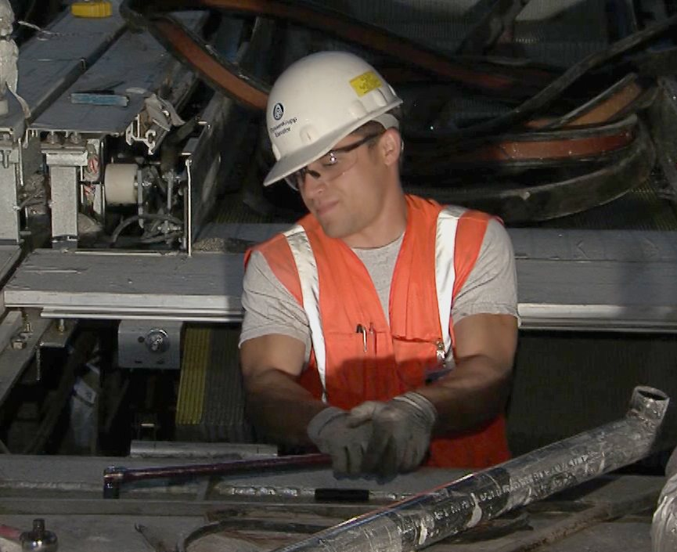
Confined Spaces
2. Large enough for bodily entry:
A person can fit inside the space.
3. Not intended for continuous occupancy:
Space is not designed with features such as ventilation, lighting, and sufficient room to work and move around.

Slide 7
Confined Spaces
Confined spaces often contain hazards.
Other (10%)
Engulfment
in Flowable Materials
(34%)
Atmospheric Hazards
(56%)
Confined Space Deaths
Many confined space deaths are would-be rescuers.
Notes:
NIOSH statistical publication on confined space:
https://www.cdc.gov/niosh/docs/94-103/pdfs/94-103.pdf?id=10.26616/NIOSHPUB94103

Slide 8
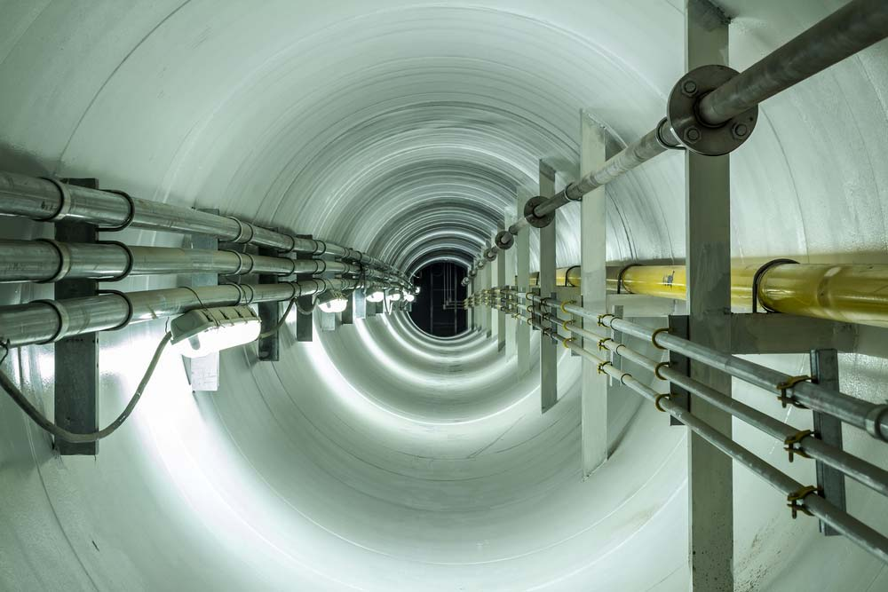
Confined Spaces
Atmospheric Hazards
They can suffocate you, poison you, or cause an explosion.
Confined spaces may have:
No air movement
Harmful build-ups of gases, vapors, or dusts
Ordinary products which can become deadly
Normal oxygen in air is 20.9%
Oxygen enrichment happens when oxygen is added to a space causing oxygen above 23.5%
Oxygen deficiency happens when oxygen is consumed or displaced. It’s life threatening below 19.5%
An oxygen level between 19.5% and 23.5% is considered safe, but trained workers will find out if toxic vapors are displacing oxygen.

Slide 9
Confined Spaces
OSHA Regulates Confined Spaces in 1910 General Industry AND 1926 Construction:
The Construction Standard 29 CFR 1926 - Subpart AA requires employers to determine:
What kinds of spaces their workers are in
What hazards could be there
How those hazards should be made safe
What training workers should receive and
How to rescue those workers if anything goes wrong
OSHA also regulates confined spaces in construction under 29 CFR 1926 Subpart J:

Slide 10
Confined Spaces
Construction & General Industry Differences:
There are 5 key differences:
More coordinated activities when multiple employers on site
Competent person must evaluate the work site and ID confined spaces and permit confined spaces
Allows for suspension of permit and re-entry
Continuous atmospheric monitoring when possible
Continuous monitoring of engulfment hazards
There are 3 clarifications: employers must…
Eliminate hazards if entering CS without permit system
Get advanced notice if local emergency service is unavailable to
rescue for a period of time
Provide training in an understandable language

Slide 11
Confined Spaces
The previous slide mentions the Permit System. It is referring to Permit Required Confined Space, or PRCS.
To be classified as a permit required confined space, the space being entered must contain at least one of the following:
Hazardous atmosphere
Material that could engulf a person
A shape that could trap or asphyxiate someone
Any other recognized safety hazard
Other hazards which may exist in confined spaces include falling objects, slips, trip and fall hazards, sloping floors or converging walls, poor lighting, extreme heat or cold, electrical hazards, mechanical hazards, biological hazards, and any other hazard that will prevent a worker from self-rescue.

Slide 12
Confined Spaces
Permit Required Confined Space cont.
Conveyance pits, hoistways, cartops, and machinery spaces are potentially a permit required confined space.
Knowing what to look for is the key to saving your life.
If the area you need to access meets the criteria to be designated as a permit space, your employer must develop practices and procedures to protect employees from the hazards of entry into that space.

Slide 13
Confined Spaces
Permit Required Confined Space cont.
Atmospheric Hazards
Atmospheric hazards in permit-required confined space are very serious.
Lack of oxygen
Oxygen enrichment
Gases
Vapors
Dusts in the air

Slide 14
Confined Spaces
Permit Required Confined Space cont.
Atmospheric Hazards (con’t)
They can suffocate you, poison you, or cause an explosion.
Permit-required confined spaces may have:
No air movement
Harmful build-ups of gases, vapors, or dusts
Ordinary products which can become deadly
Normal oxygen in air is 20.9%
Oxygen enrichment happens when oxygen is added to a space causing oxygen above 23.5% Oxygen deficiency happens when oxygen is consumed or displaced. It’s life threatening below 19.5%
An oxygen level between 19.5% and 23.5% is considered safe, but trained workers will find out if toxic vapors are displacing oxygen.

Slide 15
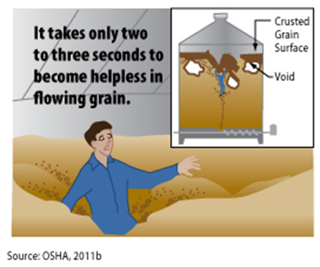
Confined Spaces
Permit Required Confined Space cont.
Engulfment
A liquid like water or a flowable solid like grain or sand can engulf you. You may drown or be suffocated.
A pocket of air can form below a hardened upper layer of grain. The layer can give way causing a worker to be buried / engulfed.

Slide 16
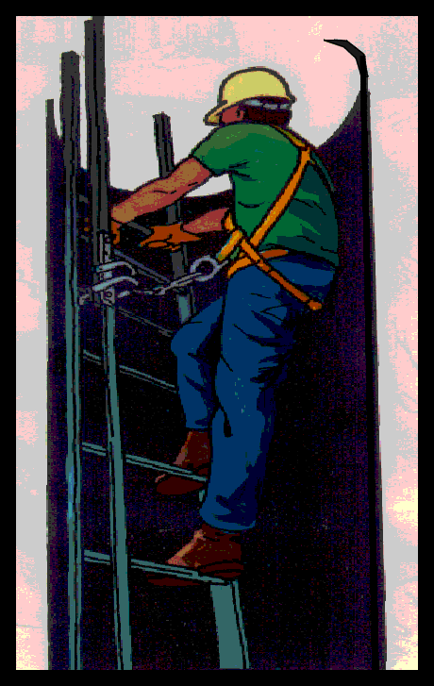
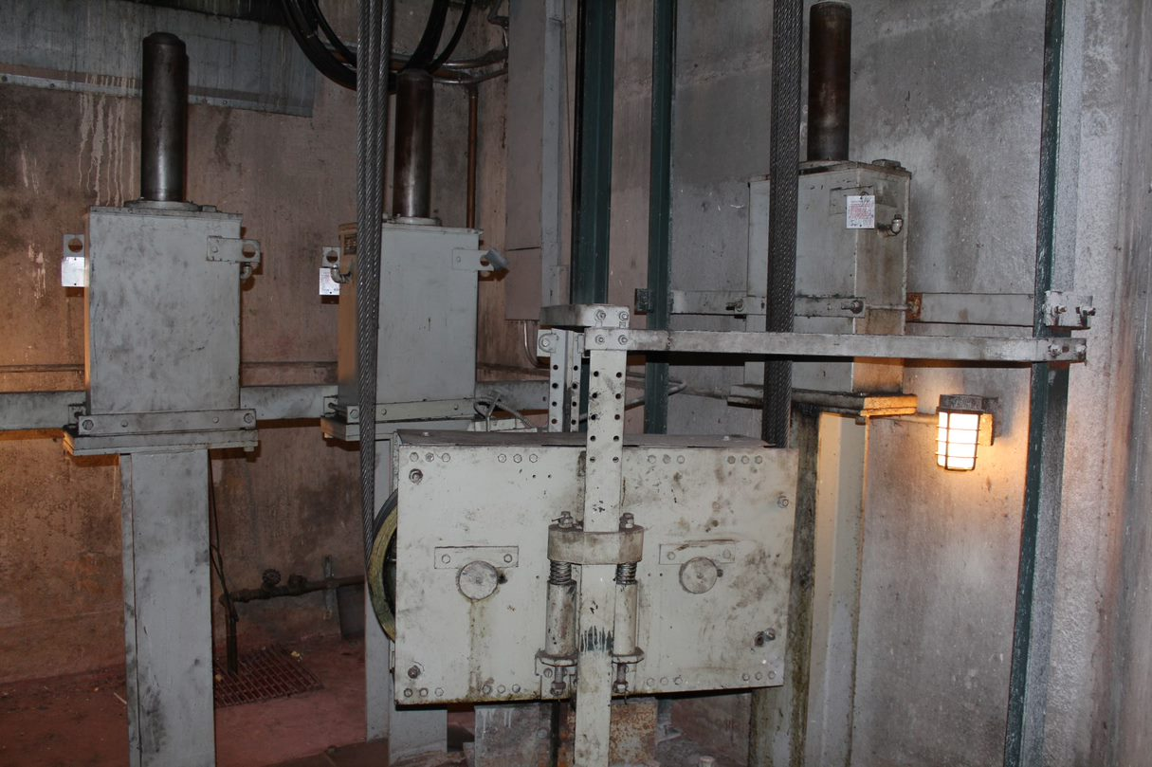
Confined Spaces
Other Permit-Required Confined Space Hazards
These hazards can injure you or keep you from escaping:
Space narrows
Corrosive chemicals
Noise
Electricity
Poor lighting
Extreme heat or cold
Falling objects
Falls
Mechanical hazards

Slide 17
Confined Spaces
Reclassification of a Permit Required Confined Space
1926.1203(g) states:
A space classified by an employer as a permit-required confined space may only be reclassified as a non-permit confined space when a competent person determines that all of the following requirements have been met.
(1) If the permit space poses no actual or potential atmospheric hazards and if all hazards within the space are eliminated or isolated without entry into the space (unless the employer can demonstrate that doing so without entry is infeasible), the permit space may be reclassified as a non-permit confined space for as long as the non-atmospheric hazards remain eliminated or isolated.
(2) The entry employer must eliminate or isolate the hazards without entering the space, unless it can demonstrate that this is infeasible. If it is necessary to enter the permit space to eliminate or isolate hazards, such entry must be performed under §1926.1204 through 1926.1211. If testing and inspection during that entry demonstrate that the hazards within the permit space have been eliminated or isolated, the permit space may be reclassified as a non-permit confined space for as long as the hazards remain eliminated or isolated.
Notes:
(g) A space classified by an employer as a permit-required confined space may only be reclassified as a non-permit confined space when a competent person determines that all of the applicable requirements in paragraphs (g)(1) through (4) of this section have been met: [1926.1203(g)]
(1) If the permit space poses no actual or potential atmospheric hazards and if all hazards within the space are eliminated or isolated without entry into the space (unless the employer can demonstrate that doing so without entry is infeasible), the permit space may be reclassified as a non-permit confined space for as long as the non-atmospheric hazards remain eliminated or isolated; [1926.1203(g)(1)]
(2) The entry employer must eliminate or isolate the hazards without entering the space, unless it can demonstrate that this is infeasible. If it is necessary to enter the permit space to eliminate or isolate hazards, such entry must be performed under §§1926.1204 through 1926.1211. If testing and inspection during that entry demonstrate that the hazards within the permit space have been eliminated or isolated, the permit space may be reclassified as a non-permit confined space for as long as the hazards remain eliminated or isolated; [1926.1203(g)(2)]
Note to paragraph (g)(2). Control of atmospheric hazards through forced air ventilation does not constitute elimination or isolation of the hazards. Paragraph (e) of this section covers permit space entry where the employer can demonstrate that forced air ventilation alone will control all hazards in the space.
(3) The entry employer must document the basis for determining that all hazards in a permit space have been eliminated or isolated, through a certification that contains the date, the location of the space, and the signature of the person making the determination. The certification must be made available to each employee entering the space or to that employee's authorized representative; and [1926.1203(g)(3)]
(4) If hazards arise within a permit space that has been reclassified as a non-permit space under paragraph (g) of this section, each employee in the space must exit the space. The entry employer must then reevaluate the space and reclassify it as a permit space as appropriate in accordance with all other applicable provisions of this standard. [1926.1203(g)(4)]

Slide 18
Confined Spaces
Reclassification of a Permit Required Confined Space cont.
(3) The entry employer must document the basis for determining that all hazards in a permit space have been eliminated or isolated, through a certification that contains the date, the location of the space, and the signature of the person making the determination. The certification must be made available to each employee entering the space or to that employee's authorized representative; and
(4) If hazards arise within a permit space that has been reclassified as a non-permit space, each employee in the space must exit the space. The entry employer must then reevaluate the space and reclassify it as a permit space as appropriate in accordance with all other applicable provisions of the standard.
Remember, if a Permit Required Confined Space is to be reclassified as a Confined Space, all hazards must be eliminated without entering the space. The employer must provide documentation showing the location of the space, that the hazards have been eliminated, the date, and the name of the person making the determination.

Slide 19
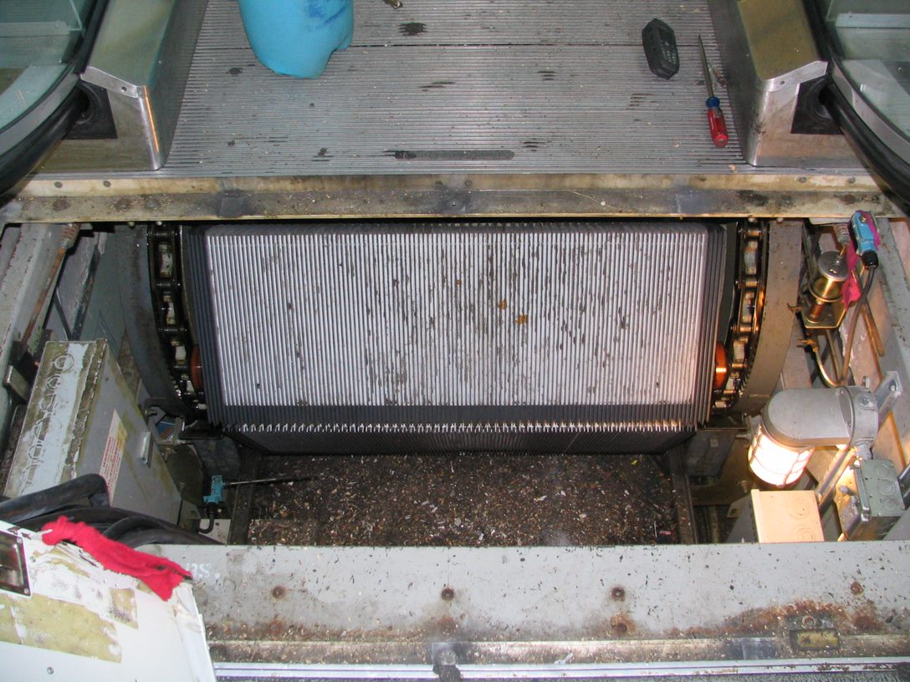
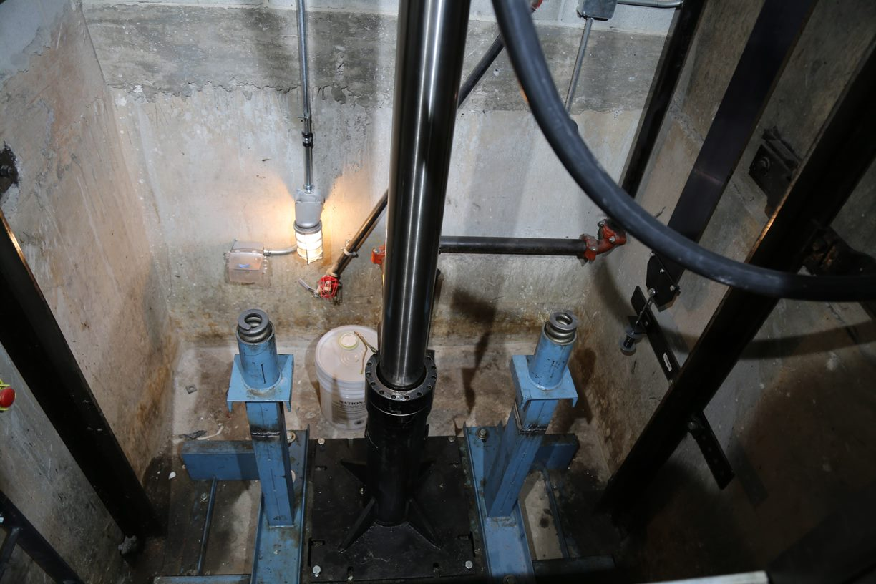
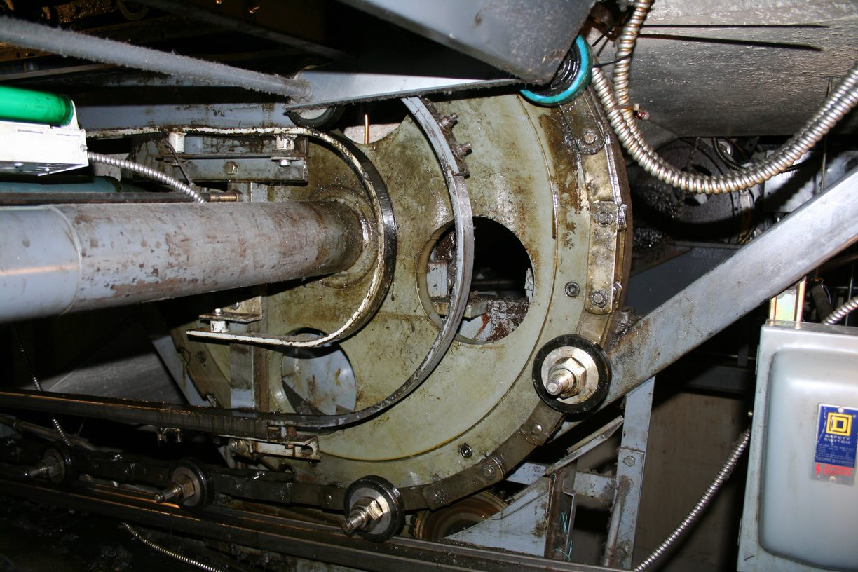
Confined Spaces
So, what is a permit-required confined space?
This space?
This?
How about here?
Here?
Notes:
Class should discuss each and determine all of these are PRCS until the hazards that classify them as PRCS are mitigated.

Slide 20
Confined Spaces
Who is Responsible for Confined Space Work?
Controlling contractor is primary point of contact.
It’s all about communication
Host employer must provide info about spaces pre entry
Controlling Contractor must pass on info to entry employers pre-entry
Entry employers must tell each other about hazards and inform the controlling contractor as well
Everyone must communicate before and after entry
Host Employer
Pre-entry
Post-entry
Controlling Contractor
Pre-entry
Post-entry
Pre-entry
Entry Emp
Entry Emp
Must coordinate during entry

Slide 21
Confined Spaces
Training is Required Before Confined Space Work
Many workers have little or no training
On-the-job
safety training
(41%)
No training (34%)
Confined Space Deaths
75% of those killed had no training or only on-the-job training.
Confined space
training
(6%)
Classroom
safety training
(19%)
Notes:
SOURCE: Worker Deaths in Confined Spaces, A summary of NIOSH Surveillance and Investigation Findings
https://www.cdc.gov/niosh/docs/94-103/pdfs/94-103.pdf?id=10.26616/NIOSHPUB94103
Slide shows the percentage of workers that have training.
In addition, OSHA has added provisions to the rule that clarifies existing requirements in
the General Industry standard. This includes requiring employers to provide training in
a language and vocabulary that the worker understands.

Slide 22
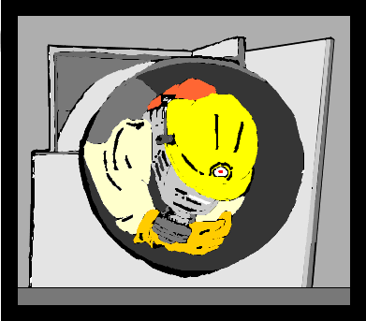
Confined Spaces
Three Types of Workers
Authorized entrant, attendant, and supervisor
Authorized entrant must:
Know the hazards you may face during entry, including symptoms, signs, and consequences of exposure
Properly use all required personal protective equipment
Communicate with the attendant as necessary to enable the attendant to monitor your status and alert entrants of any need to evacuate
Alert the attendant whenever you detect any warning sign or symptom of exposure to a dangerous situation or a prohibited condition
Exit from the space as quickly as possible when the attendant tells you to do so, when you recognize any warning sign, when you detect a prohibited condition, or when you hear the evacuation alarm

Slide 23
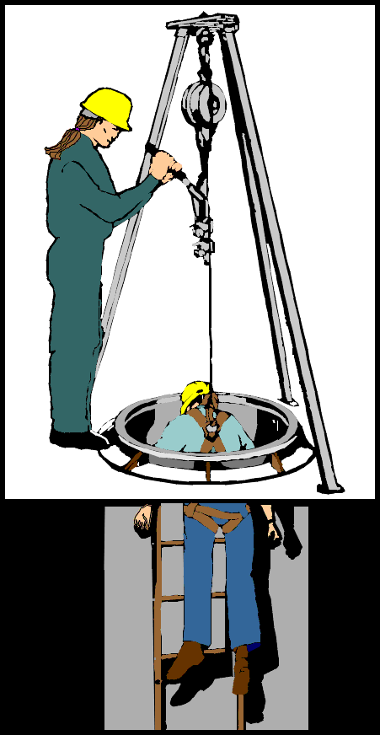
Confined Spaces
The Attendant
The attendant must:
Know hazards that may be faced during entry
Know possible behavioral effects of the hazards
Continuously maintain accurate count of entrants
Remain outside space during entry operations until relieved
Communicate with entrants to monitor their status and alert them of need to evacuate
Monitor activities inside and outside of space
Summon rescue and emergency services when necessary
Warn unauthorized persons to stay away
Perform non-entry rescues per employer’s procedure
Perform no duties that interfere with your primary duty to monitor entrants

Slide 24
Confined Spaces
The Entry Supervisor
The entry supervisor has overall responsibility for the entry.
Entry supervisor must:
Know hazards that may be faced during entry
Verify that acceptable conditions for entry exist
Terminate entry when prohibited condition arises
Verify that rescue services are available
Remove unauthorized persons who enter or attempt to enter during the entry operations
Determine that acceptable entry conditions are maintained

Slide 25
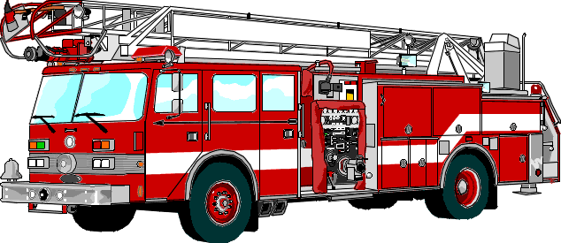
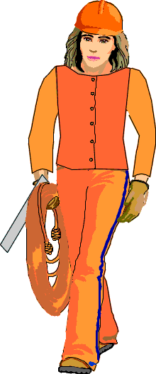
Confined Spaces
The Rescue Team
May be onsite (coworkers)
or
offsite (fire dept.)
Rescue team must:
Be properly trained in procedures and PPE use
Practice rescues at least annually from similar space
Be trained in basic first aid and CPR, one currently certified
Use retrieval equipment, if it does not increase hazard
Your contractor may choose to use offsite rescue team; for example, the local fire department - but they must be properly trained and equipped
They must also arrange to be notified if offsite responders will be unable to respond for a period of time because of another emergency or training

Slide 26
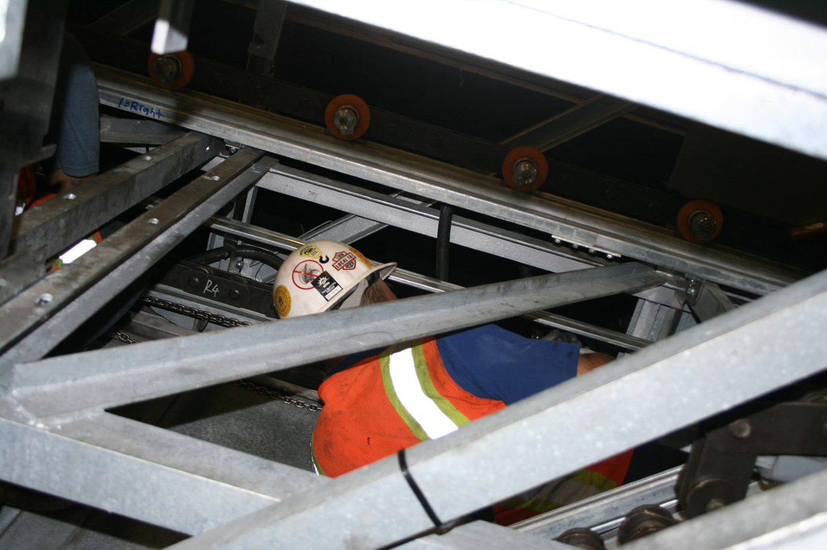
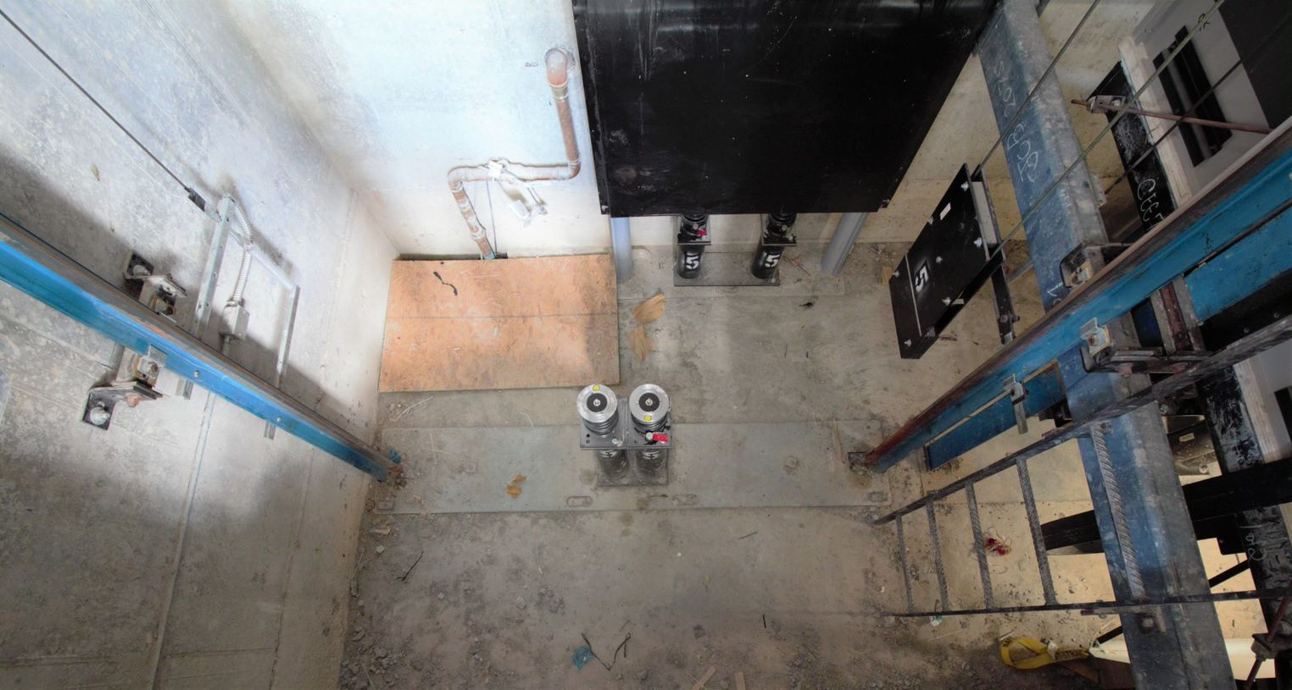
Confined Spaces
Some things to consider the next time you go to a jobsite…
Does that escalator truss or elevator pit meet the conditions of a confined space or permit space?
What about the hoistway?
A dumbwaiter pit or shaft? LULA? Rack and pinion hoist?

Slide 27
Confined Spaces
Summary:
You should now be able to recognize confined space and permit required confined space and identify the hazards associate with each classification. Your employer must provide you with training if you will enter these spaces.
Contractors, entrants, entrant supervisor, and rescue personnel have requirements and responsibilities that must be followed. If one fails, we all fail, and that means someone doesn’t make it home to their loved ones today.
Rescue personnel may be onsite or the local fire department. They must be available and must be trained in confined space rescue.
Understand the risks associated with confined spaces and the procedures your employer must have in place to protect you and those around you.

Slide 28
Confined Spaces
Test Your Knowledge
A confined space is defined as:
a. Having limited way out
b. Not designed for continuous occupancy
c. Is large enough to enter the space
d. All of the above
d. All of the above
All confined spaces must be permit-required: a. True
b. False
b. False

Slide 29
Confined Spaces
Test Your Knowledge
Who must terminate entry permit: a. Rescue personnel
b. Entry Supervisor
c. Entrant
d. None of the above
b. Entry Supervisor
All confined spaces are permit-required: a. True
b. False
b. False

Slide 30
Confined Spaces
Through the Alliance between OSHA’s 10 Regional Offices and the Elevator Contractors of America (ECA), Elevator Industry Work Preservation Fund (EIWPF), International Union of Elevator Constructors (IUEC), National Association of Elevator Contractors (NAEC), National Elevator Industry Educational Program (NEIEP), and National Elevator Industry Inc. (NEII), collectively known as The Elevator Industry Safety Partners, developed this Industry Specific Training for informational purposes only. It does not necessarily reflect the official views of OSHA or the U.S. Department of Labor. May 2021
Under the Occupational Safety and Health Act, employers are responsible (http://www.osha.gov/as/opa/worker/employer-responsibility.html) for providing a safe and healthy workplace and workers have rights (https://www.osha.gov/workers). OSHA can help answer questions or concerns from employers and workers. OSHA's On-Site Consultation Program (https://www.osha.gov/consultation) offers free and confidential advice to small and medium-sized businesses, with priority given to high-hazard worksites. For more information, contact your regional or area OSHA office (https://www.osha.gov/contactus/bystate), call 1-800-321-OSHA (6742), or visit https://www.osha.gov/.

Slide 31
Confined Spaces

