Slide 1
New Hire Training Tools - Hand and Power

Slide 2
Common Hand and Power Tools
Hand Tools | Power Tools
Hammers Saws Chisels Shovels Pry bars Pliers Screwdrivers Wrenches Measuring tools | Electric/air/powder Drill motors Nailers/staplers Impact wrenches Impact/roto hammers Jackhammers Soil tampers/compactors Grinders Bandsaws/block saws/table saws Powder actuated tools Concrete mix/vibrators

Slide 3
Basic Tool Safety Rules
Maintain regularly
Inspect before use
Operate according to manufacturer’s recommendations
Use appropriate PPE
Use guards

Slide 4
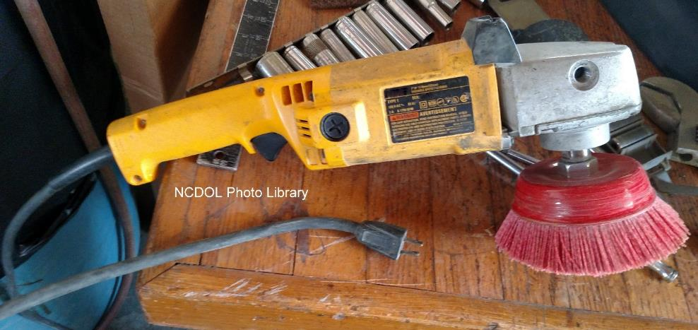
General Requirements
1926.300(a)
All hand and power tools furnished by the employer, or the employee must be maintained in a safe condition.

Slide 5
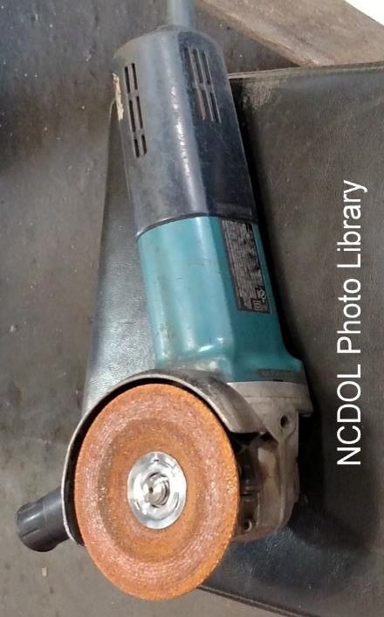
Guarding
1926.300(b)(2)
Belts, gears, shafts, pulleys, sprockets, spindles, drums, fly wheels, chains, or other reciprocating, rotating or moving parts of equipment shall be guarded if such parts are exposed to contact by employees or otherwise create a hazard.

Slide 6
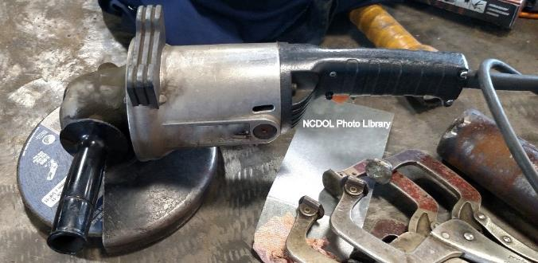
Types of Guarding
1926.300(b)
Fixed guards
Interlocked guards
Adjustable guards
Self-adjusting guards
Fixed Guard

Slide 7
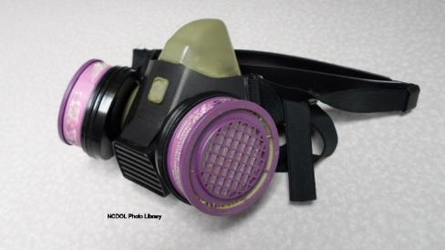
Personal Protective Equipment
1926.300(c)
Employees exposed to the hazard of falling, flying, abrasive, and splashing objects, or exposed to harmful dusts, fumes, mists, vapors, or gases, shall be provided with the personal protective equipment necessary to protect them from the hazard.

Slide 8
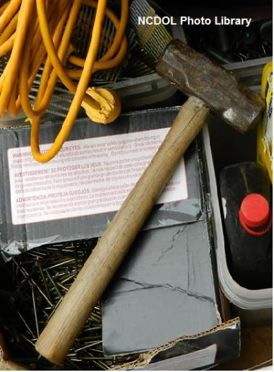
Hand Tool Hazards
1926.301(a) - (d)
Employers shall not issue or permit the use of unsafe hand tools.
Wrenches shall not be used when jaws are sprung to the point that slippage occurs.
Impact tools shall be kept free of mushroomed heads.
Wooden handles shall be kept free of splinters or cracks and shall be kept tight in the tool.
Cracked handle

Slide 9
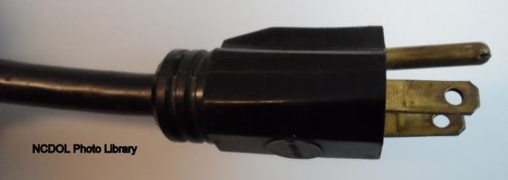
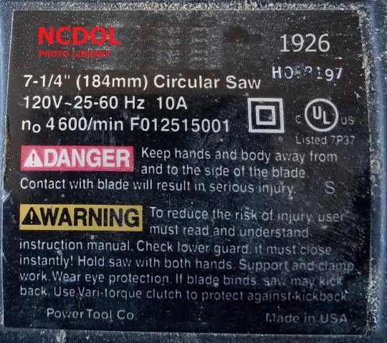
Power-Operated Hand Tools
1926.302(a)(1)
Electric power operated tools shall either be of the approved double-insulated type or grounded in accordance with Subpart K of this part.
Plug with a grounding pin
Double - insulated markings

Slide 10
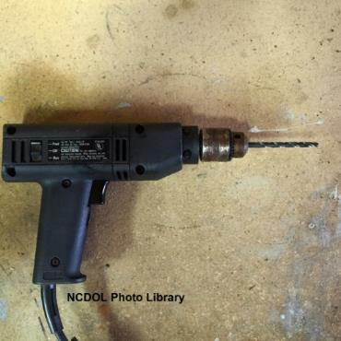
Switches
1926.300(d)
Positive “on-off” control
Routers, planers, shears, scroll saws, laminate trimmers, jig saws, nibblers
Momentary contact “on-off”
control
Power drills, grinders, tappers, disc
and belt sanders, reciprocating saws
Constant pressure switch
Circular saw, chain saw, and
percussion tools

Slide 11
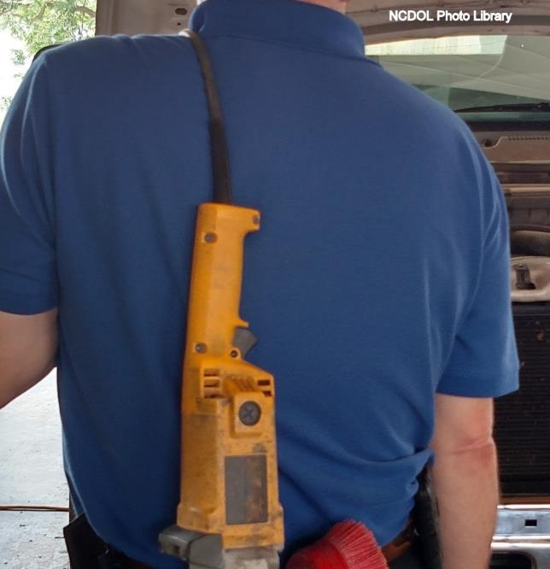
Power-Operated Hand Tools
1926.302(a)(2)
Use of electric cords for hoisting or lowering tools shall not be permitted.

Slide 12
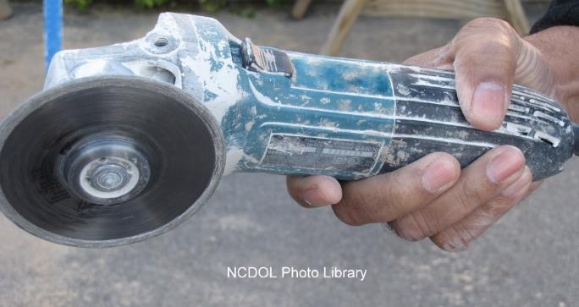
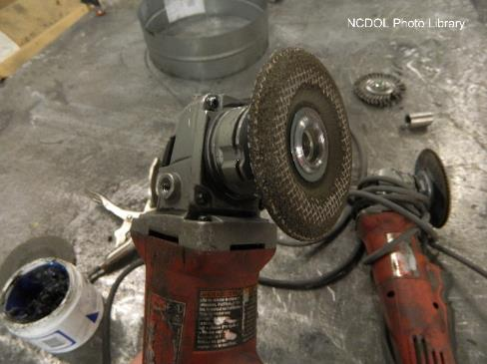
Use of Abrasive Wheels
1926.303(c)(5)
Vertical portable grinders must have safety guard on tool with a maximum exposure angle of 180 degrees.
Non-compliant portable grinders without guards.

Slide 13
Use of Abrasive Wheels
1926.303(c)(5)
Install the proper type guard located so as to be between the operator and the wheel during use.
Guard adjusted to deflect broken pieces of wheel away from operator.

Slide 14
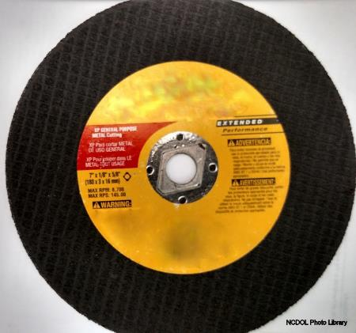
Use of Abrasive Wheels
1926.303(c)(8)
Ensure the spindle speed does not exceed the maximum speed marked on the wheel.
Grinding wheels must fit freely on the spindle.
Tighten the spindle nut only enough to hold the wheel in place.
Maximum RPM 8,700

Slide 15
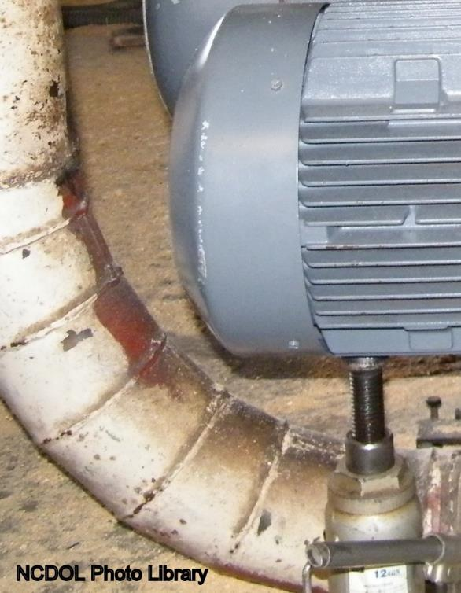
Jacks
1926.305(a)(1)
Manufacturer’s rated capacity must be marked on all jacks and must not be exceeded.
All jacks must have a positive stop to prevent over travel.

Slide 16
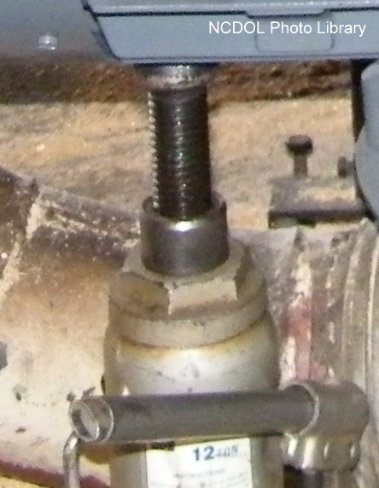
Jacks
1926.305(c), (d)(1)(i)
Operation
Base seated on a firm, level surface
Where there is a possibility of slippage
Use wood block between cap and load
Crib, block, or secure
load after it is raised
Notes:
NCDOL Photo Library Closed Case file # 314877093
Proper maintenance of jacks is essential for safety. All jacks must be inspected before each use and lubricated regularly. If a jack is subjected to an abnormal load or shock, it should be thoroughly examined to make sure it has not been damaged.
1926.305(c) Blocking. When it is necessary to provide a firm foundation, the base of the jack shall be blocked or cribbed. Where there is a possibility of slippage of the metal cap of the jack, a wood block shall be placed between the cap and the load.
1926.305(d)(1) “Operation and maintenance.” (i) After the load has been raised, it shall be cribbed, blocked, or otherwise secured at once.

Slide 17
Through the Alliance between OSHA’s 10 Regional Offices and the Elevator Contractors of America (ECA), Elevator Industry Work Preservation Fund (EIWPF), International Union of Elevator Constructors (IUEC), National Association of Elevator Contractors (NAEC), National Elevator Industry Educational Program (NEIEP), and National Elevator Industry Inc. (NEII), collectively known as The Elevator Industry Safety Partners, developed this Industry Specific Training for informational purposes only. It does not necessarily reflect the official views of OSHA or the U.S. Department of Labor. March 2025
Under the Occupational Safety and Health Act, employers are responsible (http://www.osha.gov/as/opa/worker/employer-responsibility.html) for providing a safe and healthy workplace and workers have rights (https://www.osha.gov/workers). OSHA can help answer questions or concerns from employers and workers. OSHA's On-Site Consultation Program (https://www.osha.gov/consultation) offers free and confidential advice to small and medium-sized businesses, with priority given to high-hazard worksites. For more information, contact your regional or area OSHA office (https://www.osha.gov/contactus/bystate), call 1-800-321-OSHA (6742), or visit https://www.osha.gov/.

