Slide 1

Medical Emergency

Slide 2
Steps to take in Medical Emergency
Call for Help
Call 911 if you can
911 Operator want to know Status
911 Operator – will ask someone to stay by victim until Emergency Responders arrive

Slide 3
1st Aid Kits
Required where there is no on-site health unit
You employer shall provide access to adequate first aid supplies that meet minimum ANSI Z308.1- 1998 requirements.
Additional items may be included based on existing hazards in the workplace
You should have one in your work vehicle or onsite
Inspect It!

Slide 4
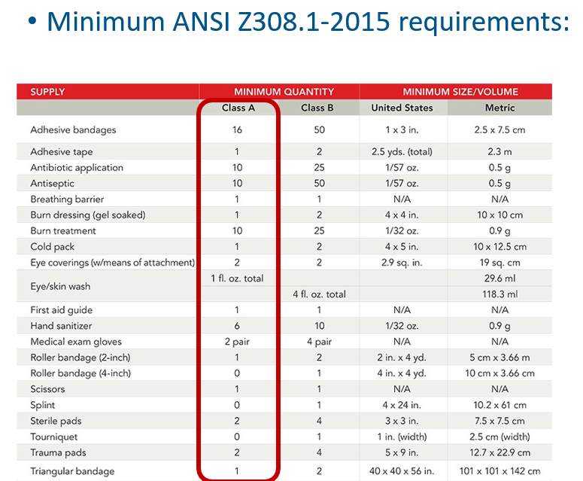
1st Aid Kit
You need more wash solution. Trust Me!

Slide 5
Step to take if you get debris in your eye
Remain calm
Don’t rub your eyes
Don’t move unless you have some vision
Locate the Eye Wash Bottle (this is why you should have a 1st Aid Kit nearby)
Tilt head back a little and flush with Eye Wash Bottle

Slide 6
AED Programs
Required if medical treatment (Ambulance) more than 5 minutes away
Many sites will have one in the building
Host should Inspected daily
Manf. Inspection yearly
Includes 1st Aid – so Host may have people to administer 1st Aid

Slide 7
Assessment
What items do you find necessary in your 1st Aid Kit?
What is the 1st thing to do in a Medical Emergency?
When should you discuss the Host’s Medical Emergency Procedures?

Slide 8
Through the Alliance between OSHA’s 10 Regional Offices and the Elevator Contractors of America (ECA), Elevator Industry Work Preservation Fund (EIWPF), International Union of Elevator Constructors (IUEC), National Association of Elevator Contractors (NAEC), National Elevator Industry Educational Program (NEIEP), and National Elevator Industry Inc. (NEII), collectively known as The Elevator Industry Safety Partners, developed this Industry Specific Training for informational purposes only. It does not necessarily reflect the official views of OSHA or the U.S. Department of Labor. March 2025
Under the Occupational Safety and Health Act, employers are responsible (http://www.osha.gov/as/opa/worker/employer-responsibility.html) for providing a safe and healthy workplace and workers have rights (https://www.osha.gov/workers). OSHA can help answer questions or concerns from employers and workers. OSHA's On-Site Consultation Program (https://www.osha.gov/consultation) offers free and confidential advice to small and medium-sized businesses, with priority given to high-hazard worksites. For more information, contact your regional or area OSHA office (https://www.osha.gov/contactus/bystate), call 1-800-321-OSHA (6742), or visit https://www.osha.gov/.

