Slide 1



New Hire Training
Escalators and Moving Walks

Slide 2
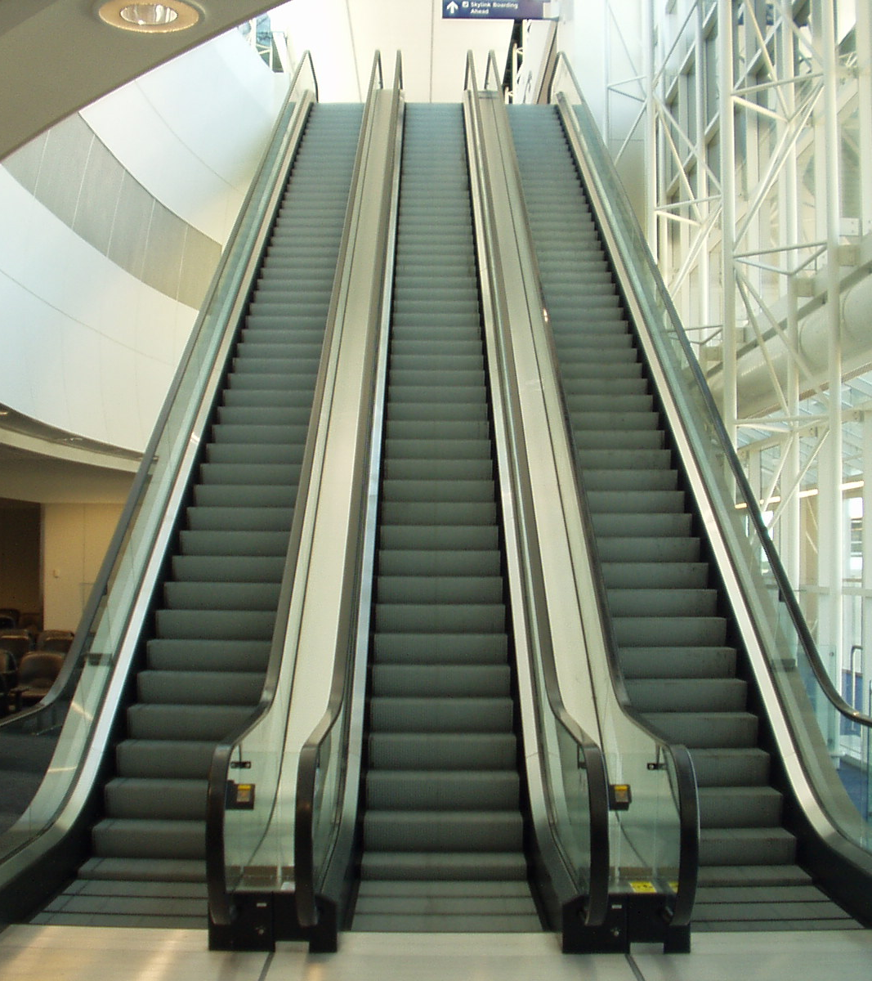

Escalators & Moving Walks
Escalators and Moving Walks have the potential to cause serious injury or death
Osha shows 20 Injuries related to Escalators from 2001-2019 including Fatalities
Common causes of escalator related fatalities are electrocution, caught-in/between, and falls.
Notes:
OSHA Focus Four: Falls, Caught in or between, Struck by, and Electrocution
https://www.osha.gov/training/outreach/construction/focus-four
OSHA Escalator Accidents and Fatalities:
https://www.osha.gov/pls/imis/AccidentSearch.search?acc_keyword=%22Escalator%22&keyword_list=on

Slide 3
Escalators
An Escalator is a moving staircase consisting of an endlessly circulating belt of steps driven by a motor, conveying passengers between the floors of a building.
In this industry you can be tasked with installing, repairing, maintaining or modernizing escalators.
Notes:
Modernizing is upgrading an existing unit with new parts and technology while preserving the main structure of the original unit.

Slide 4
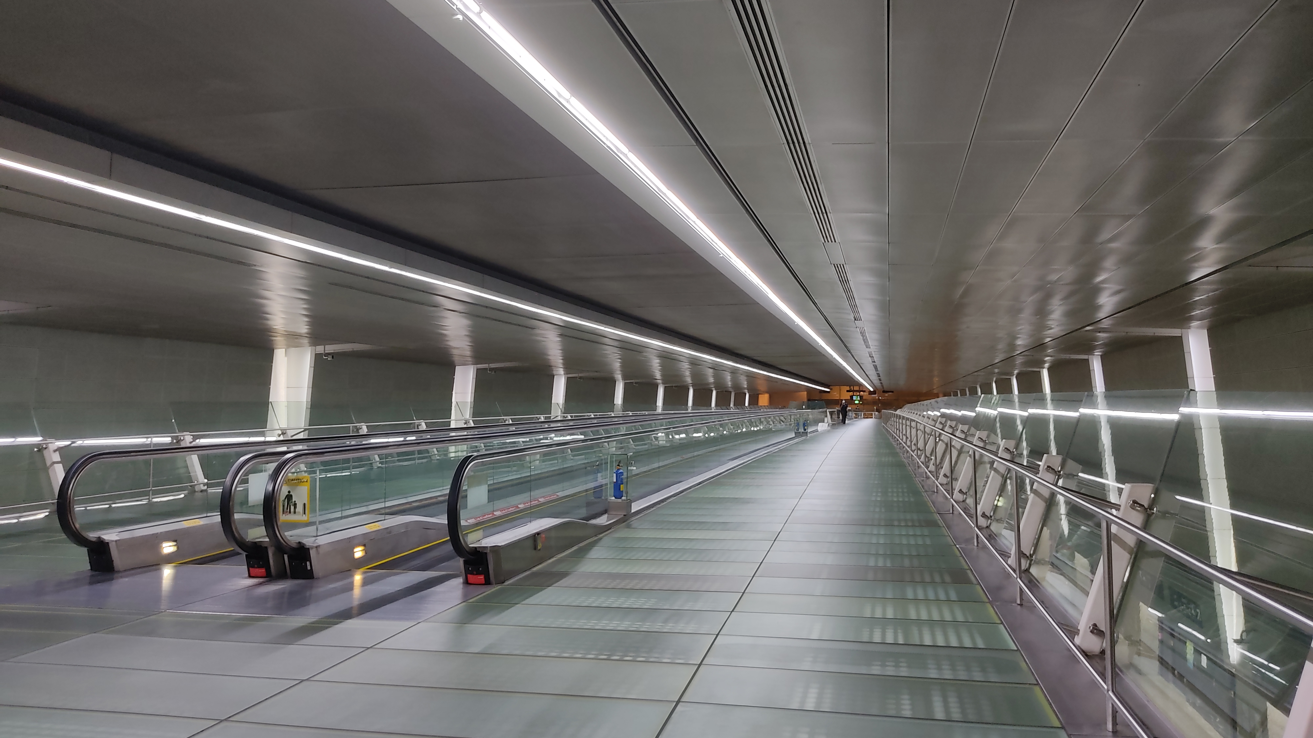
Moving Walk
A moving walkway, also known as a moving walk, moving sidewalk, people-mover, or travelator, is a slow-moving conveyor mechanism that transports people across a horizontal or inclined plane over a short to medium distance.
Moving walkways can be used by standing or walking on them.
Notes:
Commonly found in airports, theme parks, public transportation or anywhere a large amount of people need to be moved in an area efficiently.

Slide 5
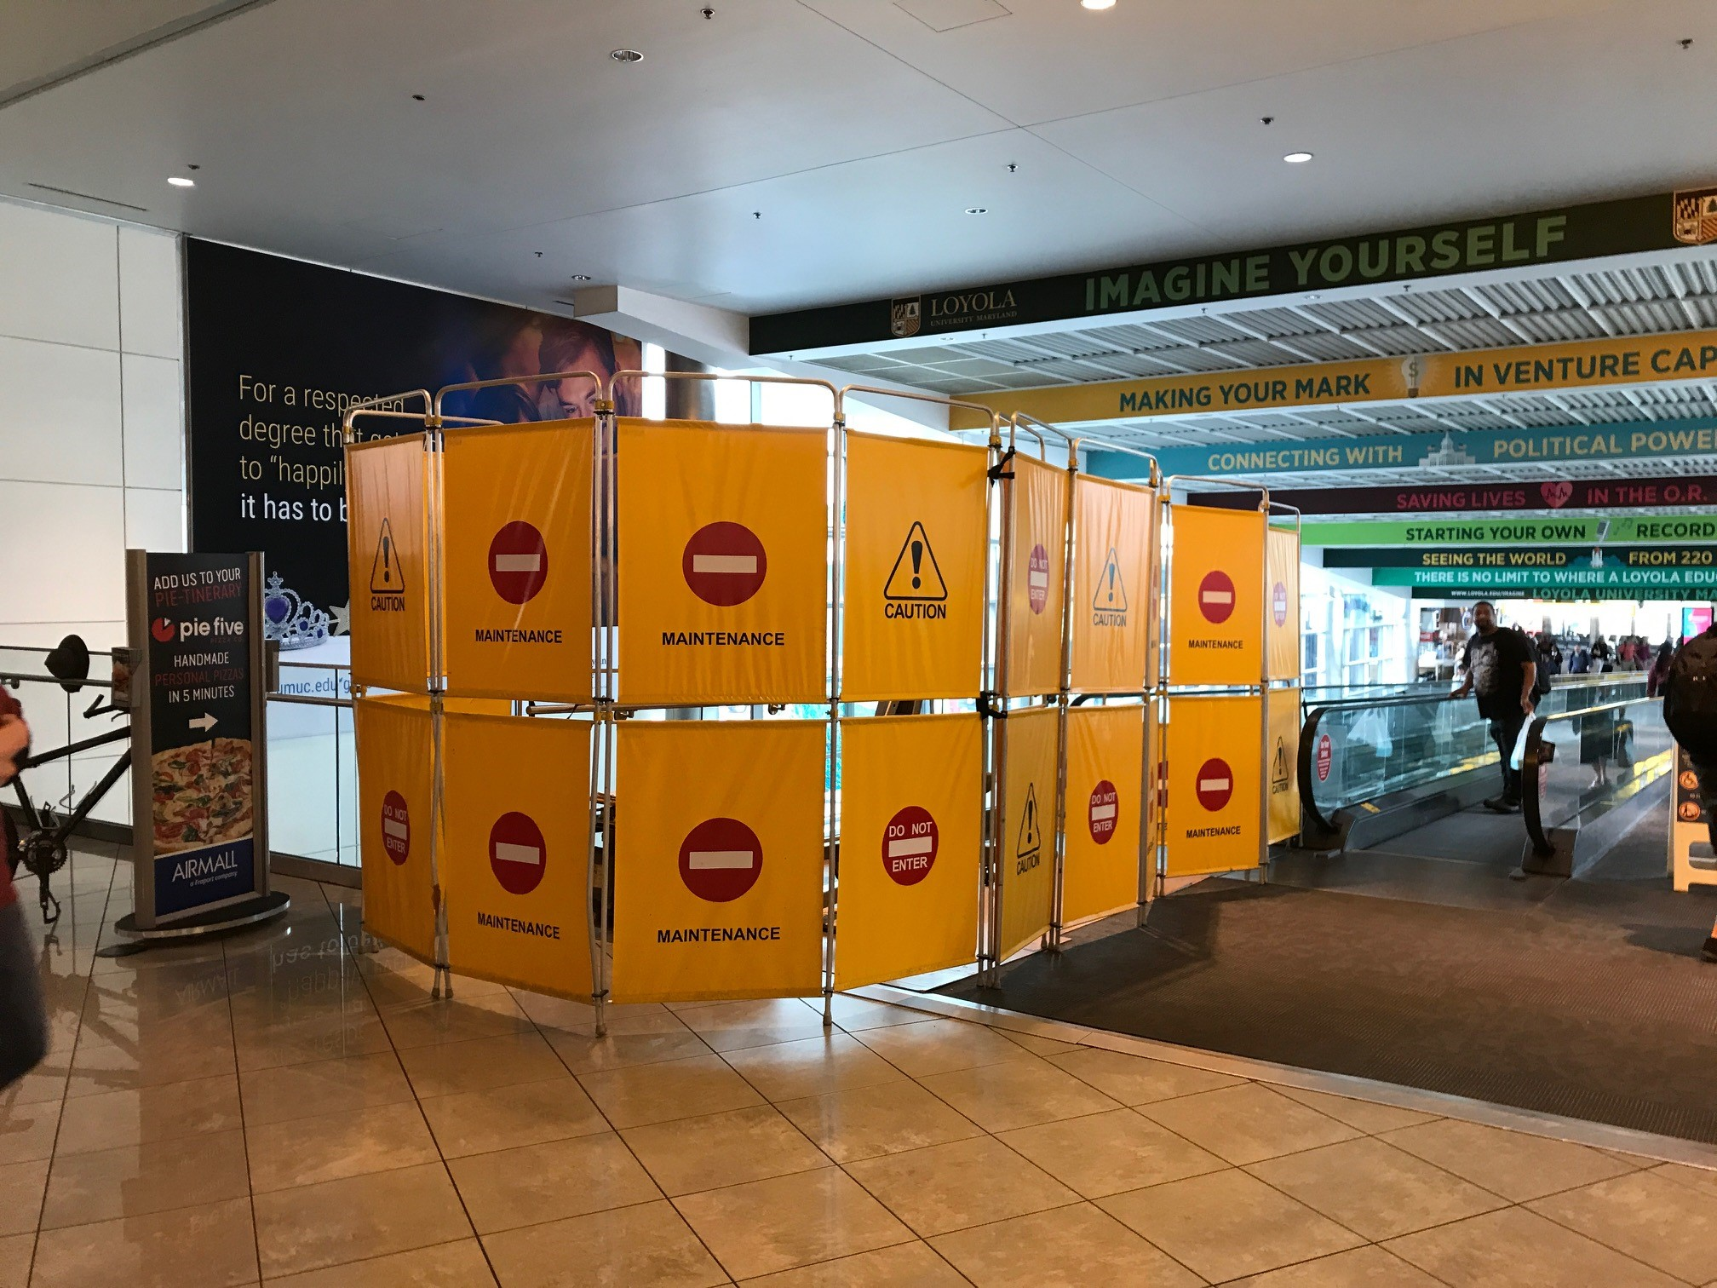
Barricades
Osha defines a *barricade as:
A physical obstruction such as tapes, cones, or A-frame type wood or metal structures that provides a warning about, and limits access to, a hazardous area.
* CFR 1926.968
Notes:
Osha Barricade definition:
https://www.osha.gov/laws-regs/regulations/standardnumber/1926/1926.968#:~:text=Barricade.,access%20to%2C%20a%20hazardous%20area.

Slide 6
Barricades
Barricades are extremely important, not just for your safety but also for the safety of the riding public
Before any escalator or moving walk work is started barricades should be erected on both ends and secured to prevent unauthorized access
Even with barricades on both ends of the unit extra caution and awareness is required to make sure the public does not try to access the unit while it is in an unsafe condition.

Slide 7
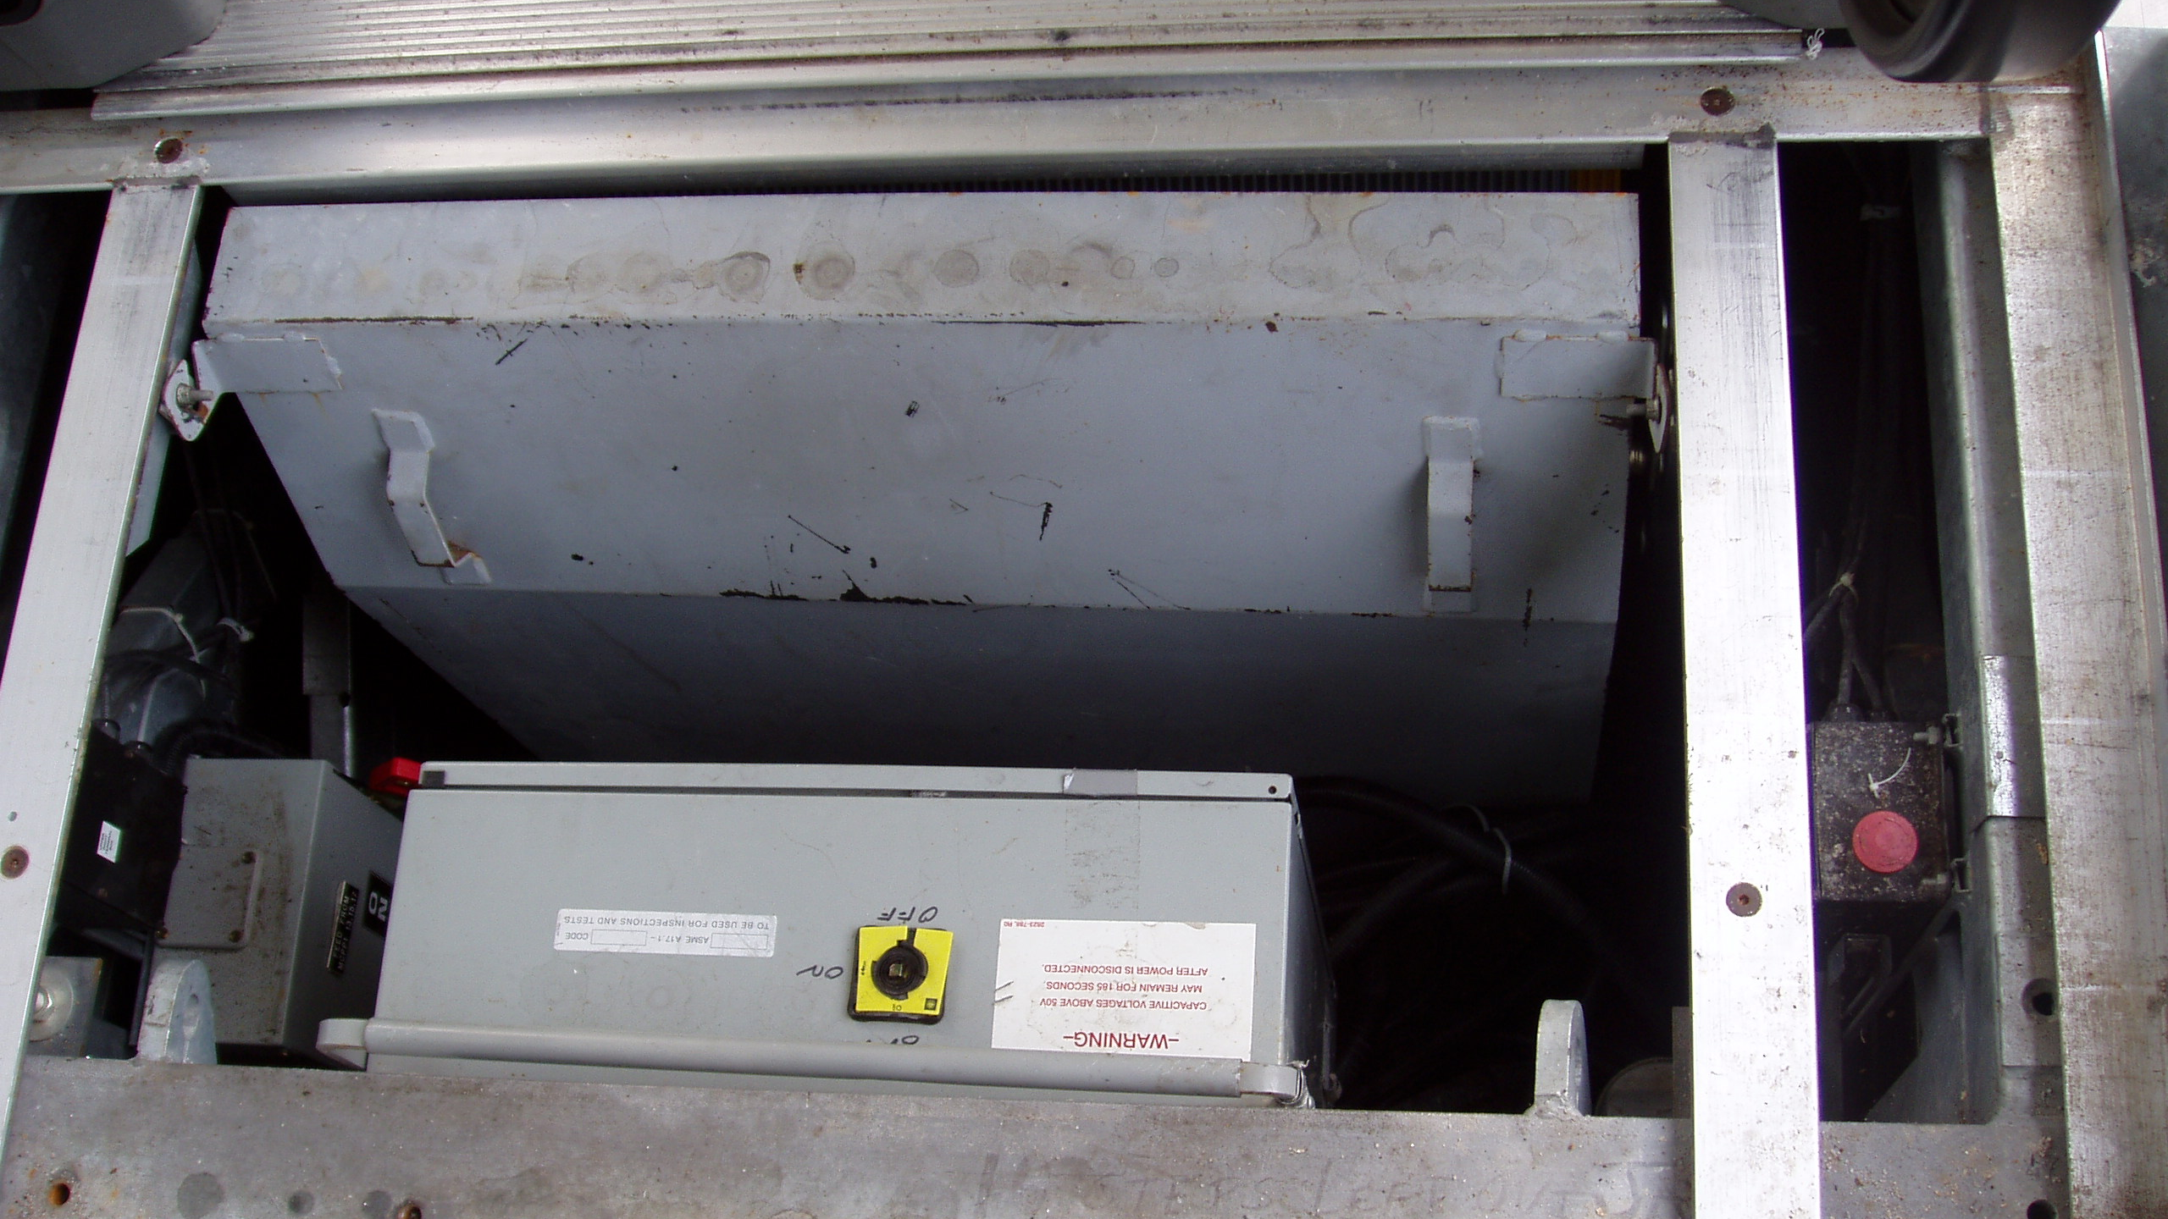
Pits and Controllers
Pits on both moving walks and escalators can contain:
High Voltage
Electricity not controlled by the main line disconnect
Moving parts
Tight or potentially confined spaces.
Notes:
Osha Confined space standards:
https://www.osha.gov/confined-spaces

Slide 8
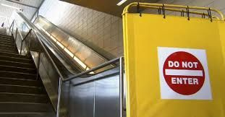
Service and Repair
Service and repair to escalator and moving walks involve different challenges and techniques than performing work on elevators
Extra care needs to be taken to ensure all stored energy is handled correctly.

Slide 9
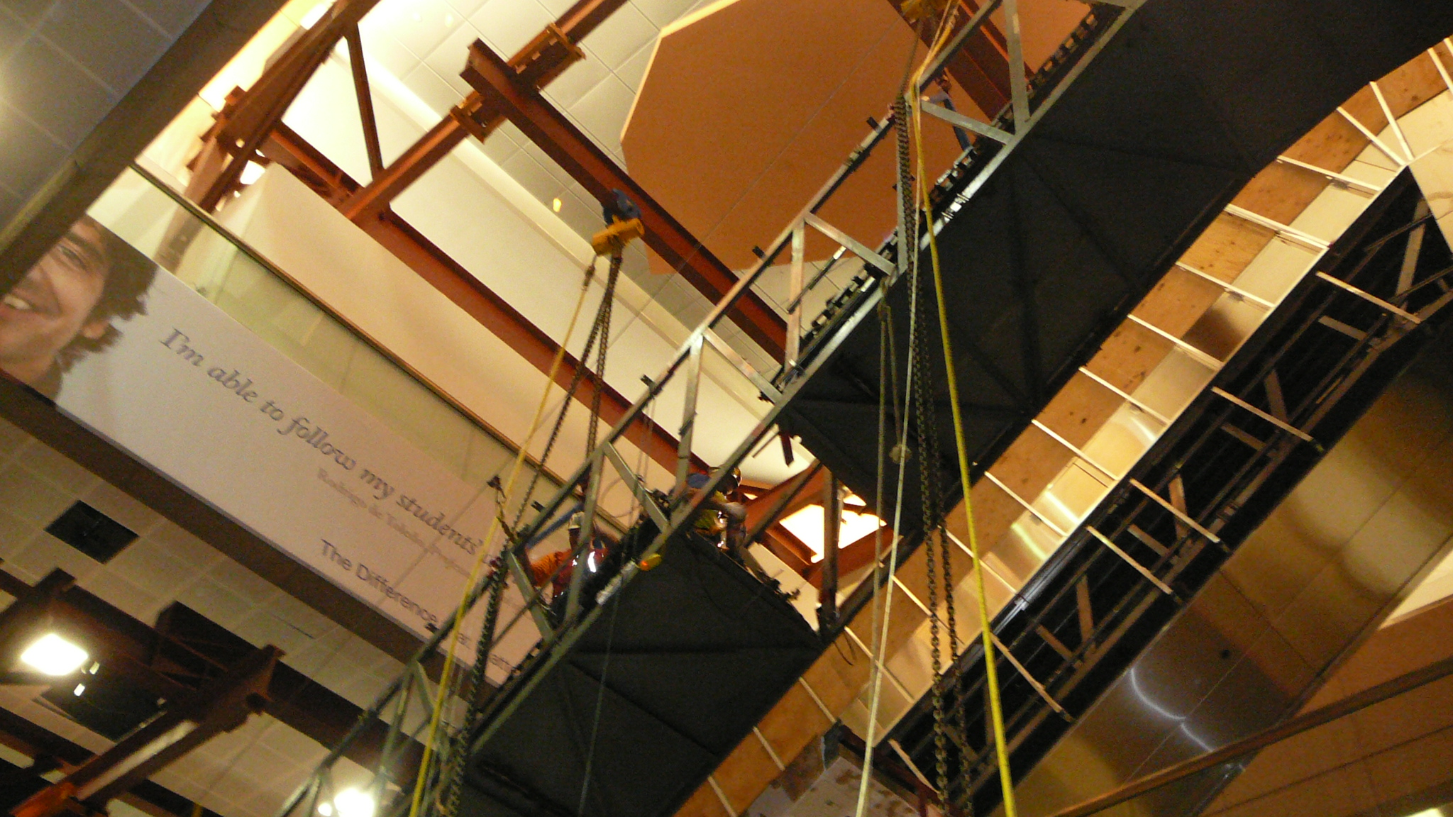
Rigging and Hoisting
Escalators and moving walks can be extremely heavy and have a center of load far from the actual center of the unit
Always verify weight of the unit before any rigging and hoisting is attempted
Always follow your company safety policy and the hoisting component manufactures guidelines.

Slide 10
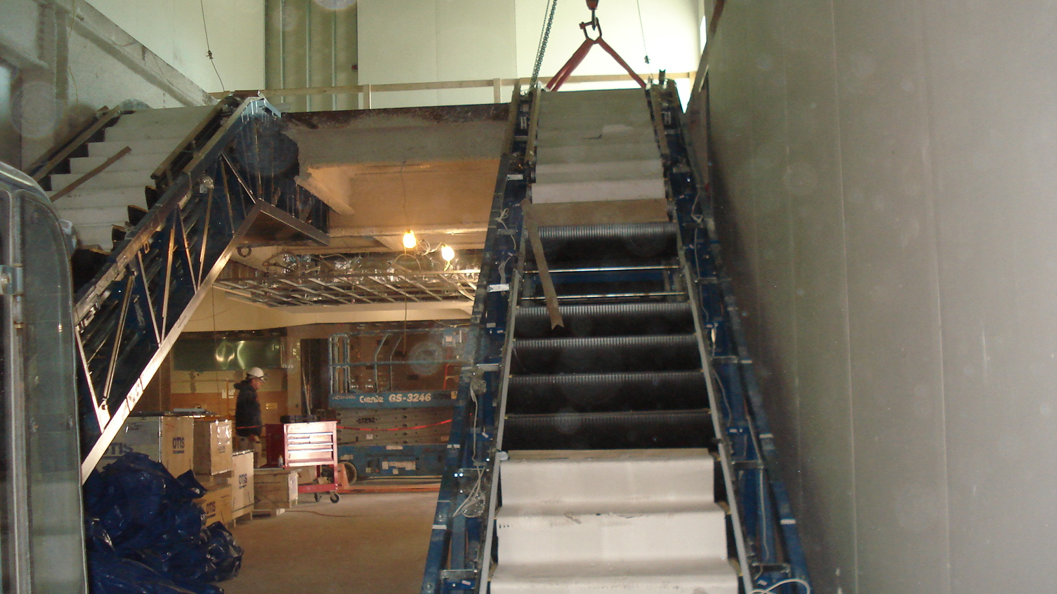
Rigging and Hoisting
Always confirm your strap placement and angle, remember the shallower the angle the lower the capacity of the strap.
Always use the correct size clevis, not just for the capacity but also for the size strap that is being used.
Never walk up a rigged escalator or moving walk truss before it is stable and landed in place.

Slide 11
In Closing remember Escalators and Moving walks can present many different safety concerns so always follow your company safety polices as well as manufactures guidelines and recommendations.

Slide 12
Through the Alliance between OSHA’s 10 Regional Offices and the Elevator Contractors of America (ECA), Elevator Industry Work Preservation Fund (EIWPF), International Union of Elevator Constructors (IUEC), National Association of Elevator Contractors (NAEC), National Elevator Industry Educational Program (NEIEP), and National Elevator Industry Inc. (NEII), collectively known as The Elevator Industry Safety Partners, developed this Industry Specific Training for informational purposes only. It does not necessarily reflect the official views of OSHA or the U.S. Department of Labor. March 2025
Under the Occupational Safety and Health Act, employers are responsible (http://www.osha.gov/as/opa/worker/employer-responsibility.html) for providing a safe and healthy workplace and workers have rights (https://www.osha.gov/workers). OSHA can help answer questions or concerns from employers and workers. OSHA's On-Site Consultation Program (https://www.osha.gov/consultation) offers free and confidential advice to small and medium-sized businesses, with priority given to high-hazard worksites. For more information, contact your regional or area OSHA office (https://www.osha.gov/contactus/bystate), call 1-800-321-OSHA (6742), or visit https://www.osha.gov/.

