Slide 1
New Hire Training
Struck-By Hazards

Slide 2
Struck-By Hazards
Introduction
The second leading cause of construction fatalities is being struck by an object or piece of equipment
You could be hit by a vehicle or piece of heavy equipment
You could be struck by a falling or flying object
You must know how to recognize and identify hazards
You must know how to avoid those hazards

Slide 3
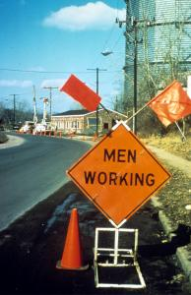
Struck-By Hazards
Vehicle and Roadway Hazards
If vehicle safety practices are not observed at your site, you risk being pinned between construction vehicles and walls, struck by swinging backhoes, crushed beneath overturned vehicles, you risk being struck by trucks or cars.
How Do I Avoid Hazards?
Use traffic signs, barricades or flaggers when construction takes place near public roadways
Workers must be highly visible in all levels of light. Warning clothing, such as red or orange vests, are required; and if worn for night work, must be of reflective material.
Communicate with operators by radio and/or eye contact
Notes:
All workers near active traffic, rights-of-way, working around moving construction equipment or in areas where visibility is limited should wear high visibility clothing.
Elevator constructors unload equipment from roadways and occasionally at night. Follow all of these precautions.

Slide 4
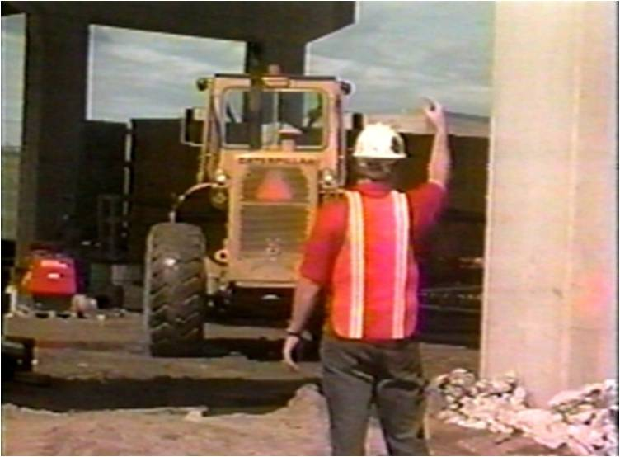
Struck-By Hazards
Vehicle and Roadway Hazards
How Do I Avoid Hazards?
Do not drive a vehicle in reverse gear with an obstructed rear view, unless it has an audible reverse alarm, or another worker signals that it is safe.
Drive vehicles or equipment only on roadways or grades that are safely constructed and maintained.
Do not exceed a vehicle's rated load or lift capacity.
Set parking brakes when vehicles and equipment are parked, and chock the wheels if they are on an incline.
Notes:
All of these precautions apply to equipment that may be operated by elevator constructors.
1926.601(b)(4) No employer shall use any motor vehicle equipment having an obstructed view to the rear unless:
(i) The vehicle has a reverse signal alarm audible above the surrounding noise level or:
(ii) The vehicle is backed up only when an observer signals that it is safe to do so.

Slide 5
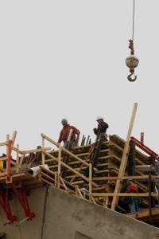
Struck-By Hazards
Falling Objects
You are at risk of being injured from falling objects when you are beneath cranes, scaffolds, etc., or where overhead work is being performed. This could come from:
Rigging failure
Loose or shifting materials
Lack of overhead protection

Slide 6
Struck-By Hazards
Falling Objects
How Do I Avoid Hazards?
Wear hardhat
Stack materials properly to prevent sliding, falling, or collapse
Use debris nets, catch platforms, or canopies to catch or deflect falling objects from scaffolds
Avoid working underneath loads being moved
Barricade hazard areas and post warning signs
Secure tools and materials to prevent them from falling on people below
Notes:
Can anyone think of any others?

Slide 7
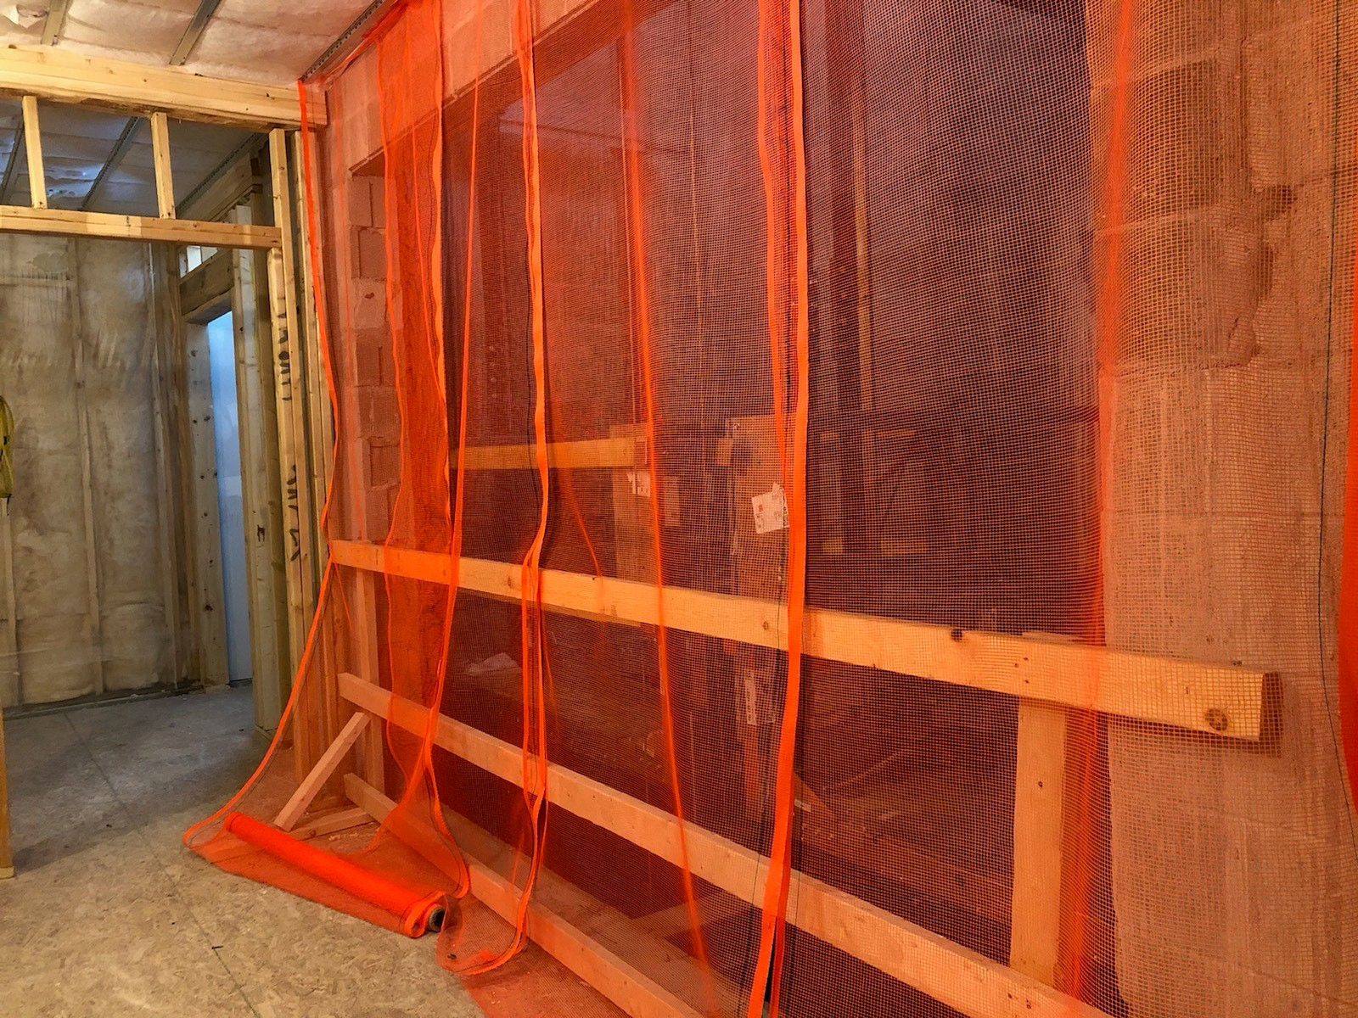
Struck-By Hazards
Falling Objects
Objects coming down the elevator hoistway
Overhead protection is required on false cars and temporary platforms. This can be accomplished by screening at the hoistway entrances, or as a solid roof.
Screening at the hoistway entrance

Slide 8
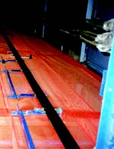
Struck-By Hazards
Falling Objects
When working in a multi-car hoistway, screening should be installed between hoistways of adjacent cars. This will help with falling objects, and provide a separation between running cars.

Slide 9
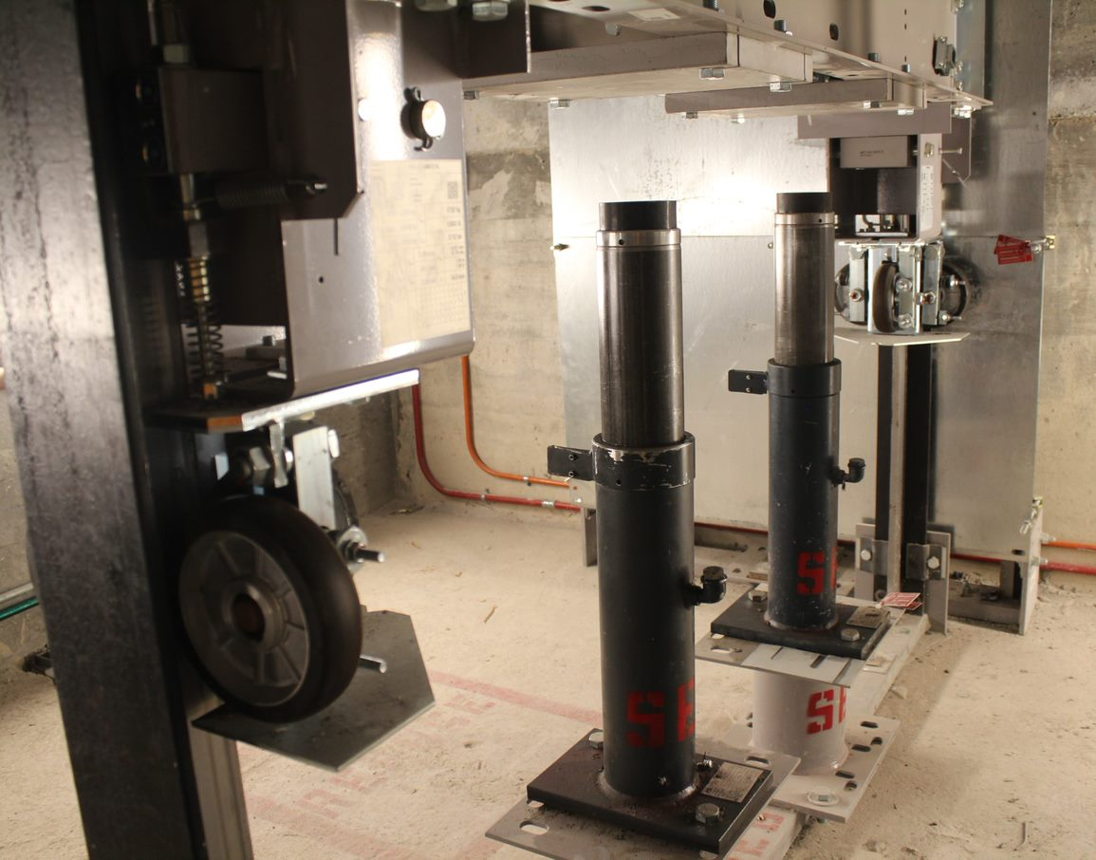
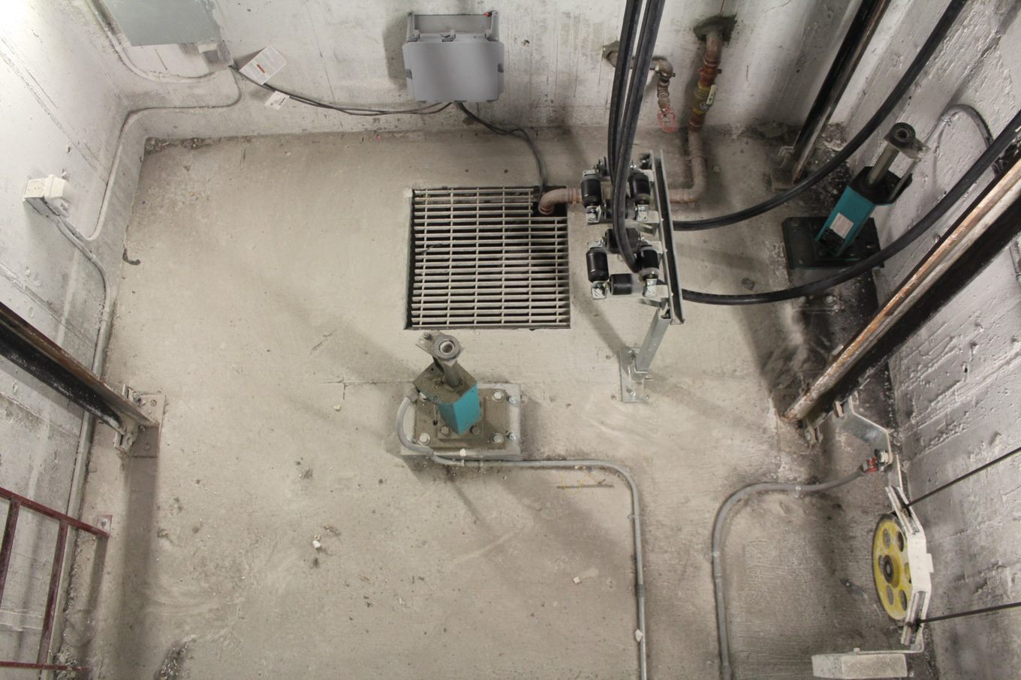
Struck-By Hazards
Pit Access: Struck-by car or counterweight
Be aware of car position when accessing the pit. Always perform LOTO and secure the car from unintended movement according to your company safety procedures before entering the pit. Identify refuge space in the pit before entering.
Notes:
Pit access procedures will vary depending on the type of equipment and the purpose for entering the pit.

Slide 10
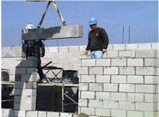
Struck-By Hazards
Struck-By Hazards When Handling Material
Many workers are hurt or killed from handling loads including: loads falling out of rigging, being struck by swinging or descending loads and being pulled off upper elevations from swinging loads.
Rigging equipment can fail, loads can shift or roll.

Slide 11
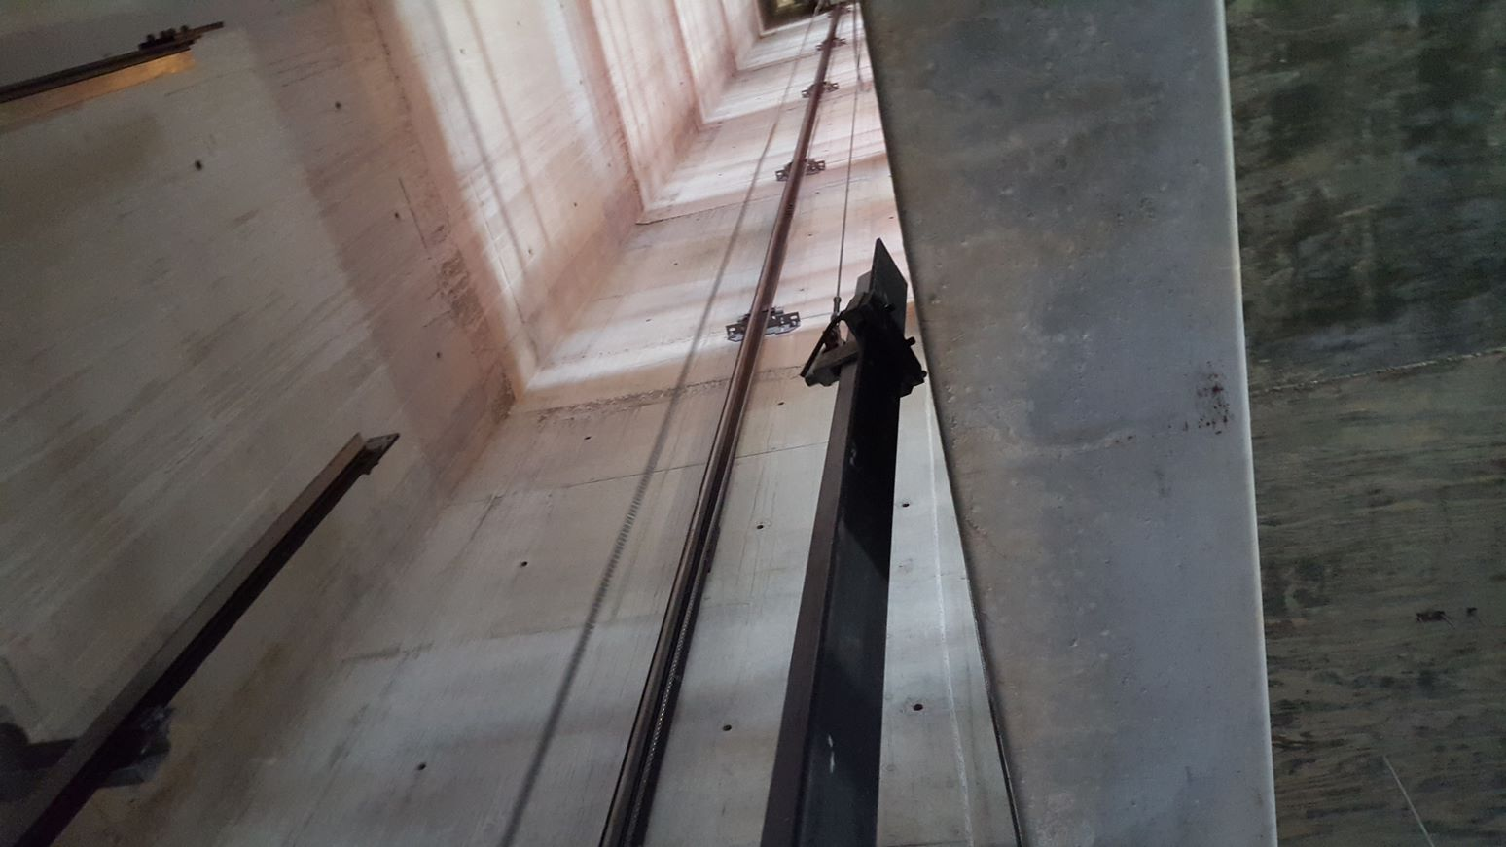
Struck-By Hazards
Working Under a Suspended Load
Elevator Constructors should never work under a suspended load.
During hoisting operations within the hoistway, workers should be positioned outside the hoistway and should control the load by using taglines from the open entrances.
If you are installing rails and brackets from a false car or running platform, never allow the load to be hoisted above you.

Slide 12
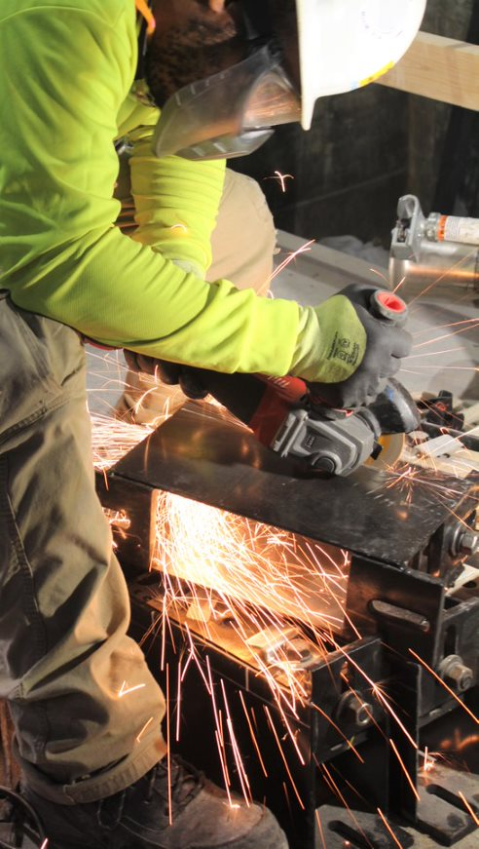
Struck-By Hazards
Struck-By Flying Objects
Tools can create particles when chipping, grinding, sawing, brushing, or hammering.
Particles from some tools move at high speed and can hit with the force of a bullet, like those from pneumatic and powder-actuated tools.
How can you be protected from flying objects?
Be sure you are properly trained before using any power tool and always wear the proper PPE.
Notes:
Wearing the proper PPE protects the user of the tool from injury.
This elevator constructor is cutting a rail bracket with a portable grinder. Notice the proper PPE: Gloves, full face shield, long sleeve shirt. Also notice the guard on the grinder is adjusted correctly.
There is a danger from flying objects when power tools like saws, grinders, hammer drills or wire wheels cause metal or wood particles to become airborne. Injuries can range from minor abrasions to concussions, blindness, or death.
Pneumatic tools are dangerous because they are operated by compressed air.
Powder-actuated tools are even more dangerous because they use gunpowder and shoot “pins” that can injure or kill a worker like a bullet from a gun.

Slide 13
Struck-By Hazards
Summary:
As you can see, struck-by hazards are everywhere. They fall into one of three categories:
Vehicle and roadway hazards
Falling objects
Flying objects
Struck-by hazards are preventable. Stay clear of operating vehicles and equipment, communicate with operators and maintain eye contact, avoid blind spots, wear high visibility clothing, and never stand under a load.
Power and powder actuated tools are dangerous and should only be used after proper training and only as directed. PPE must always be used and you must perform penetration checks when setting up the tool.
Remember who is counting on you to come home safe each day.

Slide 14
Through the Alliance between OSHA’s 10 Regional Offices and the Elevator Contractors of America (ECA), Elevator Industry Work Preservation Fund (EIWPF), International Union of Elevator Constructors (IUEC), National Association of Elevator Contractors (NAEC), National Elevator Industry Educational Program (NEIEP), and National Elevator Industry Inc. (NEII), collectively known as The Elevator Industry Safety Partners, developed this Industry Specific Training for informational purposes only. It does not necessarily reflect the official views of OSHA or the U.S. Department of Labor. March 2025
Under the Occupational Safety and Health Act, employers are responsible (http://www.osha.gov/as/opa/worker/employer-responsibility.html) for providing a safe and healthy workplace and workers have rights (https://www.osha.gov/workers). OSHA can help answer questions or concerns from employers and workers. OSHA's On-Site Consultation Program (https://www.osha.gov/consultation) offers free and confidential advice to small and medium-sized businesses, with priority given to high-hazard worksites. For more information, contact your regional or area OSHA office (https://www.osha.gov/contactus/bystate), call 1-800-321-OSHA (6742), or visit https://www.osha.gov/.

