Slide 1

New Hire Training
Caught In/Between Hazards

Slide 2
Caught In/Between Hazards
Introduction
Caught in and caught between deaths represented about 9.2% of construction fatalities in 2008.
Since 2012, 41% of Elevator Constructor deaths have been caught in/between related.
Caught in/between hazards include trench cave in, moving parts of a machine or tool, unguarded belts or pulleys, and vehicle rollovers
You must know how to identify these hazards and know how to protect yourself and others

Slide 3

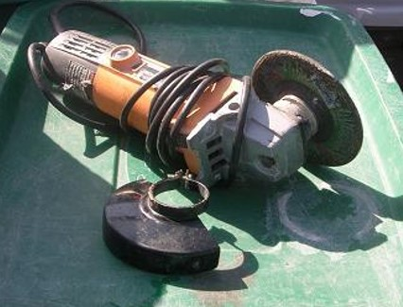
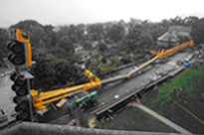
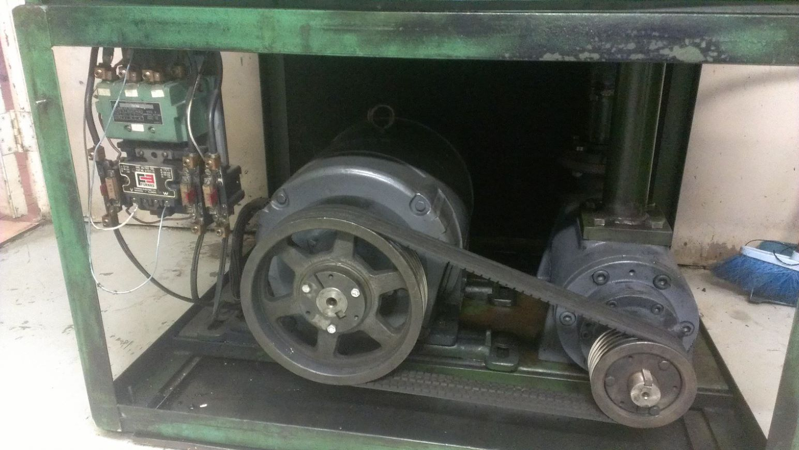
Caught In/Between Hazards
Caught In/Between Hazards
Types of caught in and caught between hazards
Trench cave-in
Moving parts of a machine,
engine, or power tool
Unguarded belts or pulleys
Vehicle rollover

Slide 4
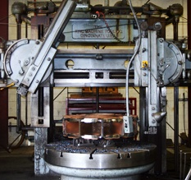
Caught In/Between Hazards
Caught In/Between Hazards
What Are Examples of Mechanical or Moving Equipment?
Saws
Presses
Conveyors
Bending, rolling, or shaping machines
Powered hand tools
Forklifts
Personnel hoists
Notes:
Almost all machines that construction workers use are equipped with guards that protect workers.
Any machine that grinds, shears, presses, punches, squeezes, cuts, rolls, mixes, or has pinch points or sharp edges that could cause potential harm to any worker should have a guard shielding the hazard.

Slide 5
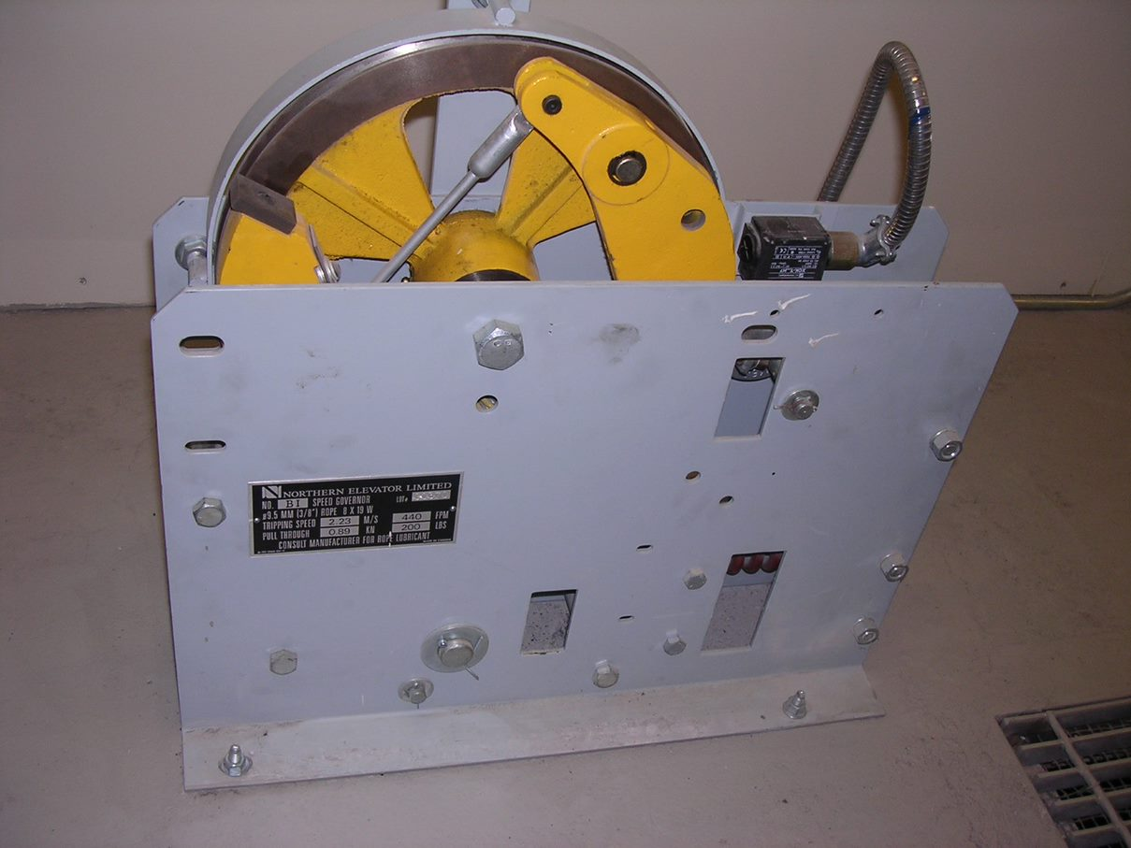
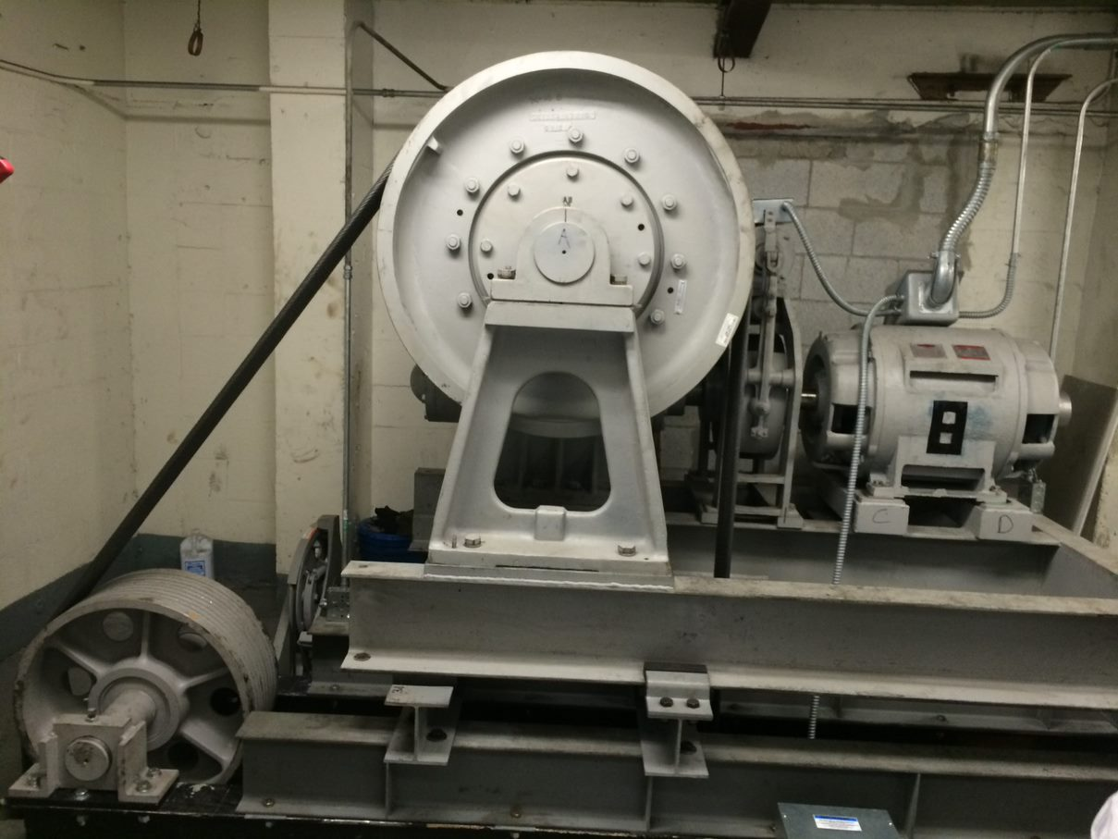
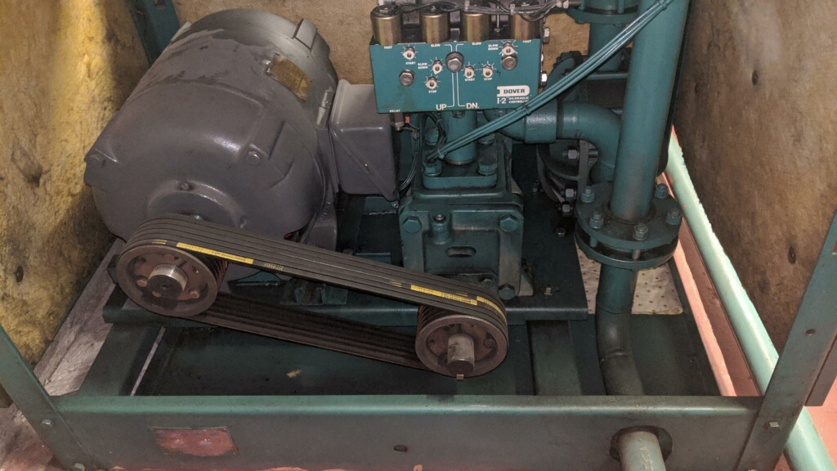
Caught In/Between Hazards
Caught In/Between Hazards
Machine room equipment
Rotating equipment can start without warning. Drive sheaves, governors, and pump motors all have the potential to cause serious injury. Be aware of your surroundings. Perform LOTO and control stored energy before servicing or repairing any equipment.

Slide 6
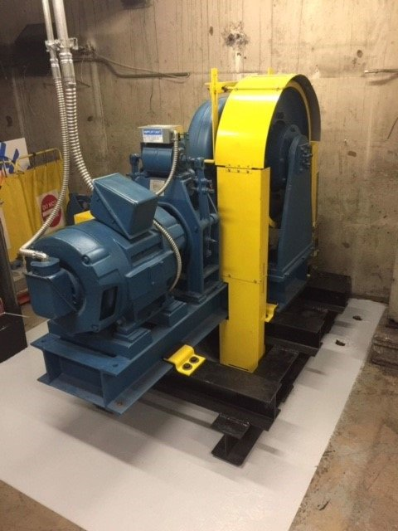
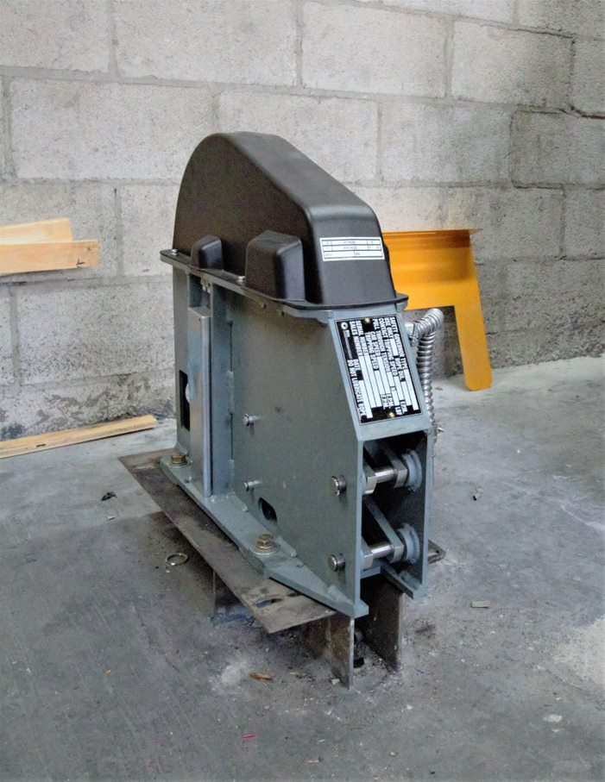
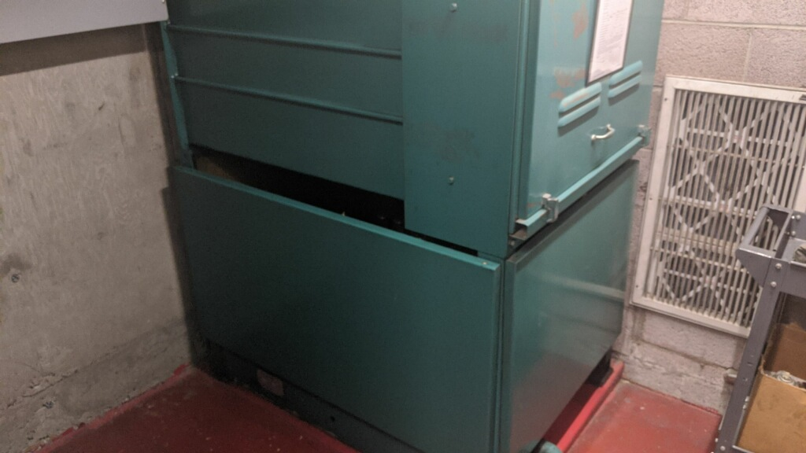
Caught In/Between Hazards
Caught In/Between Hazards
Machine room equipment cont.
Machine guarding is required by OSHA 1926.300(b). If you remove a guard while performing any work, replace it.

Slide 7
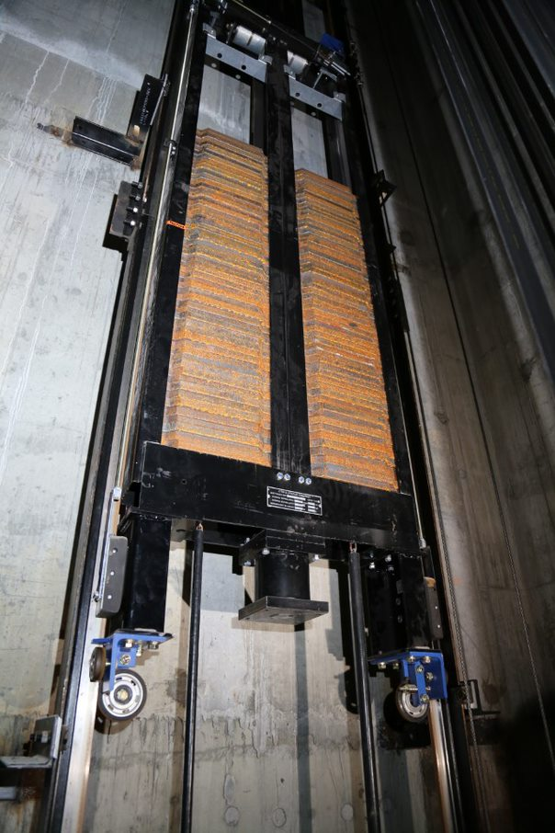
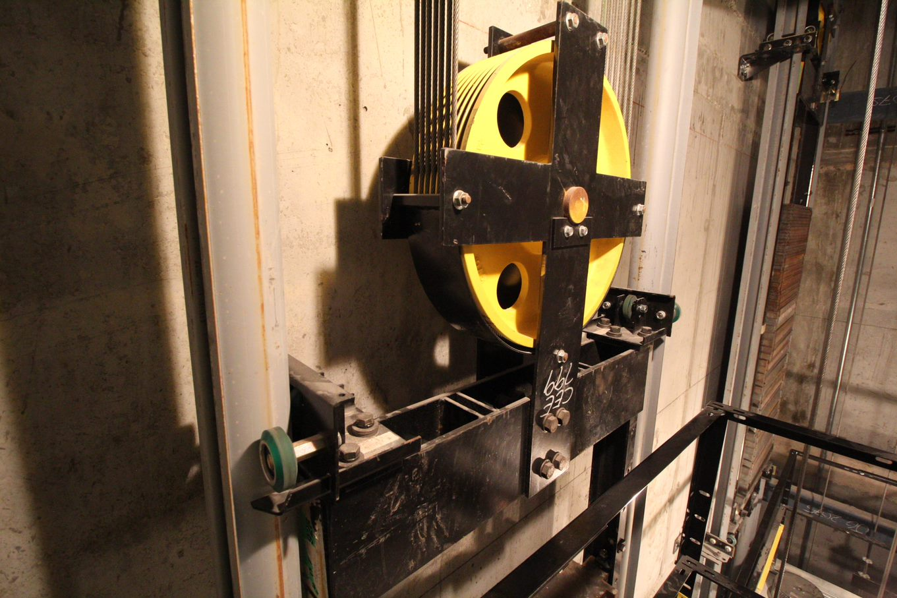
Caught In/Between Hazards
Caught In/Between Hazards
Elevator Counterweight
The elevator counterweight runs in the opposite direction of the car and passes with only a few inches of clearance. The counterweight runs silent and appears without warning. Always be aware of the position of the counterweight when running on car top inspection.
Never stand on a divider beam in an active hoistway.

Slide 8
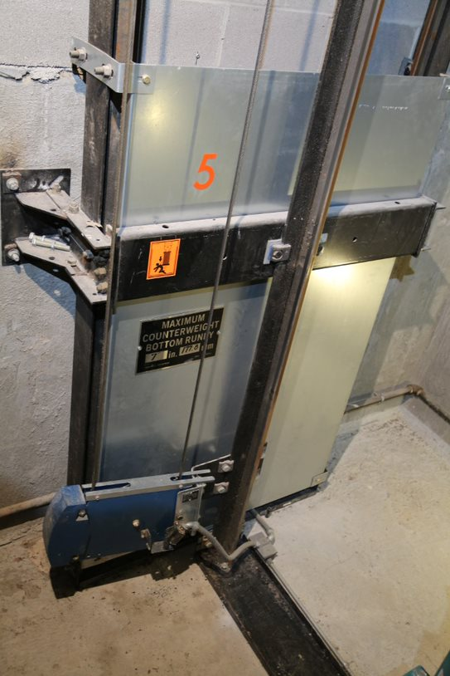
Caught In/Between Hazards
Caught In/Between Hazards
Elevator Pit
Always follow your company safety procedures for entering an elevator pit. Be aware of car position when accessing the pit. There are many pinch points to be cautious of, such as between the toe guard and hoistway sill, between the car and pit ladder, or around the counterweight. Counterweight guards should be installed as soon as the counterweight is installed.

Slide 9
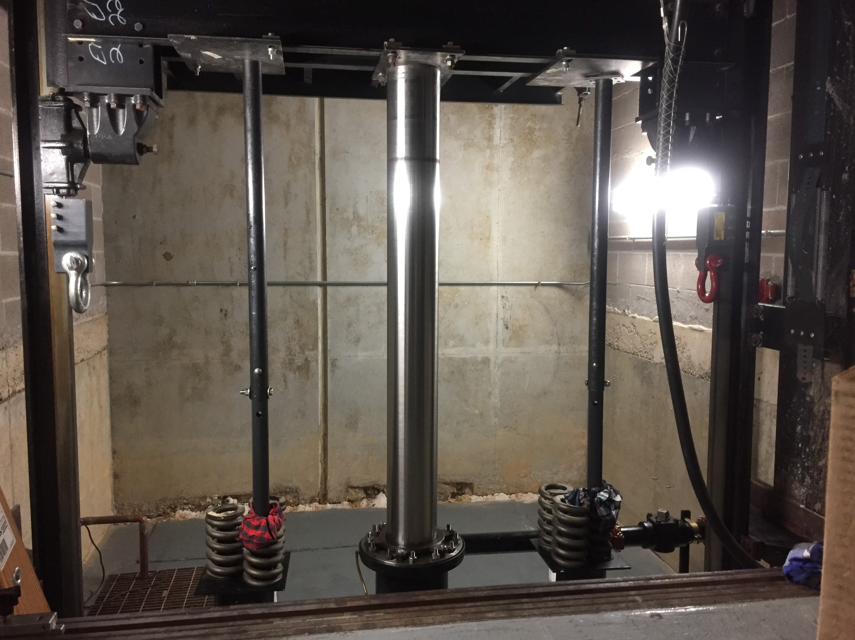
Caught In/Between Hazards
Caught In/Between Hazards
Pit cont.
Working Under a Hydraulic Elevator
Hydraulic elevators are supported by a column of oil. Before entering the pit, secure the elevator car from unintended movement and perform LOTO according to your company safety policy. In this picture, stored energy is controlled by landing the car on pipe stands and performing LOTO. Rail blocks are used as a safety backup for the pipe stands.

Slide 10
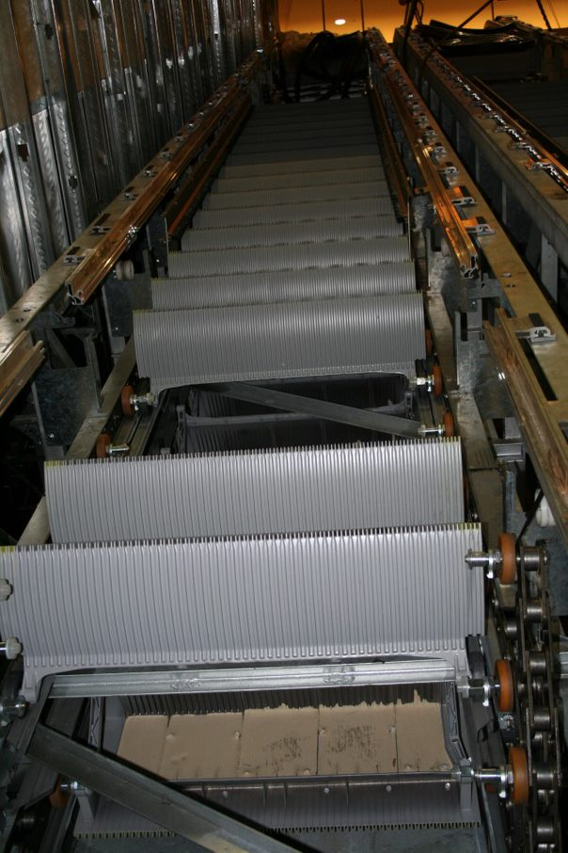
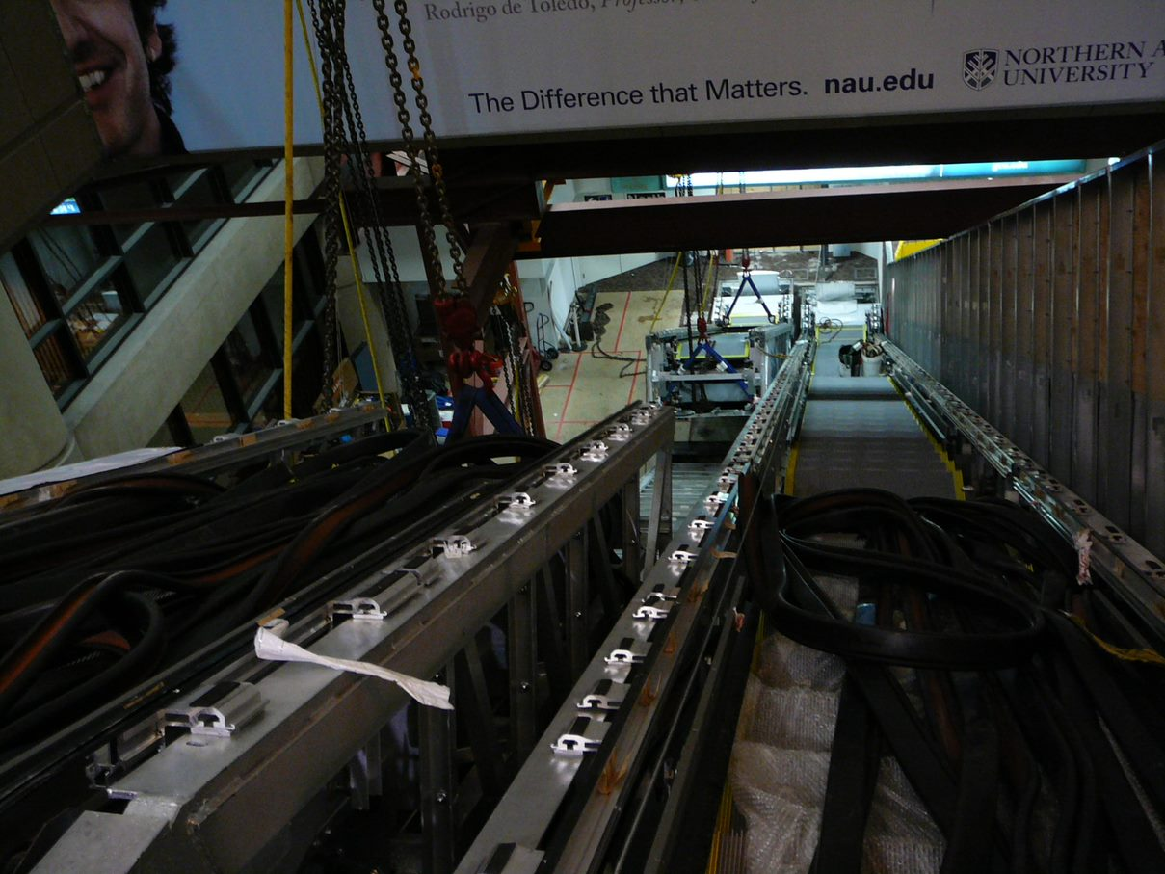
Caught In/Between Hazards
Caught In/Between Hazards
Escalators and Moving Walks
During hoisting operations, be aware of pinch points. Loads sometimes shift quickly and without notice. Units that deliver with some steps/ pallets removed can create an unbalanced load on the system.

Slide 11
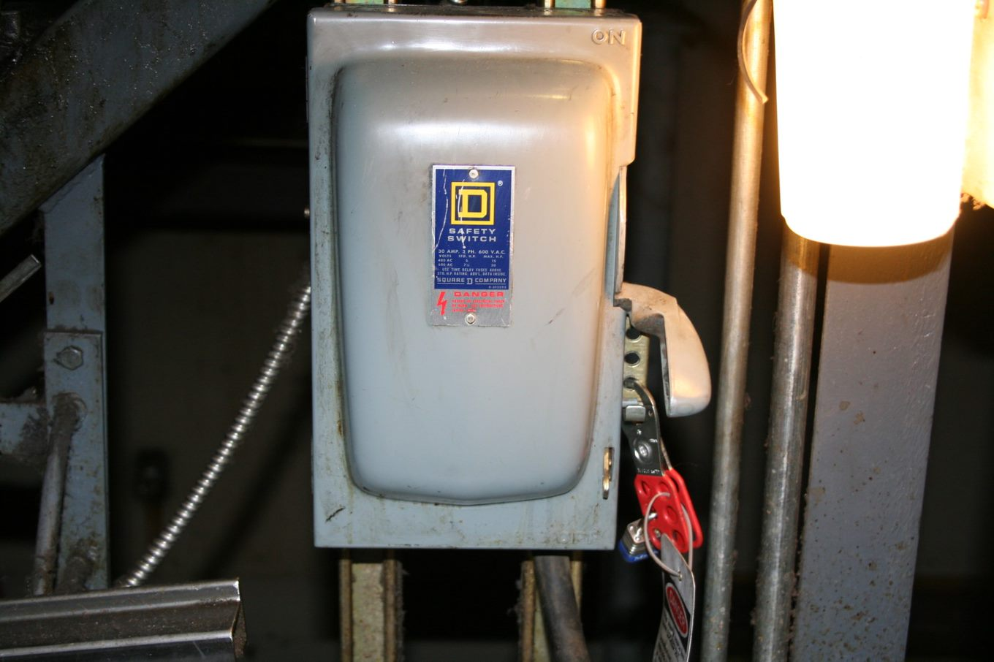
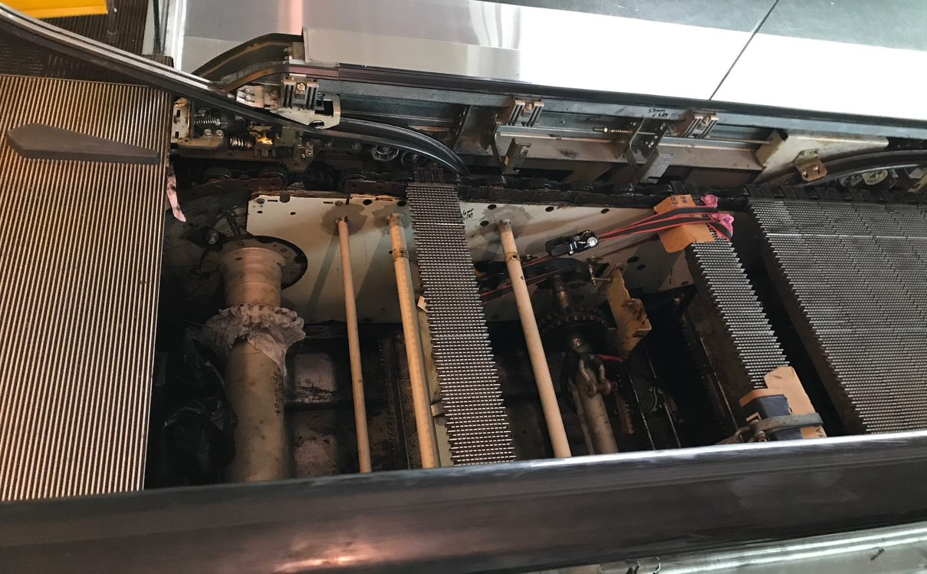
Caught In/Between Hazards
Caught In/Between Hazards
Escalators and Moving Walks
Never enter the step or tread band (inside of the escalator/moving walk) without performing LOTO and mechanically securing the unit from stored energy or unintended movement.

Slide 12
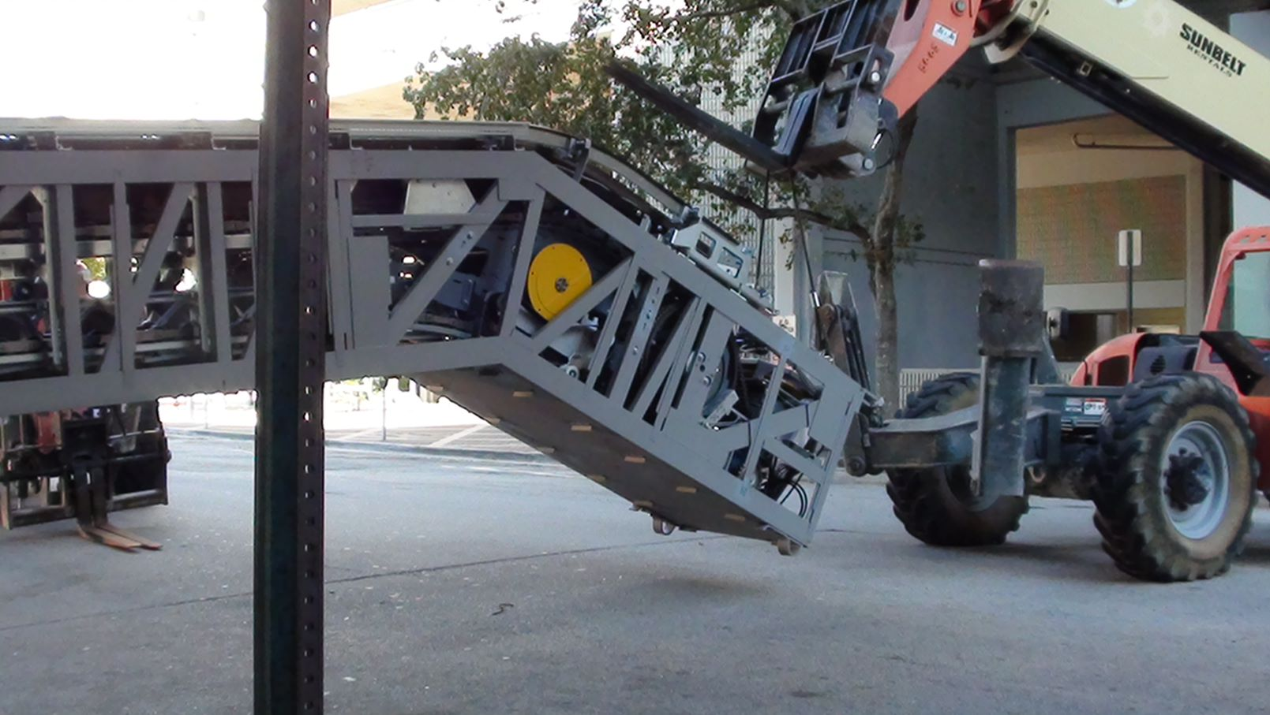
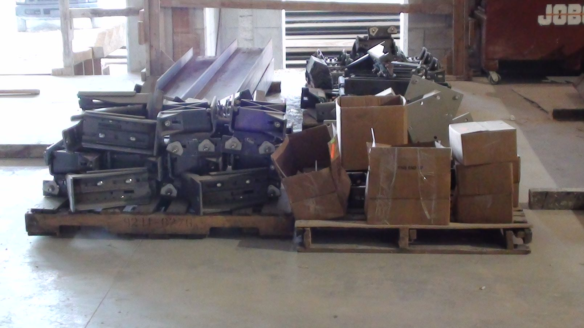
Caught In/Between Hazards
Caught In/Between Hazards
Unloading Equipment
When unloading equipment, remember that loads can shift. Never place yourself where a shifting load can pin you.

Slide 13
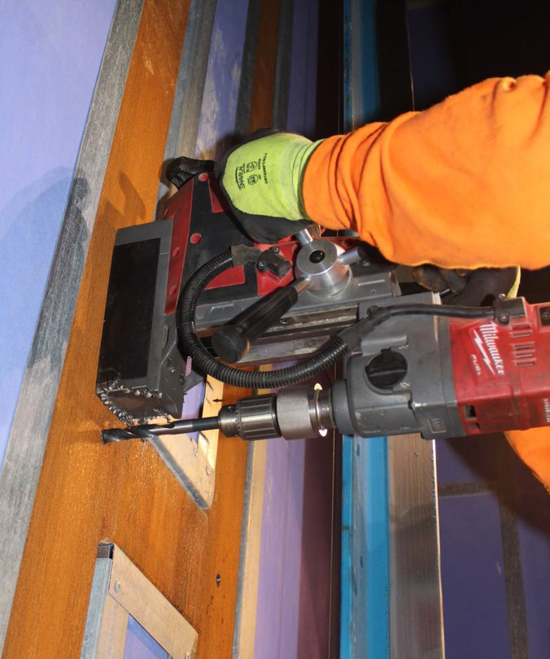
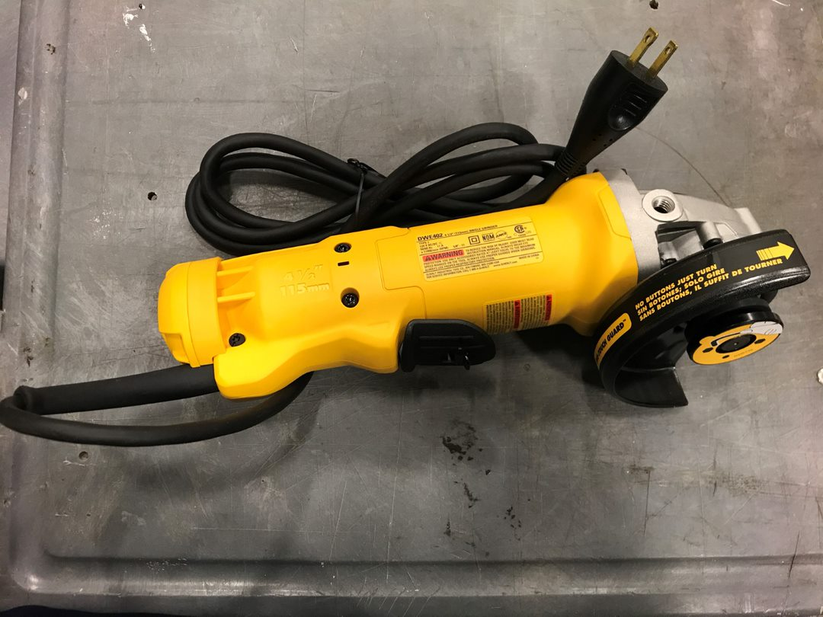
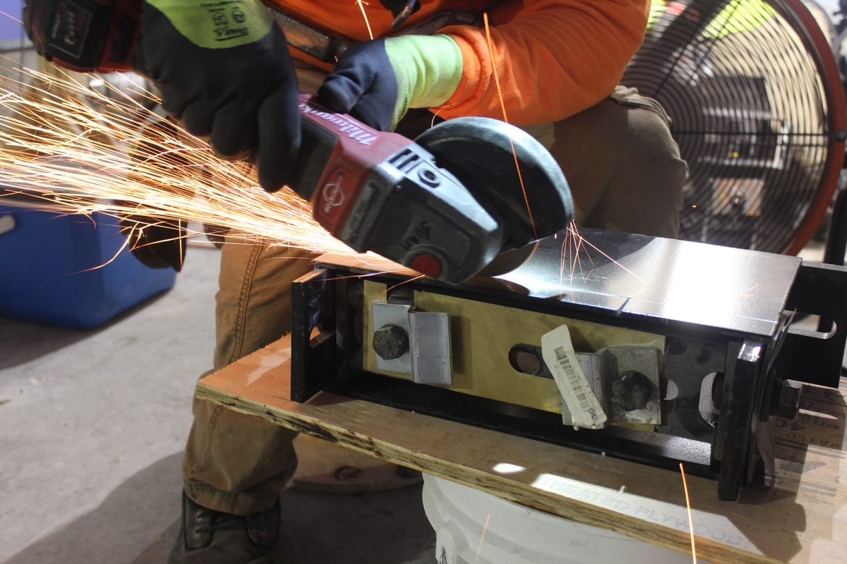
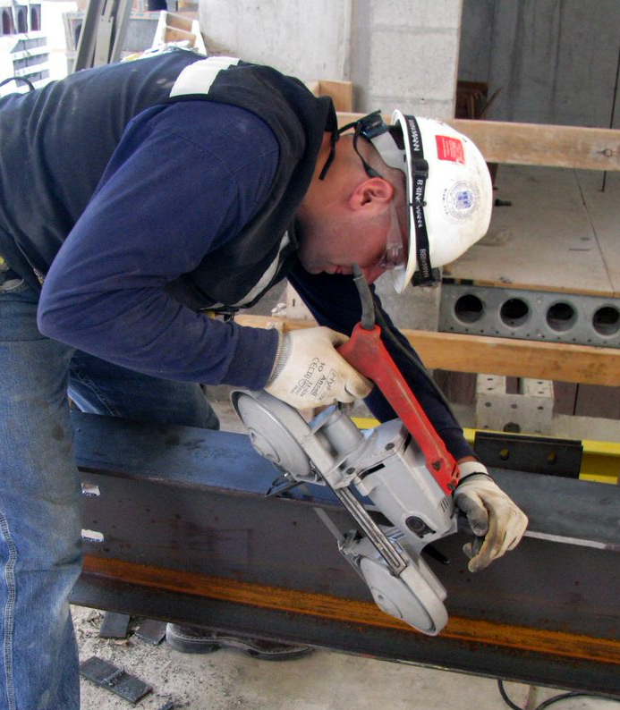
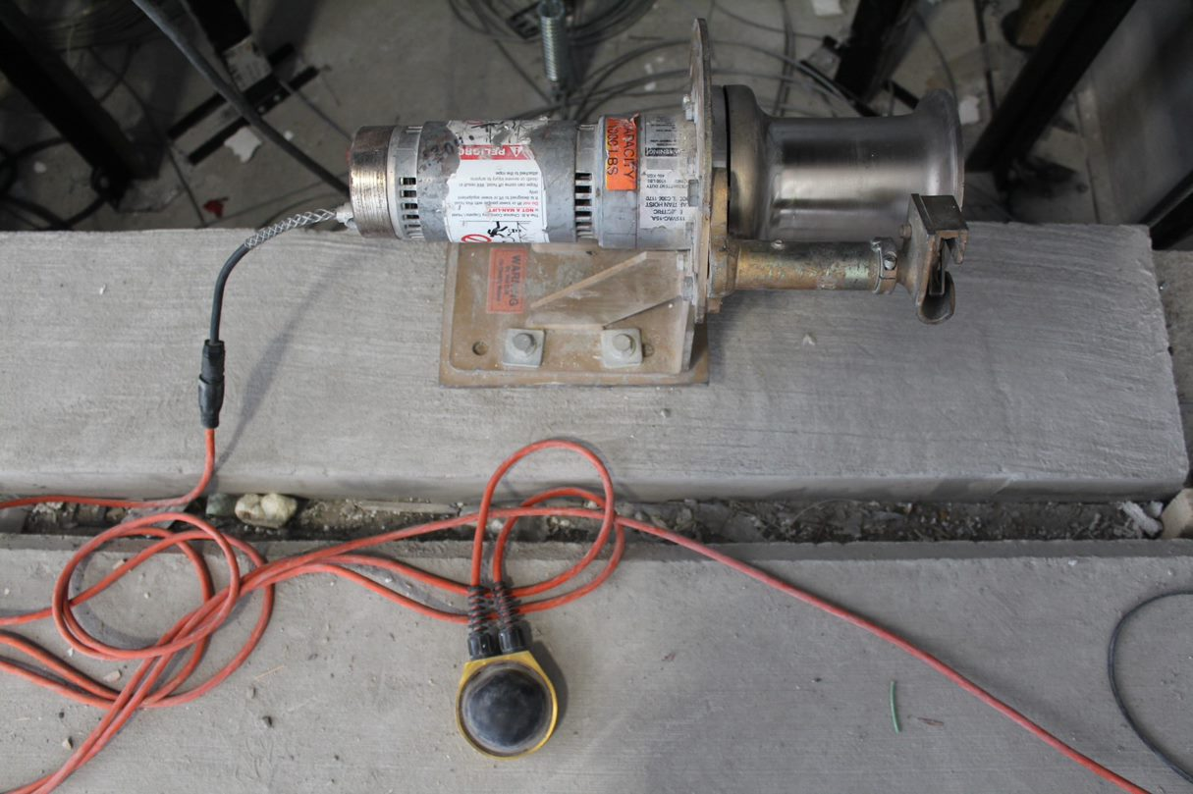
Caught In/Between Hazards
Caught In/Between Hazards
How Can Workers Be Protected From Moving Parts or Equipment?
Notes:
The next two slides address two methods workers can be protected from being caught in machinery or equipment:
1. Machine guards
2. Lock out tag out

Slide 14

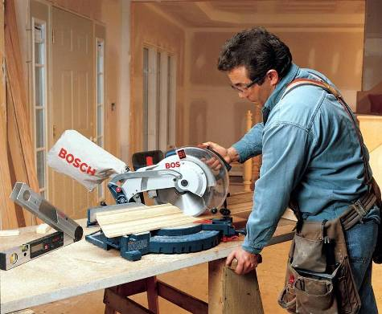
Caught In/Between Hazards
Caught In/Between Hazards
Machine guards should prevent moving parts of the machine from coming into contact with workers' arms, hands, or any other part of the body.
Employer training in safe use of equipment is required.
Notes:
Machine guards prevent moving parts of a machine from coming in contact with any part of a worker’s body. Remember:
Guards are there to protect workers
Install and maintain guards on all tools and heavy equipment.
Guards must remain in place at all times and eye protection must be worn.
Machine guards should prevent moving parts of the machine from coming into contact with workers' arms, hands, or any other part of the body. Machine guards should allow workers to use the machines comfortably and efficiently without hindering work.
Guards should be maintained in good condition.

Slide 15
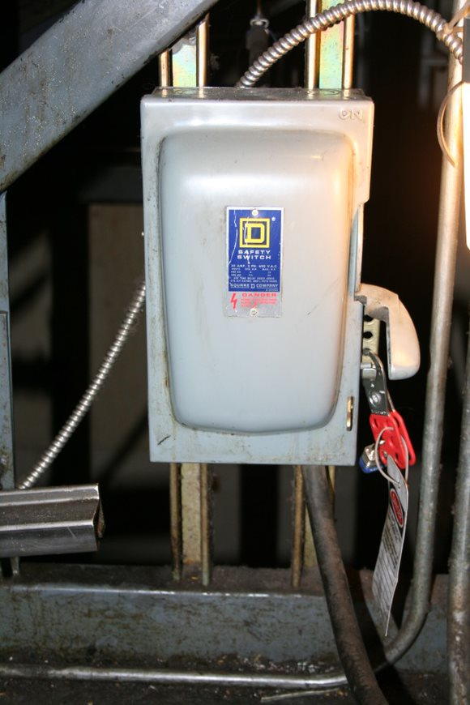
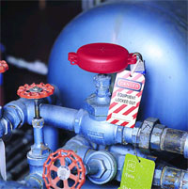
Caught In/Between Hazards
Caught In/Between Hazards
Lockout/Tagout
All types of energy need to be controlled before accessing or working on a conveyance. Types of energy elevator constructors will encounter: electric, hydraulic, pneumatic, mechanical, and pressurized liquids.
The process of controlling or eliminating the energy is called Lockout Tagout.
OSHA says that employers should:
  Set up a written lockout/ tagout program to make sure equipment is disconnected and locked before it is repaired.
  Train you to use the program.
Notes:
Dozens of construction workers are killed every year because they did not de-energize equipment or lock it out before working on it. Most of the deaths are electrocutions, but workers sometimes are crushed or have amputations or other injuries. All types of energy need to be controlled: electric, hydraulic, pneumatic, mechanical, and pressurized liquids, vapors, and gases.
• A lockout device is a lock that controls an energy source. It often has a special tag with a worker’s name. The lock is attached to an isolating device like a circuit breaker, a pipe valve, or a switch that can prevent turning on an energy source or equipment. Lock out can include using a blocking or blanking devices. These are devices used to prevent inadvertent movement in of gas or liquid in pipes.
One form of blocking is called a blind. A blind is a metal disk placed in a pipe joint that prevents the accidental release of liquid, steam, or other substances. Before installing blinds or blocks, workers must bleed down steam, air, or hydraulic lines to get rid of any pressure.
Coiled springs, spring-loaded devices, or suspended loads must also be released so that their stored energy will not result in inadvertent movement of mechanical parts.

Slide 16
Caught In/Between Hazards
Caught In/Between Hazards
Caught In and Caught Between
Hazards Summary
Rotating equipment can start without warning. Drive sheaves, governors, and pump motors all have the potential to cause serious injury
Machine guarding is required by OSHA 1926.300(b). If you remove a guard while performing any work, replace it.
The counterweight runs silent and appears without warning. Always be aware of the position of the counterweight when running on car top inspection.
Use lockout/tagout procedures when servicing or repairing machines
When unloading equipment, remember that loads can shift. Never place yourself where a shifting load can pin you.

Slide 17
Through the Alliance between OSHA’s 10 Regional Offices and the Elevator Contractors of America (ECA), Elevator Industry Work Preservation Fund (EIWPF), International Union of Elevator Constructors (IUEC), National Association of Elevator Contractors (NAEC), National Elevator Industry Educational Program (NEIEP), and National Elevator Industry Inc. (NEII), collectively known as The Elevator Industry Safety Partners, developed this Industry Specific Training for informational purposes only. It does not necessarily reflect the official views of OSHA or the U.S. Department of Labor. March 2025
Under the Occupational Safety and Health Act, employers are responsible (http://www.osha.gov/as/opa/worker/employer-responsibility.html) for providing a safe and healthy workplace and workers have rights (https://www.osha.gov/workers). OSHA can help answer questions or concerns from employers and workers. OSHA's On-Site Consultation Program (https://www.osha.gov/consultation) offers free and confidential advice to small and medium-sized businesses, with priority given to high-hazard worksites. For more information, contact your regional or area OSHA office (https://www.osha.gov/contactus/bystate), call 1-800-321-OSHA (6742), or visit https://www.osha.gov/.

