Slide 1

New Hire Training
Materials Handling, Storage, Use, and Disposal

Slide 2
Introduction
Materials Handling
Material can be handled manually or with the help of equipment
Bending, twisting, turning movements while handling material can injure you
Always wear the proper personal protective equipment
If something is bulky or heavy, ask for help before attempting to move it

Slide 3
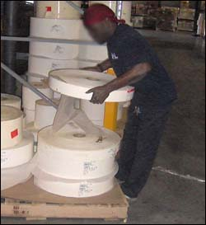
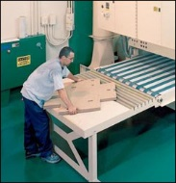
Factors Contributing to Injuries
Materials Handling
Too much weight and bulkiness of objects
Bending, twisting, turning movements while lifting
Source: OSHA
Source: OSHA
Notes:
OSHA 2002, https://www.osha.gov/Publications/osha2236/pdf
“Workers frequently cite the weight and bulkiness of objects that they lift as major contributing factors to their injuries.” A study from 1999 found that 420,000 back injuries occurred from workplace accidents. Causes of the injuries included lifting heavy or bulky items and bending, twisting, or turning movements.

Slide 4
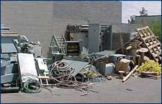
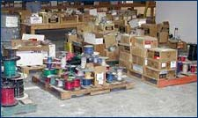
Hazards
Materials Handling
Improper operation of equipment
Accumulated materials or clutter
  Source of photos: OSHA
Notes:
Examples of improper operation of equipment – overloads, unsafe speeds,
Poor housekeeping presents tripping hazards, fire/explosion hazards, or hazards associated with harboring pests (rats, mice, etc.)

Slide 5
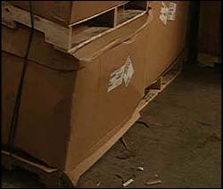
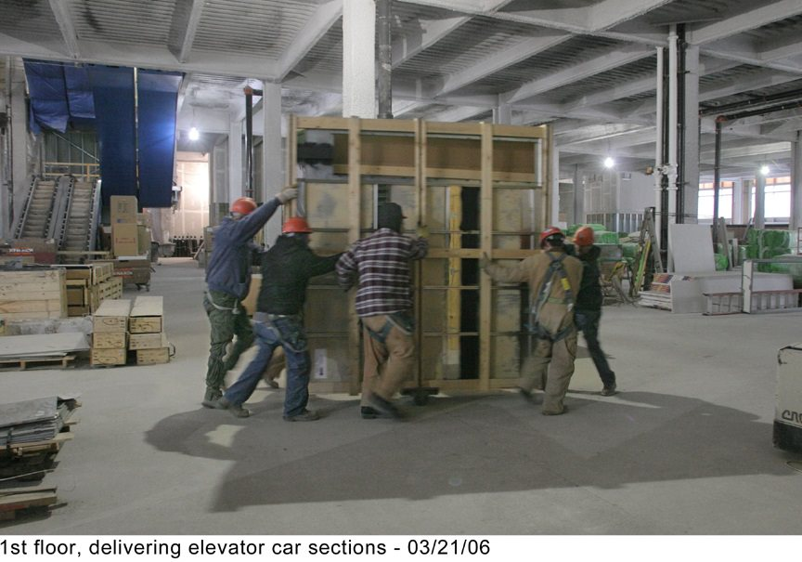
Hazards
Materials Handling
Falling objects
Lifting, pushing, pulling, or otherwise manually moving large, heavy items
Source: OSHA
Notes:
Falling objects – due to improper handling or storage, overloading capacity, etc.
Manually moving large, heavy, and/or irregularly-shaped objects can cause injuries; back injuries are a common injury associated with manual moving of heavy, bulky items

Slide 6
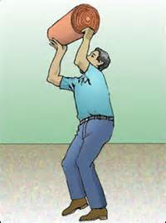
Injuries
Materials Handling
Types of injuries commonly reported
  Sprains, strains, tears
  Soreness and pain
  Bruises and contusions
  Cuts, lacerations, and
  punctures
Source: OSHA
Notes:
OSHA 2002, https://www.osha.gov/Publications/OSHA2236/osha2236.html:
Back injuries − lifting or bending and then twisting and turning
Strains and sprains − improper lifting or carrying loads too large or heavy
Fractures and bruises from − struck by materials or caught in pinch points
Cuts and bruises – falling materials that have been improperly stacked or had ties/securing devices incorrectly cut/removed

Slide 7
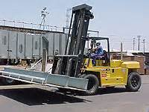
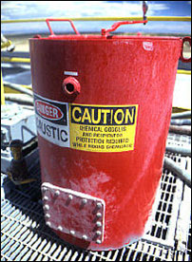
Injuries
Materials Handling
Examples of events or exposures leading to
injuries
  Contact with objects
  and equipment
  Transportation incidents
  Exposure to harmful substances or environments
Source: OSHA
Source: OSHA

Slide 8
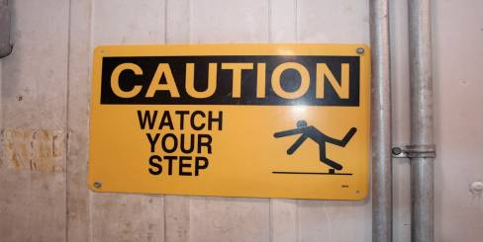
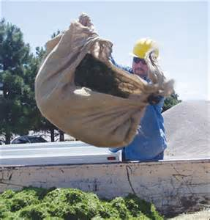
Injuries
Materials Handling
  Falls, slips, trips, or loss of balance
  Repetitive motion
  Overexertion
Source: OSHA
Source: OSHA
Notes:
Analyze job tasks and identify potential hazards associated with a task; determine/use ways to control conditions/actions of the workplace to minimize dangers.

Slide 9
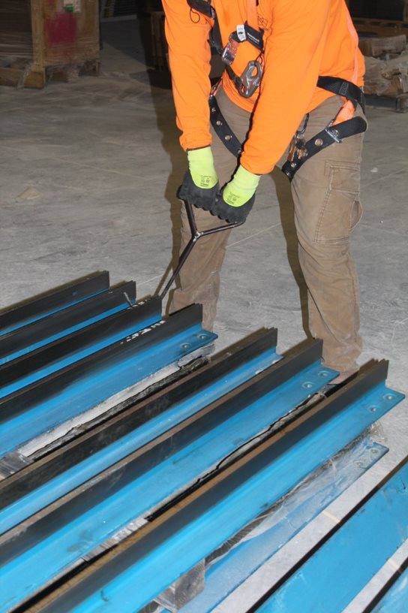
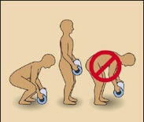
Preventing Hazards
Materials Handling
Moving materials manually
  Use devices to assist with holding loads
  Wear PPE
  Use proper lifting technique
  Seek help for oversized loads
  Use blocking materials
Source of photos: OSHA
Notes:
OSHA 2002, https://www.osha.gov/Publications/OSHA2236/osha2236.html:
Attach handles or holders to loads.
Always wear appropriate personal protective equipment. “Using the following personal protective equipment prevents needless injuries when manually moving materials:
Hand and forearm protection, such as gloves, for loads with sharp or rough edges.
Eye protection.
Steel-toed safety shoes or boots.
Metal, fiber, or plastic metatarsal guards to protect the instep area from impact or compression.
See OSHA's booklet, Personal Protective Equipment (OSHA 3077), for additional information.”
Use proper lifting techniques.
Break load into parts; get help with heavy or bulky items.
Lift with legs, keep back straight, do not twist.
Use handling aids – such as steps, trestles, shoulder pads, handles, and wheels.
Avoid lifting above shoulder level.
“To prevent injury from oversize loads, workers should seek help in the following:
When a load is so bulky that employees cannot properly grasp or lift it,
When employees cannot see around or over a load, or
When employees cannot safely handle a load. “
“Employees should use blocking materials to manage loads safely. Workers should also be cautious when placing blocks under a raised load to ensure that the load is not released before removing their hands from under the load. Blocking materials and timbers should be large and strong enough to support the load safely. In addition to materials with cracks, workers should not use materials with rounded corners, splintered pieces, or dry rot for blocking.”

Slide 10
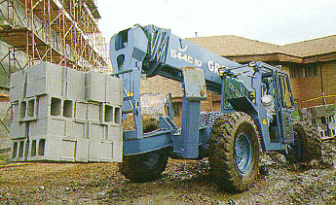
Preventing Hazards
Materials Handling
Forklifts
  Main causes of injuries
    Forklift overturns
    Forklift striking workers on foot
    Persons crushed by forklifts
    Persons falling from forklifts
Source: OSHA

Slide 11

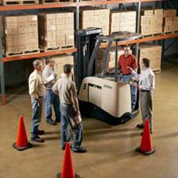
Preventing Hazards
Materials Handling
  Illegal forklift operators
    Anyone under 18
    Anyone not properly trained and certified
Source of photos: OSHA
Notes:
https://www.osha.gov/SLTC/etools/pit/assistance/index.html
The training provided must be applicable to the work site and working conditions. Trainees must be supervised by a competent persons and may not operate trucks where they would endanger anyone.
The requirements of the standards must be taught, as well as truck-related and workplace-related topics.
Three separate aspects of powered industrial truck training must be completed:
1. Formal training – lecture, discussion, interactive computer learning, written materials
2. Practical training – demonstrations and exercises performed by the trainee
3. Evaluation – practical observance and determination of the trainees’ competence and capability

Slide 12
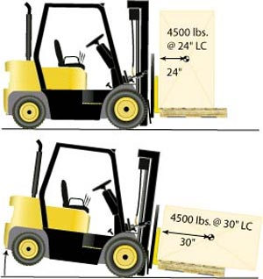
Preventing Hazards
Materials Handling
  Avoiding Excess Weight
    Do not exceed weight capacity of forklift
    Center loads and secure to keep from shifting to maintain balance of weight
Source: OSHA
Notes:
Do not exceed weight capacity of forklift.
Center loads and secure to keep from shifting to maintain balance of weight
OSHA n.d., https://www.osha.gov/SLTC/etools/pit/operations/loadhandling.html
Center load and secure.
Heaviest part of load should be placed nearest the front wheels.
“Do not overload. Know the stated capacity of your forklift and do not exceed it. Only by keeping within the weight limit can you operate the forklift safely.”
“A forklift’s capacity is rated for a specified load center. If the load is off-center, improperly distributed, or oversized, it may exceed capacity and unbalance the forklift.”

Slide 13
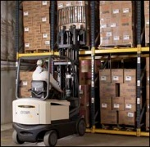
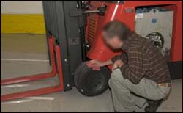
Employer Requirements
Materials Handling
Comply with OSHA standards related to materials handling, including:
  Training requirements, including requirements for forklift training.
  Inspection requirements
Source of photos: OSHA
Notes:
29 CFR 1926.602
Training requirements for operators of powered industrial trucks are located in 1910.178(l).
Per 1910.178(l)(2)(ii), “training shall consist of a combination of formal instruction…, practical training…, and evaluation of the operator’s performance in the workplace.”

Slide 14
Through the Alliance between OSHA’s 10 Regional Offices and the Elevator Contractors of America (ECA), Elevator Industry Work Preservation Fund (EIWPF), International Union of Elevator Constructors (IUEC), National Association of Elevator Contractors (NAEC), National Elevator Industry Educational Program (NEIEP), and National Elevator Industry Inc. (NEII), collectively known as The Elevator Industry Safety Partners, developed this Industry Specific Training for informational purposes only. It does not necessarily reflect the official views of OSHA or the U.S. Department of Labor. March 2025
Under the Occupational Safety and Health Act, employers are responsible (http://www.osha.gov/as/opa/worker/employer-responsibility.html) for providing a safe and healthy workplace and workers have rights (https://www.osha.gov/workers). OSHA can help answer questions or concerns from employers and workers. OSHA's On-Site Consultation Program (https://www.osha.gov/consultation) offers free and confidential advice to small and medium-sized businesses, with priority given to high-hazard worksites. For more information, contact your regional or area OSHA office (https://www.osha.gov/contactus/bystate), call 1-800-321-OSHA (6742), or visit https://www.osha.gov/.

