Slide 1
New Hire Training
Fire Prevention and Protection

Slide 2
Fire Protection and Prevention
Your employer is responsible for the development of a fire protection program and must also provide firefighting equipment.
At a minimum, your fire prevention plan must include:
A list of all major fire hazards, proper handling and storage procedures for hazardous materials, potential ignition sources and their control, and the type of fire protection equipment necessary to control each major hazard.
Procedures to control accumulations of flammable and combustible waste materials.
Procedures for regular maintenance of safeguards installed on heat-producing equipment to prevent the accidental ignition of combustible materials.
The name or job title of employees responsible for maintaining equipment to prevent or control sources of ignition or fires.
The name or job title of employees responsible for the control of fuel source hazards.
Notes:
Source: Evacuation Plans and Procedures eTool (2002), OSHA eTool, https://www.osha.gov/SLTC/etools/evacuation/fire.html

Slide 3
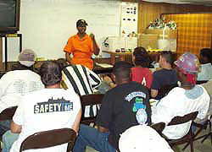
Fire Prevention Plan
FPP requirements:
Must be
In writing
Kept in the workplace
Available to employees for review
Employer must
Inform employees of fire hazards they are exposed to when initially assigned to a job
Review with each employee applicable FPP parts required for self-protection
Source: OSHA
Notes:
Source: Evacuation Plans and Procedures eTool (2002), OSHA eTool, https://www.osha.gov/SLTC/etools/evacuation/fire.html
“A fire prevention plan must be in writing, be kept in the workplace, and be made available to employees for review. However, an employer with 10 or fewer employees may communicate the plan orally to employees. [29 CFR 1910.39(b)]…
An employer must inform employees upon initial assignment to a job of the fire hazards to which they are exposed. An employer must also review with each employee those parts of the fire prevention plan necessary for self-protection.”

Slide 4
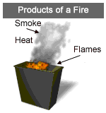
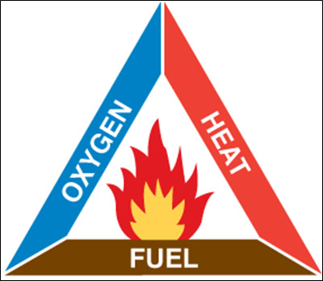
Fire Prevention Plan
Preventing fires hazards:
In order to prevent fires, it is important to understand how fires occur.
Fire is a very rapid chemical reaction between oxygen and a combustible material, which results in the release of heat, light, flames, and smoke.
For fire to exist, the following four elements must be present at the same time:
Enough oxygen to sustain combustion.
Enough heat to raise the material to its ignition temperature.
Some sort of fuel or combustible material.
The chemical reaction that is fire.
Source of graphics: OSHA
Notes:
Source: Evacuation Plans and Procedures eTool (2002), OSHA eTool, https://www.osha.gov/SLTC/etools/evacuation/portable_about.html

Slide 5
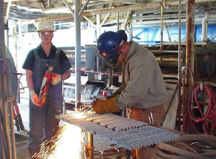
Fire Prevention Plan
Tasks that require fire protection and examples of hazards
Hotwork (welding, cutting, brazing) – fire watch:
Fire watches… are used to prevent and/or extinguish fires at the incipient (beginning) stage. They monitor the hot work sites to ensure that conditions do not change when combustible materials cannot be effectively removed, protected or shielded. Fire watches also require specialized training and are assigned to minimize damage that may be caused by a fire. If a fire occurs, they take appropriate actions to protect all workers.
Source of graphics: OSHA
Notes:
https://www.osha.gov/SLTC/etools/shipyard/fire_protection/firewatch.html

Slide 6
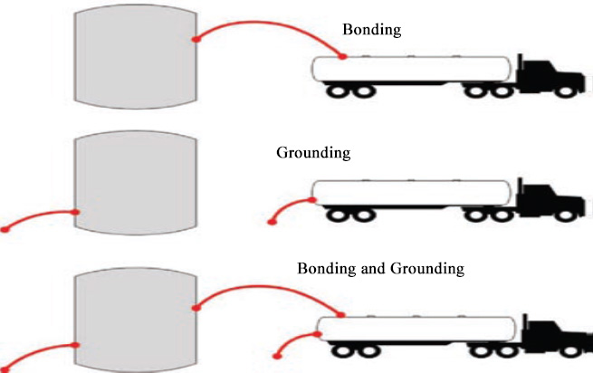
Fire Prevention Plan
Tasks that require fire protection and examples of hazards
Dispensing: When transferring liquids, gases, or solids through pipes or hoses, static electricity may be generated, creating an electric charge that can ignite the flammables. It is necessary to “bond” containers when flammables are being transferred from one to the other and have the receiving container in contact with the ground so that the static can be effectively eliminated and, thereby, remove the ignition source.
Source of graphics: OSHA
Notes:
https://www.osha.gov/SLTC/etools/shipyard/fire_protection/firewatch.html

Slide 7
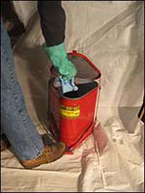
Fire Prevention Plan
Tasks that require fire protection and examples of hazards
Flammable wastes: Dispose of oils, paint thinners, solvents, rags, scraps, waste, or other flammable and combustible substances, or store them in covered fire-resistant containers, at the end of each workshift or when the job is complete, whichever occurs first.
Source of graphics: OSHA
Notes:
Flammable wastes: https://www.osha.gov/dts/maritime/sltc/ships/housekeeping/intro.html

Slide 8
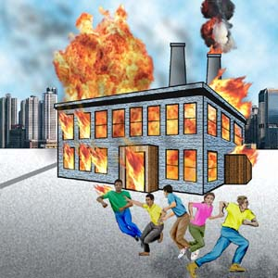
Fire Emergencies
Fight or Flee?
Portable fire extinguishers have two functions: to control or extinguish small or incipient stage fires and to protect evacuation routes that a fire may block directly or indirectly with smoke or burning/smoldering materials.
To extinguish a fire with a portable extinguisher, a person must have immediate access to the extinguisher, know how to actuate the unit, and know how to apply the agent effectively. Attempting to extinguish even a small fire carries some risk. Fires can increase in size and intensity in seconds, blocking the exit path of the fire fighter and creating a hazardous atmosphere. In addition, portable fire extinguishers contain a limited amount of extinguishing agent and can be discharged in a matter of seconds. Therefore, individuals should attempt to fight only very small or incipient stage fires.
Prior to fighting any fire with a portable fire extinguisher you must perform a risk assessment that evaluates the fire size, the fire fighters evacuation path, and the atmosphere in the vicinity of the fire.
Source: OSHA
Notes:
Source: Evacuation Plans and Procedures eTool (2002), OSHA eTool, https://www.osha.gov/SLTC/etools/evacuation/portable_relation.html#risk_table

Slide 9
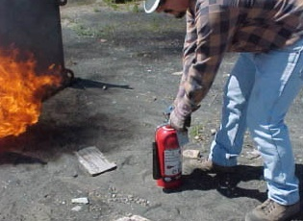
Extinguishing Fires
When used properly, fire extinguishers can save lives and property by putting out a small fire or controlling a fire until additional help arrives. A fire is the most common type of emergency for which small businesses must plan. A critical decision when planning is whether employees should fight a small fire with a portable fire extinguisher or simply evacuate.
Portable fire extinguisher training and education
Required for employees authorized to use fire extinguishers
Describes general principles of fire extinguisher use
Describes hazards of incipient stage fire fighting
Describes operation of equipment (instruction and hands-on practice)
Required upon initial employment/assignment and at least annually thereafter
Source: OSHA
Notes:
Source: Evacuation Plans and Procedures eTool (2002), OSHA eTool, https://www.osha.gov/SLTC/etools/evacuation/portable.html
“When used properly, fire extinguishers can save lives and property by putting out a small fire or controlling a fire until additional help arrives. A fire is the most common type of emergency for which small businesses must plan. A critical decision when planning is whether or not employees should fight a small fire with a portable fire extinguisher or simply evacuate.”
Source: https://www.osha.gov/pls/oshaweb/owadisp.show_document?p_table=STANDARDS&p_id=9811
“1910.157(g)Training and education.
1910.157(g)(1)Where the employer has provided portable fire extinguishers for employee use in the workplace, the employer shall also provide an educational program to familiarize employees with the general principles of fire extinguisher use and the hazards involved with incipient stage fire fighting.
1910.157(g)(2)The employer shall provide the education required in paragraph (g)(1) of this section upon initial employment and at least annually thereafter.
1910.157(g)(3)The employer shall provide employees who have been designated to use fire fighting equipment as part of an emergency action plan with training in the use of the appropriate equipment.
1910.157(g)(4)The employer shall provide the training required in paragraph (g)(3) of this section upon initial assignment to the designated group of employees and at least annually thereafter.”

Slide 10
Extinguishing fires
Classes of fires
Class A Fires
Fires in ordinary combustibles, such as wood, paper, cloth, rubber and many plastics.
Class A extinguisher : Water and foam fire extinguishers. Water extinguishers are for Class A fires only
Class B Fires
Fires in flammable liquids or flammable gases. DOES NOT include fires involving cooking oils and grease.
Class B extinguisher: Cartridge operated dry chemical fire extinguisher. A carbon dioxide fire extinguisher works on a Class B fire by expelling CO2 to suffocate the fire, removing the oxygen necessary to keep it burning. It also helps with removing the heat, as the discharge is very cold. Ordinary dry chemical is for Class B and C fires only.
Class C Fires
Fires involving energized electrical equipment. Remove the power and a Class C fire becomes one of the other classes of fire.
Class C extinguishers: Clean Agent Fire Extinguishers. Halogenated or clean agent extinguishers include the halon agents as well as the newer and less ozone depleting halocarbon agents. They extinguish the fire by interrupting the chemical reaction and/or removing heat from the fire triangle. Clean agent extinguishers are effective on Class A, B and C fires.
Notes:
Class B: Carbon dioxide. A carbon dioxide fire extinguisher works on a Class B fire by expelling CO2 to suffocate the fire, removing the oxygen necessary to keep it burning. It also helps with removing the heat, as the discharge is very cold.
Class C: Halogenated or clean agent extinguishers include the halon agents as well as the newer and less ozone depleting halocarbon agents. They extinguish the fire by interrupting the chemical reaction and/or removing heat from the fire triangle.

Slide 11
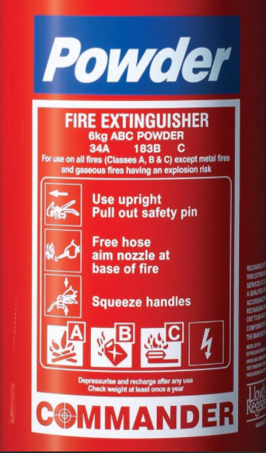
Extinguishing fires
Classes of fires
Class D Fires
Fires in combustible metals, such as magnesium, titanium, zirconium, sodium, lithium and potassium.
Class D extinguishers: Dry Powder Fire Extinguishers. Dry powder extinguishers are similar to dry chemical extinguishers except that they extinguish the fire by separating the fuel from the oxygen element or by removing the heat element of the fire triangle. Dry powder extinguishers are for Class D or combustible metal fires ONLY. They are ineffective on all other classes of fires.
Class K Fires
Fires involving vegetable oils, animal oils, or fats in cooking appliances. They use a process called saponification (turn fat or oil into soap by reaction with an alkali) by releasing an alkaline agent to create a foam that traps vapors and puts the fire out.
Most portable extinguishers are rated for use with more than one classification of fire. For example, an extinguisher with a BC rating is suitable for use with fires involving flammable liquids and energized electrical equipment. An extinguisher with an ABC rating is suitable for use with fires involving ordinary combustibles, flammable liquids and energized electrical equipment. An extinguisher that is rated for use with multiple hazards should include a symbol for each hazard type.
Notes:
Class D: Dry powder extinguishers are similar to dry chemical extinguishers except that they extinguish the fire by separating the fuel from the oxygen element or by removing the heat element of the fire triangle.
Class K: Commonly used in restaurant kitchens, class K fire extinguishers can effectively put out fires caused by cooking fats, greases, and oils.
The moral of the story:
When welding or cutting, make sure you have the proper type of extinguisher for the combustible material you are protecting.

Slide 12
Extinguishing Fires
Using a fire extinguisher:
The following steps should be followed when responding to incipient stage fire:
Sound the fire alarm and call the fire department, if appropriate.
Identify a safe evacuation path before approaching the fire. Do not allow the fire, heat, or smoke to come between you and your evacuation path.
Select the appropriate type of fire extinguisher.
Discharge the extinguisher within its effective range using the P.A.S.S. technique (pull, aim, squeeze, sweep).
Back away from an extinguished fire in case it flames up again.
Evacuate immediately if the extinguisher is empty and the fire is not out.
Evacuate immediately if the fire progresses beyond the incipient stage.
Notes:
Source: Evacuation Plans and Procedures eTool (2002), OSHA eTool, https://www.osha.gov/SLTC/etools/evacuation/portable_use.html

Slide 13
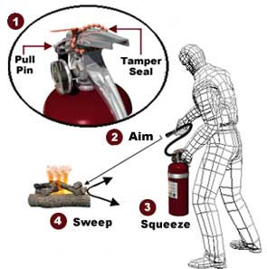
Extinguishing Fires
P.A.S.S. technique
Pull the pin
Aim at base of fire
Squeeze handle
Sweep side-to-side at base of fire until fire appears out
Watch area for re-ignition and repeat steps 2 – 4;
When in doubt, EVACUATE IMMEDIATELY!
Source: OSHA
Notes:
Source: Evacuation Plans and Procedures eTool (2002), OSHA eTool, https://www.osha.gov/SLTC/etools/evacuation/portable_use.html
“Most fire extinguishers operate using the following P.A.S.S. technique:
PULL... Pull the pin. This will also break the tamper seal.
AIM... Aim low, pointing the extinguisher nozzle (or its horn or hose) at the base of the fire. NOTE: Do not touch the plastic discharge horn on CO₂ extinguishers, it gets very cold and may damage skin.
SQUEEZE... Squeeze the handle to release the extinguishing agent.
SWEEP... Sweep from side to side at the base of the fire until it appears to be out. Watch the area. If the fire re-ignites, repeat steps 2 - 4.
If you have the slightest doubt about your ability to fight a fire....EVACUATE IMMEDIATELY!”

Slide 14
Summary
We discussed the elements of an effective fire protection plan and what the employers' obligations are. We discussed the five types of fire extinguishers and the types of fires they will be effective on. We also talked about knowing when to fight a fire or flee to safety.
Being familiar with the fire protection plan will save lives.

Slide 15
Through the Alliance between OSHA’s 10 Regional Offices and the Elevator Contractors of America (ECA), Elevator Industry Work Preservation Fund (EIWPF), International Union of Elevator Constructors (IUEC), National Association of Elevator Contractors (NAEC), National Elevator Industry Educational Program (NEIEP), and National Elevator Industry Inc. (NEII), collectively known as The Elevator Industry Safety Partners, developed this Industry Specific Training for informational purposes only. It does not necessarily reflect the official views of OSHA or the U.S. Department of Labor. March 2025
Under the Occupational Safety and Health Act, employers are responsible (http://www.osha.gov/as/opa/worker/employer-responsibility.html) for providing a safe and healthy workplace and workers have rights (https://www.osha.gov/workers). OSHA can help answer questions or concerns from employers and workers. OSHA's On-Site Consultation Program (https://www.osha.gov/consultation) offers free and confidential advice to small and medium-sized businesses, with priority given to high-hazard worksites. For more information, contact your regional or area OSHA office (https://www.osha.gov/contactus/bystate), call 1-800-321-OSHA (6742), or visit https://www.osha.gov/.

