Slide 1
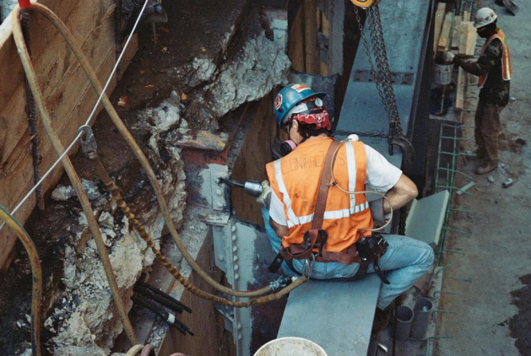
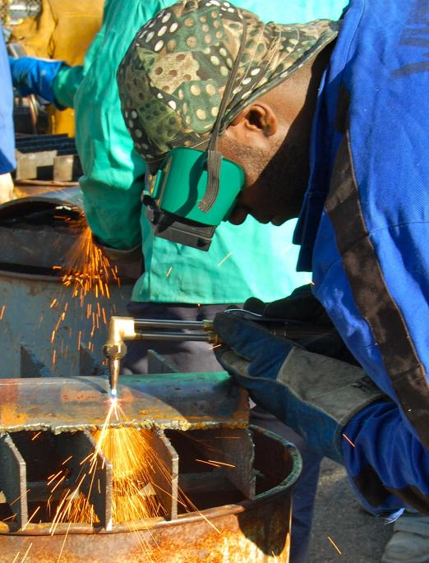
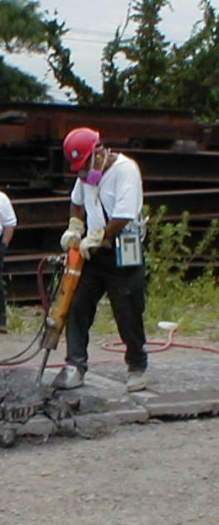
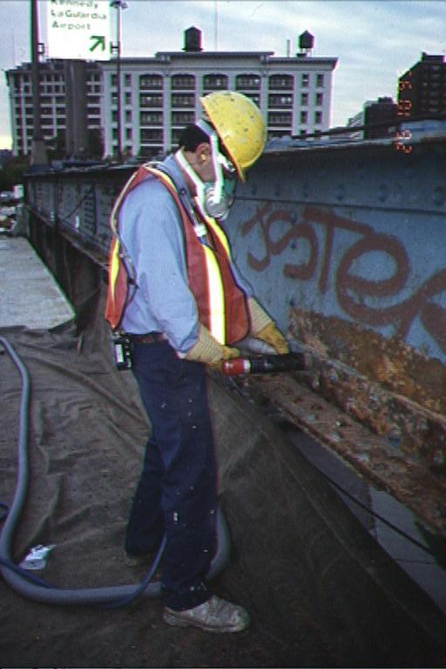
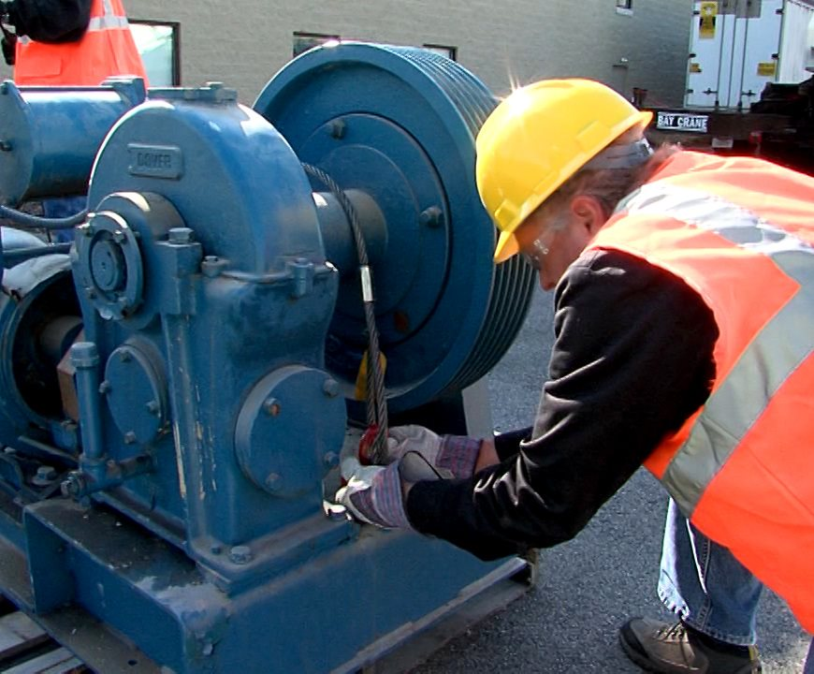

New Hire Training
Personal Protective Equipment
Source of photos: Mount Sinai/CHEP/elcosh.org
Notes:
OSHA requires employees to protect their employees from workplace hazards through the use of engineering or work practice controls.
When these controls are not feasible or do not provide sufficient protection, the use of personal protective equipment (PPE) is required.

Slide 2
Protecting Employees
Employers must protect employees:
Assess workplace
Eliminate and reduce hazards using engineering and administrative controls
Then use appropriate personal protective equipment (PPE)
Remember, PPE is the last level of control!

Slide 3
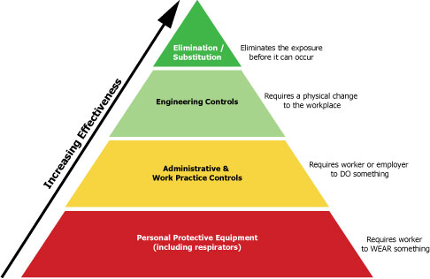
Protecting Employees
Source: OSHA
Notes:
The Hierarchy of Control Methods
Graphic illustrates the effectiveness of the systems used to prevent and control hazards.
Elimination/substitution
Provides the highest level of protection against hazards.
The hazard is eliminated from the workplace or a safer item/substance is substituted for the more hazardous item/substance.
Engineering controls are the second most effective means of protecting employees from hazards, followed by administrative and work practice controls.
PPE - last resort; it is least effective

Slide 4
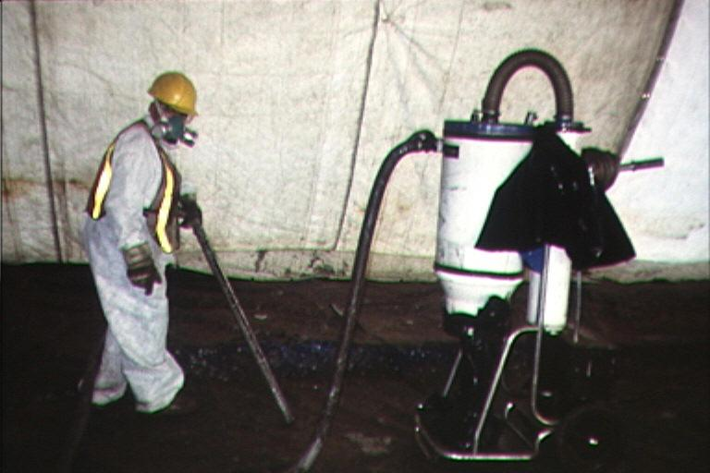
Engineering Controls
Physical changes to workplace
Isolation
Ventilation
Equipment modification
Others
Mount Sinai/CHEP/elcosh.org
Notes:
Engineering controls
Requires a physical change to the workplace
Based on the following principles: (OSHA 2001)
If feasible, design the facility, equipment, or process to remove the hazard.
If removal is not feasible, enclose the hazard to prevent exposure in normal operations.
Where complete enclosure is not feasible, establish barriers or local ventilation to reduce exposure to the hazard in normal operations.
Examples
Isolation – hazard is enclosed prohibiting exposure to worker
Ventilation – air exchanges to reduce atmospheric hazards
Equipment modifications – reduce the hazard through design of the equipment or attachments (Examples: reduced vibration, dust collection system, noise reduction, etc.)
https://www.osha.gov/SLTC/etools/safetyhealth/comp3.html

Slide 5
Administrative Controls
Requires worker to do something
Proper procedures
Inspection and maintenance
Housekeeping
Supervision
Regulated areas
Limit exposure by time or distance
Notes:
Administrative Controls
Includes work practices
Requires the worker or employer to do something
Examples
Proper procedures – workplace rules and other operation-specific rules
Inspection and maintenance – regularly inspect tools and equipment; keep them well maintained; remove from service any damaged or broken items
Housekeeping
Supervision
Regulated areas – designate areas for lunch and break times; no eating, drinking, smoking, chewing tobacco or gum, and applying cosmetics in workplace
Limit exposure by time and distance – shorten amount of time a worker is exposed to task involving the hazard; distance hazard from workers

Slide 6
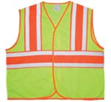

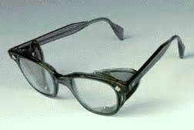

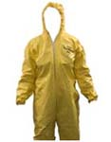
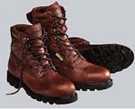

Types of PPE
Source of photos: OSHA
Notes:
“When exposure to hazards cannot be engineered completely out of normal operations or maintenance work, and when safe work practices and other forms of administrative controls cannot provide sufficient additional protection, a supplementary method of control is the use of protective clothing or equipment. This is collectively called personal protective equipment, or PPE. PPE may also be appropriate for controlling hazards while engineering and work practice controls are being installed” (OSHA 2001).
https://www.osha.gov/SLTC/etools/safetyhealth/comp3.html
The type of PPE needed by workers depends on the hazards to which they are exposed.

Slide 7

Head Protection
Frequent Causes of Head Injuries:
  Object striking head
  Head striking object
  Contact with exposed, energized electrical conductors
Source: OSHA
Notes:
https://www.osha.gov/Publications/osha3151.html
“Protecting employees from potential head injuries is a key element of any safety program. A head injury can impair an employee for life, or it can be fatal. Wearing a safety helmet or hard hat is one of the easiest ways to protect an employee's head from injury. Hard hats can protect employees from impact and penetration hazards as well as from electrical shock and burn hazards.
Employers must ensure that their employees wear head protection if any of the following apply:
Objects might fall from above and strike them on the head;
They might bump their heads against fixed objects, such as exposed pipes or beams; or
There is a possibility of accidental head contact with electrical hazards.”
(OSHA Publication 3151-12R, 2003)

Slide 8
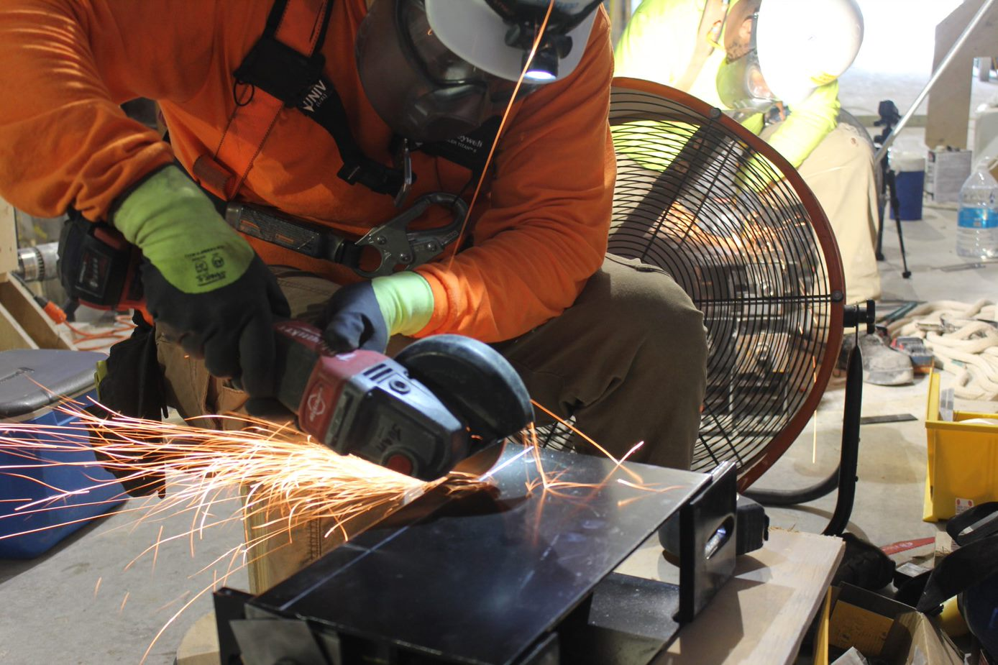
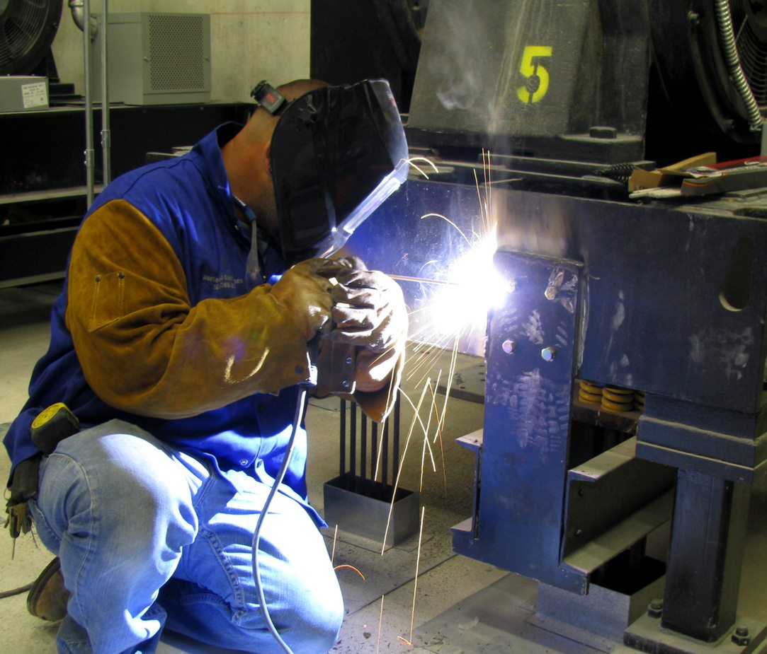
Eye and Face Protection
Common Causes of Eye Injuries
  Dust
  Flying particles
  Harmful chemicals
  Intense light
    Welding
    Lasers
Notes:
https://www.osha.gov/Publications/osha3151.html
“Employees can be exposed to a large number of hazards that pose danger to their eyes and face. OSHA requires employers to ensure that employees have appropriate eye or face protection if they are exposed to eye or face hazards from flying particles, molten metal, liquid chemicals, acids or caustic liquids, chemical gases or vapors, potentially infected material or potentially harmful light radiation.”
(OSHA Publication 3151-12R, 2003)
1926.102(a)(2)
Eye and face protection equipment required by this Part shall meet the requirements specified in American National Standards Institute, Z87.1-1968, Practice for Occupational and Educational Eye and Face Protection.

Slide 9
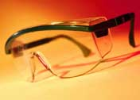
Safety Glasses
Protect against:
  Flying particles from wood, metal, cement, plastics, or other materials
  Airborne particulates such as ashes, dust, embers, sand blast, grit, paint,
  or other materials
Source: OSHA
Notes:
https://www.osha.gov/SLTC/etools/eyeandface/ppe/impact.html#spectacles
“Safety spectacles are intended to shield the wearer's eyes from impact hazards such as flying fragments, objects, large chips, and particles. Workers are required to use eye safety spectacles with side shields when there is a hazard from flying objects. Non-side shield spectacles are not acceptable eye protection for impact hazards.
The frames of safety spectacles are constructed of metal and/or plastic and can be fitted with either corrective or plano impact-resistant lenses. Side shields may be incorporated into the frames of safety spectacles when needed. Consider each component of safety spectacles when selecting the appropriate device for your workplace.”
(OSHA Eye and Face Protection eTool, 2002)

Slide 10
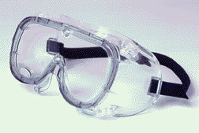
Goggles
Protect eyes, eye sockets and facial area around eyes from impact, dust, & splashes
Goggles or other eye protection
  May fit over corrective lenses
  May not interfere with the function of the glasses
Source: OSHA
Notes:
https://www.osha.gov/Publications/osha3151.html
Googles “are tight-fitting eye protection that completely cover the eyes, eye sockets and the facial area immediately surrounding the eyes and provide protection from impact, dust and splashes. Some goggles will fit over corrective lenses.”
(OSHA Publication 3151-12R, 2003)
https://www.osha.gov/SLTC/etools/eyeandface/ppe/impact.html#goggles
“Safety goggles are intended to shield the wearer's eyes from impact hazards such as flying fragments, objects, large chips, and particles. Goggles fit the face immediately surrounding the eyes and form a protective seal around the eyes. This prevents objects from entering under or around the goggles.
Safety goggles may incorporate prescription lenses mounted behind protective lenses for individuals requiring vision correction. Take time to consider specific lens, frame, and ventilation options when selecting safety goggles.”
(OSHA Eye and Face Protection eTool, 2002)

Slide 11
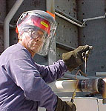
Face Shields
Protect face from nuisance
dusts and potential splashes
or sprays of hazardous liquids
Shields do not protect from
impact hazards unless so rated
Shields are for face protection, not eye protection. To protect the eyes, wear safety glasses with side shields under the face shield.
Source: OSHA
Notes:
https://www.osha.gov/SLTC/etools/eyeandface/ppe/impact.html#faceshields
“Face shields are intended to protect the entire face or portions of it from impact hazards such as flying fragments, objects, large chips, and particles. When worn alone, face shields do not protect employees from impact hazards. Use face shields in combination with safety spectacles or goggles, even in the absence of dust or potential splashes, for additional protection beyond that offered by spectacles or goggles alone.”
(OSHA Eye and Face Protection eTool, 2002)

Slide 12
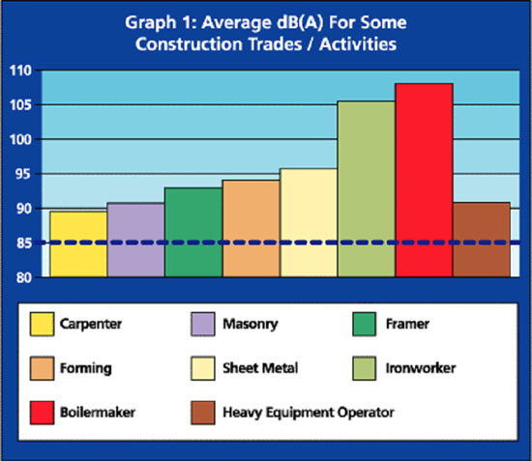
Hearing Protection
Exposure to over 85 dB can cause hearing loss
Hearing protection required at 88 dB
Effective Hearing Conservation Program
Source: Construction Safety Association of Ontario
Notes:
https://www.osha.gov/dts/osta/otm/noise/index.html
“Noise, or unwanted sound, is one of the most common health problems in American workplaces. The National Institute for Occupational Safety and Health (NIOSH) estimates that 30 million workers in the U.S. are exposed to hazardous noise. Exposure to high levels of noise may cause hearing loss, create physical and psychological stress, reduce productivity, interfere with communication, and contribute to accidents and injuries by making it difficult to hear warning signals.
The ACGIH recommends hearing protection at 88 dBA based on newer data
OSHA requires employers to determine if workers are exposed to excessive noise in the workplace. If so, the employers must implement feasible engineering or administrative controls to eliminate or reduce hazardous levels of noise. Where controls are not sufficient, employers must implement an effective hearing conservation program.”
(OSHA Noise and Hearing Conservation eTool, 2005)

Slide 13
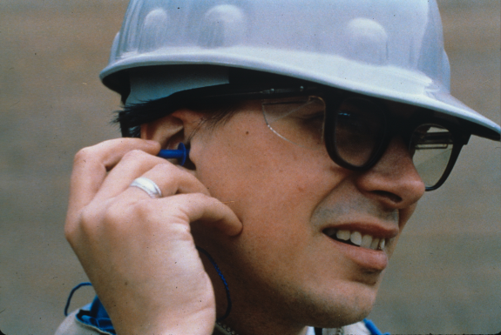
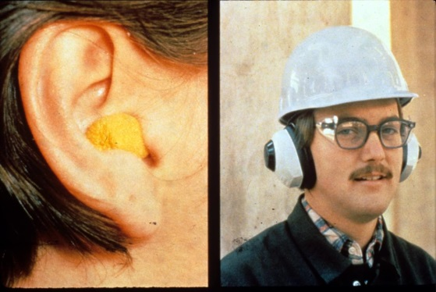
Hearing Protection
Examples
  Disposable foam plugs
  Molded ear plugs
  Noise cancelling ear plugs
  Ear muffs
Consider Noise Reduction Rating (NRR) of devices
NIOSH/John Rekus/elcosh.org
NIOSH/John Rekus/elcosh.org
Notes:
https://www.osha.gov/dts/osta/otm/noise/index.html
“Hearing protection devices (HPDs) are considered the last option to control exposures to noise. HPDs are generally used during the necessary time it takes to implement engineering or administrative controls, or when such controls are not feasible.”
(OSHA Noise and Hearing Conservation eTool, 2005)
This slide shows some examples of hearing protection devices.
https://www.osha.gov/dts/osta/otm/new_noise/appendixe.pdf
The Noise Reduction Rating of hearing protectors is required labeling on the hearing protector package; manufacturers must identify the noise reduction capability of the product through “laboratory-derived numerical estimate of the attenuation achieved by the protector” (OSHA n.d.).

Slide 14
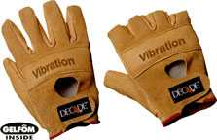
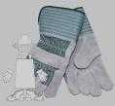

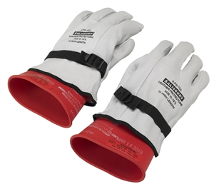
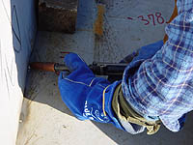
Types of Gloves
Anti-vibration
Leather Palm
Permeation Resistant
Heat Resistant
Cut Resistant
Electrical Insulated
Source of photos: OSHA
Notes:
https://www.osha.gov/Publications/osha3151.html
“There are many types of gloves available today to protect against a wide variety of hazards. The nature of the hazard and the operation involved will affect the selection of gloves. The variety of potential occupational hand injuries makes selecting the right pair of gloves challenging. It is essential that employees use gloves specifically designed for the hazards and tasks found in their workplace because gloves designed for one function may not protect against a different function even though they may appear to be an appropriate protective device.
The following are examples of some factors that may influence the selection of protective gloves for a workplace. Type of chemicals handled.
Nature of contact (total immersion, splash, etc.).
Duration of contact.
Area requiring protection (hand only, forearm, arm).
Grip requirements (dry, wet, oily).
Thermal protection.
Size and comfort.
Abrasion/resistance requirements.
Gloves made from a wide variety of materials are designed for many types of workplace hazards. In general, gloves fall into four groups:
Gloves made of leather, canvas or metal mesh;
Fabric and coated fabric gloves;
Chemical- and liquid-resistant gloves;
Insulating rubber gloves (See 29 CFR 1910.137 and the following section on electrical protective equipment for detailed requirements on the selection, use and care of insulating rubber gloves).”
(OSHA Publication 3151-12R, 2003)

Slide 15
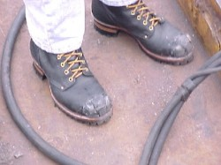
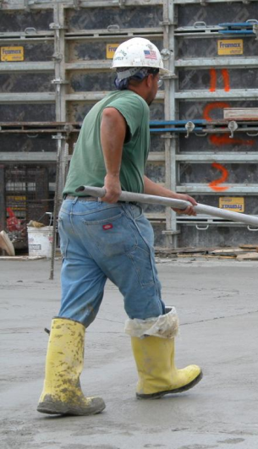
Foot and Leg Protection
Examples
  Impact-resistant toe and/or
  instep
    Steel
    Composite
  Heat-resistant soles
  Metal shanks
  Specialty footwear may be needed
    Metatarsal guards
    Liquid or chemical resistant
    Conductive or nonconductive
Source: OSHA
Steve Clark/Laborers/elcosh.org
Notes:
https://www.osha.gov/Publications/osha3151.html
“Safety shoes have impact-resistant toes and heat-resistant soles that protect the feet against hot work surfaces common in roofing, paving and hot metal industries. The metal insoles of some safety shoes protect against puncture wounds. Safety shoes may also be designed to be electrically conductive to prevent the buildup of static electricity in areas with the potential for explosive atmospheres or nonconductive to protect workers from workplace electrical hazards.”
“Metatarsal guards protect the instep area from impact and compression. Made of aluminum, steel, fiber or plastic, these guards may be strapped to the outside of shoes.”
“Electrically conductive shoes provide protection against the buildup of static electricity…. Employees exposed to electrical hazards must never wear conductive shoes.”
“Electrical hazard, safety-toe shoes are nonconductive and will prevent the wearers' feet from completing an electrical circuit to the ground. These shoes can protect against open circuits of up to 600 volts in dry conditions and should be used in conjunction with other insulating equipment and additional precautions to reduce the risk of a worker becoming a path for hazardous electrical energy. The insulating protection of electrical hazard, safety-toe shoes may be compromised if the shoes become wet, the soles are worn through, metal particles become embedded in the sole or heel, or workers touch conductive, grounded items. Note: Nonconductive footwear must not be used in explosive or hazardous locations.”
(OSHA Publication 3151-12R, 2003)

Slide 16
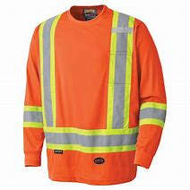
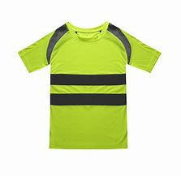
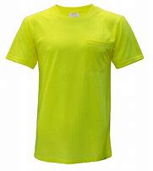
High Visibility Clothing
In addition to the OSHA requirements, some companies or general contractors may require high visibility clothing to be worn on the jobsite. Some examples of high vis clothing are:
Vests with reflective material
Long-sleeve shirt with reflective material
Short-sleeve shirt with reflective material
Short-sleeve shirt

Slide 17
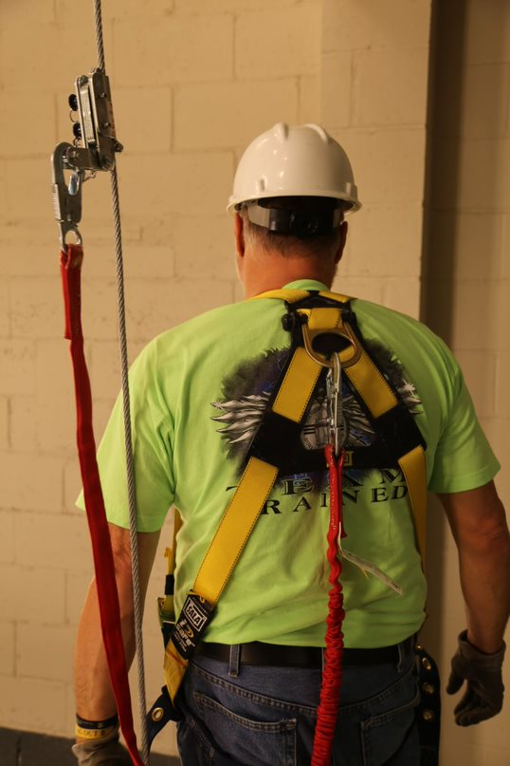
Fall Protection
Personal Fall Arrest Systems are designed to catch workers after they have fallen.
The components of a PFAS are:
Anchorage point
Lifeline/Rope grab
Connectors
Lanyard
Body Harness
Notes:
Personal fall arrest systems are for workers to wear if there is a danger of falling from elevation. They are designed to stop the fall with as little shock and recoil as possible, or to completely prevent a fall. OSHA requires employers to properly fit and train each worker who will use a PFAS.
A full-body harness has straps worn around your trunk and thighs, with the D-ring in back to attach the harness to other parts of the system. If you fall, a properly fitted harness spreads the stopping force over your thighs, pelvis, chest, and shoulders.
Follow manufacturers’ instructions for wearing harnesses and inspect your equipment before each use.
Unprotected sides and edges. Each employee on a walking/working surface (horizontal and vertical surface) with an unprotected side or edge which is 6 feet (1.8 m) or more above a lower level shall be protected from falling by the use of guardrail systems, safety net systems, or personal fall arrest systems. [1926.501(b)(1)]

Slide 18
Training
Why PPE is necessary
How PPE will protect the employee
What PPE can and cannot do
When and how to wear PPE
How to identify signs of wear and tear
How to clean and disinfect PPE
When PPE is worn out and how to properly dispose of PPE
Notes:
https://www.osha.gov/Publications/osha3151.html
“Employers are required to train each employee who must use PPE. Employees must be trained to know at least the following: When PPE is necessary.
What PPE is necessary.
How to properly put on, take off, adjust and wear the PPE.
The limitations of the PPE.
Proper care, maintenance, useful life and disposal of PPE.
Employers should make sure that each employee demonstrates an understanding of the PPE training as well as the ability to properly wear and use PPE before they are allowed to perform work requiring the use of the PPE. If an employer believes that a previously trained employee is not demonstrating the proper understanding and skill level in the use of PPE, that employee should receive retraining. Other situations that require additional or retraining of employees include the following circumstances: changes in the workplace or in the type of required PPE that make prior training obsolete.
The employer must document the training of each employee required to wear or use PPE by preparing a certification containing the name of each employee trained, the date of training and a clear identification of the subject of the certification.”
(OSHA Publication 3151-12R, 2003)

Slide 19
Responsibilities
Employers must:
  Assess hazards
  Select appropriate PPE and determine when to use
  Provide some PPE as mandated by OSHA at no cost to employee
  Make sure that employee-owned PPE is adequate, properly maintained and sanitary
  Train employees and enforce use of PPE
Notes:
https://www.osha.gov/Publications/osha3151.html
“To ensure the greatest possible protection for employees in the workplace, the cooperative efforts of both employers and employees will help in establishing and maintaining a safe and healthful work environment.
In general, employers are responsible for:
Performing a "hazard assessment" of the workplace to identify and control physical and health hazards.
Identifying and providing appropriate PPE for employees.
Training employees in the use and care of the PPE.
Maintaining PPE, including replacing worn or damaged PPE.
Periodically reviewing, updating and evaluating the effectiveness of the PPE program.”
(OSHA Publication 3151-12R, 2003)
https://www.osha.gov/dte/outreach/intro_osha/7_employee_ppe.pdf
“On May 15, 2008, a new OSHA rule about employer payment for PPE went into effect. With few exceptions, OSHA now requires employers to pay for personal protective equipment used to comply with OSHA standards. The final rule does not create new requirements regarding what PPE employers must provide.
The standard makes clear that employers cannot require workers to provide their own PPE and the worker’s use of PPE they already own must be completely voluntary. Even when a worker provides his or her own PPE, the employer must ensure that the equipment is adequate to protect the worker from hazards at the workplace.
Examples of PPE that Employers Must Pay for Include:
Metatarsal foot protection
Rubber boots with steel toes
Non-prescription eye protection
Prescription eyewear inserts/lenses for full face respirators
Goggles and face shields
Fire fighting PPE (helmet, gloves, boots, proximity suits, full gear)
Hard hats
Hearing protection
Welding PPE
Payment Exceptions under the OSHA Rule
Employers are not required to pay for some PPE in certain circumstances:
Non-specialty safety-toe protective footwear (including steel-toe shoes or boots) and nonspecialty prescription safety eyewear provided that the employer permits such items to be worn off the job site. (OSHA based this decision on the fact that this type of equipment is very personal, is often used outside the workplace, and that it is taken by workers from jobsite to jobsite and employer to employer.)
Everyday clothing, such as long-sleeve shirts, long pants, street shoes, and normal work boots.
Ordinary clothing, skin creams, or other items, used solely for protection from weather, such as winter coats, jackets, gloves, parkas, rubber boots, hats, raincoats, ordinary sunglasses, and sunscreen
Items such as hair nets and gloves worn by food workers for consumer safety.
Lifting belts because their value in protecting the back is questionable.
When the employee has lost or intentionally damaged the PPE and it must be replaced.”
(OSHA Handout #7 from Introduction to OSHA materials, Employers Must Provide and Pay for PPE)

Slide 20
Responsibilities
Employees must:
  Actively participate in training
  Consistently use PPE as prescribed
  Properly maintain, inspect, clean, and store PPE
  Immediately replace damaged PPE
Notes:
https://www.osha.gov/Publications/osha3151.html
“In general, employees should:
Properly wear PPE,
Attend training sessions on PPE,
Care for, clean and maintain PPE, and
Inform a supervisor of the need to repair or replace PPE.”
(OSHA Publication 3151-12R, 2003)

Slide 21
Always Remember
Employers must:
  Assess the workplace for hazards
  Use engineering and work practice controls to eliminate or reduce hazards
  Select and provide some PPE as mandated by OSHA at no cost to employees to protect them

Slide 22
Through the Alliance between OSHA’s 10 Regional Offices and the Elevator Contractors of America (ECA), Elevator Industry Work Preservation Fund (EIWPF), International Union of Elevator Constructors (IUEC), National Association of Elevator Contractors (NAEC), National Elevator Industry Educational Program (NEIEP), and National Elevator Industry Inc. (NEII), collectively known as The Elevator Industry Safety Partners, developed this Industry Specific Training for informational purposes only. It does not necessarily reflect the official views of OSHA or the U.S. Department of Labor. March 2025
Under the Occupational Safety and Health Act, employers are responsible (http://www.osha.gov/as/opa/worker/employer-responsibility.html) for providing a safe and healthy workplace and workers have rights (https://www.osha.gov/workers). OSHA can help answer questions or concerns from employers and workers. OSHA's On-Site Consultation Program (https://www.osha.gov/consultation) offers free and confidential advice to small and medium-sized businesses, with priority given to high-hazard worksites. For more information, contact your regional or area OSHA office (https://www.osha.gov/contactus/bystate), call 1-800-321-OSHA (6742), or visit https://www.osha.gov/.

