Slide 1

New Hire Training
Hazard Communication Program

Slide 2
Employer Responsibilities
Employer responsibilities under the Hazard Communication Standard (HCS):
Ensure labels are on incoming containers and not defaced
Maintain SDSs from shipments
Obtain SDSs if not received
Ensure SDSs are readily accessible
Ensure chemicals in workplace are properly labeled, tagged, or marked
Provide information and training to employees
Provide information/access for employees in multi-employer workplaces
Develop, implement, and maintain a written hazard communication program
Notes:
29 CFR 1910.1200
Employer responsibilities; employer shall:
Ensure that labels on incoming containers of hazardous chemicals are not removed or defaced
Maintain copies of SDS received with incoming shipments
Obtain SDS as soon as possible for chemicals received without an SDS if employee requests the SDS
Ensure that SDS are readily accessible during each work shift to employees when they are in their work area(s)
Ensure that each container of hazardous chemicals in the workplace is labeled, tagged, or marked properly
Ensure that employees are provided information and training to the extent necessary to protect them in the event of a spill or leak of a hazardous chemical from a sealed container
In multi-employer workplaces, ensure that employees of other employer(s) will have on-site access to SDSs for each hazardous chemical they may be exposed to while working, are informed of any precautionary measures needed to protect themselves under normal operating conditions or in foreseeable emergencies, and are informed of the labeling system used in the workplace
Develop, implement, and maintain a written hazard communication program

Slide 3
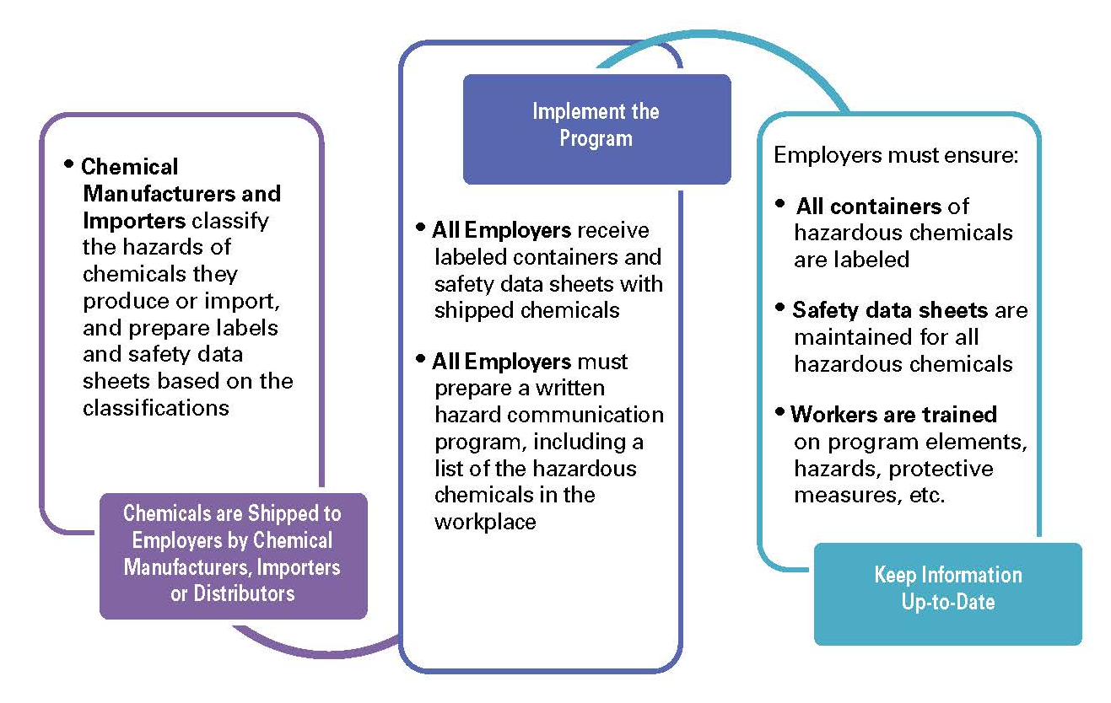
Employer Responsibilities
How hazard communication works:
Source: OSHA
Notes:
Source: Hazard Communication: Small Entity Compliance Guide for Employers That Use Hazardous Chemicals (2014), OSHA #3695-03, https://www.osha.gov/Publications/OSHA3695.pdf

Slide 4
Hazard Communication Program
Requirements for a written program:
Develop, implement, and maintain a written hazard communication program
Main intent is to ensure compliance with standard in a systematic way that coordinates all elements
Notes:
Source: Hazard Communication: Small Entity Compliance Guide for Employers That Use Hazardous Chemicals (2014), OSHA #3695-03, https://www.osha.gov/Publications/OSHA3695.pdf
“Paragraph (e), Written Hazard Communication Program, requires employers to prepare and implement a written hazard communication program. This does not need to be lengthy or complicated. The main intent of the requirement is to help ensure that compliance with the standard is done in a systematic way and that all elements are coordinated. Thus, the program must describe how the employer will address the requirements of paragraphs (f) Labels and Other Forms of Warning; (g) Safety Data Sheets; and (h) Employee Information and Training, in the workplace.”

Slide 5
Hazard Communication Program
Components of written program:
Lists of hazardous chemicals present at worksite
Availability of SDSs to employees and downstream employers
Labeling of chemical containers
Training programs regarding hazards of chemicals and protective measures
Emergency procedures in the event of a chemical spill or release

Slide 6
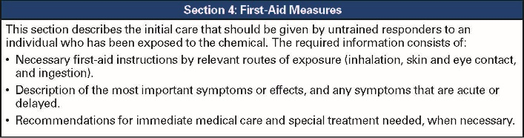
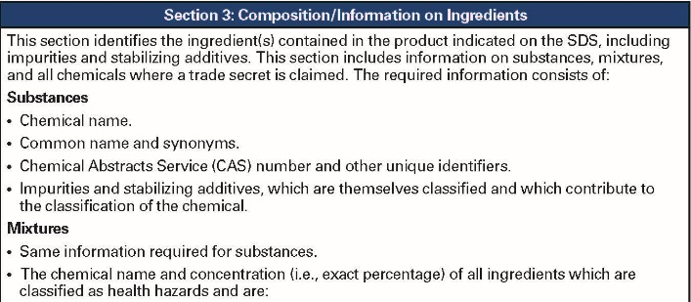
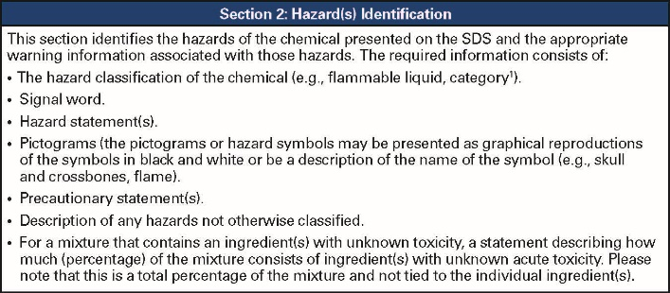
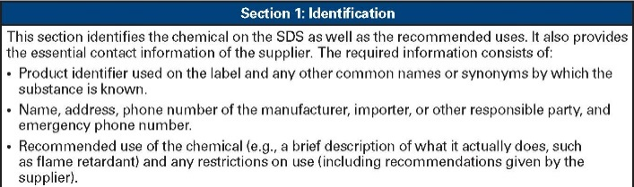
Hazard Communication Program
Safety data sheet (SDS):
Available and accessible to workers
Required for all hazardous chemical used
Do not use hazardous chemicals if there is no SDS available
16-section format
Source: OSHA
Notes:
Source: Hazard Communication Standard: Safety Data Sheets (2012), OSHA Brief DSG BR-3514, https://www.osha.gov/Publications/OSHA3514.html

Slide 7

Hazard Communication Program
SDS documentation:
Designate person(s) responsible for obtaining and maintaining SDSs
Describe how SDSs are
maintained and how
employees can access them
Procedures if SDS is not
received with first shipment
Must have SDS for each chemical; train workers on SDS format and use
Source: OSHA
Notes:
Source: Hazard Communication Standard: Safety Data Sheets (2012), OSHA Brief DSG BR-3514, https://www.osha.gov/Publications/OSHA3514.html
Written program should document:
Designated person(s) responsible for obtaining and maintaining SDSs
How SDSs are maintained in workplace (e.g., notebooks in the work area(s) or electronically); how workers obtain access to them when during the work shift
Procedures to follow when SDS is not received at time of the first shipment
SDS for each chemical in the workplace and training of workers that includes review of SDS format and use

Slide 8
Hazard Communication Program
Labeling:
All containers of hazardous materials must be labeled
Immediate warning
Snapshot of hazards and protective information
Notes:
Source: Hazard Communication Standard: Labels and Pictograms (2013), OSHA Brief DSG BR-3636, https://www.osha.gov/Publications/OSHA3636.pdf
“…Information about chemical hazards [is to] be conveyed on labels using quick visual notations to alert the user, providing immediate recognition of the hazards. Labels must also provide instructions on how to handle the chemical so that chemical users are informed about how to protect themselves.
The label provides information to the workers on the specific hazardous chemical. While labels provide important information for anyone who handles, uses, stores, and transports hazardous chemicals, they are limited by design in the amount of information they can provide. Safety Data Sheets (SDSs), which must accompany hazardous chemicals, are the more complete resource for details regarding hazardous chemicals.”

Slide 9
Hazard Communication Program
Documentation for labeling:
Designate person(s) responsible for labeling compliance
Describe alternatives to labeling of stationary process containers
Ensure all workplace containers are labeled appropriately
Labels included in training (shipping and workplace containers)
Procedures for reviewing/updating workplace label information
Notes:
Source: Hazard Communication: Small Entity Compliance Guide for Employers That Use Hazardous Chemicals (2014), OSHA #3695-03, https://www.osha.gov/Publications/OSHA3695.pdf
Written Hazard Communication Program should document:
Designated person(s) responsible for ensuring compliant labeling of shipped and in-plant containers
Description of written alternatives to labeling of stationary process containers (if used)
Appropriate labels on all workplace containers, including those received from a supplier, secondary containers, and stationary process containers
Description and explanation of labels on both shipped and workplace containers included in the employee training program
Procedures to review and update workplace label information when necessary

Slide 10
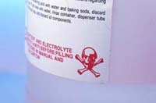
Hazard Communication Program
Requirements for workplace labels:
Employers can create own labeling system that works for their workplace/employees
Can choose same label required for shipped containers or alternative labels as long as they provide general information about hazards
Train employees to understand
Source: OSHA
Notes:
Employers may choose to label workplace containers either with the same label required for shipped containers of the chemical, or may instead use alternative labels, as long as those labels provide employees with general information about the hazards of the chemical, and the employer provides training so that employees exposed to the chemical understand the specific hazards it presents.

Slide 11
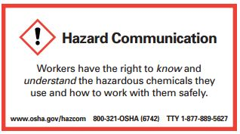
Hazard Communication Program
Training requirements:
Train employees on
hazardous chemicals
in their work area
  Before initial assignment
  When new hazards are introduced
  Non-routine tasks
Include in training
  Methods/observations to determine presence/release of chemical in work area
  Hazards of chemicals
  Appropriate protective measures
  Where and how to obtain additional information
Source: OSHA
Notes:
Source: Hazard Communication: Small Entity Compliance Guide for Employers That Use Hazardous Chemicals (2014), OSHA #3695-03, https://www.osha.gov/Publications/OSHA3695.pdf
“For information and training to be effective, the workers in the training must comprehend the hazards in the workplace and ways to protect themselves. OSHA does not expect that workers will be able to recall and recite all data provided about each hazardous chemical in the workplace. What is most important is that workers understand that they are exposed to hazardous chemicals, know how to read labels and SDSs, and have a general understanding of what information is provided in these documents, and how to access these tools. Workers must also be aware of the protective measures available in their workplace, how to use or implement these measures, and who they should contact if an issue arises.” (pg. 25)
Training… must address the following:
Methods and observations used to determine presence or release of chemical in work area, such as:
1. Monitoring – conducted by employer; continuous monitoring devices
2. Visual appearance or odor of hazardous chemical when being released
Hazards of chemicals in the work area, including:
1. Physical hazards
2. Health hazards
3. Simple asphyxiation
4. Combustible dust
5. Pyrophoric gas
6. Other hazards not otherwise classified
Measures employees can take to protect themselves from hazards, including
1. Specific procedures employer has implemented to protect employees from exposure to hazardous chemicals
2. Examples – Appropriate work practices, emergency procedures, PPE to be used
Details of hazard communication program developed by employer
1. Explanation of labels received on shipped containers and the workplace labeling system used by the employer
2. SDS, including format (where each type of information is located)
3. How employees can obtain and use the appropriate hazard information
(pg. 25-26)

Slide 12

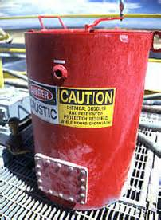


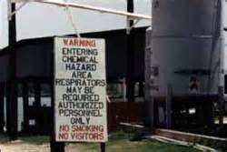
Hazard Communication Labels
Types of labels:
HCS shipping labels
HCS workplace labels
NFPA 704 labels
HMIS labels
DOT shipping labels, placarding, and markings
Source of graphics: OSHA
Notes:
There are several types of labels that might be found on hazardous chemicals in a workplace, including:
Hazard Communication Standard (HCS) shipping labels
Hazard Communication Standard (HCS) workplace labels
National Fire Protection Association 704 labels
Hazardous Materials Information Systems
Department of Transportation shipping labels, placarding, and marking

Slide 13
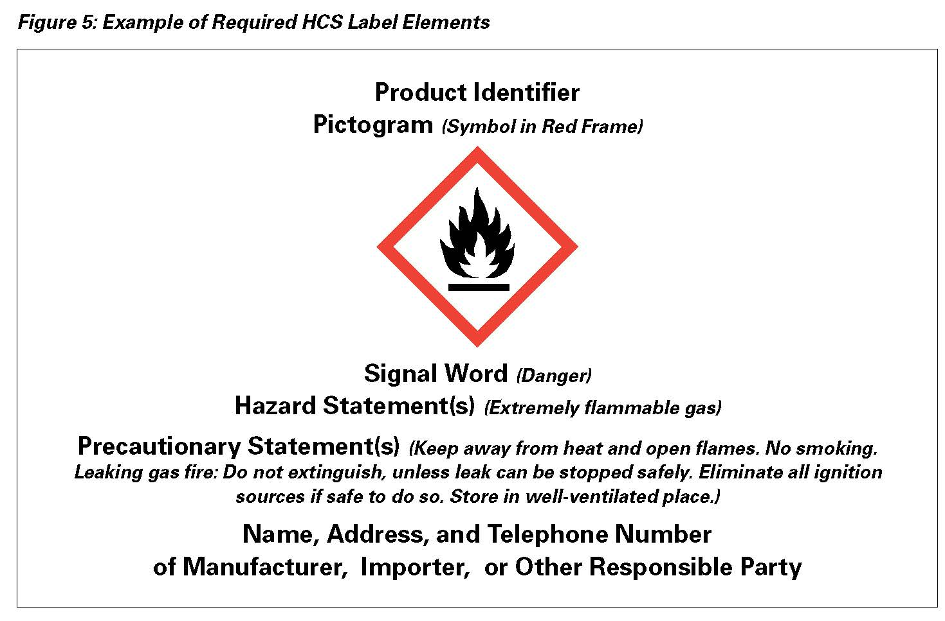
Hazard Communication Labels
How the hazardous chemical is identified
Contact information of responsible party
Source: OSHA
Notes:
(Note: click to move through animation on slide)
Source: Source: Hazard Communication: Small Entity Compliance Guide for Employers That Use Hazardous Chemicals (2014), OSHA #3695-03, https://www.osha.gov/Publications/OSHA3695.pdf
“Those who know the most about the chemicals – the companies that produce, import, or distribute them – have the responsibility to assess available information, and convey what is needed to downstream employers where the hazardous chemicals are used.” The name, address, and telephone number of the responsible party must be included on the label.
“The product identifier is any chemical, common, or trade name or designation that the chemical manufacturer or importer chooses to use on the label. The term must also appear on the SDS.” (pg. 14)

Slide 14
Hazard Communication Labels
Indicates the relative level of severity of hazard
“Danger” is used for more severe hazards and “Warning” for less severe hazards
Pictograms convey specific information about the hazards of a chemical in symbols and other graphic elements
Source: OSHA
Notes:
(Note: click to move through animation on slide)
Source: Source: Hazard Communication: Small Entity Compliance Guide for Employers That Use Hazardous Chemicals (2014), OSHA #3695-03, https://www.osha.gov/Publications/OSHA3695.pdf
“A signal word is a word used to indicate the relative level of severity of hazard and alert the reader to a potential hazard on the label. The signal words used in the standard are “danger” and “warning.” “Danger” is used for the more severe hazards, while “warning” is used for the less severe hazards.” (pg. 14) If there are multiple hazards, the word that indicates the highest severity level is used.
“A pictogram is a composition that may include a symbol plus other graphic elements, such as a border, background pattern, or color, that is intended to convey specific information about the hazards of a chemical. Eight pictograms are designated under this standard for application to a hazard category. Under HazCom 2012, pictograms are black symbols, on a white background, with a red diamond border. “ (pg. 15)

Slide 15
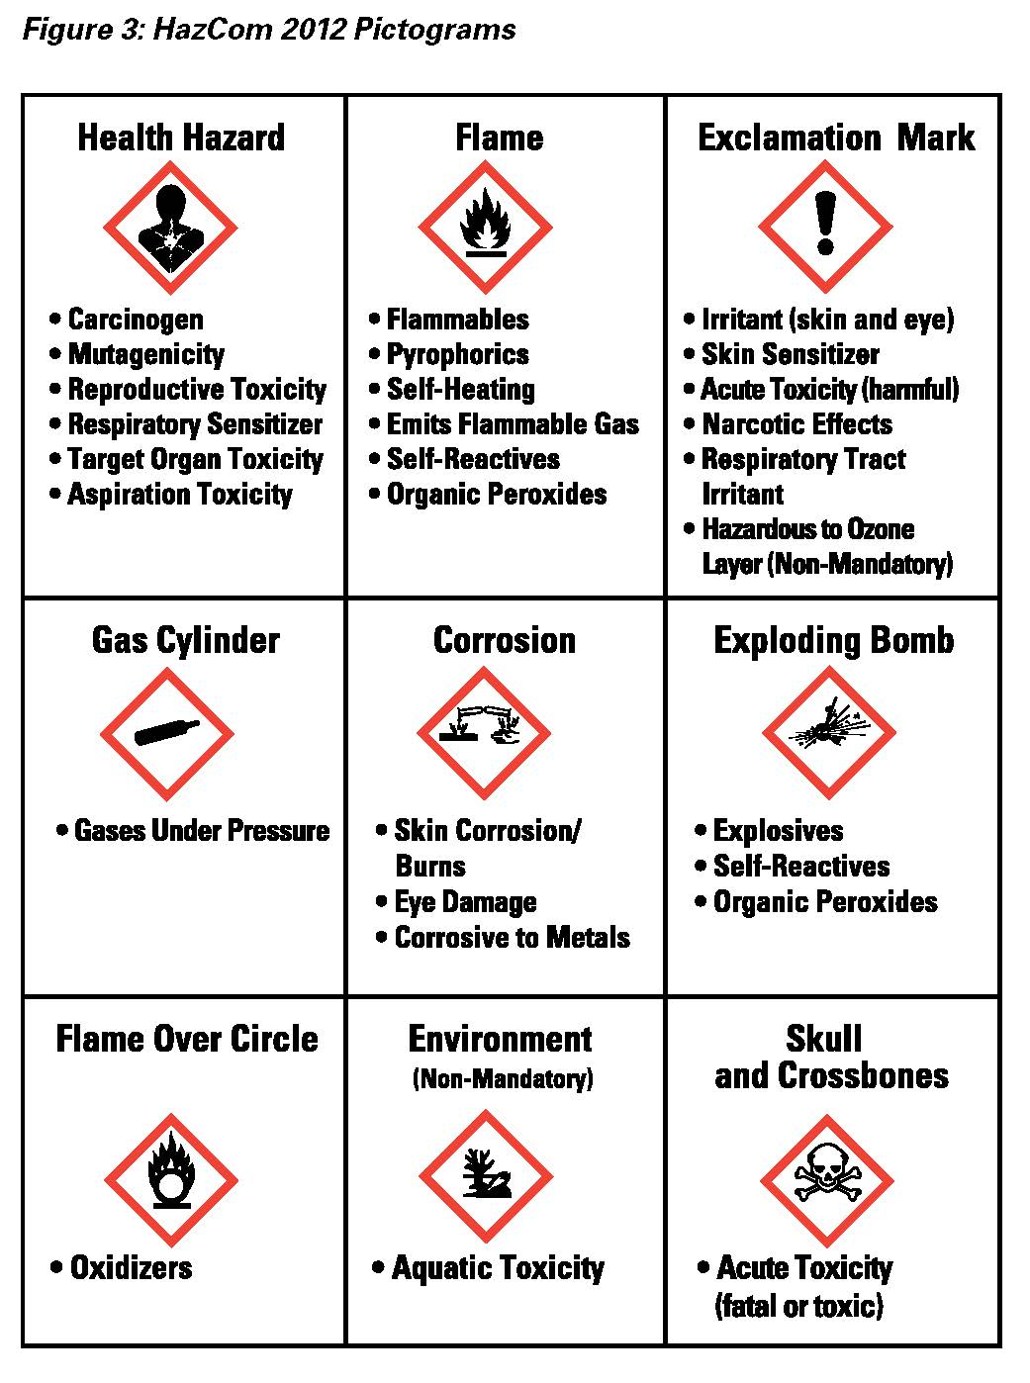



Hazard Communication Labels
Health Hazard
Flame
Exclamation Mark
Source: OSHA
Notes:
Source: Source: Hazard Communication: Small Entity Compliance Guide for Employers That Use Hazardous Chemicals (2014), OSHA #3695-03, https://www.osha.gov/Publications/OSHA3695.pdf
“Pictograms are an important addition to the hazard communication tools in the standard. A pictogram draws the attention of a label reader, and you and your workers should be aware that the appearance of a pictogram in a red diamond frame means that a hazard of concern is present in the product. Some of the pictograms in the standard have symbols that resemble the hazardous effect, and others are merely meant to attract attention. Pictograms may be used for several different hazardous effects as well.” (pg. 15)
Source: Source: Hazard Communication Standard Pictogram (2012), OSHA QuickCard 3491-02, https://www.osha.gov/Publications/HazComm_QuickCard_Pictogram.html
Pictograms include:
Health hazards – carcinogen, mutagenicity, reproductive toxicity, respiratory sensitizer, target organ toxicity, aspiration toxicity
Flame – flammables, pyrophorics, self-heating, emits flammable gas, self-reactives, organic peroxides
Exclamation mark – irritant (skin and eye), skin sensitizer, acute toxicity (harmful), narcotic effects, respiratory tract irritant, hazardous to ozone layer (non-mandatory)

Slide 16



Hazard Communication Labels
Gas Cylinder
Corrosion
Exploding Bomb
Source: OSHA
Notes:
Source: Source: Hazard Communication Standard Pictogram (2012), OSHA QuickCard 3491-02, https://www.osha.gov/Publications/HazComm_QuickCard_Pictogram.html
Pictograms include:
Gas cylinder – gases under pressure
Corrosion – skin corrosion/burns, eye damage, corrosive to metals
Exploding bomb – explosives, self-reactives, organic peroxides

Slide 17



Hazard Communication Labels
Skull and Crossbones
Environmental
(Non-Mandatory)
Flame Over Circle
Not regulated by OSHA
Source: OSHA
Notes:
Source: Source: Hazard Communication Standard Pictogram (2012), OSHA QuickCard 3491-02, https://www.osha.gov/Publications/HazComm_QuickCard_Pictogram.html
Pictograms include:
Flame over circle – oxidizers
Environmental (non-mandoatory) – aquatic toxicity
Skull and crossbones – acute toxicity (fatal or toxic)
Source: Source: Hazard Communication: Small Entity Compliance Guide for Employers That Use Hazardous Chemicals (2014), OSHA #3695-03, https://www.osha.gov/Publications/OSHA3695.pdf
“One of the systems that has long used pictograms is the international transport system. This system has been adopted by the U.S. Department of Transportation (DOT), and is familiar to those who handle shipping containers in the United States. The symbols have been harmonized as much as possible for the hazards covered both in transport and in the workplace. While both pictograms are diamond-shaped, the transport system’s pictograms have backgrounds of various colors. Where the shipping container is also the container used in the workplace, workers must be made aware of the DOT pictograms¹, as they may appear on the label in addition to, or instead of, the HazCom 2012 pictograms used to represent the same hazard…. Note that the environment pictogram located in the center of the bottom row… is not required under the OSHA standard since OSHA does not regulate environmental hazards. However, you may see this pictogram used on labels and SDSs to convey environmental hazards, and that will provide useful information for you to use in managing your chemicals.” (pg. 15)

Slide 18
Hazard Communication Labels
Statement assigned to hazard class and category that describes the nature of the hazard(s) of a chemical, including, where appropriate, the degree of hazard.
Describes recommended measures that should be taken to minimize or prevent adverse effects resulting from exposure to a hazardous chemical, or improper storage or handling.
Source: OSHA
Notes:
Source: Source: Hazard Communication: Small Entity Compliance Guide for Employers That Use Hazardous Chemicals (2014), OSHA #3695-03, https://www.osha.gov/Publications/OSHA3695.pdf
“A hazard statement is a statement assigned to a hazard class and category that describes the nature of the hazard(s) of a chemical, including, where appropriate, the degree of hazard. Example: Fatal if swallowed. The hazard statement(s) for a hazardous chemical describe the hazard(s) in text, in a simple, direct manner. There is a hazard statement for each hazard category of a hazard class, and it will vary depending on the degree of hazard. The example… [Fatal if swallowed] is a hazard statement for acute oral toxicity. The hazard statement conveys that the chemical is severely toxic, and ingestion of the chemical results in death. But for less toxic chemicals, the hazard statement may be “toxic if swallowed” or “harmful if swallowed.” As with the signal words, this information conveys the relative severity of the hazard, which impacts how it is handled and controlled.” (pgs. 14-15)
“A precautionary statement is a phrase that describes recommended measures that should be taken to minimize or prevent adverse effects resulting from exposure to a hazardous chemical, or improper storage or handling. Example: Do not eat, drink, or smoke when using this product.
Precautionary statements are key to helping you decide what you need to do to protect workers and your workplace. There are four types of statements: Prevention, Response, Storage, and Disposal. These have been assigned to hazard classes and categories.” (pg. 18)

Slide 19

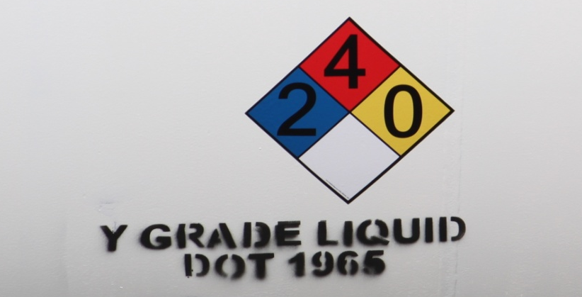
Hazard Communication Labels
Alternative workplace labels:
  Permitted for workplace labels
  Must provide at least general information regarding hazards of chemicals
  Hazard warnings or pictograms that conflict with HCS label elements cannot be used
  Examples: NFPA 704 and HMIS
Source: OSHA
Source: TEEX

Slide 20
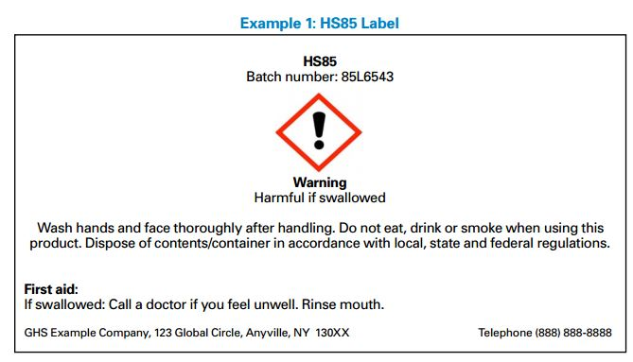
Locating Information
Source: OSHA
Notes:
Have students locate the following information on this sample label:
Signal word = Warning
Product identifier = HS85, Batch number: 85L6543
Hazard statement = Harmful if swallowed
Precautionary statements for prevention = Wash hands and face after handling. Do not eat, drink or smoke when using this product.
Precautionary statements for response = First aid: If swallowed call a doctor if you feel unwell. Rinse mouth.
Precautionary statements for disposal = Dispose of contents/container in accordance with local, state and federal regulations.

Slide 21
Locating Information
Source: OSHA
Notes:
Have students locate the following information on this sample label:
Pictograms =
Flame (used for flammables, pyrophorics, self-heating, emits flammable gas, self-reactives, and organic peroxide hazards)
Health hazard (used for carcinogen, mutagenicity, reproductive toxicity, respiratory sensitizer, target organ toxicity, and aspiration toxicity hazards)
Exclamation mark (used for irritants, skin sensitizer, acute toxicity, narcotic effects, respiratory tract irritant, and hazardous to ozone layer hazards)
Product identifier = NOMIXUP 7042012
Company = XYZ Chemical Company

Slide 22
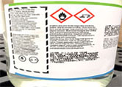
Locating Information
Source: OSHA
Notes:
Have students locate the following information on this sample label:
Pictograms =
Flame over circle (used for oxidizer hazards)
Corrosion (used for skin corrosion burns, eye damage, and corrosive to metals hazards)

Slide 23
Through the Alliance between OSHA’s 10 Regional Offices and the Elevator Contractors of America (ECA), Elevator Industry Work Preservation Fund (EIWPF), International Union of Elevator Constructors (IUEC), National Association of Elevator Contractors (NAEC), National Elevator Industry Educational Program (NEIEP), and National Elevator Industry Inc. (NEII), collectively known as The Elevator Industry Safety Partners, developed this Industry Specific Training for informational purposes only. It does not necessarily reflect the official views of OSHA or the U.S. Department of Labor. March 2025
Under the Occupational Safety and Health Act, employers are responsible (http://www.osha.gov/as/opa/worker/employer-responsibility.html) for providing a safe and healthy workplace and workers have rights (https://www.osha.gov/workers). OSHA can help answer questions or concerns from employers and workers. OSHA's On-Site Consultation Program (https://www.osha.gov/consultation) offers free and confidential advice to small and medium-sized businesses, with priority given to high-hazard worksites. For more information, contact your regional or area OSHA office (https://www.osha.gov/contactus/bystate), call 1-800-321-OSHA (6742), or visit https://www.osha.gov/.

