Slide 1

Assessing Workplace Hazards Through a JHA/JSA
EISP OSHA Alliance

Slide 2
Objectives
Identify the employer’s responsibility for a safe workplace
Identify the employee’s responsibility to work safely
Describe the process of a Job Hazard Assessment/Job Safety Analysis
Identify the employer’s responsibility to provide and train the workers on the PPE needed as a result of a JHA/JSA

Slide 3
Overview
A Job Hazard Analysis/Job Safety Analysis (JHA/JSA) can be used to identify hazards and associated risks by following a step-by-step analysis of the job at hand.
The job is broken down into the individual tasks. From there, each task is explored for potential hazards and how they will surface.
Once the hazards have been identified, the JHA/JSA exercise will identify control measures to mitigate or eliminate the hazards.
The following slides will detail the step-by-step analysis you should follow.

Slide 4
What is a Hazard?
A hazard is the potential for harm. In practical terms, a hazard often is associated with a condition or activity that, if left uncontrolled, can result in an injury or illness.

Slide 5
What is a Job Hazard Analysis
A job hazard analysis/Job Safety Analysis is a technique that focuses on job tasks as a way to identify hazards before they occur. It focuses on the relationship between the worker, the task, the tools, and the work environment.

Slide 6
Why is job hazard analysis/Job Safety Analysis important?
Many workers are injured and killed at the workplace every day in the United States. Job Hazard analyses/Job Safety Analysis can help reduce those injuries and fatalities
One of the best ways to determine and establish proper work procedures is to conduct a job hazard analysis/Job Safety Analysis.

Slide 7
What is the value of a JHA/JSA?
Individuals can use the findings of a JHA/JSA to eliminate and prevent hazards in their workplaces. This is likely to result in fewer worker injuries and illnesses; safer, more effective work methods; reduced workers’ compensation costs; and increased worker productivity.

Slide 8
What jobs are appropriate for a JHA/JSA?
A JHA/JSA can be conducted on many jobs in your workplace. Priority should go to the following types of jobs
Jobs with the highest injury or illness rates
Jobs with the potential to cause severe or disabling injuries or illness, even if there is no history of previous accidents
Jobs in which one simple human error could lead to a severe accident or injury
Jobs that are new to your operation or have undergone changes in processes and procedures
Jobs complex enough to require written instructions

Slide 9
Where do I begin?
Involve the employees
Review the accident history
Conduct a preliminary job review
List, rank, and set priorities for hazardous jobs
Outline the steps or tasks

Slide 10
Involve everyone
It is essential to involve as many people as possible in the hazard analysis process. Individuals can have a unique understanding of the job, and this knowledge is invaluable for finding hazards.

Slide 11
Review your accident history
Review the history of accidents and occupational illnesses that needed treatment, losses that required repair or replacement, and any “near misses” —events in which an accident or loss did not occur but could have.
These events are indicators that the existing hazard controls may not be adequate and deserve a deeper investigation.

Slide 12
Conduct a preliminary job review
Discuss with each other the known hazards that exist in their current work and surroundings. Brainstorm with them for ideas to eliminate or control those hazards.
If any hazards exist that pose an immediate danger to an employee’s life or health take immediate action to protect the worker. Any problems that can be corrected easily should be corrected as soon as possible. Do not wait to complete your JHA/JSA.

Slide 13
List, rank, and set priorities for hazardous jobs
List jobs with hazards that present unacceptable risks, based on those most likely to occur and with the most severe consequences. These jobs should be your first priority for analysis.

Slide 14
Outline the steps or tasks
Nearly every job can be broken down into job tasks or steps. When beginning a JHA/JSA, list each step. Be sure to record enough information to describe each job action without getting overly detailed. Avoid making the breakdown of steps so detailed that it becomes unnecessarily long or so broad that it does not include basic steps.
Sometimes, in conducting a JHA/JSA, it may be helpful to photograph or videotape performing the job. These visual records can be handy references when doing a more detailed analysis of the work.

Slide 15

How do I identify workplace hazards?
What can go wrong?
What are the consequences?
How could it arise?
What are other contributing factors?
How likely is it that the hazard will occur?
Where it is happening (environment)
Who or what it is happening to (exposure)
What precipitates the hazard (trigger)
The outcome that would occur should it happen (consequence)
Any other contributing factors.

Slide 16








Hierarchy of Controls
The hierarchy of controls provides a systematic methodology to control the risk of different hazards. The list goes from most effective to least effective and more than one method may be implemented to control the hazard.
Elements
13
Intro
Most Effective Elimination
Substitution
BCTD – AFL Smart Mark Module
Engineering Controls
Administrative Controls
Least Effective
Personal Protective Equip.
Notes:
Instructors should discuss that at this point students should understand the process of doing a JHA/JSA. Now it is time to address the hazards using the hierarchy of controls.

Slide 17

Group Exercise
You are performing maintenance on a 350 FPM gearless traction machine with six 5/8” ropes.
You need to lubricate the hoist ropes and an automatic lubricator is not installed.

Slide 18
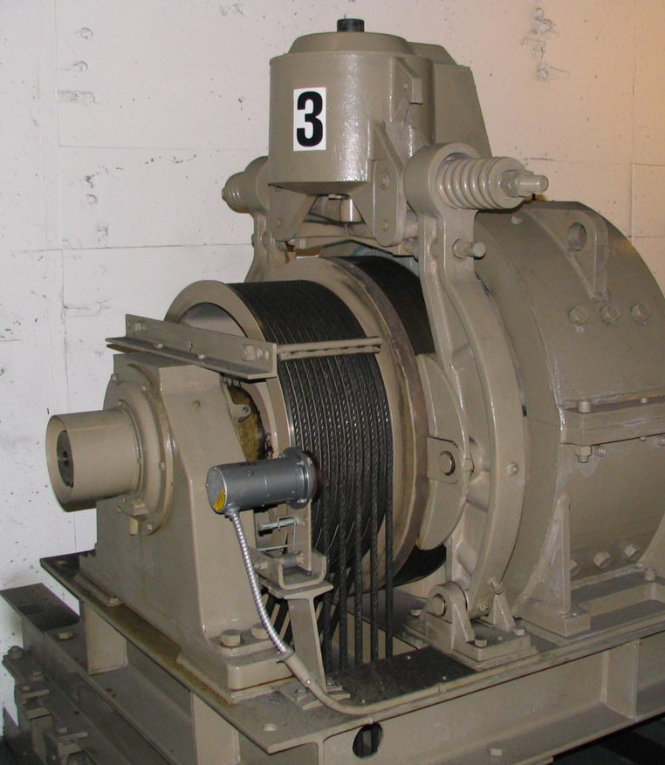
Group Exercise
Break into groups and discuss this scenario. Make a written JHA/JSA for the task being performed.
What can go wrong?
What are the consequences?
How could it arise?
What are other contributing factors?
How likely is it that the hazard will occur?
Where it is happening (environment)
Who or what it is happening to (exposure)
What precipitates the hazard (trigger)
The outcome that would occur should it happen (consequence)
Any other contributing factors.
Notes:
Instructor should hand out a sample JHA form to each participant.

Slide 19
Job Hazard Analysis/Job Safety Analysis
Job or task
Date | Location | Performed by
Special or preliminary hazards
Basic job steps | Existing/potential hazards |  | Corrective measures
Notes:
This is a sample JHA.

Slide 20
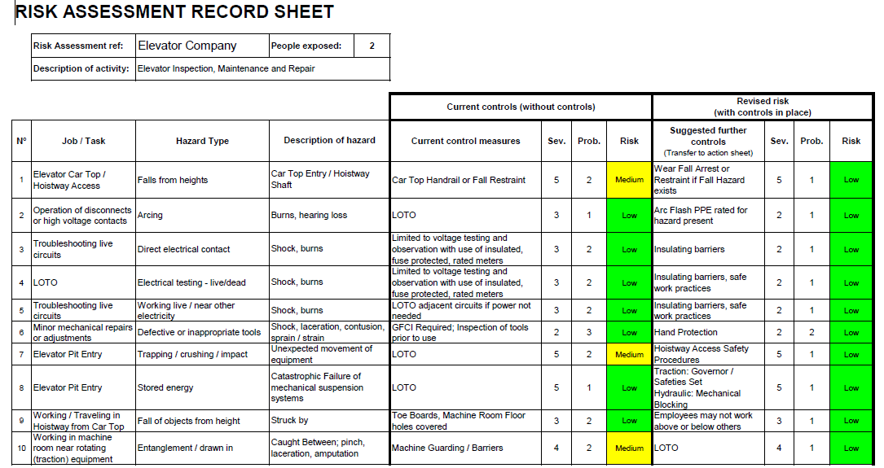
Example
Some employers have risk assessment charts available that can assist with the JHA/JSA process.

Slide 21
What else do I need to know before starting a JHA/JSA?
When conducting your own job safety analysis, be sure to consult the Occupational Safety and Health Administration standards. Compliance with these standards is mandatory, and by incorporating their requirements in your JHA/JSA, you can be sure that your health and safety program meets federal standards.
Twenty-four states and two territories operate their own OSHA-approved safety and health programs and may have standards that differ slightly from federal requirements. Employers in those states should check with the appropriate state agency for more information.

Slide 22
Why should I review my JHA/JSA?
In the elevator industry, most JHA/JSA’s are done just before preforming a job. When a task is repeated often, there can be occasions where a JHA/JSA is completed and posted at the job.
Periodically reviewing your JHA/JSA’s ensures that they remain current and continue to help reduce workplace accidents and injuries. Even if the job has not changed, it is possible that during the review process you will identify hazards that were not identified in the initial analysis.

Slide 23
When is it appropriate to hire a professional to conduct a JHA/JSA?
If employees are involved in many different or complex processes, your company may need professional help conducting a JHA/JSA. Sources of help include the insurance company, the local fire department, and private consultants with safety and health expertise.

Slide 24
Summary
OSHA requires each employer to assess the workplace to determine if hazards are present, or likely to be present, which necessitate the use of Personal Protective Equipment (PPE). Currently, this regulation does not apply to construction.
A Job Hazard Analysis/Job Safety Analysis (JHA/JSA) can be used to identify hazards and associated risks by following a step-by-step analysis of the job by breaking it down into the individual tasks. From there, each task is explored for potential hazards and how they will surface.
Once the hazards have been identified, control measures are implemented to mitigate or eliminate the hazards.

Slide 25
Knowledge Check
How could it arise?
How could it happen?
What can go wrong?
What are the consequences?
Answer: C
What is the first question you must ask yourself when completing your JHS/JSA

Slide 26
Knowledge Check
tasks in which one simple human error could lead to a severe accident or injury
tasks complex enough to require written instructions
tasks that are new to your operation or have undergone changes in processes and procedures
All of the above
Answer: D
What tasks are appropriate for a JHA/JSA?

Slide 27
Through the Alliance between OSHA’s 10 Regional Offices and the Elevator Contractors of America (ECA), Elevator Industry Work Preservation Fund (EIWPF), International Union of Elevator Constructors (IUEC), National Association of Elevator Contractors (NAEC), National Elevator Industry Educational Program (NEIEP), and National Elevator Industry Inc. (NEII), collectively known as The Elevator Industry Safety Partners, developed this Industry Specific Training for informational purposes only. It does not necessarily reflect the official views of OSHA or the U.S. Department of Labor. March 2025
Under the Occupational Safety and Health Act, employers are responsible (http://www.osha.gov/as/opa/worker/employer-responsibility.html) for providing a safe and healthy workplace and workers have rights (https://www.osha.gov/workers). OSHA can help answer questions or concerns from employers and workers. OSHA's On-Site Consultation Program (https://www.osha.gov/consultation) offers free and confidential advice to small and medium-sized businesses, with priority given to high-hazard worksites. For more information, contact your regional or area OSHA office (https://www.osha.gov/contactus/bystate), call 1-800-321-OSHA (6742), or visit https://www.osha.gov/.

Slide 28


