Slide 1

New Hire Training
Health Hazards

Slide 2
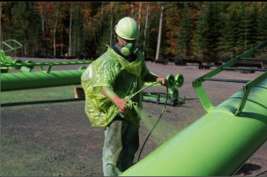
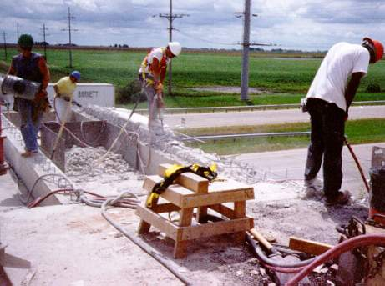
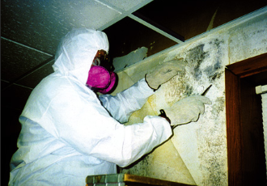

Common Health Hazards
Chemical
Physical
Source: OSHA
Source: OSHA
Biological
Ergonomic
Source: OSHA
Source: Arlosvaldo Gonzáfoles (Flickr.com)
Notes:
Types of health hazards include chemical, physical, biological, and ergonomic hazards. These hazards are broken down in subsequent slides.

Slide 3

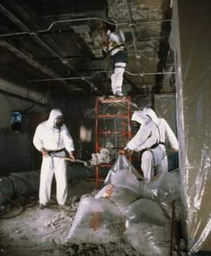

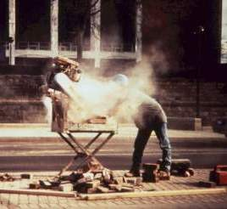

Common Ways Workers Encounter Chemical Hazards
Solids
Liquids
Gases and vapors
Aerosols
  Dust, mist, fumes
Welding Fumes
Asbestos
Source: U.S. Navy
Source: OSHA
Spraying Chemicals
Silica
Lead
Source: OSHA
Source: OSHA
Source: OSHA
Notes:
1.) Welding Fumes: Common metals include aluminum, antimony, arsenic, beryllium, cadmium, chromium, cobalt, copper, iron, lead, manganese, molybdenum, nickel, silver, tin, titanium, vanadium, and zinc.
2.) Asbestos: Removal/Repair/Demolition projects. Used in insulation for pipes, tiles, and various other building materials.
3.) Toxic Environments: "spray-finishing operation" as the "employment of methods wherein organic or inorganic materials are utilized in dispersed form for deposit on surfaces to be coated, treated, or cleaned." This may include such diverse activities as the application of flammable and combustible liquids, such as paint, in a spray booth or spray area, electrostatic coating operations, and automobile body lining operations.
4.) Crystalline Silica: Brick/mortar, concrete, slate, granite, sandstone, stone aggregate, tile, and sand
5.) Lead: Demolition/salvage/removal/encapsulation/clean-up/renovation activities. Also used in some paints, solder, electrical fittings/conduits, tank linings, plumbing fixtures, and many metal alloys.

Slide 4

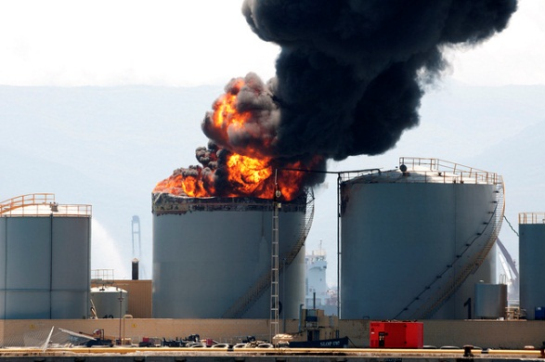
Effects of Chemical Exposure
May put workers at risk of developing health problems:
Health Problems
Heart Ailments | Lung Damage | Sterility
CNS Damage | Kidney Damage | Burns
Cancer | Liver Damage | Rashes
May pose risk of fire and explosion hazards:
Fire
Explosion
Source: Virginie Moerenhout (Flickr.com)
Source: Jonathan Perera (Flickr.com)
Notes:
[Taken from construction outreach lesson plan – Health Effects Section C]
1. May pose risk of fire and explosion hazards (physical hazards).
2. May put workers at risk of developing health problems such as heart ailments, central nervous system damage, kidney damage, lung damage, sterility, cancer, burns, or rashes (health hazards)

Slide 5

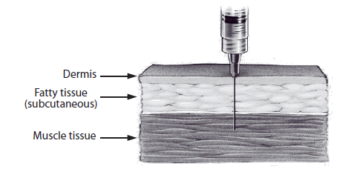
Routes of Entry
Inhalation: | Breathed in (most common route)
Source: OSHA
Ingestion: | Swallowing via eating or drinking
Source: OSHA
Absorption: | Drawn through skin or eye surface
Source: OSHA
Injection: | Punctures through skin
Source: CDC
Notes:
Inhalation is the primary route of entry for hazardous chemicals in the work environment. Nearly all materials that are airborne can be inhaled.
Ingestion - toxic materials can be swallowed and enter the body through the gastrointestinal tract. In the workplace, people can unknowingly ingest harmful chemicals when you eat, drink, or smoke in a contaminated work areas.
Absorption through the skin is another route of entry. The skin is the largest organ of your body and a common exposure site for liquid and airborne chemicals. Absorption through the skin can occur quite rapidly if the skin is cut or abraded. Intact skin is an effective barrier to many hazardous materials.
Injection occurs when a sharp object punctures the skin, allowing a chemical or infectious agent to enter your body. For example, injection can occur when a contaminated object such as a rusty nail punctures the skin. High-pressure hydraulic oil is a common construction injection hazard. (OSHA)

Slide 6
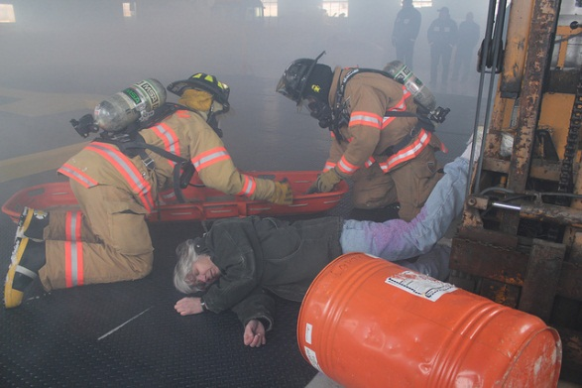
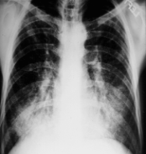
Health Effects
Exposure Condition |  | Exposure | Example
ACUTE | Immediate | Short-term, high concentration | H₂S exposure within a confined space
CHRONIC | Delayed; generally for years | Continuous; for long periods of time | Asbestosis
Acute
Chronic
Source: U.S. Army Corps of Engineers
Source: OSHA
Notes:
Acute Effect - Having an immediate response due to a short period of exposure to a relatively high concentration.
Chronic Effect - The heath effect exhibited by the body after long term exposure to relative low concentrations of a chemical. (OSHA)
Some chemical hazards can be acute or chronic – such as Carbon Monoxide
Acute Symptoms: headache, nausea, weakness, angina, dyspnea, loss of consciousness, seizures, and coma
Chronic Symptoms: lethargy, listlessness, lack of motivation, sleepiness → chronic fatigue syndrome, clinical depression, or an endocrine disorder
Sources:
[CO Acute] http://www.merckmanuals.com/professional/injuries-poisoning/poisoning/carbon-monoxide-poisoning
[CO Chronic] http://www.coheadquarters.com/table.cochronic1.htm

Slide 7
Chemical Hazard Protection
Eliminate
Substitution
Engineering
Administrative
PPE
Notes:
Newer hierarchy of hazard control. PPE is still listed as a last line of defense. (Broken down in next slide)
1.) Eliminate the hazard (if possible)
2.) Substitute hazard with safer alternative (if possible)
3.) Engineering controls: ventilation/wetting/guarding/etc.
4.) Administrative: Giving breaks/cycling work to minimize exposures/training
5.) PPE: Respirators/hearing protections/face shields/gloves/boots/etc.

Slide 8
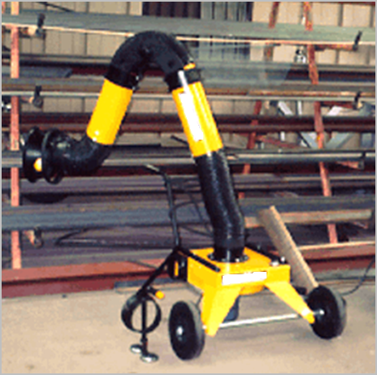
Chemical Hazard Protection
Engineering
  Ventilation (local/general)
  Process and equipment modification
  Isolation/automation
Administrative
  Monitor/measure exposure levels
  Inspections and maintenance
  Develop SOPs
PPE
  Respirators
  Gloves
  Safety glasses
  Protective clothing
Local Exhaust Ventilation
Source: OSHA
Notes:
1.) Eliminate the hazard (if possible)
2.) Substitute hazard with safer alternative (if possible)
3.) Engineering controls: ventilation/wetting/guarding/etc.
4.) Administrative: Giving breaks/cycling work to minimize exposures/training
5.) PPE: Respirators/hearing protections/face shields/gloves/boots/etc.

Slide 9

Respirable Crystalline Silica
29 CFR 1926.1153
Crystalline silica is a mineral. The most common form is quartz.

Slide 10



Crystalline Silica Is Found In Many Construction Materials
This includes natural materials such as sand, rock, and stone.
It also includes man-made materials such as concrete, brick, block, mortar, tile, and artificial stone.
Department of Labor/Shawn T Moore
Photo courtesy of DeWALT Industrial Tool Co.
John F. Rekus, PE, MS, CIH, FAIHA/elcosh.org
Notes:
Crystalline silica is found in many materials used in construction.
This includes natural materials such as sand, rock, and stone.
It also includes man-made materials such as concrete, brick, block, mortar, tile, and artificial stone.

Slide 11
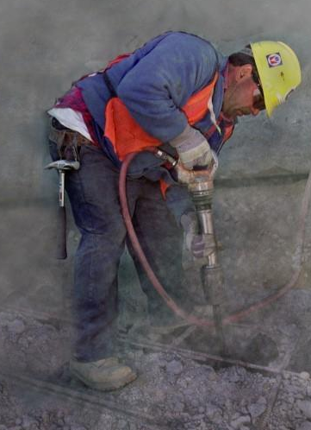
Respirable Crystalline Silica
Dust containing crystalline silica is generated when, for example, power tools are used to chip, cut, saw, drill, grind, sand, or crush crystalline silica-containing materials; it is also produced when sand is used in abrasive blasting.
Used with permission (©) www.earldotter.com

Slide 12

Respirable Crystalline Silica
Employers must train employees on tasks in their workplace that may expose them to respirable crystalline silica.
Notes:
Note to employers: Employers must train employees on the specific tasks that could expose employees to silica in their workplace (for example, cutting bricks with a handheld power saw, cutting concrete blocks with a stationary masonry saw, grinding mortar). This slide can be modified to include those specific tasks.

Slide 13
Respirable Crystalline Silica
Specific Protections in This Workplace
Employers must train employees on workplace-specific:
Engineering controls
Work practice controls
Respiratory protection
Notes:
Note 1 to employers: Employers must inform employees of the specific engineering controls, work practice controls, and respiratory protection used in their workplace. If exposures are controlled by substituting a different material for a silica-containing material, employees must be trained on that as well. The controls used in the workplace can be included as part of this slide if it is convenient for employers.
Note 2 to employers: Employees must be trained on the proper work practices associated with the tasks they perform. For example, an employee who operates a hand-held saw must know how to fully and properly implement and maintain the dust controls on the saw.
Note to trainers other than employers: The slide can be modified to let employees know that their employers must train them about the specific engineering controls, work practices, and respiratory protection used in their workplace. They should also know that the employer should show them how to fully and properly implement controls for any tools they operate.

Slide 14


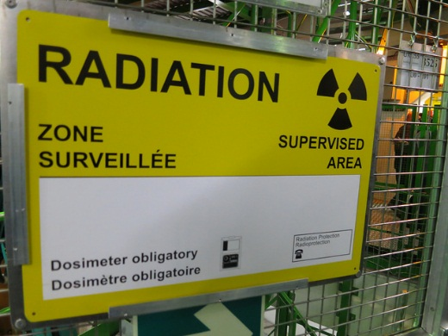

Physical Hazards in Construction
Noise and Vibration
Noise
Temperature extremes
Vibration
Radiation
Source: Nick Allen (Flickr.com)
Temperature
Radiation
Noise
Source: OSHA
Source: Alper Çuğun (Flickr.com)
Notes:
Explained in subsequent slides

Slide 15
Effects of Exposure to Physical Hazards
Temperature | Radiation | Vibration | Noise
Rash; cramps | Burns | Fatigue | Interferences
Exhaustion | Sickness | Strains | Stress
Stroke | Aging | Carpal tunnel | Tinnitus
Hypothermia | Cancer | HAVS | Headaches
Frostbite | DNA mutations | Raynaud’s | Hearing loss
Notes:
1.) Temperature extremes: Exposure occurs both indoor and outdoor. Temperatures affected by humidity, wind speed, radiant heat, physical contact with hot or cold surfaces, and strenuous physical activities.
2.) Radiation: ELF produced by power lines and electrical wiring/equipment, RF and microwave radiation (cell phones and radio emitters), IR (IR lasers, furnaces, and heat lamps), UV (welding arcs, UV lasers, and sun) --- UV is the most common in construction!
3.) Vibrating/Impact: Hand-held and stationary tools that transmit vibration through work piece (i.e. chainsaws, mowers, drillers, air hammers, pile drivers, tractors, graders, excavators, earth-moving equipment, and other large machinery)
4.) Noise: Short and long-term exposure to loud noises (more on next slide)

Slide 16
Protection Against Physical Hazards
Hazard | Engineering Controls | Administrative Controls | PPE
Temperature | Heaters; AC; windshields; ventilation | Acclimatize; Require additional fluid intake; rest; shade | Hoods; cooling vests; hard hat liners
Vibration | Vibration reduction equipment | Train not to grip too tightly; Job rotation | Anti-vibration gloves
Noise | Silencers; mufflers; enclosures; sound barriers | Increase distance between source and worker | Ear plugs; muffs
Eliminate or substitute hazard, whenever feasible
Notes:
[ https://www.osha.gov/SLTC/heatillness/index.html ]
1.) Eliminate the hazard (if possible)
2.) Substitute hazard with safer alternative (if possible)
3.) Engineering controls: ventilation/wetting/guarding/etc.
4.) Administrative: Giving breaks/cycling work to minimize exposures/training
5.) PPE: Respirators/hearing protections/face shields/gloves/boots/etc.

Slide 17



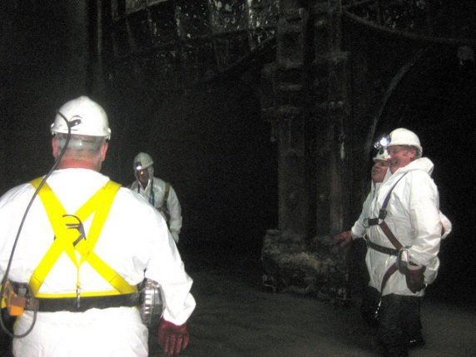

Biological Hazards in Construction
Insects
Animals
Mold
Source: James Jordan (Flickr.com)
Source: Jean-Jacques Boujot (Flickr.com)
Source: OSHA
Plants
Water/Sewage
Blood
Source: OSHA
Source: Matt Brown (Flickr.com)
Source: Monsleur Gordon (Flickr.com)
Notes:
Types of biological hazards
1. Contact with contaminated or disease-carrying soil, water, feces, animals (including insects, rodents, etc.), or plants
2. Contact with human blood or bodily fluids on a construction site, which may contain bloodborne pathogens such as HIV, Hepatitis B, Hepatitis C
3. Contact with biting or puncturing organisms
4. Exposure can occur during demolition, renovation, sewer work, or other activities that put workers in contact with biohazards
5. Pathogens causes diseases and illnesses, including, but not limited to:
a. Tetanus
b. H1N1 or Swine flu
c. Avian flu
d. West Nile virus
e. Lime disease
f. Bloodborne pathogens – HIV, Hepatitis B, Hepatitis C
6. Exposure to poisonous or harmful plants
a. Poison ivy, poison oak, poison sumac
b. Thorn-bearing plants
7. Exposure to animals
a. Mosquitoes and other biting insects, ticks, spiders, scorpions
b. Snakes
c. Stray or wild animals (OSHA)

Slide 18

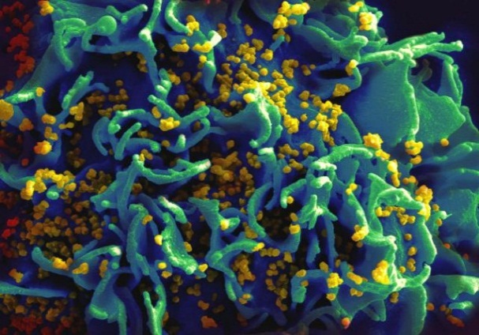
Effects of Exposure to Biological Hazards
Hepatitis C
Mild
  Allergic reaction
Serious
  Tetanus
  Swine flu
  SARS
  Avian flu
  West Nile
  Lyme disease
Chronic/Terminal
  HIV
  Hepatitis B & C
Source: OSHA
HIV-infected H9 T cell
Source: NIAID
Notes:
1. Relatively mild, allergic reactions
2. Serious medical conditions, even death
3. Most virulent and prevalent biological agents – anthrax, avian flu, bloodborne pathogens, botulism, floodborne disease, hantavirus, Legionnaires disease, mold, plague, ricin, SARS, smallpox, tularemia, viral hemorrhagic fevers

Slide 19

Protection Against Biological Hazards
Practice precaution with:
  Blood
  Bodily fluids
  Animals
  Insects
Personal hygiene
Proper first aid
  Cuts/Scratches
Proper PPE
Vaccinations – schedule
Source: U.S. Army Corps of Engineers
Notes:
In order to limit your exposure to airborne mold, wear at a minimum an N-95 respirator; for higher level of protection use a 99 or 100 (H EPA) rated filter. If oil is present in the air then make sure to use either an R or a P designated filter
The NIOSH minimum recommendation for respiratory protection for workers remediating dusty areas contaminated with highly infectious Histoplasma capsulatum spores (from bird and bat manure) is a full-facepiece respirator (APF 50).
Get vaccinated for hepatitis B and follow the universal precautions towards bloodborne pathogens. Also, practice good hygiene; hands must be washed after using toilet facilities and before preparing food
There is no vaccine against HIV – prevention is the only defense against the virus! (OSHA)

Slide 20

Ergonomic Hazards in Construction
Lifting and pushing
  Heavy
  Awkward
  Repetitive
Awkward grips and postures
Reaching
Using wrong tool or using tool improperly
Using excessive force
  Overexertion
Source: OSHA
Notes:
Types of ergonomic hazards
1. Associated with a range of tasks, including, but not limited to, lifting, holding, pushing, walking, and reaching
2. Examples of ergonomic hazards:
a. Heavy, frequent, or awkward lifting
b. Awkward grips
c. Poorly designed tools or workstations
d. Repetitive and intensive work (OSHA)

Slide 21

Effects of Exposure to Ergonomic Hazards
Musculoskeletal Disorders (MSDs)
Mild
  Joint pain
  Swelling
  Sciatica
  Acute lower back pain
Serious
  Epicondylitis (tennis elbow)
  Raynaud’s Phenomenon (white finger)
  Thoracic Outlet Syndrome
  Carpal Tunnel Syndrome
  Chronic lower back pain
  Tears (rotator cuff is common)
Source: OSHA
Notes:
Effects of exposure to ergonomic hazards
1. Musculoskeletal Disorders (MSDs)
a. Early indications – persistent pain, restriction of joint movement, soft tissue swelling
b. MSD conditions – low back pain, sciatica, rotator cuff injuries, epicondylitis, carpal tunnel syndrome, tendinitis
c. One of the leading causes of workday injury and illnesses (OSHA)
- Epicondylitis = soreness or pain on the outside (lateral) side of the upper arm near the elbow
- Raynaud’s Phenomenon = a condition in which cold temperatures or strong emotions cause blood vessel spasms. This blocks blood flow to the fingers, toes, ears, and nose.
- Thoracic Outlet Syndrome = a rare condition that involves pain in the neck and shoulder, numbness and tingling of the fingers, and a weak grip. The thoracic outlet is the area between the rib cage and collar bone.
Sources:
[Epicondylitis] http://www.nlm.nih.gov/medlineplus/ency/article/000449.htm
[Raynaud’s Phenomenon] http://www.nlm.nih.gov/medlineplus/ency/article/000412.htm
[Thoracic Outlet Syndrome] http://www.nlm.nih.gov/medlineplus/ency/article/001434.htm

Slide 22
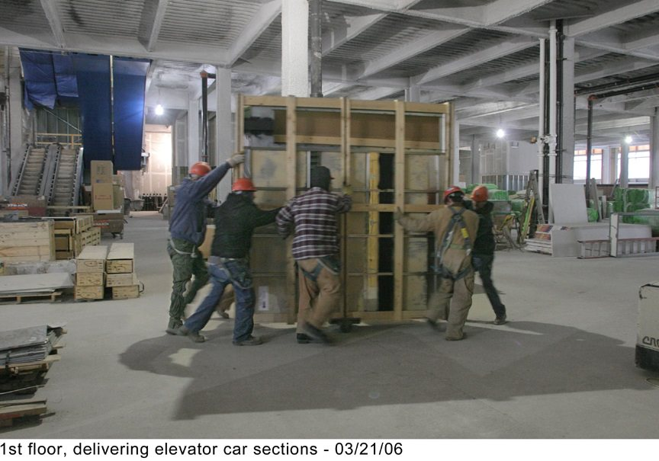
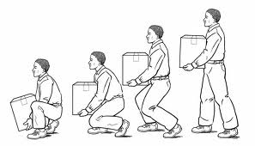
Protection Against Ergonomic Hazards
Use ergonomically designed tools
Use correct work practices
  Proper lifting techniques
  Work station setup
Ask for help when handling:
  Heavy loads
  Bulky/Awkward materials
Proper PPE
Source: Boston University (bu.edu/wellness/workplace/ergonomic)
Notes:
Methods of protecting workers against exposure to ergonomic hazards
1. Use correct work practices, such as lifting techniques
2. Ask for help when handling heavy, bulky materials
3. Use tools ergonomically designed for job
4. Worksite analysis and design of workstation
5. PPE

Slide 23
Hazard Communication – HAZ COM
Hazard Communication Standard
Requirements for a written program:
Develop, implement, and maintain a written hazard communication program
Main intent is to ensure compliance with standard in a systematic way that coordinates all elements
Notes:
Source: Hazard Communication: Small Entity Compliance Guide for Employers That Use Hazardous Chemicals (2014), OSHA #3695-03, https://www.osha.gov/Publications/OSHA3695.pdf
“Paragraph (e), Written Hazard Communication Program, requires employers to prepare and implement a written hazard communication program. This does not need to be lengthy or complicated. The main intent of the requirement is to help ensure that compliance with the standard is done in a systematic way and that all elements are coordinated. Thus, the program must describe how the employer will address the requirements of paragraphs (f) Labels and Other Forms of Warning; (g) Safety Data Sheets; and (h) Employee Information and Training, in the workplace.”

Slide 24
Hazard Communication – HAZ COM
Components of written program:
Lists of hazardous chemicals present at worksite
Availability of SDSs to employees and downstream employers
Labeling of chemical containers
Training programs regarding hazards of chemicals and protective measures
Emergency procedures in the event of a chemical spill or release

Slide 25
Hazard Communication – HAZ COM
List of hazardous chemicals known to be present in the workplace:
Use product identifier
  Product name, common name or chemical name
  Same as name used on SDS and label
Inventory of chemicals – employer must have available an SDS for each chemical
Covers all chemicals in all forms, whether contained or not - liquids, solids, gases, vapors, fumes, and mists
Include chemicals in containers, pipes, and those generated by work operations such as welding fumes and dust
Notes:
Source: Hazard Communication: Small Entity Compliance Guide for Employers That Use Hazardous Chemicals (2014), OSHA #3695-03, https://www.osha.gov/Publications/OSHA3695.pdf
List of hazardous chemicals known to be present in the workplace:
List may be kept by product identifier from SDS; may be listed by product name, common name, or chemical name;
Important: name used must be the same as term used on SDS and label for cross-referencing.
“the HCS covers chemicals in all forms---liquids, solids, gases, vapors, fumes, and mists---whether they are “contained” or not. The nature of the chemical and the potential for exposure are the factors that determine whether a chemical is covered.” (pgs. 11-12)
“Identify chemicals in containers, including pipes, but also think about chemicals that are generated during work operations. For example, welding fumes, dusts, and exhaust fumes are all sources of chemical exposures.” (pg. 12)
For use in other program elements, as you survey workplace for hazardous chemicals, you may want to make note their locations and indicate hazards found on labels.

Slide 26

Hazard Communication – HAZ COM
Training requirements:
Train employees on
hazardous chemicals
in their work area
  Before initial assignment
  When new hazards are introduced
  Non-routine tasks
Include in training
  Methods/observations to determine presence/release of chemical in work area
  Hazards of chemicals
  Appropriate protective measures
  Where and how to obtain additional information
Source: OSHA
Notes:
Source: Hazard Communication: Small Entity Compliance Guide for Employers That Use Hazardous Chemicals (2014), OSHA #3695-03, https://www.osha.gov/Publications/OSHA3695.pdf
“For information and training to be effective, the workers in the training must comprehend the hazards in the workplace and ways to protect themselves. OSHA does not expect that workers will be able to recall and recite all data provided about each hazardous chemical in the workplace. What is most important is that workers understand that they are exposed to hazardous chemicals, know how to read labels and SDSs, and have a general understanding of what information is provided in these documents, and how to access these tools. Workers must also be aware of the protective measures available in their workplace, how to use or implement these measures, and who they should contact if an issue arises.” (pg. 25)
Training… must address the following:
Methods and observations used to determine presence or release of chemical in work area, such as:
1. Monitoring – conducted by employer; continuous monitoring devices
2. Visual appearance or odor of hazardous chemical when being released
Hazards of chemicals in the work area, including:
1. Physical hazards
2. Health hazards
3. Simple asphyxiation
4. Combustible dust
5. Pyrophoric gas
6. Other hazards not otherwise classified
Measures employees can take to protect themselves from hazards, including
1. Specific procedures employer has implemented to protect employees from exposure to hazardous chemicals
2. Examples – Appropriate work practices, emergency procedures, PPE to be used
Details of hazard communication program developed by employer
1. Explanation of labels received on shipped containers and the workplace labeling system used by the employer
2. SDS, including format (where each type of information is located)
3. How employees can obtain and use the appropriate hazard information

Slide 27
Through the Alliance between OSHA’s 10 Regional Offices and the Elevator Contractors of America (ECA), Elevator Industry Work Preservation Fund (EIWPF), International Union of Elevator Constructors (IUEC), National Association of Elevator Contractors (NAEC), National Elevator Industry Educational Program (NEIEP), and National Elevator Industry Inc. (NEII), collectively known as The Elevator Industry Safety Partners, developed this Industry Specific Training for informational purposes only. It does not necessarily reflect the official views of OSHA or the U.S. Department of Labor. March 2025
Under the Occupational Safety and Health Act, employers are responsible (http://www.osha.gov/as/opa/worker/employer-responsibility.html) for providing a safe and healthy workplace and workers have rights (https://www.osha.gov/workers). OSHA can help answer questions or concerns from employers and workers. OSHA's On-Site Consultation Program (https://www.osha.gov/consultation) offers free and confidential advice to small and medium-sized businesses, with priority given to high-hazard worksites. For more information, contact your regional or area OSHA office (https://www.osha.gov/contactus/bystate), call 1-800-321-OSHA (6742), or visit https://www.osha.gov/.

