Slide 1
New Hire Training
Accident Reporting/Forms/Workers Compensation

Slide 2
Safety Policy and Goals
Safety Policy and Goals
All incidents are preventable.
Everyone returns home without injury each day.
Everyone is empowered to prevent incidents.
Our goal is to create the conditions to ensure the safety of our employees.
1

Slide 3
Substance Abuse Policy
We are committed to maintaining a safe and drug-free workplace
For more info, including our Employee Assistance Program (EAP), contact your HR rep
More info can be found at http://www.drugfreeconstruction.org/

Slide 4
Cell Phone Policy
Cell phone use is prohibited while:
Conducting job responsibilities
Operating company vehicles or machinery
Standing within 10 feet of moving vehicles

Slide 5
Worksite Hazards
Report all work related injuries to your supervisor immediately and email HR
Injury types include, but are not limited to:
Injury types include, but are not limited to:
Minor cuts
Scrapes
Scratches
Burns
Other treatments that require minimal training or technology to administer
More info can be found at http://www.drugfreeconstruction.org/

Slide 6
Worksite Hazards
OSHA’s Fatal Four:
Falls (car tops, entrances, leading edges)
Electrocution
Caught in/between objects (elevator pits, hoistways, pinch points)
Getting struck by an object (vehicles, falling objects)
Do not enter restricted areas without permission
Ensure work has stopped before entering an area. Do not work under suspended loads
We will cover more on these topics in your orientation

Slide 7
Worksite Hazards
More Effective (best)
Least Effective
(worst)
***** Elimination of Hazard | **** Substitution | *** Engineerin g | ** Labor Practices/ Administrative Controls (Training & Procedures) | * Personal Protective Equipment (PPE)

Slide 8
Stop Work Authority
Stop Work Authority empowers employees and contract workers with the ability and obligation to stop work if conditions are deemed at-risk
If you see something that doesn’t look right, say something to authorities or your supervisor

Slide 9
Incident Ratio Model-Heinrich’s Theory
Serious Injury or Death
Most Incident Investigations Conducted
1
29
Biggest percentage
of injury-causing potential!
Minor Injury
Few Investigations Conducted
300
Near-Miss
Unsafe Acts, Behaviors or Conditions
3,000
Notes:
This pyramid was developed in 1931 by William Heinrich showing a total of 3,330 incident/accident situations from a defined breakdown according to:
1. Unsafe acts, behaviors or conditions
2. 300 near-miss situations (these first 2 categories are not often investigated due to lack of injury)
3. 29 minor injuries occur, and
4. 1 serious injury or death that may result from this total of events.
Although categories 1 & 2, unsafe acts, behaviors or conditions, and near-misses are not investigated as rigorously if at all, they have the potential to escalate to more intense conditions.

Slide 10
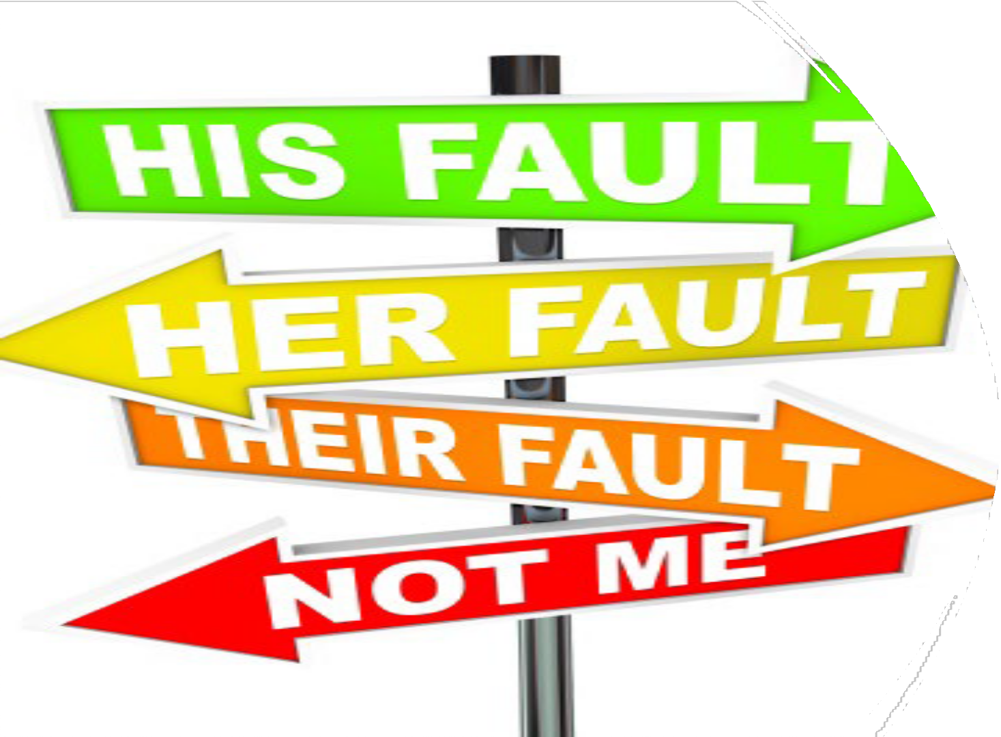
The Aim of the Investigation
Is Not To:
Exonerate individuals or management
Satisfy insurance requirements
Defend a position for legal argument
Assign blame
Remember, fact finding – not fault finding
9
Notes:
Foremost in the investigator’s mind should be that the investigation is NOT TO:
Exonerate individuals or management
Satisfy insurance requirements
Defend a position for legal argument
Assign blame
Investigations are about fact finding - - not fault finding.

Slide 11
WEED OUT THE CAUSES OF INJURIES AND ILLNESSES
Direct causes of injury/illness
Strains
Burns
Cuts
Unguarded machine
Horseplay
Broken tools
Create a hazard
Surface Causes of the Accident
Chemical spill
Ignore a hazard
Defective PPE
Fail to report injury
Conditions
Untrained worker
Fail to inspect
Behaviors
Lack of time
Fail to enforce
Too much work
Fail to train
Inadequate training
No recognition
No discipline procedures
Inadequate labeling procedures
No orientation process
Outdated procedures
Root Causes of the Accident
Inadequate training plan
No recognition plan
No accountability policy
No inspection policy
Don’t delay in reporting near misses. Even a minor incident can be the precursor to a deadly incident if the underlying causes aren’t identified and addressed. If you eliminate the root cause of an accident, you will eliminate those accidents in the future!
9
Notes:
Review this slide. On the left, “above-ground” conditions that could contribute to injuries are listed; these are contributing factors to an injury.
The same is true on the right side dealing with behaviors. The visible, “above-ground” behaviors are but surface causes.
You need to determine the invisible “root causes” of both conditions and behaviors, remove them and your injuries may go away!

Slide 12
Through the Alliance between OSHA’s 10 Regional Offices and the Elevator Contractors of America (ECA), Elevator Industry Work Preservation Fund (EIWPF), International Union of Elevator Constructors (IUEC), National Association of Elevator Contractors (NAEC), National Elevator Industry Educational Program (NEIEP), and National Elevator Industry Inc. (NEII), collectively known as The Elevator Industry Safety Partners, developed this Industry Specific Training for informational purposes only. It does not necessarily reflect the official views of OSHA or the U.S. Department of Labor. March 2025
Under the Occupational Safety and Health Act, employers are responsible (http://www.osha.gov/as/opa/worker/employer-responsibility.html) for providing a safe and healthy workplace and workers have rights (https://www.osha.gov/workers). OSHA can help answer questions or concerns from employers and workers. OSHA's On-Site Consultation Program (https://www.osha.gov/consultation) offers free and confidential advice to small and medium-sized businesses, with priority given to high-hazard worksites. For more information, contact your regional or area OSHA office (https://www.osha.gov/contactus/bystate), call 1-800-321-OSHA (6742), or visit https://www.osha.gov/.

