Slide 1

1926 Construction
Fall Hazards

Slide 2
Focus Four
Falls are the leading cause of death in the Construction Industry
Caught in/ 9% between
Other 36%
Falls 35%
Electrical 9%
Struck-by 11%
969 Total Fatalities
Notes:
Source: Bureau of Labor Statistics

Slide 3
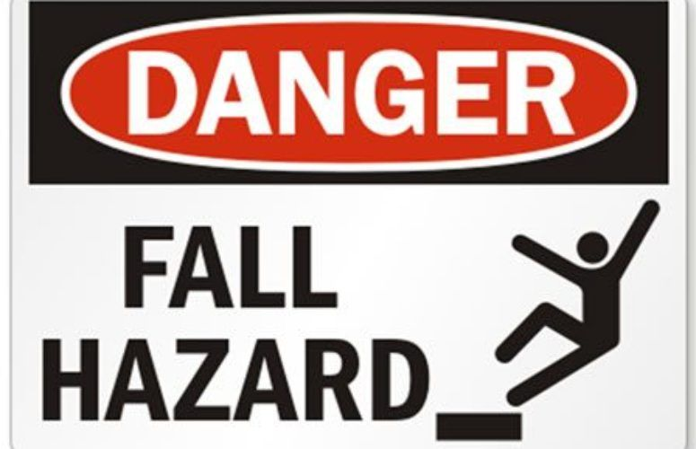
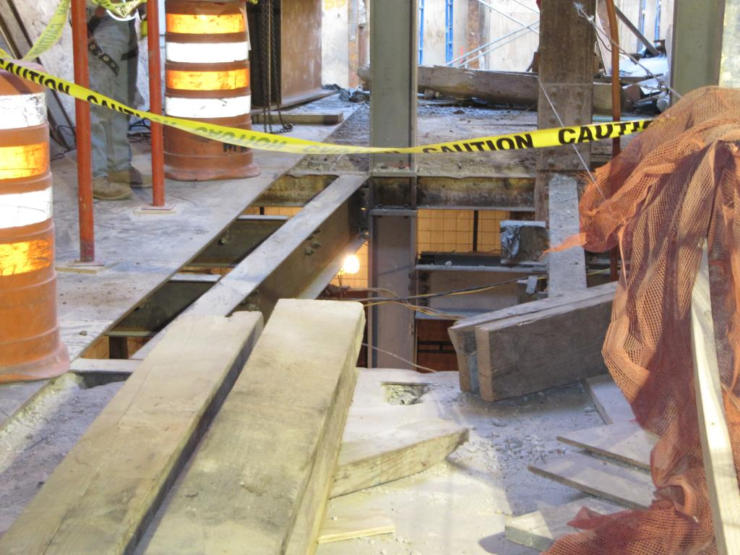
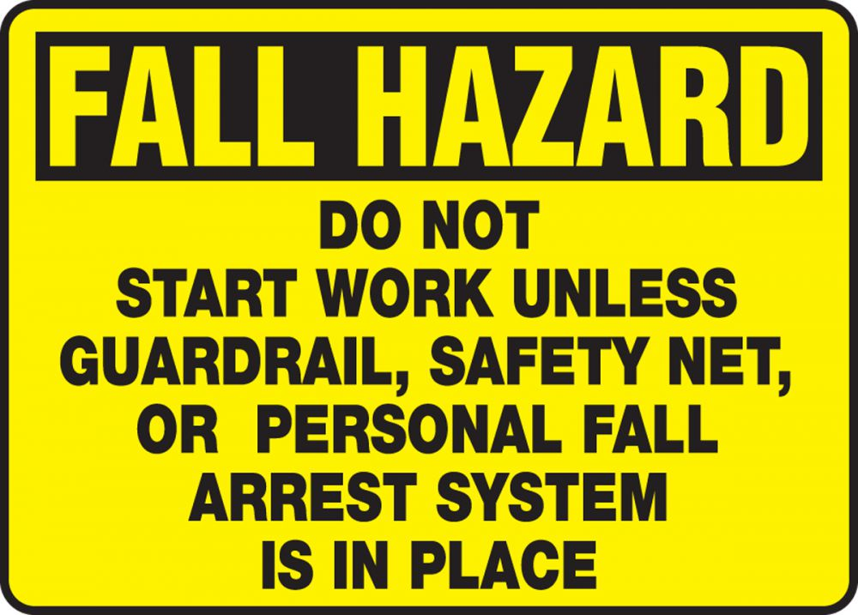
Fall Hazards
Focus Four
Fall Hazards
Source: OSHA elcosh

Slide 4
Fall Hazards
Focus Four
FALLS ARE THE LEADING CAUSE OF DEATH IN CONSTRUCTION. In 2018, there were 320 fatal falls to a lower level out of 1,008 construction fatalities (BLS data). These deaths are preventable.
Since 2012, OSHA has partnered with the National Institute for Occupational Safety and Health and National Occupational Research Agenda (NORA) - Construction Sector on the Fall Prevention Campaign to raise awareness among workers and employers about common fall hazards in construction, and how falls from ladders, scaffolds and roofs can be prevented.
PLAN ahead to get the job done safely

Slide 5
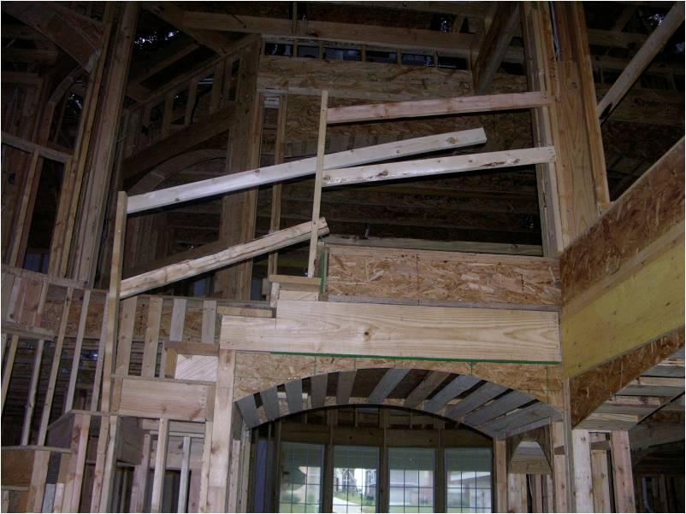
Fall Hazards
Focus Four
Objectives
By the end of this session, students will be able to:
Identify major fall hazards
Describe types of fall hazards
Identify methods to protect him/herself from fall hazards
Recognize employer requirements to protect workers from fall hazards
Source: elcosh

Slide 6

Fall Hazards
Focus Four
Falls are the leading cause of construction fatalities.
Falls accounted for 35%
of construction deaths nationwide in 2008.
Discussion:
Have you or has anyone you know had a fall on the job?
What happened?
Source: elcosh
Notes:
Ask participants if they know anyone who has had a serious fall on the job.
Ask them if they are willing to describe what happened and how it could have been prevented.
Ask if others in the class have additional suggestions of how a similar fall might have been prevented.

Slide 7
Fall Hazards
Focus Four
Elevator Industry Related Fall Hazards
Since 2012, 18% of Elevator Constructor
deaths have been from falls.

Slide 8

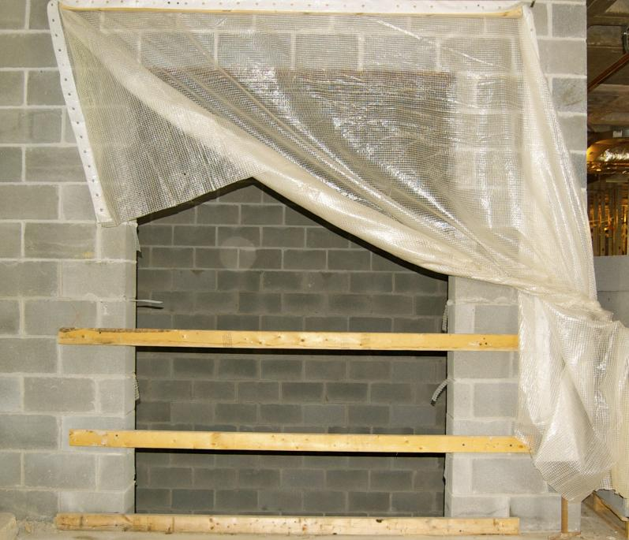

Fall Hazards
Focus Four
Falling Off an Edge.
Common exposed edges in construction:
Roofs
Unprotected edges
Holes
Stairwells
Elevator shafts
Decking
Can you think of any others?
Source: elcosh

Slide 9
Fall Hazards
Focus Four
Falls: Elevator-Related Hazards
Elevator constructors are exposed to falls at hoistways, wellways, false cars, running platforms, entering pits, to name just a few.
§1926.501 establishes the duty for the employer to provide fall protection.
§1926.502 establishes the criteria for Fall protection systems.
For Elevator Constructors on a construction site, fall protection is usually provided in one of three ways:
1. Eliminate the hazard.
2. A guardrail system
3. Personal fall arrest system
Since it is rare that we can eliminate the hazard, guardrails and PFAS will be discussed in more detail later.

Slide 10

Fall Hazards
Focus Four
Working on Scaffolds
Scaffolds must be erected and dismantled under the supervision of a “competent person” trained in scaffold erection.
Must have guardrails, midrails, and toe boards. Top guardrail at 42” +/- 3” above working surface or utilize a Personal Fall Arrest System.
Scaffolds (and all people working on them) must be at least 10 feet from energized power lines.
Scaffolds must have safe access
Source: elcosh
Notes:
Competent Person: one who is capable of identifying existing and predictable hazards in the surroundings or working conditions which are unsanitary, hazardous, or dangerous to employees, and who has authorization to take prompt corrective measures to eliminate them.

Slide 11

Fall Hazards
Focus Four
Can You Identify the Fall Hazards?
A worker is working from a carpenters' scaffold that has no guardrail
The worker inside of the window is not provided with fall protection as there is no standard guardrail for the window.
The worker also does not have proper access to the scaffold.
The worker working below is exposed to the struck-by hazards of tools and equipment falling from the employees working above.
Notes:
There is no guardrail or other fall protection for the worker on the carpenters' scaffold. This scaffold extends too far beyond either end, and is not wide enough. It must be at least 18 inches. The scaffold must meet 1926.451(a)(1), four times the intended load. If installed, the top rails must have 200 lbs. capacity and the midrails must have 150 lbs. capacity. In addition, the worker did not have proper access to the scaffold. The worker inside of the window was not provided with fall protection because a standard guardrail was not provided for the window. The worker working below was exposed to the struck-by hazards of tools and equipment from the employees working above. When workers are exposed to falling objects, the employer shall have each employee wear a hard hat and implement protective measures, such as toeboards, screens, or barricades for the area underneath. In addition, scaffolds must be erected, moved, dismantled and altered only under the supervision of a competent person. See 1926.451(f)(7).

Slide 12

Fall Hazards
Focus Four
Can You Identify the Fall Hazard?
Lack of fall protection for workers on fabricated frame scaffolds.
Planks appear to be overloaded and there is no safe access for workers.
The workers are exposed to a 35-foot fall hazard from a scaffold while stacking blocks prior to overhand bricklaying operations.
Notes:
Workers on fabricated frame scaffolds stacking blocks are exposed to a 35-foot fall hazard from a scaffold.
Lack of fall protection for workers on fabricated frame scaffolds. The workers are exposed to a 35-foot fall hazard from a scaffold while stacking blocks prior to overhand bricklaying operations. The planks appear to be overloaded and there is no safe access for the workers.

Slide 13
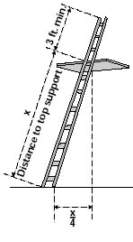
Fall Hazards
Focus Four
Safe Ladder Practices
Portable extension ladders should be set up in a 4:1 ratio, height to distance from wall
Inspect ladders before using them. if it’s defective, don’t use it!
Don’t work on the top step of a step ladder
Position the portable ladder so the side rails extend at least 3 feet above the landing
Secure side rails at the top of the ladder to a rigid support
Make sure that the weight on the ladder will not cause it to slip.
Source: OSHA

Slide 14
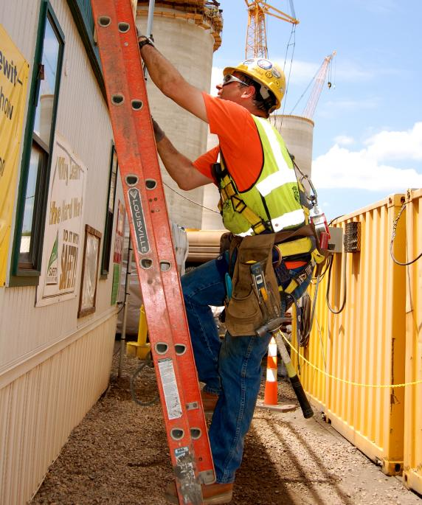
Fall Hazards
Focus Four
Safe Ladder Practices Cont.
When climbing up or down:
  Always face the ladder
  Maintain three-point contact at all times
  Don’t carry anything in your hands
Make sure the ladder is on a firm, level surface
Consider securing the ladder at top and bottom
  Don’t reach so far that your belt buckle is outside the rails of the ladder.
Source: elcosh
Notes:
With extension ladders, make sure the ladder is:
free of damage to rungs, side rails, and hardware
set up so that the base is level and the bottom can’t slip, if slip hazard is possible secure base.
sloped 4:1 height to base ratio
tall enough to extend at least 3 feet above the landing area at the top
secured at the top if it will be a regular means of access.

Slide 15
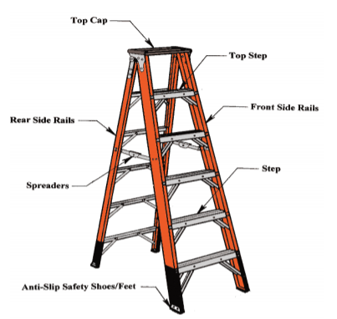
Fall Hazards
Focus Four
Step Ladders
A competent person must visually inspect stepladders for visible defects on a periodic basis and after any occurrence that could affect their safe use. Defects include, but are not limited to:
Structural damage, split/bent side rails, broken or missing rungs/steps/cleats and missing or damaged safety devices.
Grease, dirt or other contaminants that could cause slips or falls.
Paint or stickers (except warning or safety labels) that could hide possible defects.
Source: OSHA
Notes:
Never use the top step or top cap as a step.

Slide 16
Fall Hazards
Focus Four
Step Ladders cont.
Make sure all four feet of the portable step ladder are set on a level and stable surface, and that both ladder spreaders are fully extended and locked into place before use
Keep your ladder, your body, your tools and any materials at least 10 feet away from energized electrical conductors (or even further for higher voltages exceeding 50kv)
Maintain your balance and center of gravity on your portable step ladder by keeping your belt-buckle between the two side rails. Reposition the ladder instead of over-reaching
Notes:
While these are not the only precautions applicable to the use of a portable step ladder, heeding these simple tips can go a long ways towards protecting all of us who do use them from accidents, injuries, and even death.

Slide 17
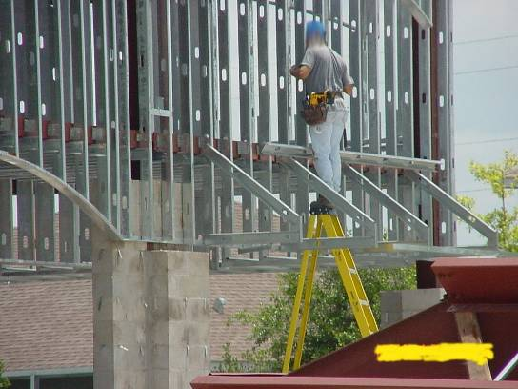
Fall Hazards
Focus Four
Is This a Fall Hazard?
YES!!
Worker is working off of the top of a step ladder.
The top of a stepladder shall not be used as a step.
Notes:
OSHA standards do not permit the top or top step of a stepladder to be used as a step. See 1926.1053(b)(13).

Slide 18
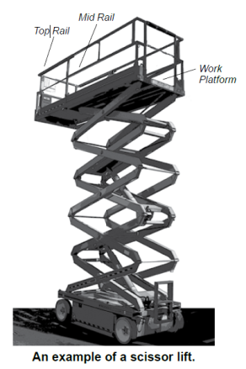
Fall Hazards
Focus Four
Controlling fall hazards – scissor lifts
OSHA’s investigations regarding injuries and fatalities involving scissor lifts were the result of employers not addressing:
  Fall Protection
  Stabilization
  Positioning
Source: OSHA
Notes:
Only trained workers should be allowed to use scissor lifts, and employers should make sure that those workers show that they can use a scissor lift properly.
Although scissor lifts present hazards similar to scaffolding when extended and stationary, using scissor lifts safely depends on considering equipment capabilities, limitations and safe practices.

Slide 19
Fall Hazards
Focus Four
Fall protection
Check to see that a guardrail system is in place before working on the scissor lift.
Only stand on the work platform; never stand on the guardrails.
Keep work within easy reach to avoid leaning away from the scissor lift.
Source: OSHA
Note: Some manufacturers require a PFAS in addition to the unit’s guardrails.
Notes:
Employers should train workers to:
Check to see that a guardrail system is in place before working on the scissor lift.
Guardrails must meet §1926.451(g)(4). Top rail, mid rail, toe board. A personal Fall Arrest System is not required if guardrails are installed and meet the OSHA standard.
Only stand on the work platform; never stand on the guardrails.
Keep work within easy reach to avoid leaning away from the scissor lift.

Slide 20
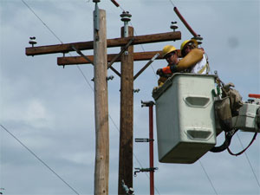
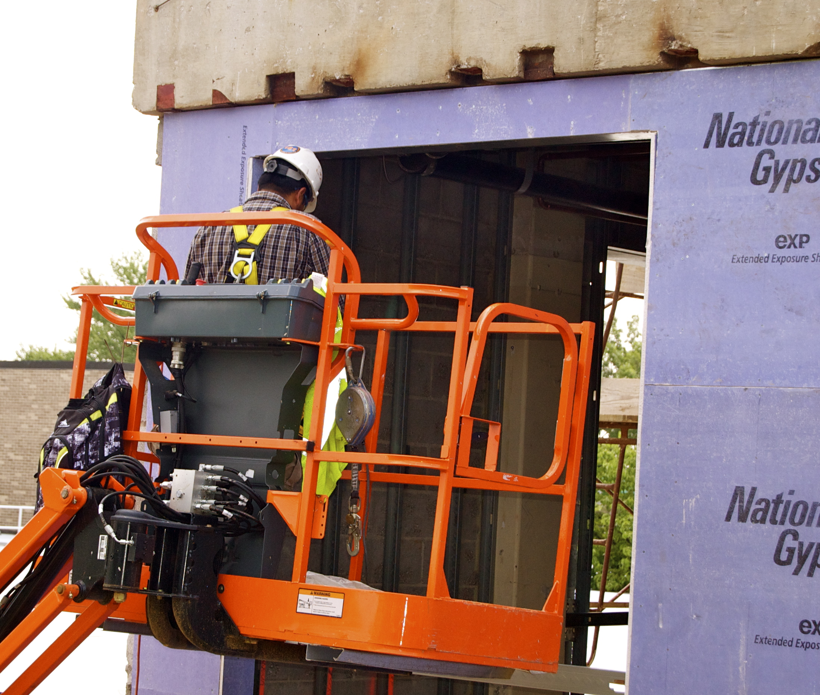
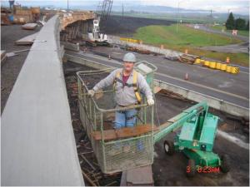
Fall Hazards
Focus Four
Controlling fall hazards – aerial lifts
Source: OSHA
Source: elcosh
PFAS is required for all workers using an aerial lift.
Source: elcosh
Notes:
Unlike scissor lifts, employers must ensure that employees tie off at all times when working from an aerial lift [§1926.453(b)(2)(v)]. Employers must ensure that employees using personal fall arrest systems while working on aerial lifts at heights six feet or more above a lower level comply with §1926.502(d) of subpart M.

Slide 21
Fall Hazards
Focus Four
Hierarchy of Hazard Controls
The hazard no longer exists
Elimination
Replace with a less hazardous condition, process, or practice
Substitution
Physical change that reduces exposure or isolates worker from the hazard
Engineering Control
Administrative
Controls
Change or improve the way people do the work
Protect the worker with personal protective equipment
PPE
Notes:
Elimination: An example of elimination is ensuring no work has to be executed at height because machinery is moved to ground level. The reason this is always the preferred method to control fall hazards is because the workers will not be faced with any fall risks and thus cannot get injured by a potential fall. This is the most effective control.
Substitution: If removing a hazard is not an option, substitution may be a possibility. Find safer alternatives to the existing hazards. For example, safe cutting tools in place of dangerously sharp blades lowers the risk on a cutting activity. Alternatives could also mean substituting dangerous materials for safer ones or substituting dangerous work practices for safer ones. This is an effective control.
Engineering Controls: Engineering controls use engineered measures to isolate hazards. A company can choose to build structures like barriers or guardrails to separate workers from the hazards.
Administrative Controls: Administrative controls shift focus from the hazard to managing the human element involved in risk. For any hazard to cause harm, a worker must complete an action. Training and awareness are the focus of administrative safety controls. Ensuring workers understand hazards and associated risks is an essential step in enforcing workplace safety.
PPE: PPE can be considered the last line of measures in a hierarchy of controls in occupational health and safety. This step intends to protect workers in scenarios where a company has not or cannot implement the other steps fully. PPE implementation means providing safety gear and equipment optimized for existing hazards. PPE is considered the least effective safety step because safety gear and equipment can fail, leaving the worker fully exposed to the hazard.

Slide 22
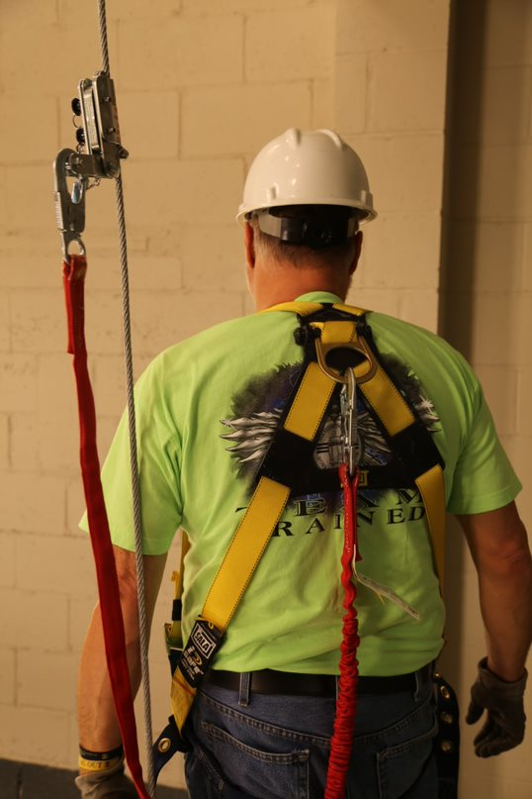
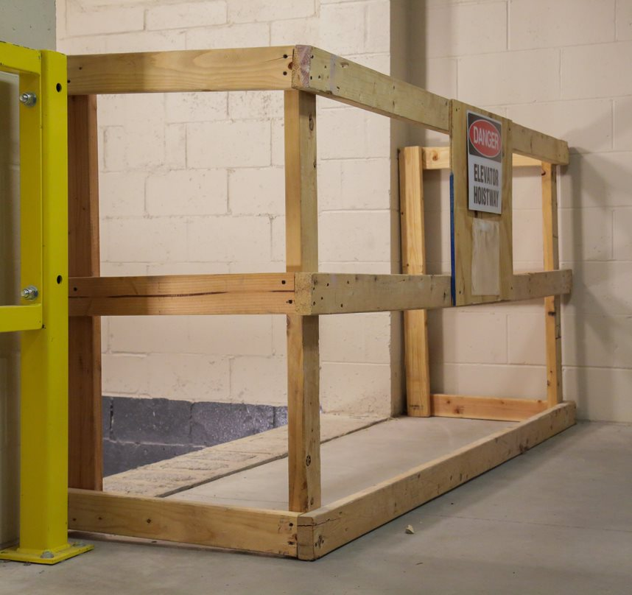
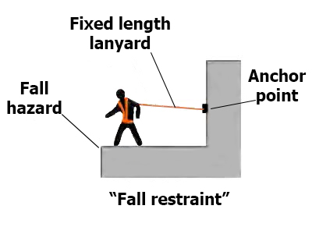
Fall Hazards
Focus Four
Methods of Fall Protection
We have discussed the hierarchy of controls (Elimination, substitution, engineering controls, administrative controls, and personal protective equipment). Let’s look at the types of fall protection that fall under engineering and PPE.
There are two types of fall protection:
Fall Prevention
Fall Arrest

Slide 23
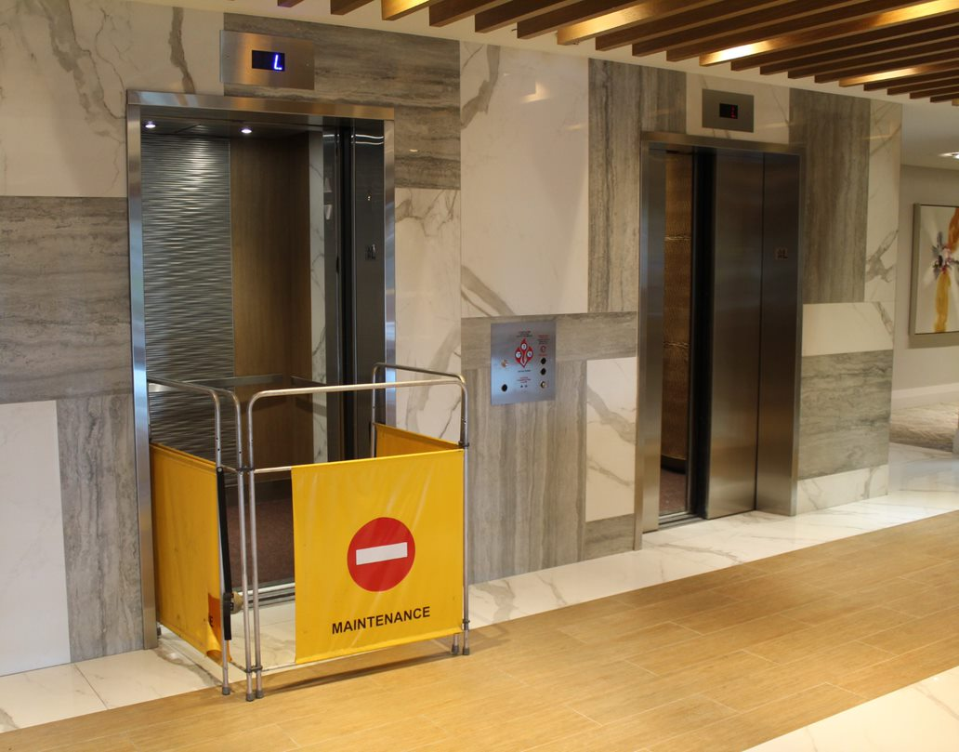
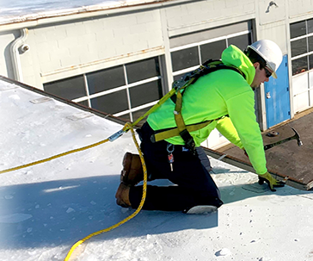
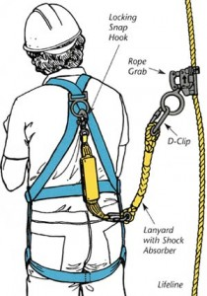
Fall Hazards
Focus Four
Fall Prevention
Fall prevention systems use equipment to prevent workers from falling.
Barricades
Barriers
Guardrails
Fall Restraint
Fall arrest systems are designed to catch
workers after they have fallen

Slide 24
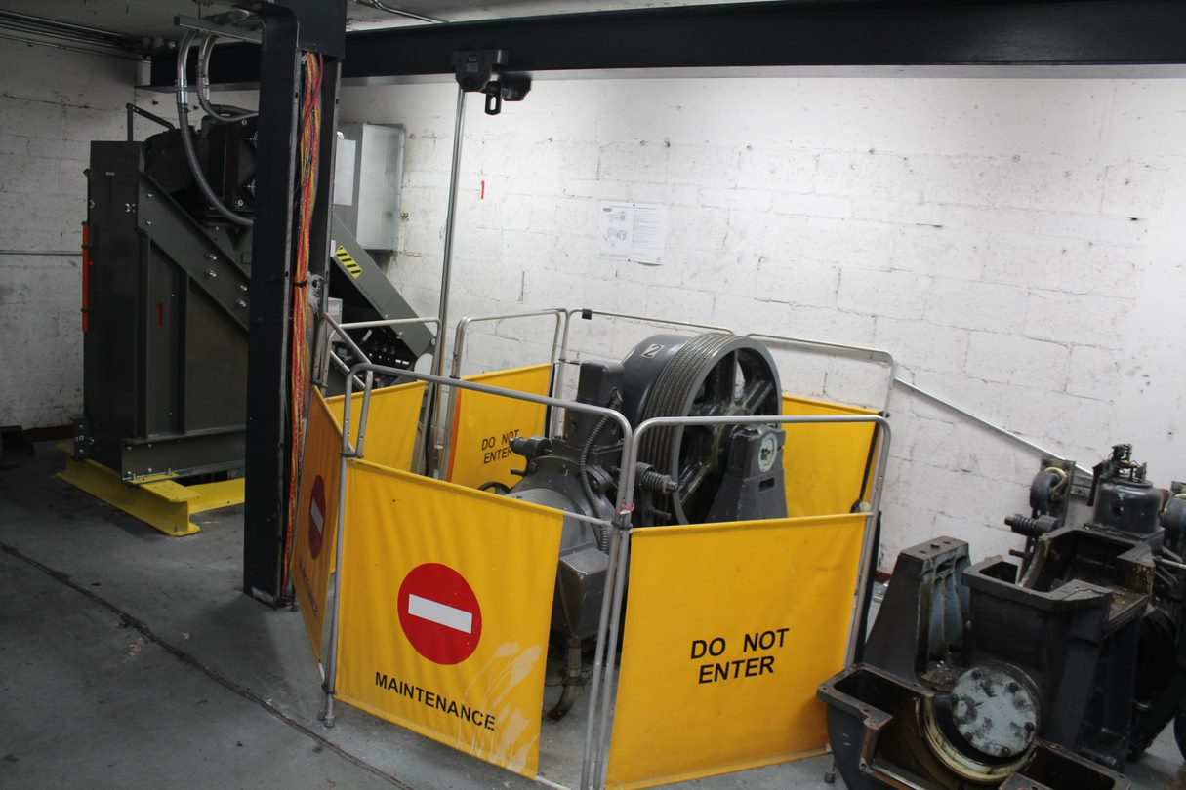

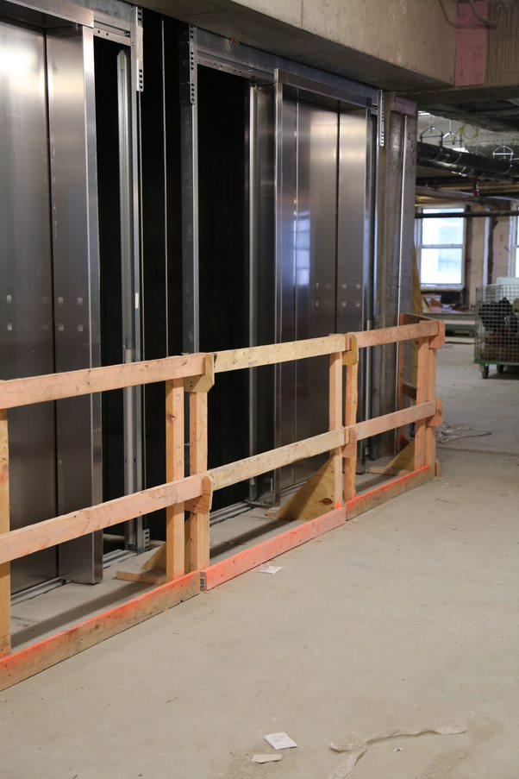
Fall Hazards
Focus Four
Fall Prevention
Barrier, Barricade, or Guardrail System? What’s the difference?
OSHA defines Barriers, Barricades, and Guardrail Systems as follows:
Barrier. The term means a physical obstruction which is intended to prevent contact with energized lines or other equipment.
Barricade. The term means a physical obstruction such as tapes, screens, or cones intended to warn and limit access to a hazardous area.
Guardrail system means a vertical barrier, consisting of, but not limited to, toprails, midrails, toeboards, and posts erected to prevent employees from falling off a walking/working surface to lower levels.

Slide 25
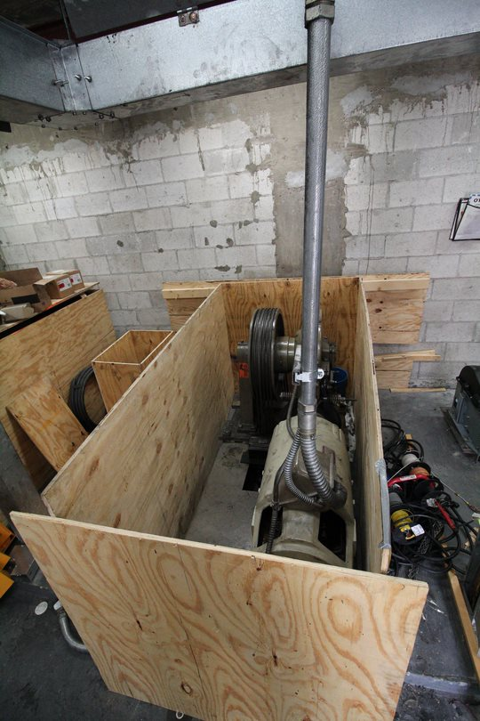
Fall Hazards
Focus Four
Fall Prevention
Barrier:
  Used mostly during mod and major repair jobs to isolate running equipment and prevent people from accidentally getting caught in rotating equipment or energized electrical components.
Notes:
Barrier. A physical obstruction that prevents contact with energized lines or equipment or prevents unauthorized access to a work area.
Does not meet the requirement for fall protection.

Slide 26
Fall Hazards
Focus Four
Fall Prevention
Barricade:
  Mostly used during maintenance and repair to warn others and limit their access to fall hazards and dangerous areas.
  Escalator and moving walks MUST have barricades in place at both ends anytime work is being done. Hoistways must have barricades in place if a door will be unlocked.
  Barricades must completely surround the escalator/moving walk entrance and egress, as well as the hoistway entrance to restrict public access.
  Barricades must be at least 42″ tall, and must securely attach to the balustrades, handrails, or floor on escalators and moving walks.
Notes:
Barricade. A physical obstruction such as tapes, cones, or A-frame type wood or metal structures that provides a warning about, and limits access to, a hazardous area.
Does not meet the requirements for fall protection.

Slide 27
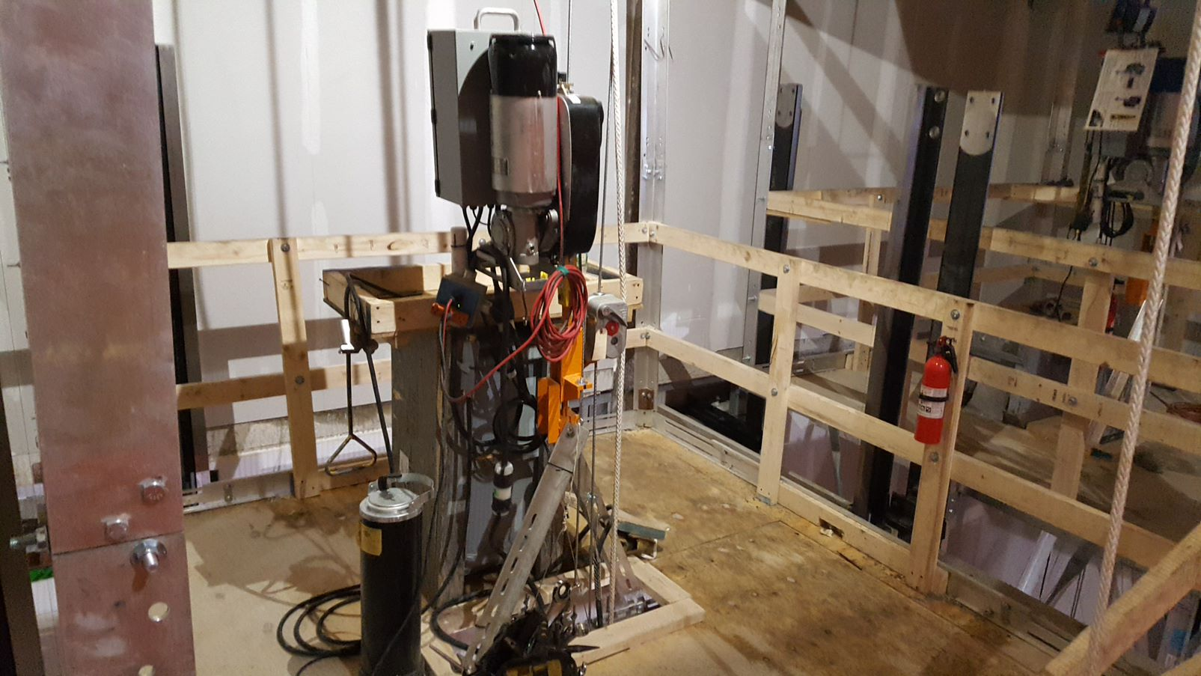
Fall Hazards
Focus Four
Fall Prevention
Guardrail system: Must meet the requirements of OSHA 1926.502(1)
Top rails must be capable of withstanding a force of 200 lbs. and mid-rails a force of 150 lbs, applied in any outward or downward direction.
42″ top rail (+- 3″)
21″ mid rail
While not a regulation, for safe access and egress, guardrail systems must be removable at hoistway entrances, escalator/moving walk wellways, and at the entrance to false car/running platforms
3 ½″ toe board
Posts shall not be more than 8′ apart.

Slide 28
Fall Hazards
Focus Four
Fall Prevention
Fall Restraint System means a fall protection system that prevents the user from falling any distance.
Uses a body belt or body harness
A fixed length or adjustable lanyard
An anchorage
Fall restraint systems prevent the worker from getting close enough to the fall hazard to fall off the edge.

Slide 29
Fall Hazards
Focus Four
Fall Arrest
Personal Fall Arrest Systems are designed to catch workers after they have fallen.
The components of a PFAS are:
Anchorage
Lifeline/Rope grab
Connectors
Lanyard
Body Harness
Notes:
Personal fall arrest systems are for workers to wear if there is a danger of falling from elevation. They are designed to stop the fall with as little shock and recoil as possible, or to completely prevent a fall. OSHA requires employers to properly fit and train each worker who will use a PFAS.
A full-body harness has straps worn around your trunk and thighs, with the D-ring in back to attach the harness to other parts of the system. If you fall, a properly fitted harness spreads the stopping force over your thighs, pelvis, chest, and shoulders.
Follow manufacturers’ instructions for wearing harnesses and inspect your equipment before each use.

Slide 30
Fall Hazards
Focus Four
Fall Arrest
Inspect all parts of your personal fall arrest system before each use.
Can anyone think of what you should look for when inspecting
your PFAS?
Cuts
Chemical damage
Nicks
Burns
Make sure the manufacturers tag is there and legible, and includes the manufactured date
Notes:
There is no such thing as a predetermined or mandated expiration date on fall protection harnesses. Neither OSHA nor ANSI have current codes or standards that set a specific time period for taking a harness out of service. Even most manufacturers will not suggest how long a harness will last.
The only person who can determine when a harness is due for removal is you or your competent, trained inspector. More important than who determines when a harness should be removed from service, is what determines it.

Slide 31
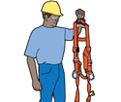

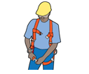
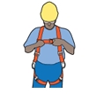
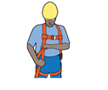
Fall Hazards
Focus Four
Fall Arrest Training
Required training should include:
Explanation of the company’s fall protection policies and systems
Selection, inspection, and proper use of fall arrest systems and all related
equipment and components
Selection of an adequate anchor point
Adjust the harness so it fits snug and the D-Ring is in the proper position
Position D-Ring
between shoulders
Inspect
Buckle legs
Buckle front
Source: OSHA
Notes:
If possible, instructor should demonstrate the proper way to inspect and put on a harness.
When workers wear a fall arrest system, they think it is OK to unhook for a minute, walk somewhere else, then hook it back up. You should never do that. Make sure you are always tied off.
Some employers mandate 100% fall protection. A worker may be expected to use two lanyards so that the worker is never exposed to a fall.
Selecting the tie off point is often left to employees’ discretion. Tie off points must support 5,000 lbs., about the weight of a half-ton pickup.

Slide 32
Fall Hazards
Focus Four
Fall Arrest Training
Explanation of the companies’ fall protection policies and systems:
Each employer will have their own fall protection policies and procedures. OSHA requires all employees to be trained by the employer to recognize a fall hazard and how to utilize the company fall protection program to minimize those hazards.
1926.503 Training requirements.
(a) Training Program.
1. The employer shall provide a training program for each employee who might be exposed to fall hazards. The program shall enable each employee to recognize the hazards of falling and shall train each employee in the procedures to be followed in order to minimize these hazards.
2. The employer shall assure that each employee has been trained, as necessary, by a competent person qualified in the following areas:
(i) The nature of fall hazards in the work area;
(ii) The correct procedures for erecting, maintaining, disassembling, and inspecting the fall protection systems to be used.
Notes:
The employer must provide training for any employee that might be exposed to a fall hazard. The training will enable the employee to recognize a fall hazard and what to do.
A competent person must conduct the training.

Slide 33

Fall Hazards
Focus Four
Fall Arrest Selection and Use
Your employer provides you with your fall arrest PPE. It is your responsibility to use it, and use it correctly. § 1926.502(d) is the standard for fall protection systems criteria and practices. Here are some important points:
Dee-rings and snaphooks shall have a minimum tensile strength of 5,000 pounds.
Effective January 1, 1998, only locking type snaphooks shall be used.
Lanyards and vertical lifelines shall have a minimum breaking strength of 5,000 pounds.
Each employee shall be attached to a separate lifeline. Follow your company policy on lifelines.
Lifelines shall be protected against being cut or abraded. Ropes and straps (webbing) used in lanyards, lifelines, and strength components of body belts and body harnesses shall be made from synthetic fibers.
Personal fall arrest systems and components subjected to impact loading shall be immediately removed from service and shall not be used again for employee protection until inspected and determined by a competent person to be undamaged and suitable for reuse.
Notes:
Use of PFAS and barricades on false cars (and similar temporary moving platforms within the hoistway) is covered under the fall protection requirements specific to single-point suspension scaffolds 1926.451(g)(3)(i) by their definition.
Each employee on a single-point or two-point adjustable suspension scaffold shall be protected by both a personal fall arrest system and guardrail system; [1926.451(g)(1)(ii)]

Slide 34
Fall Hazards
Focus Four
Fall Arrest Anchorage Selection
Where you attach your PFAS is very important. § 1926.502(15) is the standard that covers anchorage criteria.
Anchorages used for attachment of personal fall arrest equipment shall be independent of any anchorage being used to support or suspend platforms and capable of supporting at least 5,000 pounds per employee attached, or shall be designed, installed, and used as follows:
  as part of a complete personal fall arrest system which maintains a safety factor of at least two; and
  under the supervision of a qualified person.
Personal fall arrest systems, when stopping a fall, shall:
  limit maximum arresting force on an employee to 1,800 pounds when used with a body harness;
  be rigged such that an employee can neither free fall more than 6 feet, nor contact any lower level;
  bring an employee to a complete stop and limit maximum deceleration distance an employee travels to 3.5 feet (1.07 m); and,
  have sufficient strength to withstand twice the potential impact energy of an employee free falling a distance of 6 feet, or the free fall distance permitted by the system, whichever is less.

Slide 35
Fall Hazards
Focus Four
Fall Arrest Rescue Plan
§ 1926.502(d)(20): The employer shall provide for prompt rescue of employees in the event of a fall or shall assure that employees are able to rescue themselves.
APPENDIX C TO SUBPART M OF PART 1926—PERSONAL FALL ARREST SYSTEMS:
(f) Rescue considerations. As required by § 1926.502(d)(20), when personal fall arrest systems are used, the employer must assure that employees can be promptly rescued or can rescue themselves should a fall occur. The availability of rescue personnel, ladders or other rescue equipment should be evaluated. In some situations, equipment which allows employees to rescue themselves after the fall has been arrested may be desirable, such as devices which have descent capability.
Always know the rescue plan and review it with your team members.

Slide 36
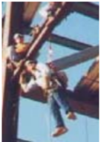
Fall Hazards
Focus Four
Fall Arrest Rescue cont.
So you’ve been in a fall arrest accident and are suspended in your PFAS waiting for rescue. What now?
Prolonged suspension from fall arrest systems can cause orthostatic intolerance, which, in turn, can result in serious physical injury, or potentially, death. Research indicates that suspension in a fall arrest device can result in unconsciousness, followed by death, in less than 30 minutes.
Signs & Symptoms of Orthostatic Intolerance:
Faintness Nausea
Breathlessness Dizziness
Sweating Low heart rate
Paleness Low blood pressure
Hot flashes “Greying” or loss of vision
Increased heart rate
Notes:
Taken from OSHA Bulletin SHIB 03-24-2004, included in handouts.

Slide 37
Fall Hazards
Focus Four
Fall Arrest Rescue cont.
To reduce the risk associated with prolonged suspension in fall arrest systems, employers should implement plans to prevent prolonged suspension in fall protection devices. The plan should include procedures for:
preventing prolonged suspension
identifying orthostatic intolerance signs and symptoms
performing rescue and treatment as quickly as possible
OSHA recommends the following general practices/considerations:
• Rescue suspended workers as quickly as possible.
• Be aware that suspended workers are at risk of orthostatic intolerance
and suspension trauma.
• Be aware of signs and symptoms of orthostatic intolerance.
• Be aware that orthostatic intolerance is potentially life threatening.
Suspended workers with head injuries or who are unconscious are
particularly at risk.
• Be aware of factors that can increase the risk of suspension trauma.
Notes:
Taken from OSHA Bulletin SHIB 03-24-2004, included in handouts.

Slide 38
Fall Hazards
Focus Four
Fall Hazards: Conclusion
The purpose of a fall protection program is to ensure that fall hazards are identified, a control method is implemented (eliminate the hazard, guardrail system, or personal fall arrest system), and workers are trained according to the control method, and the specific work practice (how to access, where to anchor, which system to use, etc.).
For employers, ANSI/ASSE Z359.2-2017 - Minimum Requirements for a Comprehensive Managed Fall Protection Program is a great resource for guidance on how to develop and implement a fall protection program. Employees can review this standard to educate themselves on what a fully functional fall protection program requires.
OSHA requires fall protection when an unprotected side or edge is greater than 6 feet above a lower level

Slide 39
Fall Hazards
Focus Four
Fall Hazards: Conclusion cont.
Fall prevention keeps workers from falling:
Guardrails
Hole covers
Fall arrest catches a worker after they have fallen:
Personal fall arrest system
Floor openings must be covered and labeled, and covers should support twice
the intended load.
Scaffolds must be erected and dismantled under the supervision of a competent
person.
Set ladders at a 4:1 height-to-base ratio, and extend at least 3’ beyond the level you are accessing. Climb ladders using 3 points of contact.

Slide 40
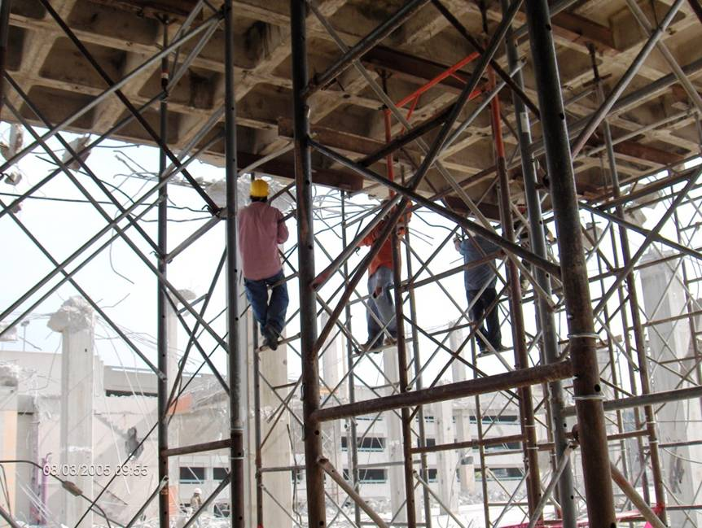
Fall Hazards
Is This a Fall Hazard?
YES
Workers could fall while climbing on the shoring structure to set it up and remove it.
Ladders and lifts must be provided.
Photos in this presentation are from the OSHA Region 4 National Photo Archive and OSHA Region 5.
Notes:
PHOTO: Workers are climbing on the shoring structure during set up and removal.
Ladders/lifts are needed for safe access to the shoring structure.

Slide 41

Fall Hazards
Focus Four
Is This a Fall Hazard?
YES
Workers must be protected from falls over 6 feet.
Workers are exposed to a fall hazard greater than 6 feet, while working near stairwell opening.
Notes:
Workers are exposed to a fall hazard greater than 6 feet, while working near a stairwell opening.
A guardrail system or PFAS should be used here.

Slide 42
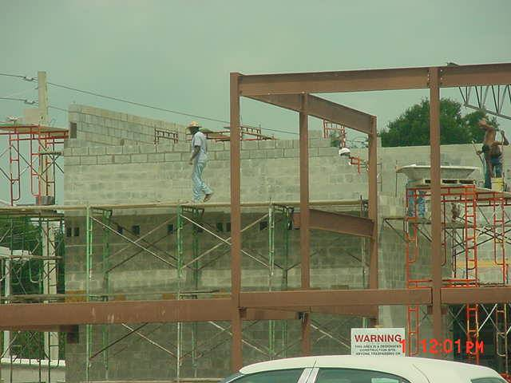
Fall Hazards
Focus Four
Is This a Fall Hazard?
YES
Scaffold was not erected with guardrails in areas where workers were working at heights greater than 10 feet.

Slide 43
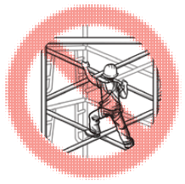
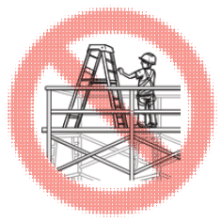
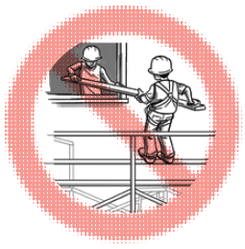
Fall Hazards
Focus Four
Remember PPT:
PLAN ahead to get the job done safely
PROVIDE the right equipment
TRAIN everyone to use the equipment safely
Wear a harness and always stay connected
Make sure your harness fits
Use guardrails and lifelines
Inspect all fall protection before use
Guard or cover all holes and openings
Use fully planked scaffold platforms
Ensure proper access to scaffolds
Inspect scaffold before use (competent person
Choose the right ladder for the job
Maintain three points of contact
Secure the ladder
Always face the ladder

Slide 44
Fall Hazards
Focus Four
Through the Alliance between OSHA’s 10 Regional Offices and the Elevator Contractors of America (ECA), Elevator Industry Work Preservation Fund (EIWPF), International Union of Elevator Constructors (IUEC), National Association of Elevator Contractors (NAEC), National Elevator Industry Educational Program (NEIEP), and National Elevator Industry Inc. (NEII), collectively known as The Elevator Industry Safety Partners, developed this Industry Specific Training for informational purposes only. It does not necessarily reflect the official views of OSHA or the U.S. Department of Labor. March 2025
Under the Occupational Safety and Health Act, employers are responsible (http://www.osha.gov/as/opa/worker/employer-responsibility.html) for providing a safe and healthy workplace and workers have rights (https://www.osha.gov/workers). OSHA can help answer questions or concerns from employers and workers. OSHA's On-Site Consultation Program (https://www.osha.gov/consultation) offers free and confidential advice to small and medium-sized businesses, with priority given to high-hazard worksites. For more information, contact your regional or area OSHA office (https://www.osha.gov/contactus/bystate), call 1-800-321-OSHA (6742), or visit https://www.osha.gov/.

Slide 45

Fall Hazards
Focus Four

